Slide 1
DISCRETE MATHEMATICS
Prof. Dr. Hui Gao（高辉）
huigao@uestc.edu.cn
Inovation Center (创新中心): B316
University of Electronic Science and Tech. of China

Slide 2
The Course
Totally 48 (class hours)
Grading policy:
Attendance & Homework: 20%
Collaboration is encouraged.
Solutions must be your own.
Randomly chosen students share solutions.
Expected Middle Exam(open-book): 10%
Final Exam(closed-book): 70%

Slide 3
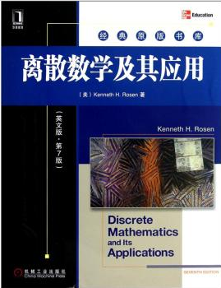
Textbook
Discrete Mathematics and Its Applications by Kenneth H. Rosen. （English Version） 离散数学及其应用 英文版, 7th Edition. 机械工业出版社(Mechanical Industry Press), 2012.

Slide 4
Course Summary
Chapter 1: Logic and Proofs
Chapter 2: Basic Structures (2.1-2.4)
Chapter 3: Algorithms
Chapter 4: Number Theory and Cryptography (4.1-4.4)
Chapter 5: Induction and recursion(5.1-5.4)
Chapter 9: Relations (9.1,9.3-9.6)
Chapter 10: Graphs
.....

Slide 5
So, What’s this class about?
“Discrete Mathematics” - The study of discrete, mathematical objects and structures. right framework for describing precisely Computer Science concepts.
“Discrete” - Composed of distinct, separable parts. discrete:continuous
“Structures” - Objects built up from simpler objects according to some definite pattern.
Notes:
Calculus deals with continuous objects and is not part of discrete mathematics.

Slide 6
Why Study Discrete Math?
The basis of all of digital information processing is: Discrete manipulations of discrete structures represented in memory.
A generally useful tool for rational thought!
analyzing the efficiency
proving the validity
It provides the mathematical background needed for all subsequent courses in computer science.

Slide 7
Goals of learning Discrete Mathematics
Mathematical Reasoning: Ability to read, understand, and construct mathematical arguments and proofs.
Discrete Structures: Abstract mathematical structures that represent objects and the relationships between them.
Such a course should teach students how to think logically and mathematically.

Slide 8
The Foundations: Logic and Proofs
Chapter 1, Part I: Propositional Logic

Slide 9
Foundations of Logic
Mathematical Logic is a tool for working with elaborate compound statements. It includes:
A formal language for expressing them.
A concise notation for writing them.
A methodology for objectively reasoning about their truth or falsity.
It is the foundation for expressing formal proofs in all branches of mathematics.

Slide 10
§1.1 Propositional Logic
The area of logic that deals with propositions is called the propositional calculus or propositional logic. It is the logic of compound statements built from simpler statements using so-called Boolean connectives
Some applications in computer science:
Used for designing electronic circuitry.
Important for program design.
Verification the correctness of programs.
Queries to databases & search engines.
Notes:
We normally attribute propositional logic to George Boole, who first formalized it.

Slide 11
Definition of a Proposition
Definition: A proposition is simply:
a statement (i.e., a declarative sentence)
with some definite meaning, (not vague or ambiguous)
a truth value that’s either true (T) or false (F) .
Never both, neither, or somewhere “in between!”
However, you might not know the actual truth value,
and, the truth value might depend on the situation or context.
Axiom: False is the opposite to Truth.
Notes:
Proposition variable
Both: IMPOSSIBLE, by our Axiom.

Slide 12
Examples of Propositions
It is raining. (In a given situation.)
Beijing is the capital of China. ( true )
72 >= 49. ( true )
5 > 6. ( false )
There exists infinitely many primes which are the sum of a square and 1. (unknown)
There is a God. (unknown)
There is a dog. ( true )
I am the Pope. ( false )

Slide 13
But, the following are NOT
Who’s there? (interrogative, question)
La la la la la. (meaningless interjection)
Just do it! (imperative, command)
Yeah, I sorta dunno, whatever... (vague)
1 + 2. (expression with no truth value)
x + y = z. (neither true or false)
She is very talented. (neither true or false)
Notes:
we need to specify what we mean by “talented”

Slide 14
A paradox
I’m lying to you. (neither true or false)
1) suppose that q = “I’m lying to you.”
were true. In particular, I am actually lying, so q
is false. So it’s both true and false, impossible
by the Axiom.
2) Okay, so I guess q must be false. But then I
must not be lying to you. So q is true. Again
it’s both true and false.
In both cases we get the opposite of our
assumption, so q is neither true nor false.
Notes:
(denoted by proposition variable p, q, r, …)

Slide 15
Operators / Connectives
An operator or connective combines one or more operand expressions into a larger expression. (e.g., “+” in numeric exprs.)
Unary operators take 1 operand (e.g., −3); binary operators take 2 operands (e.g., 3 × 4).
Propositional or Boolean or logical operators operate on propositions (or their truth values) instead of on numbers.

Slide 16
Compound Propositions
In Propositional Logic, we assume a collection of atomic (or component) propositions are given: p, q, r, s, t, ….
Then we form compound propositions by using logical connectives (logical operators) to form propositional “molecules”.

Slide 17
Some Popular Logical Operators
Formal Name | Nickname | Parity | Symbol
Negation operator | NOT | Unary | ¬
Conjunction operator | AND | Binary | ∧
Disjunction operator | OR | Binary | ∨
Exclusive-OR operator | XOR | Binary | ⊕
Implication operator | IMPLIES | Binary | →
Biconditional operator | IFF | Binary | ↔
Notes:
We can use these operators to build up more complicated compound propositions

Slide 18
Constructing a truth table
Determine the truth values of the compound proposition
one row for every possible combination of values for the atomic propositions.
one column for each propositional variable.
one for the compound proposition.
count in binary
n propositional variables = rows.
e.g.
p | q | p∧q
F | F | F
F | T | F
T | F | F
T | T | T
2^{n}
Notes:
New Propositions from old: calculus of propositions -
relate new propositions to old using
TRUTH TABLES

Slide 19
The Negation Operator “¬”
The unary negation operator transforms a prop. into its logical negation.
E.g. If p = “I have brown hair.”
then ¬p = “I do not have brown hair.”
The truth table for NOT:
T :≡ True; F :≡ False
“:≡” means “is defined as”
Operand column
Result column
It is not the case that......
Notes:
It is not the case that

Slide 20
The Conjunction Operator “∧”
The binary conjunction operator combines two propositions to form their logical conjunction.
E.g. p=“I will have salad for lunch.” and q=“I will have steak for dinner.”, then p∧q=“I will have salad for lunch and I will have steak for dinner.”
Meaning is like “and” in English.

Slide 21
Conjunction Truth Table
p | q | p∧q
F | F | F
F | T | F
T | F | F
T | T | T
Both p and q must be true!
Note that a conjunction p₁ ∧ p₂ ∧ … ∧ p_{n} of n propositions will have 2^{n} rows in its truth table.
Also: ¬ and ∧ operations together are sufficient to express any Boolean truth table!

Slide 22
The Disjunction Operator “∨”
The binary disjunction operator Combines two propositions to form their logical disjunction.
p=“My car has a bad engine.”
q=“My car has a bad transmission.”
p∨q=“Either my car has a bad engine, or my car has a bad transmission.”
Meaning is like “or” in English.
Notes:
OR is also commutative and associative.

Slide 23
Disjunction Truth Table
Note that p∨q means that p is true, or q is true, or both are true!
Only one of p, q need be true.
So, this operation is also called inclusive or, because it includes the possibility that both p and q are true.
Note difference from AND

Slide 24
A Simple Exercise
Let p = “It rained last night”, q = “The sprinklers came on last night,” r = “The lawn was wet this morning.”
Translate each of the following into English:
¬p =
r ∧ ¬p =
¬ r ∨ p ∨ q =
“It didn’t rain last night.”
“The lawn was wet this morning, and it didn’t rain last night.”
“Either the lawn wasn’t wet this morning, or it rained last night, or the sprinklers came on last night.”
Notes:
For slides that have interactive exercises, it may be a good idea to stop the class for a minute to allow the students to discuss the problem with their neighbors, then call on someone to answer. This will help keep the students engaged in the lecture activity.

Slide 25
The Exclusive Or Operator
The binary exclusive-or operator “⊕” (XOR) combines two propositions to form their logical “exclusive or”.
p = “I will earn an A in this course,”
q = “I will drop this course,”
p ⊕ q = “I will either earn an A in this course, or I will drop it (but not both!)”

Slide 26
Exclusive-Or Truth Table
Note that p⊕q means that p is true, or q is true, but not both!
Only one of p and q must be true.
This operation is called exclusive or, because it excludes the possibility that both p and q are true.
Note difference from OR.

Slide 27
Natural Language is Ambiguous
Note that English “or” can be ambiguous regarding the “both” case!
“Pat is a singer or Pat is a writer.” -
“Pat has got an A or Pat has got a B.” -
Need context to disambiguate the meaning!
For this class, assume “or” means inclusive.
∨
⊕
Notes:
Note: in this course any usage of “or” will connote the logical operator ∨ as opposed to the exclusive-or.

Slide 28
The Implication Operator
The implication p → q states that p implies q.
e.g., let p = “You study hard.” q = “You will get a good grade.”
p → q = “If you study hard, then you will get a good grade.”
Hypothesis
Conclusion
p: hypothesis, premise, antecedent
q: conclusion, consequence

Slide 29
Implication Truth Table
p → q is false only when p is true but q is not true.
p → q does not require that p or q are ever true!
p → q does not say that p causes q!
E.g. “(1=0) → pigs can fly” is TRUE!
The only False case!

Slide 30
Why does this seem wrong?
Consider a sentence like,
“If I wear a red shirt tomorrow, then it will snow!”
In logic, we consider the sentence True as long as either I don’t wear a red shirt, or it snowed.
But, in normal English conversation, if I were to make this claim, you would think that I was lying.

Slide 31
Examples of Implications
“If this lecture ever ends, then the sun will rise tomorrow.” True or False?
“If Tuesday is a day of the week, then I am a penguin.” True or False?
“If 1+1=6, then Bush is president.” True or False?
“If the moon is made of green cheese, then I am richer than Bill Gates.” True or False?
Notes:
The first one is true because T->T is True. It doesn’t matter that my lecture ending is not the cause of the sun rising tomorrow.
The second one is false for me, because although Tuesday is a day of the week, I am most certainly NOT a penguin. (But, if a penguin were to say this statement, then it would be true for him.)
The third one is true, because 1+1 is not equal to 6. F->T is True.
The last one is true, because the moon is not made of green cheese. F->F is True.
In other words, anything that’s false implies anything at all. p->q if p is false. Why? If p is false, then if p is true, then p is both false and true at the same time, and so truth and falsity are the same thing. So if q is false then q is true.

Slide 32
English Phrases Meaning p → q
“p implies q”
“if p, then q”
“if p, q”
“when p, q”
“whenever p, q”
“q if p”
“q when p”
“q whenever p”
“p only if q”
“p is sufficient for q”
“q is necessary for p”
“q follows from p”
“q is implied by p”
“q unless ¬p”
Notes:
synonymy

Slide 33
Converse, Inverse, Contrapositive
Different Ways of Expressing p → q:
Its converse is: q → p.
Its inverse is: ¬p → ¬q.
Its contrapositive: ¬q → ¬ p.
One of these three has the same meaning (same truth table) as p → q. Can you figure out which?
Contrapositive
Notes:
Also, note that the converse and inverse of p->q also have the same meaning as each other.
Semantically the same.

Slide 34
How do we know for sure?
Proving the equivalence of p → q and its contrapositive using truth tables:
Notes:
Truth tables are the simplest way to prove such facts. We will learn other ways later.

Slide 35
Using a Truth Table to Show Non-Equivalence
Example: Show using truth tables that neither the converse nor inverse of an implication are equivalent to the implication.
Solution:
p | q | ¬ p | ¬ q | p →q | ¬ p →¬ q | q → p
T | T | F | F | T | T | T
T | F | F | T | F | T | T
F | T | T | F | T | F | F
F | F | T | T | F | T | T

Slide 36
Example of the Converse, Inverse, Contrapositive
‘Raining tomorrow is a sufficient condition for my not going to town.’
Step 1: Assign propositional variables to component propositions, the assertion: .
p: It will rain tomorrow q: I will not go to town
Step 2: Symbolize the converse: , inverse: , contrapositive: .
Step 3: Convert the symbols back into words
converse: .
inverse: .
contrapositive: .
p → q
q → p
¬ p → ¬ q
¬q → ¬ p
If I do not go to town, then it is raining
If it is not raining, then I will go to town
If I go to town, then it will not rain
Notes:
‘Raining tomorrow is a necessary condition for my not going to town.’
Or ‘My not going to town is a sufficient condition for it raining tomorrow.’

Slide 37


The biconditional operator
The biconditional p ↔ q states that p is true if and only if (IFF) q is true.
p = “Trump wins the 2016 election.”
q = “Trump will be president for all of 2017.”
p ↔ q = “If, and only if, Trump wins the 2016 election, Trump will be president for all of 2017.”
I Win!
2016
2017

Slide 38
Biconditional Truth Table
p ↔ q means that p and q have the same truth value.
Note this truth table is the exact opposite of ’s!
p ↔ q does not imply that p and q are true.
p ↔ q is equivalent to (p → q) /\ (q → p).
⊕
Thus, p ↔ q means ¬(p ⊕ q)
Notes:
Also, p IFF q is equivalent to (p -> q) /\ (q -> p). (“/\” being the AND wedge)

Slide 39
Expressing the Biconditional
Some alternative ways “p if and only if q” is expressed in English:
p is necessary and sufficient for q
if p then q , and conversely
p iff q

Slide 40
Precedence of operators
We can have compound statements
r ∨ p → q
What is the order of applying logical operators?
We use parenthesis to specify the order
If no parenthesis, we still have a precedence list.
¬p ∨ q means (¬p ) ∨ q
Operator | Preced.
¬ | 1
∧ | 2
∨ | 3
⊕ | 3
→ | 4
↔ | 5
Notes:
less number, higher procedence

Slide 41
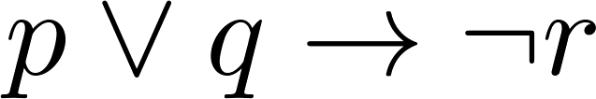
Example Truth Table
Construct a truth table for
p | q | r | ¬r | p ∨ q | p ∨ q → ¬r
F | F | F | T | F
F | F | T | F | F
F | T | F | T | T
F | T | T | F | T
T | F | F | T | T
T | F | T | F | T
T | T | F | T | T
T | T | T | F | T
p ∨ q → ¬r
T
T
T
F
T
F
T
F

Slide 42
§1.2 Applications of Propositional Logic
Translating English to Propositional Logic
System Specifications
Logic Puzzles
....
Notes:
We normally attribute propositional logic to George Boole, who first formalized it.

Slide 43
Translating English Sentences
To remove the ambiguity
“ You can access the Internet from campus only if you are a computer science major or you are not a freshman”
Solution: Let
a=“You can access the Internet from campus”
c=“You are a computer science major”
f=“You are a freshman”
The sentence can be represented by .
Implies
Breaking assertions into atomic propositions-look for the logical operators!
a → c ∨ ¬ f
Notes:
no boolean connective in the atomic proposition. Logic is unambiguous.

Slide 44
Translating English Sentences
Unless you are older than 16 years old, you cannot ride the roller coaster if you are under 4 feet tall
Solution: Let
q: you can ride the roller coaster
r: you are under 4 feet tall
s: you are older than 16
The sentence can be represented by:
.
Breaking assertions into atomic propositions-look for the logical operators!
¬s → (r → ¬q) or (¬s ∧r → ¬q)
Notes:
Quite often, “Unless” is treated as a logic connective equivalent to “if not”

Slide 45
System Specifications
System and Software engineers take requirements in English and express them in a precise specification language based on logic.
Definition: A list of propositions is consistent if it is possible to assign truth values to the proposition variables so that each proposition is true.

Slide 46
Consistent System Specifications
Whether following specifications are consistent:
“ The message is stored in the buffer or is retransmitted”
“The message is not stored in the buffer”
“If the message is stored in the buffer, then it is retransmitted”
Solution: Let
p denote “The message is stored in the buffer”
q denote “The message is retransmitted”
p ∨ q
¬ p
p → q
They are consistent when p is false and q is true.
Notes:
If the system is consistent iff all the specifications of the system hold.

Slide 47
Logic Puzzles
Two kinds of inhabitants:
Knights: always tell the truth; Knaves: always lie.
You encounter 2 people A and B. A says:”B is a knight”, B says: “I and A are of opposite types”. What are A and B?
Solution: Let
p denote “A is a knight” ;
q denote “B is a knight”
○ : consistent; X : inconsistent
Notes:
what he says should be consistent with his identity

Slide 48
Knight, Knave and Spy Problem
Added rule: Spy can lie or tell the truth.
There is one spy, one knight, and one knave.
A says that C is a knave.
B says that A is a knight.
C says “I am the spy.”
What are A, B and C?
From C’s statement, C can’t be a knight because a knight never lie about his identity. Therefore, C is either a knave or a spy.

Slide 49
Knight, Knave and Spy Problem
There is one spy, one knight, and one knave.
A says that C is a knave.
B says that A is a knight.
C says “I am the spy.”
What are A, B and C?
Solution: C is either a knave or a spy. Suppose C is a spy. Then C is not a knave. Then What A says is false, so A is knave. Then B must be a knight, and what B says must be true. Then A is a knight. Contradiction!
Answer:
C is a knave.
A is telling the truth, so A is a knight.
B is a spy.
Notes:
Miran
Discuss the origins of the problem
Discuss the difference from the Knights and Knaves problem

Slide 50
Blackboard Exercises
q = “You miss the final exam.” r = “You pass the course.” Express q → ¬r in English.
Construct a truth table for ¬p ⊕¬q.
Can one determine relative salaries of F (Fannie), J (Janice) and M (Maggie) from the following?
If F is not highest paid, then J is.
If J is not lowest paid, then M is highest paid.
Notes:
F<>3 -> j=3
J<>1 -> M=3

Slide 51
§1.3 Propositional Equivalences
Two syntactically (i.e., textually) different compound propositions may be the semantically identical (i.e., have the same meaning). We call them equivalent. Learn:
Various equivalence rules or laws.
How to prove equivalences using symbolic derivations.

Slide 52
Tautologies and Contradictions
A tautology is a compound proposition that is true no matter what the truth values of its atomic (or component) propositions are!
Ex. p ∨ ¬p [What is its truth table?]
A contradiction is a compound proposition that is false no matter what! Ex. p ∧ ¬p [Truth table?]
A contingency is a proposition which is neither a tautology nor a contradiction, such as p

Slide 53
Logical Equivalence
p ⇔ q
Compound propositions p and q are logically equivalent to each other (written p ⇔ q, or p ≡ q) IFF p and q contain the same truth values as each other in all rows of their truth tables.
Question: How many different propositions can be constructed from n propositional variables?
Notes:
2^(2^n)

Slide 54
Proving Equivalence via Truth Tables
Ex. Prove that p∨q ⇔ ¬(¬p ∧ ¬q).
The left side and the right side must have the same truth values independent of the truth value of the component propositions.
F
T
T
T
F
T
T
F
F
T
T
F
T
F
T
T
F
F
F
T

Slide 55
Proving Equivalence via Abbreviated Truth Tables
Try to find a counter example
Ex. Prove that p∨q ⇔ ¬(¬p ∧ ¬q).
Case 1: Try left side false, right side true
Assume p=F and q=F, then ¬(¬p ∧ ¬q) =F.
Case 2: Try right side false, left side true
Assume ¬(¬p ∧ ¬q) ≡F, then (¬p ∧ ¬q) ≡T, then ¬p ≡ ¬q ≡T, then p=F and q=F, then p∨q =F.
We have exhausted all possibilities and not found a counterexample.
Notes:
If we have exhausted all possibilities and not find a counter example where the proposition is false, then two propositions must be logically equivalent.

Slide 56
Logical Non-Equivalence
Ex. p →q and q →p are not logically equivalent. Prove that.
p | q | p →q | q →p | (p →q) ↔ (q →p)
T T F F | T F T F | T F T T | T T F T
T
F
F
T

Slide 57
Equivalence Laws
Equivalence Laws provide a pattern or template that can be used to match all or part of a much more complicated proposition and to find an equivalence for it.
Equivalent expressions can always be substituted for each other in a more complex expression - useful for simplification.

Slide 58
Equivalence Laws - Examples
Identity: p∧T ⇔ p p∨F ⇔ p
Domination: p∨T ⇔ T p∧F ⇔ F
Idempotent: p∨p ⇔ p p∧p ⇔ p
Double negation: ¬¬p ⇔ p
Commutative: p∨q ⇔ q∨p p∧q ⇔ q∧p
Associative: (p∨q)∨r ⇔ p∨(q∨r) (p∧q)∧r ⇔ p∧(q∧r)
Notes:
¬ Is Right associative
幂等律Idempotent 同一律Identity

Slide 59
More Equivalence Laws
Distributive: p∨(q∧r) ⇔ (p∨q)∧(p∨r) p∧(q∨r) ⇔ (p∧q)∨(p∧r)
De Morgan’s: ¬(p₁∧p₂∧…∧p_{n}) ⇔ (¬p₁∨¬p₂∨…∨¬p_{n}) ¬(p₁∨p₂∨…∨p_{n}) ⇔ (¬p₁∧¬p₂∧…∧¬p_{n})
Trivial tautology/contradiction: p ∨ ¬p ⇔ T p ∧ ¬p ⇔ F
Implication: p → q ⇔ ¬p ∨ q
Notes:
Trivial tautology/contradiction:排中律/矛盾律

Slide 60
More Equivalence Laws
Absurdity: (p → q) ∧ (p → ¬q ) ⇔ ¬p
Contrapositive: p → q ⇔ ¬q → ¬p
Absorption: p ∧ (p ∨ q) ⇔ p p ∨ (p ∧ q) ⇔ p
Exportation: (p ∧ q) → r ⇔ p → (q → R)
Notes:
归谬论: Absurdity 假言易位:Contrapositive

Slide 61
Defining Operators via Equivalences
Using equivalences, we can define operators in terms of other operators:
Exclusive or: p⊕q ⇔ (p∨q) ∧ ¬(p∧q) p⊕q ⇔ (p∧¬q) ∨ (q∧¬p)
Implies: p→q ⇔ ¬p ∨ q
Biconditional: p↔ q ⇔ (p→q) ∧ (q→p) p↔ q ⇔ ¬(p ⊕q)
p↔ q ⇔ (p ∧ q) ∨ (¬ p ∧ ¬ q)
Notes:
¬(p↔ q) ⇔ p↔ ¬q

Slide 62
Tautology Example
Demonstrate that
[¬p ∧(p ∨q )]→q
is a tautology in two ways:
Using a truth table (did above)
Using a proof relying on “Equivalence Laws” to derive True through a series of logical equivalences

Slide 63
Tautology by proof
[¬p ∧(p ∨q )]→q
⇔ [(¬p ∧p)∨(¬p ∧q)]→q Distributive
⇔ [ F ∨ (¬p ∧q)]→q Trivial Contradiction
⇔ [¬p ∧q ]→q Identity
⇔ ¬ [¬p ∧q ] ∨ q Implies
⇔ [¬(¬p)∨ ¬q ] ∨ q DeMorgan
⇔ [p ∨ ¬q ] ∨ q Double Negation
⇔ p ∨ [¬q ∨q ] Associative
⇔ p ∨ [q ∨¬q ] Commutative
⇔ p ∨ T Trivial Tautology
⇔ T Domination

Slide 64
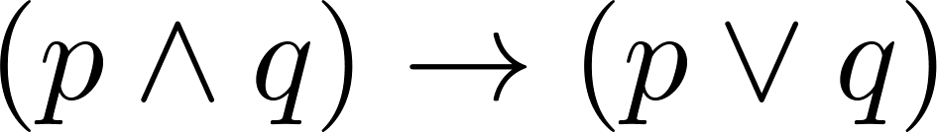
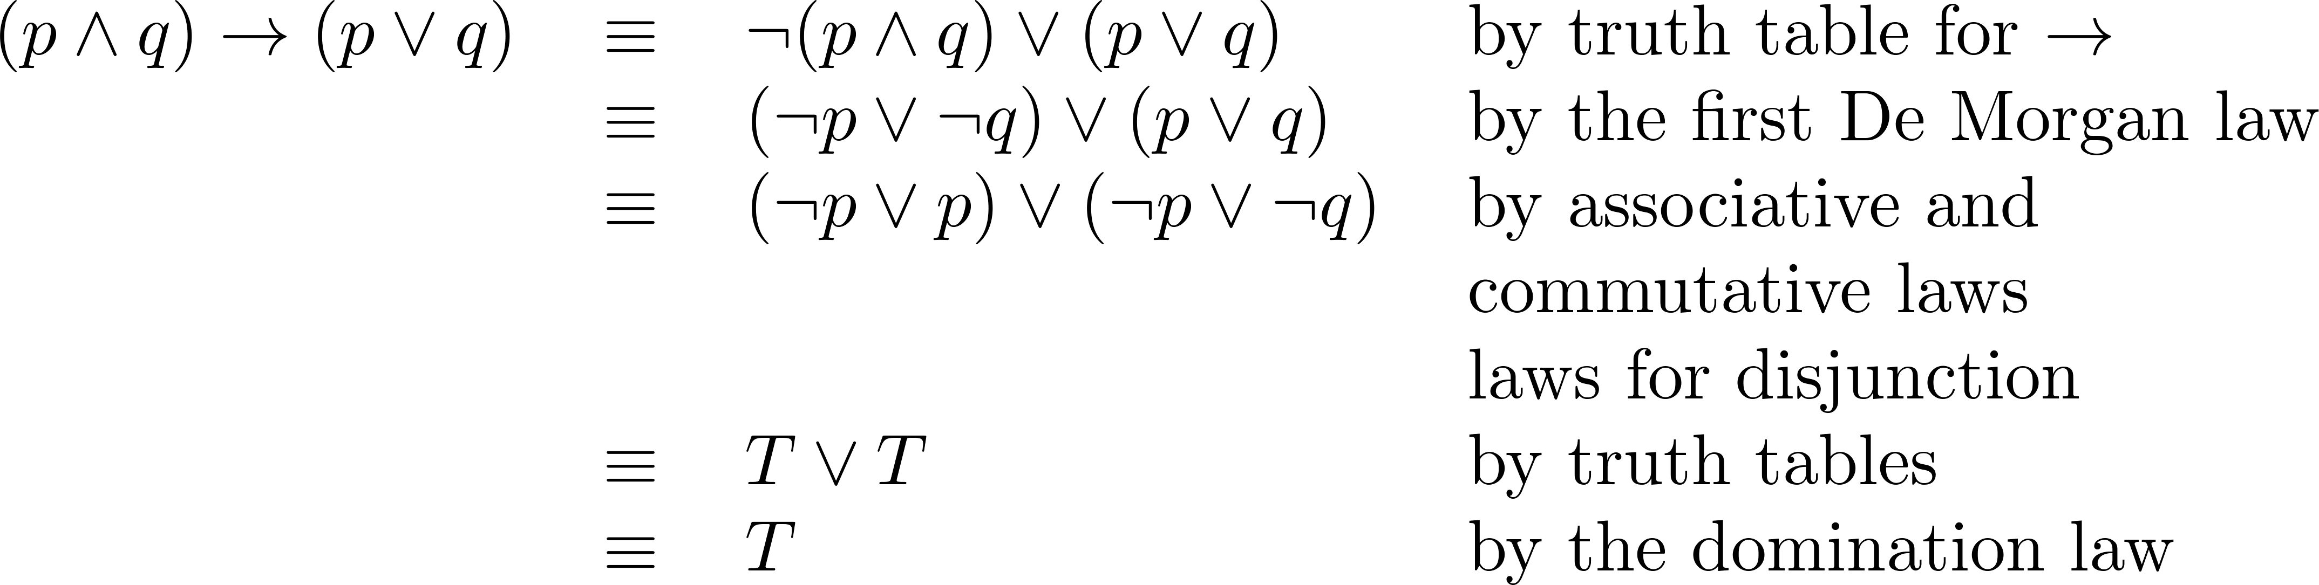
Equivalence Proofs
Example: Show that
is a tautology.
Solution:

Slide 65
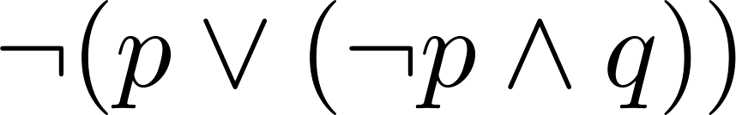
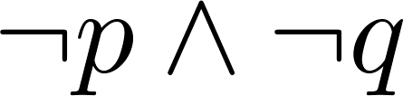
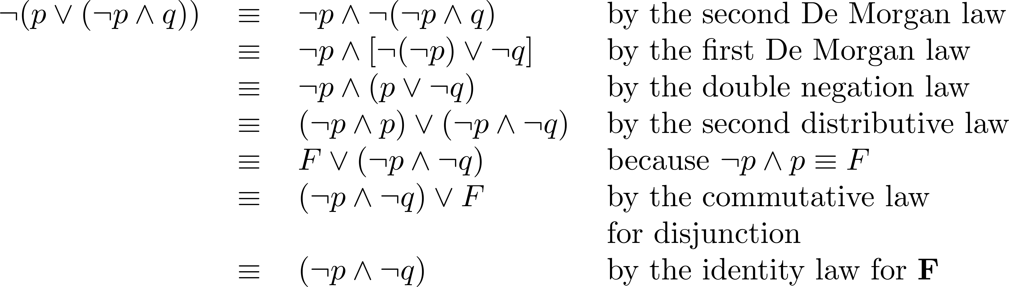
Equivalence Proofs
Example: Show that
is logically equivalent to
Solution:

Slide 66
Blackboard Exercises
Worked out on the black-board.
“I don’t drink and drive” is logically equivalent to “If I drink, then I don’t drive”
Notes:
I don’t drink while driving

Slide 67
§1.4 Predicates and Quantifiers
Predicate logic is an extension of propositional logic that permits concisely reasoning about whole classes of entities.
If we have: “All men are mortal.” “Socrates is a man.” Does it follow that “Socrates is mortal?”
Can’t be represented in propositional logic.
Recall: propositional logic treats component propositions as atomic entities.
Notes:
凡人

Slide 68
Subjects and Predicates
In the sentence “The dog is sleeping”:
The phrase “the dog” denotes the subject - the object or entity that the sentence is about.
The phrase “is sleeping” denotes the predicate- a property that is true of the subject.
In predicate logic, a predicate is modeled as a function P(·) from objects to propositions.
P(x) = “x is sleeping” (where x is a variable, which can be replaced by any element from their domain.).

Slide 69
Convention
Lowercase variables x, y, z... denote objects/entities; uppercase variables P, Q, R… denote predicates.
Keep in mind that the result of applying a predicate P to an object x is the proposition P(x). But the predicate P itself is not a proposition (not a complete sentence).
E.g. if P(x) = “x is a prime number”, then what is P(3)?
P(3) is the proposition “3 is a prime number.”

Slide 70
Applications of Predicate Logic
It is the formal notation for writing perfectly clear, concise, and unambiguous mathematical definitions, axioms, and theorems for any branch of mathematics.
Predicate logic is sufficient for defining any conceivable mathematical system, and for proving anything that can be proved within that system!

Slide 71
Universes of Discourse
The power of distinguishing objects from predicates is that it lets you state things about many objects at once.
E.g., let P(x)=“x+1>x”. We can then say, “For any number x, P(x) is true” instead of (0+1>0) ∧ (1+1>1) ∧ (2+1>2) ∧ ...
The collection of values that a variable x can take is called x’s universe of discourse or domain. Often the domain is denoted by U.

Slide 72
Examples of Propositional Functions
Let “x + y = z” be denoted by R(x, y, z) and U (for all three variables) be the integers. Find these truth values:
R(2,-1,5), R(3,4,7)， R(x, 3, z)
Let “x - y = z” be denoted by Q(x, y, z), with U as the integers. Find these truth values:
Q(2,-1,3)，Q(3,4,7)，Q(x, 3, z)

Slide 73
Compound Expressions
Connectives from propositional logic carry over to predicate logic.
If P(x) denotes “x > 0,” find these truth values: P(3) ∧ P(-1), P(3) → P(-1) , P(3) → P(-1)
Expressions with variables are not propositions and therefore do not have truth values. For example: P(3) ∧ P(y) , P(x) → P(y)
When used with quantifiers (to be introduced next), these expressions (propositional functions) become propositions.

Slide 74
Quantifier Expressions
Quantifiers provide a notation that allows us to quantify (count) how many objects in U satisfy a given predicate. e.g.
All men are Mortal.
Some cats do not have fur.
“∀” is the FOR ALL or universal quantifier. ∀x P(x) means for all x in U, P(x) holds.
“∃” is the EXISTS or existential quantifier. ∃x P(x) means there exists an x in U. (that is, 1 or more) such that P(x) is true.

Slide 75
Universal Quantifier
∀x P(x) is read as:
“ For all x, P(x)” or “For every x, P(x)”
Examples:
If P(x) denotes “x > 0” and U is the integers,then ∀x P(x) is false.
If P(x) denotes “x > 0” and U is the positive integers, then ∀x P(x) is true.
If P(x) denotes “x is even” and U is the integers, then ∀x P(x) is false.

Slide 76
Existential Quantifier
∃x P(x) is read as “For some x, P(x)”, or as “There is an x such that P(x),” or “For at least one x, P(x).”
Examples:
If P(x) denotes “x > 0” and U is the integers, then ∃x P(x) is true. It is also true if U is the positive integers.
If P(x) denotes “x < 0” and U is the positive integers, then ∃x P(x) is false.
If P(x) denotes “x is even” and U is the integers, then ∃x P(x) is true.

Slide 77
Thinking about Quantifiers
When the domain of discourse is finite, we can think of quantification as looping through the elements of the domain.
To evaluate ∀x P(x) loop through all x in the domain.
If at every step P(x) is true, then ∀x P(x) is true.
If at a step P(x) is false, then ∀x P(x) is false and the loop terminates.

Slide 78
Thinking about Quantifiers
To evaluate ∃x P(x) loop through all x in the domain.
If at some step, P(x) is true, then ∃x P(x) is true and the loop terminates.
If the loop ends without finding an x for which P(x) is true, then ∃x P(x) is false.
Even if the domains are infinite, we can still think of the quantifiers this fashion, but the loops will not terminate in some cases.

Slide 79
Properties of Quantifiers
The truth value of ∃x P(x) and ∀ x P(x) depend on both the predicate P(x) and on the domain U.
Examples:
If U is the positive integers and P(x) is the predicate “x < 2”, then ∃x P(x) is true, but ∀x P(x) is false.
If U is the negative integers and P(x) is the predicate “x < 2”, then both ∃x P(x) and ∀x P(x) are true.

Slide 80
Precedence of Quantifiers
∀ ∃ have higher precedence than all binary operators from Propositional Logic.
So ∀x P(x) ∨ Q(x) ⇔ (∀x P(x)) ∨ Q(x), and is not logically equivalent to ∀x (P(x) ∨ Q(x))
∀x ¬P(x) ⇔ ∀x (¬P(x))

Slide 81
Thinking about Quantifiers as…
If the domain is finite,
a universally quantified proposition is equivalent to a conjunction of propositions without quantifiers
∀x P(x) ⇔ P(a) ∧ P(b) ∧ P(c) ∧ …
an existentially quantified proposition is equivalent to a disjunction of propositions without quantifiers.
∃x P(x) ⇔ P(a) ∨ P(b) ∨ P(c) ∨ …

Slide 82
Quantifier Equivalence Laws
Definitions of quantifiers: If U=a,b,c,… ∀x P(x) ⇔ P(a) ∧ P(b) ∧ P(c) ∧ … ∃x P(x) ⇔ P(a) ∨ P(b) ∨ P(c) ∨ …
From those, we can prove the laws: ∀x P(x) ⇔ ¬∃x ¬P(x) ∃x P(x) ⇔ ¬∀x ¬P(x)
Which propositional equivalence laws can be used to prove this?
DeMorgan's

Slide 83
Negation of Quantifiers
There is no student who can …
Not all professors are bad….
¬ ∀x P(x) ≡ ∃ x ¬P(x)
¬ ∃ x P(x) ≡ ∀ x ¬P(x)
Careful: The negation of “Every Canadian loves Hockey” is NOT “No Canadian loves Hockey”! Many, many students make this mistake!

Slide 84
Binding Variables
Predicate P(x) is said to have a free variable x (meaning, x is undefined).
Predicates become propositions once every variable is bounded by
either assigning it a value from the Universe of Discourse, or quantifying it
E.g. P(y) ∨ P(0) is not a proposition. The variable y has not been bound. However, P(3) ∨ P(0) is a proposition which is true.
Notes:
universe of discourse or domain of discourse:讨论或辩论的范围, 论域

Slide 85
Example of Binding
P(x,y) has 2 free variables, x and y.
∀x P(x,y) has 1 free variable, and one bound variable.
“P(x), where x=3” is another way to bind x.
An expression with zero free variables is a proposition.
An expression with one or more free variables is still only a predicate:
e.g. let Q(y) = ∀x P(x,y)

Slide 86
Extra Definitions
An assertion involving predicates is satisfiable if there is an interpretation for which the assertion is true. Else it is unsatisfiable.
The scope of a quantifier is the part of an assertion in which variables are bound by the quantifier. E.g. ∀x P(x,y) ∨ Q(x)

Slide 87
More to Know About Binding
∀x ∃x P(x) - x is not a free variable in ∃x P(x), therefore the ∀x binding isn’t used.
(∀x P(x)) ∧ Q(x) - The variable x is outside of the scope of the ∀x quantifier, and is therefore free. Not a complete proposition!
(∀x P(x)) ∧ (∃x Q(x)) – This is legal, because there are 2 different x’s!
Notes:
the scope of the quantifier is a part of a logic expression to which a quantifier is applied

Slide 88
Translating from English to Logic
Example 1: Translate the following sentence into predicate logic: “Every student in this class has taken a course in Java.”
Solution 1: If U is all students in this class, J(x) denotes “x has taken a course in Java” and translate as：∀x J(x).
Solution 2: But if U is all people, also define S(x) as “x is a student in this class” and translate as：
∀x (S(x)→ J(x)).
∀x (S(x) ∧ J(x)) is not correct. Why?

Slide 89
Translating from English to Logic
Example 2: Translate the following sentence into predicate logic: “Some student in this class has taken a course in Java.”
First decide on the domain U.
Solution 1: If U is all students in this class, translate as：∃x J(x)
Solution 2: But if U is all people, then translate as：∃x (S(x) ∧ J(x))
∃x (S(x)→ J(x)) is not correct. What does it mean?

Slide 90
Translation from English to Logic
Example 3: Some student in this class has visited Mexico.
Solution: Let M(x) denote “x has visited Mexico” and S(x) denote “x is a student in this class,” and U be all people.
∃x (S(x) ∧ M(x))

Slide 91
Translation from English to Logic
Example 4: Every student in this class has visited Canada or Mexico.
Solution: Add C(x) denoting “x has visited Canada.”
∀x (S(x)→ (M(x)∨C(x)))

Slide 92
§1.5 Nested Quantifiers
Example: Let U = {1,2,3}. Find an expression equivalent to ∀x ∃y P(x, y)
Expand from inside out or outside in.
Outside in:
∃ yP(1, y) ∧ ∃ yP(2, y) ∧ ∃ yP(3, y)
⇔ [P(1,1) ∨ P(1,2) ∨ P(1,3)] ∧
[P(2,1) ∨ P(2,2) ∨ P(2,3)] ∧
[P(3,1) ∨ P(3,2) ∨ P(3,3)]
Notes:
Remember: A predicate is not a proposition until all variables have been bound either by quantification or assignment of a value!

Slide 93
Nested Quantifier Exercises
∀x : For all x
∃y : There exist a ‘y’
If R(x,y)=“x relies upon y,” express the following in unambiguous English:
∀x(∃y R(x,y))=
∃y(∀x R(x,y))=
∃x(∀y R(x,y))=
∀y(∃x R(x,y))=
∀x(∀y R(x,y))=
Everyone has someone to rely on.
There’s someone whom everyone relies upon (including himself)!
There’s someone who relies upon everybody (including himself).
Everyone has someone who relies upon them.
Everyone relies upon everybody, (including themselves)!

Slide 94
Nested Quantifier Exercises
∀x ∃y (x + y = 0) is true over the integers
Assume an arbitrary integer x.
Choose y = -x. Clearly y is an integer, and thus is in the domain.
So x + y = x + (-x) = x – x = 0.
Since we assumed nothing about x (other than it is an integer), the argument holds for any integer x.
Therefore, the proposition is TRUE.

Slide 95
Thinking of Nested Quantification
Nested Loops
To see if ∀x∀yP (x,y) is true, loop through the values of x :
At each step, loop through values for y.
If for some pair of x and y, P(x,y) is false, then ∀x ∀yP(x,y) is false and both the outer and inner loop terminate.
∀x ∀y P(x,y) is true if the outer loop ends after stepping through each x.

Slide 96
Thinking of Nested Quantification
Nested Loops
To see if ∀x ∃yP(x,y) is true, loop through the values of x :
At each step, loop through the values for y.
The inner loop ends when a pair x and y is found such that P(x, y) is true.
If no y is found such that P(x, y) is true the outer loop terminates as ∀x ∃yP(x,y) has been shown to be false.
If the domains of the variables are infinite, then this process can not actually be carried out.

Slide 97
Questions on Order of Quantifiers
Example: Let U be the real numbers,
Define P(x,y) : x ∙ y = 0
What is the truth value of the following:
∀x∀yP(x,y) ∀x∃yP(x,y)
∃x∀y P(x,y) ∃x ∃ y P(x,y)

Slide 98
More Conventions
Sometimes the universe of discourse is restricted within the quantification, e.g.,
∀x>0: P(x) is shorthand for “For all x that are greater than zero, P(x).” =∀x (x>0 → P(x))
∃x>0: P(x) is shorthand for “There is an x greater than zero such that P(x).” =∃x (x>0 ∧ P(x))

Slide 99
Still More Conventions
Unique existential quantifier: ∃ !
∃ !xP(x) : P(x) is true for one and only one x in the universe of discourse.
E.g. U={1,2,3}
P(1) P(2) P(3) ∃!xP( x)
0 0 1 1
0 1 0 1
1 0 0 1

Slide 100
More Equivalence Laws
∀x ∀y P(x,y) ⇔ ∀y ∀x P(x,y) ∃x ∃y P(x,y) ⇔ ∃y ∃x P(x,y)
∀x (P(x) ∧ Q(x)) ⇔ (∀x P(x)) ∧ (∀x Q(x)) ∃x (P(x) ∨ Q(x)) ⇔ (∃x P(x)) ∨ (∃x Q(x))
See if you can prove these yourself.

Slide 101
Dangerous situations
∀x ∃ y P(x,y) ⇔ ∃ y ∀x P(x,y) ?
Caveat: In general, order matters! Consider the following propositions over the integer domain: ∀x ∃y (x < y) and ∃y ∀x (x < y)
∀x ∃y (x < y) : “there is no maximum integer”
∃y ∀x (x < y) : “there is a maximum integer”
Not the same meaning at all!!!

Slide 102
Dangerous situations
∀x ∃ y P(x,y) ⇔ ∃ y ∀x P(x,y) ?
suppose U consists of two objects a and b.
Then, ∀x ∃ y P(x,y) ⇔ (∃ y P(a,y)) /\ (∃ y P(b,y)) ⇔ (P(a,a) \/ P(a,b)) /\ (P(b,a) \/ P(b,b)).
∃ y ∀x P(x,y) ⇔ (∀ x P(x,a)) \/ (∀ x P(x,b))
⇔ (P(a,a) /\ P(b,a)) \/ (P(a,b) /\ P(b,b)).
suppose only P(a,a) and P(b,b) are true. Then, the first proposition is true, but, the second proposition is false.
Notes:
to see why the order of quantifiers matters is to expand out the definitions of FORALL and EXISTS in terms of AND and OR.

Slide 103
Dangerous situations
∀x (P(x) ∨ Q(x)) ⇔ (∀x P(x)) ∨ (∀x Q(x)) ?
∃x (P(x) ∧ Q(x)) ⇔ (∃x P(x)) ∧ (∃x Q(x)) ?
∀x[P( x) →Q( x)] ⇔[∀xP(x) →∀xQ( x)] ?
∃x (P(x) → Q(x)) ⇔ (∃x P(x)) → (∃x Q(x)) ?
E.g., U={1,2}, P(1)=T, P(2)=F, Q(1)=F, Q(2)=T

Slide 104
Negation of Nested Quantifiers
Ex 1: ¬ ∃x ∀y (x + y = 0)
This is equivalent to ∀x ¬∀y (x + y = 0)
This is equivalent to ∀x ∃ y ¬(x + y = 0)
This is equivalent to ∀x ∃ y (x + y ≠ 0)
Ex 2:¬ ∀x ∃y (x < y)
This is equivalent to ∃x ¬∃y (x < y)
This is equivalent to ∃x ∀y ¬(x < y)
This is equivalent to ∃x ∀y (x ≥ y)

Slide 105
More Examples
∀x( C(x) ∨ ∃y( C(y)∧F(x,y) ) ) where
C(x): “x has a computer”
F(x,y): “x and y are friend”
U.d. for x and y are all students in school
For all x, x has a computer OR There exist a y who has a computer AND x and y are friends

Slide 106
More Examples
If a person is female and is a parent, then this person is someone’s mother.
Let:
F(x): “x is female”,
P(x): “x is a parent”,
M(x,y): x is mother of y
Then, ∀x ( ( F(x) ∧ P(x) ) → ∃yM(x,y) )
Notes:
For every person x, if x is female and is a parent, then there exists someone y of whom x is a mother.

Slide 107
Blackboard Exercises
L(x) = “x is a lion.”
F(x) = “x is fierce.”
C(x) = “x drinks coffee.”
All lions are fierce.
Some lions don’t drink coffee.
Some fierce creatures don’t drink coffee.
Universe of discourse is all creatures.
Universe of discourse is all creatures.
∀x (L(x) → F(x))
∃x (L(x) ∧ ¬C(x))
∃x (F(x) ∧ ¬C(x))

Slide 108
§1.6 Rules of Inference
Revisiting the Socrates Example
We have the two premises:
“All men are mortal.”
“Socrates is a man.”
And the conclusion:
“Socrates is mortal.”
How do we get the conclusion from the premises?

Slide 109
Inference Rule
An Inference Rule is
A pattern establishing that if a set of antecedent statements (hypotheses) are all true, then we can validly deduce that a certain related consequent statement (conclusion) is true.
antecedent 1 antecedent 2 … ∴ consequent “∴” means “therefore”
Corresponding tautology:
((ante. 1) ∧ (ante. 2) ∧ …) → consequent
i.e., ((ante. 1) ∧ (ante. 2) ∧ …) consequent

Slide 110
Modus Ponens
p→q Rule of modus ponens p (a.k.a. law of detachment) ∴q
Corresponding Tautology?
p | q | p→q | p | q
T T F F | T F T F | T F T T | T T F F | T F T F
Example:
If I dance all night, then I get tired.
I danced all night.
Therefore I got tired.

Slide 111
Modus Tollens
p→q ¬q Rule of modus tollens ∴¬p
Corresponding Tautology?
Example:
If it is snowing, then I will study discrete math.
I will not study discrete math.
Therefore , it is not snowing.

Slide 112
Rule of Addition
p Rule of Addition ∴ p∨q
Corresponding Tautology?
Example:
“I will study discrete math.”
“Therefore, I will study discrete math or I will visit Las Vegas.”

Slide 113
Rule of Simplification
p∧q Rule of Simplification ∴ p
Corresponding Tautology?
Example:
“I will study discrete math and English literature”
“Therefore, I will study discrete math.”

Slide 114
Rule of Conjunction
p Rule of Conjunction q
∴ p∧q
Corresponding Tautology?
Example:
“I will study discrete math.”
“I will study English literature.”
“Therefore, I will study discrete math and I will study English literature.”

Slide 115
Hypothetical Syllogism
p→q Rule of hypothetical q→r syllogism ∴p→r
Corresponding Tautology?
Example:
“If it snows, then I will study discrete math.”
“If I study discrete math, I will get an A.”
“Therefore , If it snows, I will get an A.”

Slide 116
Disjunctive Syllogism
p ∨ q Rule of disjunctive ¬p syllogism ∴ q
Corresponding Tautology?
Example:
“I will study discrete math or I will study English literature.”
“I will not study discrete math.”
“Therefore , I will study English literature.”

Slide 117
More inference rules
(P → Q) ∧ (R → S)
P ∨ R Constructive dilemma
∴ Q ∨ S
(P → Q) ∨ (¬ P → S)
P ∨ ¬ P Resolution
∴ Q ∨ S
Notes:
两难
归结

Slide 118
Formal Proofs
A formal proof of a conclusion C, given premises p₁, p₂,…,p_{n} consists of a sequence of steps，
each of which applies some inference rule to premises or previously-proven statements (antecedents) to yield a new true statement (the consequent).
A proof demonstrates that if the premises are true, then the conclusion is true.

Slide 119
Formal Proof Example
Suppose we have the following premises: “It is not sunny and it is cold.” “We will swim if only if it is sunny.” “If we do not swim, then we will canoe.” “If we canoe, then we will be home early.”
Given these premises, prove the theorem “We will be home early” using inference rules.

Slide 120
Proof Example cont.
Let us adopt the following abbreviations:
sunny = “It is sunny”;
cold = “It is cold”; swim = “We will swim”;
canoe = “We will canoe”;
early = “We will be home early”.
Then, the premises can be written as: (1) ¬sunny ∧ cold (2) swim ↔ sunny (3) ¬swim → canoe (4) canoe → early

Slide 121
Proof Example cont.
Step Proved by 1. ¬sunny ∧ cold Premise #1. 2. ¬sunny Simplification of 1. 3. swim ↔ sunny Premise #2. 4. ¬swim IFF Truth table on 2,3. 5. ¬swim→canoe Premise #3. 6. canoe Modus ponens on 4,5. 7. canoe→early Premise #4. 8. early Modus ponens on 6,7.

Slide 122
Another Example
Show that (R→S) can be derived from (P →(Q →S)), (¬R ∨ P), and Q
Step Inference Rule
¬R ∨ P P
R P (assumed premise)
P disjunctive syllogism on (1), (2)
P→(Q →S) P
Q →S Modus ponens on (3), (4)
Q P
S Modus ponens on (5), (6)
R → S conditional premise of (2), (7)
Notes:
Instead of deriving R →S directly, we shall include R as an additional premise and show S can be derive from there premises.

Slide 123
More Examples
Show that S ∨ R can be derived from (P ∨ Q), (P → R) and (Q → S)
Step Inference Rule
P ∨ Q P
¬P → Q T, (1)
Q → S P
¬P → S hypo. Syll. on (2), (3)
¬S→ P T, (4)
P → R P
¬S → R T, (5), (6)
S ∨ R T, (7)

Slide 124
Inference Rules for Quantifiers
∀x P(x) Universal instantiation (US) ∴P(o) (substitute any object o)
Example: Our domain consists of all dogs and Fido is a dog.
“All dogs are cuddly.” “Therefore, Fido is cuddly.”
P(g) (for g a general element of U) ∴∀x P(x) Universal generalization (UG)
Used often implicitly in Mathematical Proofs.

Slide 125
Inference Rules for Quantifiers
∃x P(x) Existential instantiation (ES) ∴P(c) (substitute a new constant c)
P(o) (substitute any extant object o) ∴∃x P(x) Existential generalization (EG)
Example: “There is someone who got an A in the course.” “Let’s call her c and say that c got an A”
Example: “Michelle got an A in the class.”
“Therefore, someone got an A in the class.”

Slide 126
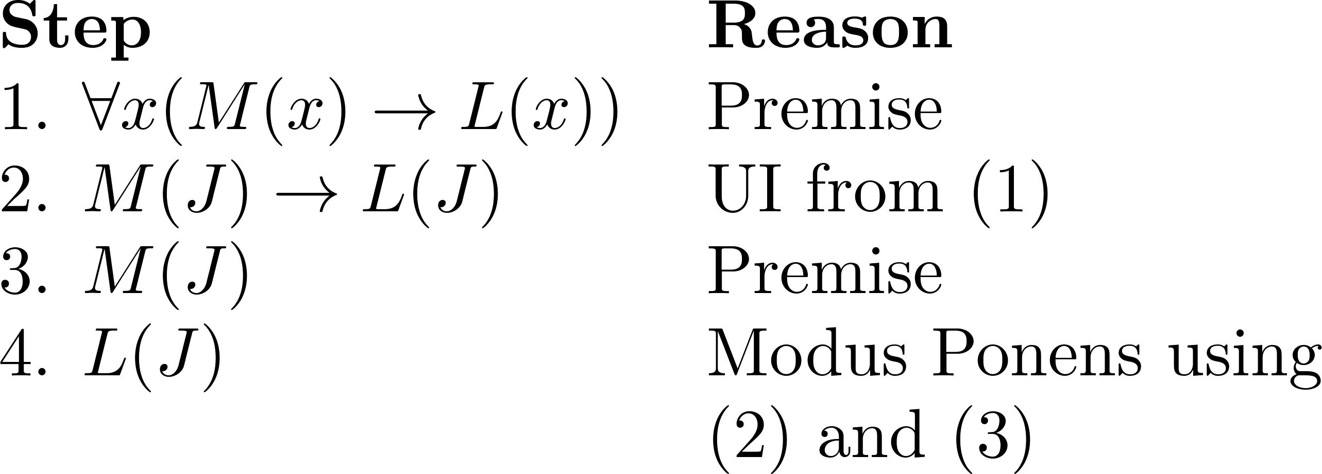
Using Rules of Inference
Example : Construct a valid argument to show that “John Smith has two legs”
is a consequence of the premises:
“Every man has two legs.” “John Smith is a man.”
Solution: Let M(x) denote “x is a man” and L(x) “ x has two legs” and let John Smith be a member of the domain.

Slide 127
More Examples
Show that (∀x) (P(x) → Q(x)) ∧ (∀x) (Q(x) → R(x))⇒ (∀x) (P(x) → R(x))
Step Inference Rule
(∀x) (P(x) → Q(x)) P
P(y) → Q(y) US, (1)
(∀x) (Q(x) → R(x)) P
Q(y) → R(y) US, (3)
P(y) → R(y) hypo. Syll. on (2), (4)
(∀x) (P(x) → R(x)) UG, (5)

Slide 128
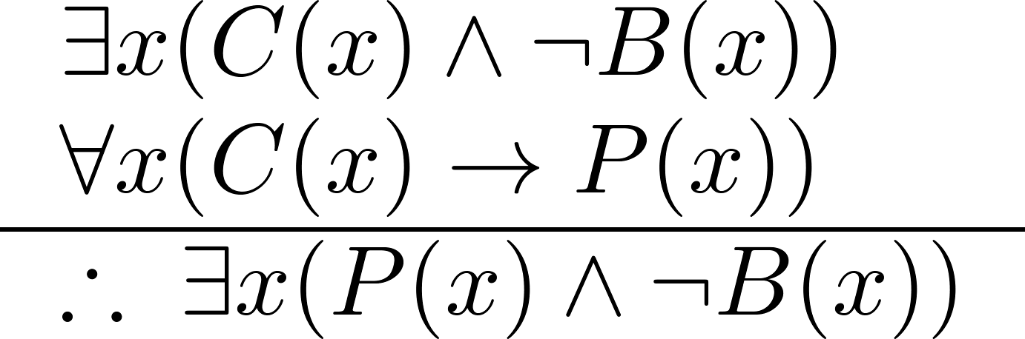
More examples
Show that the conclusion: “Someone who passed the first exam has not read the book.” follows from the premises
“A student in this class has not read the book.”
“Everyone in this class passed the first exam.”
Solution: Let C(x) denote “x is in this class,” B(x) denote “ x has read the book,” and P(x) denote “x passed the first exam.”
First we translate the
premises and conclusion
into symbolic form

Slide 129
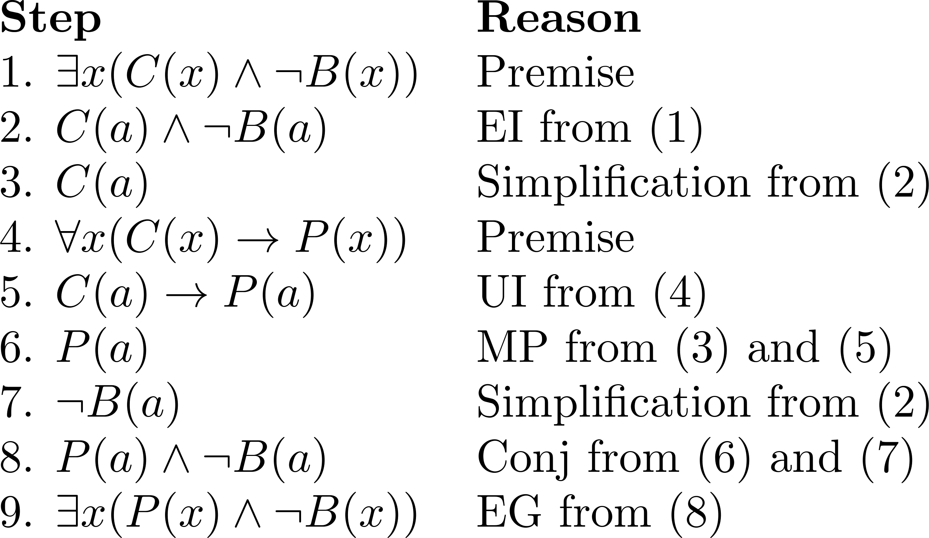
More examples

Slide 130
Common Fallacies
A fallacy is an inference rule or other proof method that is not logically valid.
Fallacy of affirming the conclusion:
“p→q is true, and q is true, so p must be true.”
Fallacy of denying the hypothesis:
“p→q is true, and p is false, so q must be false.”
Circular reasoning:
This occurs when we use the truth of statement being proved (or something equivalent) in the proof itself.
∀x P(x) ∃x P(x)
Notes:
It’s easy for each fallacy to give a counter-example showing why it is not valid.

Slide 131
§1.7 Introduction to Proofs
In mathematics, a proof is:
a correct (well-reasoned, logically valid) and complete (clear, detailed) argument that rigorously & undeniably establishes the truth of a mathematical statement.
Why must the proof be correct & complete?
Correctness: If the system (claims to) prove something is true, it really is true.
Completeness: If something really is true, the system is capable of proving it.

Slide 132
Proof Terminology
Axioms: assertions given to be true.
Postulates, Hypotheses, Premises
Assumptions defining the structures about which we are reasoning.
Rules of inference
Patterns of logically valid deductions from hypotheses to conclusions.
Theorem：a valid logical assertion which can be proved using other theorems, axioms, postulates and rules of inference.

Slide 133
More Proof Terminology
Lemma - A minor theorem used as a stepping-stone to proving a major theorem.
Corollary - A minor theorem proved as an easy consequence of a major theorem.
Conjecture - A statement whose truth value has not been proven. (A conjecture may be widely believed to be true, regardless.)
Theory – The set of all theorems that can be proven from a given set of axioms.

Slide 134
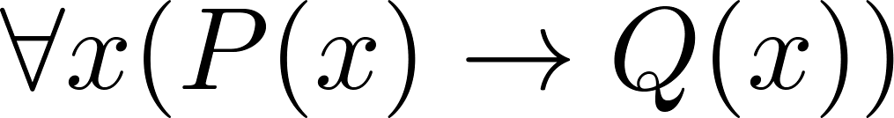
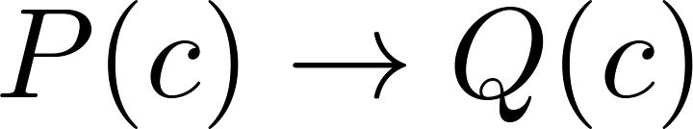
Proving Theorems
Many theorems have the form:
To prove them, we show that where c is an arbitrary element of the domain,
By universal generalization the truth of the original formula follows.
we must prove something of the form: p→q
Notes:
we must prove something of the form: p→q

Slide 135
Proof Methods for Implications
For proving implications p→q, we have:
Direct proof: Assume p is true, and prove q.
Indirect proof
Proof by contraposition: Assume ¬q, and prove ¬p.
Proof by Contradiction: Assume p∧¬q, and prove both r and ¬r for some proposition r.
Vacuous proof: Prove ¬p by itself.
Trivial proof: Prove q by itself.
Notes:
(r∧ ¬r) is a trivial contradiction

Slide 136
Direct Proof Example
Definition: An integer n is called odd iff n=2k+1 for some integer k; n is even iff n=2k for some k.
Theorem: (For all numbers n) If n is an odd integer, then n² is an odd integer.
Proof: If n is odd, then n = 2k+1 for some integer k. Thus, n² = (2k+1)² = 4k² + 4k + 1 = 2(2k² + 2k) + 1. Therefore n² is of the form 2j + 1 (with j the integer 2k² + 2k), thus n² is odd. □
Notes:
The statement that every integer is either odd or even can actually be proven from simpler axioms, the Peano axioms of arithmetic. However, for

Slide 137
Indirect Proof Example
Theorem: (For all integers n) If 3n+2 is odd, then n is odd.
Proof: Suppose that the conclusion is false, i.e., that n is even. Then n=2k for some integer k. Then 3n+2 = 3(2k)+2 = 6k+2 = 2(3k+1). Thus 3n+2 is even, because it equals 2j for integer j = 3k+1. So 3n+2 is not odd. We have shown that ¬(n is odd)→¬(3n+2 is odd), thus its contra-positive (3n+2 is odd) → (n is odd) is also true. □

Slide 138
Proof by Contradiction Example
Example: Prove that there is no largest prime number.
Solution: Assume that there is a largest prime number. Call it p_{n}. Hence, we can list all the primes 2,3,.., p_{n}. Form
None of the prime numbers on the list divides r. Therefore, either r is prime or there is a smaller prime that divides r. This contradicts the assumption that there is a largest prime. Therefore, there is no largest prime.

Slide 139
Proof by Contradiction Example
Theorem: is irrational.
Proof: Assume 2^{1/2} were rational. This means there are integers i,j with no common divisors such that 2^{1/2} = i/j. Squaring both sides, 2 = i²/j², so 2j² = i². So i² is even; thus i is even. Let i=2k. So 2j² = (2k)² = 4k². Dividing both sides by 2, j² = 2k². Thus j² is even, so j is even. But then i and j have a common divisor, namely 2, so we have a contradiction. □

Slide 140
Vacuous Proof Example
Theorem: (For all n) If n is both odd and even, then n² = n + n.
Proof: The statement “n is both odd and even” is necessarily false, since no number can be both odd and even. So, the theorem is vacuously true. □

Slide 141
Trivial Proof Example
Theorem: (For integers n) If n is the sum of two prime numbers, then either n is odd or n is even.
Proof: Any integer n is either odd or even. So the conclusion of the implication is true regardless of the truth of the antecedent. Thus the implication is true trivially. □

Slide 142
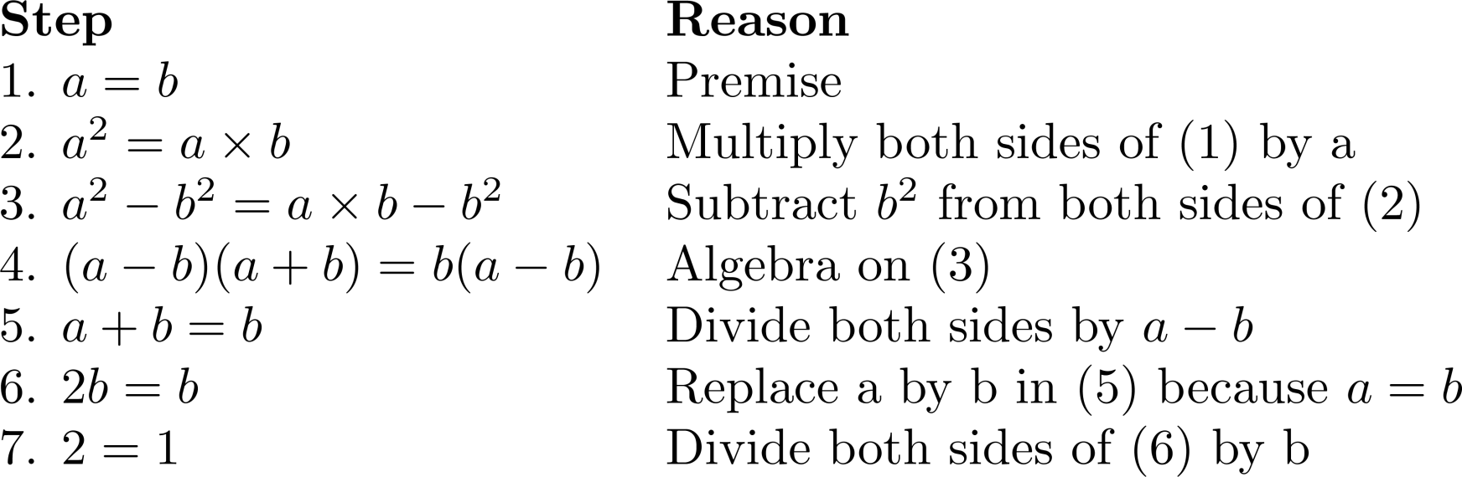
What is wrong with this?
“Proof” that 1 = 2
Solution: Step 5. a - b = 0 by the premise and division by 0 is undefined.

Slide 143
§1.8 Proof Methods and Strategy
In this module, we will see examples of:
More proof methods
Forward vs. backward reasoning.
Turning conjectures into proofs.

Slide 144
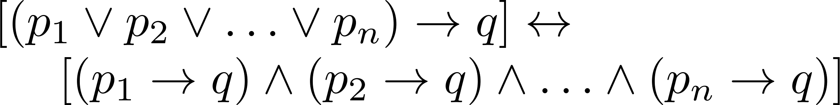

More Proof methods
Proof by Cases
To prove a conditional statement of the form:
Use the tautology
Each of the implications is a case.

Slide 145
Proof by Examples (Cases)
Theorem: ¬∃x,y∈Z: x²+3y² = 8.
Proof: If |x|≥3 or |y|≥2 then x²+3y² >8. This leaves x²∈{0,1,4} and 3y²∈{0,3}. The largest pair sum to 4+3 = 7 < 8.

Slide 146
Without Loss of Generality
Example: Show that if x and y are integers and both x∙y and x+y are even, then both x and y are even.
Proof: Use a proof by contraposition. Suppose x and y are not both even. Then, one or both are odd. Without loss of generality, assume that x is odd. Then x = 2m + 1 for some integer k.
Case 1: y is even. Then y = 2n for some integer n, so x + y = (2m + 1) + 2n = 2(m + n) + 1 is odd.
Case 2: y is odd. Then y = 2n + 1 for some integer n, so x ∙ y = (2m + 1) (2n + 1) = 2(2m ∙ n +m + n) + 1 is odd.
Notes:
We only cover the case where x is odd because the case where y is odd is similar. The use phrase without loss of generality (WLOG) indicates this.

Slide 147
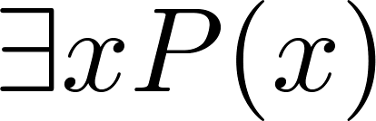
Constructive Proof
Proof of theorems in the form .
Constructive existence proof:
Find an explicit value of c, for which P(c) is true.
Then is true by Existential Generalization (EG).

Slide 148
Constructive Proof example
Theorem: For every three natural numbers x, y, z larger than 1 (x, y, z > 1), there is some natural number larger than all x, y, z such that it is not divisible by x or y or z.
Proof: Construct xyz+1. we first assume xyz+1 can be evenly divided by x, i.e. (xyz+1)/x = yz + 1/x, where 1/x must be an integer. The only possible value for x must be 1. But this is in contradiction with the fact that x, y, z > 1. Therefore, xyz+1 cannot be divided by x, and similarly, by y or z.

Slide 149
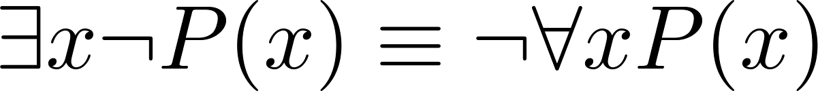
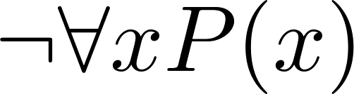
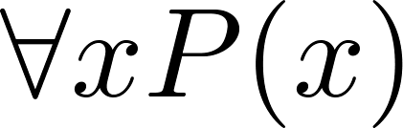
Counterexamples
Recall .
To establish that is true (or is false) find a c such that ¬P(c) is true or P(c) is false.
In this case c is called a counterexample to the assertion .
Example: “Every positive integer is the sum of the squares of 3 integers.” The integer 7 is a counterexample. So the claim is false.

Slide 150
Uniqueness Proofs
Some theorems asset the existence of a unique element with a particular property, ∃!x P(x). The two parts of a uniqueness proof are
Existence: We show that an element x with the property exists.
Uniqueness: We show that if y≠x, then y does not have the property.

Slide 151
Uniqueness Proofs
Example: Show that if a and b are real numbers and a ≠0, then there is a unique real number r such that ar + b = 0.
Solution:
Existence: The real number r = −b/a is a solution of ar + b = 0 because a(−b/a) + b = −b + b =0.
Uniqueness: Suppose that s is a real number such that as + b = 0. Then ar + b = as + b, where r = −b/a. Subtracting b from both sides and dividing by a shows that r = s.

Slide 152
Proof Strategies for proving p → q
Choose a proof method.
First try a direct method of proof.
If this does not work, we may need a clever use of a proof by contraposition or a proof by contradiction.
For whichever method you are trying, choose a strategy.
Forward reasoning.
Backward reasoning.

Slide 153
Forward Reasoning
Start with axioms and known theorems.
Have premises p, and want to prove q.
Find a s₁ such that p→s₁
Then, modus ponens gives you s₁.
Then, find an s₂ ∋ (such that) s₁→s₂.
Then, modus ponens gives you s₂.
And hope to eventually get to an s_{n} ∋ s_{n}→q.
The problem with this method is…
It can be tough to see the path looking from p.

Slide 154
Backward Reasoning
It can often be easier to see the very same path if you just start looking from the conclusion q instead…
That is, first find an s₋₁ such that s₋₁→q.
Then, find an s₋₂ ∋ s₋₂→s₋₁, and so on…
Working back to an s_{−n} ∋ p→s_{−n.}
Note we still are using modus ponens to propagate truth forwards down the chain from p to s_{−n} to … to s₁ to q!

Slide 155
Backward Reasoning Example
Theorem: ∀a>0,b>0,a≠b: (a+b)/2 > (ab)^{1/2}.
Proof:
Notice it is not obvious how to go from the premises a>0, b>0, a≠b directly forward to the conclusion (a+b)/2 > (ab)^{1/2}.
So, let’s work backwards from the conclusion, (a+b)/2 > (ab)^{1/2} !

Slide 156
Steps of Example
(a+b)/2 > (ab)^{1/2} ⇔ (squaring both sides)
This preserves the “>” since both sides are positive.
(a+b)²/4 > ab ⇔ (multiplying through by 4)
(a+b)² > 4ab ⇔ (squaring a+b)
a²+2ab+b² > 4ab ⇔ (subtracting out 4ab)
a²−2ab+b² > 0 ⇔ (factoring left side)
(a−b)² > 0
Now, since a≠b, (a−b)≠0, thus (a−b)²>0, and we can work our way back along the chain of steps…

Slide 157
“Forwardized” version of Example
Theorem: ∀a>0,b>0,a≠b: (a+b)/2 > (ab)^{1/2}.
Proof. If Since a≠b, (a−b)≠0. Thus, (a−b)²>0, i.e., a²−2ab+b² > 0.
Adding 4ab to both sides, a²+2ab+b² > 4ab. Factoring the left side, we have (a+b)² > 4ab, so (a+b)²/4 > ab.
Since ab is positive, we can take the square root of both sides and get (a+b)/2 > (ab)^{1/2}. ■

Slide 158
Stone Game Example
Game rules:
There are 15 stones in a pile. Two players take turns removing either 1, 2, or 3 stones. Whoever takes the last stone wins.
Theorem: There is a strategy for the first player that guarantees him a win.
How do we prove this?
Looks complicated… How do we pick out the winning strategy from among all possible strategies?
Work backwards from the endgame!

Slide 159
Working Backwards in the Game
Player 1 wins if it is player 2’s turn and there are no stones…
P1 can arrange this if it is his turn, and there are 1, 2, or 3 stones…
This will be true as long as player 2 had 4 stones on his turn…
And so on…
Player 1 | Player 2
 | 0
1, 2, 3
 | 4
5, 6, 7
 | 8
9, 10, 11
 | 12
13, 14, 15

Slide 160
“Forwardized” version
Theorem. Whoever moves first can always force a win.
Proof. Player 1 can remove 3 stones, leaving 12. After player 2 moves, there will then be either 11, 10, or 9 stones left. In any of these cases, player 1 can then reduce the number of stones to 8. Then, player 2 will reduce the number to 7, 6, or 5. Then, player 1 can reduce the number to 4. Then, player 2 must reduce them to 3, 2, or 1. Player 1 then removes the remaining stones and wins.

Slide 161
Conjecture & Counterexamples
Conjecture: ∀ integers n>0, n²−n+41 is prime.
Hm, let’s see if we can find any counter-examples:
1²−1+41 = 41 (prime)
2²−2+41 = 4−2+41 = 43 (prime)
3²−3+41 = 9−3+41 = 47 (prime) Looking good so far!!
Can we conclude after showing that it checks out in, say, 20 or 30 cases, that the conjecture must be true?
NEVER!
Of course, 41²−41+41 is divisible by 41!!

Slide 162
Even Great Mathematicians Can Propose False Conjectures!
Euler conjectured that for n>2, the sum of n−1 n^{th} powers of positive integers is not an n^{th} power.
Remained true for all cases checked for 200 years, but no proof was found.
Finally, in 1966, someone noticed that 27⁵ + 84⁵ + 110⁵ + 133⁵ = 144⁵.
Larger counter-examples have also been found for n=4, but none for n>5 yet.

Slide 163
Fermat’s “Last Theorem”
Theorem: x^{n}+y^{n}=z^{n} has no solutions in integers xyz ≠ 0 with integer n>2.
In the 1600s, Fermat famously claimed in a marginal note that he had a “wondrous proof” of the theorem.
But unfortunately, if he had one, he never published it!
The theorem remained a publicly unproven conjecture for the next ~400 years!
Finally, a proof that requires hundreds of pages of advanced mathematics was found by Wiles at Princeton in 1990.
It took him 10 years of work to find it!
Challenge: Find a short, simple proof of Fermat’s last theorem, and you will become instantly famous!

Slide 164
Some Open Conjectures
Conjecture: There are infinitely many primes of the form n²+1, where n∈Z.
Conjecture: (Twin Prime Conjecture) There are infinitely pairs of primes of the form (p, p+2).
Conjecture: (The Hailstone Problem) If h(x) = x/2 when x is even, and 3x+1 when x is odd, then ∀x∈N ∃n∈N h^{n}(x) = 1 (where the superscript denotes composition of h with itself n times).
Prove any of these, and you can probably have a lifetime career sitting around doing pure mathematics…

