Slide 1
§2.1 Sets
A set is a type of structure, representing an unordered collection of zero or more distinct (different) objects.
Set theory deals with operations between, relations among, and statements about sets.
Sets are ubiquitous in computer software systems.
All of mathematics can be defined in terms of some form of set theory (using predicate logic).

Slide 2
Basic notations for sets
For sets, we’ll use variables S, T, U, …
Explicitly: {John, Paul, George, Ringo}
Implicitly: {1,2,3,…}, or {2,3,5,7,11,13,17,…}
Set builder notation: For any proposition P(x) over any universe of discourse, {x|P(x)} is the set of all x such that P(x).
Ex. Let D(x,y) denote “x is divisible by y.”
Give another name for
{ x : ∀y ((y > 1) ∧ (y < x)) → ¬D(x,y) }.
Can we use any predicate P to define a set S = { x : P(x) }?
{x | P(x) : 9 < x <16}
Notes:
Read {a, b, c} as “the set whose elements are a, b, and c” or just “the set a, b, c”.

Slide 3
Basic properties of sets
Sets are inherently unordered
No matter what objects a, b, and c denote, {a, b, c} = {a, c, b} = {b, a, c} = {b, c, a} = {c, a, b} = {c, b, a}.
All elements are distinct (unequal) multiple listings make no difference!
If a=b, then {a, b, c} = {a, c} = {b, c} = {a, a, b, a, b, c, c, c, c}.
This set contains (at most) 2 elements!

Slide 4
Definition of Set Equality
Two sets are declared to be equal if and only if they contain exactly the same elements.
In particular, it does not matter how the set is defined or denoted.
For example: The set {1, 2, 3, 4} = {x | x is an integer where x>0 and x<5 } = {x | x is a positive integer whose square is >0 and <25}

Slide 5
Infinite Sets
Conceptually, sets may be infinite (i.e., not finite, without end, unending).
Symbols for some special infinite sets: N = {0, 1, 2, …} The Natural numbers. Z = {…, -2, -1, 0, 1, 2, …} All Integers. Z⁺ = {1,2,3,…..} positive integers = Q = { p/q | p ∈ Z, q ∈ Z, and q ≠ 0} Rational
numbers.
R = The “Real” numbers
Infinite sets come in different sizes!

Slide 6
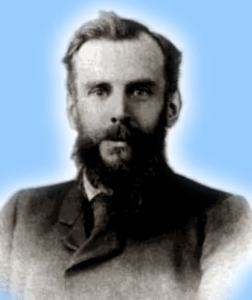
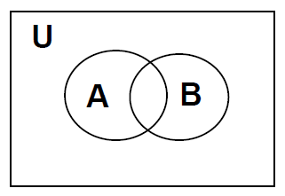

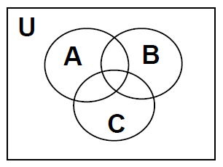

Venn Diagrams
John Venn 1834-1923
A useful geometric visualization tool
• The Universe U is the rectangular box
• Each set is represented by a circle and its interior
• Shade the appropriate region to represent the given set operation.
Notes:
All possible combinations of the sets must be Represented

Slide 7
Basic Set Relations: Member of
x∈S (“x is in S”) is the proposition that object x is an ∈lement or member of set S.
e.g. 3∈N, “a”∈{x | x is a letter of the alphabet}
Can define set equality in terms of ∈ relation: ∀S,T: S=T ↔ (∀x: x∈S ↔ x∈T) “Two sets are equal iff they have all the same members.”
x∉S :≡ ¬(x∈S) “x is not in S”

Slide 8
The Empty Set
∅ (“null”, “the empty set”) is the unique set that contains no elements whatsoever.
∅ = {} = {x|False}
No matter the domain of discourse, we have the axiom ¬∃x: x∈∅.

Slide 9
Subset and Superset Relations
S⊆T (“S is a subset of T”) means that every element of S is also an element of T.
S⊆T ⇔ ∀x (x∈S → x∈T)
∅⊆S, S⊆S.
S⊇T (“S is a superset of T”) means T⊆S.
Note S=T ⇔ S⊆T∧ S⊇T.
means ¬(S⊆T), i.e. ∃x(x∈S ∧ x∉T)
Showing that S is not a Subset of T: find an element x ∈ S with x ∉ T.

Slide 10

Proper (Strict) Subsets & Supersets
S⊂T (“S is a proper subset of T”) means that S⊆T but . Similar for S⊃T.
Example: {1,2} ⊂ {1,2,3}
S
T
Venn Diagram equivalent of S⊂T
Notes:
We may also say, “S is a strict subset of T”, or “S is strictly a subset of T” to mean the same thing.

Slide 11
Sets Are Objects, Too!
The objects or structures are elements of a set or may themselves be sets.
Sets can be both members and subsets of other sets.
If A={a}, B={{a},{{a}}}, then {A}∈B and {A}⊆B
if A = {∅,{∅}}, then A has two elements ∅,{∅}, and hence four subsets: ∅, {∅}, {{∅}}. {∅,{∅}}
Note that 1 ≠ {1} ≠ {{1}} !!!!
Very
Important!

Slide 12
Russell's paradox (Cont.)
Russell's paradox: Let A be the set of all sets which are not members of themselves. Is A a member of itself?
A={ X | X ∉ X}
if A∈ A then A ∉ A;
if A ∉ A then A ∈ A;
Since neither " A∈ A " nor " A ∉ A " holds, this is trivially a paradox.

Slide 13
Another paradox:
Henry is a barber who shaves all people who do not shave themselves. Does Henry shave himself?
H={x| ¬ Shave(x,x)}
The premise: ∀x: x ∈H ↔ Shave(Henry,x)
By univ. inst.: Henry ∈H↔ Shave(Henry,Henry)
If Henry is in H (i.e., ¬ Shave(Henry,Henry)) then we have Shave(Henry,Henry).
If Henry is not in H (i.e., Shave(Henry,Henry) ) then we have Henry∈H.

Slide 14
Cardinality and Finiteness
|S| (read “the cardinality of S”) is a measure of how many different elements S has.
E.g., |∅|=0, |{1,2,3}| = 3, |{a,b}| = 2, |{{1,2,3},{4,5}}| = ____
If |S|∈N, then we say S is finite. Otherwise, we say S is infinite.
N is infinite since |N| is not a natural number. It is called a transfinite cardinal number.
2

Slide 15
The Power Set Operation
The power set P(S) of a set S is the set of all subsets of S.
P(S) :≡ {x | x⊆S}.
E.g. P({a,b}) = {∅, {a}, {b}, {a,b}}.
Sometimes P(S) is written 2^{S}. Note that for finite S, |P(S)| = 2^{|S|}.
Notes:
画蛇添足：∀S≠∅ :|P(S)|>|S|.
We’ll get to different sizes of infinite sets later, in the module on functions.

Slide 16
Ordered n-tuples
These are like sets, except that duplicates matter, and the order makes a difference.
For n∈N, an ordered n-tuple or a sequence or list of length n is written (a₁, a₂, …, a_{n}). Its first element is a₁, etc.
Note that (1, 2) ≠ (2, 1) ≠ (2, 1, 1).
Empty sequence, singlets, pairs, triples, quadruples, quintuples, …, n-tuples.
Contrast with sets’ {}
Notes:
Sometimes people also define “bags”, which are unordered collections in which duplicates matter. If you have a bag of coins, they are in no particular order, but it matters how many coins of each type you have.

Slide 17
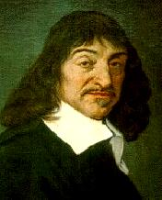
Cartesian Products of Sets
For sets A, B, their Cartesian product A×B :≡ {(a, b) | a∈A ∧ b∈B }.
E.g. {a,b}×{1,2} = {(a,1),(a,2),(b,1),(b,2)}
Note that for finite A, B, |A×B|=|A||B|.
Note that the Cartesian product is not commutative: i.e., ¬∀AB: A×B=B×A.
Extends to A₁ × A₂ × … × A_{n}...
René Descartes (1596-1650)
Notes:
注意： ¬∀AB: A×B=B×A. 与 ∀AB: A×B<>B×A的区别。
Usually AxBxC is defined as {(a,b,c) | a is in A and b is in B and c is in C}.

Slide 18
Review of §2.1
Sets S, T, U… Special sets N, Z, R.
Set notations {a,b,...}, {x|P(x)}…
Set relation operators x∈S, S⊆T, S⊇T, S=T, S⊂T, S⊃T. (These form propositions.)
Finite vs. infinite sets.
Set operations |S|, P(S), S×T.
Next up: §2.2: More set ops: ∪, ∩, −.

Slide 19
Blackboard Exercises
Yes
If S = {∅,{∅}}, then 2^{S} =
If S = ∅, then 2^{S} = If S = {3,3,3}, then |S| =
If A,B finite then |AxB| =
Is {x} ⊆ {x}?
Is {x} ∈ {x,{x}}?
Is {x} ⊆ {x,{x}}?
Is {x} ∈ {x}?
Is ∅ ⊆ {1,2,3}?
Is ∅ ∈ {1,2,3}?
Is ∅ ⊆ {∅,1,2,3}?
Is ∅ ∈ {∅,1,2,3}?
Yes
2^{S} = {∅, {∅}, {{∅}}, {∅,{∅}}}.
Yes
No
2^{S} = {∅}.
Yes
No
|S| = 1.
Yes
Yes
|A||B|

Slide 20
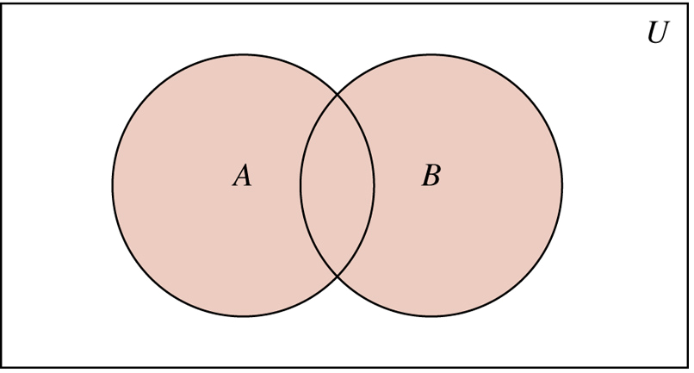
§2.2: Set operations
For sets A, B, their union A∪B is the set containing all elements that are either in A, or (“∨”) in B (or, of course, in both).
Formally, ∀A,B: A∪B = {x | x∈A ∨ x∈B}.
Note that A∪B is a superset of both A and B (in fact, it is the smallest such superset): ∀A, B: (A∪B ⊇ A) ∧ (A∪B ⊇ B)
Notes:
A∪B is shaded

Slide 21

Union Examples
{a,b,c}∪{2,3} = {a,b,c,2,3}
{2,3,5}∪{3,5,7} = {2,3,5,3,5,7} ={2,3,5,7}
Required Form
2
5
3
7

Slide 22
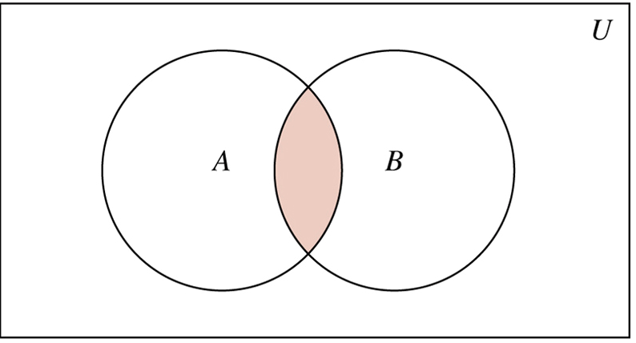
The Intersection Operator
For sets A, B, their intersection A∩B is the set containing all elements that are simultaneously in A and (“∧”) in B.
Formally, ∀A,B: A∩B={x | x∈A ∧ x∈B}.
Note that A∩B is a subset of both A and B (in fact it is the largest such subset): ∀A, B: (A∩B ⊆ A) ∧ (A∩B ⊆ B)

Slide 23
Intersection Examples
∅
{a,b,c}∩{2,3} = ___
{2,4,6}∩{3,4,5} = ______
{4}
3
2
4
6
5

Slide 24
Disjointedness
Two sets A, B are called disjoint (i.e., unjoined) iff their intersection is empty. (A∩B=∅)
Example: the set of even integers is disjoint with the set of odd integers.
Help, I’ve been disjointed!

Slide 25
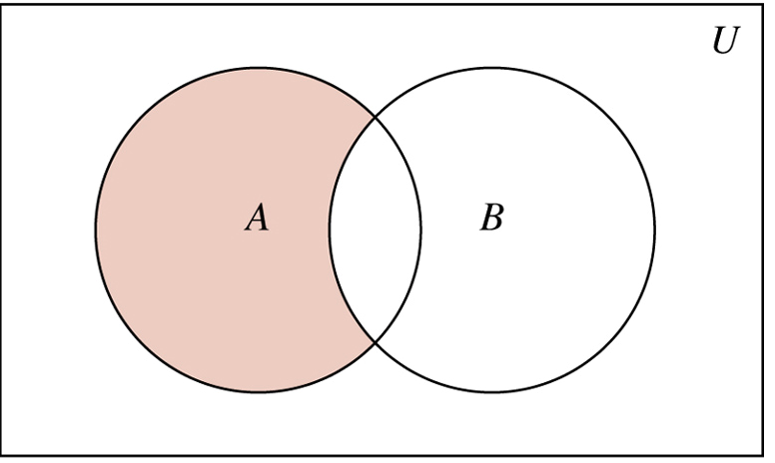
Set Difference
For sets A, B, the difference of A and B, written A−B, is the set of all elements that are in A but not B.
Formally: A − B :≡ {x | x∈A ∧ x∉B} = {x | ¬(x∈A → x∈B) }
Also called: The complement of B with respect to A.
Notes:
NOT (x in A -> x in B) = NOT (x not in A or x in B) (defn. of implies) = x in A AND x not in B (DeMorgan’s law).

Slide 26
Set Difference Examples
{1,2,3,4,5,6} − {2,3,5,7,9,11} = ___________
Z − N = {… , −1, 0, 1, 2, … } − {0, 1, … } = {x | x is an integer but not a nat. #} = {x | x is a negative integer}
Result = {… , −3, −2, −1}
{1,4,6}

Slide 27
Set Difference
A−B is what’s left after B “takes a bite out of A”
Chomp!
Set A−B
Set A
Set B
Notes:
For remember

Slide 28
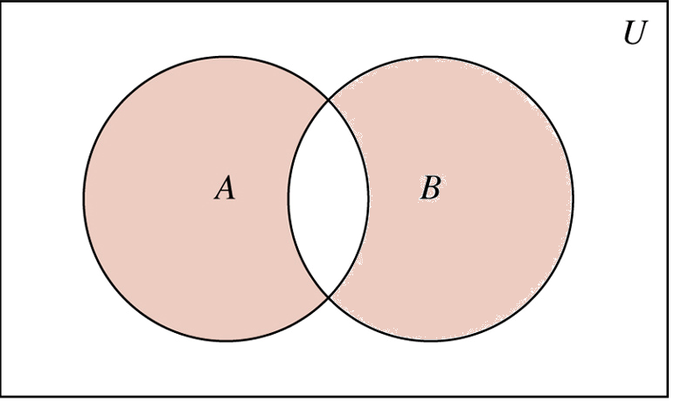
Symmetric Difference
For sets A, B, the symmetric difference of A and B, written A ⊕ B, is the set: A ⊕ B :≡ (A − B) ∪(B − A) ≡ (A ∪ B) − (A ∩ B)
E.g. A= {1, 2, 3, 4, 5}, B = {4, 5, 6, 7, 8},
A ⊕ B= {1, 2, 3, 6, 7, 8}

Slide 29
Set Complements
When the context clearly defines The universe of discourse U, we say that for any set A⊆U, the complement of A, written , is the complement of A w.r.t. U, i.e., it is U−A.
E.g., If U=N,
Note: Alternative notation is A^{c}, and {x| x∈U and x ∉ A}.
Notes:
U take away A

Slide 30
More on Set Complements
An equivalent definition, when U is clear:
A
U
Notes:
Note that set difference and complement do not relate to each other like arithmetic difference and negative. In arithmetic, we know that a-b = -(b-a). But in sets, A-B is not generally the same as the complement of B-A.

Slide 31
Set Identities
Identity: A∪∅ = A = A∩U
Domination: A∪U = U, A∩∅ = ∅
Idempotent: A∪A = A = A∩A
Double complement:
Commutative: A∪B = B∪A, A∩B = B∩A
Associative: A∪(B∪C)=(A∪B)∪C , A∩(B∩C)=(A∩B)∩C
Distributive: Ａ∩(Ｂ∪Ｃ)=(Ａ∩Ｂ)∪(Ａ∩Ｃ)
Ａ∪(Ｂ∩Ｃ)=(Ａ∪Ｂ)∩(Ａ∪Ｃ)

Slide 32
DeMorgan’s Law for Sets
Exactly analogous to (and provable from) DeMorgan’s Law for propositions.
Don’t memorize them, understand them!

Slide 33
Proving Set Identities
To prove statements about sets, of the form E₁ = E₂ (Es are set expressions), here are three useful techniques:
1. Prove E₁ ⊆ E₂ and E₂ ⊆ E₁ separately.
2. Use set builder notation & logical equivalences.
3. Use a membership table.
Notes:
A membership table is like a truth table.

Slide 34
Method 1: Mutual subsets
Example: Show A∩(B∪C)=(A∩B)∪(A∩C).
Part 1: Show A∩(B∪C)⊆(A∩B)∪(A∩C).
Assume x∈A∩(B∪C), & show x∈(A∩B)∪(A∩C).
We know that x∈A, and either x∈B or x∈C.
Case 1: x∈B. Then x∈A∩B, so x∈(A∩B)∪(A∩C).
Case 2: x∈C. Then x∈A∩C , so x∈(A∩B)∪(A∩C).
Therefore, x∈(A∩B)∪(A∩C).
Therefore, A∩(B∪C)⊆(A∩B)∪(A∩C).
Part 2: Show (A∩B)∪(A∩C) ⊆ A∩(B∪C). …

Slide 35



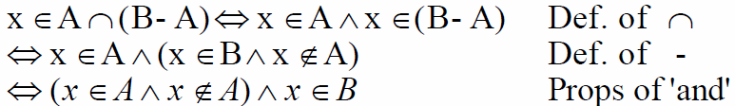

Method 2: Logical equivalence
Show
or
or is a tautology.
But the consequent is always false. Therefore, the antecedent better always be false also.
Notes:
X is arbitrary: Universal Instantiation, Universal Generalization

Slide 36
Method 3: Membership Tables
Just like truth tables for propositional logic.
Columns for different set expressions.
Rows for all combinations of memberships in constituent sets.
Use “1” to indicate membership in the derived set, “0” for non-membership.
Prove equivalence with identical columns.

Slide 37
Membership Table Example
Prove (A∪B)−B = A−B.

Slide 38
Blackboard Exercise
Prove (A∪B)−C = (A−C)∪(B−C).

Slide 39
Generalized Unions & Intersections
Since union & intersection are commutative and associative, we can extend them from operating on ordered pairs of sets (A,B) to operating on sequences of sets (A₁,…,A_{n}), or even on unordered sets of sets, X={A | P(A)}.
Notes:
because 'and' and 'or' are commutative and associative

Slide 40
Generalized Union
Binary union operator: A∪B
n-ary union: A∪A₂∪…∪A_{n} :≡ ((…((A₁∪ A₂) ∪…)∪ A_{n}) (grouping & order is irrelevant)
“Big U” notation:
Or for infinite sets of sets:
Notes:
扩展的并集

Slide 41
Generalized Intersection
Binary intersection operator: A∩B
n-ary intersection: A₁∩A₂∩…∩A_{n}≡((…((A₁∩A₂)∩…)∩A_{n}) (grouping & order is irrelevant)
“Big Arch” notation:
Or for infinite sets of sets:

Slide 42
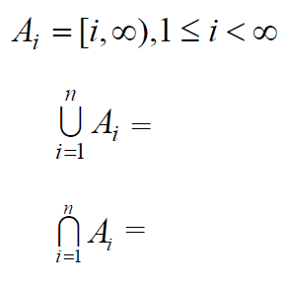


Examples
Let
Notes:
interval

Slide 43
Examples
if
Then
Then
Multiples of LCM(1,…,n)
{0，1} ∪ primes
Notes:
interval

Slide 44
Inclusion/Exclusion
Example:
How many people are wearing a watch?
How many people are wearing sneakers?
How many people are wearing a watch OR sneakers?
B
|A ∪ B| = |A| + |B| - |A ∩ B|
A

Slide 45
Generalized Inclusion/Exclusion
Suppose we have:
A
B
C
And I want to know |A U B U C|
|A U B U C| = |A| + |B| + |C|
- |A ∩ B| - |A ∩ C| - |B ∩ C|
+ |A ∩ B ∩ C|

Slide 46
Blackboard Exercises
Example:
There are 217 cs majors.
157 are taking cs125.
145 are taking cs173.
98 are taking both.
How many are taking neither?
125
173
217 - (157 + 145 - 98) = 13
Notes:
Yes! ∀x (x ∈ ∅) → (x ∈ {1,2,3}) holds, because (x ∈ ∅) is false.

Slide 47
Representations
A frequent theme of this course will be methods of representing one discrete structure using another discrete structure of a different type.
E.g., one can represent natural numbers as
Bit strings: 0:≡0, 1:≡1, 2:≡10, 3:≡11, 4:≡100, …

Slide 48
Representing Sets with Bit Strings
For an enumerable u.d. U with ordering x₀, x₁, x₂, …, represent a finite set S⊆U as the finite bit string B=b₀b₁b₂…b_{n} where ∀i: x_{i}∈S ↔ (i<n ∧ b_{i}=1).
e.g. U=N, S={2,3,5,7,11}, B=001101010001.
In this representation, the set operators “∪”, “∩”, “—”are implemented directly by bitwise OR, AND, NOT!
A | 1 | 0 | 1 | 0 | 1 | 1
B | 0 | 1 | 1 | 0 | 0 | 1
A ∪ B A ∩ B | 1 | 1 | 1 | 0 | 1 | 1
 | 0 | 0 | 1 | 0 | 0 | 1

Slide 49
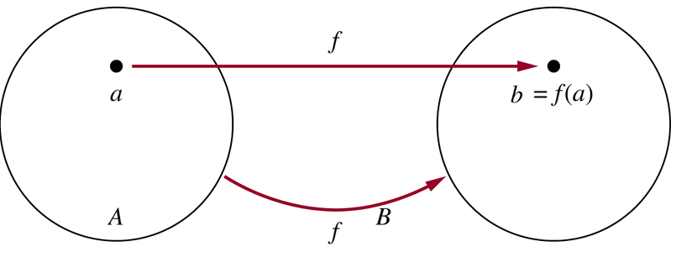
§2.3: Functions
Def: Let A and B be sets. A function f: A → B is a rule that assigns to each element a∈ A exactly one element f(a)∈ B.
We also say that f : A → B is a mapping from domain A to codomain B.
f(a) is called the image of the element a, and the element a is called a preimage of f(a).
Notes:
does” f(n)=a positive integer multiple of n” define a function?

Slide 50
Graphical Representations
Functions can be represented graphically in several ways:
f
A
B
•
•
f
•
•
•
•
•
y
a
b
•
•
•
•
x
A
B
Bipartite Graph
Plot
Like Venn diagrams

Slide 51
Some Function Terminology
If it is written that f:A→B, and f(a)=b (where a∈A & b∈B), then we say:
A is the domain of f.
B is the codomain of f.
b is the image of a under f.
a is a pre-image of b under f.
In general, b may have more than 1 pre-image.
The range R⊆B of f is R={b | ∃a f(a)=b }.
Notes:
codomain上域

Slide 52
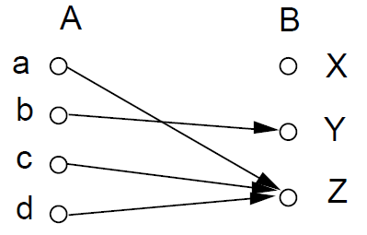
Example
If S is a subset of A then f(S) = {f(s) | s in S}.
f(a) =
f(A) =
f({c,d}) =
the image of d is
the preimage of Y is
the preimages of Z are
the domain of f is A =
the codomain is B =
Z
{Y, Z}
{Z}
Z
b
a, c and d
{a, b, c, d}
{X, Y, Z}

Slide 53
Range versus Codomain
The range of a function might not be its whole codomain.
The codomain is the set that the function is declared to map all domain values into.
The range is the particular set of values in the codomain that the function actually maps elements of the domain to.

Slide 54
Range vs. Codomain - Example
Suppose I declare to you that: “f is a function mapping students in this class to the set of grades {A,B,C,D,E}.”
At this point, you know f’s codomain is: __________, and its range is ________.
Suppose the grades turn out all As and Bs.
Then the range of f is _________, but its codomain is __________________.
{A,B,C,D,E}
unknown!
{A,B}
still {A,B,C,D,E}!

Slide 55
Image & Preimage
What is image(preimage(S))?
S
{ }
subset of S
superset of S
who knows?
⊆ S
Michael Tito Janet Cindy Bobby
Katherine
Scruse
Carol Brady
Teresa
What is preimage(image(S))?
⊇ S

Slide 56
Function Operator Example
+,× (“plus”,“times”) are binary operators over R. (Normal addition & multiplication.)
Therefore, we can also add and multiply functions f,g:R→R:
(f + g):R→R, where (f + g)(x) = f(x) + g(x)
(f × g):R→R, where (f × g)(x) = f(x) × g(x)

Slide 57
One-to-One (Injective) Functions
A function is one-to-one (1-1), or injective, or an injection, iff preimages are unique.
Note: this means that if a ≠ b then f(a) ≠ f(b).
Bipartite (2-part) graph representations of functions that are (or not) one-to-one:
•
•
•
•
•
•
•
•
•
•
•
•
•
•
•
•
•
•
•
•
•
•
•
•
•
•
•
Not one-to-one
Not even a function!
One-to-one

Slide 58
Onto (Surjective) Functions
A function f:A→B is onto or surjective or a surjection iff its range is equal to its codomain (∀b∈B, ∃a∈A: f(a)=b).
Think: An onto function maps the set A onto (over, covering) the entirety of the set B, not just over a piece of it.

Slide 59
Illustration of Onto
Some functions that are, or are not, onto their codomains:
•
•
•
•
•
•
•
•
•
•
•
•
•
•
•
•
•
•
•
•
•
•
•
•
•
•
•
•
•
•
•
•
•
•
•
Onto (but not 1-1)
Not Onto (or 1-1)
Both 1-1 and onto
1-1 but not onto

Slide 60
Bijections
A function f is said to be a one-to-one correspondence, or a bijection, iff it is both one-to-one and onto.
For bijections f:A→B, there exists an inverse of f, written f ⁻¹:B→A, which is defined as: f ⁻¹(y) = x iff f(x) = y

Slide 61
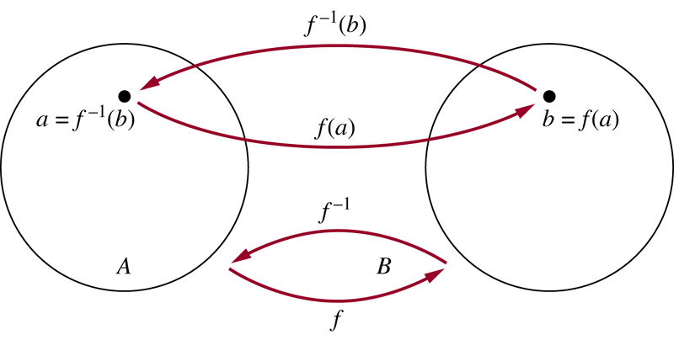
Illustration of Inverse
•
Note: No inverse exists unless f is a bijection.

Slide 62
Same Cardinality
Whenever there is a bijection from A to B, the two sets must have the same number of elements or the same cardinality.
E.g. Let E = {0, 2, 4, 6, . . . .}. Then there is a bijection f from N to E,, defined by f(x) = 2x. Hence, the set of even integers has the same cardinality as the set of natural numbers.
OH, E LOOKS ONLY HALF AS BIG!!!
Notes:
That will become our definition, especially for infinite sets.

Slide 63
Composition
Definition: Let f: B → C, g: A → B. The composition of f with g, denoted f o g, is the function from A to C defined by
f g(x) = f(g(x))
If f(x) = x² and g(x) = 2x + 1, then f(g(x)) = and g(f(x)) =
f ⁻¹ is the unique function such that
where I_{A} is the identity function on A
(2x+1)²
2x² + 1
Notes:
Read as f composed with g

Slide 64
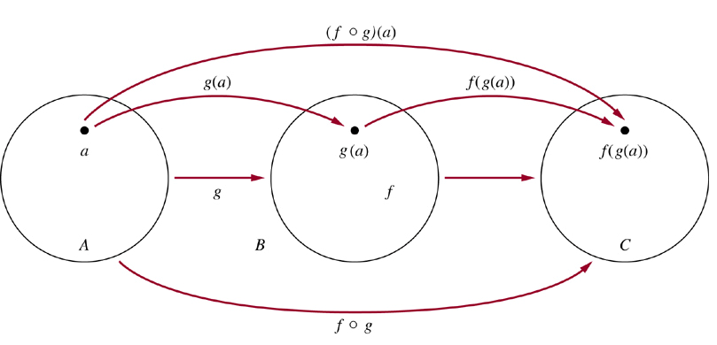
Illustration of Composition

Slide 65
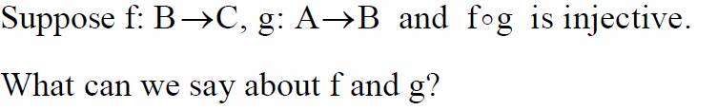
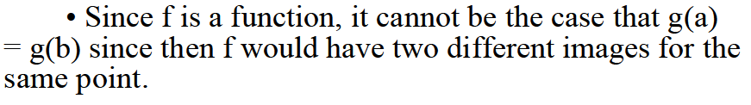

Example
It follows that g must be an injection. However, f need not be an injection

Slide 66
Graphs of Functions
We can represent a function f:A→B as a set of ordered pairs {(x,f(x)) | x∈A}.
Note that ∀x, there is only 1 pair (x,f(x)).
For functions over numbers, we can represent an ordered pair (x,y) as a point on a plane.
A function is then drawn as a curve (set of points), with only one y for each x.

Slide 67
A Couple of Key Functions
In discrete math, we will frequently use the following two functions over real numbers:
The floor function ⎣·⎦:R→Z, where ⎣x⎦ (“floor of x”) means the largest (most positive) integer ≤ x. i.e., ⎣x⎦ :≡ max({i∈Z|i≤x}).
The ceiling function ⎡·⎤ :R→Z, where ⎡x⎤ (“ceiling of x”) means the smallest (most negative) integer ≥ x. ⎣x⎦ :≡ min({i∈Z|i≥x})

Slide 68
Visualizing Floor & Ceiling
Real numbers “fall to their floor” or “rise to their ceiling.”
Note that if x∉Z, ⎣−x⎦ ≠ − ⎣x⎦ & ⎡−x⎤ ≠ − ⎡x⎤
Note that if x∈Z, ⎣x⎦ = ⎡x⎤ = x.
3
.
2
⎡1.6⎤=2
.
1.6
.
1
⎣1.6⎦=1
0
.
−1
⎡−1.4⎤= −1
.
−1.4
.
−2
.
.
.
⎣−1.4⎦= −2
−3
−3
⎡−3⎤=⎣−3⎦= −3
Notes:
In this example, we use vertical axis for illustration

Slide 69
Plots with floor/ceiling: Example
Plot of graph of function f(x) = ⎣x/3⎦:
f(x)
Set of points (x, f(x))
+2
−3
+3
x
−2
Notes:
Step function

Slide 70
Proving Properties of Functions
Example: Prove that x is a real number, then
⌊2x⌋= ⌊x⌋ + ⌊x + 1/2⌋
Solution: Let x = n + ε, where n is an integer and 0 ≤ ε< 1.
Case 1: ε < ½
2x = 2n + 2ε and ⌊2x⌋ = 2n, since 0 ≤ 2ε< 1.
⌊x + 1/2⌋ = n, since x + ½ = n + (1/2 + ε ) and 0 ≤ ½ +ε < 1.
Hence, ⌊2x⌋ = 2n and ⌊x⌋ + ⌊x + 1/2⌋ = n + n = 2n.
Case 2: ε ≥ ½
2x = 2n + 2ε = (2n + 1) +(2ε − 1) and ⌊2x⌋ =2n + 1, since 0 ≤ 2 ε - 1< 1.
⌊x + 1/2⌋ = ⌊ n + (1/2 + ε)⌋ = ⌊ n + 1 + (ε – 1/2)⌋ = n + 1 since 0 ≤ ε – 1/2< 1.
Hence, ⌊2x⌋ = 2n + 1 and ⌊x⌋ + ⌊x + 1/2⌋ = n + (n + 1) = 2n + 1.

Slide 71
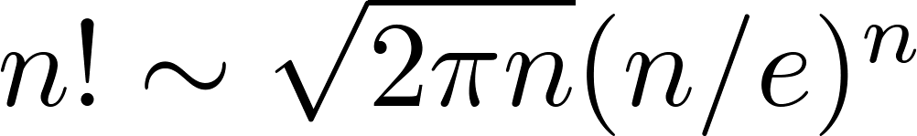
Factorial Function
Definition: f: N → Z⁺ , denoted by f(n) = n! is the product of the first n positive integers when n is a nonnegative integer.
f(n) = 1 ∙ 2 ∙∙∙ (n – 1) ∙ n, f(0) = 0! = 1
Examples:
^{f(1) = 1! = 1}
^{f(2) = 2! = 1 ∙ 2 = 2}
^{f(6) = 6! = 1 ∙ 2 ∙ 3∙ 4∙ 5} ^{∙ 6 = 720}
f(20) = 2,432,902,008,176,640,000.
Stirling’s Formula:

Slide 72
Review of §2.3 (Functions)
Function variables f, g, h, …
Notations: f:A→B, f(a), f(A).
Terms: image, preimage, domain, codomain, range, one-to-one, onto, strictly (in/de)creasing, bijective, inverse, composition.
Function unary operator f ⁻¹, binary operators +, −, etc., and .
The R→Z functions ⎣x⎦ and ⎡x⎤.

Slide 73
§2.4: Sequences and Summations
A sequence or series is just like an ordered n-tuple, except:
Each element in the series has an associated index number.
A sequence or series may be infinite.
A string is a sequence of symbols from some finite alphabet.
A summation is a compact notation for the sum of all terms in a (possibly infinite) series.

Slide 74
Sequences
A sequence or series {a_{n}} is identified with a generating function f:S→A for some subset S⊆N.
If f is a generating function for a series {a_{n}}, then for n∈S, the symbol a_{n} denotes f(n), also called term n of the sequence.
The index of a_{n} is n. (Or, often i is used.)
A series is sometimes denoted by listing its first and/or last few elements, and using ellipsis (…) notation.
E.g., “{a_{n}} = 0, 1, 4, 9, 16, 25, …” is taken to mean ∀n∈N, a_{n} = n².

Slide 75


Sequence Examples
Some authors write “the sequence a₀, a₁, …” or or instead of {a_{n}}, to ensure that the set of indices is clear.
An example of an infinite series:
Consider the series {a_{n}}, where (∀n) a_{n}= f(n) = 1/(n+1).
Then, using zero-origin indexing we have {a_{n}} = 1, 1/2, 1/3, …
using one-origin indexing we have {a_{n}} = 1/2, 1/3, 1/4, …
Notes:
Using zero-origin indexing or one -origin indexing

Slide 76
Example with Repetitions
Like tuples, but unlike sets, a sequence may contain repeated instances of an element.
Consider the sequence {b_{n}} = b₀, b₁, … (note that 0 is an index) where b_{n} = (−1)^{n}.
Thus, {b_{n}} = 1, −1, 1, −1, …
Note repetitions!
This {b_{n}} denotes an infinite sequence of 1’s and −1’s, not the 2-element set {1, −1}.

Slide 77
Recognizing Sequences
Sometimes, you’re given the first few terms of a sequence,
and you are asked to find the sequence’s generating function,
or a procedure to enumerate the sequence.
Examples: What’s the next number?
1,2,3,4,…
1,3,5,7,9,…
2,3,5,7,11,...
5 (the 5th smallest number >0)
11 (the 6th smallest odd number >0)
13 (the 6th smallest prime number)
Notes:
These are included in the exam for civil servant

Slide 78
What are Strings, Really?
This book says “finite sequences of the form a₁, a₂, …, a_{n} are called strings”,
but infinite strings are also discussed sometimes.
Strings are normally restricted to sequences composed of symbols drawn from a finite alphabet.
Either way, the length of a (finite) string is just its number of terms (or of distinct indices).

Slide 79
Strings, more formally
Let Σ be a finite set of symbols, i.e. an alphabet.
A string s over alphabet Σ is any sequence {s_{n}} of symbols, s_{n}∈Σ, normally indexed by N or N−{0}.
If a, b, c, … are symbols, the string s = a, b, c, … can also be written abc…(i.e., without commas).
If s is a finite string and t is any string, then the concatenation of s with t, written just st,
is simply the string consisting of the symbols in s, in sequence, followed by the symbols in t, in sequence.

Slide 80
More Common String Notations
The length |s| of a finite string s is its number of terms (i.e., its number of index values i).
If s is a finite string and n∈N,
Then s^{n} denotes the concatenation of n copies of s.
ε or “” denotes the empty string, the length 0.
This is fairly common, but the book uses λ instead.
If Σ is an alphabet and n∈N, Σ^{n} :≡ {s | s is a string over Σ of length n}, and Σ* :≡ {s | s is a finite string over Σ}.

Slide 81
Summation Notation
Given a series {a_{n}}, an integer lower bound (or limit) j≥0, and an integer upper bound k≥j, then the summation of {a_{n}} from j to k is written and defined as follows:
Here, i is called the index of summation.

Slide 82
Generalized Summations
For an infinite series, we may write:
To sum a function over all members of a set X={x₁, x₂, …}:
Or, if X={x|P(x)}, we may just write:

Slide 83








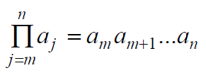
Examples

Slide 84
Simple Summation Example

Slide 85
More Summation Examples
An infinite series with a finite sum:
Using a predicate to define a set of elements to sum over:

Slide 86
Summation Manipulations
Some handy identities for summations:
(Distributive law.)
(An application of commut- ativity.)
(Index shifting.)

Slide 87
More Summation Manipulations
Other identities that are sometimes useful:
(Series splitting.)
(Order reversal.)
(Grouping.)

Slide 88
Example: Impress Your Friends
Boast, “I’m so smart; give me any 2-digit number n, and I’ll add all the numbers from 1 to n in my head in just a few seconds.”
I.e., Evaluate the summation:
There is a simple closed-form formula for the result, discovered by Euler at age 12!
And frequently rediscovered by many…
Notes:
Closed-form expression, a finitary expression, rather than one involving (for example) an infinite series, or use of recursion

Slide 89
Euler’s Trick, Illustrated
Consider the sum: 1+2+…+(n/2)+((n/2)+1)+…+(n-1)+n
We have n/2 pairs of elements, each pair summing to n+1, for a total of (n/2)(n+1).
n+1
…
n+1
n+1

Slide 90
Example: Geometric Progression
A geometric progression is a series of the form a, ar, ar², ar³, …, ar^{k}, where a,r∈R.
The sum of such a series is given by:
We can reduce this to closed form via clever manipulation of summations...

Slide 91
Summation
Shift and reduce
Example:
. shift the series
. reduce

Slide 92
Summation
Guess and test
Example:
. Guess the result
. Solve for the coefficients (let n=0,1,2)
. Prove by induction
Notes:
If you know the result is polynomial.
Method of undetermined coefficient.

Slide 93
Nested Summations
These have the meaning you’d expect.

Slide 94
Some Shortcut Expressions
Geometric series.
Euler’s trick.
Quadratic series.
Cubic series.
Notes:
Geometric/arithmetical progression
method of undetermined coefficient;

Slide 95
Using the Shortcuts
Example:
Use series splitting.
Solve for desired summation.
Apply quadratic series rule.
Evaluate.

Slide 96
Summations: Conclusion
You need to know:
How to read, write & evaluate summation expressions like:
Summation manipulation laws we covered.
Shortcut closed-form formulas, & how to use them.

Slide 97
§2.5: Cardinality of Sets
Using what we learned about functions, it’s possible to formally define cardinality even for infinite sets.
We can also show that infinite sets come in different sizes of infinite!
This also gives us some interesting proof examples.

Slide 98
Cardinality: Formal Definition
For any two (possibly infinite) sets A and B, we say
|A|=|B| (A and B have the same cardinality) iff there exists a bijection from A to B；
| A | ≤ | B | iff there is an injection from A to B.
With infinite sets proper subsets can have the same cardinality. This cannot happen with finite sets.
When A and B are finite, it is easy to see that such a function exists iff A and B have the same number of elements n∈N.

Slide 99
Countable versus Uncountable
For any set S, if S is finite or if |S|=|N|, we say S is countable. Else, S is uncountable.
Intuition behind “countable:” we can enumerate (sequentially list) elements of S in such a way that any individual element of S will eventually be counted in the enumeration. Examples: N, Z, Q.
Uncountable means: No series of elements of S (even an infinite series) can include all of S’s elements. Examples: R, R²

Slide 100
Countable Sets: Examples
Theorem: The set Z is countable.
Proof: Consider f:Z→N where f(i)=2i for i≥0 and f(i) = −2i−1 for i<0. Note f is bijective.
Theorem: The set of all ordered pairs of natural numbers (n,m) is countable.
Consider listing the pairs in order by their sum s=n+m, then by n. Every pair appears once in this series; the generating function is bijective.

Slide 101
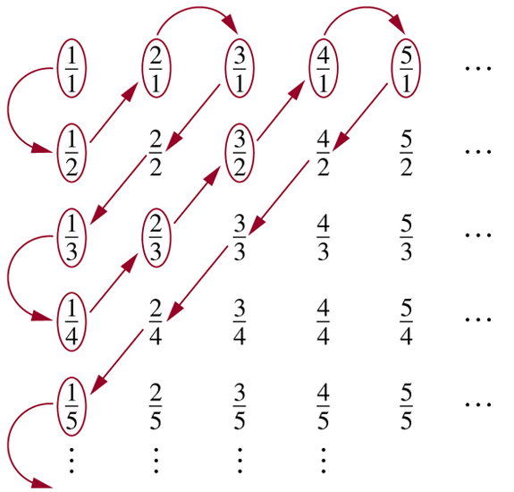
Countable Sets: Examples
Theorem: The set of positive rational numbers Q⁺ is countably infinite.
Proof: Every rational number appears on the list. Terms not circled are not listed because they repeated previously listed terms.
Notes:
Whenever we encounter a number that is already listed, we don’t list it again.

Slide 102
Uncountable Sets: Example
Theorem: The open interval of reals [0,1) :≡ {r∈R| 0 ≤ r < 1} is uncountable.
Proof by diagonalization: (Cantor, 1891)
Assume there is a series {r_{i}} = r₁, r₂, ... containing all elements r∈[0,1).
Consider listing the elements of {r_{i}} in decimal notation (although any base will do) in order of increasing index: ... (continued on next slide)

Slide 103
Uncountability of Reals, cont’d
A postulated enumeration of the reals: r₁ = 0.d_{1,1} d_{1,2} d_{1,3} d_{1,4} d_{1,5} d_{1,6} d_{1,7} d_{1,8}… r₂ = 0.d_{2,1} d_{2,2} d_{2,3} d_{2,4} d_{2,5} d_{2,6} d_{2,7} d_{2,8}… r₃ = 0.d_{3,1} d_{3,2} d_{3,3} d_{3,4} d_{3,5} d_{3,6} d_{3,7} d_{3,8}… r₄ = 0.d_{4,1} d_{4,2} d_{4,3} d_{4,4} d_{4,5} d_{4,6} d_{4,7} d_{4,8}…
Now, consider a real number generated by taking all the digits d_{i,i} that lie along the diagonal in this figure and replacing them with different digits.
That real doesn't appear in the list!
Notes:
Why? Because it’s first digit is different from the first digit of r1, its second digit is different from the second digit of r2, and in general its nth digit is different from the nth digit of rn. Therefore it is different from every number in the list. We may want to restrict ourselves to change the digit to one other than 9 because if we change it to a nine, the resulting number could be say .1239999999999… infinitely which is equal to .1240000000000… (which could be in the list) even though the digits don’t match. But, actually this imagined problem doesn’t actually arise because since there are an infinite number of reals that don’t include any 9’s, it is impossible for the diagonal to be all 9’s beyond some finite point.

Slide 104
Uncountability of Reals
E.g., a postulated enumeration of the reals: r₁ = 0.301948571… r₂ = 0.103918481… r₃ = 0.039194193… r₄ = 0.918237461…
OK, now let’s add 1 to each of the diagonal digits (mod 10), that is changing 9’s to 0.
0.4103… can’t be on the list anywhere!

Slide 105
Can we write programs for all functions?
How many different programs can we write?
Depends on the size of the alphabet we use. Let’s say our alphabet is size 100.
How many 1 character programs are there?
How many 2 character programs are there?
…
How many n character programs are there?
How many programs are there?
Countably many, we can list them by length.

Slide 106
Can we write programs for all functions?
How many different functions are there?
Suppose domain is N, and codomain is {0,1,…9}, so we’re really only asking “how many functions f:N→{0,1,2,…9} are there?”
Can we even write programs for all of these?
x | 0 | 1 | 2 | 3 | 4 | 5 | 6 | 7 | …
f(x) | 0 | 1 | 4 | 1 | 5 | 9 | 2 | 6 | …
0.1415926…
Real, irrational.

Slide 107
Can we write programs for all functions?
How many different functions are there?
We can make a function for each of the real numbers in [0,1].
This means there are uncountably many functions.
x | 0 | 1 | 2 | 3 | 4 | 5 | 6 | 7 | …
f(x) | 0 | 1 | 4 | 1 | 5 | 9 | 2 | 6 | …
there are MANY more functions than programs.
0.1415926…
Real, irrational.

Slide 108
Countable vs. Uncountable
You should:
Know how to define “same cardinality” in the case of infinite sets.
With infinite sets proper subsets can have the same cardinality. This cannot happen with finite sets.
Know the definitions of countable and uncountable.
Know how to prove (at least in easy cases) that sets are either countable or uncountable.

Slide 109
§2.6 Matrices
A matrix is a rectangular array of objects (usually numbers).
An m×n (“m by n”) matrix has exactly m horizontal rows, and n vertical columns.
Plural of matrix = matrices
An n×n matrix is called a square matrix, whose order or rank is n.
a 3×2 matrix

Slide 110
Applications of Matrices
Tons of applications, including:
Solving systems of linear equations
Computer Graphics, Image Processing
Models within many areas of Computational Science & Engineering
Quantum Mechanics, Quantum Computing
Many, many more…

Slide 111
Matrix Equality
Two matrices A and B are considered equal iff they have the same number of rows, the same number of columns, and all their corresponding elements are equal.

Slide 112
Row and Column Order
The rows in a matrix are usually indexed 1 to m from top to bottom. The columns are usually indexed 1 to n from left to right. Elements are indexed by row, then column.

Slide 113
Matrix Sums
The sum A+B of two matrices A, B (which must have the same number of rows, and the same number of columns) is the matrix (also with the same shape) given by adding corresponding elements of A and B.
A+B = [a_{i,j}+b_{i,j}]

Slide 114
Matrix Products
For an m×k matrix A and a k×n matrix B, the product AB is the m×n matrix:
i.e., the element of AB indexed (i,j) is given by the vector dot product of the ith row of A and the jth column of B (considered as vectors).
Note: Matrix multiplication is not commutative!

Slide 115
Identity Matrix and Powers of Matrices
The identity matrix of order n, I_{n}, is the rank-n square matrix with 1’s along the upper-left to lower-right diagonal, and 0’s everywhere else.
∀1≤i,j≤n
Kronecker Delta
Powers of square matrices can be defined. When A is an n × n matrix, we have:
A⁰ = I_{n} A^{r} = AAA∙∙∙A
r times

Slide 116
Matrix Inverses
For some (but not all) square matrices A, there exists a unique multiplicative inverse A⁻¹ of A, a matrix such that A⁻¹A = I_{n}.
If the inverse exists, it is unique, and A⁻¹A = AA⁻¹.
Notes:
full rank matrix

Slide 117

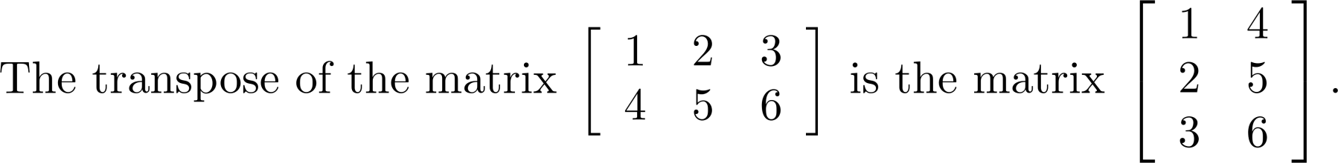
Transposes of Matrices
Definition: Let A = [a_{ij}] be an m n matrix. The transpose of A, denoted by A^{t} ,is the n m matrix obtained by interchanging the rows and columns of A.

Slide 118
Zero-One Matrices
Definition: A matrix all of whose entries are either 0 or 1 is called a zero-one matrix.
Definition: Let A = [a_{ij}] and B = [b_{ij}] be an m × n zero-one matrices.
The join of A and B is the zero-one matrix with (i,j)th entry a_{ij} ∨ b_{ij}. The join of A and B is denoted by A ∨ B.
The meet of of A and B is the zero-one matrix with (i,j)th entry a_{ij} ∧ b_{ij}. The meet of A and B is denoted by A ∧ B.

Slide 119
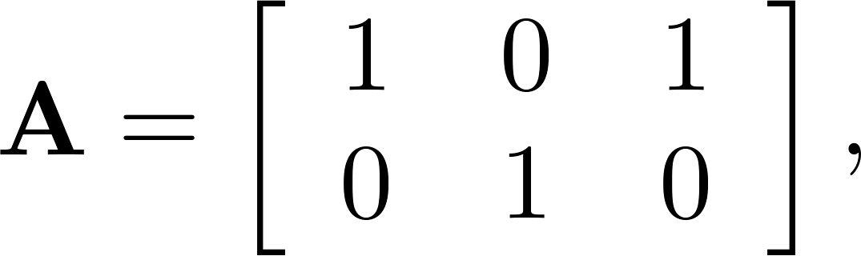
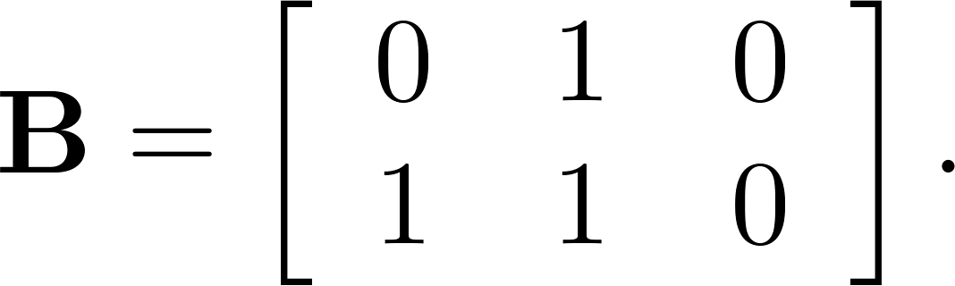
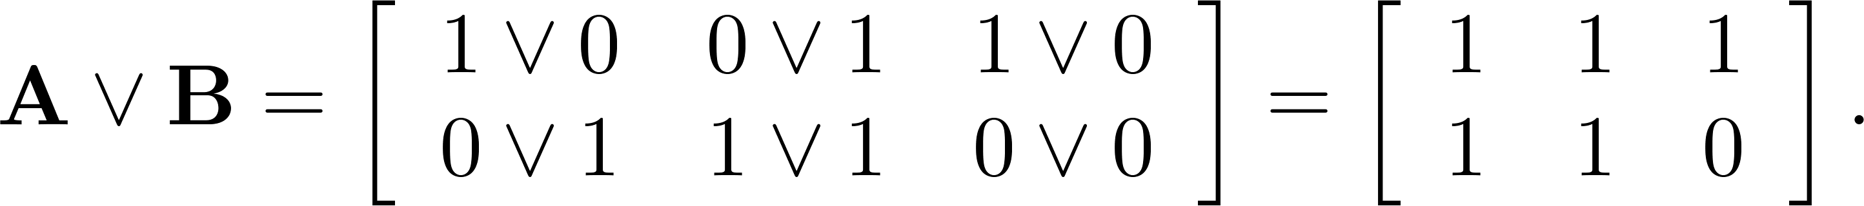
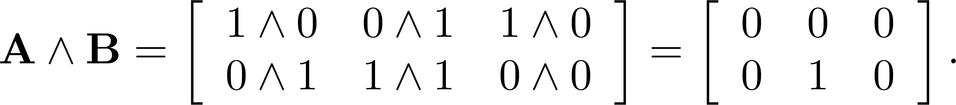
Joins and Meets of Zero-One Matrices
Example: Find the join and meet of the zero-one matrices
Solution: The join of A and B is
The meet of A and B is

Slide 120
Boolean Product of Zero-One Matrices
Definition: Let A = [a_{ij}] be an m k zero-one matrix and B = [b_{ij}] be a k n zero-one matrix. The Boolean product of A and B, denoted by A ⊙ B, is the m n zero-one matrix with (i,j)^{th} entry
c_{ij} = (a_{i1} ∧ b_{1j})∨ (a_{i2} ∧ b_{2j}) ∨ … ∨ (a_{ik} ∧ b_{kj}).

Slide 121
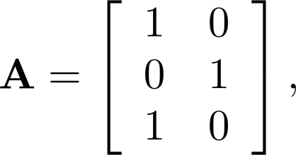
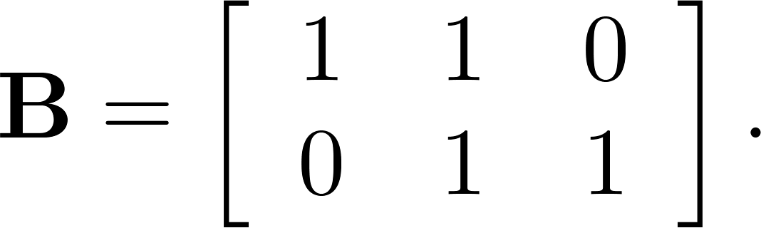
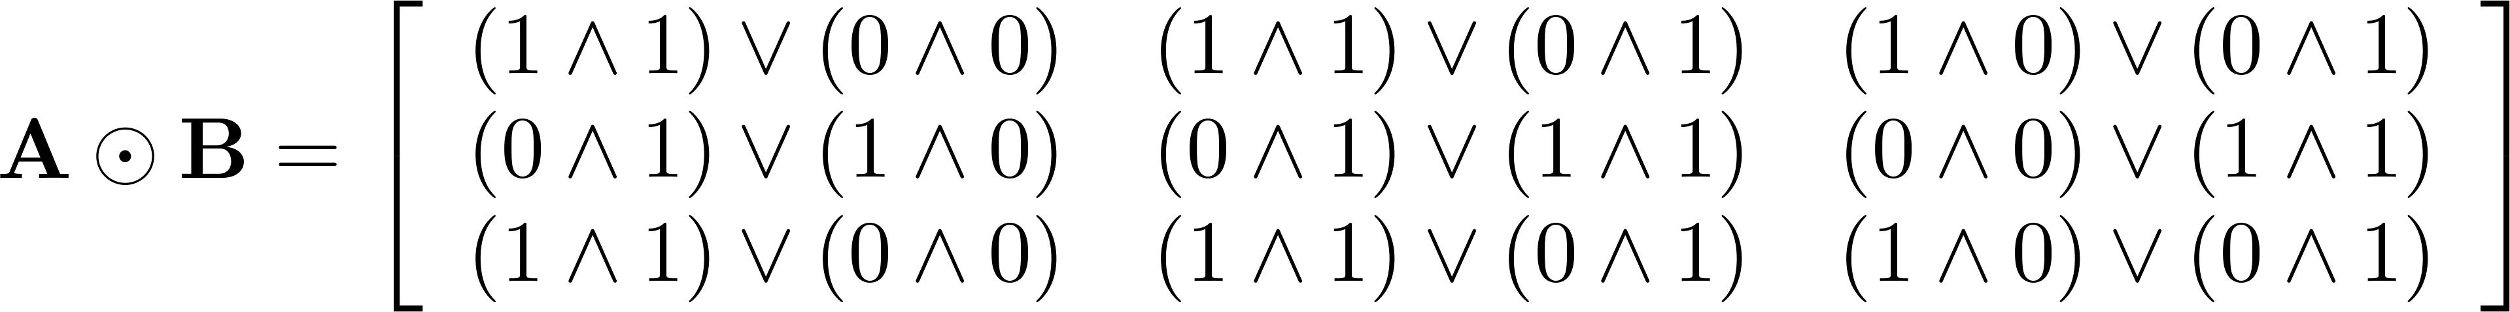
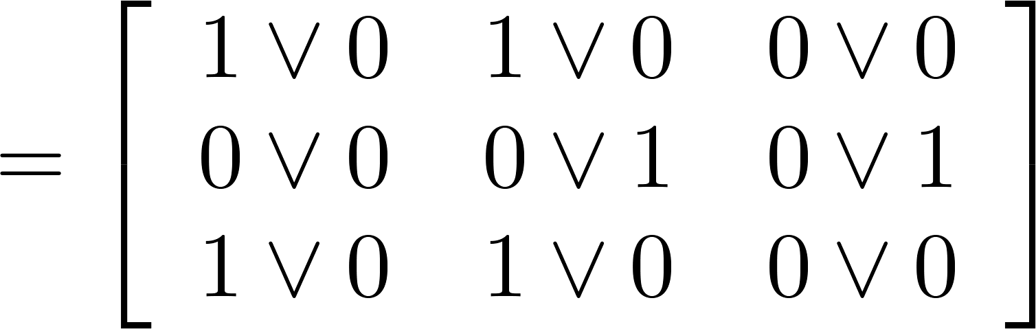
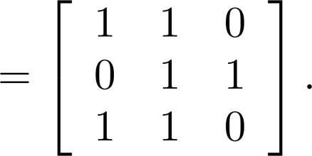
Boolean Product of Zero-One Matrices
Example: Find the Boolean product of A and B, where
Solution:

Slide 122
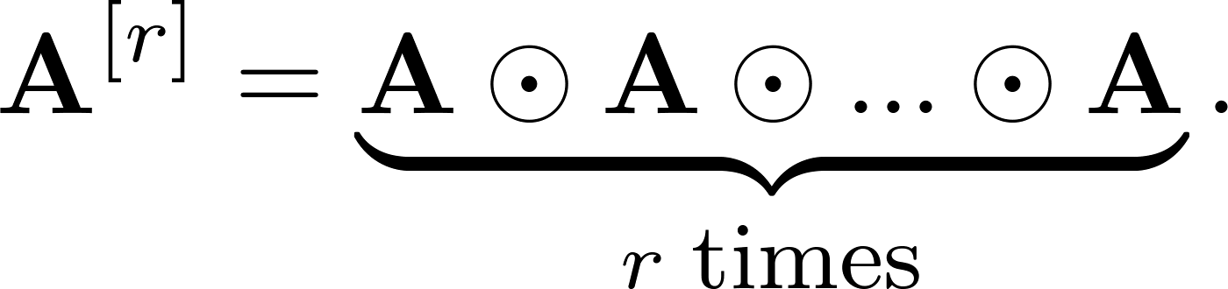
Boolean Powers of Zero-One Matrices
Definition: Let A be a square zero-one matrix and let r be a positive integer. The rth Boolean power of A is the Boolean product of r factors of A, denoted by A^{[r]} . Hence,
We define A^{[0]} to be I_{n}.
(The Boolean product is well defined because the Boolean product of matrices is associative.)

Slide 123
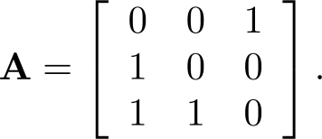
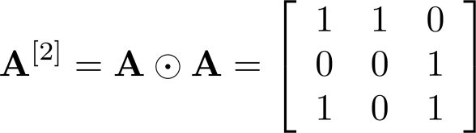
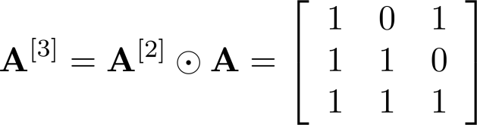
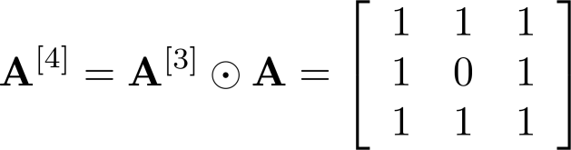
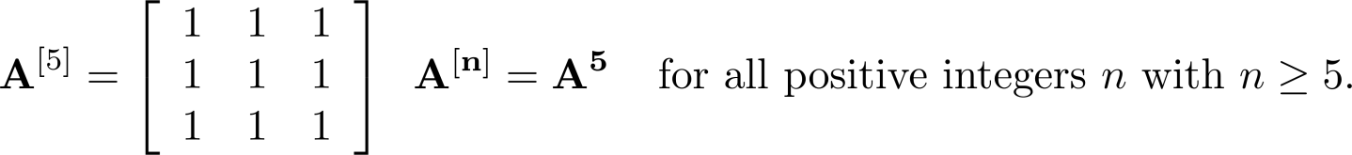
Boolean Powers of Zero-One Matrices
Example: Let
Find A^{[n]} for all positive integers n.
Solution:

