Slide 1
Packaging: Past, Present and Future
R. R. Tummala, "Packaging: past, present and future," 2005 6th International Conference on Electronic Packaging Technology, Shenzhen, 2005, pp. 3-7, doi: 10.1109/ICEPT.2005.1564643.

Slide 2
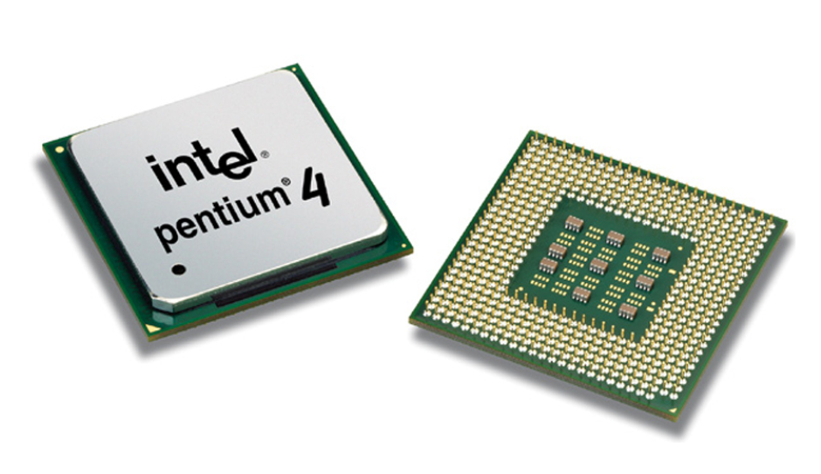
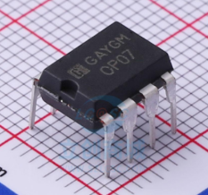
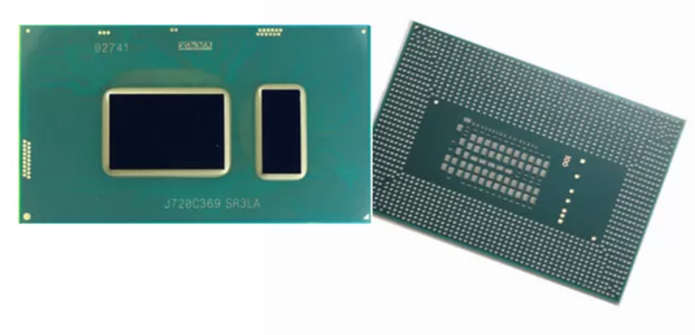
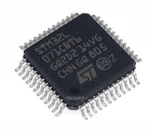
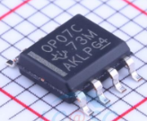
History of packaging
PGA
(Pin Grid Array Package)
DIP
(Double In-Line Package)
BGA
(Ball Grid Array Package)
CSP
WLP
SIP
…
SOP
(Small Out-Line Package)

Slide 3
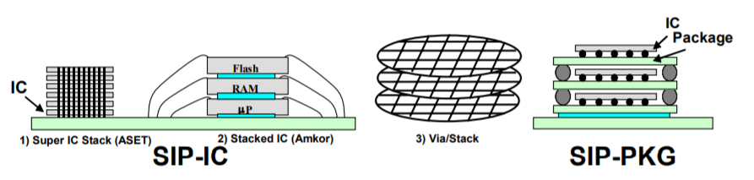
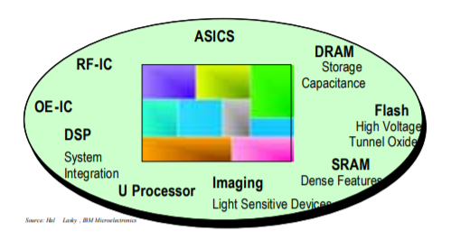
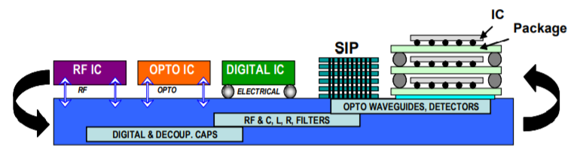
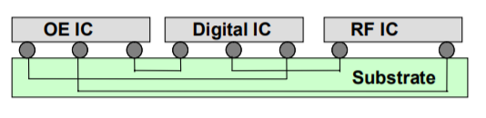
Future Packaging
SIP
(System-in-Package)
SOC
(System-on-Chip)
SOP
(System-on-Package)
MCM
(Multichip Module)

