Slide 1
Signals and Systems
Dr. Bo Xu (许渤)
Phone #: 13981784692
Email: xubo@uestc.edu.cn
School of Information and Communication Engineering
QQ Group: 920590611

Slide 2
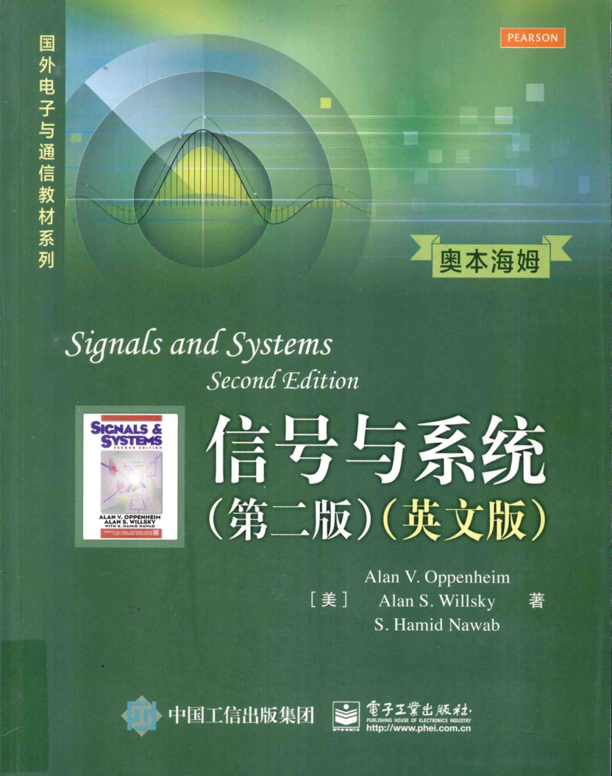
Important things:
1. Meeting time and meeting places
Monday 1/2, C-312; Wednesday 3/4, C-308;
Friday (odd week) 3/4, C-308
2. Textbook
Signals and Systems, by Oppenheim
3. Final exam, Class project,
Homework, Discussion,
in-class Quiz

Slide 3
First Big Picture of the Class:
General descriptions of signals & systems.
1. Signals
Signals used in previous courses, seems to be an easy concept.
Here, we focus on properties of signals and how to describe a general signal.
2. Systems
Input a signal, processing on the input for output.
General description of the system’s response to any input signal.

Slide 4
Second Big Picture of the Class:
1. Time and Frequency: two important concepts
Signal description in time and Signal description in frequency: both important to us !!!
For example, a signal with magnitude changing over time, sometimes strong, sometimes weak
Two description methods are equivalent !!!
2. How are they related with each other?
Fourier Transform (傅立叶变换)

Slide 5
Third Big Picture of the Class:
1. Continuous-time (连续) x(t) and Discrete-time (离散) x[n]: independent variables t and n
2. Periodic (周期) or Aperiodic (非周期)
Periodicity allows easier description of a signal.
3. Four different forms of Fourier Transform:
Continuous and Periodic Continuous and Aperiodic
Discrete and Periodic Discrete and Aperiodic
4. Use the right one !!!

Slide 6
Importance of this course:
1. General study on signals and systems
2. Simple, but fundamental course with only deterministic (repeatable) signals and systems
3. Many possible following courses
Digital signal processing: discrete-time
Principle of communications: communication signals and systems, with random properties
Random signal analysis: random properties and probabilistic ways to study

