Slide 1
Ch.9 The Laplace Transform
1. The Laplace Transform (Ch.9.1)
2. The Region of Convergence for Laplace Transform (Ch.9.2)
3. The Inverse Laplace Transform (Ch.9.3)
4. Properties of Laplace Transform (Ch.9.5)
5. Analysis of LTI systems using LT (Ch.9.7)
6. System Function Algebra and Block Diagram
7. Unilateral Laplace Transform (Ch.9.9)

Slide 2
1. The Laplace Transform (Ch.9.1)
Why do we need Laplace transform?
1. A generalization of Fourier transform.
2. A signal or system may not have Fourier transform. (Dirichlet conditions)
3. Laplace transform allows easy study on stability or causality of a system.

Slide 3
1. The Laplace Transform (Ch.9.1)
Review from Chapter 3 (Fourier series)
x(t)=e^{st}
y(t)=H(s)e^{st}
h(t)
For any complex number with converging integral
System function
--- Laplace transform of h(t).
Connection with FT, or the frequency response:
if converging on the jω-axis.

Slide 4
1. The Laplace Transform (Ch.9.1)
Basic requirements:
1. Definition of Laplace transform
2. Concept of ROC (Region of Convergence)
3. Commonly-used LT pairs
4. How to find the LT of a signal
5. Concept of zeros and poles

Slide 5
1. The Laplace Transform (Ch.9.1)
(1) Definition
(2) Definition based on Fourier transform
Fourier transform of with suitable σ for the integral to converge.
Note: The ROC is only determined by Re{s}= σ.

Slide 6
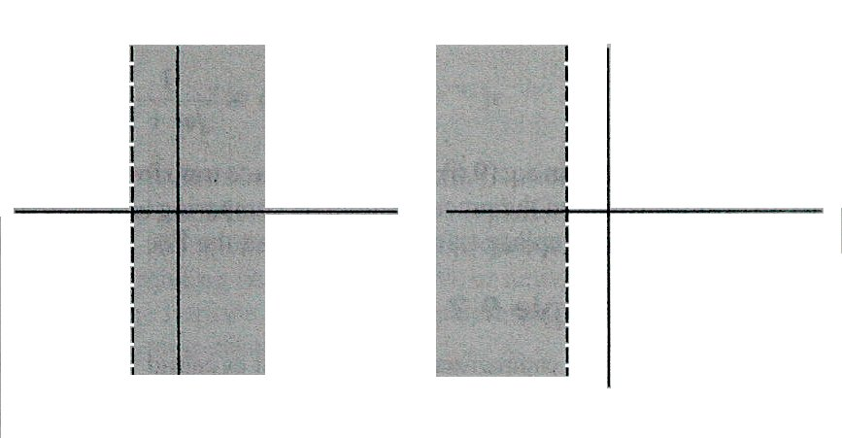
1. The Laplace Transform (Ch.9.1)
(3) Region of Convergence ( ROC )
ROC: Range of σ for X(s) to converge
Representation: A. Inequality
B. Region in S-plane
Im
Im
S-plane
S-plane
-a
-a
Re
Re
The ROC is determined by Re{s}= σ and it consists of strips parallel to jω-axis.

Slide 7
1. The Laplace Transform (Ch.9.1)
(4) Relationship between Fourier and Laplace transform
if the ROC includes the jω-axis.
Example 9.1 9.2 9.3 9.4 9.5
Note: the same LT expression, but different ROC’s. Only one of them has FT transform

Slide 8
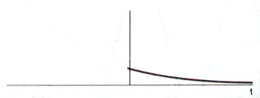
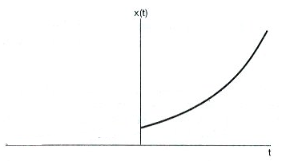
1. The Laplace Transform (Ch.9.1)
Ex 9.1:
with positive a
Fourier transform:
a) When a > 0, x(t) is exponentially decreasing in the positive time and its Fourier transform exists
b) When a < 0, x(t) is exponentially increasing in the positive time and its Fourier transform does NOT exist
How about the Laplace transform for x(t)?

Slide 9
Ex 9.1: Find the Laplace transform of
Solution:
Bounded

Slide 10
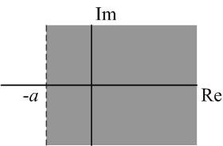
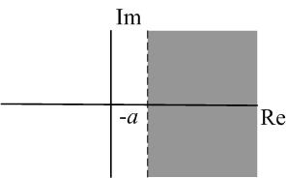
Ex 9.1: Find the Laplace transform of
or

Slide 11
Ex 9.1: Find the Laplace transform of
Note the following:
1. The ROC consists of strips parallel to the jω-axis.
2. If a > 0, x(t) is absolutely integrable and has Fourier transform; also, the ROC for X(s) includes the jω-axis.
If the Fourier transform exists, then

Slide 12
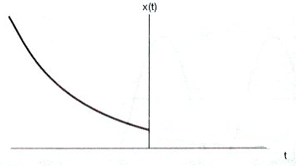
1. The Laplace Transform (Ch.9.1)
Ex 9.2: Find the Laplace transform of
Solution:
To make exponentially decreasing in negative time.

Slide 13
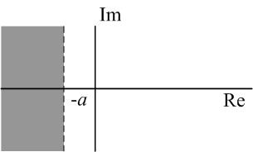
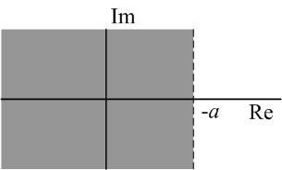
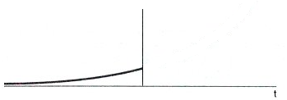
Ex 9.2: Find the Laplace transform of

Slide 14
1. The Laplace Transform (Ch.9.1)
Important results:
Right-sided
Right-sided
Left-sided
Left-sided
ROC is important and never forget to write down the ROC for a Laplace transform.
Expression plus ROC determines the Laplace transform for a signal.

Slide 15
Group discussion:
1. Given an LTI system with , determine the possible output signal if the input signal is
2. Given an LTI system with , determine the possible output signal if the input signal is

Slide 16
1. The Laplace Transform (Ch.9.1)
Ex 9.3:
Solution:
Laplace transform is linear.
The ROC is the overlap of the two.
Laplace transform in rational form
Note: The ROC is determined by the roots of the denominator.

Slide 17
1. The Laplace Transform (Ch.9.1)
Ex 9.4:
Solution:
Laplace transform in rational form

Slide 18
1. The Laplace Transform (Ch.9.1)
Ex 9.5:
Solution:
for any s.
Its ROC is the entire s-plane.

Slide 19
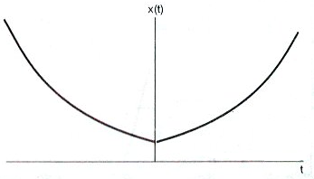
1. The Laplace Transform (Ch.9.1)
Note that: some signals do not have LT
s-domain:
The two ROC don’t overlap.
Time-domain:

Slide 20
1. The Laplace Transform (Ch.9.1)
Note that: some signals do not have LT
Another example:
s-domain:
The two ROC don’t overlap.
However,
Divergent on the jω-axis.

Slide 21
1. The Laplace Transform (Ch.9.1)
Laplace transform in rational form
Pole-zero plot:
zeros --- roots of the numerator polynomial and X(s) = 0; (if outside ROC, X(s) = infinity)
poles --- roots of the denominator polynomial and X(s) = infinity; ROC can not contain poles. Why?
Poles and zeroes can be defined for both Laplace transform of rational form and LT of irrational form.

Slide 22
1. The Laplace Transform (Ch.9.1)
Note that there might exist poles or zeros at infinity. For example, 1/s has a pole at s=0 and a zero at s=infinity.
In general,
1. If the order of the denominator exceeds the order of the numerator by k, then X(s) will have k zeros at infinity
2. If the order of the numerator exceeds the order of the denominator by k, then X(s) will have k poles at infinity.

Slide 23
1. The Laplace Transform (Ch.9.1)
Example 9.5:
Pole-zero plot:
No Fourier transform for this signal. Why?
The ROC can NOT contain poles.
Note: For the zero outside ROC, can confirm that

Slide 24
1. The Laplace Transform (Ch.9.1)
Summaries:
1. Definition of Laplace transform and its connection with FT, system function
2. Concept of ROC and its importance
3. Commonly-used LT pairs
4. How to find the
LT of a signal
Linear property of LT, ROC intersection
5. LT in rational form
6. Concept of zeros and poles: no poles in the ROC

Slide 25
1. The Laplace Transform (Ch.9.1)
Exercise 9.44:
ROC:
Still a right-sided signal with right-sided ROC

Slide 26
1. The Laplace Transform (Ch.9.1)
Exercise 9.44:
Im
poles:
-1
Re
But complex numbers:
Note: Another example, see Exercise 9.60

Slide 27
Group discussion:
1. For the signal , its Laplace transform has ( ) number of zeros in the finite s-plane.
2. From the ROC of the signal’s x(t) = u(t) Laplace transform, does the signal u(t) have Fourier transform or not?

Slide 28
2. The Region of Convergence for Laplace Transform (Ch.9.2)
For Fourier transform, we have Dirichlet conditions for its convergence; here, we need to study the ROC.
Basic requirements:
1. Based on the properties of ROC, can determine the ROC of a signal’s LT from its time-domain property (four types of signals).
2. Understanding and flexible usage of the properties

Slide 29
2. The Region of Convergence for Laplace Transform (Ch.9.2)
Property 1: The ROC of X(s) consists of strips parallel to jω-axis in the s-plane. (The ROC is determined by Re{s}.)
Property 2: For rational Laplace transform, the ROC does not contain any poles. (At the pole, X(s) = infinity. )

Slide 30
2. The Region of Convergence for Laplace Transform (Ch.9.2)
Property 3: If x(t) is of finite duration and is absolutely integrable, then the ROC is the entire s-plane.
Proof: absolutely integrable
(1). σ> 0, the exponential is monotonically decreasing,

Slide 31
2. The Region of Convergence for Laplace Transform (Ch.9.2)
Property 3: If x(t) is of finite duration and is absolutely integrable, then the ROC is the entire s-plane.
Proof (cont’d):
(2). σ< 0, the exponential is monotonically increasing,
In summary, no matter what σ (positive or negative) is, the integral X(s) is converging and the ROC is the entire s-plane.

Slide 32
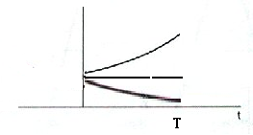
2. The Region of Convergence for Laplace Transform (Ch.9.2)
Example 9.6:
Otherwise, x(t) = 0.
Solution:
Looks like X(s) has a pole at s = -a. While from Property (3), the ROC should be the entire s-plane. Which one is correct?

Slide 33
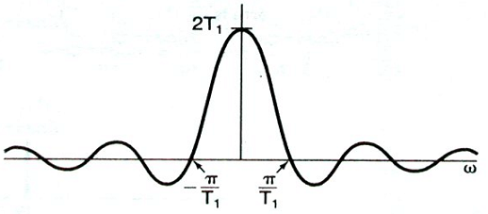
2. The Region of Convergence for Laplace Transform (Ch.9.2)
Example 9.6:
Otherwise, x(t) = 0.
The ROC is the entire s-plane.
No poles on the finite s-plane.
Zeros:
Many zeros equally spaced on the Im-axis
Im
Re

Slide 34
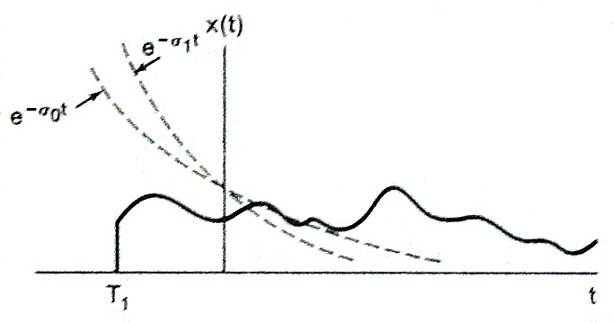
2. The Region of Convergence for Laplace Transform (Ch.9.2)
Property 4: If x(t) is right sided, and if the line Re{s}=σ₀ is in the ROC, then all values of s for which Re{s}>σ₀ will also be in the ROC.
jω
0
σ₀
σ
However, not necessarily the boundary for the ROC!

Slide 35
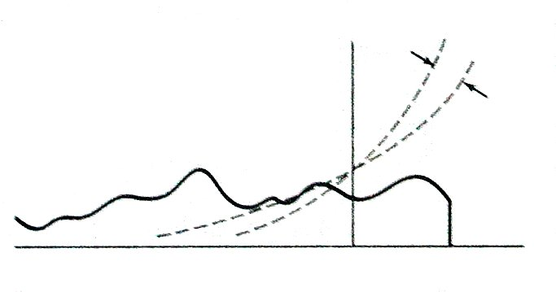
2. The Region of Convergence for Laplace Transform (Ch.9.2)
Property 5: If x(t) is left sided, and if the line Re{s}=σ₀ is in the ROC, then all values of s for which Re{s}<σ₀ will also be in the ROC.
jω
x(t)
e^{-σ1t}
e^{-σ0t}
0
σ₀
σ
T₂
t
However, not necessarily the boundary!

Slide 36
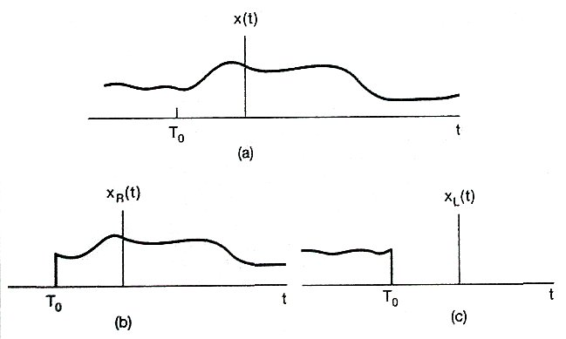
2. The Region of Convergence for Laplace Transform (Ch.9.2)
Property 6: If x(t) is two sided, and if the line Re{s}=σ₀ is in the ROC, then the ROC will consist of a strip in the s-plane that includes the line Re{s}=σ₀ .
σ₀
σ
Don’t know where the boundary is!

Slide 37
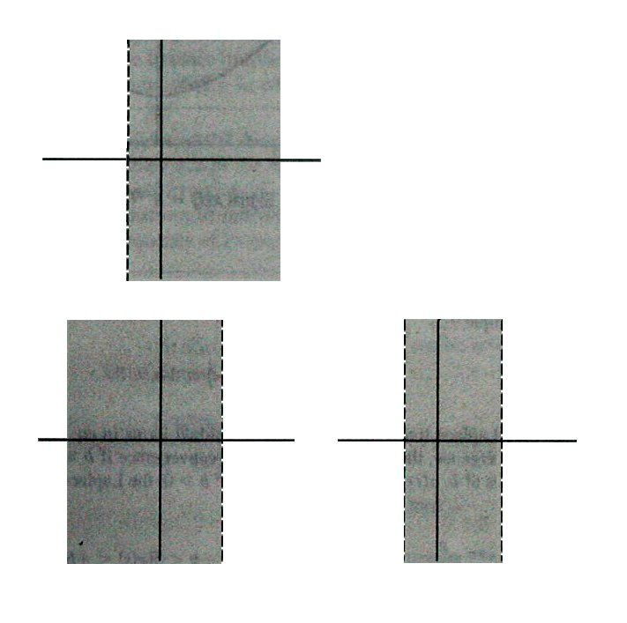
2. The Region of Convergence for Laplace Transform (Ch.9.2)
The three different cases:
Im
S-plane
σ_{R}
Re
Im
Im
σ_{L}
Re
σ_{R}
σ_{L}
Re
Example 9.7:
The key is to divide the signal into one right sided signal and one left sided signal.

Slide 38
2. The Region of Convergence for Laplace Transform (Ch.9.2)
Property 7: If the Laplace transform X(s) of x(t) is rational, then its ROC is bounded by poles or extends to infinity. In addition, no poles of X(s) are contained in the ROC.
Property 8: If the Laplace transform X(s) of x(t) is rational, then if x(t) is right sided, the ROC is the region in the s-plane to the right of the rightmost pole. If x(t) is left sided, the ROC is the region in the s-plane to the left of the leftmost pole. (Here, we do NOT include poles at infinity.)

Slide 39
2. The Region of Convergence for Laplace Transform (Ch.9.2)
Example 9.8:
Two poles at
s = -1 and s = -2.
Three possible ROC’s:
-2
-1
0
-2
-1
0
-2
-1
0
Re{s} > -1
Re{s} < -2
-2 <Re{s}<-1
Each one of them corresponds to a different signal.

Slide 40
2. The Region of Convergence for Laplace Transform (Ch.9.2)
Summaries:
1. ROC: strips parallel to the imaginary axis in the s-plane
2. Four different types of signals, corresponds to four different types of ROC
3. For rational LT, ROC is bounded by poles: rightmost pole and the leftmost pole
Note: No non-contiguous ROC. For example, three poles, -2, -1, and +1, no following ROC:
-2 < Re{s} < -1 OR Re{s} > +1

Slide 41
Group discussion:
1. For the signal , the ROC of its Laplace transform is ( )
2. For the following and an absolutely integrable signal, the signal is ( )

Slide 42
3. The Inverse Laplace Transform (Ch.9.3)
Basic requirements:
Understanding the concept of inverse LT: a contour integral in the ROC;
Inverse LT based on partial fraction expansion

Slide 43
3. The Inverse Laplace Transform (Ch.9.3)
Write X(s) as a FT with suitable chosen real part:
Based on the one-to-one mapping property of FT:
Finally:
Contour integral in the ROC of the complex s-plane. The contour is a straight line parallel to the imaginary axis.

Slide 44
3. The Inverse Laplace Transform (Ch.9.3)
The calculation for inverse Laplace transform:
(1) Contour Integration of complex function.
(2) Compute by partial fraction expansion.
Important transform pair:
Example 9.9 9.10 9.11

Slide 45
3. The Inverse Laplace Transform (Ch.9.3)
For example:
1. Determine the ROC of the LT: poles and other conditions;
2. Partial fraction expansion of the LT;
3. For each term, do the inverse LT with the determined ROC based on

Slide 46
3. The Inverse Laplace Transform (Ch.9.3)
The two poles at s = -1 and -2 give three possible ROC’s.
-2
-1
0
-2
-1
0
-2
-1
0
Re{s} > -1
Re{s} < -2
-2 <Re{s}<-1

Slide 47
3. The Inverse Laplace Transform (Ch.9.3)
Do partial fraction expansion (independent of ROC):

Slide 48
3. The Inverse Laplace Transform (Ch.9.3)
Inverse LT for each term
(1). Re{s} > -1:
-2
-1
0
a right ROC to the pole
a right-sided signal

Slide 49
3. The Inverse Laplace Transform (Ch.9.3)
(2). Re{s} < -2: The same partial fraction expansion
For both terms, the ROC is a left ROC to the pole

Slide 50
3. The Inverse Laplace Transform (Ch.9.3)
(3). -2 < Re{s} < -1:
-2
-1
0
For the first term, the ROC is a left ROC to the pole
For the second term, the ROC is a right ROC to the pole

Slide 51
3. The Inverse Laplace Transform (Ch.9.3)
Summaries:
1. Determine the ROC of the LT: poles and other conditions;
2. Partial fraction expansion of the LT;
3. For each term, do the inverse LT with the determined ROC based on

Slide 52
3. The Inverse Laplace Transform (Ch.9.3)
Extra examples:
1. Given , and x(t) is
absolutely integrable, determine x(t).
ROC includes the Im-aixs.
2. Given , and
determine x(t).
ROC includes Re{s}=0 line.

Slide 53
Extra. Geometric evaluation of FT (Ch.9.4)
Example:
Im
Re

Slide 54
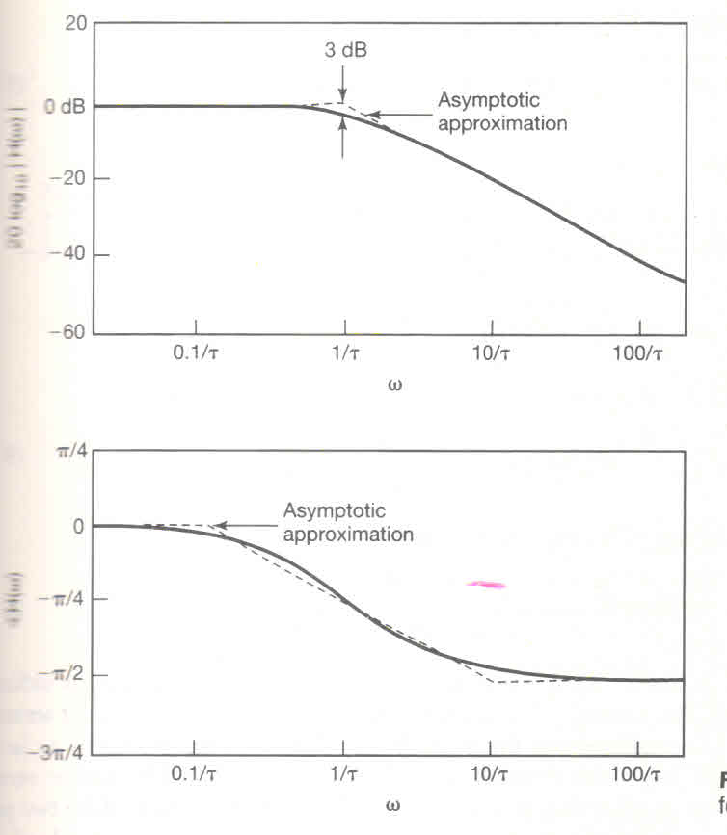
Extra. Geometric evaluation of FT (Ch.9.4)
First-order system:
Im
Re
Low-pass type:

Slide 55
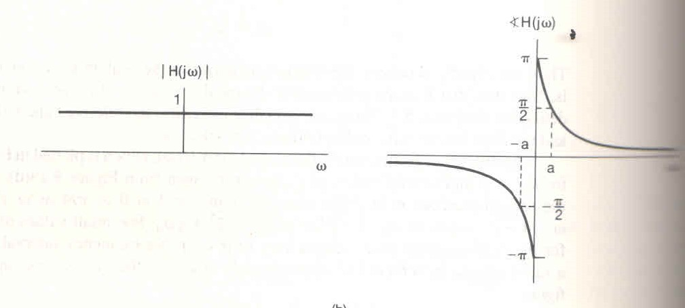
Extra. Geometric evaluation of FT (Ch.9.4)
Second-order system:
Im
All-pass system:
Re

Slide 56
Extra. Geometric evaluation of FT (Ch.9.4)
High-pass system:
Band-pass system:

Slide 57
Group discussion:
1. Do partial fraction on , the result is ( )
2. Do the inverse LT for the previous signal if the signal has FT.

Slide 58
4. Properties of Laplace Transform (Ch. 9.5)
Basic requirements:
1. Understanding each property: how the time transform affects both X(s) and its ROC;
2. Flexible usage of the properties:
Computing LT, inverse LT
Determine the ROC
LTI system analysis
……

Slide 59
4. Properties of Laplace Transform (Ch. 9.5)
Change in the ROC is also important.
1). Linearity
Note that the ROC of x(t) is at least the intersection of R₁ and R₂. It could be empty, and it could be larger than the intersection.
Why?

Slide 60
4. Properties of Laplace Transform (Ch. 9.5)
Example 9.13:
Now,
This is called pole-zero cancellation.
Since we have only one pole now at s = -2, we can extend the original ROC to Re{s} > -2 .

Slide 61
4. Properties of Laplace Transform (Ch. 9.5)
1). Linearity
Only true for sum of finite terms!
Exercise 9.44:
A right-sided impulse train
A right-sided ROC

Slide 62
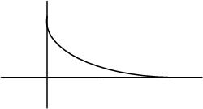
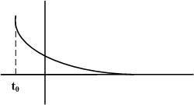
4. Properties of Laplace Transform (Ch. 9.5)
2). Time shifting:
with ROC = R.
A time shift doesn’t affect the convergence.
No change on the exponential varying rate, no change on poles.
Proof: (The same as in the Fourier transform.)

Slide 63
4. Properties of Laplace Transform (Ch. 9.5)
3). Shifting in the s-domain:
with ROC = R + Re{s₀}.
Meaning?
For any s in the original ROC R, s + Re{s₀} will be in the new ROC. (Or, shift the ROC by Re{s₀}.)
Meanwhile, from the property:

Slide 64
4. Properties of Laplace Transform (Ch. 9.5)
3). Shifting in the s-domain:
with ROC = R + Re{s₀}.
Meaning?
For any s in the original ROC R, s + Re{s₀} will be in the new ROC. (Or, shift the ROC by Re{s₀}.)
Note: the change on ROC can also be treated as change on poles, but the direction of the ROC remains, for example, still right-sided signal with right-sided ROC
Example:
Given , and
has FT, determine x(t).

Slide 65
4. Properties of Laplace Transform (Ch. 9.5)
3). Shifting in the s-domain:
with ROC = R + Re{s₀}.
Example: given that , and
has FT, determine x(t).
Solution: the key is to determine the ROC for X(s). Two poles with three possible ROC as
Due to the fact that the new signal has FT, thus

Slide 66


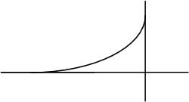
4. Properties of Laplace Transform (Ch. 9.5)
4). Time scaling:
with ROC = aR.
with ROC = -R.
Proof:

Slide 67
4. Properties of Laplace Transform (Ch. 9.5)
5). Conjugation:
with ROC = R.
take conjugate of X(s) and replace s with s*.
Proof:
First, take conjugate of the function:
Then, replace s with s*:
The ROC does NOT change, why?

Slide 68
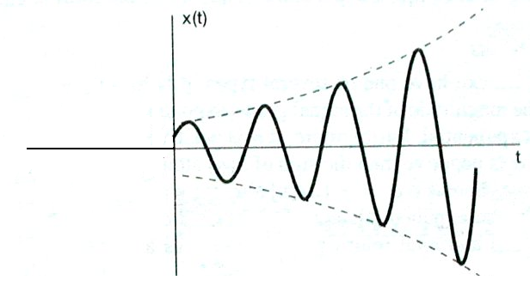
4. Properties of Laplace Transform (Ch. 9.5)
5). Conjugation:
with ROC = R.
Example:
While, from the property:

Slide 69
4. Properties of Laplace Transform (Ch. 9.5)
5). Conjugation:
If x(t) is real,
and its zeros and poles must come in conjugate pairs.
For example, if x(t) is real and s = -1+j is a pole, then s = -1-j must also be a pole.
Proof: if
then
Thus, also a zero for X(s).
Similar proof for poles.

Slide 70
4. Properties of Laplace Transform (Ch. 9.5)
6). Convolution:
Proof?
Basis for LTI system analysis with LT.
LTI

Slide 71
4. Properties of Laplace Transform (Ch. 9.5)
6). Convolution:
LTI

Slide 72
Group discussion:
1. A real signal x(t) is known to have three poles for X(s). Two of them are at s = -2 and s = +1+2j. It is also given
The ROC of X(s) can be determined to be ( ).
2. It is given that
It is known a stable LTI system has
The ROC of X(s) can be determined to be ( ).

Slide 73
4. Properties of Laplace Transform (Ch. 9.5)
7). Differentiation in the Time-Domain:
Basis for LT analysis on LTI systems described by constant-coefficient differential equations.
For example:
Example:

Slide 74
4. Properties of Laplace Transform (Ch. 9.5)
8). Differentiation in the s-domain:
How to explain that the signal has its ROC not changed?
1. From time domain, tx(t) will not change the exponential varying rate of the signal in time
2. From complex domain, will not change the location of poles

Slide 75
4. Properties of Laplace Transform (Ch. 9.5)
8). Differentiation in the s-domain:
Example 9.14:
Use the property:
In general:

Slide 76
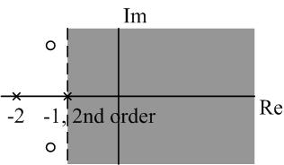
Example 9.15: Do the inverse Laplace transform for
Solution:
Do partial fraction expansion:

Slide 77
Example 9.15: Do the inverse Laplace transform for
Solution:

Slide 78
4. Properties of Laplace Transform (Ch. 9.5)
9). Integration in the time-domain:
with ROC containing R Ո {Re{s}>0}.
Proof:
Also note that,
With a = 0,
Then, apply the convolution property.

Slide 79
4. Properties of Laplace Transform (Ch. 9.5)
10). The Initial- and Final-Value Theorem:
a. If x(t) = 0 for t<0, and x(t) contains no impulses or higher-order singularities at t=0, then
b. If x(t) = 0 for t<0, and x(t) has a finite limit as , then

Slide 80
4. Properties of Laplace Transform (Ch. 9.5)
a. If x(t) = 0 for t<0, and x(t) contains no impulses or higher-order singularities at t=0, then
Proof: Use Taylor expansion
Using

Slide 81
4. Properties of Laplace Transform (Ch. 9.5)
Example 9.16:

Slide 82
4. Properties of Laplace Transform (Ch. 9.5)
Table 9.2 for Laplace transform pairs:
Why don’t we have Laplace transform for signals like
For x(t) = 1, we can write it as x(t) = u(t) + u(-t).
The intersection of the two ROC’s is empty.

Slide 83
4. Properties of Laplace Transform (Ch. 9.5)
Summaries:
1. Understanding each property: how the time change affects both X(s) and its ROC;
2. Flexible usage of the properties:
Computing LT, inverse LT
Determine the ROC
LTI system analysis
……

Slide 84
Extra examples: Inverse LT with term
Time shifting property

Slide 85
Extra examples: Inverse LT with term
The series expansion should be done within ROC.

Slide 86
Extra examples: Inverse LT with term

Slide 87
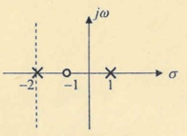
Group discussion:
1. The pole-zero plot is given for a causal system H(s) with
The system function can be determined to be ( ).
2. It is given that and is of finite duration with no zeros. The number of poles for X(s) is ( ).

Slide 88
5. Analysis of LTI systems using LT
LTI
H(s)
Requirements:
Comprehensive understanding and application of knowledge about LT.
Determine the input X(s) plus it ROC: …
Determine the system function H(s) and its ROC: …
Y(s) and its ROC, the inverse LT for y(t)
Key is flexible usage of LT and ROC properties.

Slide 89
5. Analysis of LTI systems using LT
1). ROC from Causality property:
h(t) = 0 for t < 0
Anti-causal:
h(t) = 0 for t > 0
The ROC associated with the system function for a causal system is a right-half plane.
The converse of this statement is not necessarily true as illustrated in Ex. 9.19 unless for rational system functions.
For rational system functions, causality for the system is equivalent to the ROC being the right-half plane to the right of the rightmost pole.

Slide 90
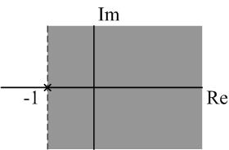
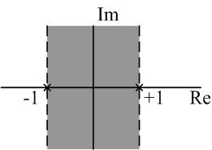
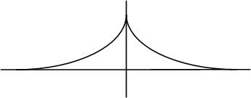
5. Analysis of LTI systems using LT
Example 9.17:
Rational system function plus ROC being a right-half plane, thus the system is causal.
Example 9.18:

Slide 91
5. Analysis of LTI systems using LT
Example 9.19:
Though ROC being a right-half plane, the system function is not rational. So, can NOT determine whether the system is causal or not.
Instead, try to find h(t) first.
Use time shifting property of Laplace transform,
NOT causal from h(t).

Slide 92
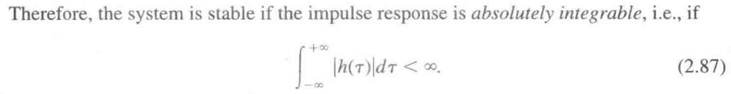
5. Analysis of LTI systems using LT
2). ROC from Stability property:
a. An LTI system is stable if and only if the ROC of its system function H(s) includes the entire jω-axis. (No matter whether the system function is rational or not.) Then, the Fourier transform H(jω) exists.)
b. A causal system with rational system function H(s) is stable if and only if all the poles of H(s) lie in the left-half of the s-plane – i.e., all of the poles have negative real parts.

Slide 93
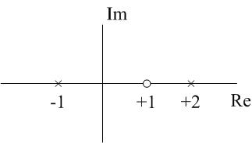
5. Analysis of LTI systems using LT
Example 9.20:
Two poles and three possible ROC’s:
(1). Re{s} > 2;
(2). Re{s} < -1;
(3). -1<Re{s} < 2
For each ROC, causal or stable?

Slide 94
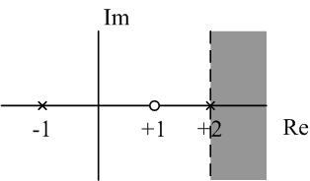
Example 9.20:
Partial fraction expansion:
(1). Re{s} > 2:
Causal: rational and right ROC
Not stable: ROC not including jω-axis
Both terms are causal, but the second one is the reason for the system to be not stable.

Slide 95
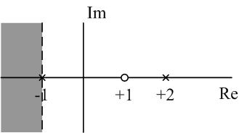
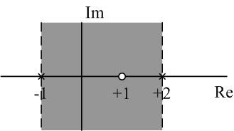
Example 9.20:
(2). Re{s} < -1: not causal (anti-causal) and not stable
(3). -1 < Re{s} < 2: not causal, but stable

Slide 96
5. Analysis of LTI systems using LT
Ch. 2/4:
time and frequency-domain
Take Laplace transform of both sides,
Basis of LT analysis on LTI system described by constant-coefficient differential equations.

Slide 97
5. Analysis of LTI systems using LT
Poles determined with possible ROC’s
Rational form determined by poles and zeros except for a constant factor.
However, no ROC can be derived from the differential equation. If at initial rest, then the system is causal and the ROC is the right plane to the right of the rightmost pole.

Slide 98
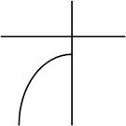
Example 9.23:
Find its impulse response.
ROC ?
One pole at s = -3, two possible ROC’s.
(1) Causal, right ROC, Re{s} > -3,
(2) Anti-causal, left ROC, Re{s} < -3,

Slide 99
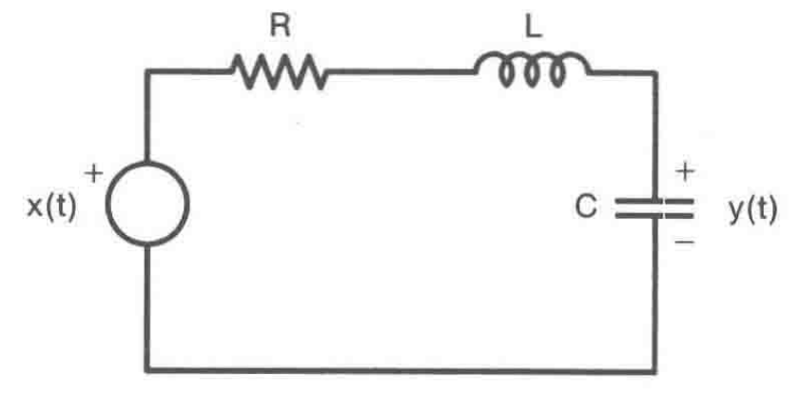
5. Analysis of LTI systems using LT
Example 9.24: A series RLC circuit with initial rest

Slide 100
Group discussion:
1. A rational system with only two poles at s = -1 and s = +1 plus the information that the output y(t) = 2 when input x(t) = 1. Determine which one of the following choice ( ) is true.
(a) Causal and stable
(b) Causal and not stable
(c) Not causal but stable
(d) Not causal and not stable
2. A system with real and causal h(t) and two poles for rational H(s) with one at s = -1+j. For system , determine which one of the following choice ( ) is true.
(a) Causal and stable
(b) Causal and not stable
(c) Not causal but stable
(d) Not causal and not stable

Slide 101
5. Analysis of LTI systems using LT
Example 9.25: given
Find its system function and write out the differential equation.
ROC?

Slide 102
5. Analysis of LTI systems using LT
Example 9.25:
ROC: two poles at s = -1 and s = -2, three possible ROC’s.
The overlap of the ROC’s of X(s) and H(s) should be the ROC of Y(s). So, the only possible choice is then
Note: why this pair of input-output signal can be used to determine the system by using Laplace transform?

Slide 103
5. Analysis of LTI systems using LT
Example 9.26:
Given the following information, determine the LTI system:
The system is causal.
The system function is rational and has only two poles at s = -2 and s = -4.
If x(t) = 1, then y(t) = 0.
The value of the impulse response at t = 0⁺ is 4.

Slide 104
Example 9.26:
1. The system is causal.
The ROC is a right ROC.
2. The system function is rational and has only two poles at s = -2 and s = -4.
3. If x(t) = 1, then y(t) = 0.
Cannot apply H(s) = Y(s)/X(s) as Example 25,
x(t) = 1 has no LT, plus y(t) = 0 gives Y(s) = 0 !

Slide 105
Example 9.26:
Thus, s = 0 is a zero for H(s). Re-write H(s) as
4. The value of the impulse response at t = 0⁺ is 4.

Slide 106
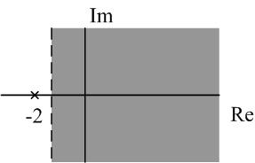
Example 9.27:
Consider a stable and causal system. Its H(s) is rational, contains a pole at s = -2, and does not have a zero at the origin. The location of other poles and zeros is unknown.
For each of the following statement, determine whether it is true, or false, or can’t determine.
What can we say from above facts?
Stable, the ROC includes Re{s} = 0.
Rational and causal, a right ROC.
One pole at s = -2 plus causal, boundary of the ROC.

Slide 107
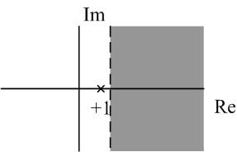
Example 9.27:
F{h(t) e^{3t}} converges.
Need to know whether the ROC of Y(s) for the new signal y(t) = h(t) e^{3t} includes the jw-axis.
However, the original ROC is no larger than Re{s} > -2, thus the ROC for the new singal is no larger than Re{s} > 1.
Answer: False.

Slide 108
Example 9.27:
(b)
What is this? A zero
Answer: False.
(c) th(t) is the impulse response of a causal and stable system.
ROC is not changed, still stable.
H(s) is rational, differentiation in s-domain is still rational, with a right ROC, so still causal.
Answer: True.
Question: Can you obtain the same answer from the time-domain properties of impulse response?

Slide 109
Example 9.27:
(d) dh(t) /dt contains at least one pole in its LT.
No pole-zero cancellation at s = -2, still one pole.
Answer: True.
(e) h(t) has finite duration.
Answer: False. If it is of finite duration, the ROC should be the entire s-plane.

Slide 110
Example 9.27:
(f) H(s) = H(-s).
s = -2 is a pole, then s = 2 is also a pole. For the system to be causal, the (right) ROC should NOT be larger than Re{s} > 2. However, this violates the stable condition.
Answer: False.
(g)
Answer: Can NOT determine.

Slide 111
5. Analysis of LTI systems using LT
Summaries:
Comprehensive understanding and application of knowledge about LT.
1. Determine the input X(s) and its ROC: …
2. Determine the system function H(s) and its ROC: …
zeros, poles; differential equations;
given special input-output pair;
if x(t) = 1, y(t) = 0
causal, stable
4. Y(s) and its ROC, inverse LT for h(t)

Slide 112
5. Analysis of LTI systems using LT
Exercise 9.49: Minimum-delay or minimum-phase system
A class of systems which are causal and stable and the inverse systems are also causal and stable.
Conclusion:
For such class of systems, all poles and zeros of the transfer function must be in the left half of the s-plane.
Systems:
Inverse systems:

Slide 113
Group discussion:
1. For a 2nd-order lowpass Butterworth filter designed as
Confirm that the system is both causal and stable.
2. For a system with
For the system, determine which one of the following choice ( ) is true.
(a) Causal and stable
(b) Causal and not stable
(c) Not causal but stable
(d) Not causal and not stable

Slide 114
6. System Function Algebra and Block Diagram
Basic requirements:
Can derive the system function from the system block diagram;
Several equivalent block diagrams are possible. Given a system function in rational form, can draw a block diagram, especially the direct-form.
Location of poles plus causal and stable properties
Inter-connection of sub-systems

Slide 115
6. System Function Algebra and Block Diagram
Interconnections of LTI systems:
1) Determine the input and output of the system;
2) Decompose the system into subsystems, and find the input-output relationship for each subsystem;
3) Obtain the overall input-output relationship.

Slide 116
6. System Function Algebra and Block Diagram
Series:
Parallel:
ROC? Causal or stable?
Convolution property and linear property: ROC no change
Plus, location of poles not change. Still right-sided ROC for causality and still ROC include the jw-axis for stability

Slide 117
6. System Function Algebra and Block Diagram
Feedback:
Get rid of Z(s), we have
ROC? Causal or stable?
ROC: If the two subsystems are causal, the whole system will be causal. But, location of poles will change. ROC determined by new rightmost pole.

Slide 118
Feedback system
Location of poles might change completely.
Examples:
Unstable.
Stable.

Slide 119
6. System Function Algebra and Block Diagram
Basic elements:
adder
multiplication by a coefficient
integrator
Examples 9.28 9.29 9.30 9.31

Slide 120
6. System Function Algebra and Block Diagram
Examples 9.28：

Slide 121
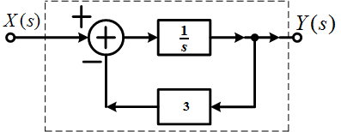
6. System Function Algebra and Block Diagram
Examples 9.28：
Adder:
Note: No ROC is given here. The ROC is determined by new poles.

Slide 122
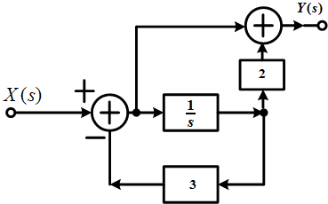
6. System Function Algebra and Block Diagram
Examples 9.29：

Slide 123
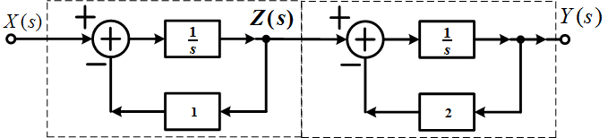
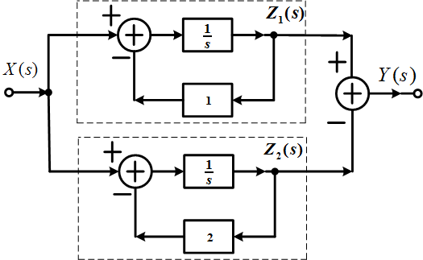
6. System Function Algebra and Block Diagram
Examples 9.30：

Slide 124
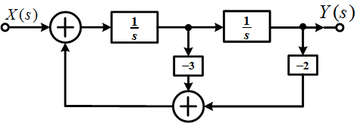
6. System Function Algebra and Block Diagram
Examples 9.30：

Slide 125
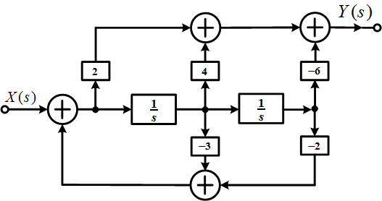
Examples 9.31：

Slide 126
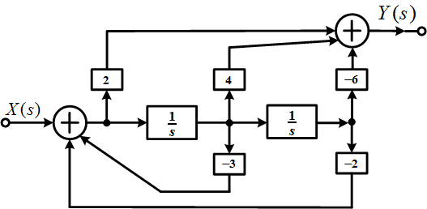
6. System Function Algebra and Block Diagram
Examples 9.31：

Slide 127
Group discussion:
1. The following system function is for a causal system, its unit impulse response is ( )
2. Draw a system block diagram for the following system in direct form.

Slide 128
7. Unilateral Laplace transform
Including integration of impulses at t = 0 etc.
Basic requirements:
Concept of UL and its difference from bilateral LT
Time-differentiation property of UL and its application

Slide 129
7. Unilateral Laplace transform
Including integration of impulses at t = 0 etc.
ROC: always a right-half plane.
If x(t) = 0 for t < 0, then its unilateral LT is identical to the bilateral LT; otherwise, they might be different.

Slide 130
Example 9.33:
Find the bilateral and unilateral LT for
Solution: for bilateral LT,

Slide 131
Example 9.34:
Find unilateral LT.
Including impulses at t = 0
Solution:
For impulse:
For unit-doublet:

Slide 132
7. Unilateral Laplace transform
Properties: similar to the bilateral transform (Here, we focus on the differences. )
Convolution: If x₁(t) = 0 and x₂(t) = 0 for t<0, then
Differentiation:

Slide 133
7. Unilateral Laplace transform
Example 9.37: Solving a causal LTI system described by differential equations together with the condition of initial rest
with

Slide 134
7. Unilateral Laplace transform
Unilateral Laplace transform can be used to Solve differential equations with nonzero initial conditions.
Importance: the system is not at initial rest now, thus not LTI, and can NOT be described uniquely by h(t).
Example 9.38:
with
for 2nd-order equation
and
Find the output y(t).

Slide 135
7. Unilateral Laplace transform
Example 9.38:
Take UL transform,

Slide 136
7. Unilateral Laplace transform
Zero-state response
Zero-input response
For

Slide 137
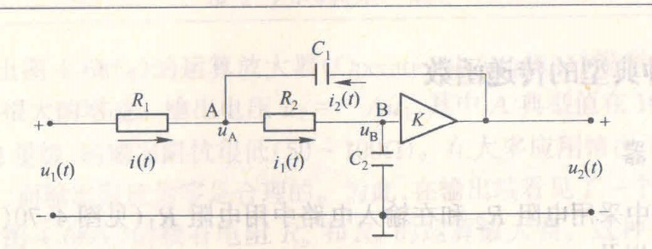
Extra examples: circuit analysis using LT
Point A:

Slide 138
Point B:
An ideal amplifier:

Slide 139
Extra examples: circuit analysis using LT
Analysis on stability: 2nd-order system
Two poles at:
If , two complex poles in conjugate pair, its real part is , or

Slide 140
If ,
If , two real poles with
If
No amplification in the circuit, must be stable.

Slide 141
Extra examples: LC with non-zero initial condition
Capacitor:
Inductor:

Slide 142
Summary
1. Concept of Laplace transform: extension of FT to the complex domain
Convergence: ROC determined by real part of s, pole-zero plot
LTI system:
If …,
Commonly-used FT pairs:

Slide 143
Summary
2. ROC properties:
(1) Four types of time-domain signals, four types of ROC
(2) ROC determined by poles, how to determine the ROC from possible ROC’s
3. Inverse LT
Inverse LT based on partial fraction expansion

Slide 144
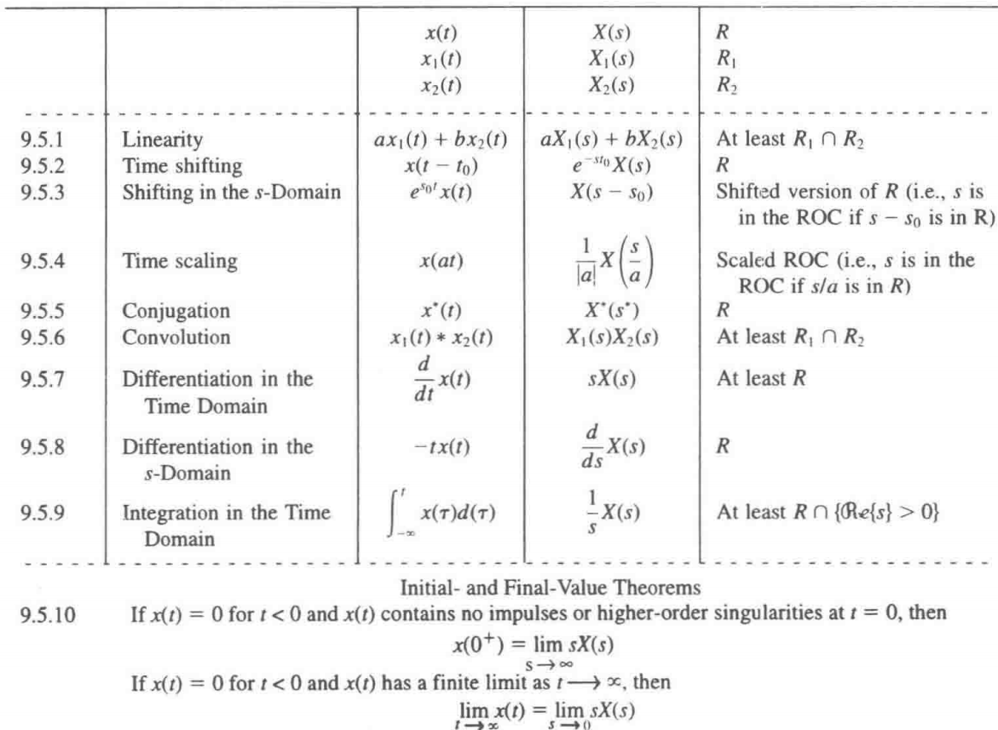
Summary
4. Properties of LT: be careful of ROC change

Slide 145
Summary
5. LT-based system analysis
(1) Causal or stable property determined from ROC
(2) Systems of linear constant-coefficient differential equations
(3) Flexible usage of LT properties
6. System Function Algebra and Block Diagram
(1) Series, parallel, feedback interconnection: ROC? Causal? Stable?
(2) Block diagram: system function
7. Unilateral Laplace transform
(1) Concept of unilateral LT and difference from bilateral LT
(2) Solving differential equations with non-zero initial conditions

Slide 146
Group discussion:
1. The unilateral LT for signal is ( )
2. The signal for the following unilateral LT is ( ) .

