Slide 1
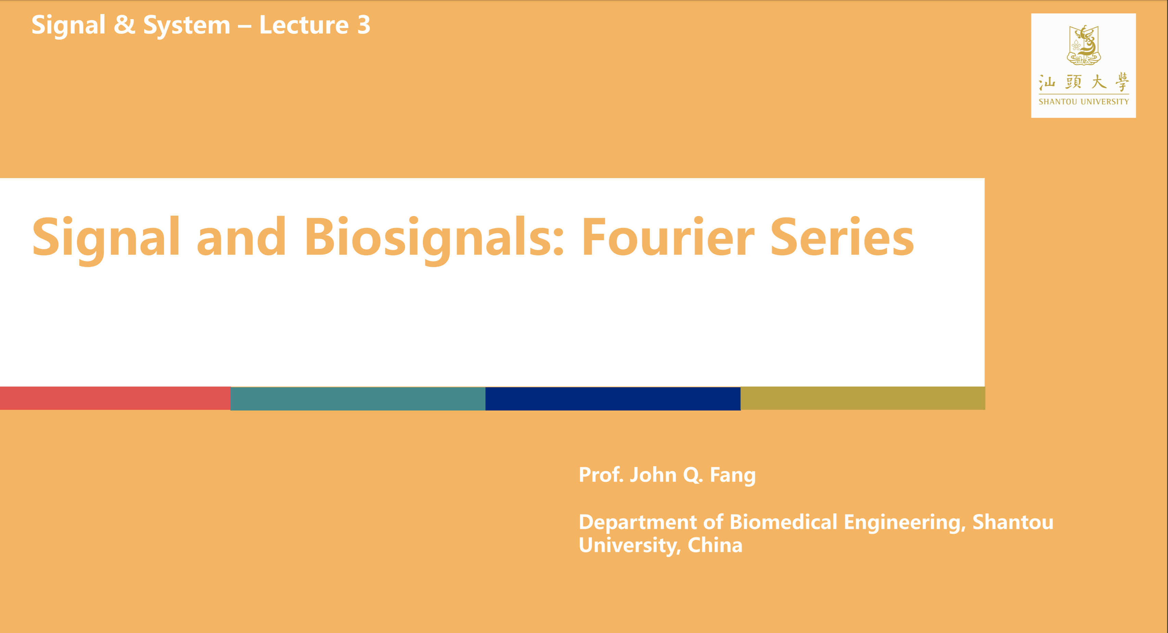

Digital Circuits – Lab1
数字逻辑与微处理器系统设计
实验1: Introduction to Development Tools
韩凯宁, 胡剑浩
邮箱: knhan@stu.edu.cn
办公室: 主楼B3-509，B3-421
通信抗干扰技术国家级重点实验室

Slide 2
Outline
1. Introduction to Final Project
2. Introduction to Field Programmable Gate Array (FPGA)
3. Introduction to Vivado Design Suite
4. Examples of development on Vivado (reach software Simulation)
5. Resources on learning VHDL hardware description language
6. Mission: 8-bits adder

Slide 3
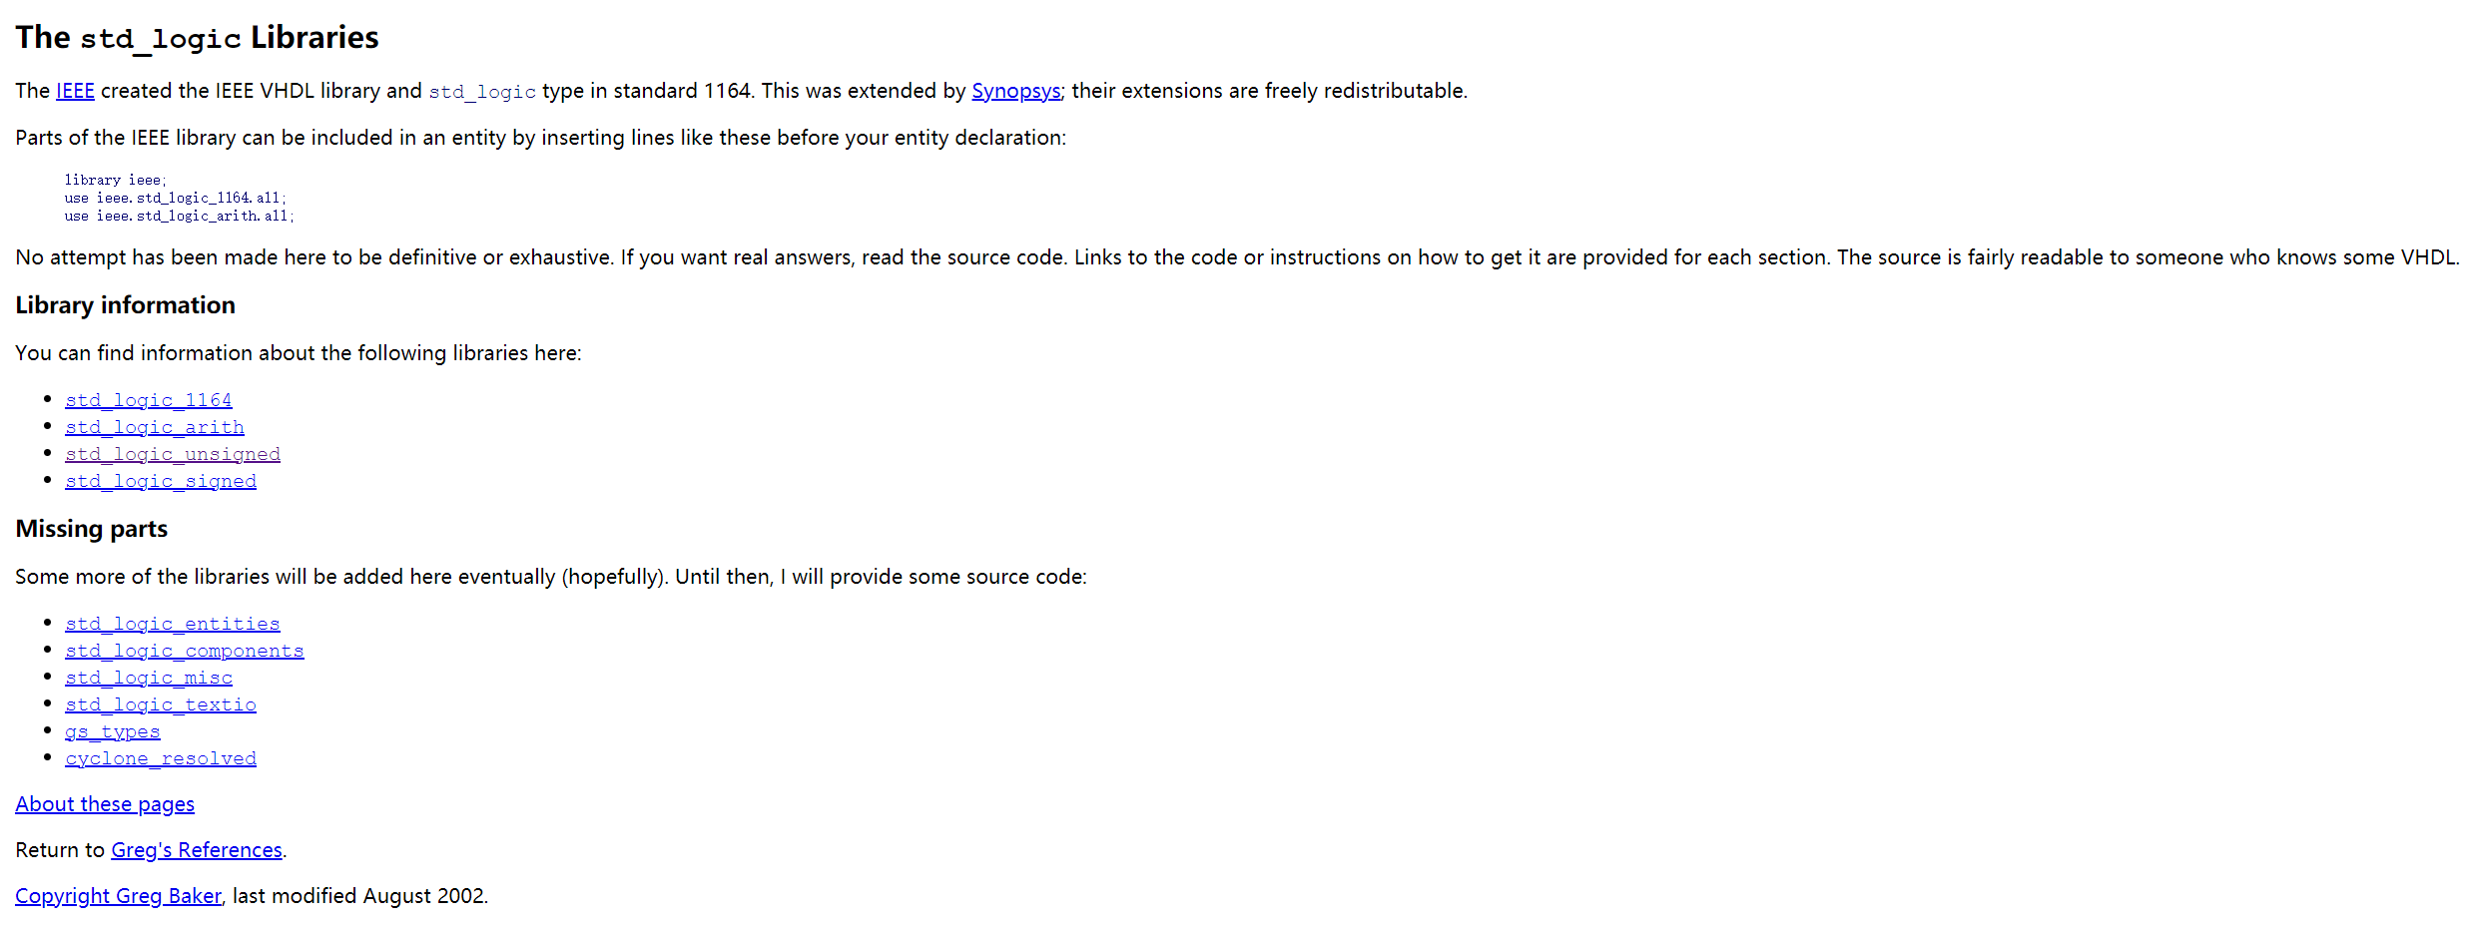
VHDL Package
https://www.cs.sfu.ca/~ggbaker/reference/std_logic/

