Slide 1
Calories
Group 25
Yingchen Zhou
Xinjin Hua
Jiabin Xiong
Jiawen Ye

Slide 2
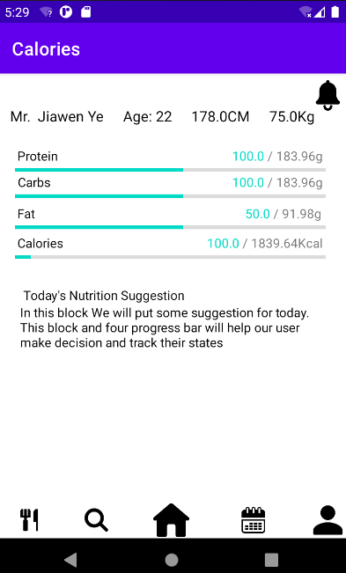
HOME PAGE
Personal information
Whatever users enter in the setting page, it will show up here
Dietary Intakes for today
Presenting the status
Intake advice
The suggested amount of each nutrition is generated according to the user’s age, gender, weight, and height.
The principle we used is “The 40/40/20 Principle”

Slide 3
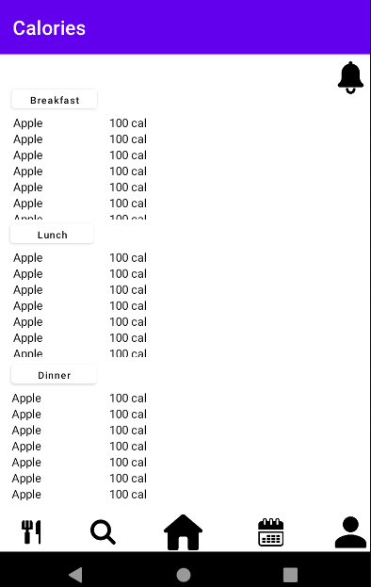
MEAL PAGE
Meal list
Representing the food of each meal
For breakfast, lunch, and dinner, user can manage their meal whenever needed

Slide 4
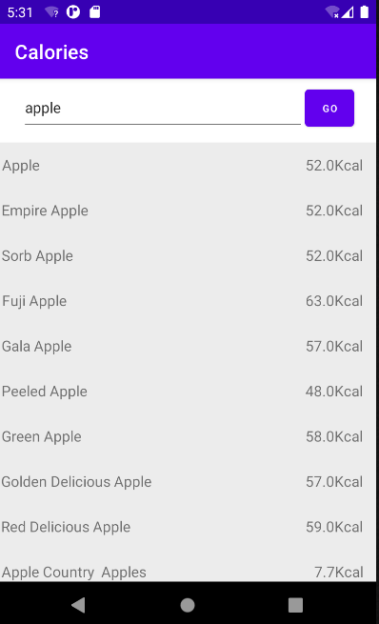
MEAL SEARCH PAGE
search & add food

Slide 5
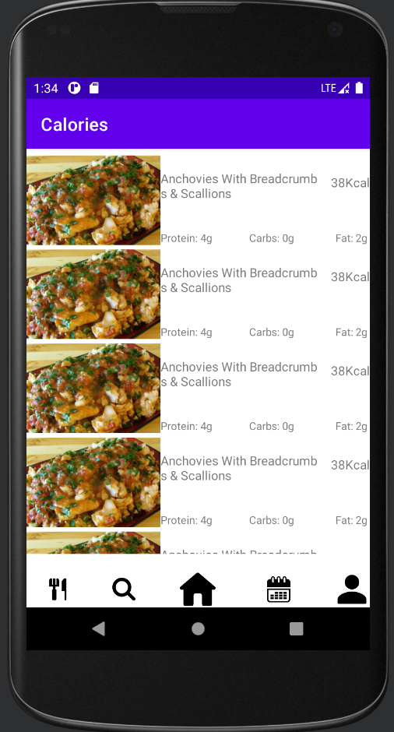
RECOMMENDATION PAGE
Recommend food to user
Based on user’s health data, the system automatically generate the food recommendation to user
The recommendation page returns the food to user, with all the data of the food

Slide 6
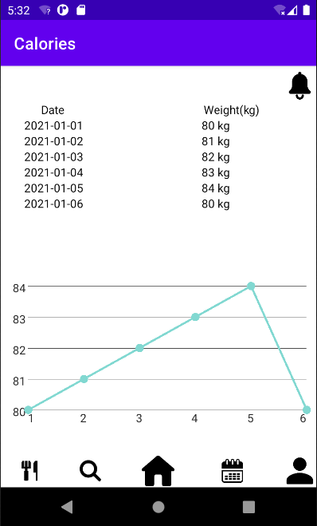
CALENDAR PAGE
Display user’s weight for the previous few days
Show data in a linear graph

Slide 7
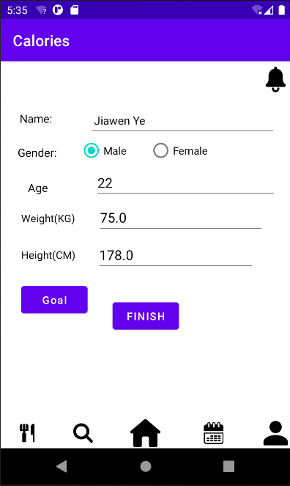
SETTING PAGE
Display user’s information
Input goal weight and the data you hope to achieve the goal

Slide 8
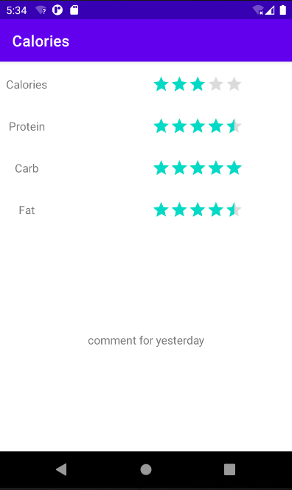
YESTERDAY SUMMARY PAGE
Dietary Intakes Score for yesterday
Comments on Yesterday

Slide 9
Thanks for watching
Appreciate your time!!:D

