Slide 1
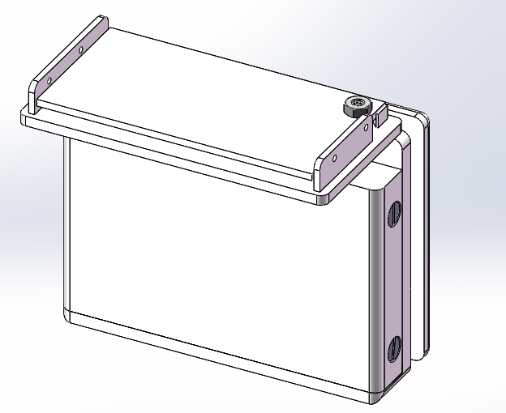
Overview
Assemble order is as the order of slides
battery box
M3 flat screw to combine front cover with base

Slide 2
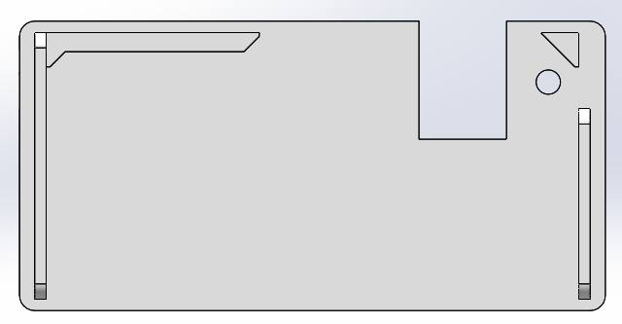
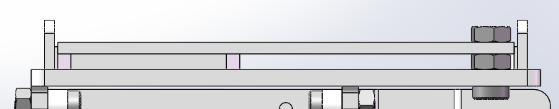
1.PCB Plate
M3 hex screw
to fix PCB
Because of the height of pin under PCB, use one more nut between the PCB and the plate

Slide 3
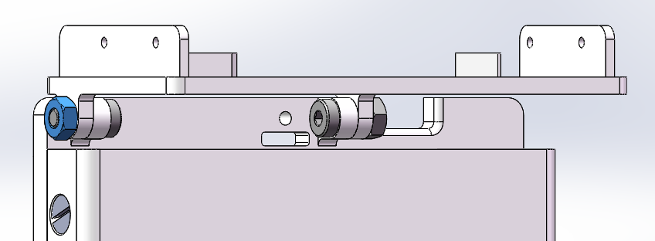
2. Hinge
M3 hex screw + nut
Notice the blued nut should be installed outside,
so that we can use a twister to tighten firmly
Use this side to fix the rotation angle
M3 hex screw + nut
Due to limited workspace, we cannot use twister, use hand to tighten is ok

Slide 4
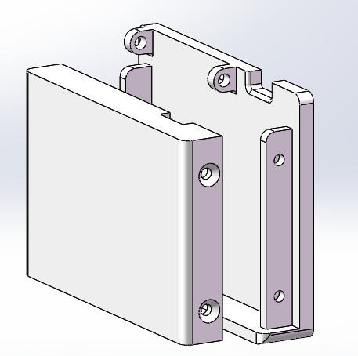
3. Battery Box
M3 flat screw
to combine the front cover and the base as battery box
2 at each side and 4 in total

Slide 5
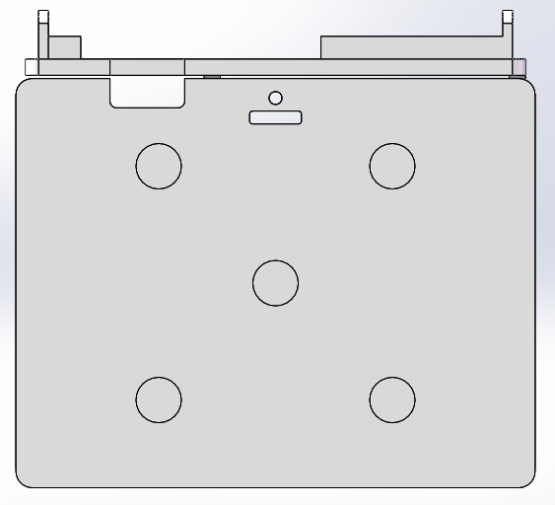
4.Base
gap for
battery connector
hole for thin string/chain
gap for flat strap
(backup besides the hole)
Holes to hold magnets
5 in total

Slide 6
Feel free to contact me for further information!
YingfenYi2019@u.northwestern.edu

