Slide 1
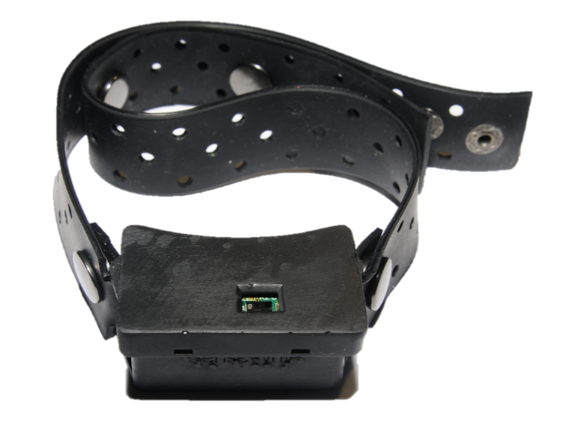
Overview
Assemble order is as the order of slides
Silicone Band
Spring Bar inside
Rivet Button
3D Printed Case

Slide 2
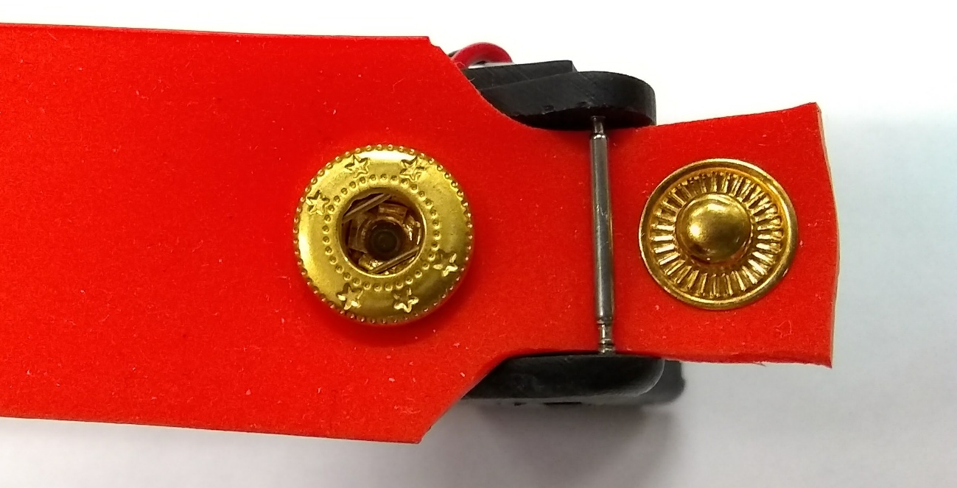
1. Make a band
An example for 50 cm max circumference for overweight people
Expand it according to your requirement
Truncate the material to get two bands
Band1: Female button, 27 cm
Band2: Male button, 24 cm
Don’t need to be very exactly, just approximation
Truncate both sides so that it can fit with the gap of the case
Use the puncher (or a driller) to punch two holes at the center line, gap ~= 2 cm
Puncher: 2 mm hole (smallest one) recommended
Place the male button in the hole close to the end, and the female button in another hole
Use tools to fix the buttons (read next page)
Female
Male

Slide 3
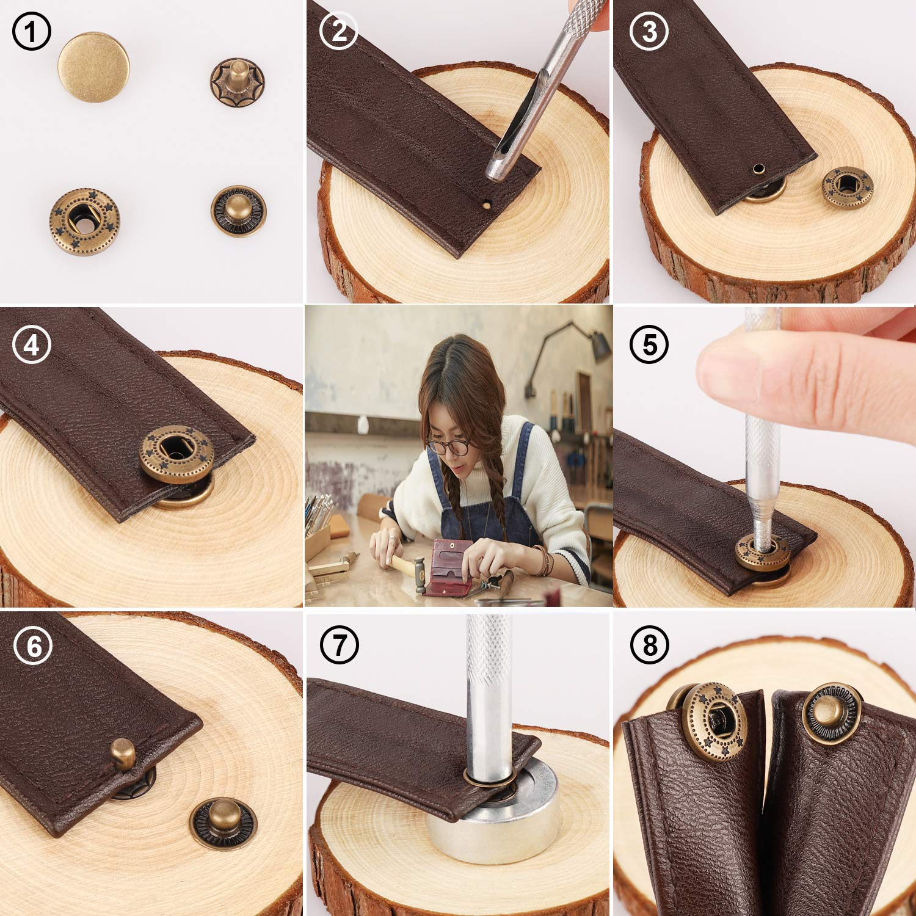
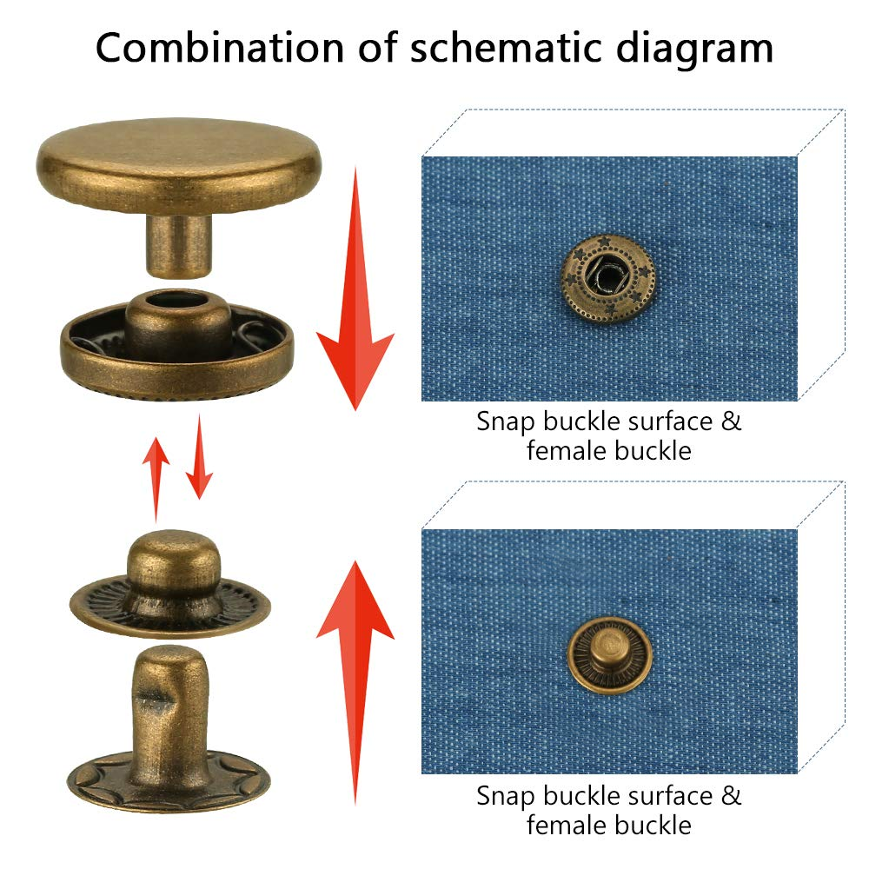
1. Make a band
source: https://www.amazon.com/dp/B07BK2PVN1

Slide 4
1. Make a band
Similarly, fix 3 buttons at each band
Gap between female buttons: 4.5 cm
Gap between male buttons: 1.5 cm
So that with 3 pairs of buttons, we can have 3x3=9 circumference options,
You can also change the parameters, or add more buttons, to get more options
But if you change the parameter, remember to adapt the length of both bands, to make their length balanced

Slide 5
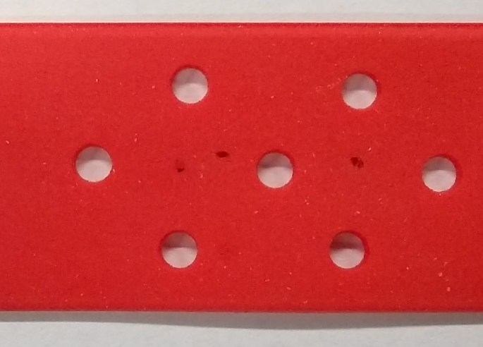
1. Make a band
Use leather puncher to punch breathing holes, no pattern or size of hole standard, here is just a recommended style:
1.5 cm between every two holes at the same row
3.5 mm hole (4th smallest on the puncher)

Slide 6
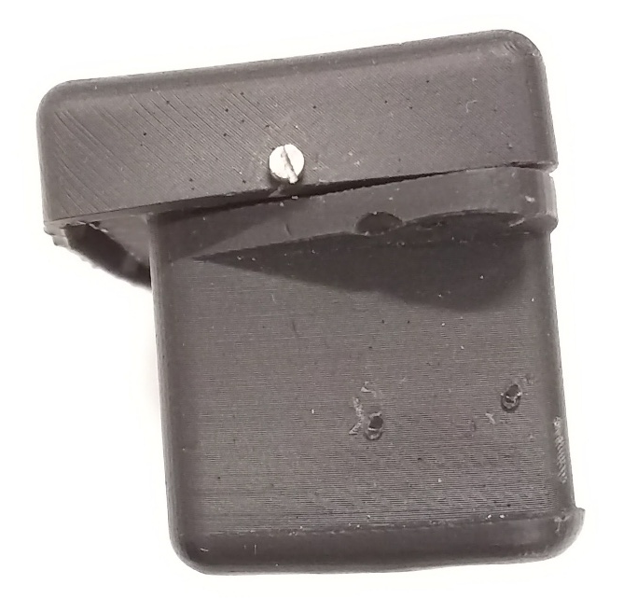
2. Assemble the case
Cover Attach the cover to the base,
Notice: Squeeze the base so that the snap joint will not break
Base
Use M1.2x4 screw to fix them

Slide 7

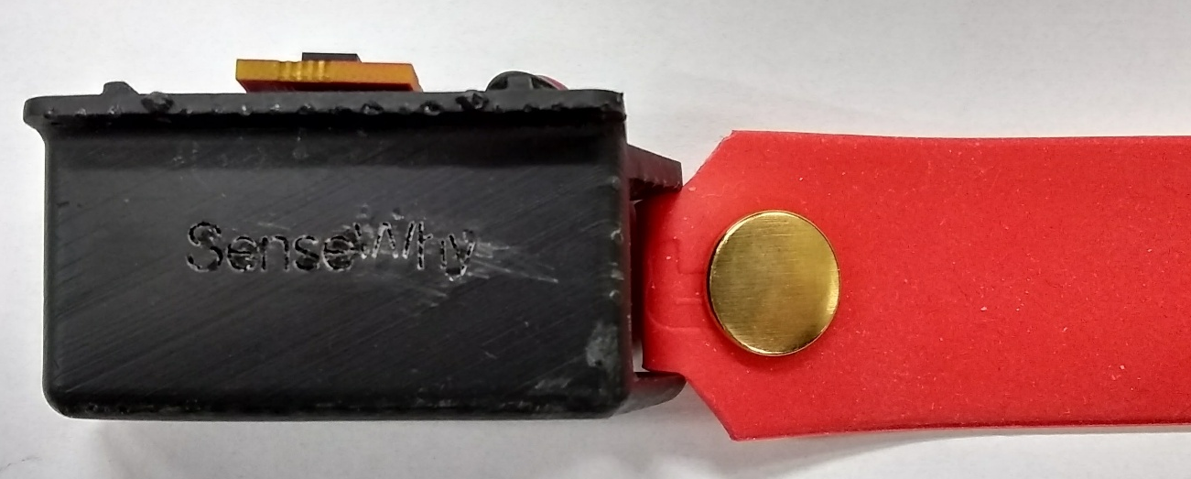
3. Connect the band and the case
Place the band between the gap
Notice the direction, female outside, male inside
Install the spring bar with tools
When it is finished, the female button will be at the outside

Slide 8
Feel free to contact me for further information!
YingfenYi2019@u.northwestern.edu

