Slide 1
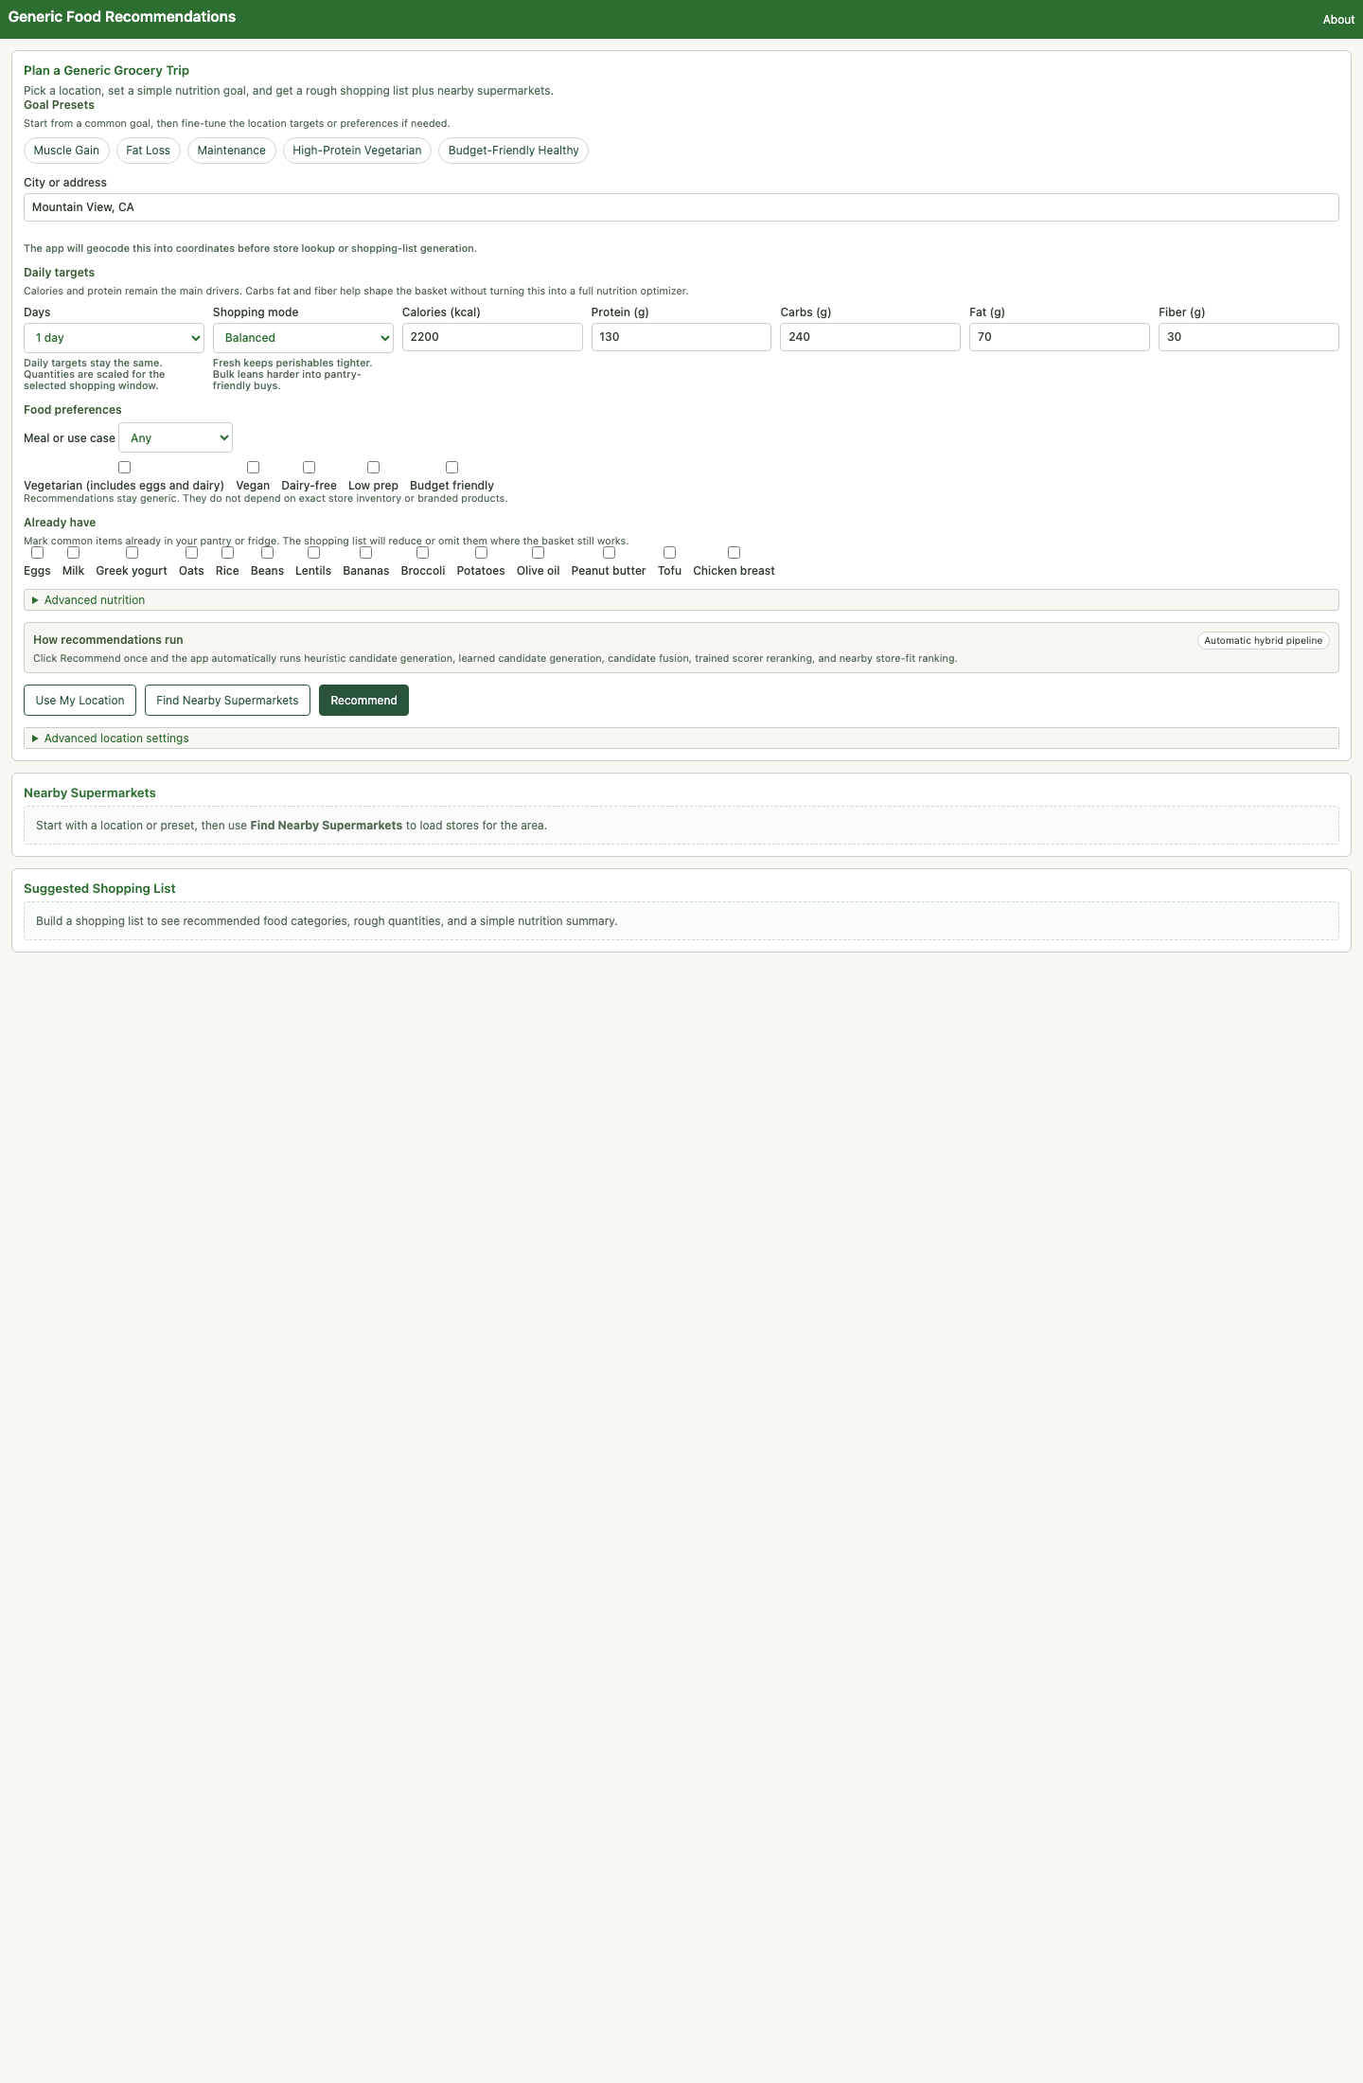
INDENG 243 ANALYTICS COMMUNICATION FINAL
From Nutrition Goals to a Grocery Trip
This tool turns a health goal into a practical grocery list, a rough cost estimate, and nearby store suggestions.
Non-technical audience first
Observed on the deployed app
Focus: decisions, tradeoffs, outcomes
What the audience sees
• Preset goals like muscle gain, fat loss, maintenance, and budget-friendly healthy.
• A one-click path from location and targets to a shopping list and store suggestions.
• Outputs that read like a grocery assistant, not a technical dashboard.
Hero view: the deployed dashboard starts with presets, local store lookup, and a guided form.
01
Notes:
Today I am presenting a grocery-planning dashboard that takes a nutrition goal and turns it into a practical shopping trip.

Slide 2
AUDIENCE
Who This Is For
The clearest non-technical audience is a shopper who wants healthier and easier grocery decisions, not a model developer.
Primary user persona
Fast setup
Affordable
Busy students and young professionals
Preset buttons and a one-click recommend flow lower setup effort.
The app surfaces a typical basket cost so the recommendation feels practical.
People who want to shop for muscle gain, fat loss, maintenance, or a healthier budget without building a meal plan from scratch.
Local
Understandable
• They want a recommendation in minutes, not a spreadsheet exercise.
• They care about rough basket cost before they get to the store.
• They need outputs they can trust without knowing the math.
Nearby store lookup makes the output feel tied to a real trip, not just a nutrition target.
The interface uses grocery language and simple controls instead of technical settings.
Why that audience fit makes sense: the dashboard exposes presets, pantry checkboxes, shopping modes, nearby stores, and plain-language notes. That is the shape of a guided consumer tool, not a specialist analytics console.
02
Notes:
The clearest audience for this tool is a busy, health-conscious shopper who is not a nutrition expert.

Slide 3
PROBLEM
The Real-World Problem
Nutrition advice is abstract, but shopping is local, budget-constrained, and full of practical tradeoffs.
Abstract advice
Too many tradeoffs
Someone may know they want more protein or a lower-cost basket, but that still does not tell them what to buy.
Calories, protein, produce, convenience, pantry items, and cost all pull the basket in different directions.
Local reality
Decision fatigue
The decision depends on nearby stores and regional price levels, not just the target on paper.
Without structure, the user either guesses or buys a basket that does not really match the goal.
Communication goal: help a non-expert user turn a health goal into a grocery decision they can actually act on.
03
Notes:
The real-world problem is that eating for a goal sounds simple until someone has to stand in a store and decide what to buy.

Slide 4
HOW IT WORKS
What The Tool Does
The clearest explanation is a simple decision pipeline, not a technical architecture diagram.
1
2
3
4
1. User inputs
2. Basket options
3. Final choice
4. Decision support
Location, targets, preferences, pantry, and shopping window.
The planner builds several plausible grocery baskets.
It chooses the basket that best balances nutrition fit, practicality, and price-awareness.
It returns a list, a summary, a rough cost, and store suggestions.
Plain-English summary
In other words, the app tries a few sensible shopping baskets and picks one that seems closest to the user's goal without ignoring realism.
04
Notes:
At a high level, the tool asks for a location, a daily target, a few food preferences, and any pantry items the user already has.

Slide 5
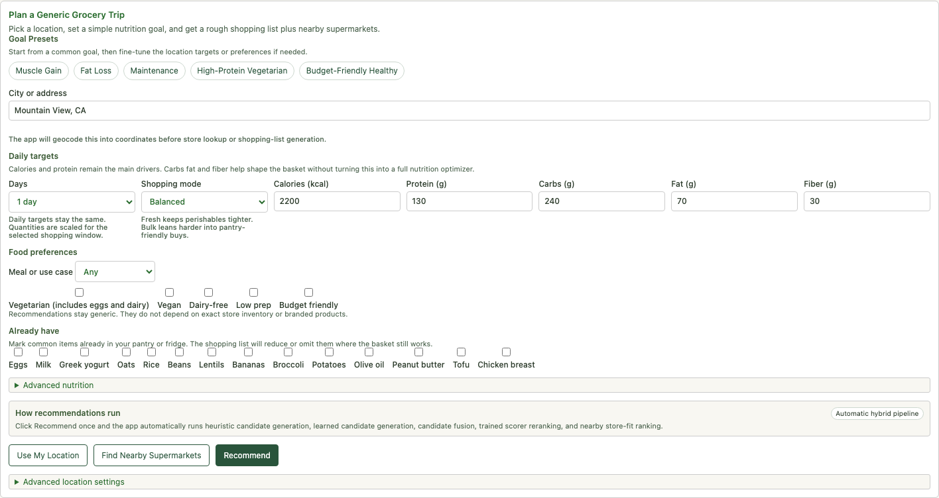
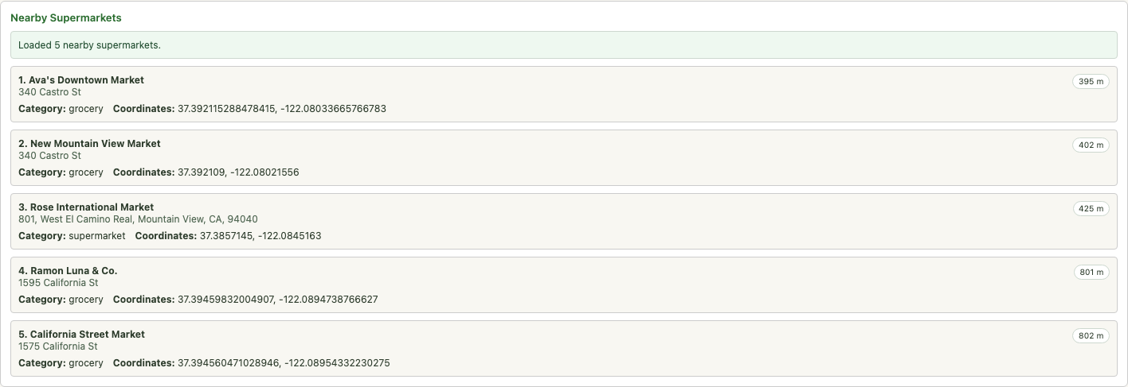
INTERACTION
How A User Interacts With It
The interface is organized like a guided grocery-planning workflow rather than a technical analytics dashboard.
Step 1: set the goal and preferences
Step 2: load nearby supermarkets
Why this is user-friendly
• Preset buttons reduce setup effort for common goals like muscle gain, fat loss, and budget-friendly healthy.
• The main controls are everyday choices: calories, protein, days, shopping mode, dietary flags, and pantry items.
• Nearby store lookup and Recommend are separate steps, which helps a first-time user explore before committing.
05
Notes:
This slide shows why the tool is accessible for a non-specialist audience.

Slide 6
DECISION IMPACT
What Changes When Decisions Change
These outputs were observed on the deployed app in Mountain View while holding the same base target constant.
Shared setup: Mountain View, CA | 2,200 kcal | 130 g protein | 1 day | balanced shopping mode
Base plan
Budget preference
Low-prep preference
$8.54
$5.44
$9.39
Typical basket cost
Typical basket cost
Typical basket cost
Chicken breast, Rotisserie chicken, Wholemeal bread, Spinach, Carrots
Lentils, Eggs, Rice, Cabbage, Carrots
Rotisserie chicken, Chicken breast, Wholemeal bread, Apples, Bell peppers
Observed effect
Observed effect
Observed effect
Balances the target with familiar staples and a produce stop.
Shifts toward cheaper pantry staples and keeps shopping simpler.
Leans into convenience foods while still staying close to the target.
Protein gap: +7.7 g
Protein gap: -19.4 g
Protein gap: +1.9 g
Produce fit: La Plaza
Produce fit: Safeway
Produce fit: La Plaza
Takeaway: the app is not just filling calories and protein. It visibly trades off cost, convenience, and basket composition when the user changes preferences.
06
Notes:
Here is the most important interaction story: changing one preference changes cost, basket composition, and sometimes store fit.

Slide 7
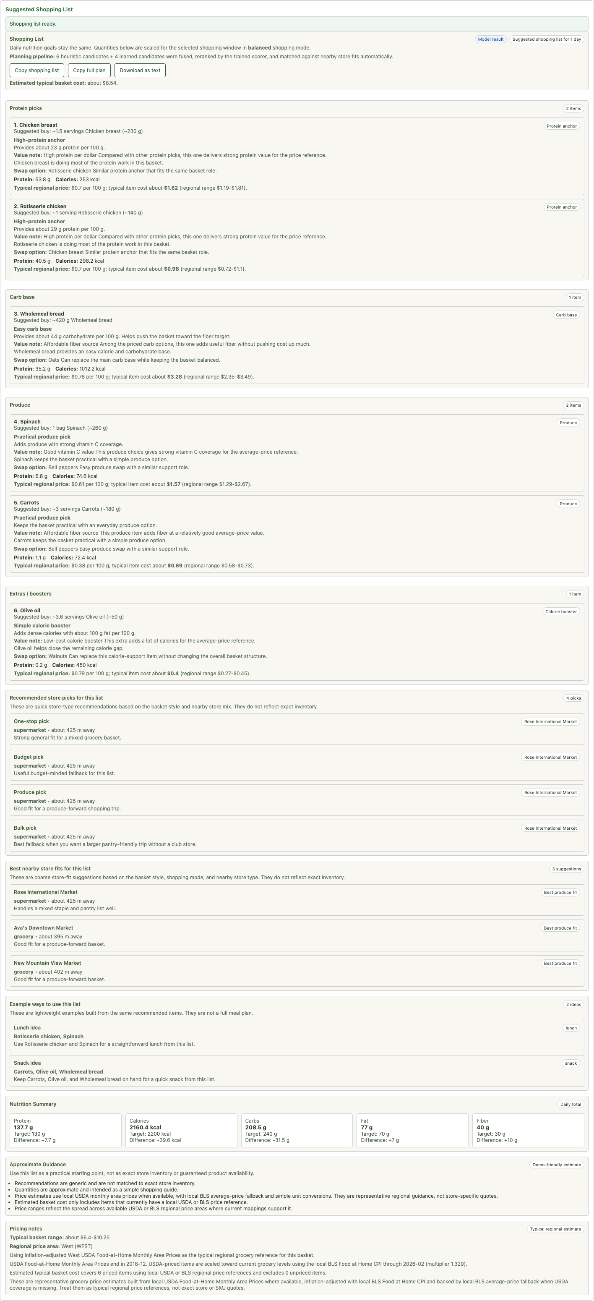
EXAMPLE
Key Insight / Recommendation Example
A concrete recommendation helps the audience understand what the tool is actually saying.
Observed base recommendation
What the model is saying
Buy a small set of versatile staples that gets you close to the target without making the trip expensive or overly complicated.
Protein
137.7 g vs 130.0 g target
Calories
2160.4 vs 2200.0 target
Cost
About $8.54 for the basket
Why this matters
The recommendation is useful because it is actionable: it tells the user what to buy, what the basket roughly achieves, and where it may fit best nearby. In this observed case, Safeway is the one-stop pick and La Plaza is the stronger produce fit.
07
Notes:
This is a concrete example of the tool speaking in plain English through a single observed recommendation.

Slide 8
LIMITS
Limitations + How To Improve
Strong communication includes being honest about uncertainty, assumptions, and what the current tool still cannot do.
Current limitations
How to improve it
• The basket uses generic foods, not exact branded products or exact live store inventory.
• Price estimates are regional references from public price tables, not store quotes.
• Store recommendations are coarse fit suggestions based on nearby store type, brand, and distance.
• Long shopping windows are heuristic. Fresh and bulk modes both soften perishables, so results become approximate.
• The tool is not medical nutrition advice and does not capture allergies or complex health needs.
• Add real store inventory and current store-specific prices where possible.
• Let the user set a hard spending cap, not just a budget-friendly preference.
• Support allergies, household size, cultural preferences, and stronger nutrition guardrails.
• Collect feedback from real student or young professional users and adapt the interface around what confuses them.
• Show confidence labels more clearly so users know what is exact versus approximate.
Observed evidence: in 7-day mode, fresh landed at 631.6 g protein versus a 910.0 g target, and bulk landed at 780.2 g versus 910.0 g. That shows why perishables and scaling remain a real limitation.
08
Notes:
The tool is useful, but it is important to state its limits clearly and honestly.

Slide 9
ETHICS
Stakeholders + Ethics
A useful recommendation system should help without overstating certainty or excluding the people who need help most.
Shoppers
Stores and educators
They gain a clearer starting point for cost, nutrition, and store choice, especially if they feel overwhelmed by grocery planning.
Nearby stores may benefit from more intentional trips, and nutrition coaches or campus wellness groups could use the tool as a teaching aid.
Potentially underserved users
Ethical design responsibility
People with allergies, medical conditions, low food access, or strong cultural constraints may need more safeguards than the current tool provides.
The tool should keep telling the truth about approximation: regional prices are not store quotes and store-fit suggestions are not inventory guarantees.
Thoughtful ethical stance
The responsible position is to present the tool as a practical starting point for grocery decisions, not as medical advice or a perfect answer. Transparency is part of the product, not a disclaimer added at the end.
09
Notes:
Several groups are affected by this tool, so transparency and accessibility matter.

Slide 10
CLOSE
Takeaways + Future Use
The strongest close is simple: this project makes nutrition goals more actionable for an everyday shopper.
Why it matters
Why it is worth using
What comes next
It turns an abstract nutrition goal into groceries, prices, and store choices a person can immediately use.
The outputs are understandable, local-feeling, and honest about what is approximate.
Pilot it with real users, collect feedback, and strengthen the data and confidence signals.
Closing line
If the goal is better grocery decisions for non-experts, this tool already works as a strong communication bridge between nutrition targets and real shopping behavior.
10
Notes:
The big takeaway is that this project makes nutrition goals more actionable.

