Slide 1
Address Challenges in Reproducing Electrodermal Activity (EDA) Data.
FA23 PSYCH 490.009 Final Project Presentation
Yinghe Liu

Slide 2
What is EDA?
Electrodermal activity (EDA) refers to small changes in electrical activity of the skin, usually occurring 1–3s following the onset of a stimulus (Scarpa & Raine, 1997).
- Early in 19th century
- Past names: galvanic skin response (GSR), electrodermal response (EDR), psychogalvanic reflex (PGR), skin conductance response (SCR), sympathetic skin response (SSR) and skin conductance level (SCL). response (SCR), sympathetic skin response (SSR) and skin conductance level (SCL).

Slide 3
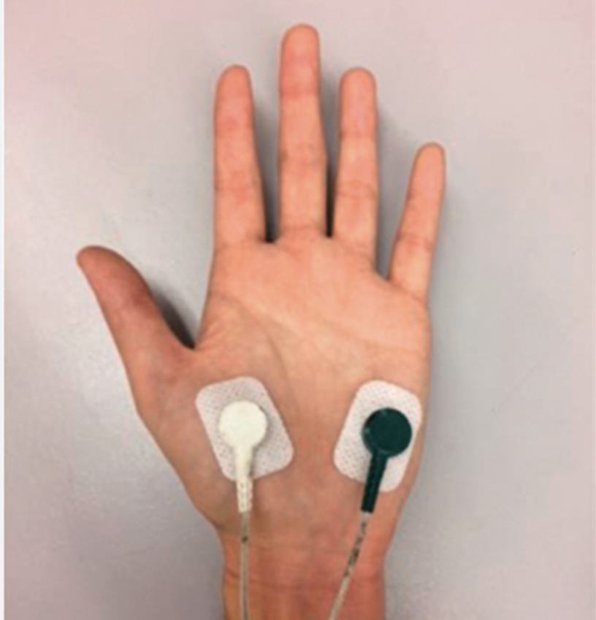
Mechanisms of EDA
Input, Information Process, Output as Model
Stimulation -> CNS -> PNS (Autonomic) -> Sweat Gland -> Electrical Conductance
The Sympathetic Nervous System (SNS)
Mobilize Body Resources to respond to stressful or challenging situations.
Usually Coupled with Other Techniques
Breathe
Heart Rate Variability (HRV)
Notes:
The activity of the glands is controlled by the sympathetic branch of the autonomic nervous system, and when the glands are activated, the skin moisturizes and is accompanied by electrical signals. In the most widely measured method of EDA, the experimental measurements are made by applying two electrodes to the subject's skin and applying a weak electric current at a constant voltage, and estimating the skin conductivity based on the numerical change in the current, or known as skin conductance level (SCL).

Slide 4
Who use EDA?
Emotion Research
Stress and Anxiety Studies
Affective computing and interactions (My case)
Pain Perception
Biofeedback in PNS
Marketing and Consumer Behavior
Clinically: Anxiety-related Disorder/ Traumatic experience
Notes:
Emotion Research: EDA is often used to study emotional responses and arousal levels. Researchers may use EDA data to investigate how individuals react to emotional stimuli, such as images, videos, or emotional experiences.
Stress and Anxiety Studies: EDA can be a valuable tool for assessing stress and anxiety levels in individuals. It has been used in studies to understand the physiological responses to stressors and anxiety-inducing situations.
Psychophysiological Research: EDA is commonly employed in psychophysiological research to measure autonomic nervous system activity. Researchers may examine how EDA correlates with other physiological measures like heart rate and respiration in response to various stimuli.
Biofeedback and Stress Management: EDA biofeedback is used in therapeutic settings to help individuals learn to control their physiological responses, particularly for stress management and relaxation techniques.
Human-Computer Interaction (HCI): EDA data can be used to improve the design of user interfaces and interactions in HCI research. It helps assess user engagement, frustration, or cognitive load during tasks.
Decision-Making and Cognitive Load: EDA can be used to study decision-making processes and cognitive load. Researchers can analyze how EDA patterns change when individuals make choices or engage in cognitive tasks.
Affective Computing: In the field of affective computing, EDA data is used to develop technology that can recognize and respond to human emotions. This has applications in areas like virtual reality and human-robot interaction.
Clinical Psychology: EDA is sometimes used in clinical psychology and psychiatry to assess physiological responses in individuals with conditions such as anxiety disorders, post-traumatic stress disorder (PTSD), and phobias.
Social Psychology: EDA can be employed in social psychology studies to investigate how social interactions and social stimuli elicit physiological responses, such as changes in skin conductance during social interactions or exposure to social cues.
Marketing and Consumer Behavior: EDA is used in marketing research to assess consumer reactions to advertisements, products, and branding. It helps companies understand emotional responses to marketing stimuli.
Neuropsychology: EDA data may be used in neuropsychological research to examine how brain injuries or disorders impact autonomic nervous system functioning and emotional responses.

Slide 5
Paradigms Example of EDA
Trier Social Stress Test (TSST)
Iowa Gambling Task (IGT)
Lie Detector Tests (Polygraph Examinations) *
Human-Computer Inyteraction
Sleep Arousal Assessment
Exposure Therapy

Slide 6
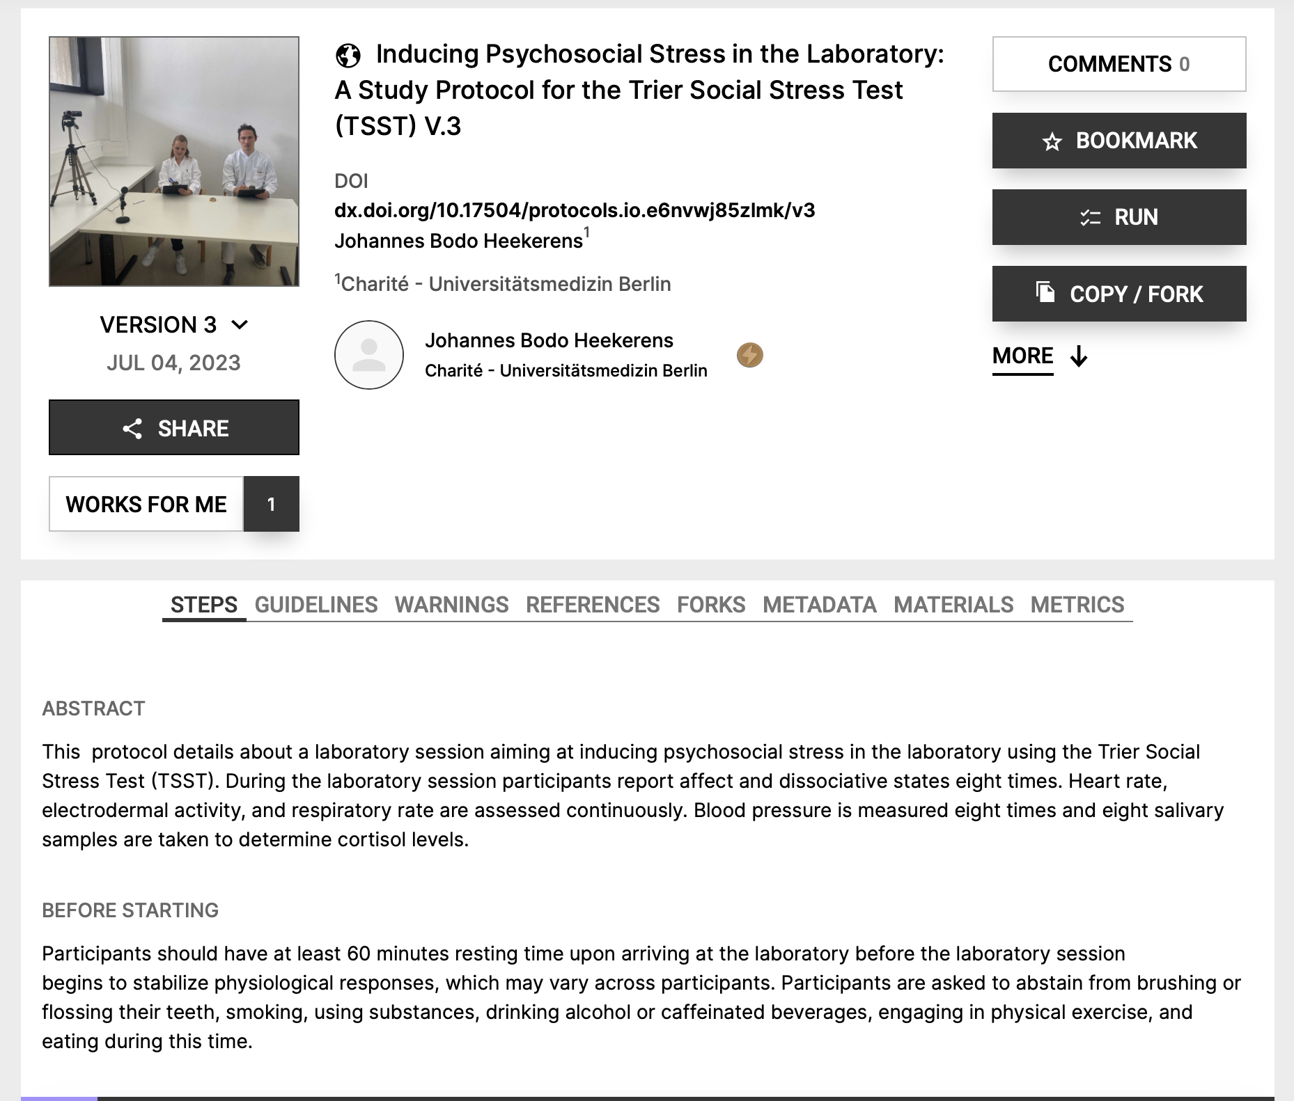
Practical Examples (TSST)

Slide 7
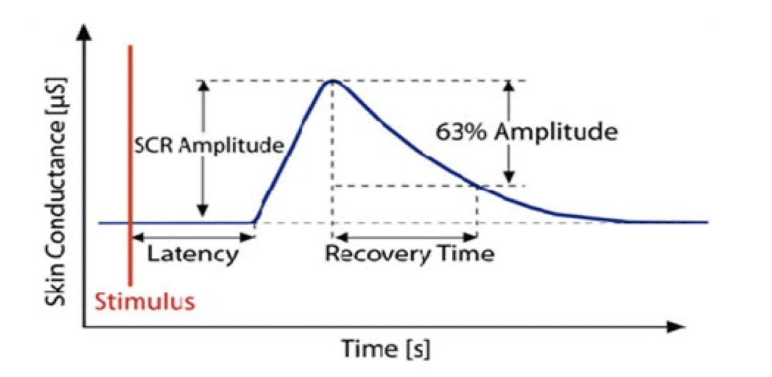
Basic Property of EDA
Skin Conductance Response (SCR)
Latency
Amplitude
Draw from Usha Desai, Akshaya D. Shetty (2021).

Slide 8
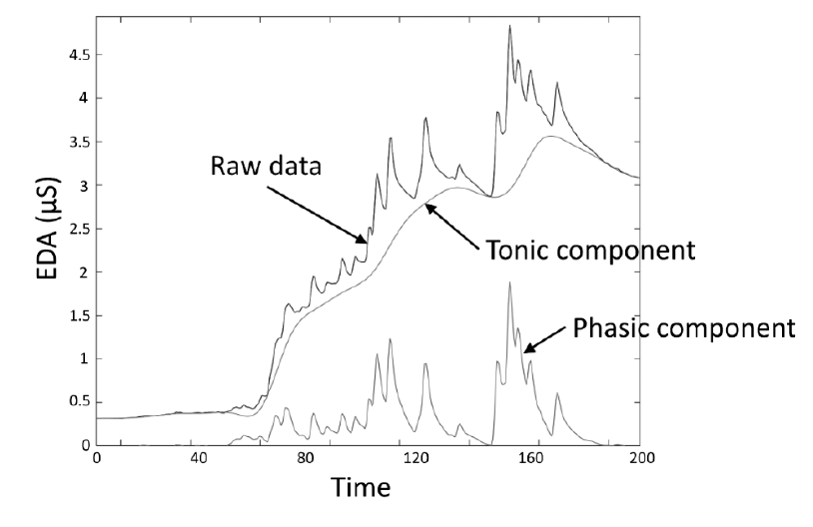
Basic Property of EDA
Tonic: Non-Specific Skin Conductance Response.
Phasic: Event-related Skin Conductance Response.
Draw from Posada-Quintero, H. F., & Chon, K. H. (2020).
Notes:
Posada-Quintero, H. F., & Chon, K. H. (2020). Innovations in electrodermal activity data collection and signal processing: A systematic review. Sensors, 20(2), 479.

Slide 9
Common Influencing factors
Technique:
Electrode wear
Electrode material (flexible or rigid, contains gel or not)
Electrode size
Type of current (DC or AC)
Measured loci (number of sweat glands)
Environment:
Air temperature, humidity
Other
Drugs, exercise, respiration, age, water content of skin.

Slide 10
Laboratory Settings VS. Natural Settings
Controlled:
Technique
Environment
Water content of skin
Drugs
Exercise Status
Uncontrolled:
Respiration
Connection
Miscellaneous
Deleting falsely marked troughs/peaks (usually at beginning of segments)
Participant (significantly) pressing electrode

Slide 11
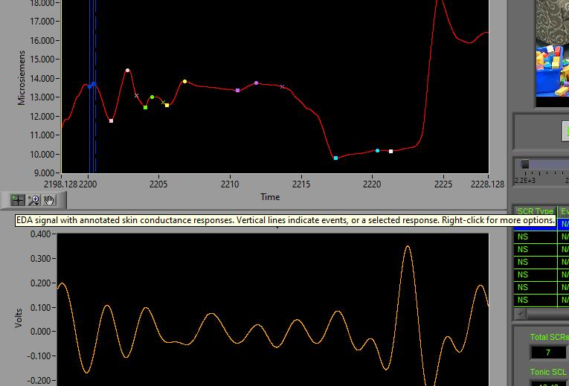
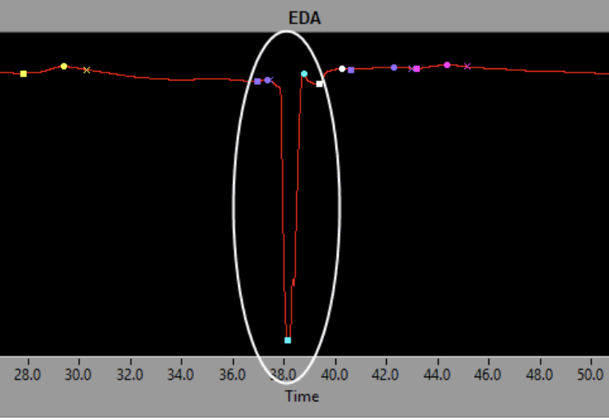
Artifacts: Pressing on Sensor

Slide 12
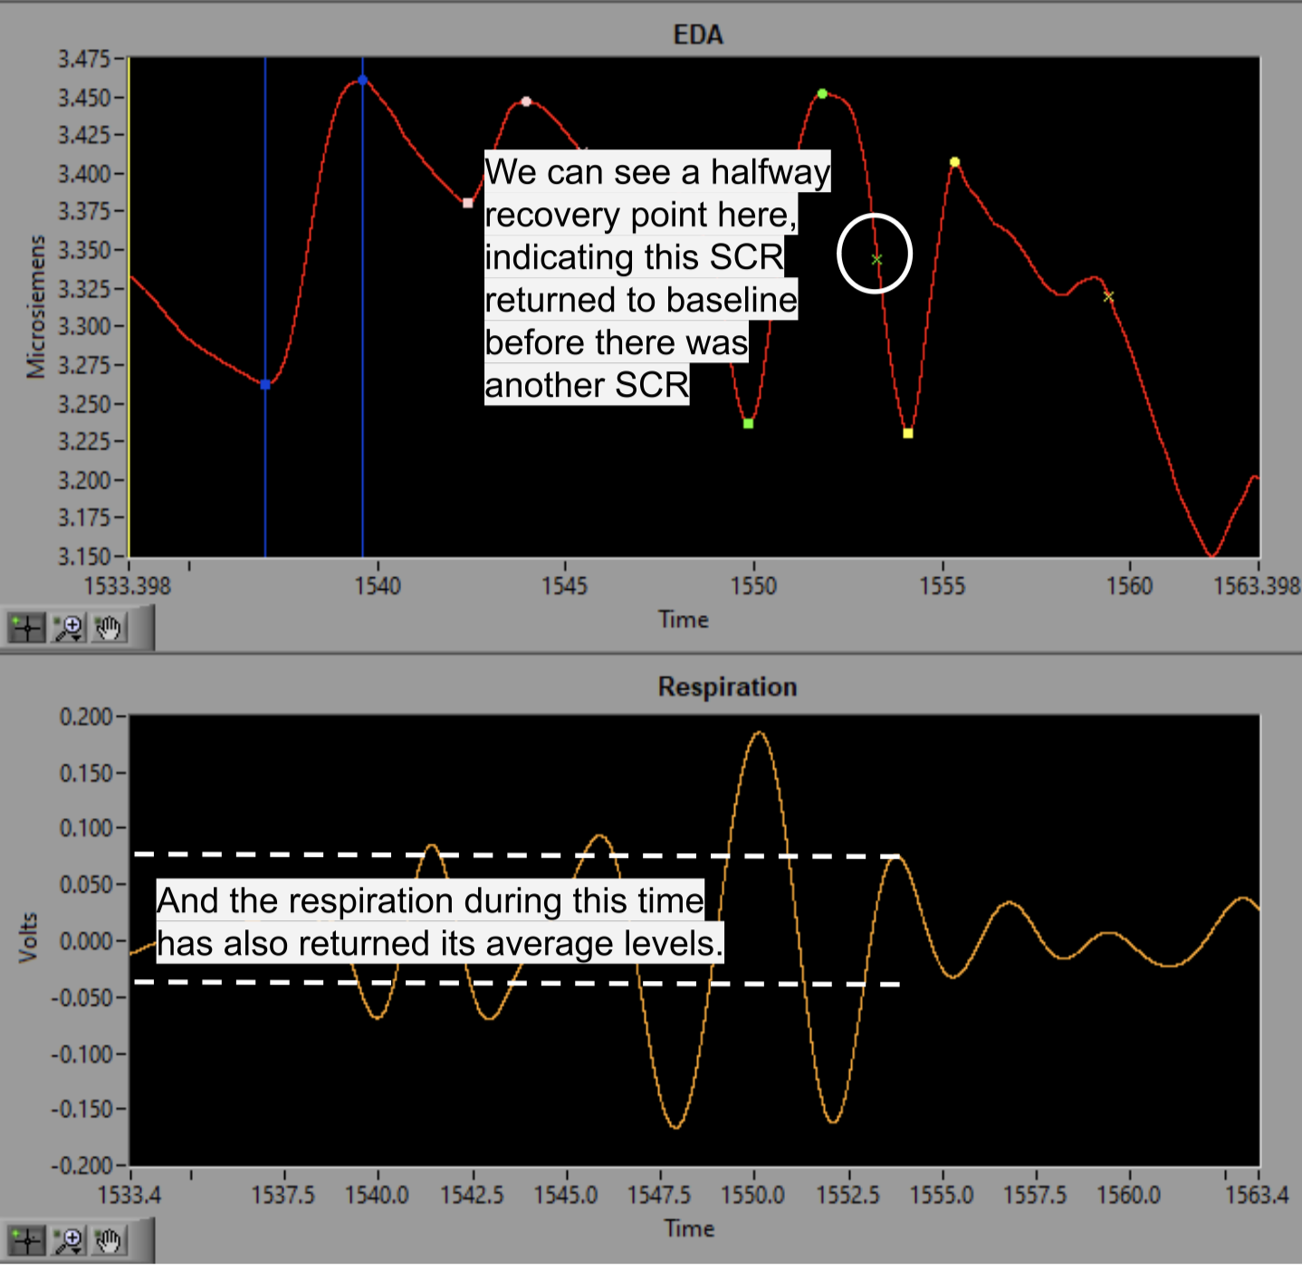
Artifacts: Respiration
Increasing SNS activity.
Stretch on Skin

Slide 13
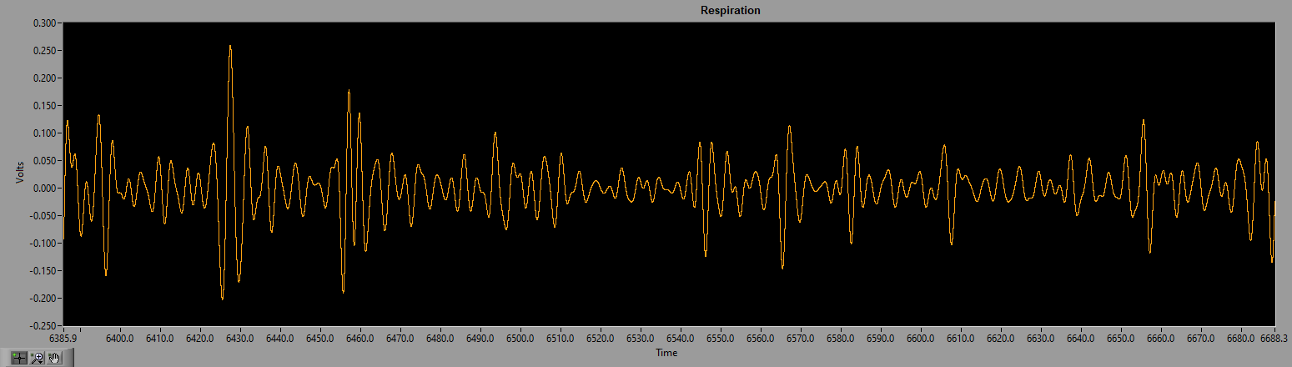
Cognitive Bias (1)
What is the Average Respiration Rate?
A. 0.05 uS.
B. 0.1 uS.
C. Other

Slide 14
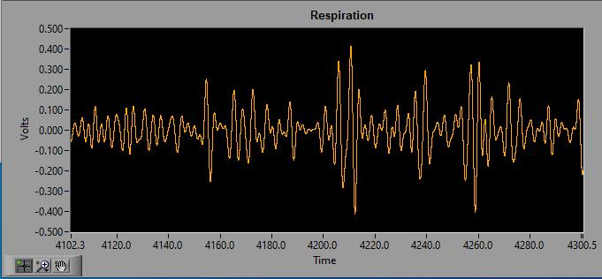
Cognitive Bias (2)
What is the Average Respiration Rate?
-Sometimes it is difficult to reach an agreement.

Slide 15
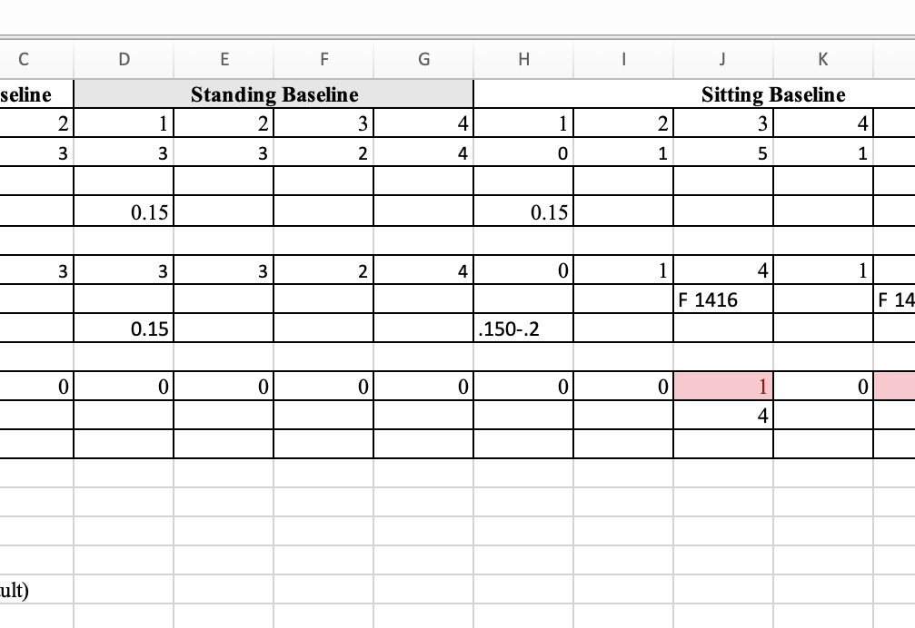
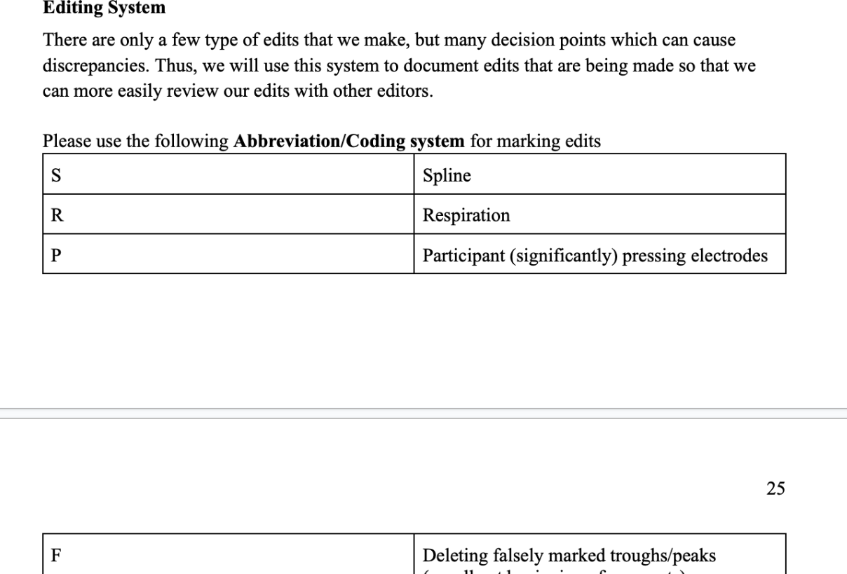
Effort Towards Open Science
Notes:
Screenshots from Manual.

Slide 16
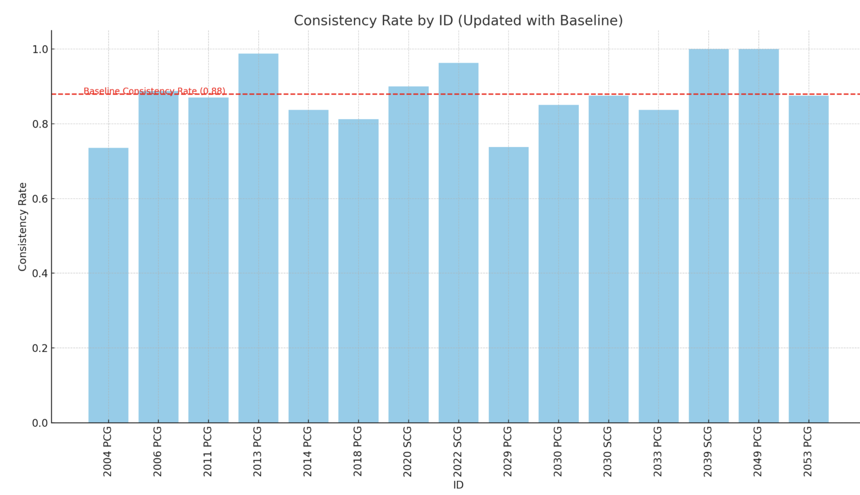
Many-Analyst Approach
Multiple Independent Analyses that leads to
Diverse Perspetives
Reducing Bias
Collaboration and Transparency
Same Raw data, but interpreted by different manuals and editors
Preliminary result in our practice: 15 of 45 files are double-edited

