Slide 1
Regression Model For Predicting Movie Box Office Gross
By
Ying Wu, Yingjuan Wu, Sahand Zeinali

Slide 2
Task
To predict a movie’s worldwide box-office gross using relevant features. This is useful because we can use it to predict a movie’s commercial success before it is released.

Slide 3
Dataset
We used a dataset from Kaggle which contains data on over 5000 movies
We chose number of critic reviews, duration of movie, face number in poster, genres, budget, country, content-rating, imdb score, number of director facebook likes, number of cast total facebook likes as input variables, and gross as the target variable.
We removed movies that are over 50 years old, and the ones that do not have box-office revenue or director facebook likes
After binarizing the categorical variables, our dataset has 3321 rows and 87 columns

Slide 4
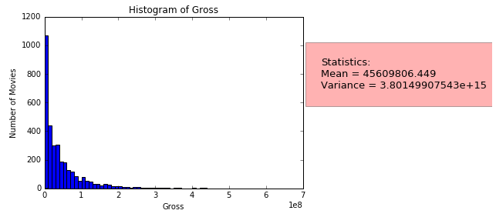
Visualization of the Class
Movie gross (continuous variable)

Slide 5
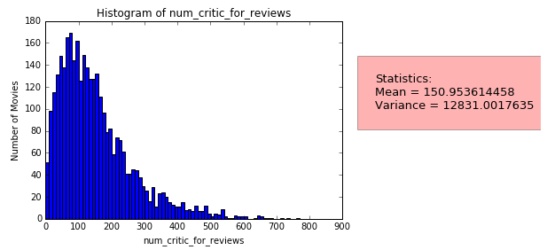
Visualization of one feature
Number of critic reviews (continuous variable)

Slide 6
Model Selection Results
We use two measures to evaluate the performance of the regression models:
1. Mean Squared Error – it measures the average of the squares of the errors. It is a risk function corresponding to the expected value of the squared error loss. We use 'neg_mean_squared_error' as scoring parameter in the cross-validation function to calculate the MSE scores.
2. R^2 Score – it measures how well future instances are likely to be predicted by the model. We use 'r2_score' as scoring parameter in the cross-validation function to calculate the R^2 scores.
We performed 10-fold cross validation

Slide 7
Model Selection Results
Model | Parameters | Performance
Baseline | Mean of target | MSE=4.127e+15, R^2=-1.523
Ordinary Least Squares | Default | MSE=2.073e+40, R^2=0.472
 | Fit_intercept=False | MSE=5.662e+37 R^2=-0.075
 | N_jobs=-1 | MSE=2.261e+40 R^2=0.472
 | Normalize=True | MSE=1.853e+73 R^2=0.471
 | Copy_X=False | MSE=1.534e+40 R^2=0.472
To be continued on next slide

Slide 8
Model Selection Results
Model | Parameters | Performance
Ridge | Default | MSE=2.466e+15, R^2=0.471
 | Alpha=0.5 | MSE=2.497e+15, R^2=0.472
 | Fit_intercept=False | MSE=2.466e+15 R^2=0.471
 | Solver=‘lsqr’ | MSE=2.446e+15 R^2=0.470
Bayesian Ridge | Default | MSE=4.127e+15 R^2=9.300e-13
 | alpha_1=1.e1, alpha_2=1.e2, lambda_1=1.e3, lambda_2=1.e4 | MSE=4.127e+15 R^2=9.351e-12
To be continued on next slide

Slide 9
Model Selection Results
Model | Parameters | Performance
Bayesian Ridge | Fit_intercept=False | MSE=5.874e+15, R^2=-0.547
 | Compute_score=True | MSE=4.127e+15, R^2=9.300e-13
Lasso | Tol=1 | MSE=2.533e+15 R^2=0.458
 | Tol=1,alpha=0.5 | MSE=2.533e+15 R^2=0.458
 | Tol=1,normalize=True | MSE=2.533e+15 R^2=0.458
 | Tol=1,fit_intercept=False | MSE=2.753e+15 R^2=0.391
To be continued on next slide

Slide 10
Model Selection Results
Model | Parameters | Performance
Lasso | Tol=1,precomputer=True | MSE=2.533e+15 R^2=0.458
 | Tol=1,positive=True | MSE=2.495e+15, R^2=0.441
 | Tol=1,warm_start=True | MSE=2.533e+15 R^2=0.458
 | Tol=1,copy_X=False | MSE=2.533e+15 R^2=0.178
The best model and parameter setting is Ridge regression model with
solver set to ‘lsqr’. Performance: MSE=2.446e+15, R^2=0.470

Slide 11
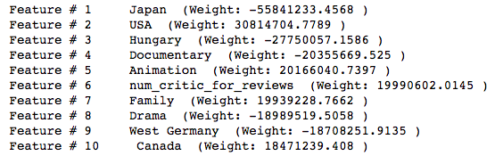
Top Features
Based on our model, which is Ridge regression model, top features are

Slide 12
Interesting/unexpected cases
<Discuss a few interesting cases. Use extra slides if needed. Use images if needed. Here is an example.>
Here is a user who tweeted “…”. The user is definitely a Republican, as you can see from the tweet, but my model classified the user as Democrat. The reason is that my model used bag-of-words model and did not take linguistic features into account, because the user used terms that mostly Democrats use, but used in a negative way…

