Slide 1
Regression Model for Predicting Movie Box Office Gross
By
Ying Wu
Yingjuan Wu
Sahand Zeinali

Slide 2
Task
To predict a movie’s worldwide box-office gross using relevant features. This is useful because we can use this model to predict a movie’s commercial success before it is released.

Slide 3
Dataset
We used a dataset from Kaggle which contains data from over 5000 movies
We chose number of critic reviews, duration of movie, face number in poster, genres, budget, country, content-rating, imdb score, number of director facebook likes, number of cast total facebook likes as input variables, and gross as the target variable.

Slide 4
Dataset (cont.)
We removed movies that are over 50 years old, and the ones that do not have box-office revenue or director facebook likes
After binarizing the categorical variables, our dataset has 3321 rows and 87 columns

Slide 5
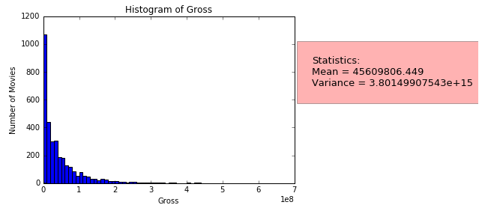
Visualization of the Class
Movie gross (continuous variable)

Slide 6
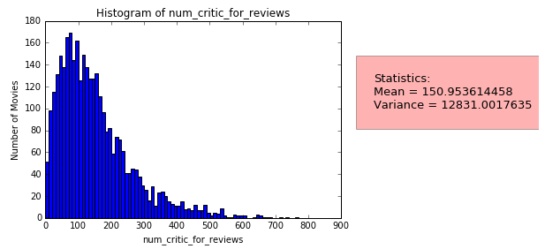
Visualization of one feature
Number of critic reviews (continuous variable)

Slide 7
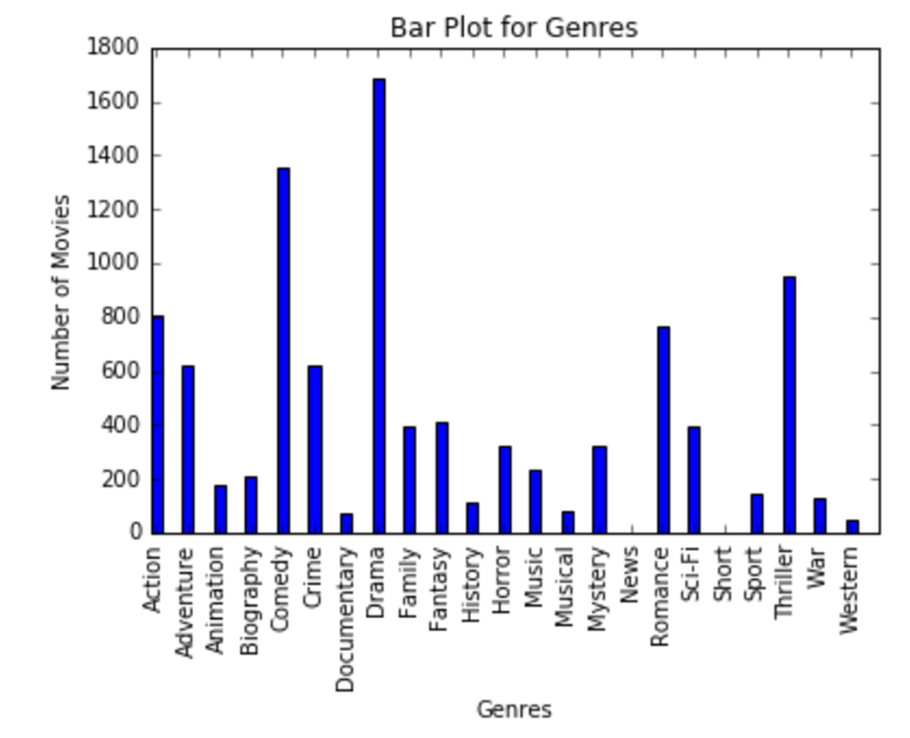
Visualization of one feature (cont.)
Genres (categorical variable)

Slide 8
Model Selection Results
We use two measures to evaluate the performance of the regression models:
1. Mean Squared Error – it measures the average of the squares of the errors. It is a risk function corresponding to the expected value of the squared error loss. We use 'neg_mean_squared_error' as scoring parameter in the cross-validation function to calculate the MSE scores.

Slide 9
Model Selection Results (cont.)
2. R^2 Score – it measures how well future instances are likely to be predicted by the model. We use 'r2_score' as scoring parameter in the cross-validation function to calculate the R^2 scores.
We performed 10-fold cross validation

Slide 10
Model Selection Results
Model | Parameters | Performance
Baseline | Mean of target | MSE=4.127e+15, R^2=-1.523
Ordinary Least Squares | Default | MSE=2.073e+40, R^2=0.472
 | Fit_intercept=False | MSE=5.662e+37 R^2=-0.075
 | N_jobs=-1 | MSE=2.261e+40 R^2=0.472
 | Normalize=True | MSE=1.853e+73 R^2=0.471
 | Copy_X=False | MSE=1.534e+40 R^2=0.472

Slide 11
Model Selection Results (cont.)
Model | Parameters | Performance
Ridge | Default | MSE=2.466e+15, R^2=0.471
 | Alpha=0.5 | MSE=2.497e+15, R^2=0.472
 | Fit_intercept=False | MSE=2.466e+15 R^2=0.471
 | Solver=‘lsqr’ | MSE=2.446e+15 R^2=0.470
Bayesian Ridge | Default | MSE=4.127e+15 R^2=9.300e-13
 | alpha_1=1.e1, alpha_2=1.e2, lambda_1=1.e3, lambda_2=1.e4 | MSE=4.127e+15 R^2=9.351e-12

Slide 12
Model Selection Results (cont.)
Model | Parameters | Performance
Bayesian Ridge | Fit_intercept=False | MSE=5.874e+15, R^2=-0.547
 | Compute_score=True | MSE=4.127e+15, R^2=9.300e-13
Lasso | Tol=1 | MSE=2.533e+15 R^2=0.458
 | Tol=1,alpha=0.5 | MSE=2.533e+15 R^2=0.458
 | Tol=1,normalize=True | MSE=2.533e+15 R^2=0.458
 | Tol=1,fit_intercept=False | MSE=2.753e+15 R^2=0.391

Slide 13
Model Selection Results (cont.)
Model | Parameters | Performance
Lasso | Tol=1,precomputer=True | MSE=2.533e+15 R^2=0.458
 | Tol=1,positive=True | MSE=2.495e+15, R^2=0.441
 | Tol=1,warm_start=True | MSE=2.533e+15 R^2=0.458
 | Tol=1,copy_X=False | MSE=2.533e+15 R^2=0.178
The best model and parameter setting is Ridge regression model with
solver set to ‘lsqr’. Performance: MSE=2.446e+15, R^2=0.470

Slide 14
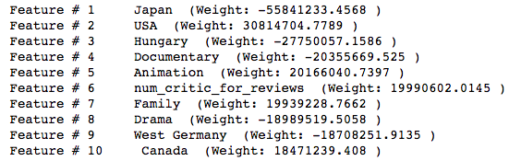
Top Features
Based on our model, which is Ridge regression model, top features are

Slide 15
Interesting cases
Among the top 10 features, there are 3 non-US country features (Japan, Hungary, West Germany) that have strong negative correlation with the target – movie gross. By looking closely into the data, we found that the average gross for these three countries are all below 100,000 while the average gross for all movies are 45,608,461. Thus, the gross of movies produced in these three countries are significantly below the world-wide average, which explains why the three features are among the top negative features.

Slide 16
Interesting cases (cont.)
Animation and family-theme movies achieve highest world-wide box office gross amongst all the genres. This is useful information for movie production companies because it suggests what themes will be more popular and commercially successful.

Slide 17
Interesting/unexpected cases (cont.)
Drama(as a genre) is one of the top negative features. This is possibly due to the fact that many non-US movies that have low gross are drama movies, which leads to a low average gross for all drama movies.

Slide 18
Interesting/unexpected cases (cont.)
If numerical features are not scaled, the performance of models are similar to scaled case. But the top six important features will be numerical features since our target, i.e. gross, is a very large number.
When playing with the parameters of models, some change will increase or decrease the MSE and R^2 at the same time.

