Slide 1
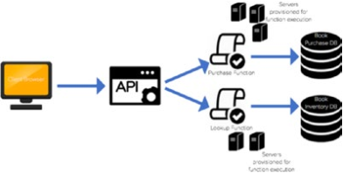

Serverless Computing
Generally, when people think of serverless computing, they tend to think of applications with back-ends that run on third-party services, also described as code running on ephemeral containers.
many businesses and people who are new to serverless computing will consider serverless applications to be simply “in the cloud.” While most serverless applications are hosted in the cloud, it’s a misperception that these applications are entirely serverless. The applications still run on servers that are simply managed by another party.
The configuration of a traditional architecture in which the server is provisioned and managed by the developer
The configuration of a serverless architecture where servers are spun up and down based on demand

Slide 2
Serverless computing: function as a service (FaaS)
Imagine having the ability to simply write code, upload it, and run it, without having to worry about any of the underlying infrastructure, setup, or environment maintenance… The possibilities are endless, and the speed of development increases rapidly. By utilizing serverless architecture, you can push out fully functional and scalable applications in half the time it takes you to build them from the ground up.
As mentioned earlier, serverless computing is a cloud computing model in which code is run as a service without the need for the user to maintain or create the underlying infrastructure. This doesn’t mean that serverless architecture doesn’t require servers, but instead that a third party is managing these servers so they are abstracted away from the user. A good way to think of this is as “Functions as a Service” (FaaS). Custom event-driven code is created by the developer and run on stateless, ephemeral containers created and maintained by a third party

Slide 3
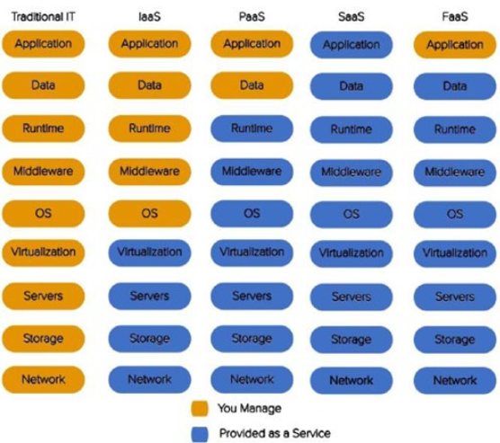
Serverless computing: function as a service (FaaS)
Amazon Elastic Compute Cloud (EC2) instance.
AWS Elastic Beanstalk, Azure Web Apps, and Heroku
What the developer manages compared to what the provider manages in different architectural systems

Slide 4
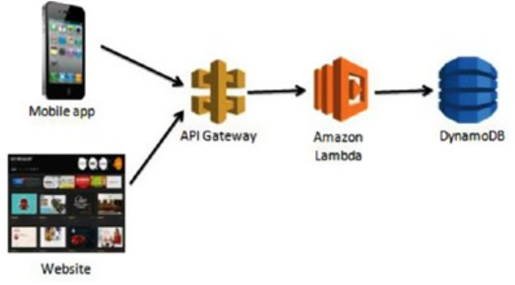
Serverless As an Event-Driven Computation
In this event-driven architecture, the functions are event consumers because they are expected to come alive when an event occurs and are responsible for processing it. Some examples of events that trigger serverless functions include these:
API requests
Object puts and retrievals in object storage
Changes to database items
Scheduled events
Voice commands (for example, Amazon Alexa)
Bots (such as AWS Lex and Azure LUIS, both natural-language–processing engines)

Slide 5
Serverless As an Event-Driven Computation
In this example, a request to the API Gateway is made from a mobile or web application. API Gateway is Amazon’s API service that allows you to quickly and easily make RESTful HTTP requests. The API Gateway has the specific Lambda function created to handle this method set as an integration point. The Lambda function is configured to receive events from the API Gateway. When the request is made, the Amazon Lambda function is triggered and executes.
An example use case of this could be a movie database. A user clicks on an actor’s name in an
application. This click creates a GET request in the API Gateway, which is pre-established to trigger the Lambda function for retrieving a list of movies associated with a particular actor/actress. The Lambda function retrieves this list from DynamoDB and returns it to the application.
Another important point you can see from this example is that the Lambda function is created to handle a single piece of the overall application. Let’s say the application also allows users to update the database with new information. In a serverless architecture, you would want to create a separate Lambda function to handle this. The purpose behind this separation is to keep functions specific to a single event. This keeps them lightweight, scalable, and easy to refactor.

Slide 6
How Is It Different?
The main two differences you are likely to see are in the development of applications and the independent processes that are used to create them.
Development
The command-line interface (CLI) is a powerful development tool because it makes serverless
functions and their necessary services easily deployable and allows you to continue using the development tools you want to use to write and produce your code. The Serverless Framework tool is another development option that can be installed using NPM, as you will see in greater detail later in the chapter.
Independent Processes
Another way to think of serverless functions is as serverless microservices. Each function serves its own purpose and completes a process independently of other functions. Serverless computing is stateless and event-based, so this is how the functions should be developed as well.
The idea of maintaining modularity still applies in the serverless level. Each function could represent one API method and perform one process. Serverless Framework helps with this, as it enforces smaller functions which will help focus your code and keep it modular

Slide 7


How Is It Different?
The microservices approach breaks away from the monolithic architecture pattern by separating
services into independent components that are created, deployed, and maintained apart from one another.
This figure demonstrates the dependency each functionally distinct aspect of the system has on another
This figure demonstrates the independent services that make up a microservices architecture

Slide 8
Benefits and Use Cases
Serverless的优势，有点像Python
Many of the concerns that we saw with the monolithic approach are addressed through this solution. Services are built as individual components with a single purpose. This enables the application to be consumed and used by other services more easily and efficiently. It also enables better scalability as you can choose which services to scale up or down without having to scale the entire system. Additionally, spreading functionality across a wide range of services decreases the chance of having a single point of failure within your code. These microservices are also quicker to build and deploy since you can do this independently without building the entire application. This makes the development time quicker and more efficient, and also allows for faster and easier development and testing.
Rapid development and deployment
Ease of use
Lower cost
Enhanced scalability
No maintenance of infrastructure

Slide 9
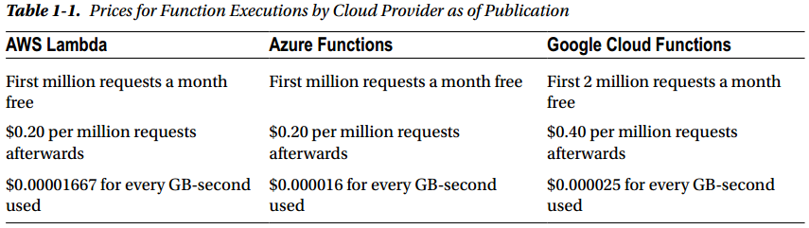
Benefits and Use Cases
Ease of use
Testing, logging, and versioning are all possibilities with serverless technology and they are all managed by the cloud provider. These built in features and services allow the developer to focus on the code and outcome of the application.
Lower cost
For serverless solutions, you are charged per execution rather than the existence of the entire applications. This means you are paying for exactly what you’re using. Additionally, since the servers of the application are being managed and autoscaled by a cloud provider, they also come at a cheaper price than what you would pay in house.

Slide 10
Limits to Serverless Computing
You want control of your infrastructure.
You’re designing for a long-running server application.
You want to avoid vendor lock-in.
You are worried about the effect of “cold start.”
You want to implement a shared infrastructure.
There are a limited number of out-of-the-box tools to test and deploy locally.
Serverless Framework, not to be confused with serverless architecture, is an open source application framework that lets you easily build serverless architectures. This framework allows you to deploy auto-scaling, pay-per-execution, event-driven functions to AWS, Azure, Google Cloud.
One of the limitations to the growth of serverless architectures is the limited number of testing and deployment tools. This is anticipated to change as the serverless field grows, and there are already some upand-coming tools that have helped with deployment.
Serverless Framework deployment tool. It is compatible with AWS, Azure, Google, and IBM. I like it because it makes configuring and deploying your function to your given provider incredibly easy, which also contributes to a more rapid development time.

Slide 11
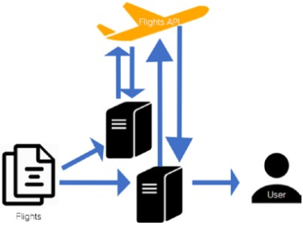
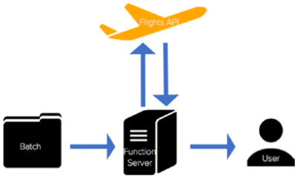
Limits to Serverless Computing
Long-Running Server Application
One of the benefits of serverless architectures is that they are built to be fast, scalable, event-driven functions. Therefore, long-running batch operations are not well suited for this architecture. Most cloud providers have a timeout period of five minutes, so any process that takes longer than this allocated time is terminated. The idea is to move away from batch processing and into real-time, quick, responsive functionality.
The configuration of a flight monitoring application that uses functions and an API trigger to
monitor and update flights

Slide 12
Limits to Serverless Computing
Control of your infrastructure
Control of Infrastructure A potential limit for going with a serverless architecture is the need to control infrastructure. While cloud providers do maintain control and provisioning of the infrastructure and OS, this does not mean developers lose the ability to determine pieces of the infrastructure.
Within each cloud provider’s function portal, users have the ability to choose the runtime, memory, permissions, and timeout. In this way the developer still has control without the maintenance.
Vendor Lock-In
serverlessframework.com
Companies worry that by committing to using Lambda, they are committing to AWS and either will not be able to move to another cloud provider or will not be able to afford another transition to a cloud provider.
While this is understandable, there are many ways to develop applications to make a vendor switch using functions more easily. A popular and preferred strategy is to pull the cloud provider logic out of the handler files so it can easily be switched to another provider.

Slide 13
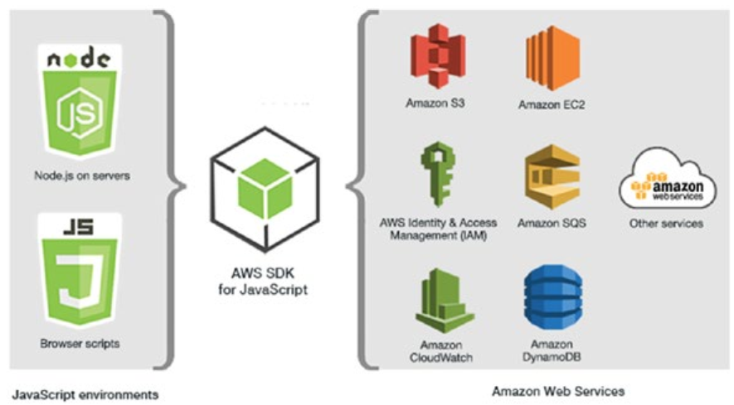
AWS Lambda November 2014
NPM (node package manager)
Lambda functions are built independently from other resources but are required to be assigned to an IAM (Identity and Access Management) role(Roles, Policies, and Users). This role includes permissions for CloudWatch, which is AWS’s cloud monitoring and logging service.
AWS UI
What Are Triggers?
Triggers are simply events. They are services and HTTP requests that create events to wake up the functions and initiate a response. Triggers are usually set within the function console or the command-line interface and are typically created within the same cloud provider’s environment. A function must have exactly one trigger. In AWS a trigger can be an
HTTP request or an invocation of another AWS service.
AWS SDK
Software development kits (SDKs) are powerful tools for
developing serverless applications.
```npm install aws-sdk```
```npm install –g serverless```
the Serverless Framework is a powerful deployment and
development tool.

Slide 14
Example
For our first fleshed-out serverless application with Lambda, we are going to use AWS API Gateway to trigger a Lambda function that returns data from a DynamoDB NoSQL Database. API Gateway allows you to create HTTP resources and methods and set them to specific endpoints.
This application will mimic a virtual recipe book. We will create an API Gateway with one resource,
Recipes, and one method for that resource, GET. For the endpoint to this GET request, we will set a Lambda function we create, called GetRecipes. This function will access a DynamoDB table that we will have prepopulated with recipes and return a JSON value of these recipes as the response. Before setting up our API Gateway, we will go ahead and create our Lambda function, leaving the trigger and code blank for now. Once you have done this, you can move on to exploring API Gateway.
An HTTPTrigger project with a Shared folder and a GetRecipes folder. The GetRecipes folder will hold our handler.js file, which will be triggered by the GET request. The Shared folder contains a Recipes model that defines the structure of the incoming request.
The recipeModel.ts file is used to format requests and responses so they match the structure of our DynamoDB table.
The handler.ts function takes in the HTTP event and responds to it by reaching into DynamoDB and grabbing the full list of recipes.
Import the AWS SDK and RecipeModel.
Create a DynamoDB client to communicate with the table.
Utilize environment variable for the table name (We will set this variable in AWS).
Set the response of the message.
Create the table connection with parameters (table name, expressions, attributes).
Format response to scan

Slide 15
Example
A separate Lambda function triggered by a storage event. a storage event to trigger a Lambda function that responds to the PUT request. The purpose of this application will build from our previous recipe example. Now, we would like to provide pictures of our recipes along with a description, meal, and prep time. To do this, we will use S3 (Simple Storage Service) as our trigger, and a Lambda function that appends a recently uploaded image’s URL to the recipe it is associated with.
From the Lambda console, create a Lambda function called UpdateRecipe. This Lambda function will
receive events from S3 as an object is uploaded (PUT). It will then update the corresponding object’s recipe with an image URL.
Parse the incoming request to gather the key from the image.
Set the Image ID to the Key ID to search DynamoDB and find the correct recipe.
Your bucket ARN is the beginning of the S3 object image URL. Use this and the name of the image to set the URL in the DynamoDB table.
Finally, return the status of the execution.
You learned how to navigate the console, configure Lambda functions, and assign triggers, as well as how to build a couple services to both trigger and respond to Lambda functions. You should now have a good handle on how Lambda functions operate and the power they have within AWS. You should also have a more applicable understanding of serverless functions as a whole and how they can be used.

