Slide 1
The MIPS R10000 Superscalar Microprocessor
Kenneth C. Yeager
Nishanth Haranahalli
February 11, 2004

Slide 2
A superscalar processor is one that can fetch, execute an complete more than one instruction in parallel.
The Microprocessor without Interlocked Pipeline Stages R10000 superscalar processor fetches and decodes four instructions per cycle and issues them to five-fully pipelined low latency execution units.
The Instructions are fetched and executed speculatively beyond branches.

Slide 3
Features
The R10000 processor is a single-chip superscalar RISC processor that
fetches & decodes four instructions per cycle, appending them to one of three instruction queues
Speculatively executes beyond branches, with a four-entry branch stack.
Dynamic Execution Scheduling and out-of-order execution.
implements the 64-bit MIPS IV instruction set architecture.
it uses a precise exception model (exceptions can be traced back to the
instruction that caused them)
Five independent pipelined executions include
nonblocking load/store unit
Two 64-bit integer ALU’s
Floating point adder
Floating point multiplier
Floating point divide & square root
The hierarchical, non-blocking memory subsystem includes
• Separate on-chip 32-Kbyte primary instruction and data caches
• External secondary cache and System interface ports
• 64-bit multiprocessor system interface

Slide 4
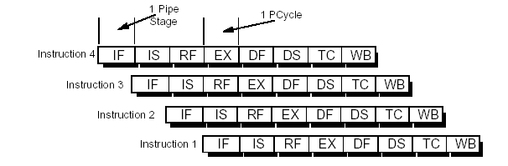
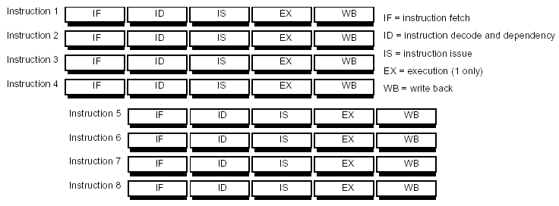
Previous MIPS processors had linear pipeline architectures; an example of such a linear pipeline is the R4400 pipeline. In R4400 pipeline architecture, an instruction is executed each cycle of the pipeline clock.
The structure of 4-way superscalar pipeline At each stage, four instructions are handled in parallel.

Slide 5
Design Rationale
R10000 implements register mapping & nonblocking caches. If an instruction misses the cache, it must wait until the operand to be refilled, but other instructions can continue out of order. This reduces effective latency, because refills begin early and up to four refills proceed in parallel.
R10000 design includes complex hardware that dynamically reorders instruction execution based on operand availability. The processor looks ahead up to 32 instructions to find possible parallelism. This window is large enough to hide memory refills from secondary cache.

Slide 6
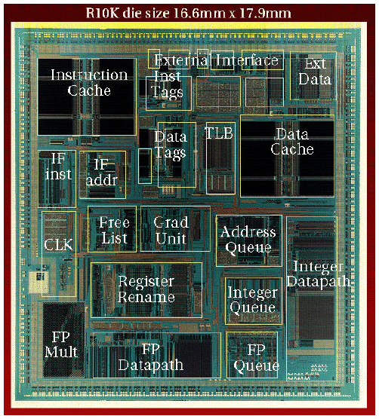
Hardware Implementation
  0.35um CMOS technology
  16.64 X 17.934 mm chip
  298 mm²
  6.8 million transistors

Slide 7
Operation overview
Stage 1 - Fetching
Stage 2 - Decoding
Stage 3 - Issuing Instructions
Stage 4 - Stage 6 execution stage
  Integer - one stage
  Load - two stage
  Floating-point - three stage
  Writes results into the register file - first half of the next stage
Stage 7 - Storing Results

Slide 8
Instruction fetch
Instruction fetching is the process of reading instructions
from the instruction cache.
The Processor fetches four instructions in parallel at any
word alignment within 16-word instruction cache line.
R10000 fetches unaligned instructions using separate
select signal for each instruction. These instructions rotate
If necessary, so that they are decoded in order.

Slide 9
Branch Unit
Prediction (fetches instructions speculatively along predicted path)
  2-bit algorithm based on a 512-entry branch history table
  87% prediction accuracy for Spec92 integer programs
Branch stack
  When it decodes a branch, the processor saves its state in a four-entry branch stack
  Contains
    Alternate branch address
    complete copies of the integer and floating-point map tables, control bits
Branch verification - If the prediction was incorrect
  The processor immediately aborts all instructions fetched along the mis-predicted path and restores its state from the branch stack

Slide 10
Instruction Decode
Decodes and maps four instructions in parallel during stage 2 and writes them into the appropriate instruction queue.
  Stops if the active list or a queue becomes full
  Few decode instructions depend on type of
  instructions being decoded.
  Instructions that modify/read control registers are
  executed serially.

Slide 11
Register Renaming
Register renaming is used to resolve register dependencies during the dynamic execution of instructions. It determines memory address dependencies in the address queue.
Each time a new value is put in a logical register, it is assigned to a new physical register.
Each physical register has only a single value. Dependencies are determined
using these physical register numbers.
Register map tables
  Integer – 33X6 bit RAM (r1 – r31, Hi and Lo)
  Floating-point – 32X6 bit RAM (f0 – f31)
  5-bit logical to 6-bit physical address mapping
Free lists
  Lists of currently unassigned physical registers
  32 entry circular FIFO
    four parallel, eight-deep

Slide 12
Active list
  All instructions currently active in the machine kept in 32 entry FIFO
    four parallel, eight-deep
  Provides unique 5-bit tag for each instruction
  When execution unit completes an instruction, it sends its tag to the active list, which sets the done bit.
  Logical destination number
  Old physical register number
  When an exception occurs, subsequent instructions never graduate. Processor restores old mappings from the active list.
Busy-bit tables
  For each physical register (integer and floating-point)
  64X1 bit multiport RAM
  Indicate whether the register currently contains a valid value.
  The bit is set when the corresponding register leaves the free list.
  Resets the bit when execution unit writes a value into the register.

Slide 13
Instruction Queues
Each instruction decoded in stage 2 is appended to one of the three instruction queues.
• integer queue (the integer queue issues instructions to the two
integer ALU pipelines)
• address queue (the address queue issues one instruction to the
Load/Store Unit pipeline)
• floating-point queue (the floating-point queue issues instructions
to the floating-point adder and multiplier pipelines)

Slide 14
Integer Queue
The integer queue issues instructions to the two integer arithmetic units: ALU1 and ALU2.
The integer queue contains 16 instruction entries. Up to four instructions may be written during each cycle. The queue releases the entry as soon as it issues the instruction to an ALU.
Branch and shift instructions can be issued only to ALU1. Integer multiply and divide instructions can be issued only to ALU2. Other integer instructions can be issued to either ALU.
Integer queue contains three operand select fields; which contain physical register numbers. Each field contains a ready bit, initialized from busy bit table. The queue compares each select with the three destination selects corresponding to write ports in the integer register file. The queue issues the function code and immediate values to the execution units. The branch mask determines if the instruction aborted because of a mispredicted branch.

Slide 15
Floating point Queue
The floating-point queue issues instructions to the floating-point multiplier and
the floating-point adder.
The floating-point queue contains 16 instruction entries. Up to four instructions
may be written during each cycle; newly-decoded floating-point instructions are
written into empty entries in random order. Instructions remain in this queue
only until they have been issued to a floating-point execution unit.
Floating point loads have three-cycle latency.

Slide 16
Address Queue
The address queue issues instructions to the load/store unit. The address queue contains more complex control logic than the other queues.
The address queue contains 16 instruction entries. Unlike the other two queues, the address queue is organized as a circular First-In First-Out (FIFO) buffer. The decoded load/store instruction is written into the next available sequential empty entry; up to four instructions may be written during each cycle and removes the entry after that instruction graduates. The queue uses instruction order to determine memory dependencies and to give priority to the oldest instruction. The FIFO order maintains the program’s original instruction sequence so that memory address dependencies may be easily computed.
Instructions remain in this queue until they have graduated; they cannot be deleted immediately after being issued, since the load/store unit may not be able to complete the operation immediately.
When the processor restores a mispredicted branch, the address queue removes all instructions decoded after that branch from the end. Store instructions require special coordination between the address queue and active list. The queue must write data cache precisely when store instruction graduates.

Slide 17
Register Files
Integer register files
  64 registers
  7 read ports
  3 write ports
Floating-point register file
  64 registers
  5 read ports
  3 write ports
Execution units read operands directly from the register files and write results directly back.
A separate 64word*1bit condition file indicates if the value in the corresponding physical register is non-zero.

Slide 18
Functional Units
The five execution pipelines allow overlapped instruction execution by issuing instructions to the following five functional units:
• two integer ALUs (ALU1 and ALU2)
• the Load/Store unit (address calculate)
• the floating-point adder
• the floating-point multiplier
• Integer multiply and divide operations are performed by an Integer
Multiply/Divide execution unit; these instructions are issued to ALU2.
ALU2 remains busy for the duration of the divide.
• Floating-point divides are performed by the Divide execution unit;
these instructions are issued to the floating-point multiplier.
• Floating-point square root are performed by the Square-root execution
unit; these instructions are issued to the floating-point multiplier.

Slide 19
Integer ALU’s
During each cycle, the integer queue can issue two instructions to the integer execution units
  Each of the two integer ALUs contains a 64-bit adder and a logic unit. In addition,
    ALU 1 - 64-bit shifter and branch condition logic
    ALU 2 – a partial integer multiplier array and integer-divide logic
Integer multiplication and division
    Hi and Lo registers
      Multiplication – double-precision product
      Division – remainder and quotient
    Algorithm
      Multiplication – Booth’s algorithm
      Division – nonrestoring algorithm

Slide 20
Floating-point execution units
All floating-point operations are issued form the floating-point queue
Values are packed in IEEE std 754 single or double precision formats in the floating-point register file
  Operands are unpacked as they are read and results are packed before they are written back.
It has a 64-bit parallel multiply unit which also performs move
instructions.
• it has a 64-bit add unit which handles addition, subtraction, and
miscellaneous floating-point operations
• it has separate 64-bit divide and square-root units which can operate
concurrently.
Algorithm
Multiplication – Booth’s
Divide & Square root – SRT algorithm

Slide 21
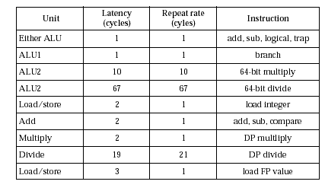

Slide 22
Memory Hierarchy
To run large programs effectively, the R10000 implements a non-blocking memory hierarchy with two levels of caches.
Memory address Translation.
- It has a 44-bit virtual address calculation unit.
- Converts 44-bit virtual address to 40-bit Physical address.
- It has a 64-entry Translation-Lookaside Buffer (TLB).
Address Calculation.
The R10000 calculates virtual memory address as the sum of two.
64-bit registers or sum of a register and a 16-bit immediate field.

Slide 23
Primary Instruction Cache (I-cache)
• It contains 32 Kbytes
• It reads four consecutive instructions per cycle, beginning on any
word boundary within a cache block, but cannot fetch across a block
boundary.
• Its instructions are predecoded, appended with 4-bit execution identification
bits.
Primary Data Cache (D-cache)
• It has two interleaved arrays (two 16 Kbyte banks)
• It contains 32 Kbytes
• It handles 64-bit load/store operations
• It handles 128-bit refill or write-back operations
• It permits non-blocking loads and stores.
Secondary cache
128 b wide interface
512KB–16 MB

Slide 24
System interface
64-bit split-transaction system bus with multiplexed address and data
Up to four R10000 chips can directly connected a cluster
Overlaps up to eight read request
Substantial resources are allocated to support concurrency and oit-of-order
operation.
Eight entry cluster buffer tracks all outstanding operations on the system bus.
Clock
  Pipeline clock – 200 MHz
  System interface bus - 50 ~ 200MHz
  Secondary cache – 66.7 ~ 200MHz
Test features
  Observes internal signal with ten 128-bit linear-feedback shift registers

Slide 25
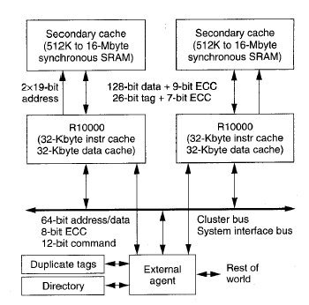
System Configuration

Slide 26
Summary
MIPS R10000 is
  Dynamic, superscalar RISC processor
  Fetches/decodes four instructions per cycle
  Speculatively executes
  Dynamic out-of-order execution
  Register renaming using map table
  Future Work
  Pipelines operating at faster clock rates
  Latency reduction
  To Split Integer Multiplication & division as separate blocks
  To reduce the repeat cycle rate.

