Slide 1
THE MIPS R10000 SUPERSCALAR MICROPROCESSOR
Kenneth C. Yeager
IEEE Micro in April 1996
Presented by Nitin Gupta

Slide 2
Presentation Outline
Motivation
Overview of the processor
Selected topics
  Branch Unit
  Register Renaming
  Instruction Queues
  Execution Units
Conclusion

Slide 3
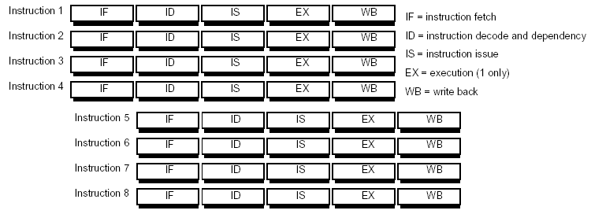
What is Superscalar Processor?

Slide 4
Why Superscalar Processor?
CPI < 1
  Allow multiple instructions to execute
  Out of order execution
    Dynamic execution of instructions based on operand availability
    Initiate cache refill early
    Improve memory bandwidth and latency
    Non-blocking caches

Slide 5
What are the problems?
Need Multiple Execution Units (Multiple Pipelines)
Structural Hazards:
  Need multiple simultaneous accesses to register files.
  Need multiple simultaneous accesses to caches
Data Hazards:
  How to deal with RAW hazards
  How to deal with WAR and WAW hazards
  What to do with stalled instructions.
Control Hazards:
  What to do with conditional branches

Slide 6
What is the solution?
Multiple pipelines : We already have them
Structural Hazards: Build register files, caches with many read and write ports
Data Hazard Solutions
  Issue instruction in-order
  Execute instructions out-of-order
  Use register renaming to avoid data hazards
  Graduate instructions in-order
Control Hazard Solution
  Use Branch Prediction
  Use speculative Execution

Slide 7
MIPS R10000
Four way superscalar RISC processor
  Fetch & decode - 4 instruction/cycle
  Speculative execution beyond branches
    Four-entry branch stack
  Dynamic out-of-order execution
  Register renaming using map tables
  In-order graduation for precise exceptions
  Five pipelined execution units
  Non-blocking caches

Slide 8
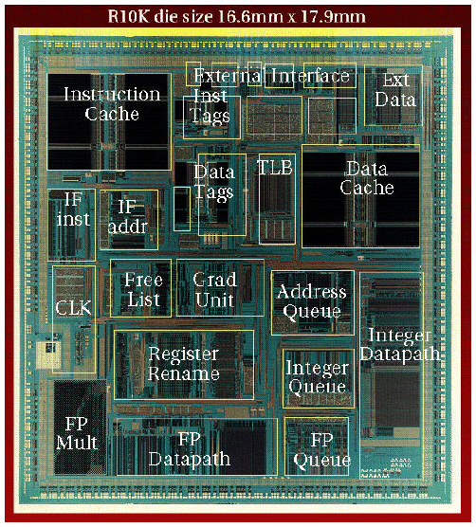
Implementation
Shipped in 1996
0.35-µm CMOS technology
298-mm² chip
6.8 million transistors
  4.4 million cache
  2.4 million logic

Slide 9
System Flexibility
As a uniprocessor or in a multiprocessor cluster
Maintains cache coherency using either snoopy or directory-based protocols
Cache range
  From 512Kbytes to 16Mbytes (secondary cache)

Slide 10
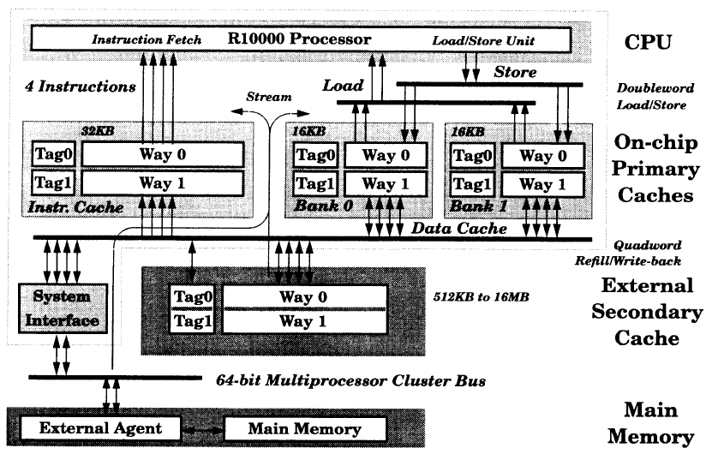
Memory hierarchy

Slide 11
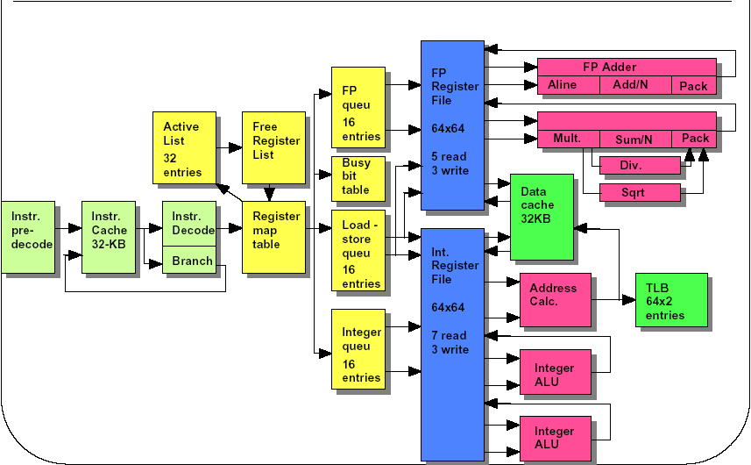
R10000 Block Diagram

Slide 12
Operation overview
Stage 1
  fetches next four instructions
Stage 2
  decodes and renames these instructions
  calculate target address for branch instructions
Stage 3
  writes the renamed instructions into the queue
  reads the busy-bit table to determine if the operands are busy
    Instructions wait in the queues until all their operands are ready

Slide 13
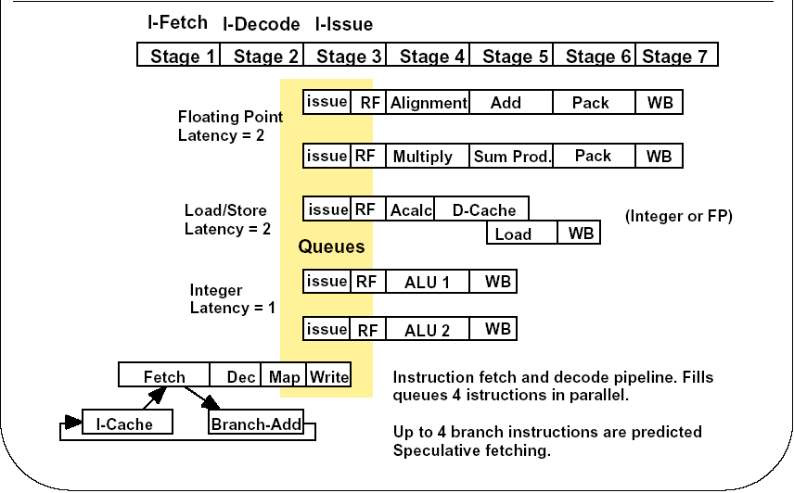
Pipeline Architecture

Slide 14
Operation overview
Stage 3 Contd..
  Queue issues the instruction
  Execution Unit reads the register file in second half of this cycle
Stage 4 ~ execution stage
  Integer – one stage
  Load – two stage
  Floating-point – three stage
Stage ~ write back
  Writes results into the register file – first half of this stage

Slide 15

Instruction Predecode
32 bit instruction in memory to 36 bit instruction in I-cache
Rearranges opcodes & operands

Slide 16

Branch unit
Control dependencies can become the limiting factor
  Branch instruction will come 4 times faster
  Amdahl’s Law – Impact for control stalls would be larger

Slide 17
Branch unit
Prediction
  2-bit algorithm based on a 512-entry branch history table
    87% prediction accuracy for Spec92 integer programs
  Do not commit instructions until branches are resolved
  Roll back results if branches were predicted wrong

Slide 18
Branch unit
Branch stack
  When it decodes a branch, the processor saves its state in a four-entry branch stack
  Contains
    Alternate branch address
    Complete copies of the integer and floating-point map tables
Branch verification - If the prediction was incorrect
  Aborts all instructions fetched along the mispredicted path and restores its state from the branch stack
  Doesn’t abort unneeded cache refills

Slide 19
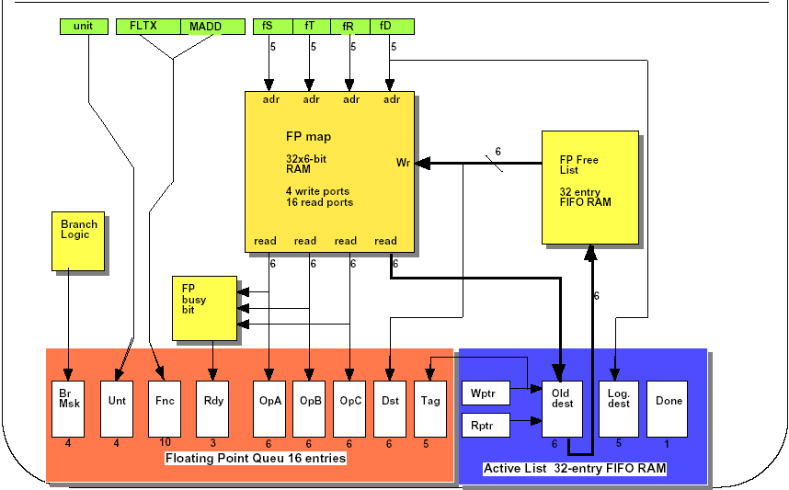
Register Renaming

Slide 20
Register Renaming
32 logical register and 64 physical registers
Convert 5-bit logical register numbers to 6-bit physical register numbers
  Eliminates WAR and WAW hazard
Register map tables
  Integer – 33X6 bit RAM (Hi and Lo)
  Floating-point – 32X6 bit RAM
Free lists
  Lists of currently unassigned physical registers

Slide 21
Register Renaming
Active list
  All instructions “in flight” in the machine kept in 32 entry FIFO
    Logical destination number
    Old physical register number
    Done bit
  Provides unique 5-bit ID for each instruction
  Operates like a reorder buffer
Busy-bit tables
  Indicate whether the physical register currently contains a valid value

Slide 22
Instruction queues
Integer and Floating-point queue
  16 entries, no order
  Releases the entry as soon as it issues the instruction to ALU
  When all operands are ready, the queue can issue the instruction to an execution unit
  Ten 16 bit comparator per entry for RAW hazard
Address queue
  Circular FIFO that preserves the original program order
  Load or store instruction may not complete immediately
    Memory dependency or cache miss
  Removes the entry only after the instruction graduates

Slide 23
Integer execution units
During each cycle, the integer queue can issue two instructions to the integer execution units
  Each of the two integer ALUs contains a 64-bit adder and a logic unit. In addition,
    ALU 1 - 64-bit shifter and branch condition logic
    ALU 2 – a partial integer multiplier array and integer-divide logic
Integer multiplication and division
    Hi and Lo registers
      Multiplication – double-precision product
      Division – remainder and quotient

Slide 24
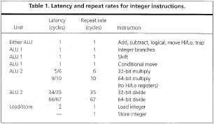
Integer execution units

Slide 25
Floating-point execution units
All floating-point operations are issued from the floating-point queue
Values are packed in IEEE std 754 single or double precision formats

Slide 26
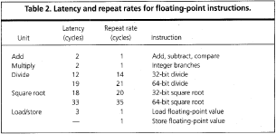
Floating-point execution units

Slide 27
Conclusions
Simple RISC ISA doesn’t imply simpler implementation.
  Simultaneous Multithreading next
Still x86 microprocessor’s dominate the market
  A good design alone doesn’t guarantee bigger market share

Slide 28
Thank You!
References:
  MIPS R10000 Microprocessor User’s Manual
  kedem.cs.duke.edu/cps220/Lectures/ lecture09.pdf

