Slide 1



Slide 2
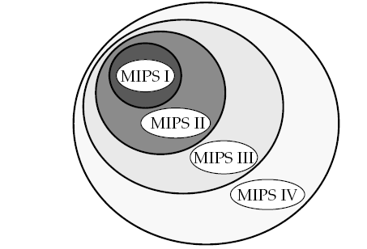
The original MIPS I CPU ISA has been extended forward three times
The practical result is that a processor implementing MIPS IV is also able to run MIPS I, MIPS II, or MIPS III binary programs without change.

Slide 3
MIPS is implemented in the following sets of CPU designs:
• MIPS I, implemented in the R2000 and R3000
• MIPS II, implemented in the R6000
• MIPS III, implemented in the R4400
• MIPS IV, implemented in the R8000 and R10000

Slide 4
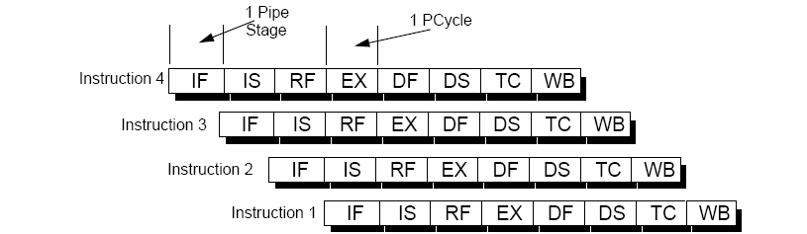
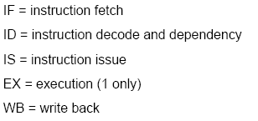
Pipeline and Superpipeline Architecture
R4400 Pipeline
Previous MIPS processors had linear pipeline architectures
Example of such a linear pipeline is the R4400 superpipeline
In the R4400 Superpipeline architecture, an instruction is executed each cycle of the pipeline clock (PCycle), or each pipe stage

Slide 5
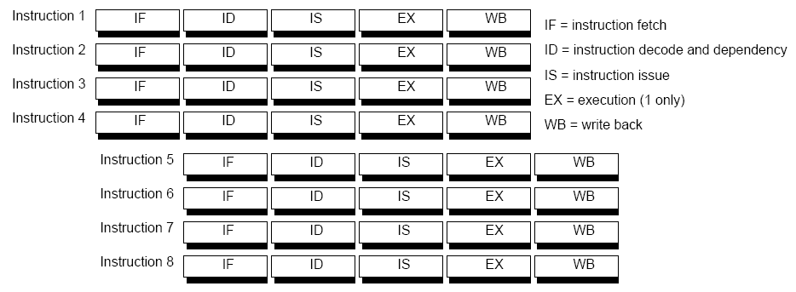
What is a Superscalar Processor?
A superscalar processor is one that can fetch, execute and complete more than one instruction in parallel.
At each stage, four instructions are handled in parallel.
The structure of 4-way superscalar pipeline is shown in Figure

Slide 6
The R10000 processor has the following major features
• It implements the 64-bit MIPS IV instruction set architecture (ISA)
• It can decode four instructions each pipeline cycle, appending them to
one of three instruction queues
• It has five execution pipelines connected to separate internal integer and
floating-point execution (or functional) units
• It uses dynamic instruction scheduling and out-of-order execution

Slide 7
• It uses a precise exception model (exceptions can be traced back to the instruction that caused them)
• It uses non-blocking caches
• It has separate on-chip 32-Kbyte primary instruction and data caches
• It has individually-optimized secondary cache and System interface
Ports
• It has an internal controller for the external secondary cache
• It has an internal System interface controller with multiprocessor
support

Slide 8
It uses speculative instruction issue (also termed “speculative branching”) (speculation is a means of hiding latency, Modern superscalar processors rely heavily on speculative execution for performance.
Speculation hides branch latencies and thereby boosts performance by executing the likely branch path without stalling. Branch predictors, which provide accuracies up to 96% are the key to effective speculation.

Slide 9
R10000 Superscalar Pipeline
The R10000 superscalar processor fetches and decodes four instructions in parallel each cycle (or pipeline stage).
Each pipeline includes stages for fetching (stage 1 )
decoding (stage 2)
Issuing instructions (stage 3)
Reading register operands (stage 3)
Executing instructions (stages 4 through 6)
Storing results(stage 7).

Slide 10
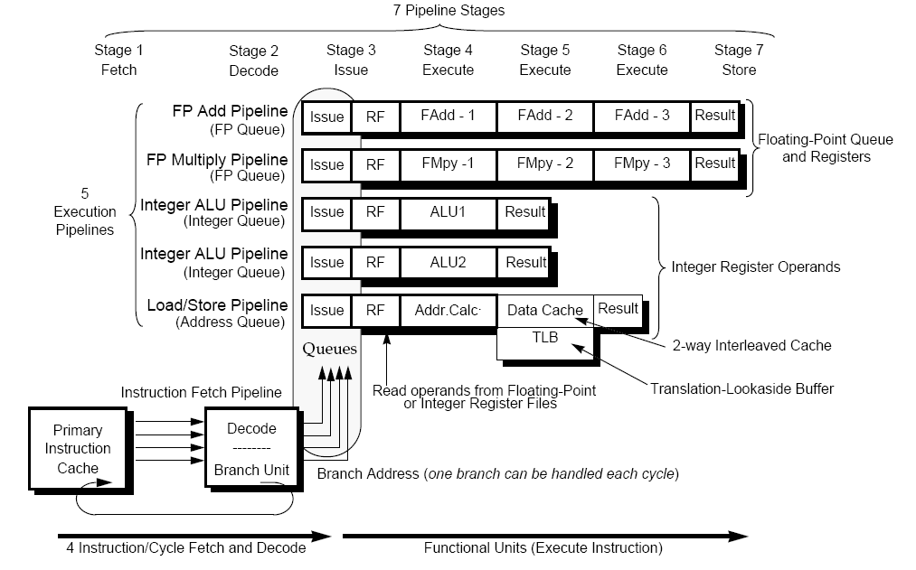
Superscalar Pipeline Architecture in the R10000

Slide 11
Instruction Queues
As shown in Figure, each instruction decoded in stage 2 is appended to one of three instruction queues:
• integer queue
• address queue
• floating-point queue
Execution Pipelines
The three instruction queues can issue one new instruction per cycle to each of the five execution pipelines:
• the integer queue issues instructions to the two integer ALU pipelines
• the address queue issues one instruction to the Load/Store Unit
pipeline
• the floating-point queue issues instructions to the floating-point adder
and multiplier pipelines
A sixth pipeline, the fetch pipeline, reads and decodes instructions from the instruction cache.

Slide 12
64-bit Integer ALU Pipeline
The 64-bit integer pipeline has the following characteristics:
• It has a 16-entry integer instruction queue that dynamically issues
Instructions
• It has a 64-bit 64-location integer physical register file, with seven read
and three write ports
• It has two 64-bit arithmetic logic units:
- ALU1 contains an arithmetic-logic unit, shifter, and integer
branch comparator
-ALU2 contains an arithmetic-logic unit, integer multiplier, and
divider

Slide 13
Load/Store Pipeline
The load/store pipeline has the following characteristics:
• It has a 16-entry address queue that dynamically issues instructions,
and uses the integer register file for base and index registers
• It has a 16-entry address stack for use by non-blocking loads and
Stores
• It has a 44-bit virtual address calculation unit
• It has a 64-entry fully associative Translation-Look aside Buffer (TLB), which converts virtual addresses to physical addresses, using a 40-bit physical address. Each entry maps two pages, with sizes ranging from 4 Kbytes to 16 Mbytes, in powers of 4.

Slide 14
64-bit Floating-Point Pipeline
The 64-bit floating-point pipeline has the following characteristics:
• It has a 16-entry instruction queue, with dynamic issue
• It has a 64-bit 64-location floating-point physical register file, with five
read and three write ports (32 logical registers)
• It has a 64-bit parallel multiply unit (3-cycle pipeline with 2-cycle
latency) which also performs move instructions
• It has a 64-bit add unit (3-cycle pipeline with 2-cycle latency) which
handles addition, subtraction, and miscellaneous floating-point
Operations
• It has separate 64-bit divide and square-root units which can operate
concurrently (these units share their issue and completion logic with
the floating-point multiplier)

Slide 15
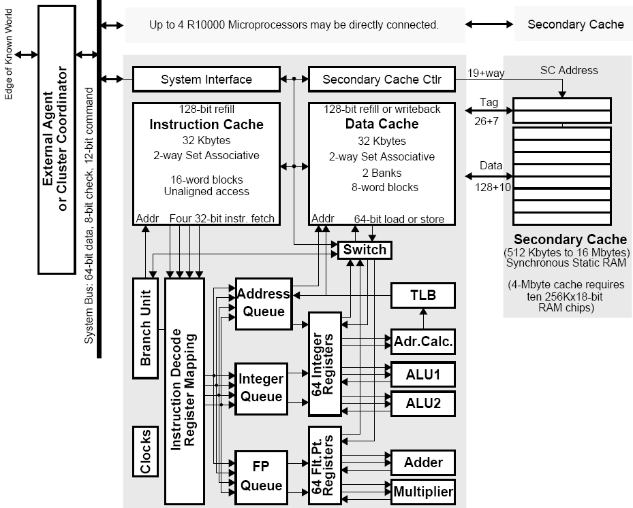
Block Diagram of
the R10000 Processor

Slide 16
Functional Units
The five execution pipelines allow overlapped instruction execution by issuing instructions to the following five functional units:
• Two integer ALU’s (ALU1 and ALU2)
• The Load/Store unit (address calculate)
• The floating-point adder
• The floating-point multiplier
There are also three “iterative” units to compute more complex results:
• Integer multiply and divide operations are performed by an Integer
Multiply/Divide execution unit; these instructions are issued to ALU2.
ALU2 remains busy for the duration of the divide.
• Floating-point divides are performed by the Divide execution unit;
these instructions are issued to the floating-point multiplier.
• Floating-point square root are performed by the Square-root execution
unit; these instructions are issued to the floating-point multiplier.

Slide 17
Primary Instruction Cache (I-cache)
The primary instruction cache has the following characteristics:
• It contains 32 Kbytes, organized into 16-word blocks, is 2-way set
associative, using a least-recently used (LRU) replacement algorithm
• It reads four consecutive instructions per cycle, beginning on any
word boundary within a cache block, but cannot fetch across a block
boundary.
• Its instructions are predecoded, its fields are rearranged, and a 4-bit
unit select code is appended
• It checks parity on each word
• It permits non-blocking instruction fetch

Slide 18
Primary Data Cache (D-cache)
The primary data cache has the following characteristics:
• It has two interleaved arrays (two 16 Kbyte ways)
• It contains 32 Kbytes, organized into 8-word blocks, is 2-way set
associative, using an LRU replacement algorithm.
• It handles 64-bit load/store operations
• It handles 128-bit refill or write-back operations
• It permits non-blocking loads and stores
• It checks parity on each byte

Slide 19
Instruction Decode And Rename Unit
The instruction decode and rename unit has the following characteristics:
• It processes 4 instructions in parallel
• It replaces logical register numbers with physical register numbers
(register renaming)
- It maps integer registers into a 33-word-by-6-bit mapping table
that has 4 write and 12 read ports
- It maps floating-point registers into a 32-word-by-6-bit mapping
table that has 4 write and 16 read ports
• It has a 32-entry active list of all instructions within the pipeline.

Slide 20
Branch Unit
The branch unit has the following characteristics:
• It allows one branch per cycle
• Conditional branches can be executed speculatively, up to 4-deep
• It has a 44-bit adder to compute branch addresses
• It has a 4-quadword branch-resume buffer, used for reversing mispredicted speculatively-taken branches

Slide 21
Instruction Queues
The processor keeps decoded instructions in three instruction queues, which
dynamically issue instructions to the execution units.
The queues allow the processor to fetch instructions at its maximum rate, without stalling because of instruction conflicts or dependencies.
Each queue uses instruction tags to keep track of the instruction in each execution pipeline stage.
These tags set a Done bit in the active list as each instruction is completed.

Slide 22
Integer Queue
The integer queue issues instructions to the two integer arithmetic units: ALU1 and ALU2.
The integer queue contains 16 instruction entries. Up to four instructions may be written during each cycle; newly-decoded integer instructions are written into empty entries in no particular order. Instructions remain in this queue only until they have been issued to an ALU.
Branch and shift instructions can be issued only to ALU1. Integer multiply and divide instructions can be issued only to ALU2. Other integer instructions can be issued to either ALU.
The integer queue controls six dedicated ports to the integer register file: two operand read ports and a destination write port for each ALU.

Slide 23
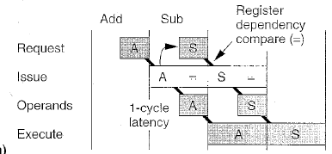
Releasing Register Dependency In Integer Queue
In the one cycle queue must issue two instruction.
Find out which operands will be ready
Request dependent instructions

Slide 24
Floating-Point Queue
The floating-point queue issues instructions to the floating-point multiplier and
the floating-point adder.
The floating-point queue contains 16 instruction entries. Up to four instructions may be written during each cycle; newly-decoded floating-point instructions are
written into empty entries in random order. Instructions remain in this queue
only until they have been issued to a floating-point execution unit.
The floating-point queue controls six dedicated ports to the floating-point register
file: two operand read ports and a destination port for each execution unit.
The floating-point queue uses the multiplier’s issue port to issue instructions to
the square-root and divide units. These instructions also share the multiplier’s
register ports.

Slide 25
Address Queue
The address queue issues instructions to the load/store unit.
The address queue contains 16 instruction entries. Unlike the other two queues,
the address queue is organized as a circular First-In First-Out (FIFO) buffer. A
newly decoded load/store instruction is written into the next available sequential
empty entry; up to four instructions may be written during each cycle.
The FIFO order maintains the program’s original instruction sequence so that
memory address dependencies may be easily computed.
Instructions remain in this queue until they have graduated; they cannot be
deleted immediately after being issued, since the load/store unit may not be able
to complete the operation immediately.
The address queue contains more complex control logic than the other queues.
An issued instruction may fail to complete because of a memory dependency, a cache miss, or a resource conflict; in these cases, the queue must continue to reissue the instruction until it is completed.

Slide 26
Register Files
Integer and floating point register files each contain 64 physical registers.
Execution units read operands from the register files and write directly back.
Integer Register File:
7 Read ports and 3 Write ports
2 dedicates read ports and one dedicated write port to each ALU
2 dedicated read ports to Address Calculation Unit.
Seventh read port handles store,jump register and move to floating point instructions.
Third write port handles load,branch-and-link, and move from floating point instructions.
Floating Point Register File:
5 read and 3 write ports
Adder and multiplier each have two dedicated read ports and one dedicated write port.
Fifth read port handles store and move instructions
Third write port handles load and move instructions

Slide 27
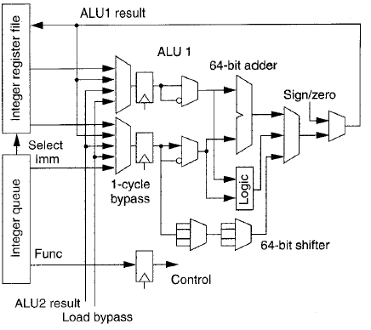
ALU Block Diagram
Each of the two integer ALU’s contains a 64 bit adder and a logic unit
ALU1 contains a 64-bit shifter and branch conditional logic.
ALU 2 contains partial integer multiplier and integer divide logic.

Slide 28
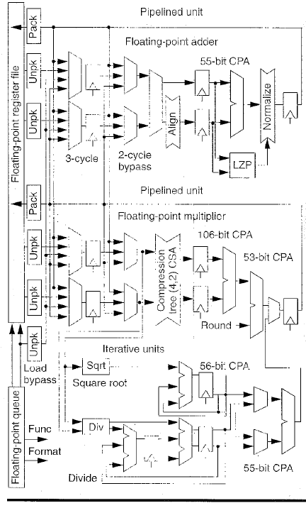
Floating Point Execution Unit Block Diagram

Slide 29
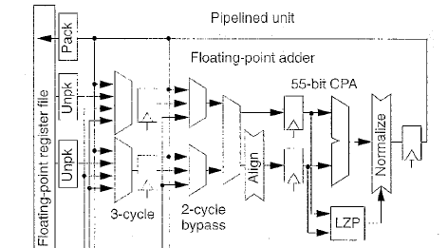
Floating point adder
The adder does floating point addition, subtraction, compare and
conversion operations.
In first stage subtracts the operand exponents, selects the larger operand, and aligns the smaller mantissa in a 55-bit right shifter.
The second stage adds or subtracts the mantissas, depending on the operation and signs of the operands.

Slide 30
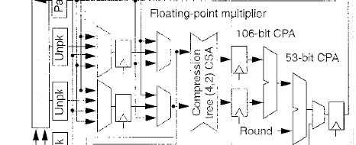
Floating point multiplier.
During the first cycle, the unit booth encodes the 53 bit mantissa of the multiplier and uses it to select 27 partial products.
A Compression tree uses an array of (4,2) carry save address(csa) which sum 4 bits into 2 sum and carry outputs.
During the second cycle the resulting 106 bit sum and carry values are combined using a 106 bit carry propagate adder .
A final 53 bit adder rounds the result.

Slide 31
Memory Hierarchy
To run large programs effectively , the R10000 implements a non blocking memory hierarchy with tow levels of set associative caches.
The chip also controls a large external secodary cache.
All chaches use a least recently used(LRU) replacement algorithm
Both primary chaches use a virtual address and a physical address stag.
To minimize latency the processor can access each primary cache concurrently with address translation in its TLB. This techniques simplifies the cache design.
Disadvantages:
It works well as long as the program uses consistent virtual index to reference the
Same page.
The secondary cache controller detects any violation and ensures that the primary caches retain a single copy of each cache line.

Slide 32
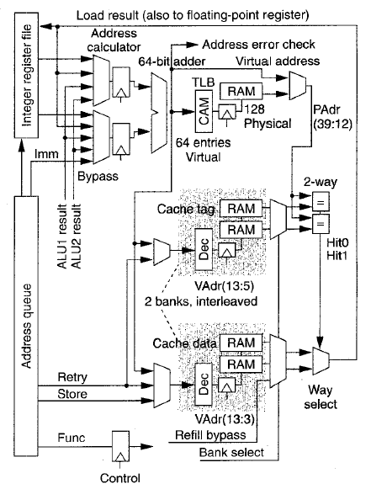
Address calculation unit and data cache block diagram

Slide 33
Load and Store unit
The address queue issues load and store instruction to address calculation unit and data cache.
When cache is not busy a load instruction simultaneously access the TLB, cache tag array and cache data array.
Address calculation
The R 10000 calculates virtual memory address as the sum of two 64-bit registers or the sum of the register and a 16-bit immediate field.
Results from the data cache or the ALU’s can bypass the register files into the operand registers.
The TLB translates the virtual address to physical address

Slide 34
Memory Address Translation
TLB translates the 44-bit virtual address to 40 bit physical address.
It can have 64 entries
Each entry maps the pair of virtual pages and independently selects the page size of any power of 4 between 4Kilobytes and 16Kbytes
TLB consists of Content addressable memory which compares virtual address, and a ram section which contains corresponding physical address

Slide 35
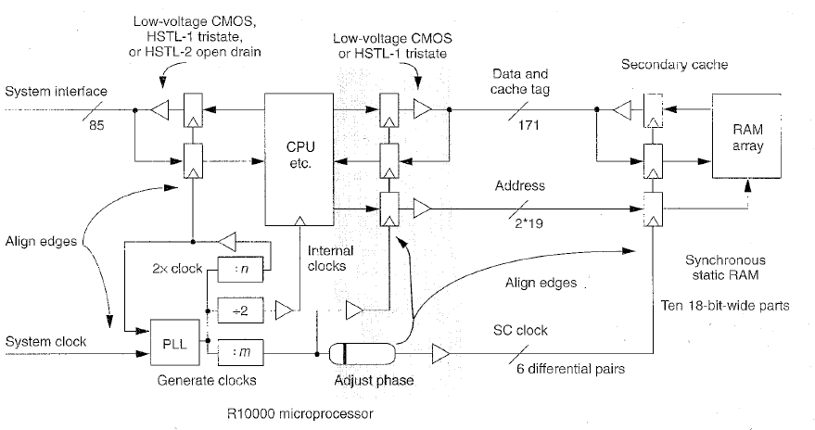
Clock And Output Drives

Slide 36
Clocks
An on chip phase locked loop generates all timing synchronously with an
External system interface clock.
System Interface
The R10000 communicates with the outside world using a 64 bit split transaction
System bus with multiplexed address and data.

Slide 37
Performance
An aggressive, superscalar microprocessor the R10000 features fast clocks and non blocking caches, set associative memory subsystem.
Its design emphasize concurrency and latency hiding techniques to effectively run large real world applications

Slide 38
References:
http://en.wikipedia.org/wiki/MIPS_architecture
http://techpubs.sgi.com/library/manuals/2000/007-2490-001/pdf/007-2490-001.pdf

Slide 39
Thank You

