Slide 1
Machine Learning a Transposable Element Classifier
Deep-learning classification of TEs from the Pantera VGP catalogue
Yingrui Yang Supervisor: Prof. Richard Durbin Day-to-day: Pio Sierra, Hadi Khan Department of Genetics, University of Cambridge | 2026
Machine Learning a TE Classifier | Yingrui Yang | Cambridge Genetics 2026
1

Slide 2
Outline
▪ Background: What are Transposable Elements?
▪ The Pantera Catalogue & Dataset
▪ Project Goals
▪ Model Architecture: CNN + GNN Hybrid
▪ Three-Stage Evaluation Protocol
▪ Stage 1 — Label Validation (v3, v4, v4.1)
▪ Stage 2 — Species-Disjoint Protocol (v4.3)
▪ k-mer Baseline & Attention Gating
▪ Stage 3 — Single-Fold Inner Split
▪ Mini-Benchmark: Cross-Species Transfer
▪ Interpretability: Saliency & Clustering (v5)
▪ Summary, Limitations & Future Directions
Machine Learning a TE Classifier | Yingrui Yang | Cambridge Genetics 2026
2

Slide 3
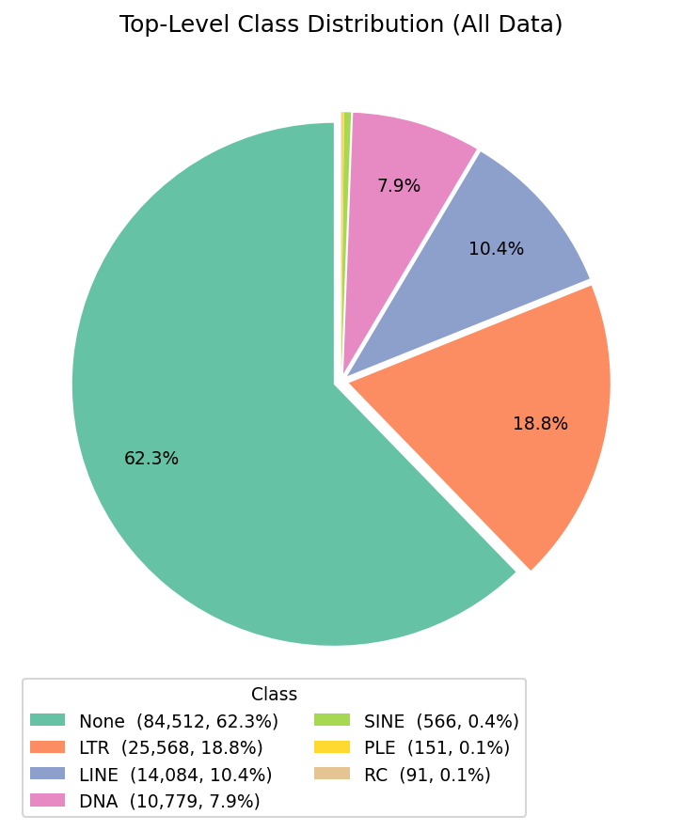
Background: What Are Transposable Elements?
Mobile DNA sequences that propagate within host genomes
"TEs are mobile DNA sequences capable of independently replicating within host genomes. They typically range in length from 100 to 10,000 bp. Along with viruses, TEs are the most intricate selfish genetic elements."
— Wells & Feschotte (2020) Annu Rev Genet
▪ ~50% of the human genome; 10–80%+ across vertebrates
▪ Autonomous elements encode mobilisation enzymes (transposase / reverse transcriptase)
▪ Non-autonomous elements parasitise the machinery of an active driver element
Hallmark sequence features by class:
Class I (Retrotransposons) · LTR: flanked by Long Terminal Repeats (200–600 bp)
Class I (Retrotransposons) · LINEs: poly-A tail, target-primed reverse transcription
Class II (DNA Transposons) · TIRs: Terminal Inverted Repeats (10–50 bp), cut-and-paste
Machine Learning a TE Classifier | Yingrui Yang | Cambridge Genetics 2026
3

Slide 4
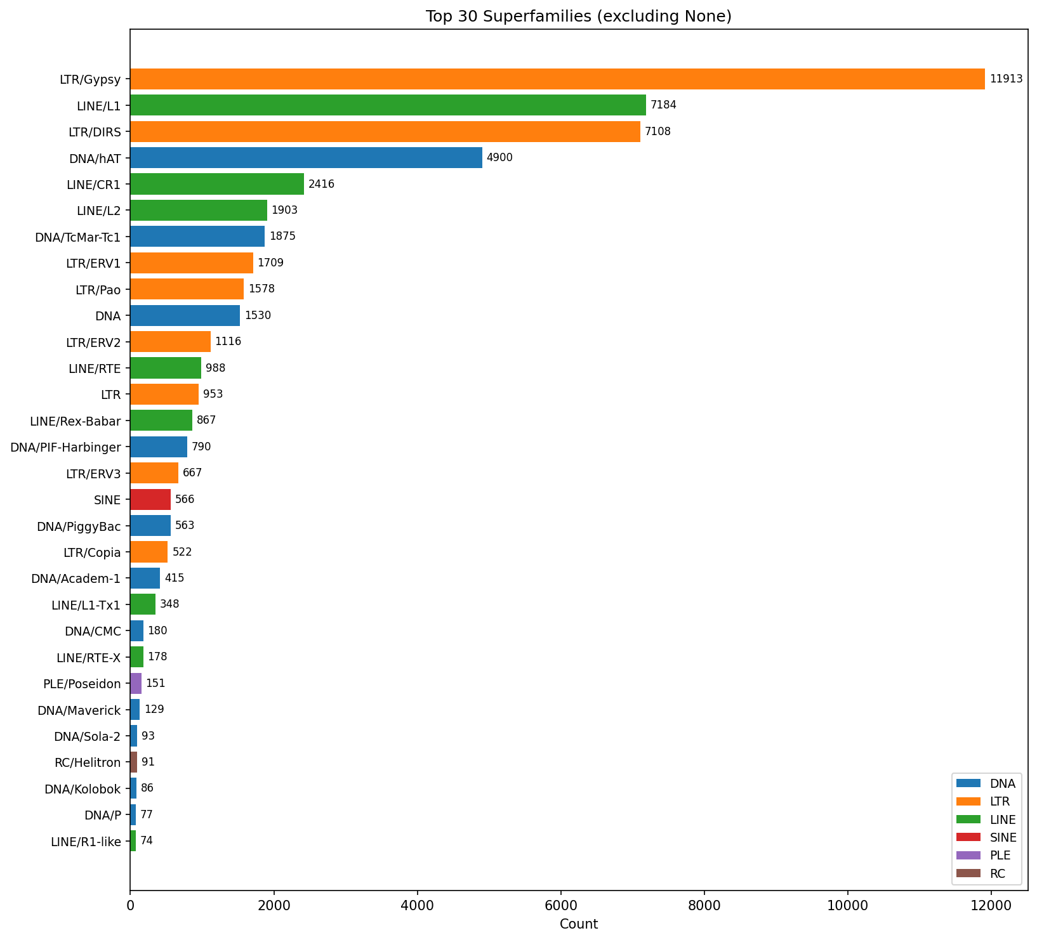
The Pantera Catalogue
Alignment-independent TE detection from pangenome polymorphisms (Sierra & Durbin 2024)
▪ Identifies TE families from insertions absent in some haplotypes
▪ Applied to Vertebrate Genomes Project (VGP): high-quality long-read assemblies
▪ 135,751 sequences from 509 unique species
▪ Sequence lengths: 173 bp – 19,907 bp (median 3,263 bp); heavily imbalanced across superfamilies
Why do we need a learned classifier?
▪ RepeatMasker / Dfam rely on curated libraries — miss divergent or novel families
▪ Non-autonomous elements are especially hard to assign to driver superfamilies
▪ Alignment scales poorly with long-read assembly volume from projects like VGP
Machine Learning a TE Classifier | Yingrui Yang | Cambridge Genetics 2026
4

Slide 5
Three-Stage Evaluation Protocol
Progressively stricter data splits — separating architecture effects from evaluation artefacts
Stage 1 Label Validation
Stage 2 Species-Disjoint Outer
Stage 3 Single-Fold Inner
Models:
Models:
Models:
v3, v4, v4.1
v4.2, v4.3
v4.3-singlefold
Outer split:
Outer split:
Outer split:
Sequence-level shuffle 80/20 ratio
Species-level shuffle + mini-benchmark excised
Same as Stage 2
→
→
Inner split:
Inner split:
Inner split:
Sequence rotating k-fold (k=5)
Species rotating k-fold (val species recycle → inflated!)
Single fixed species shuffle (fully disjoint throughout)
Train/val disjoint:
Train/val disjoint:
Train/val disjoint:
No
No (per epoch only)
Yes ✓
Train/test disjoint:
Train/test disjoint:
Train/test disjoint:
No
Yes
Yes ✓
Purpose:
Purpose:
Purpose:
Confirm labels carry learnable signal; identify mislabels
Measure cross-species generalisation; expose val leak
Most conservative estimate; val/test metrics aligned
Machine Learning a TE Classifier | Yingrui Yang | Cambridge Genetics 2026
7

Slide 6
Project Goals
▪ Build machine learning models to classify TE sequences collected by Pantera
▪ Implement CNN to capture local sequence motifs (TIR signals, internal repeats) via one-hot encoding
▪ Implement k-mer GNN to exploit global compositional patterns across the sequence
▪ Incorporate attention-based fusion to balance both modalities adaptively per input
▪ Design hierarchical classification heads (top-level class + superfamily) mirroring TE biology
▪ Evaluate cross-species generalisation with a species-disjoint mini-benchmark (3 amniote genomes)
▪ Use interpretability tools (saliency, contrastive clustering) to probe learned representations
Stretch: apply unsupervised / generative models to discover novel TE families and link non-autonomous elements to drivers.
Machine Learning a TE Classifier | Yingrui Yang | Cambridge Genetics 2026
5

Slide 7
Model Architecture: CNN + GNN Hybrid (v4)
Dual-branch encoder with attention gating and hierarchical classification heads
▪ CNN Tower: 3 parallel branches (kernels 7/15/21 bp, 128 maps) → 4 dilated blocks (dilation 1–8, GELU, BN, dropout 0.15, residual) → masked global-avg pool → 128-dim embedding
▪ GNN Branch: 512 bp windows (50% overlap) → canonical 7-mer histogram (2048-dim hash) → chain graph → 3-layer GraphSAGE → scatter-mean pool → 128-dim embedding
▪ Attention Gate: per-input 2-element softmax over CNN vs. GNN branches (convex combination, learned per sequence)
▪ RC Invariance: forward + reverse-complement views averaged before heads — no extra parameters
▪ Hierarchical Heads: top-level (binary or 3-class DNA/LTR/LINE) + superfamily head (7 or 23 classes, masked loss)
▪ Boundary Regression: auxiliary MLP predicts normalised start/end/length on canvas (MSE, weight 0.1)
Training Setup
• AdamW, lr = 1e-3, cosine annealing
• Batch: 16 (hybrid), 32 (CNN-only)
• Canvas: 40 kb, random placement
• Dropout: 0.15, label smooth: 0.1
• Early stop: patience 10, cap 40 ep
• Hardware: Apple MPS / NVIDIA A100
• Framework: PyTorch 2.0+
Machine Learning a TE Classifier | Yingrui Yang | Cambridge Genetics 2026
6

Slide 8
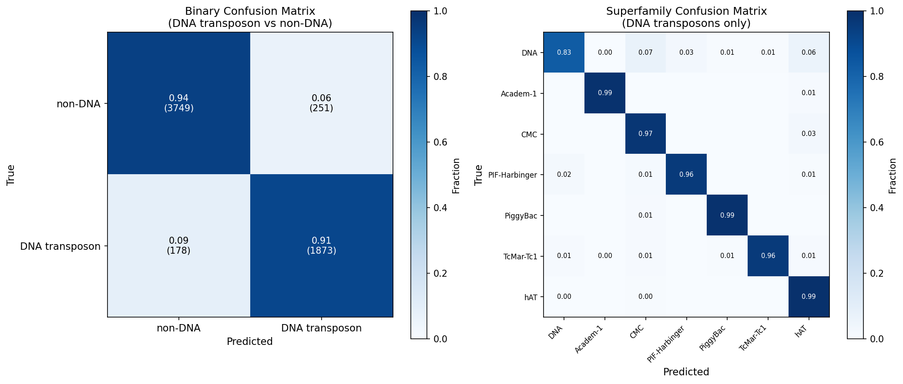
Stage 1 — Label Validation (v3, v4, v4.1)
Sequence-level split: confirms Pantera labels carry a strong learnable signal
Model Progression — Stage 1 (sequence-level test set)
Model
Task
Cls Acc
Cls F1
SF F1
v1 (CNN)
TIR detection (binary)
86%
0.86
—
v3 (CNN Tower)
DNA vs non-DNA + 7 DNA superfamilies
91.3%
0.87
0.90
v4 (CNN+GNN Hybrid)
DNA vs non-DNA + 7 DNA superfamilies
93.1%
0.89
0.96
v4.1 (Hybrid, 3-class)
DNA/LTR/LINE + 23 superfamilies
98.4%
0.984
0.872
Stage 1 is a label audit, not a generalisation estimate
Species overlap inflates test scores. Residual confusions (DNA/CMC, LINE/L1-Tx1) flag mislabelled sequences — enabling confident-learning-style curation of the Pantera catalogue.
Machine Learning a TE Classifier | Yingrui Yang | Cambridge Genetics 2026
8

Slide 9
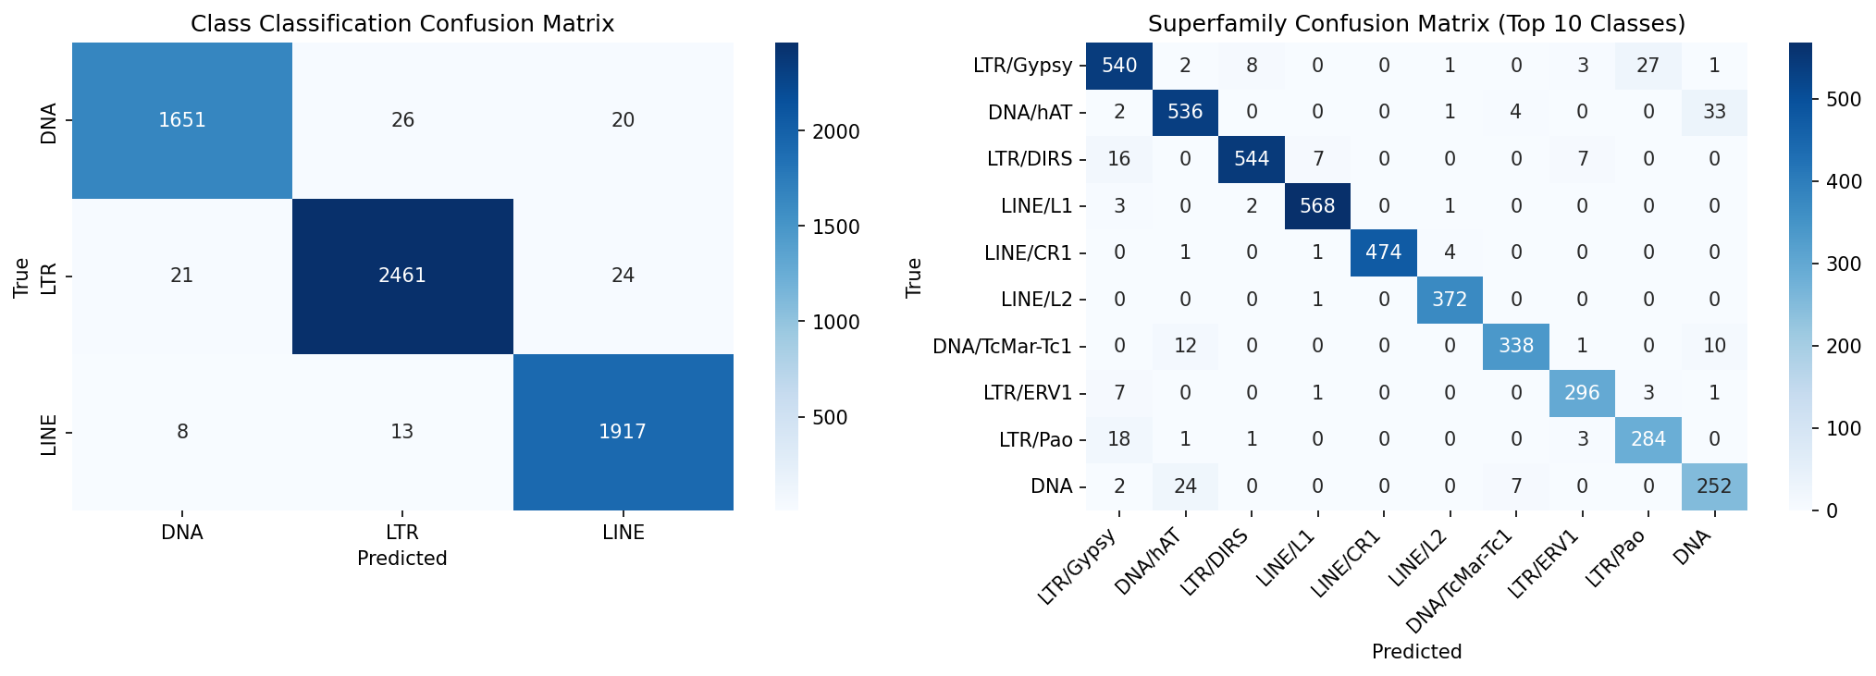
Stage 2 — Species-Disjoint Protocol (v4.3)
Outer split at species level; three amniote genomes excised as mini-benchmark
v4.3 — Species-disjoint Pantera test set
Three-class (DNA/LTR/LINE)
98.4%
0.982
Superfamily (23 classes)
89.3%
0.727
Per-class: DNA 0.978 | LTR 0.990 | LINE 0.978
—
—
⚠ DNA/hAT F1 = 0.92 is inflated by the rotating inner CV
Val species recycle into training across epochs → contaminated early-stopping signal. This apparent result collapses to F1 = 0.26 once the rotation is removed in Stage 3.
GNN gate converges to ~72% weight (three-class task):
Consistent with standalone 7-mer baseline: LR F1 = 0.855; near-chance within class (0.064–0.097). GNN provides the top-level compositional prior; CNN drives superfamily discrimination.
Machine Learning a TE Classifier | Yingrui Yang | Cambridge Genetics 2026
9

Slide 10
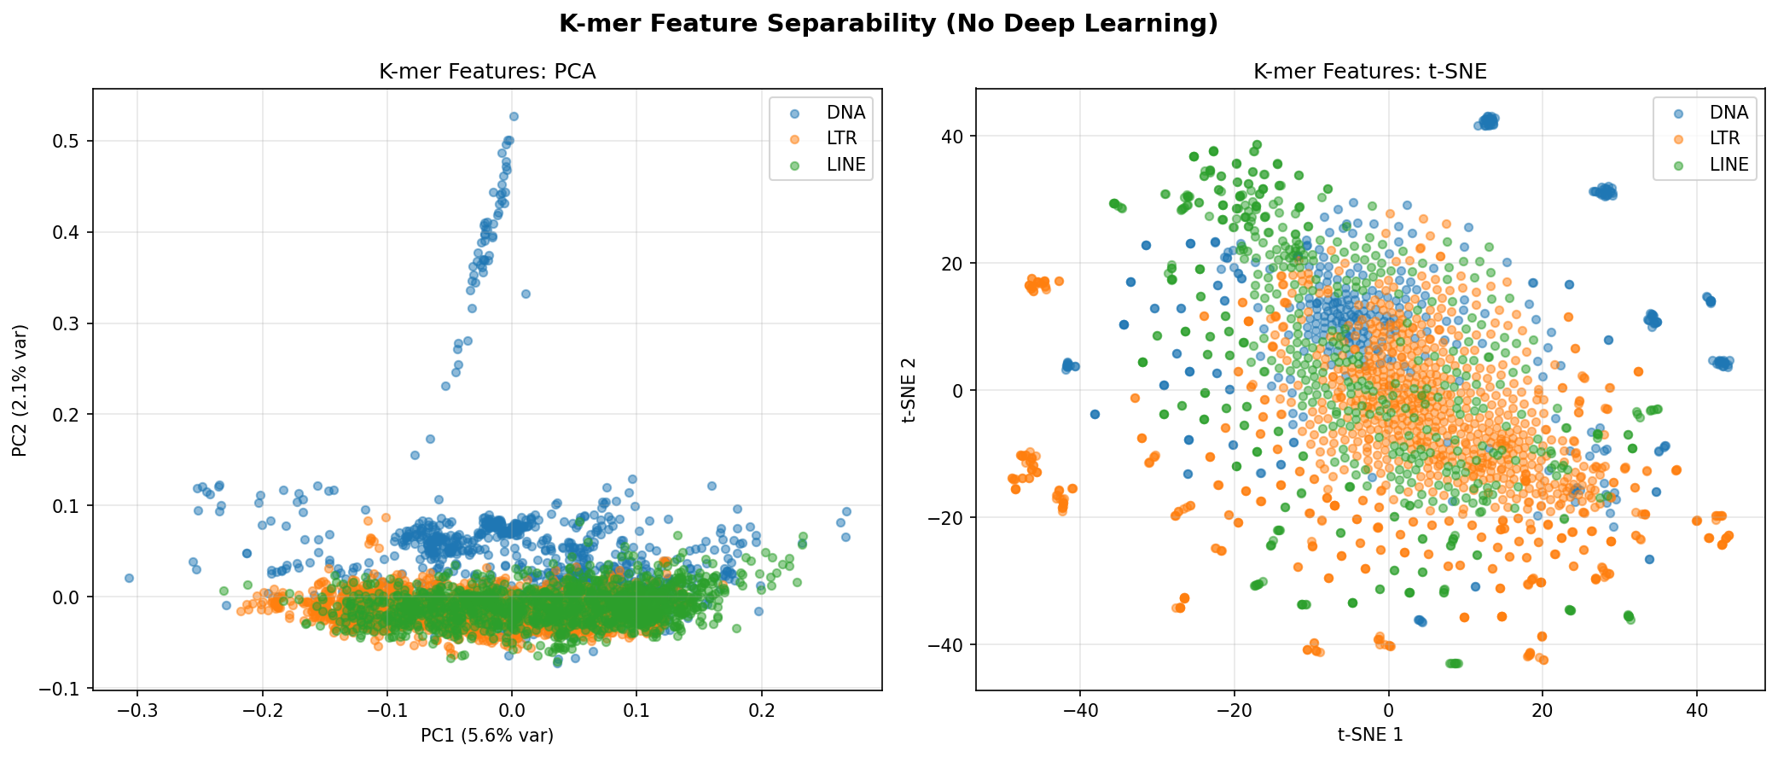
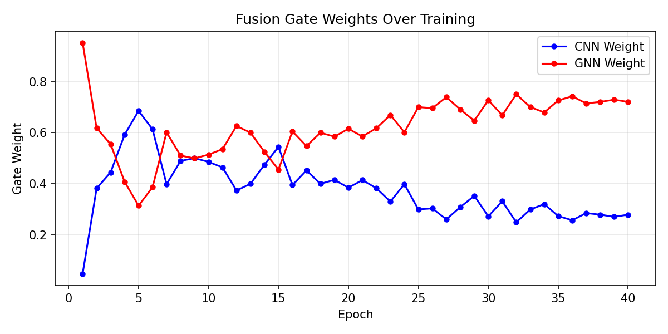
k-mer Baseline & Attention Gating
What does the GNN branch contribute? Global composition vs. local motifs
Standalone k-mer baseline (no CNN)
▪ Logistic regression on canonical 7-mer frequencies: macro F1 = 0.855 ± 0.010 (3-class, 5-fold CV)
▪ Random forest on same features: macro F1 = 0.848 ± 0.015
▪ Compositional signal alone provides strong prior for top-level class (DNA/LTR/LINE)
▪ Within class (e.g., DNA superfamilies): k-mer F1 = 0.064 – 0.097 ≈ near chance
▪ → Superfamily discrimination is driven entirely by the CNN local-motif branch
Attention-gate interpretation
▪ Binary head (v4): gate weights highly variable — no branch consistently dominates
▪ Three-class head (v4.3): GNN weight converges to ~72% from epoch 25
▪ Gate pattern tracks the standalone k-mer advantage for top-level class identity
▪ The gate acts as a soft prior: downweights GNN when asked a within-class question
Machine Learning a TE Classifier | Yingrui Yang | Cambridge Genetics 2026
10

Slide 11
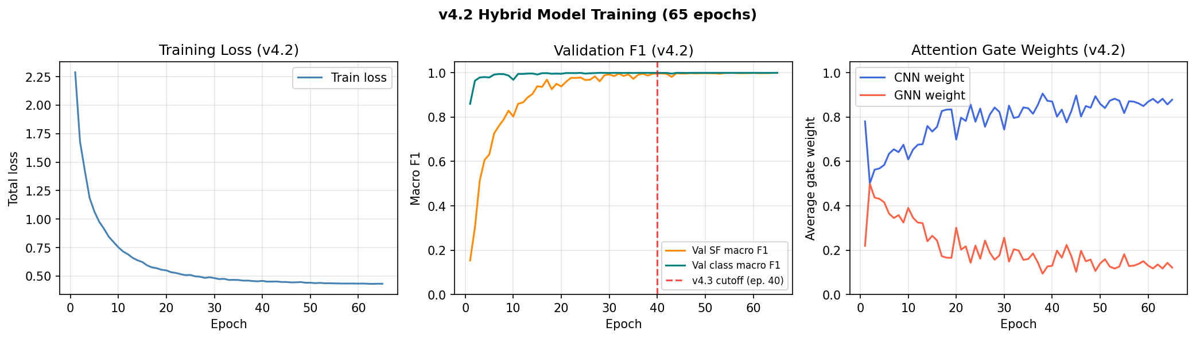
Stage 3 — Single-Fold Inner Split (v4.3-singlefold)
Train/val species fully disjoint — most conservative estimate of generalisation
Side-by-side stage comparison (species-disjoint Pantera test set)
Stage
Variant
Cls Acc
Cls F1
SF F1
hAT F1
Tr/Val Disjoint?
Stage 1
v4.1
98.4%
0.984
0.872
—
No
Stage 2
v4.2
92.5%
0.895
0.604
0.265
No
Stage 2
v4.3
98.4%
0.982
0.727
0.919 ⚠
No
Stage 3
v4.3-SF
95.9%
0.955
0.638
0.256
Yes ✓
DNA/hAT collapse: 0.919 (Stage 2 rotating) → 0.256 (Stage 3 disjoint)
Two distinct drops: (1) cap=3,000 removes diverse hAT training data (v4.2); (2) removing inner rotation exposes phylogenetic gap — hAT test subvariants have no close phylogenetic neighbours in training. Exact mechanism remains open.
Machine Learning a TE Classifier | Yingrui Yang | Cambridge Genetics 2026
11

Slide 12
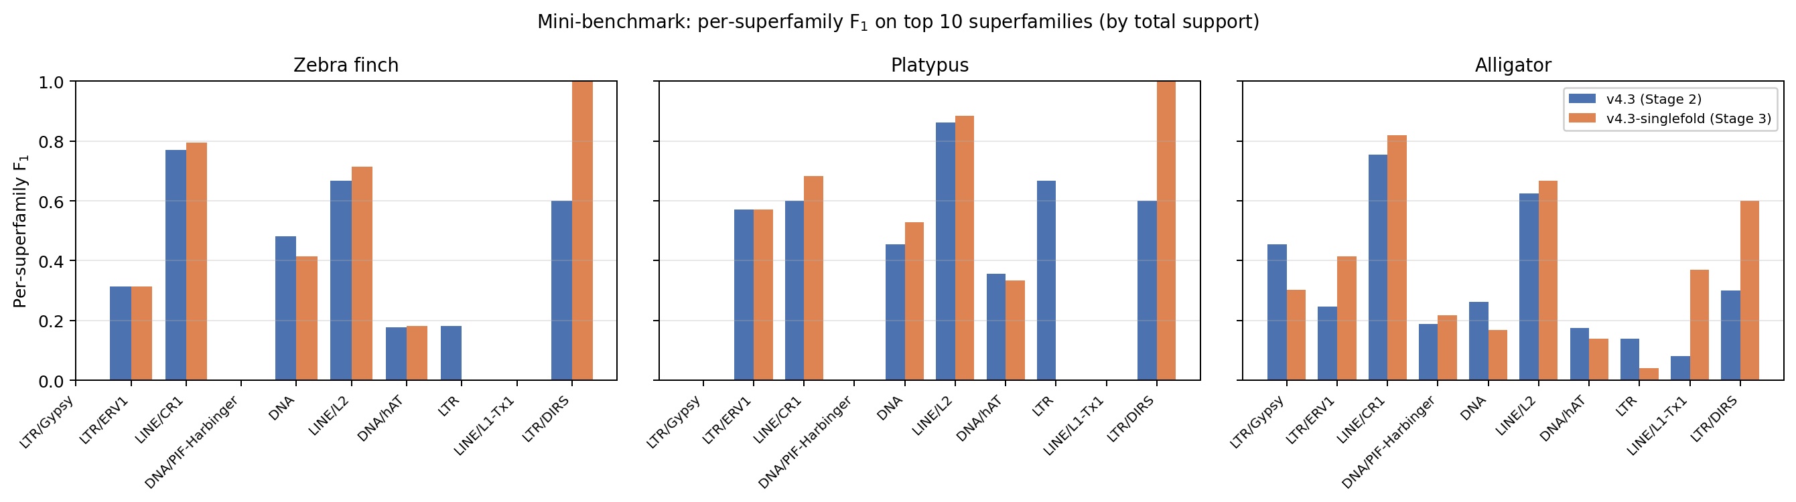
Mini-Benchmark: Cross-Species Transfer
Three held-out amniote genomes — entirely unseen during training and validation
Benchmark species — spanning major amniote lineages
Species
Lineage
Pantera
Curated lib
Struct. LTR
Zebra finch (T. guttata)
Aves
161
543
6,480
Platypus (O. anatinus)
Mammalia
25
380
49,814
Alligator (A. mississippiensis)
Reptilia
296
1,196
15,557
Cross-species headline performance (all DNA/LTR/LINE sequences)
Variant
ZF cls
Plat cls
Alli cls
Overall cls
ZF sf
Plat sf
Alli sf
Overall sf
v4.3 (Stage 2)
0.639
0.821
0.787
0.763
0.168
0.274
0.216
0.231
v4.3-singlefold
0.428
0.703
0.654
0.607
0.244
0.235
0.238
0.250
Primary finding: Both stages agree closely at superfamily level — the Stage-2 class-level advantage (+0.156) reflects checkpoint selection on a contaminated val set, not genuine architectural benefit.
Machine Learning a TE Classifier | Yingrui Yang | Cambridge Genetics 2026
12

Slide 13
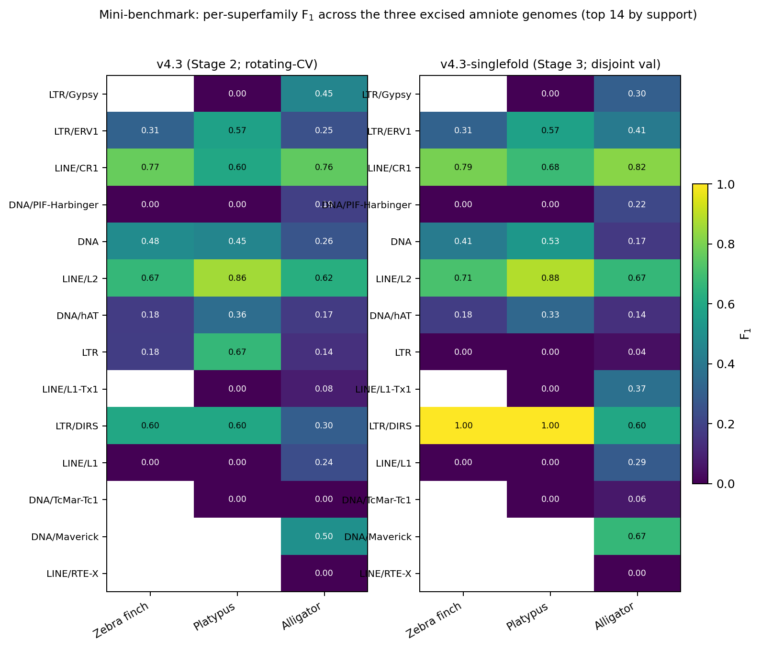
Species-Shift as the Primary Failure Mode
Phylogenetic coverage of training data is the bottleneck — not model capacity
▪ Removing rotating-CV inner split drops Pantera SF F1 by 0.089 but raises mini-benchmark SF F1 (+0.019)
▪ → Rotating CV inflates in-distribution numbers without improving out-of-distribution generalisation
▪ Transfer is lineage-dependent: Platypus best · Alligator second · Zebra finch worst
▪ Zebra finch DNA F1 = 0.40, LTR F1 = 0.37 (Stage 3): avian ERV families absent from training pool
▪ DNA/hAT collapse (0.92 → 0.26) is shared by both leak-controlled variants — genuine species-shift
Productive remedies:
→ Broader phylogenetic training coverage (more avian / monotreme genomes)
→ Domain-adversarial training to encourage species-invariant representations
→ Pre-training on large DNA corpus (DNA foundation model) → fine-tune on Pantera
→ Meta-learning (MAML) across species for low-shot lineage generalisation
Machine Learning a TE Classifier | Yingrui Yang | Cambridge Genetics 2026
13

Slide 14
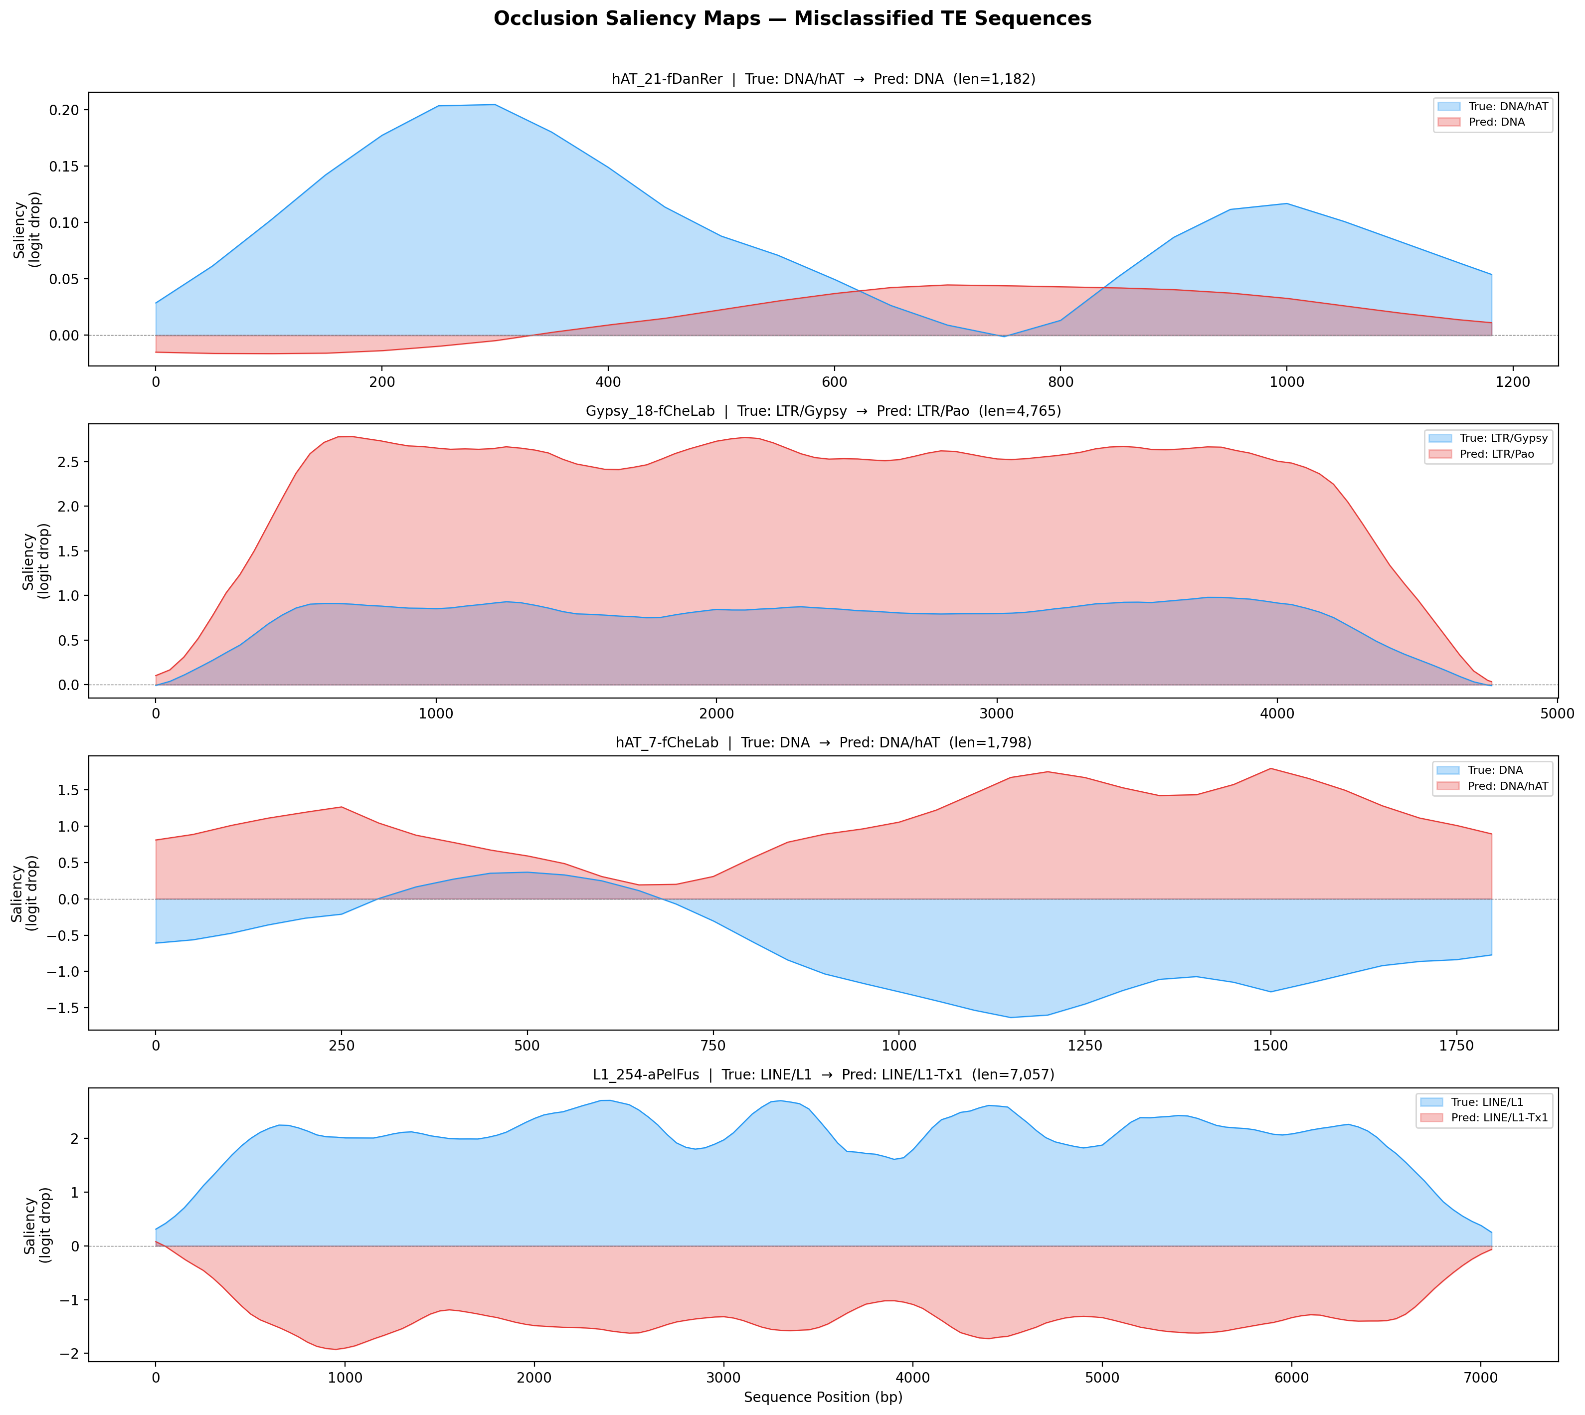
Interpretability: Gradient-based Saliency
Which sequence positions drive the model's predictions?
▪ Compute ℓ₂-normalised input gradient ∇ₓL for each test sequence
▪ Positive attribution: positions that increase the true-class logit
▪ Generated from v4 model (position-invariant, representative across folds)
Findings from 4 representative misclassifications:
▪ LTR/Gypsy → LTR/Pao: true- and predicted-class attribution envelopes overlap → shared internal motifs
▪ LINE/L1 → LINE/L1-Tx1: broadly negative true-class saliency → confident subfamily flip
▪ DNA/hAT: crisp attribution peaks at element ends → TIR boundary signal
▪ DNA/CMC: diffuse gradients across body → no clear structural hallmark recoverable
▪ Note: aggregated correct vs. misclassified analysis not performed — patterns remain illustrative
Machine Learning a TE Classifier | Yingrui Yang | Cambridge Genetics 2026
14

Slide 15
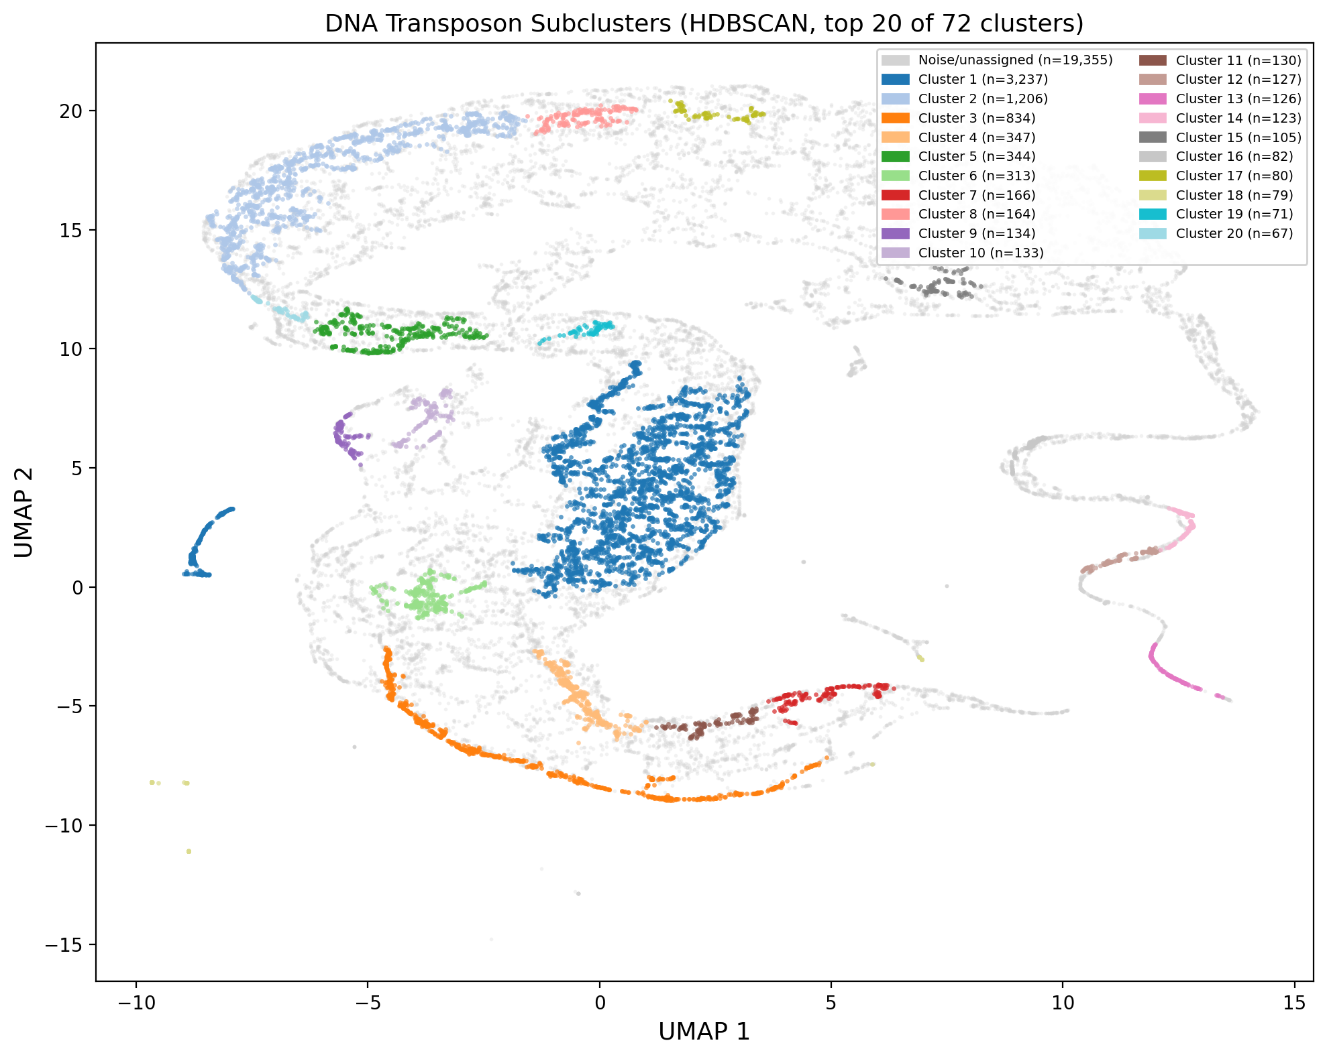
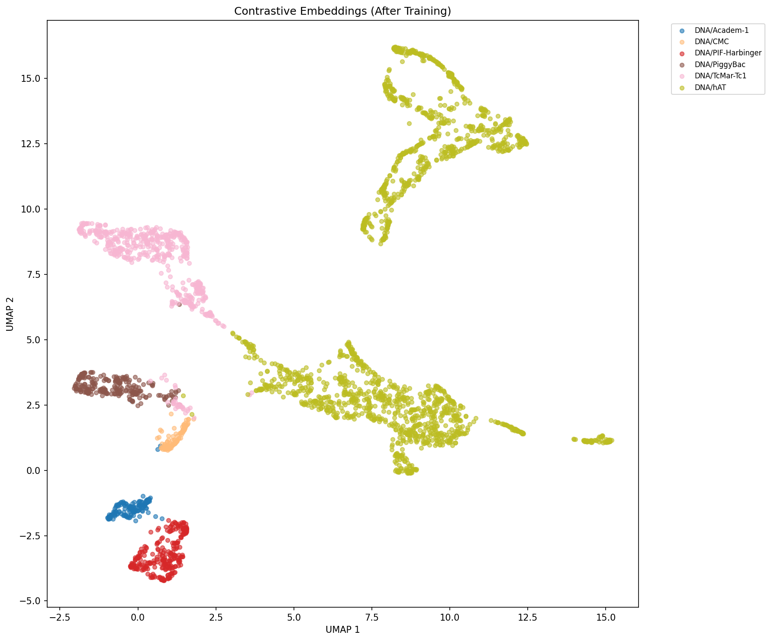
Semi-supervised Clustering (v5)
Contrastive learning probes the encoder's internal representation geometry
▪ Combined loss: L_SupCon (τ=0.3) + 0.5·L_CE + 0.01·L_center — anchors to known label structure
▪ Base encoder: pretrained v4 hybrid; 256-dim fused embedding → UMAP → HDBSCAN clustering
▪ 72 HDBSCAN clusters discovered from DNA transposon embeddings (7,966 sequences)
▪ ARI = 0.036 / NMI = 0.136 / Homogeneity = 0.247 — finer-grained than annotated superfamilies
▪ Clusters are superfamily-specific but each SF is fragmented: model captures sequence subvariants
▪ 7 of 10 largest mixed clusters have 'Unknown' as top annotation → candidate novel subfamilies
Compactness varies with biological heterogeneity (mean L₂ from centroid):
▪ DNA/PiggyBac 1.84 | DNA/TcMar-Tc1 2.38 | DNA/PIF-Harbinger 2.48
▪ DNA/CMC 3.05 | DNA/hAT 3.71 (most diverse; 1,882 sequences)
Machine Learning a TE Classifier | Yingrui Yang | Cambridge Genetics 2026
15

Slide 16
Summary & Discussion
Splits > Architecture
Species-Shift
Changing the data-split protocol changes headline numbers more than any modelling choice. Stage-1 (random) → Stage-2 (species-disjoint outer) → Stage-3 (fully-disjoint) tells a coherent story. Stage-3 is the only setting where val and test agree.
Primary failure mode is species-shift, not classical overfitting. Rotating-CV inflation buys nothing out-of-distribution. Lineage-specific TE biology (avian ERVs, hAT subvariants) limits cross-species transfer.
GNN vs. CNN Role
Boundary Regression
GNN contributes meaningfully to top-level 3-class task (gate ≈72% GNN weight). Within-class superfamily discrimination is driven entirely by CNN local motifs; k-mer composition is near-chance inside a single class.
Sequence length recoverable (r≈0.94); absolute canvas position not (r≈0.07–0.18). Consequence of position-invariant masked global-avg pool. Motivates v4.4 with sinusoidal positional channels + per-position segmentation head.
Machine Learning a TE Classifier | Yingrui Yang | Cambridge Genetics 2026
16

Slide 17
Limitations & Future Directions
Current limitations
▪ Stage-1 test F1 inflated for rare classes — use only as label-quality audit, not generalisation estimate
▪ Mini-benchmark limited to n=3 species across 3 lineages — universal phrasing is unwarranted
▪ DNA/hAT collapse mechanism unresolved — phylogenetic gap vs. flat-softmax insufficiency unclear
▪ v5 clustering evaluated only on DNA transposons; broader scope needed for full picture
Future directions
▪ v4.4: sinusoidal positional channels + per-position segmentation head (TE boundary localisation)
▪ Broader phylogenetic training coverage — prioritise avian and monotreme genomes
▪ Domain-adversarial training (Ganin & Lempitsky 2015) or MAML (Finn et al. 2017) for cross-species transfer
▪ DNA foundation model pre-training (DNABERT / Nucleotide Transformer) → fine-tune on Pantera
▪ Confident-learning relabelling of Stage-1 disagreements to tighten ground truth
▪ Link non-autonomous elements to autonomous drivers — beyond alignment-based methods
Machine Learning a TE Classifier | Yingrui Yang | Cambridge Genetics 2026
17

Slide 18
Thank You
Machine Learning a Transposable Element Classifier
Questions welcome
Machine Learning a TE Classifier | Yingrui Yang | Cambridge Genetics 2026
18

