Slide 1
Machine Learning a Transposable Element Classifier
Supervisors:
Prof Richard Durbin, Pio Sarra, Hadi Khan
Department of Genetics

Slide 2
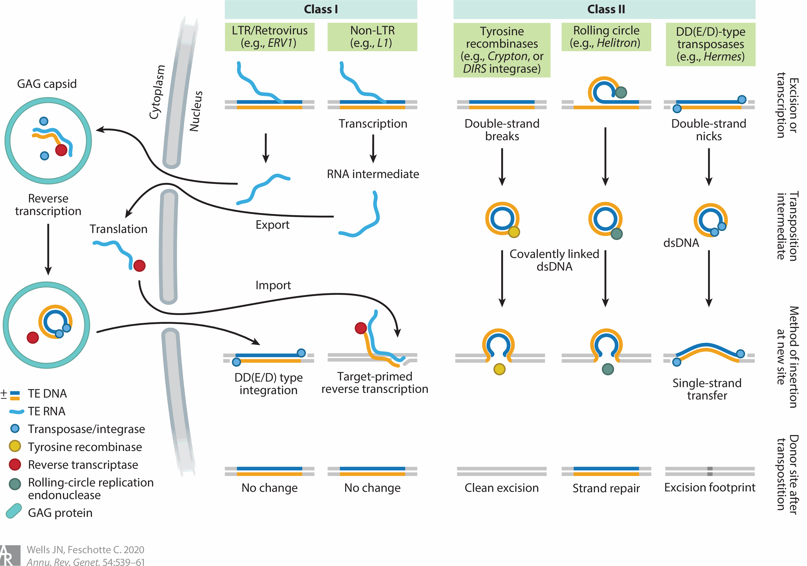
What is Transposable Elements
“Transposable elements (TEs) are mobile DNA sequences capable of independently replicating within host genomes. They typically range in length from 100 to 10,000 bp, but are sometimes far larger. Along with viruses, TEs are the most intricate selfish genetic elements. They frequently encode proteins with multiple biochemical activities as well as complex noncoding regulatory sequences that promote their transposition. “
Wells JN, Feschotte C (2020) A Field Guide to Eukaryotic Transposable Elements. Annu Rev Genet. 54:539-561. https://doi.org/10.1146/annurev-genet-040620-022145
Notes:
Transposable elements (TEs) are kilobase-scale segments of DNA that insert new copies of themselves in the genome, generating over time large families of interspersed repeats (ref 1). Some of these are autonomous, themselves encoding the proteins needed to mobilise themselves, but others are non-autonomous, needing an active autonomous element to move.
The most fundamental division of eukaryotic TEs, introduced by David Finnegan (51) in 1989, distinguishes two major classes based on their transposition intermediates: class I—retrotransposons, and class II—DNA transposons. Class I elements replicate via an RNA intermediate, which is then reverse-transcribed into a DNA copy and integrated into the genome. Because the original template element remains intact, retrotransposons are commonly referred to as copy-and-paste elements. In contrast, the majority of (but not all) class II elements mobilize through a cut-and-paste mechanism, in which the transposon itself is excised and moved to a new genomic location. Both classes can be further subdivided many times, first into subclasses (or orders) (162), which are primarily delineated according to their mechanisms of replication and/or chromosomal integration ( Figure 1 ), and then into superfamilies and families, which are more accurately characterized in terms of phylogenetic relationships (4, 35, 49, 162, 169).

Slide 3
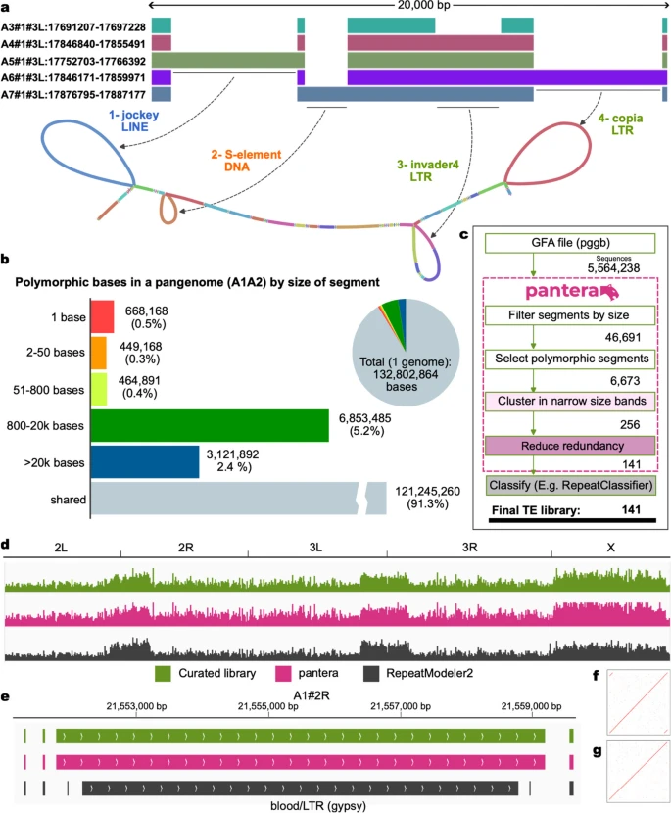
What dataset are we using
The group has developed a new pipeline named Pantera to identify TE families. The dataset contains more than 130k TE sequences.
“Our hypothesis is that most of the structural variants in the size range of hundreds to tens of thousands of bases that we detect when comparing two or more closely related genomes are caused by TE insertions or deletions, as illustrated in Fig. 1a,b. We identify candidate TE families by clustering the inserted sequences with high stringency for both sequence identity (default 95%) and full length alignment. ”
Sierra P, Durbin R (2024) Identification of transposable element families from pangenome polymorphisms. Mobile DNA. 15:13. https://doi.org/10.1186/s13100-024-00323-y

Slide 4
The goals
Build machine learning models to classify the TE sequences collected by Pantera
Implement CNN and RNN to capture local motifs with one-hot encoding and global patterns with k-mer features
Implement attention layer as the sequences could be very long
Apply unsupervised and generative models to identify novel TE families and model evolutionary relationships.
Develop frameworks linking non-autonomous sequences to their driver elements, moving beyond alignment-based methods.

