Slide 1
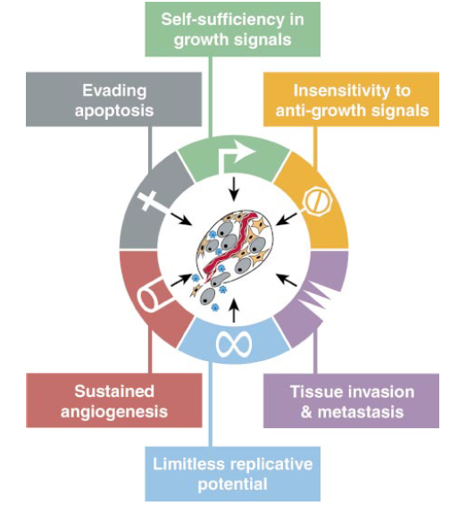
Hallmarks of cancer regression for identification of robust and interpretable composite biomarkers
Alex Yang,
Fabio Rigat, PhD

Slide 2
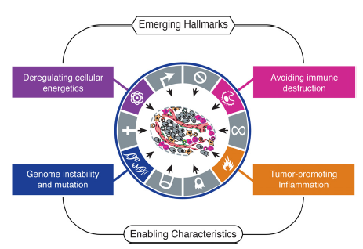
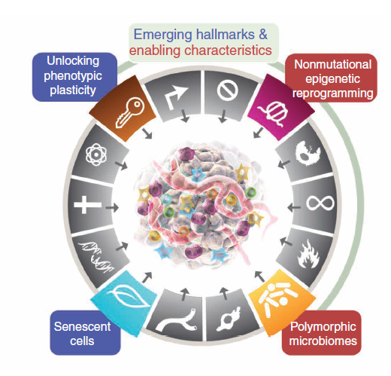
The Hallmarks of cancer define alternations to cell physiology
Cancer was recognised in the 20th century as resulting from multiple DNA alternations, including mutations and epigenetic alterations
The Hallmarks of Cancer research in the 21st century expanded to characterising cancer’s functional traits, to
identify biological processes consistent with emerging gene ontology pathways and
identify multiple drug targets able to be hit together by combining medicines to achieve synergistic efficacy effects
2011
(N=10)
2000
(N=6)
2022
(N=14)
Hanahan et al, Cell, 2000: “We suggest that […] cancer […] is a manifestation of six essential alterations in cell physiology”
https://aacrjournals.org/cancerdiscovery/article/12/1/31/675608/Hallmarks-of-Cancer-New-DimensionsHallmarks-of
21Aug2025
Notes:
The Hallmarks of Cancer literature summarises common disruptions of cell physiology associated with cancer, providing potential mechanism of action for targeted therapy

Slide 3
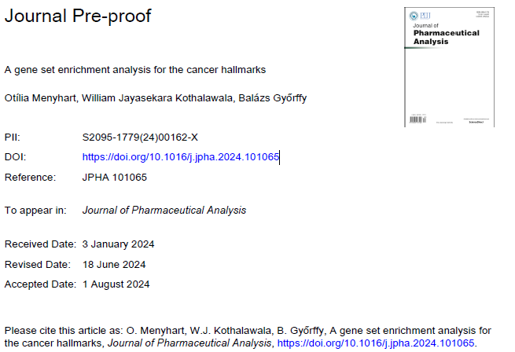
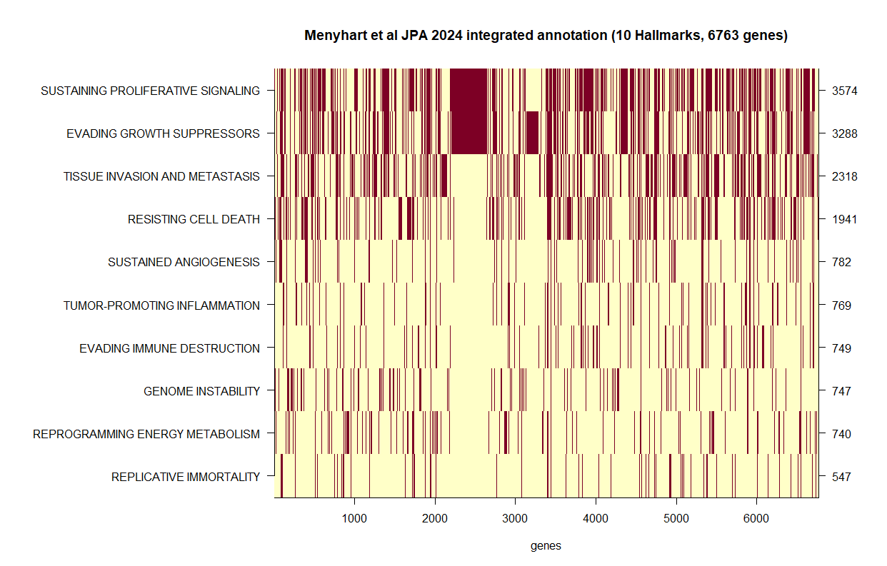
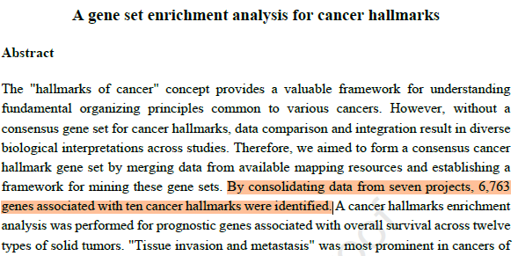
Annotation of genes into Hallmarks bridges cell genetics and cell physiology
https://doi.org/10.1016/j.jpha.2024.101065
https://cancerhallmarks.com/
Annotation = Connecting the cancer Hallmarks to their underlying genetic determinants resulted in the first partial annotations of genes which expression (or lack thereof) contributes to one of more of the 10 2011 Hallmarks.
21Aug2025
Notes:
Enterprise RA = 12.8 = 0.4 x 32

Slide 4
Motivating example: the TCGA COAD dataset
The Cancer Genome Atlas (TCGA) Data
TCGA is a large NIH/NCI initiative that collected molecular and clinical profiles from thousands of patients across multiple cancer types.
For Colorectal Adenocarcinoma (COAD), TCGA provides (N~450 subjects):
RNA-seq (FPKM) expression profiles
Mutation calls
Clinical & survival information (stage, primary site, disease type, outcome)
In this project we developed models and code for analysing the TCGA COAD data using survival regression embedding the Hallmarks of cancer annotation
The Cancer Genome Atlas Research Network. The Cancer Genome Atlas Pan-Cancer analysis project. Nat Genet. 45, 1113–1120 (2013). https://doi.org/10.1038/ng.2764
21Aug2025

Slide 5
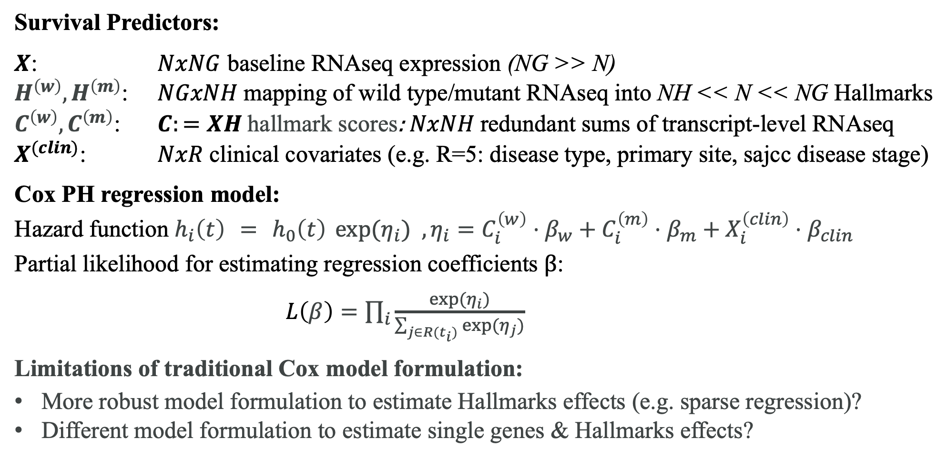
Cox survival regression of Hallmark annotated data
Survival Predictors:
$X$: $NxNG$ baseline RNAseq expression (NG >> N)
$H^{\left(w\right)},H^{\left(m\right)}$: $NGxNH$ mapping of wild type/mutant RNAseq into NH << N << NG Hallmarks
$C^{\left(w\right)},C^{\left(m\right)}$: $C:=XH$ hallmark scores: $NxNH$ redundant sums of transcript-level RNAseq
$X^{(clin)}$: $NxR$ clinical covariates (e.g. R=5: disease type, primary site, sajcc disease stage)
Cox PH regression model:
Hazard function $h_{i}\left(t\right) = h_{0}\left(t\right) \exp{(η_{i}) }, η_{i}=C_{i}^{\left(w\right)}⋅β_{w}+C_{i}^{\left(m\right)}⋅β_{m}+X_{i}^{\left(clin\right)}⋅β_{clin}$
Partial likelihood for estimating regression coefficients $β$:
$L\left(β\right)=\prod_{i}{\frac{\exp{(η_{i})}}{\sum_{j∈R(t_{i})}{\exp{(η_{j})}}}}$
Limitations of traditional Cox model formulation:
More robust model formulation to estimate Hallmarks effects (e.g. sparse regression)?
Different model formulation to estimate single genes & Hallmarks effects?
21Aug2025

Slide 6
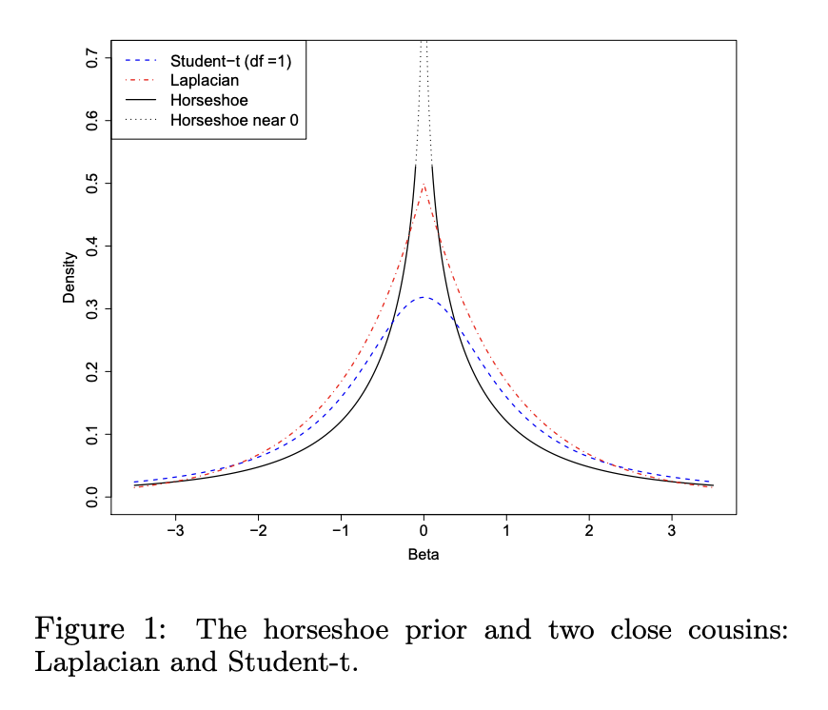
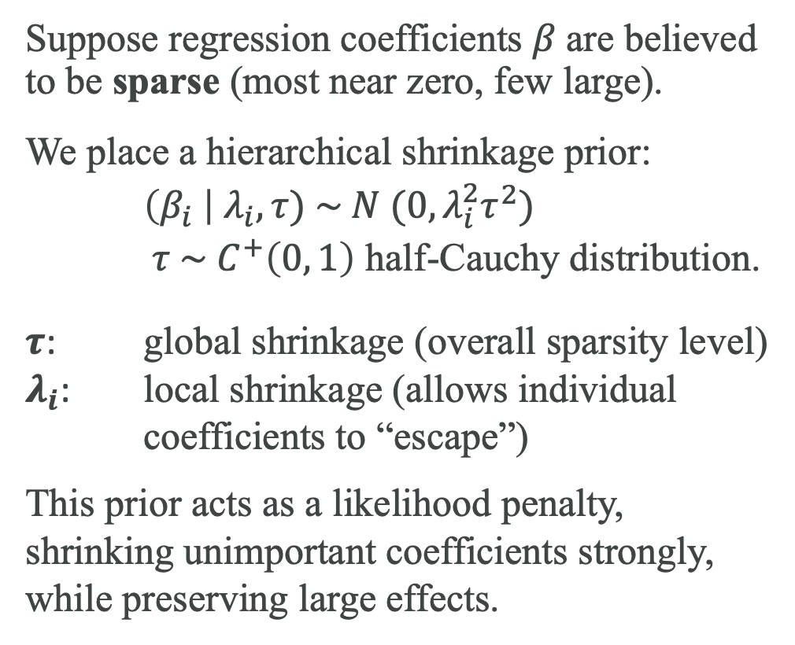
The Horseshoe prior induces sparsity in regression models
Suppose regression coefficients $β$are believed to be sparse (most near zero, few large).
We place a hierarchical shrinkage prior:
$\left(β_{i} \right| λ_{i}, τ) \sim N (0,λ_{i}^{2}τ^{2})$
$τ \sim C^{+}\left(0, 1\right)$ half-Cauchy distribution.
$τ$: global shrinkage (overall sparsity level)
$λ_{i}$: local shrinkage (allows individual coefficients to “escape”)
This prior acts as a likelihood penalty, shrinking unimportant coefficients strongly, while preserving large effects.
21Aug2025
Notes:
Enterprise RA = 12.8 = 0.4 x 32

Slide 7
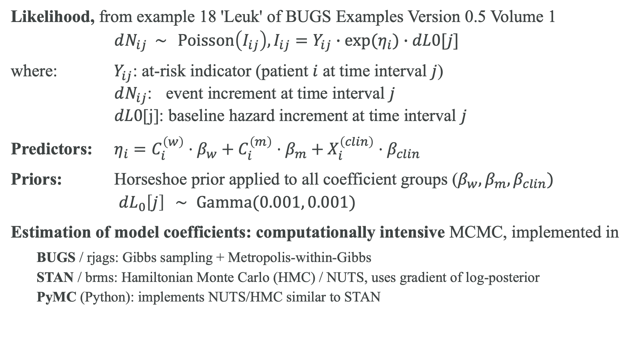
Bayesian Horseshoe Cox regression model
Likelihood, from example 18 'Leuk' of BUGS Examples Version 0.5 Volume 1
$dN_{ij} \sim \operatorname{Poisson}\left(I_{ij}\right),I_{ij}=Y_{ij}∙\exp{(η_{i})}∙dL0[j]$
where: $Y_{ij}$: at-risk indicator (patient $i$ at time interval $j$)
$dN_{ij}$: event increment at time interval $j$
$dL0$[j]: baseline hazard increment at time interval $j$
Predictors: $η_{i}=C_{i}^{\left(w\right)}⋅β_{w}+C_{i}^{\left(m\right)}⋅β_{m}+X_{i}^{\left(clin\right)}⋅β_{clin}$
Priors: Horseshoe prior applied to all coefficient groups ($β_{w},β_{m},β_{clin})$
$dL_{0}\left[j\right] ∼ \operatorname{Gamma}{(0.001, 0.001)}$
Estimation of model coefficients: computationally intensive MCMC, implemented in
BUGS / rjags: Gibbs sampling + Metropolis-within-Gibbs
STAN / brms: Hamiltonian Monte Carlo (HMC) / NUTS, uses gradient of log-posterior
PyMC (Python): implements NUTS/HMC similar to STAN
21Aug2025

Slide 8
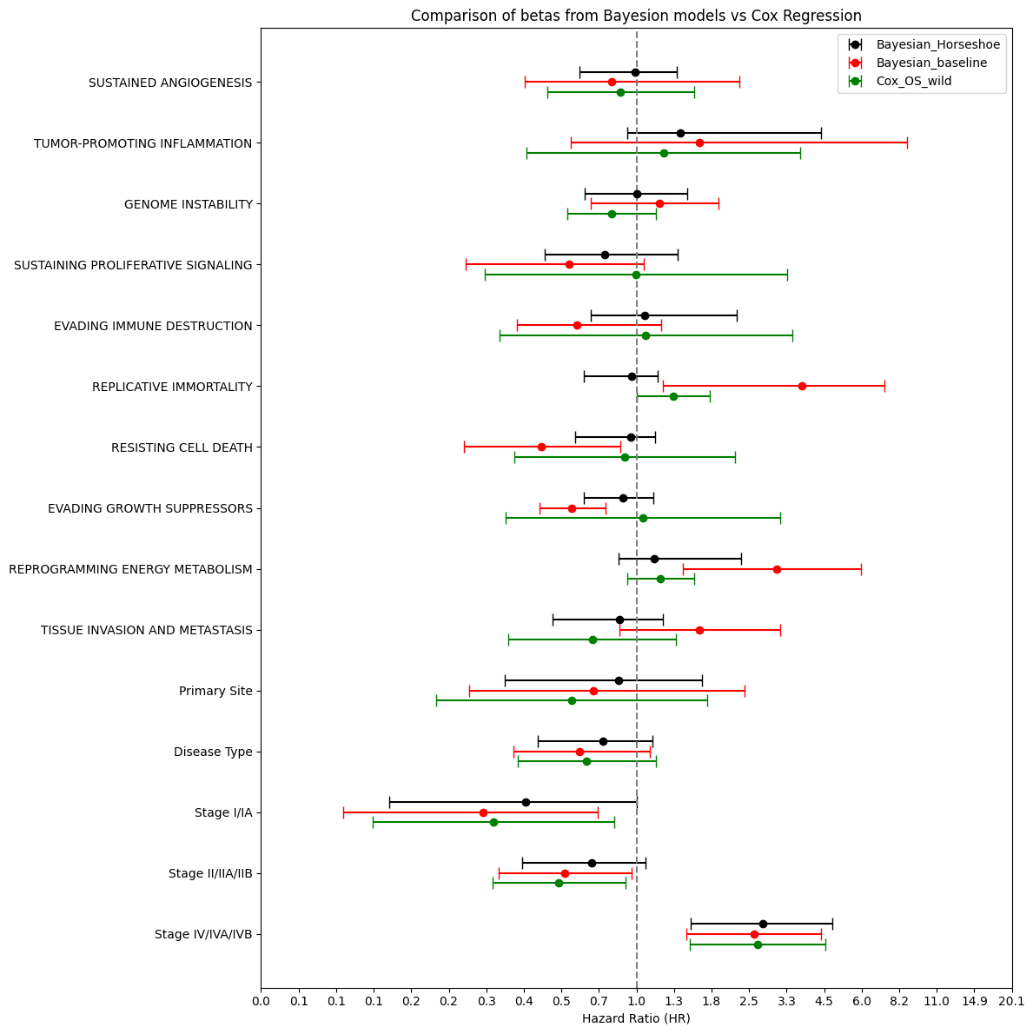
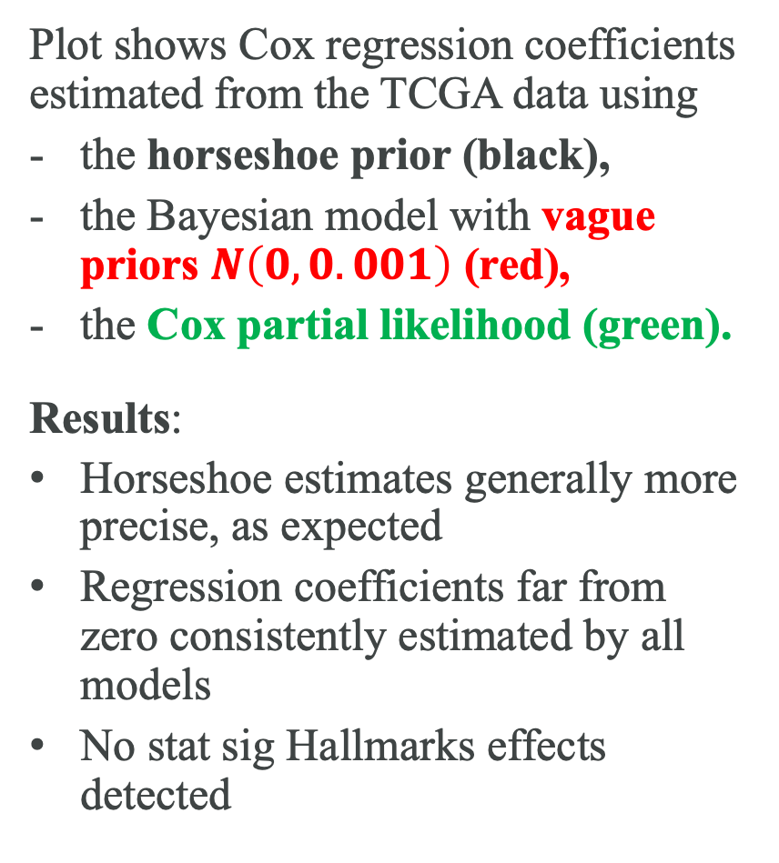
Analysis of TCGA data using Hallmark annotated Cox regression
No strong prognostic effect of any Hallmark identified
Plot shows Cox regression coefficients estimated from the TCGA data using
the horseshoe prior (black),
the Bayesian model with vague priors $N\left(0, 0.001\right)$ (red),
the Cox partial likelihood (green).
Results:
Horseshoe estimates generally more precise, as expected
Regression coefficients far from zero consistently estimated by all models
No stat sig Hallmarks effects detected
Bayesian model using weak priors shows several potential false positives
Horseshoe shrinks weak effects towards 0 (HR=1)
Strong signal consistently estimated by all methods
21Aug2025

Slide 9
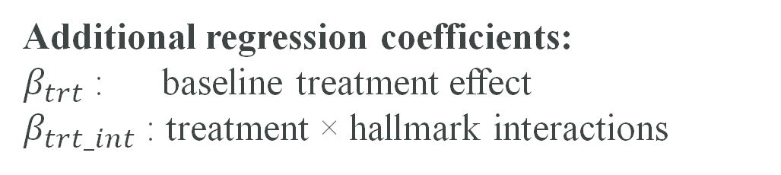
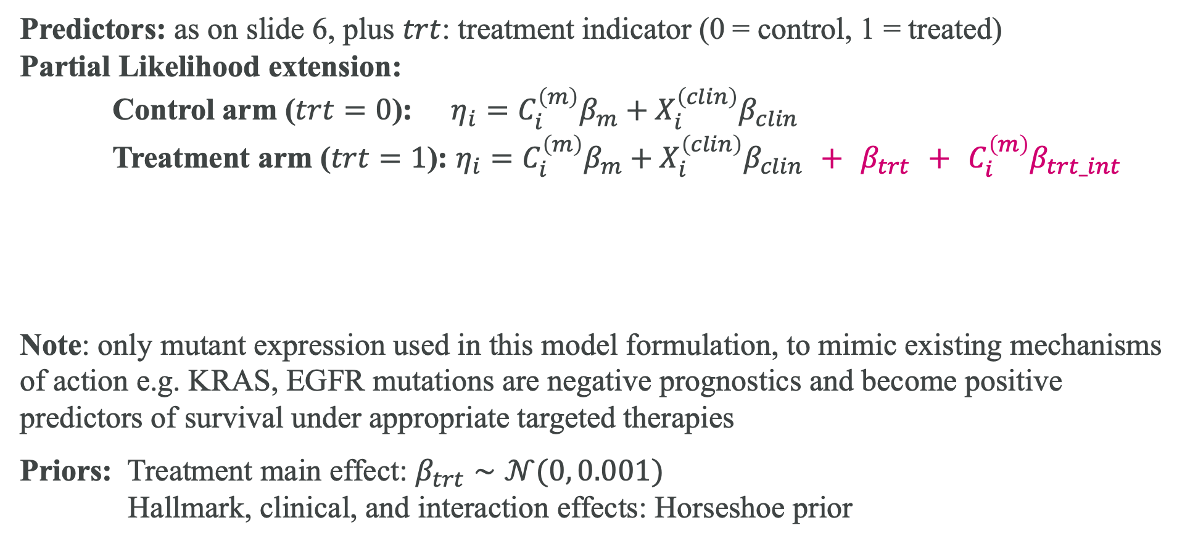
Extension 1: treatment effects Hallmark predictive model
Predictors: as on slide 6, plus $trt$: treatment indicator (0 = control, 1 = treated)
Partial Likelihood extension:
Control arm ($trt=0$): $η_{i}=C_{i}^{\left(m\right)}β_{m}+X_{i}^{\left(clin\right)}β_{clin}$
Treatment arm ($trt=1$): $η_{i}=C_{i}^{\left(m\right)}β_{m}+X_{i}^{\left(clin\right)}β_{clin} + β_{trt} + C_{i}^{\left(m\right)}β_{trt_int}$
Note: only mutant expression used in this model formulation, to mimic existing mechanisms of action e.g. KRAS, EGFR mutations are negative prognostics and become positive predictors of survival under appropriate targeted therapies
Priors: Treatment main effect: $β_{trt}∼𝒩(0, 0.001)$
Hallmark, clinical, and interaction effects: Horseshoe prior
Additional regression coefficients:
$β_{trt}$: baseline treatment effect
$β_{trt_int}$ : treatment × hallmark interactions
21Aug2025

Slide 10
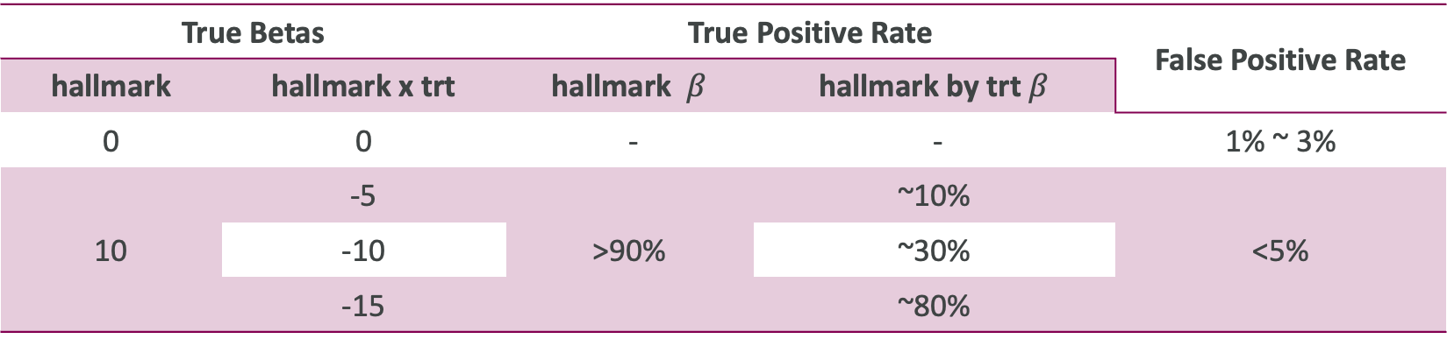
Predictive model performance shows control of false positives and high power
Goals: To test the ability to detect true effects while controlling false positives.
Data: we used the actual measurements of hallmark expression for the stage III subjects of the TCGA dataset (N=130), and we simulated exponentially distributed survival data using the annotated regression model including trt and hallmark x trt effects
Results: - Given the lack of ability of parallelization of MCMC, the simulation run time was excessive for the duration of this project (>10min per simulation).
- Maximisation of the partial likelihood for the Cox model runs extremely fast, so we could test the model performance without the horseshoe penalty
True Betas |  | True Positive Rate |  | False Positive Rate
hallmark | hallmark x trt | hallmark $β$ | hallmark by trt $β$
0 | 0 | - | - | 1% ~ 3%
10 | -5 | >90% | ~10% | <5%
 | -10 |  | ~30%
 | -15 |  | ~80%
21Aug2025

Slide 11
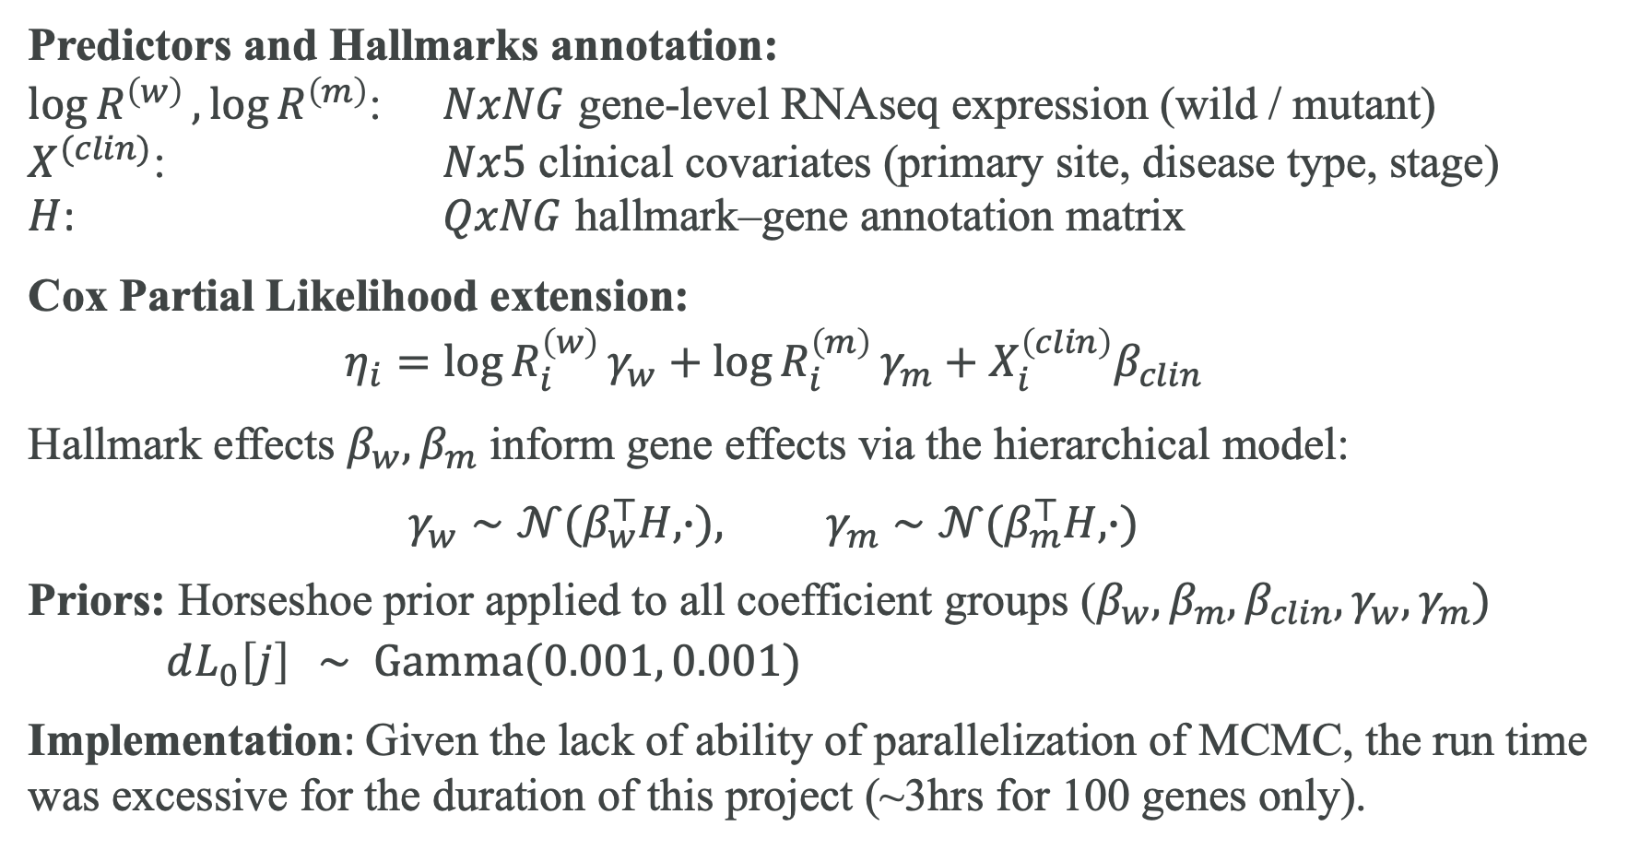
Extension 2: gene-level Hallmark annotated Cox model
Predictors and Hallmarks annotation:
$\log{R^{\left(w\right)}}, \log{R^{\left(m\right)}}$: $NxNG$ gene-level RNAseq expression (wild / mutant)
$X^{(clin)}$: $Nx5$ clinical covariates (primary site, disease type, stage)
$H$: $QxNG$ hallmark–gene annotation matrix
Cox Partial Likelihood extension:
$$η_{i}=\log{R_{i}^{\left(w\right)}}γ_{w}+\log{R_{i}^{\left(m\right)}}γ_{m}+X_{i}^{\left(clin\right)}β_{clin}$$
Hallmark effects $β_{w},β_{m}$ inform gene effects via the hierarchical model:
$$γ_{w}∼𝒩(β_{w}^{⊤}H, ∙), γ_{m}∼𝒩(β_{m}^{⊤}H, ∙)$$
Priors: Horseshoe prior applied to all coefficient groups ($β_{w},β_{m},β_{clin},γ_{w},γ_{m})$
$dL_{0}\left[j\right] ∼ \operatorname{Gamma}{(0.001, 0.001)}$
Implementation: Given the lack of ability of parallelization of MCMC, the run time
was excessive for the duration of this project (~3hrs for 100 genes only).
21Aug2025

Slide 12
Summary and ways forward
This project demonstrated feasibility of analysing data to test the prognostic and predictive value of Hallmarks annotations, to inform patient management and to focus clinical development of novel targeted therapies
Cancer genetics and systems biology come together by leveraging Hallmarks annotation of single genes in survival regression models
The true/false positive rates of Hallmarks annotated regression using simulated data suggest that practical application is feasible.
MCMC methods for fitting Hallmark annotated models including single gene effects (~14k parameters) are extremely cumbersome
Ways forward:
more efficient numerical solutions are needed for estimation/simulation, e.g. LASSO implementation for hierarchical survival regression or GPU-based parallel simulations
added interpretability of results/coefficients may be gained by adding an intermediate hierarchy level reflecting pathways, i.e. gene -> pathway -> hallmark
21Aug2025

Slide 13
Thank you for
your attention

Slide 14
References
Handling Sparsity via the Horseshoe (Carvalho 09a) https://proceedings.mlr.press/v5/carvalho09a/carvalho09a.pdf
Carvalho, C. M., Polson, N. G., & Scott, J. G. (2010). The horseshoe estimator for sparse signals. Biometrika, 97(2), 465–480. https://doi.org/10.1093/biomet/asq017
Hanahan, D., & Weinberg, R. A. (2000). The hallmarks of cancer. Cell, 100(1), 57–70. https://doi.org/10.1016/S0092-8674(00)81683-9
Hanahan, D., & Weinberg, R. A. (2011). Hallmarks of Cancer: The Next Generation. Cell, 144(5), 646–674. https://doi.org/10.1016/j.cell.2011.02.013
Hanahan, D. (2022). Hallmarks of cancer: New dimensions. Cancer Discovery, 12(1), 31–46. https://doi.org/10.1158/2159-8290.CD-21-1059
Menyhárt, O., Kothalawala, W. J., & Győrffy, B. (2025). A gene set enrichment analysis for cancer hallmarks. Journal of Pharmaceutical Analysis, (5), Article 101065. https://doi.org/10.1016/j.jpha.2024.101065
Spiegelhalter, D., Thomas, A., Best, N., & Gilks, W. (1996). BUGS Examples, Version 0.5 (Vol. 1). MRC Biostatistics Unit, Institute of Public Health, University of Cambridge.
The Cancer Genome Atlas Research Network. (2013). The Cancer Genome Atlas Pan-Cancer analysis project. Nature Genetics, 45(10), 1113–1120. https://doorg/10.1038/ng.2764
21Aug2025

