Slide 1
The Fitness Tutorial For Student

Slide 2
Background
[Relevance] – for students or people who need lose weight but really busy.
[Relevance] – Student should find a health way to keep fit, because they can’t spent a lot of time in workout.

Slide 3
Design objectives & strategy
Help student to exercise and diet.
Plan the workout and food for a student.
AD?

Slide 4
Site audience
This tutorial site will help student who don’t have a lot of time in workout.
Visitors include people want to keep their body fit. People need lose weight but don’t want to go to gym. Student who need a healthy way to lose weight.

Slide 5
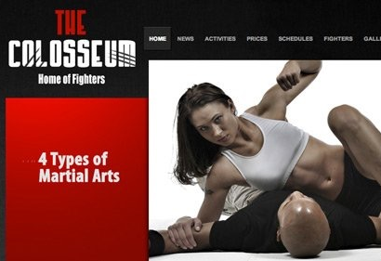
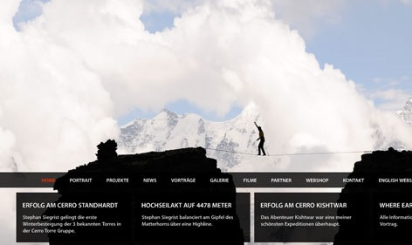
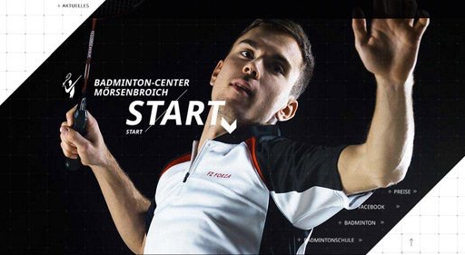

Competitors

Slide 6


Colors and textures

Slide 7
Keywords
Site should be
Site shouldn’t be
Graphic
Powerful
Vivid
Organized
Vibrant
Moveable
Strong
Energetic
Soft
Mass
Light

Slide 8
Content for the site
The site should include content like…
photos
Sample tour
Stores in the area

