Slide 1
BGP FSM
Yingzhen Qu
Jeff Tantsura

Slide 2
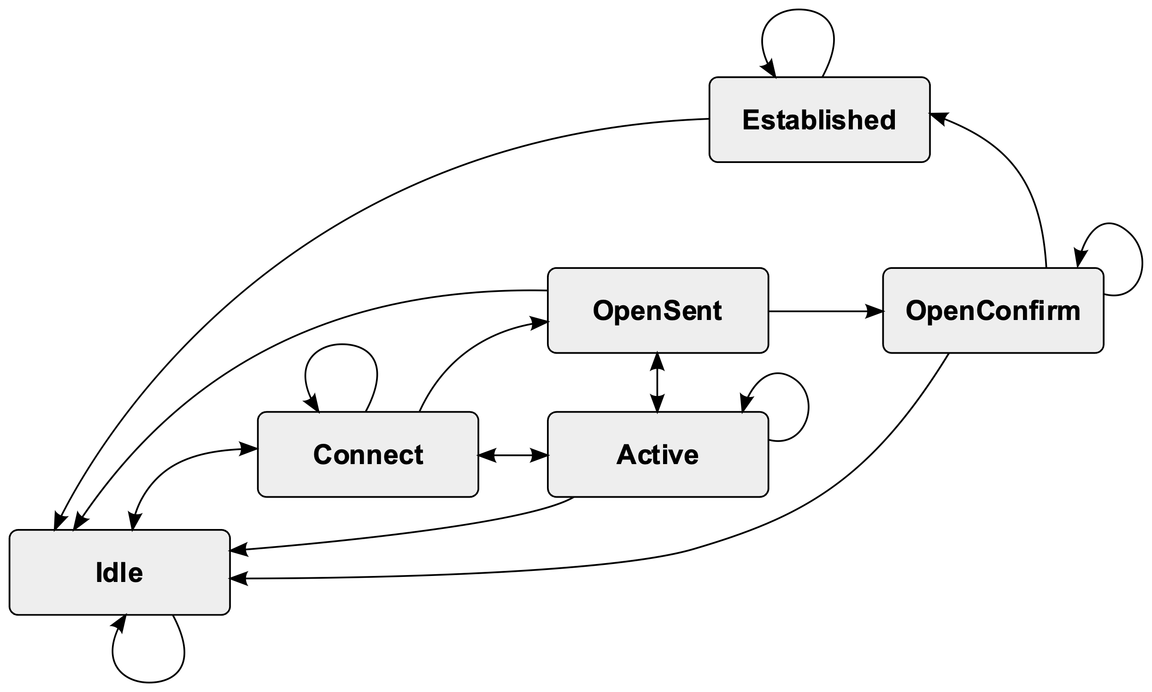
BGP FSM – RFC 4271
https://en.wikipedia.org/wiki/Border_Gateway_Protocol

Slide 3
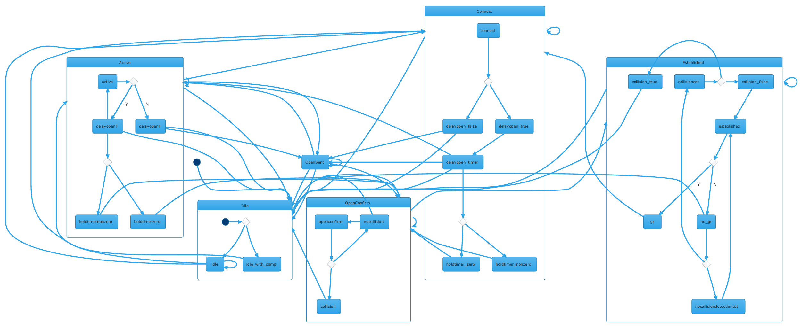
Real BGP FSM

Slide 4
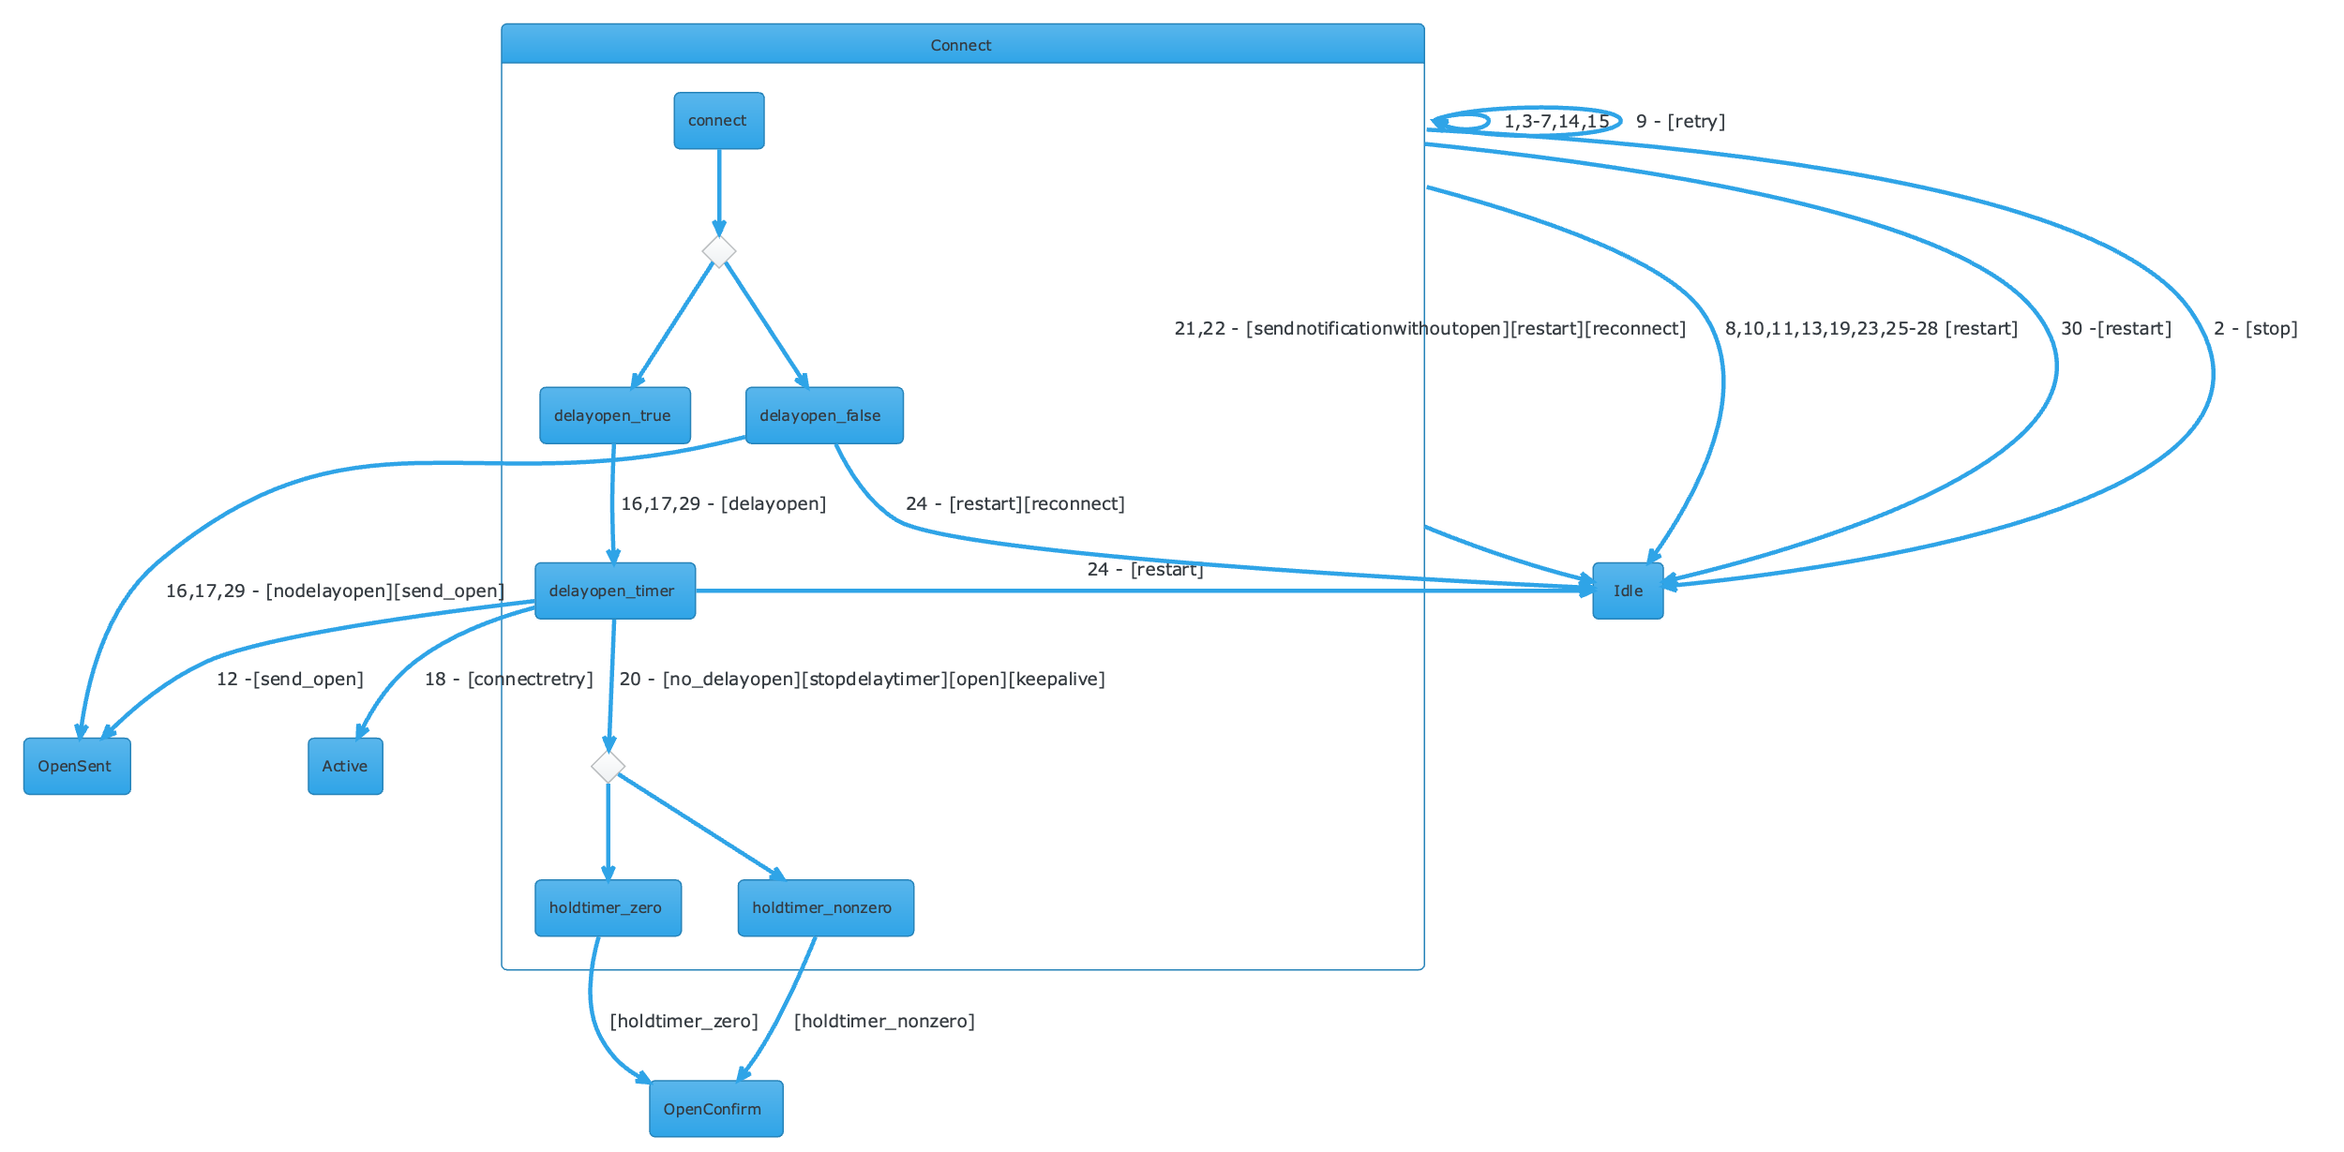
BGP FSM – Connect State
Text used to generate the UML diagram:
state Connect {
state DelayOpen <<choice>>
connect --> DelayOpen
DelayOpen --> delayopen_false
DelayOpen --> delayopen_true
delayopen_true --> delayopen_timer:16,17,29 - [delayopen]
state holdtimer <<choice>>
delayopen_timer --> holdtimer: 20 - [no_delayopen][stopdelaytimer][open][keepalive]
holdtimer --> holdtimer_zero
holdtimer --> holdtimer_nonzero
}
delayopen_timer --> OpenSent: 12 -[send_open]
delayopen_false --> OpenSent: 16,17,29 - [nodelayopen][send_open]
delayopen_timer --> Active: 18 - [connectretry]
holdtimer_zero -->OpenConfirm : [holdtimer_zero]
holdtimer_nonzero --> OpenConfirm : [holdtimer_nonzero]
Connect --> Idle: 30 -[restart]
Connect -> Idle: 21,22 - [sendnotificationwithoutopen][restart][reconnect]
delayopen_timer -> Idle:24 - [restart]
delayopen_false -> Idle:24 - [restart][reconnect]
Connect --> Connect: 1,3-7,14,15
Connect --> Idle: 2 - [stop]
Connect --> Connect: 9 - [retry]
Connect -> Idle: 8,10,11,13,19,23,25-28 [restart]
Open-source tool that uses simple textual descriptions to draw beautiful UML diagrams (plantuml.com)

Slide 5
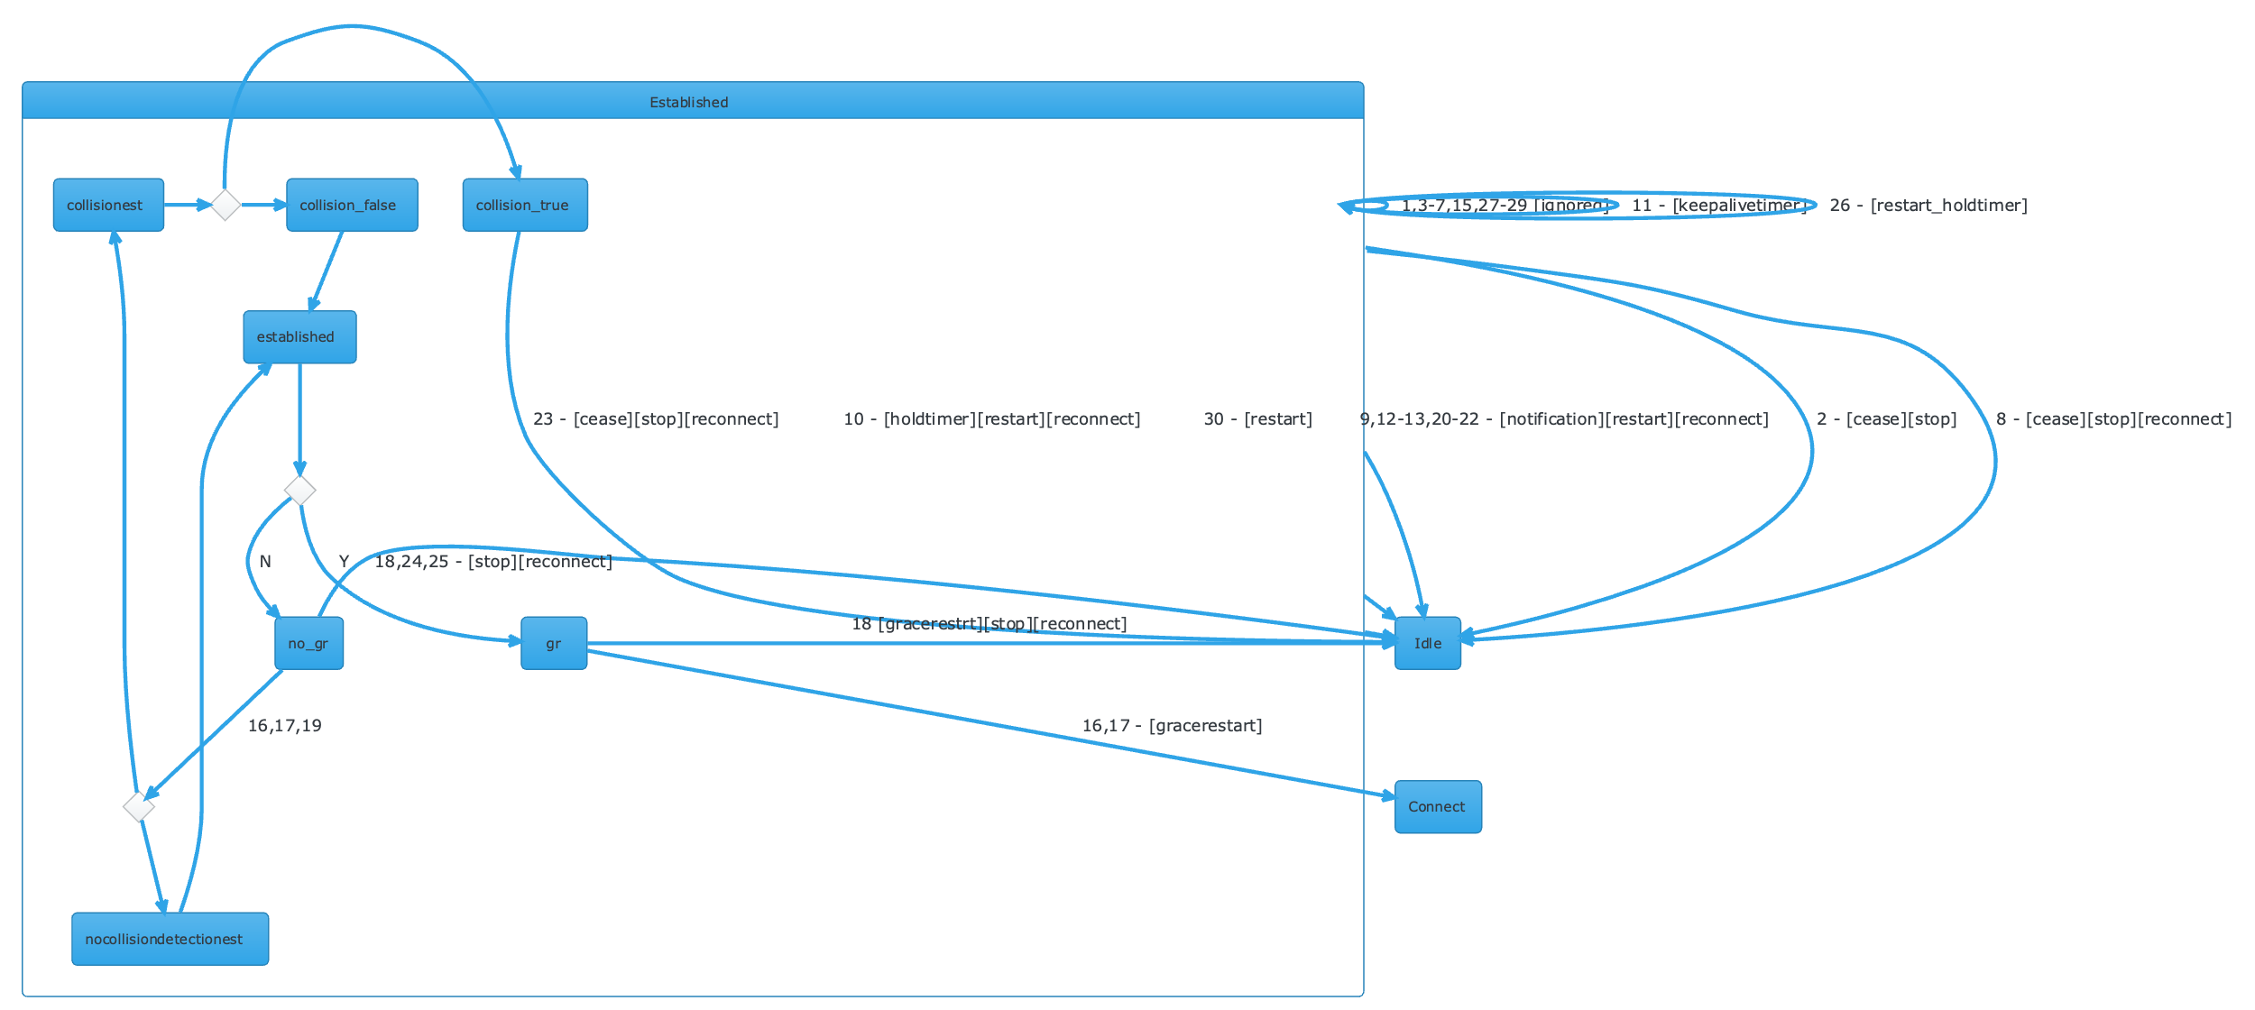
BGP FSM– Established State

