Slide 1

Why Network Notifications Matter - Enabling Resilient Networking for AI
Jeff Tantsura

Slide 2
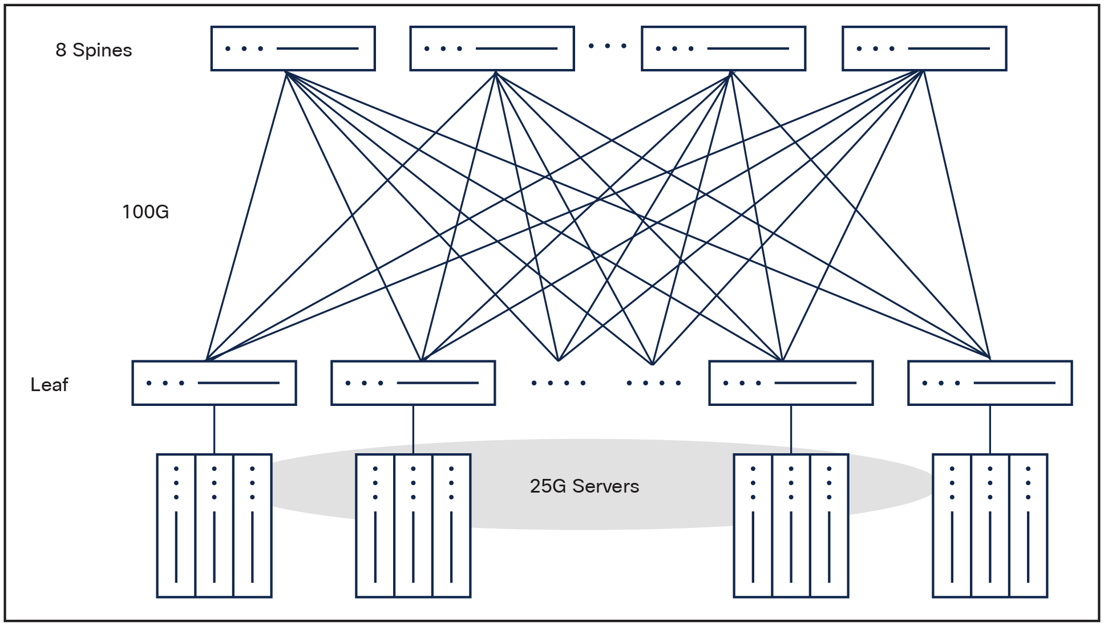
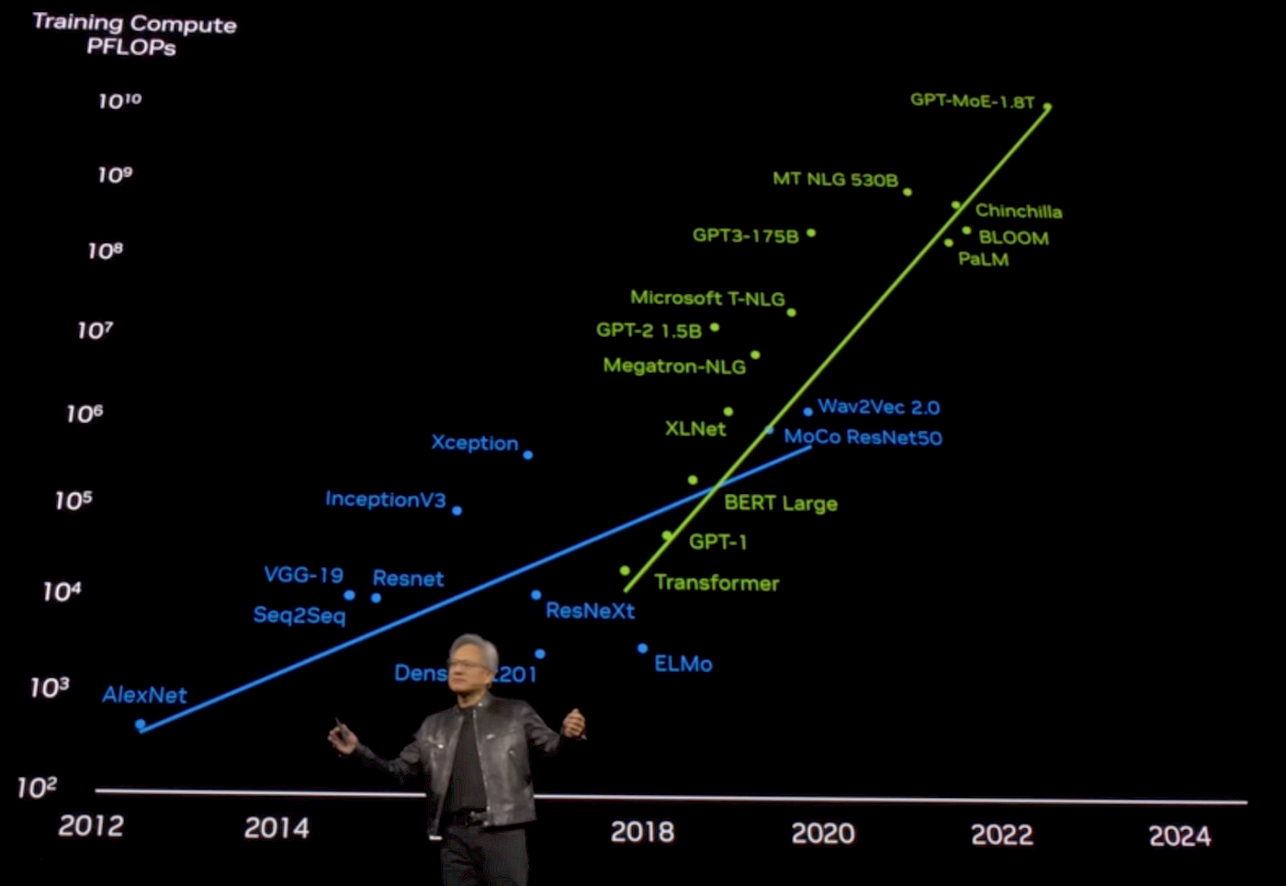
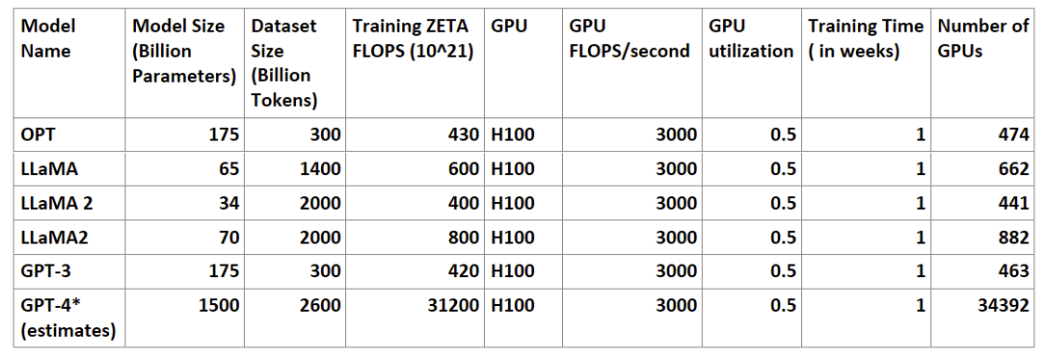
The Growing Demands of AI Workloads
The network connecting GPUs or accelerators during training/inference of large language models.
LLM backend fabrics are built for extreme performance at scale — ultra-high throughput, low latency, massive concurrency, and deterministic behavior are all essential.
Data Center Network Fabric
Demystify Transformers: A Guide to Scaling Laws
PFLOPs are growing to catch up with the scaling law of LLMs
Notes:
LLM training clusters often separate their network architecture into frontend and backend components. The frontend handles tasks like job management and storage, while the backend is dedicated to the high-volume traffic generated during training. This separation ensures that training performance is not hindered by other network activities. ​

Slide 3
Characteristics of AI Training Clusters
Explosive growth of AI/ML training clusters
High-performance, low-latency network needs
Distributed compute across multiple data centers
Sensitivity to network failures and congestion
Multi-GPU, multi-node distributed training (e.g., Horovod, DeepSpeed)
Synchronized traffic (e.g., AllReduce)
Impact of network delays on training convergence and performance
Need for tight coordination between compute and network layers

Slide 4
Inter-DC Network Realities
AI workloads often span multiple data centers
Latency and jitter affect job completion time
Link failures and congestion are inevitable
Requires real-time awareness of network conditions

Slide 5
The Problem – Gaps in Today’s Notification Mechanisms
Traditional IETF mechanisms (e.g., IGP/BGP convergence) provide routing related information, not much about network quality
Rely on polling or periodic updates (SNMP, streaming telemetry)
Lack of near real time, event-driven notifications
Missed opportunities for real-time response

Slide 6
What Network Notifications Enable
Real-time congestion signaling
Application-aware network adaptation
Use cases: rerouting traffic, scaling paths, pausing jobs, etc.

Slide 7
Example Scenarios
Loss of a link in a GPU cluster causes training to slow down significantly due to its collective nature
A node failure may cause complete job failure
In time failure notifications are a critical enabler for mitigating the impact of failures in AI training clusters.
The faster the network or system can detect and react to a failure, the smaller is the disruption

Slide 8

Call to Action
Recognize network notifications as critical infrastructure for AI
Identify use cases where current protocols fall short
Support standardization efforts

