Slide 1


Slide 2
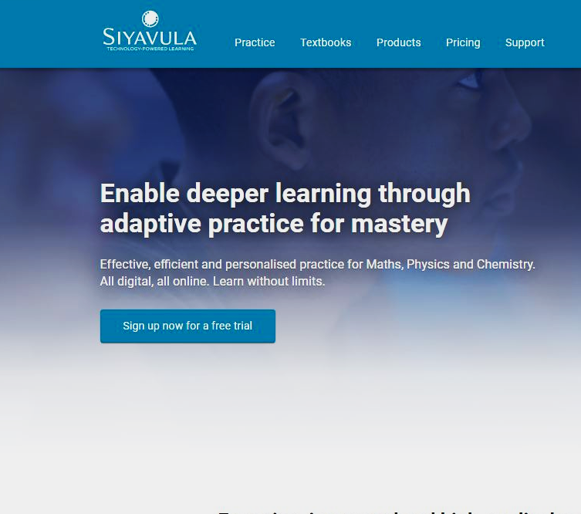
Introduction

Slide 3
Patrick Onduto
Team Lead
Mark Mutaiti
Data Engineer
Yinka Akindele
Communication
Meet Our
Team
Jan Legodi
Tech Lead
Joshua Omukoro
Research
Edward Nqosa
Communication

Slide 4
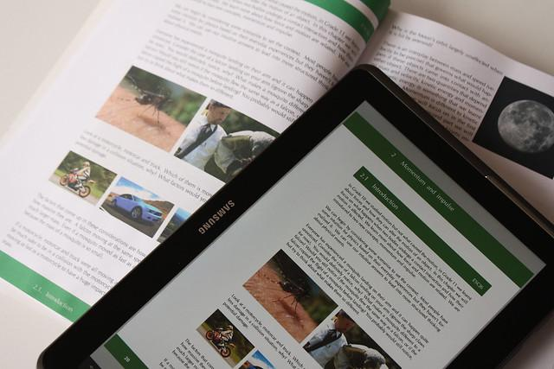
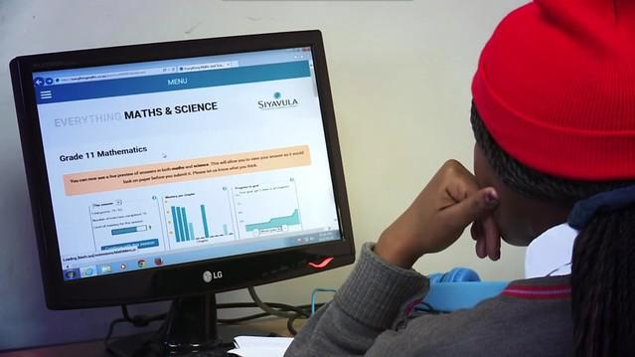
What is Siyavula?
Siyavula is an ed-tech company with a mission to uplift education through enabling digital accessibility of online contents to high school students in Africa to support the mastery of concepts in Mathematics, Physics and Chemistry
Website: https://www.siyavula.com/

Slide 5
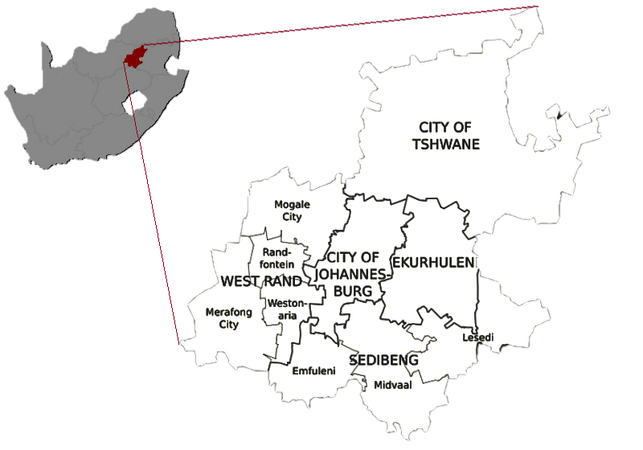
The Baseline Assessment
Administered to the grade 8 students in 2022.
To test the level of understanding of the foundational knowledge in Mathematics.
To evaluate effect of covid on learning and performance of this class.

Slide 6

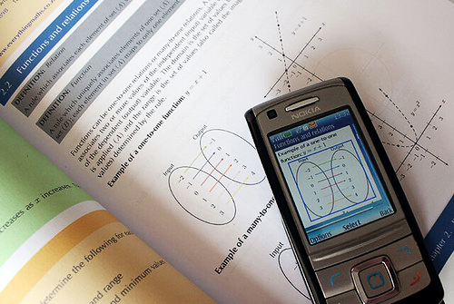


Problem Statement
Quality of learning estimated to have dropped by 50%-75% during 2020 and 2021.
Uncertainty on which foundational knowledge has been successfully acquired by the class 8 cohort.
Need to analyse baseline assessment results to assess any gaps and inform potential curriculum adjustments.

Slide 7



Deputy Director of Curriculum:
- Current State of Cohort
- Track progress
Our Objective
Analyse the baseline assessment items and build a dashboard for the student results on the baseline assessment.
District Officials:
- How is my district doing?
- How do schools compare?

Slide 8
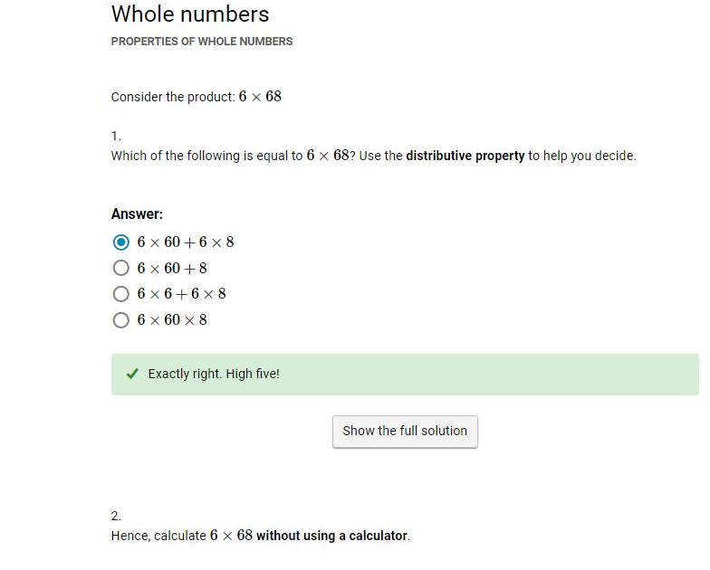
Getting our hands dirty...

Slide 9
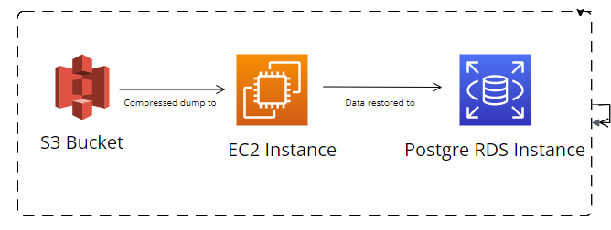
Setting up the Database
Siyavula provided a 100GB anonymised Postgres Database in the form of a 25GB compressed dump in an S3 bucket.
To access this data, we had to:
Restore the DB in a Amazon RDS instance.
Connect to the DB using pgAdmin

Slide 10
Exploring the Database
155 Tables available in the DB.
155
tables
16 Relevant tables for our study.
16
Over 103 million rows of data in some relevant tables.
103M
data rows

Slide 11
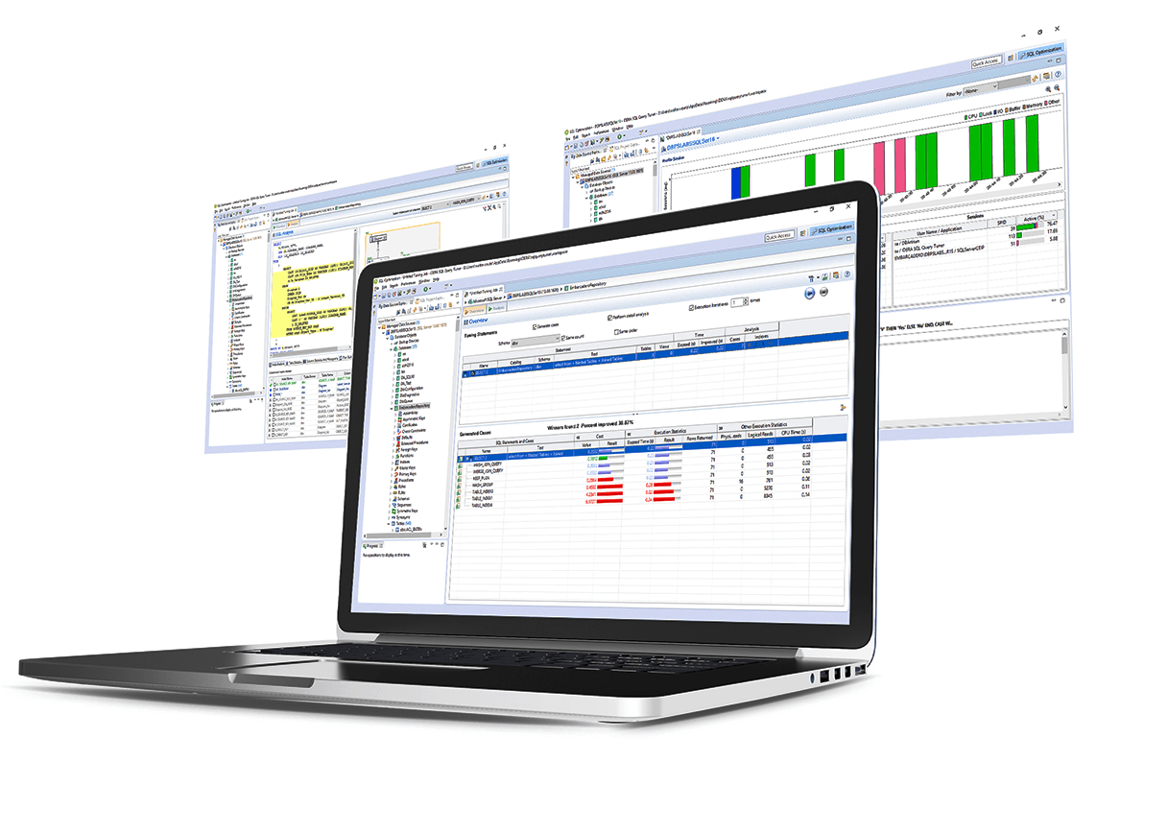
Data Extraction
SQL queries were used to extract our relevant data from the database.
The Queries had to be efficient and fast due huge amounts of data in some tables.
Also, we created complex queries to be able to get relevant columns from different tables.

Slide 12

Cleaning the Data
Removed any duplicates
Created new columns
Combined other tables to produce single table (e.g. schools and users)

Slide 13
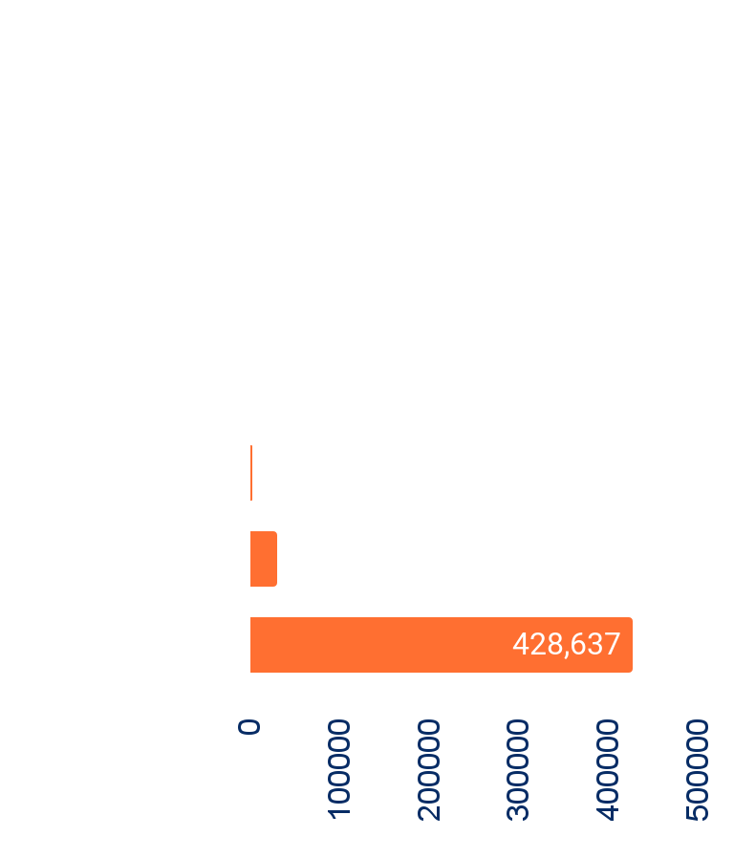
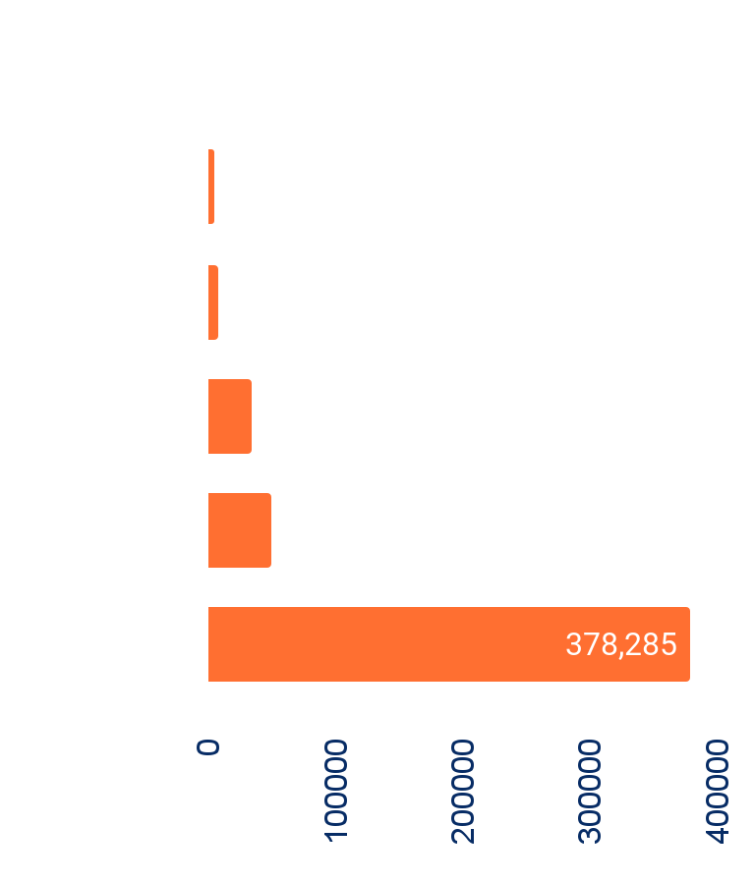
Exploratory Data Analysis

Slide 14
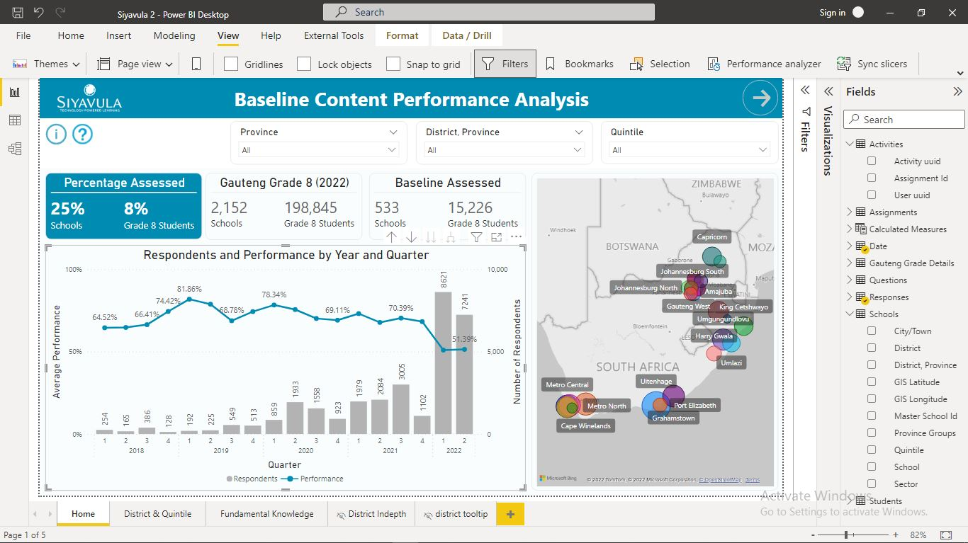
Hacking the Dashboard…

Slide 15
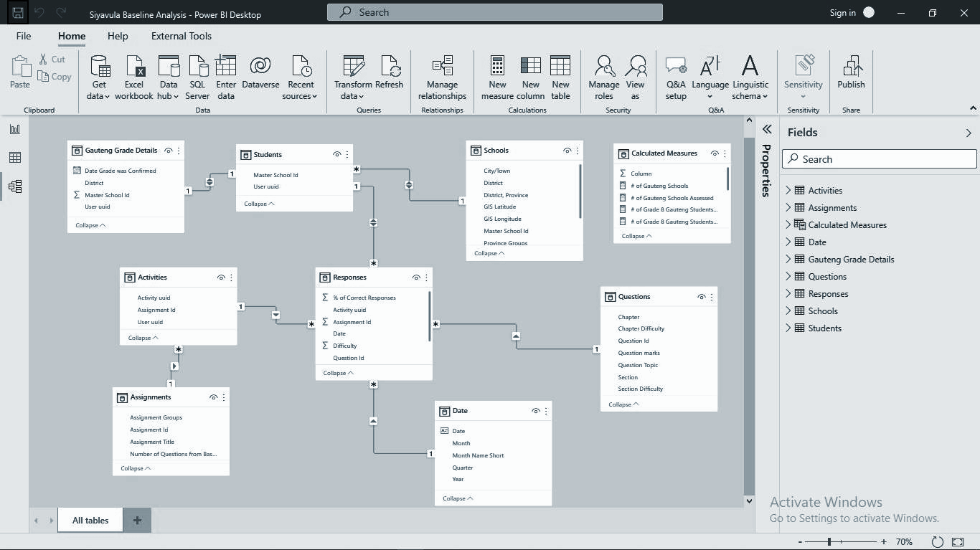
Creating the tables
For data modeling we created:
A Responses Table as our Fact Table
A Date table, and
Six other dimensional tables

Slide 16
Creating the tables Continued…
Baseline Questions Table
Contains 50 items questions in the baseline assessment
Responses Table
Contains responses from students pertaining to the baseline quizzes
Assignment Table
Contains assignments that have any of the baseline quizzes

Slide 17
Creating the tables Continued…
Schools Table
Contains all Gauteng schools and any school that was involved in the baseline assessment
Activities Table
Contains student activities for any assignment with the baseline quizzes
Students and Grade 8 Details Tables
Contains student user information & grade details for students in grade 8 from Gauteng Province

Slide 18
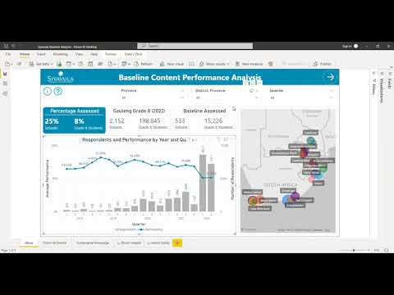

Slide 19


Our Take

Slide 20

Conclusions
The highest economic class, quintile 5, has the highest average performance in the baseline assessment this exacerbate the lack of equitable access to resources
On average students get 70% of the questions correctly, with a notable 19% drop in performance in 2022
There is a poor average performance in summarising data, volume and capacity and area and perimeter of triangles topics in the baseline assessment

Slide 21

Next steps >>
Explore the impact of previous Interventions
Investigate the relationship between effort in terms of time spent on resources and performance.
Explore time spent to provide respond
Explore the first attempts, last attempts and best attempts of the students

Slide 22
Maswali na
Majibu
?

