Slide 1



Cross-VM Side Channels and Their Use to Extract Private Keys
Yinqian Zhang (UNC-Chapel Hill)
Ari Juels (RSA Labs)
Michael K. Reiter (UNC-Chapel Hill)
Thomas Ristenpart (U Wisconsin-Madison)

Slide 2













Motivation

Slide 3


Security Isolation by Virtualization
VM
VM
Crypto Keys
Attacker
Victim
Virtualization Layer
Computer Hardware

Slide 4
Access-Driven Cache Timing Channel
VM
VM
Crypto Keys
Attacker
Victim
Side Channels
Virtualization (Xen)
An open problem:
Are cryptographic side channel attacks possible in virtualization environment?

Slide 5


Related Work
Publication | Multi-Core | Virtualization | w/o SMT | Target
Percival 2005 |  |  |  | RSA
Osvik et al. 2006 |  |  |  | AES
Neve et al. 2006 |  |  |  | AES
Aciicmez 2007 |  |  |  | RSA
Aciicmez et al. 2010 |  |  |  | DSA
Bangerter 2011 |  |  |  | AES

Slide 6
Related Work
Publication | Multi-Core | Virtualization | w/o SMT | Target
Percival 2005 |  |  |  | RSA
Osvik et al. 2006 |  |  |  | AES
Neve et al. 2006 |  |  |  | AES
Aciicmez 2007 |  |  |  | RSA
Ristenpart el al. 2009 |  |  |  | load
Aciicmez et al. 2010 |  |  |  | DSA
Bangerter 2011 |  |  |  | AES

Slide 7
Related Work
Publication | Multi-Core | Virtualization | w/o SMT | Target
Percival 2005 |  |  |  | RSA
Osvik et al. 2006 |  |  |  | AES
Neve et al. 2006 |  |  |  | AES
Aciicmez 2007 |  |  |  | RSA
Ristenpart el al. 2009 |  |  |  | load
Aciicmez et al. 2010 |  |  |  | DSA
Bangerter 2011 |  |  |  | AES
Our work |  |  |  | ElGamal

Slide 8
Outline
Stage 1
Stage 2
Cross-VM Side Channel Probing
Cache Pattern Classification
Vectors of cache measurements
Sequences of SVM-classified labels
Noise Reduction
Code-Path Reassembly
Fragments of code path
Stage 3
Stage 4

Slide 9


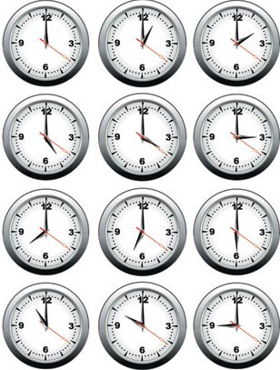
Digress: Prime-Probe Protocol
PRIME
PRIME-PROBE Interval
PROBE
Time
4-way set associative L1 I-Cache
Cache Set

Slide 10
Cross-VM Side Channel Probing
VM
VM
Attacker
Victim
Virtualization (Xen)
L1
I-Cache
L1
I-Cache
L1
I-Cache
L1
I-Cache

Slide 11


Challenge: Observation Granularity
VM/VCPU
VM/VCPU
W/ SMT: tiny prime-probe intervals
W/o SMT: gaming schedulers
Attacker
Victim
L1
I-Cache
Time
30ms
30ms

Slide 12
Ideally …
Time
Short intervals
Use Interrupts to preempt the victim:
Timer interrupts?
Network interrupts?
HPET interrupts?
Inter-Processor interrupts (IPI)!

Slide 13
Inter-Processor Interrupts
Attacker VM
For( ; ; ) {
send_IPI();
Delay();
}
VM/VCPU
IPI
VCPU
Attacker
VCPU
Victim
Virtualization (Xen)
CPU core
CPU core

Slide 14
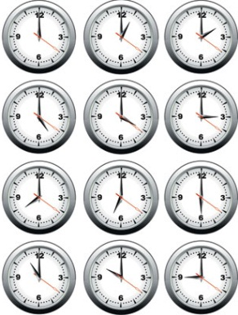
Cross-VM Side Channel Probing
Time
2.5 µs
2.5 µs
2.5 µs

Slide 15
Outline
Stage 1
Stage 2
Cross-VM Side Channel Probing
Cache Pattern Classification
Vectors of cache measurements
Sequences of SVM-classified labels
Noise Reduction
Code-Path Reassembly
Fragments of code path
Stage 3
Stage 4

Slide 16
Square-and-Multiply (libgcrypt)
/* y = x^{e} mod N , from libgcrypt*/
Modular Exponentiation (x, e, N):
let e_{n} … e₁ be the bits of e
y ← 1
for e_{i} in {e_{n} …e₁}
y ← Square(y) (S)
y ← Reduce(y, N) (R)
if e_{i} = 1 then
y ← Multi(y, x) (M)
y ← Reduce(y, N) (R)
e_{i} = 1 → “SRMR”
e_{i} = 0 → “SR”

Slide 17
Cache Pattern Classification
Key observation:
Footprints of different functions are distinct in the I-Cache !
Square(): cache set 1, 3, …, 59
Multi(): cache set 2, 5, …, 60, 61
Reduce(): cache set 2, 3, 4, …, 58
Square()
Classification
Multi()
Reduce()

Slide 18


Support Vector Machine
Noise: hypervisor context switch
Square()
SVM
Multi()
Reduce()
Read more on SVM training

Slide 19
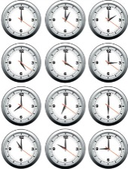
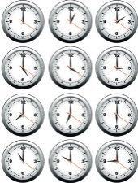
Support Vector Machine
SVM
……
S
S
S
S
R
R
R
R
M
M
M
M
R
S
R
R

Slide 20
Outline
Stage 1
Stage 2
Cross-VM Side Channel Probing
Cache Pattern Classification
Vectors of cache measurements
Sequences of SVM-classified labels
Noise Reduction
Code-Path Reassembly
Fragments of code path
Stage 3
Stage 4

Slide 21
Noise Reduction
S
S
R
S
R
R
S
R
M
R
M
……
R
Square
Reduce
Multi
requires robust automated error correction

Slide 22
Hidden Markov Model
S
R
M
Square
Reduce
Multi
Unkn

Slide 23
Hidden Markov Model
S
S
R
S
M
R
M
R
……
R
R
S
R
S
R
M
Square
Reduce
Multi
Unkn

Slide 24
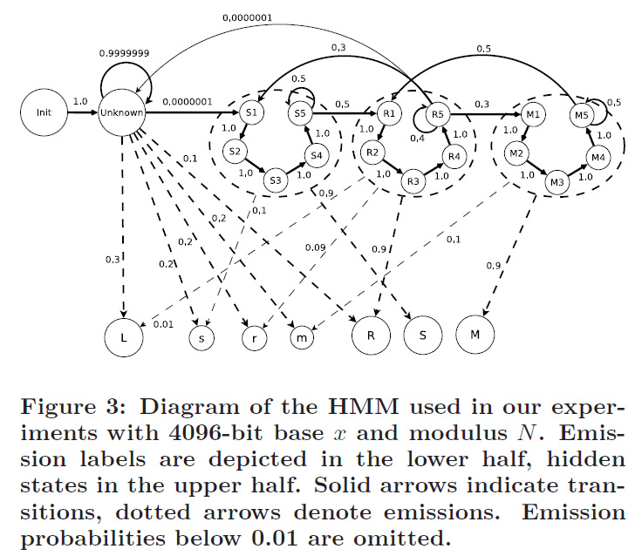
Hidden Markov Model
low confidence

Slide 25

Eliminate Non-Crypto Computation
SVM
S
R
R
R
R
R
R
M
R
R
S
M
M
……

Slide 26
Eliminate Non-Crypto Computation
S
R
R
R
R
R
R
M
R
R
S
M
M
……
S
R
M
Square
Reduce
Multi
Unkn

Slide 27
Eliminate Non-Crypto Computation
Key Observations
S:M Ratio should be roughly 2:1 for long enough sequences!
“MM” signals an error (never two sequential multiply operations)

Slide 28
Key Extraction
Start Decryption
Unkn
Unkn
Unkn
VCPU
VCPU
Square
Reduce
Square
Reduce
Multi
Reduce
Victim
Attacker
Virtualization (Xen)
L1
I-Cache
L1
I-Cache
L1
I-Cache
L1
I-Cache

Slide 29
Multi-Core Processors
0100011...
Another
VCPU
Dom0
VCPU
Victim
VCPU
Attacker
VCPU
IPI
VCPU
L1
I-Cache
L1
I-Cache
L1
I-Cache
L1
I-Cache

Slide 30
Multi-Core Processors
..#####...
Dom0
VCPU
Another
VCPU
Victim
VCPU
IPI
VCPU
Attacker
VCPU
L1
I-Cache
L1
I-Cache
L1
I-Cache
L1
I-Cache

Slide 31
Multi-Core Processors
##10100...
Another
VCPU
Dom0
VCPU
IPI
VCPU
Victim
VCPU
Attacker
VCPU
L1
I-Cache
L1
I-Cache
L1
I-Cache
L1
I-Cache

Slide 32
From an Attacker’s Perspective
#####1001111010####
#0111101011########
####110101101#####0
1101110############
###########........

Slide 33
Outline
Stage 1
Stage 2
Cross-VM Side Channel Probing
Cache Pattern Classification
Vectors of cache measurements
Sequences of SVM-classified labels
Noise Reduction
Code-Path Reassembly
Fragments of code path
Stage 3
Stage 4

Slide 34
Code-Path Reassembly
1001110010
0111101111
110101101
11101110
DNA Assembly
No error bit!
100111*01*1101110

Slide 35
A DP/Graph Solution
1001011
1001011
0101-010
0101010

Slide 36
Correcting False Alignment
0101001
1001011
1001011
0101-010
0101001
0101-010

Slide 37
Cross-Fragments Error Correction
A:
0101001
D:
1010-11
E:
010-11
A
D
A:
01010-11
D:
1010-11
E:
010-11
E

Slide 38
Fragments Stitching
F
Greedy Algorithm:
“Longest” Path in DAG
Spanning Sequences
Potential key bits
B
A
C
D
C:
110101
E:
101011
E

Slide 39
Combining Spanning Sequences
10*011*110101*101-10
1000111-101010101110
100011*1101-10101110
100011*1101010101110
UNCERTAINTY OKEY, NO ERROR ALLOWED!!

Slide 40
Outline
Stage 1
Stage 2
Cross-VM Side Channel Probing
Cache Pattern Classification
Vectors of cache measurements
Sequences of SVM-classified labels
Noise Reduction
Code-Path Reassembly
Fragments of code path
Stage 3
Stage 4

Slide 41

Evaluation
Intel Yorkfield processor
4 cores, 32KB L1 instruction cache
Xen + linux + GnuPG + libgcrypt
Xen 4.0
Ubuntu 10.04, kernel version 2.6.32.16
Victim runs GnuPG v.2.0.19 (latest)
libgcrypt 1.5.0 (latest)
ElGamal, 4096 bits

Slide 42
Results
Work-Conserving Scheduler
300,000,000 prime-probe results (6 hours)
Over 300 key fragments
Brute force the key in ~9800 guesses
Non-Work-Conserving Scheduler
1,900,000,000 prime-probe results (45 hours)
Over 300 key fragments
Brute force the key in ~6600 guesses

Slide 43

Conclusion
A combination of techniques
IPI + SVM + HMM + Sequence Assembly
Demonstrate a cross-VM access-driven cache-based side-channel attack
Multi-core processors without SMT
Sufficient fidelity to exfiltrate cryptographic keys

Slide 44
Thank You
Questions?
Please contact: yinqian@cs.unc.edu

