Slide 1


Data and Model Analytics
01
Mis 6334
Professor Geng
Group Member
Siyang Zan, Kaier Ying,
Jingwen Zhang, Xuerong Zhang

Slide 2
Content
02
Model Performance Comparison
What We Tried
Data Modification and Input Selection
Transform Variables
Let’s see the improvement
What We Tried
Summary
Data with High Variance
Data Sampling
Ensemble
What We Learned
Notes:
分几块

Slide 3
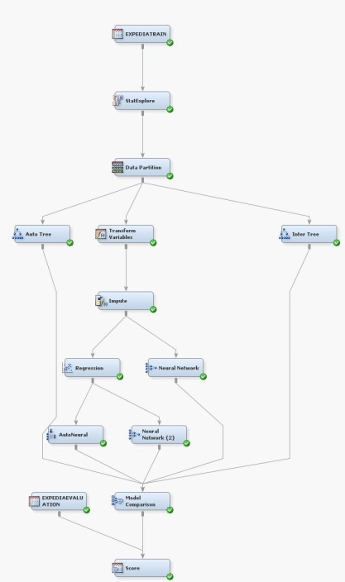
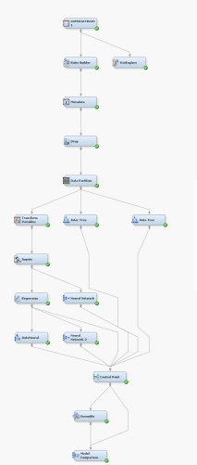
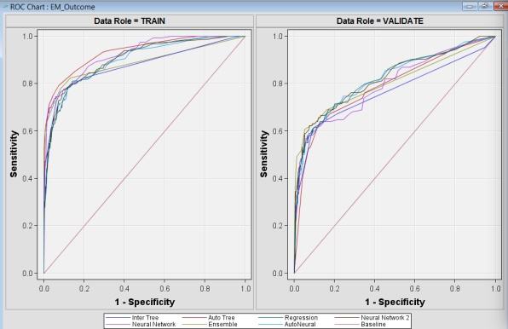
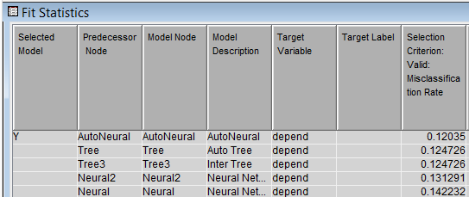
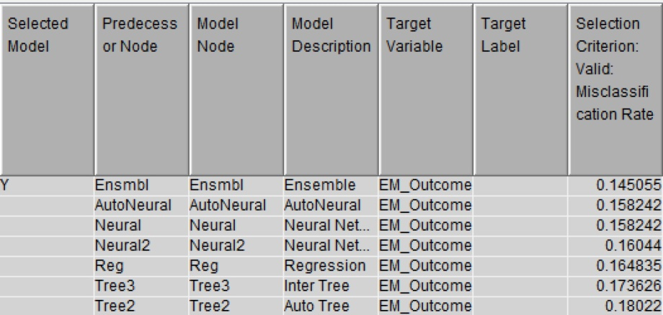
Model Performance Comparison
03
Notes:
开头所有图都放这页

Slide 4
Misclassification Rate
04
12%
14.5%
Benchmark 13.2%
Benchmark 26.7%
Initial Model
Improved Model
Notes:
Improve结果放这页

Slide 5
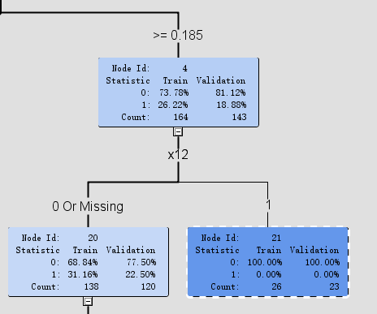
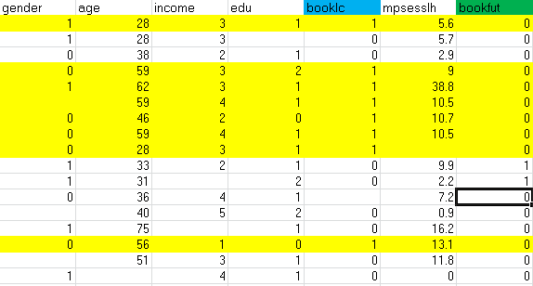
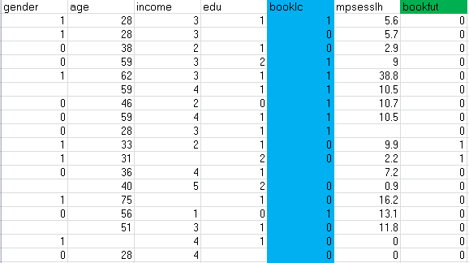
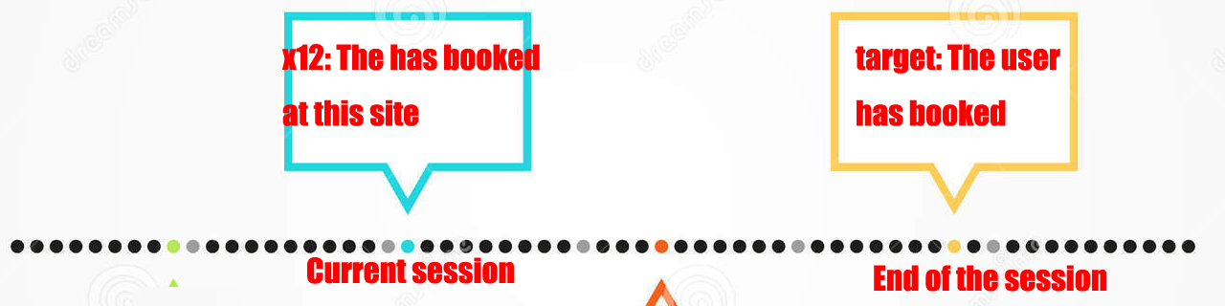
Data Modification and Input Selection
05
What’s wrong with x12
Delete the whole row?
Delete all the records?
Why we need to modify the target?
Perfect Prediction?
100%
0%
100%
100%
100%
0%
0%
100%
0%
0%
Notes:
X12， 解释在左 图在右

Slide 6
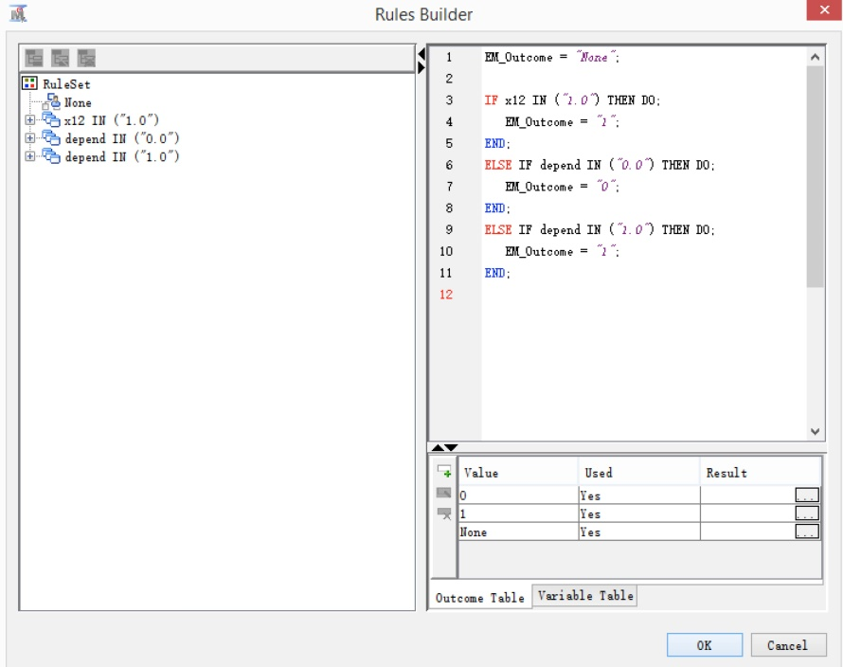
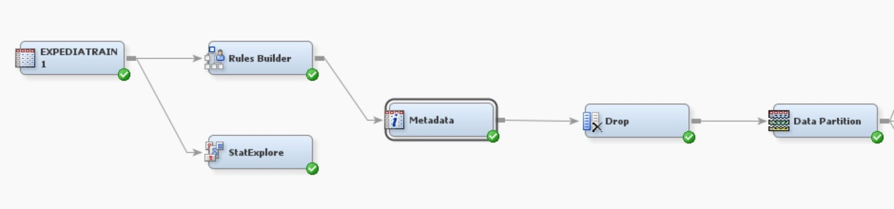
Data Modification and Input Selection
06
How to
achieve that?
100%
0%
Notes:
X12， 解释在左 图在右

Slide 7

Data Modification and Input Selection
07
x33
Trouble maker?
x33:whether the user has booked at any sites up to this point in the current session
x33 should include x12
if x33 is 1, then x12 must be 1 and target value must be 0
Notes:
X33， 图在上，解释在下

Slide 8
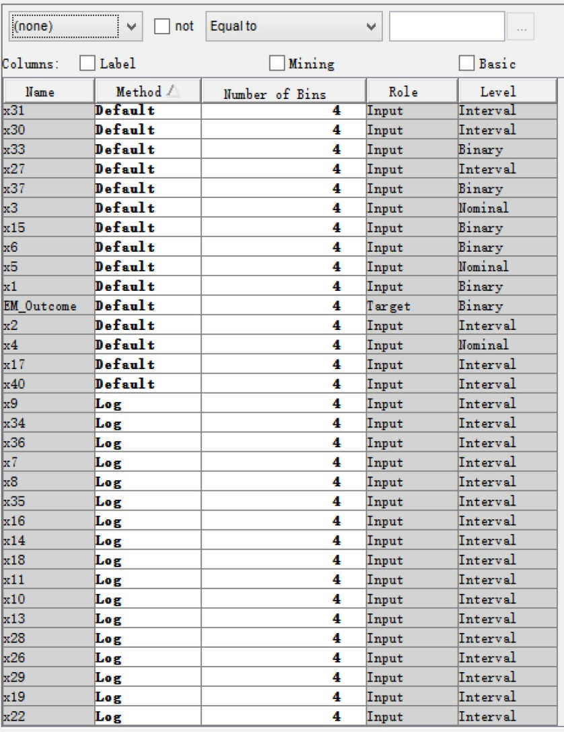
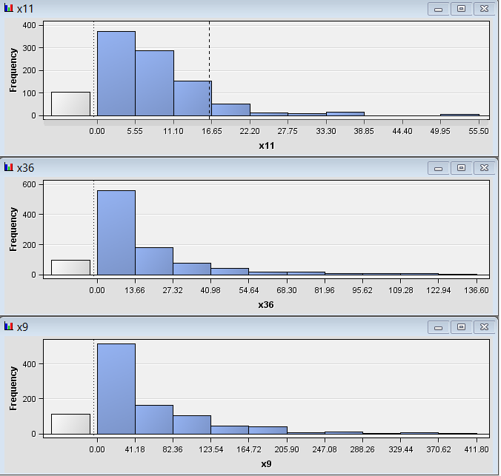
Transform Variables
08
How to
regularize skewed distribution ?
100%
0%
Notes:
X12， 解释在左 图在右

Slide 9
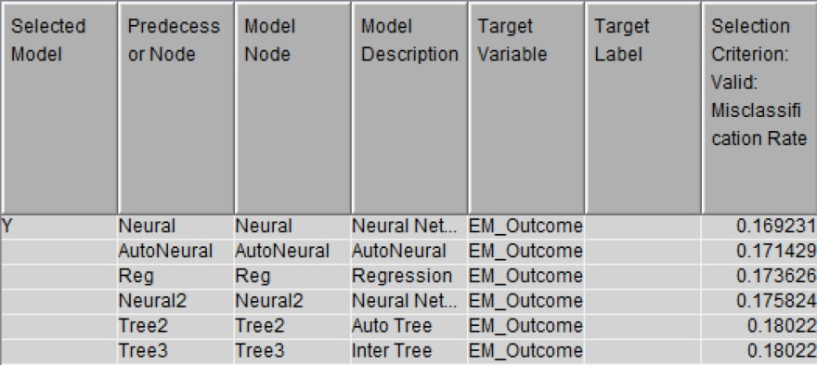
Data with High Variance
09
However,
the performance get worse T T
Use replacement node to eliminate some extreme value or outlier

Slide 10
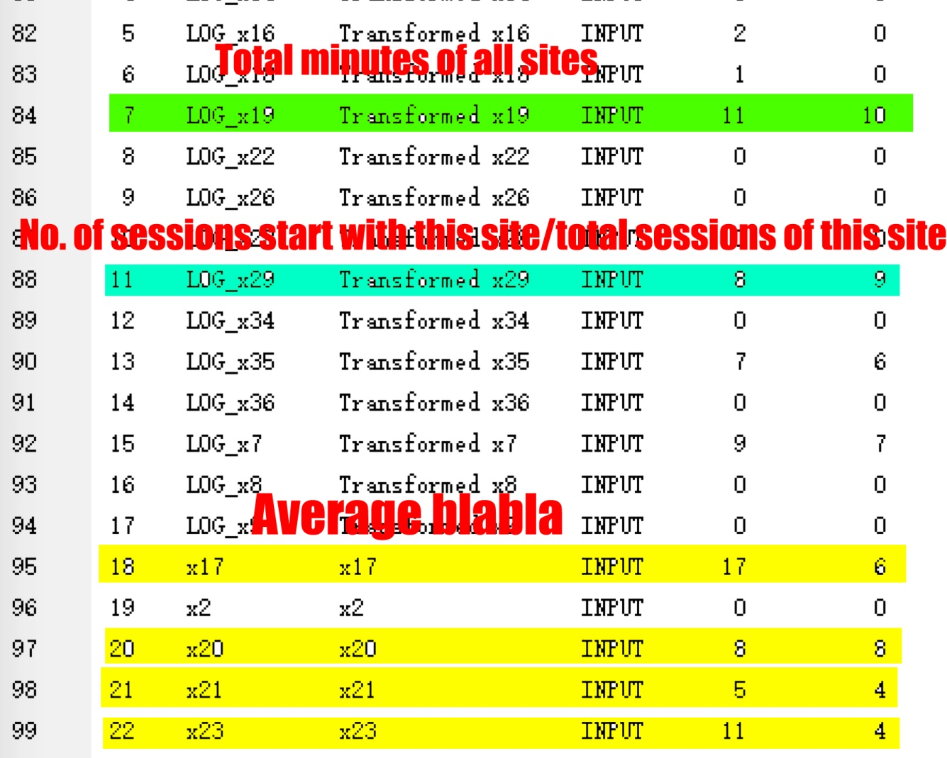
Data with High Variance
10

Slide 11
Data with High Variance
11
Total
Ratio
Average
x19 (total minutes of all sites)
x28 (minutes spent at this site divided by total minutes of all sites)
If x19 changed, we need to adjust x28 accordingly
Otherwise, x28 will be invalid

Slide 12
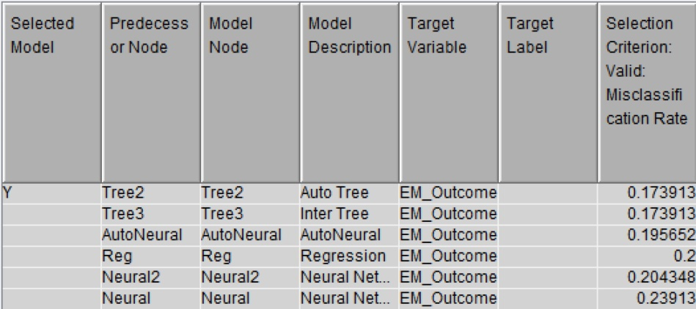
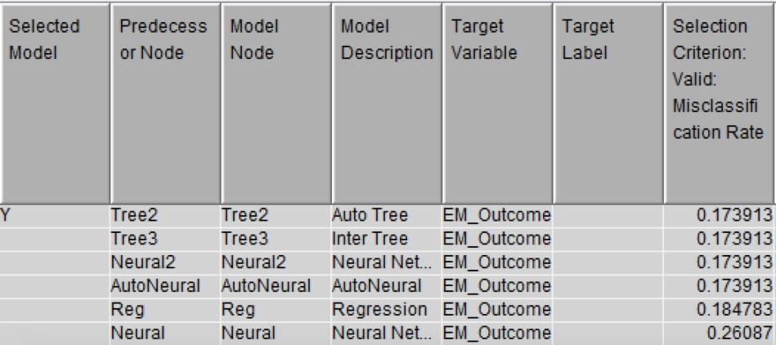
Data Sampling
12
1,010
Observations
Large data set?
26.7%
73.3%

Slide 13
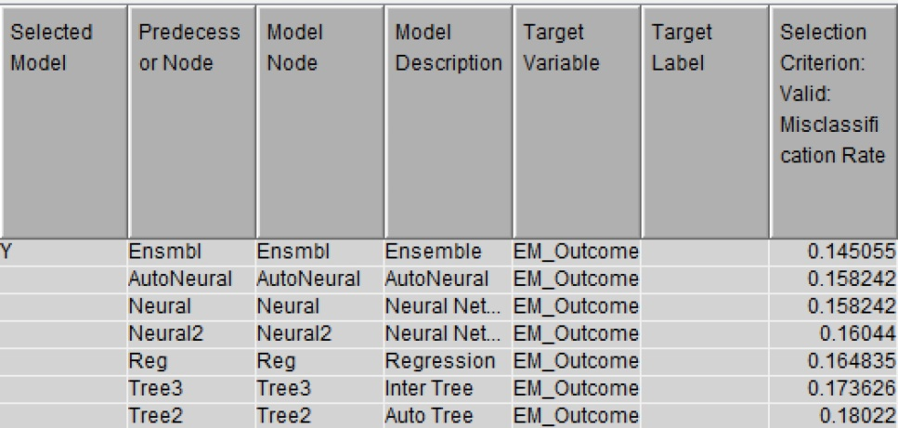
Ensemble
13
Ensemble
creates a new model by combining the predictions from multiple models

Slide 14

Summary
14
What we learn?
Input Selection
Data Modification
Data Manipulation
Classifier Adjustment

Slide 15

14
Thank you!

