Slide 1
Week12: Revision Part 1
Lecturer: Dr. Thomas Roelleke
Room CS423

Slide 2
Outline
DB History
Entity-Relationship (ER) modelling (ERM) and ER Mapping
Relational Model & Algebra
Legal and Ethical Issues; DB Admin
DWH, NoSQL, ORDBMS
Part 2: E-ERM, SQL, Normalisation, Transactions, Security, JDBC

Slide 3
DB Intro
History --- Milestones
Applications
Actors on the scene

Slide 4
Entity-Relationship (ER) Modelling
Entities + Relationships + Attributes
Design steps: 1, 2, 3, 4: each step with sup-steps
Identifying entities: real-world objects
What is “Booking”? A relationship!
A relationship can have attributes!
Foreign keys in ERM? No!
Specification: in textual form and as graph (diagram)

Slide 5
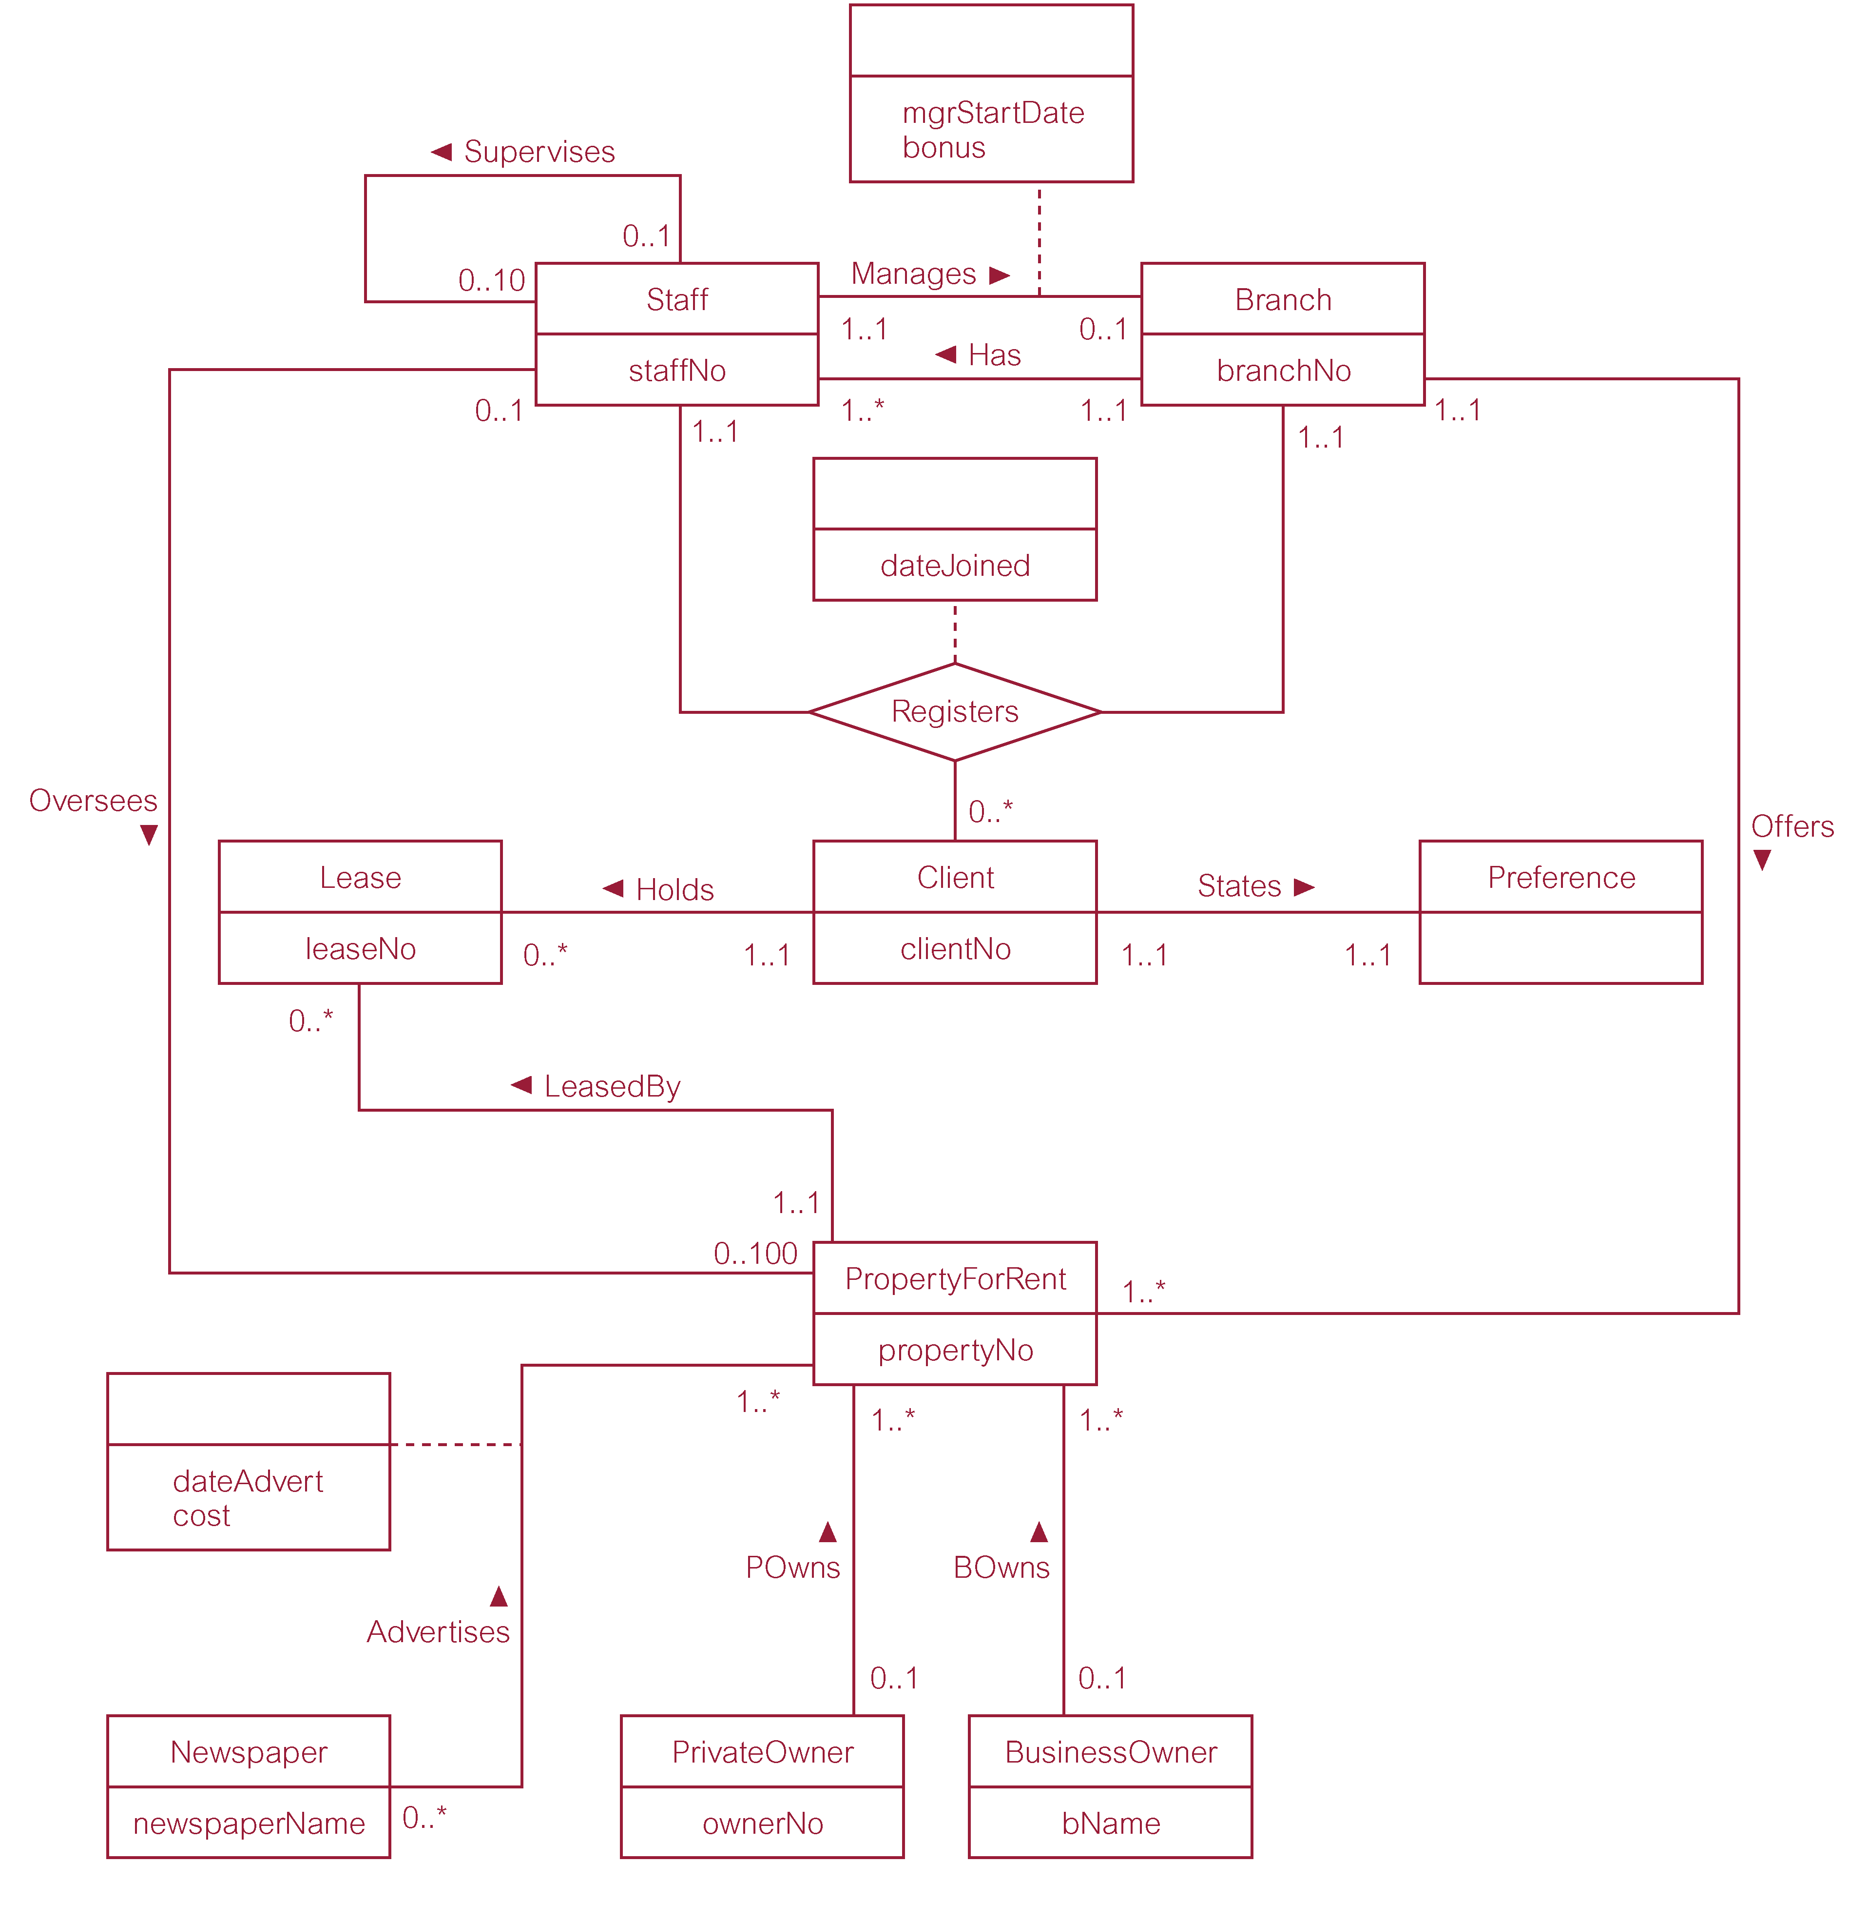
ER Diagram of the Company DreamHome
Notes:
One relationship as diamond; other relationships as simple edges.

Slide 6
ER Mapping
Entity -> Table
Relationship: 1:1, 1:n, m:n
1:1 and 1:n -> key migration
m:n -> Table
Multi-valued attributes -> Table
E-ER: Mapping of superclass-subclass relationship
Multiple relation option
Single relation option

Slide 7
Relational Model/Algebra
Algebra:
Select (WHERE! not to be confused with SQL SELECT).
Project (SELECT …)
Unite
Subtract (Minus)
Product (Join)
Others: Intersect, Divide
Syntax: keep it simple and clear
Relational Model: Foreign Keys! Constraints, cascading.

Slide 8
Legal & Ethical Issues; DB Admin
Ethical issues: Provide examples
Data protection acts: What about? What for?
What is not ethical might be not illegal … yet.
Terminology: IP, patent, copyright, trademark
DB Admin: Create User, Create Role, Grant Privilege

Slide 9
DWH, NoSQL, ORDBMS
The binding link: schema guidelines
DWH
Dimension Modelling (as opposed to ER modelling)
Schemas: star, snow-flake, star-flake
Fact table and dimension tables (with normalisation options)
NoSQL:
A movement
Stores: key-value, document, record, triplet
Key features: distributed, parallel, light-weight, “no” ACID
ORDBMS
Create Type PERSON; usage in “Create Table” command

