Slide 1


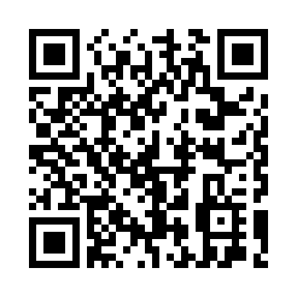
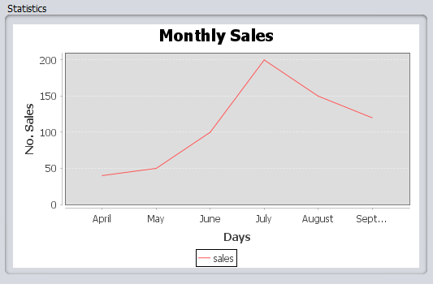
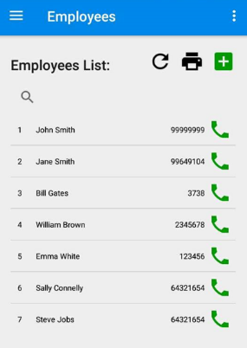
PANAYIOTA MICHAELIDES
Download
QR code:
Project Proposal:
Methodology:
Conclusion:
Create a business management system consisting of two applications for a local fresh juice company:
A desktop application for management.
A mobile application for salesmen and management.
Create a MySQL database to store the company’s information.
Create a web-based API using a generator to be used by both applications.
Create an Android application using Android Studio and Java.
Create a management application using NetBeans and JSwing.
The mobile application allows the system to be used at any time and location.
The desktop application gives a more detailed view of various statistics to the manager
-> leads to better management over company resources.
The entire system helps the company to be more organized and efficient.
Mobile Application:
Create a mobile application for the managers and salesmen which allows:
Recording of sales to each individual customer and printing statements of purchases.
Manage lists of products, customers , suppliers etc which can be printed .
Provide useful statistics about the performance.
Desktop Application:
Objectives:
Create a desktop business management application, which allows:
The director to get an overview of the company and manage different entities.
Allows to print sales statements and showing graphs .
Results:
A business Management system that allows a company to track their sales, manage their inventory etc.
Reduced amount of paper used to print receipts and reports.
Records always up to date with the latest information.
Organises actions between the director and his employees and leads to more efficient management.
Overall:
Create synchronized system that allows:
Members of the company to share information.
Managers to analyze the company’s performance.

