Slide 1

EP0611 · THINKING WITH DATA FOR DECISION MAKING
What Really Drives
Your Medical Insurance Bill?
Investigating the factors that influence individual medical insurance charges
RESEARCH QUESTION
Which personal and lifestyle factors are most strongly associated with medical insurance charges, and how large is the smoking-related gap?
Why it matters: medical costs create real financial pressure. Knowing which factors drive them most helps individuals, insurers, and policymakers make better-informed decisions.
Group Members: Lee Jun Lin Cheston · Jun Yi Yip
Data: Medical Cost Personal Dataset, Kaggle (mirichoi0218) — originally from Lantz, B., Machine Learning with R
Notes:
TIMING ~0:45. Open with the hook question, then read the research question card verbatim. One sentence on why it matters, then move to the data slide.

Slide 2





From Raw Data to Evidence
How we turned 1,338 raw records into a tested, evidence-backed answer
1,338 → 1,337
7
0
2
rows after removing
1 duplicate record
variables — 4 numerical,
3 categorical
missing values
across all columns
statistical techniques:
bootstrap CI + permutation
Load CSV
›
Clean Data
›
EDA
›
Bootstrap CI
›
Permutation
1,338 raw rows
Dedup + null check
Distributions & relationships
Resample smoker vs. non-smoker
Test significance of the gap
Source: Medical Cost Personal Dataset, Kaggle (mirichoi0218) — originally from Lantz, B., Machine Learning with R. Libraries: NumPy, Pandas, Matplotlib, Seaborn — bootstrap and permutation implemented as custom NumPy resampling functions.
We first cleaned and explored the data to identify possible drivers of cost — then selected the strongest pattern for formal statistical testing.
02
Notes:
TIMING ~1:00. Move quickly — scene-setting, not the payoff. State the dataset, the cleaning result, land on the bridge line, then move to EDA.

Slide 3
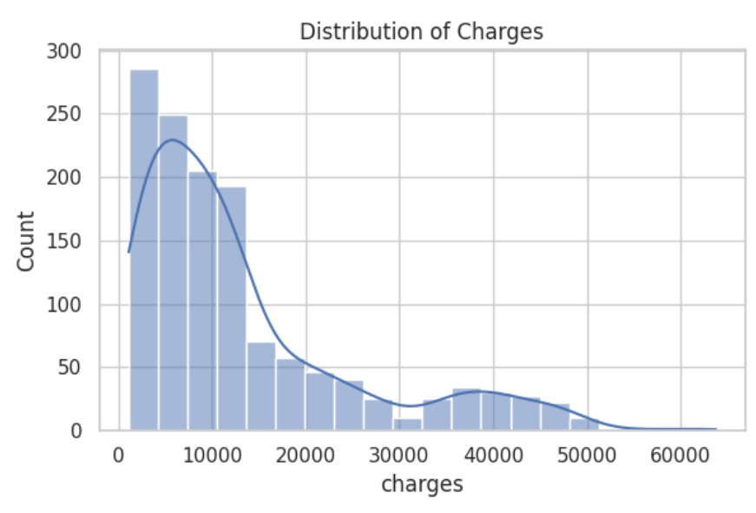
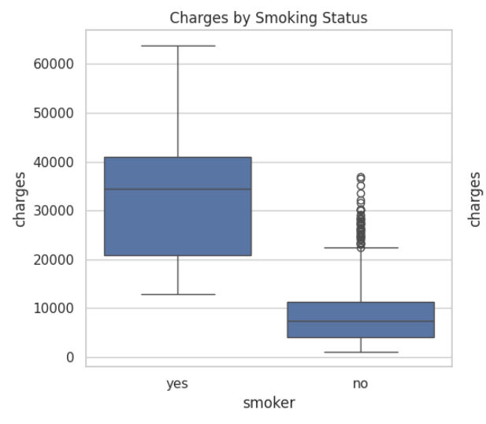
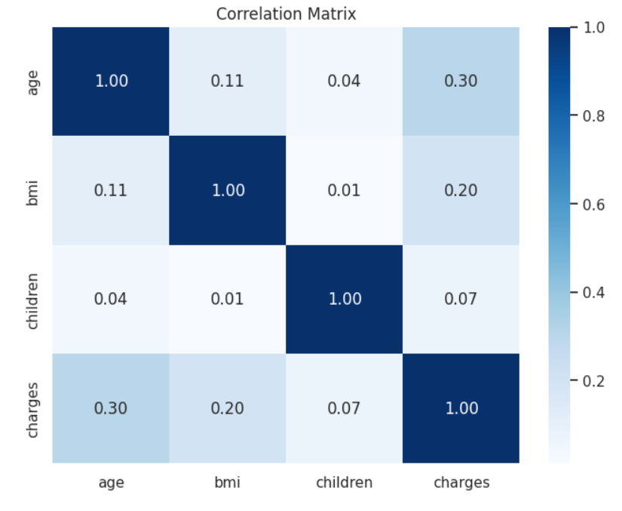
What Does the Data Reveal?
Three patterns from the exploratory analysis
Charges Are Right-Skewed
Smokers Pay Far More
Age & BMI Correlate Mildly
Most individuals pay under $10k; a small group pays over $50k — a heavy right tail.
Smokers' median charges are ~4.7× non-smokers' — the largest gap of any factor tested.
Both trend positively with charges (r ≈ 0.30, 0.20); children is nearly uncorrelated.
Among all the factors explored, smoking showed the clearest and largest difference. But visual evidence alone can't tell us whether this gap reflects a real population pattern — or chance. So we tested it statistically.
03
Notes:
TIMING ~2:15. Walk the 3 findings quickly (don't over-explain the boxplot/heatmap mechanics — they had this in EDA already). Land hard on the bridge banner — it sets up the entire rest of the talk.

Slide 4
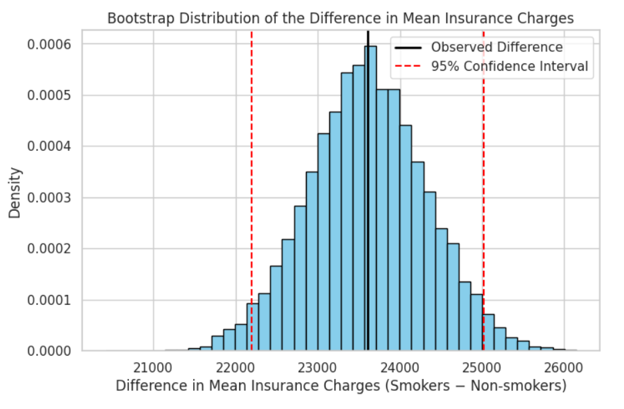
How Large Is the Smoking Gap?
Estimating the true difference with 10,000 bootstrap resamples
Smokers average $32,050 · Non-smokers average $8,441
OUR ESTIMATE
$23,610
more per year, on average, than non-smokers
95% Bootstrap CI: $22,199 — $25,020
The 95% bootstrap confidence interval for the difference in mean charges is entirely above $0 — providing strong evidence of a substantial, consistent gap in the population.
1
Resample each group
with replacement
2
Compute the resampled
mean difference
Distribution of 10,000 bootstrap mean differences (smoker − non-smoker)
3
Repeat 10,000 times
4
Take the 2.5th–97.5th
percentiles → 95% CI
04
Notes:
TIMING ~2:00. Lead with the headline number, not the mechanism — say the answer before explaining how you got it. Mechanism chips are for Q&A backup, don't read them verbatim.

Slide 5

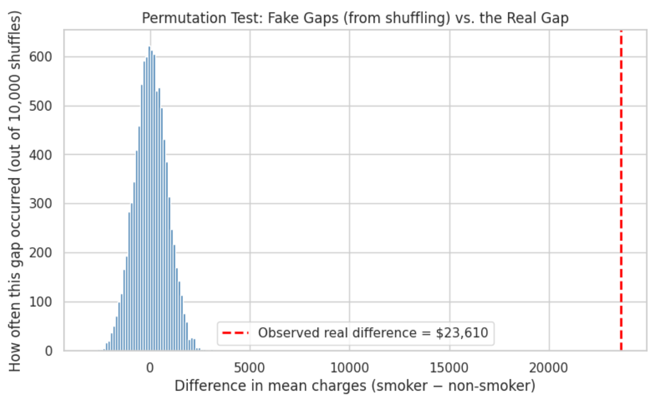
Could This Gap Be Due to Chance?
Testing the smoking gap with a permutation test
H₀: mean charges are equal for smokers and non-smokers
H₁: mean charges are higher for smokers
Significance level: α = 0.05
RESULT
p ≈ 0.0001
0 of 10,000 shuffles matched the observed $23,610 gap. Since simulation can't tell '0' from 'extremely small,' we use the standard +1 correction: p = 1 ÷ 10,001 ≈ 0.0001.
✓ Reject H₀ — strong evidence that the observed difference is unlikely under the assumption of no true group difference.
Pool all charges → shuffle the smoker/non-smoker labels 10,000× → recompute the gap each time → compare to the real gap.
05
Notes:
TIMING ~1:45. This is a common Q&A trap: if asked 'does p=0 mean probability is literally zero?' say no — it means 0 of 10,000 simulated permutations reached the observed gap, so we apply the standard +1 correction rather than reporting exactly zero.

Slide 6




Testing the Evidence From Every Angle
Does the choice of alternative hypothesis change the conclusion?
p = 0.0001
Δ > 0 — smokers pay MORE
P( shuffled gap ≥ observed )
✓ Matches our research question
p = 1.0000
Δ < 0 — smokers pay LESS
P( shuffled gap ≤ observed )
✗ No evidence at all
Same 10,000 shuffles — examined from three directions
p = 0.0001
Δ ≠ 0 — any difference
Why we chose one-tailed: our research question was directional from the start, “does smoking raise charges”, so the upper-tail test is the most appropriate test, because our alternative hypothesis specifies a higher mean charge for smokers.
P( |shuffled gap| ≥ |observed| )
✓ Confirms the result is robust
06
Notes:
TIMING ~1:00. Keep this brisk — the point is 'we checked all three ways, conclusion doesn't change.' Don't re-derive the math live; point at the table and move on.

Slide 7



The Answer: What Really Drives Higher Charges?
Bringing the evidence together
OUR ANSWER
Smoking status had the strongest association with higher medical insurance charges among the factors we explored.
$32,050
$8,441
$23,610
$22,199–25,020
≈ 0.0001
Smokers avg
Non-smokers avg
Difference
95% CI
p-value
What This Means
But — Association ≠ Causation
Age and BMI also trend positively with charges, but smoking produces by far the clearest, largest, and most statistically robust gap in this dataset — directly relevant to how individuals and insurers think about cost drivers.
This analysis doesn't control for age, BMI and other variables simultaneously, and the dataset is observational. Next step: multiple linear regression to estimate smoking's association while accounting for age, BMI, sex, children and region together.
07
Notes:
TIMING ~1:45. This is the payoff slide — deliver the headline answer with confidence, then the caveat. If asked in Q&A why not just say 'causes', point to the caveat card: observational data, no simultaneous control for confounders.

Slide 8

Limitations, Reflection & Sources
What we'd caveat, learn from, and build on next
Limitations
Future Work
Citation
• Dataset is simulated for a textbook (Machine Learning with R) — not verified real insurer claims data
• Both techniques isolate smoking alone — they don't yet control for age or BMI at the same time
• Cross-sectional, single dataset, limited to 4 US regions — no time trend
• Our bootstrap and permutation analyses isolate smoking status on its own
• Next: multiple linear regression to estimate the association between charges and smoking while simultaneously accounting for age, BMI, sex, children and region
• Lantz, B. Machine Learning with R
• Dataset via Kaggle: kaggle.com/datasets/mirichoi0218/insurance
Thank you! Bring out the questions!
08
Notes:
TIMING ~1:15. Deliver limitations with confidence, not apology — self-awareness reads as rigor. This slide closes the 12-minute presentation; Q&A follows.

