Slide 1
YIPING YIN · PERSONAL KNOWLEDGE IN THE AI ERA
Loom
Build a digital extension of yourself.
A living knowledge identity — your learning, projects, work, and AI conversations,
woven into one source-backed self that grows over time and can answer for you.
2026

Slide 2
THE PROBLEM
We lose ourselves in fragments.
Years of learning, projects, portfolios, and AI conversations pile up — then scatter across documents, notes, chats, certificates, and platforms.
Documents
Notes
AI chats
Certificates
So every interview, collaboration, application, or introduction means rebuilding your story from scratch — and most of what you know never shows.
Projects
Platforms
LOOM
02

Slide 3
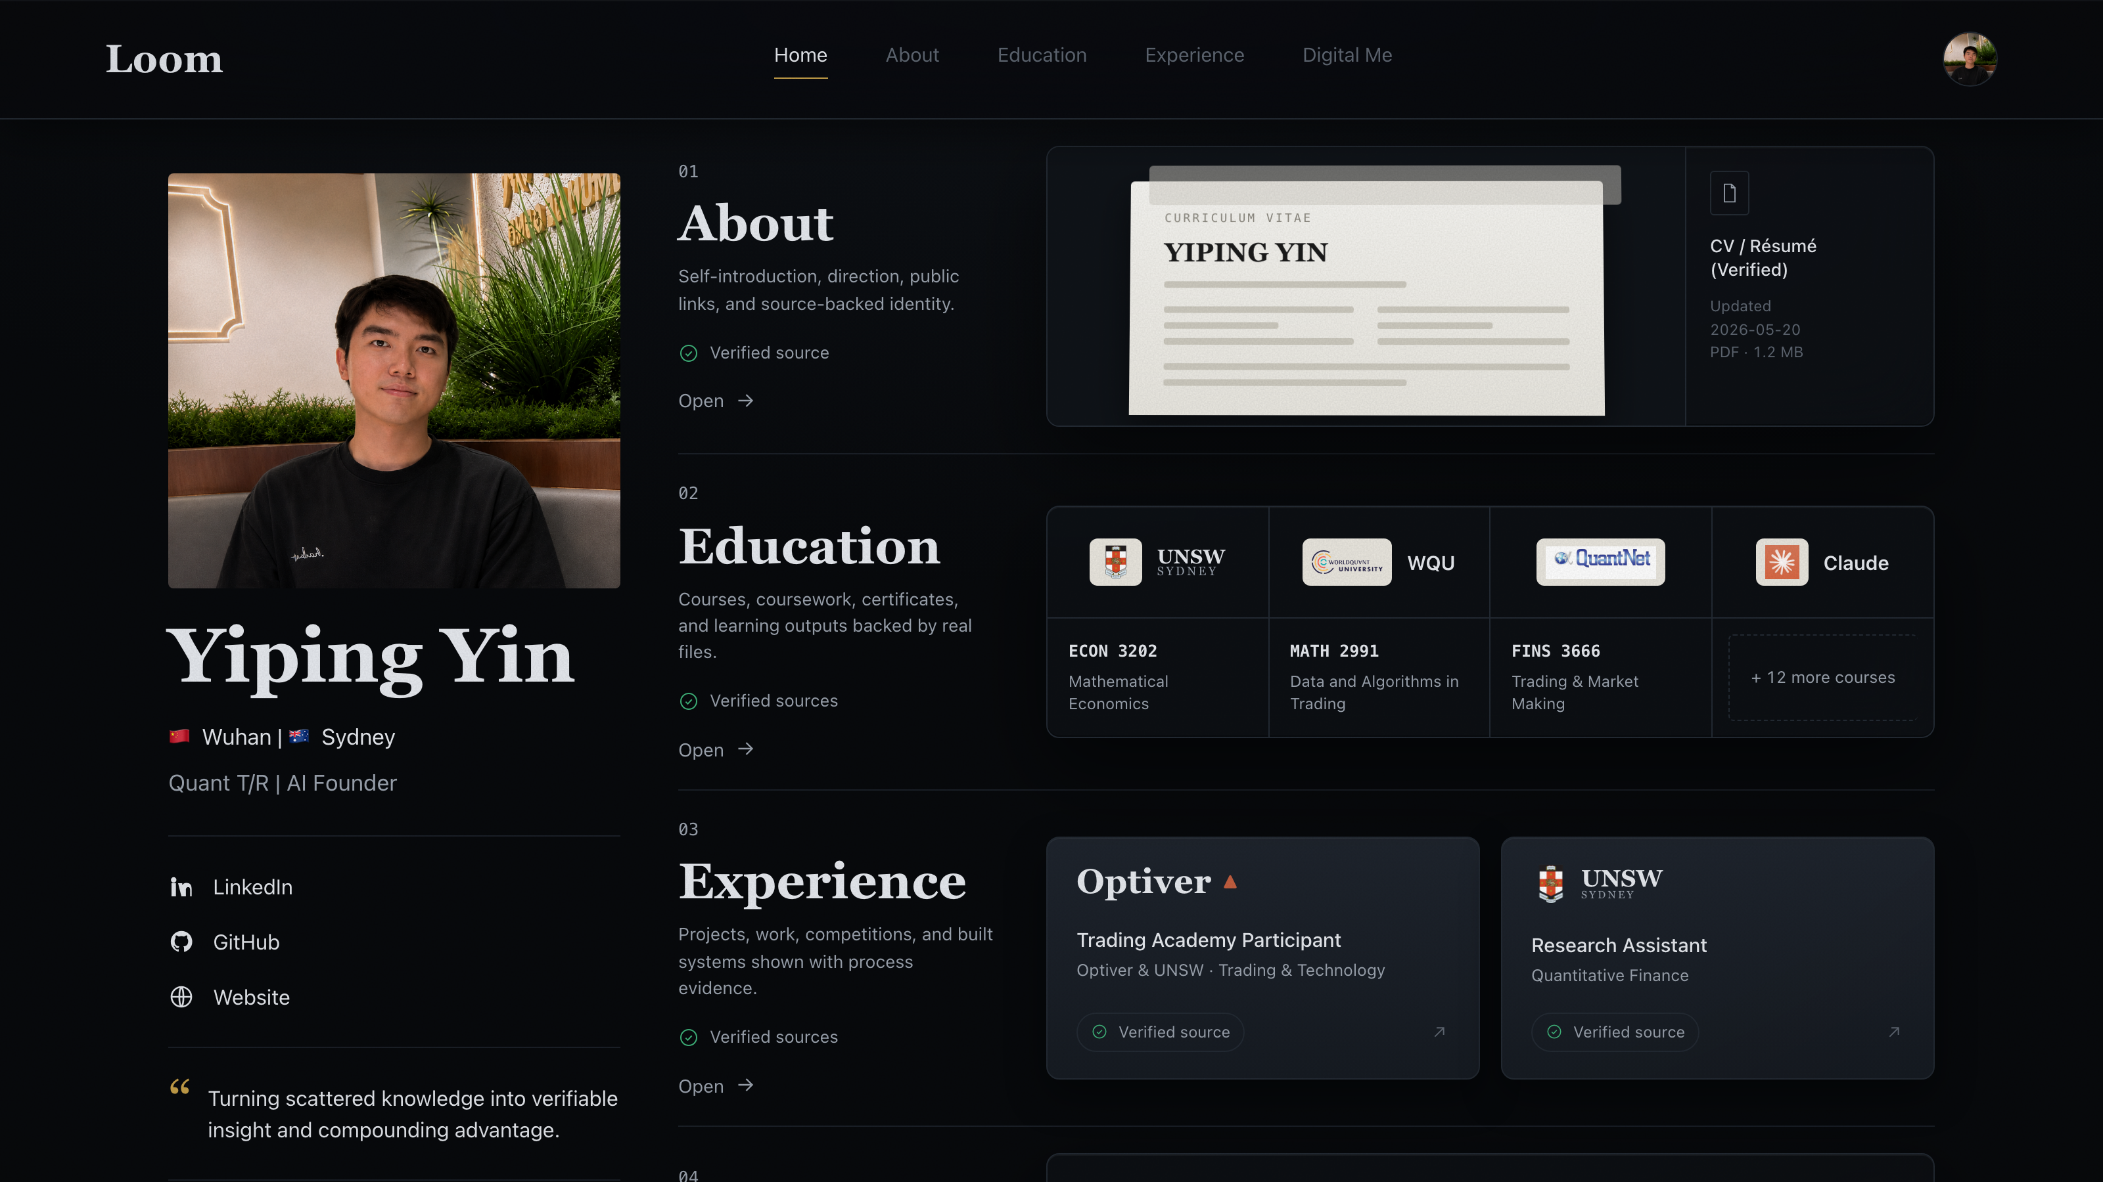
THE SOLUTION
Loom weaves it into one living identity.
Loom connects your learning journey, projects, experiences, and AI conversations into a single searchable knowledge base — one that grows with you.
Every claim is source-backed. Over time it becomes a personalised AI that can represent and communicate what you know.
The live reference instance — yiping.loom
LOOM
03

Slide 4
PRODUCT · THE VERIFIED DOSSIER
Not a résumé. A source-backed self.
Numbered dossier
About · Education · Experience · Digital Me — one coherent identity.
Every claim verified
Each card resolves to a real file: CV, course folders, project artifacts.
Inspect, don’t trust
Visitors open the source behind any statement — proof, not assertion.
LOOM
04

Slide 5
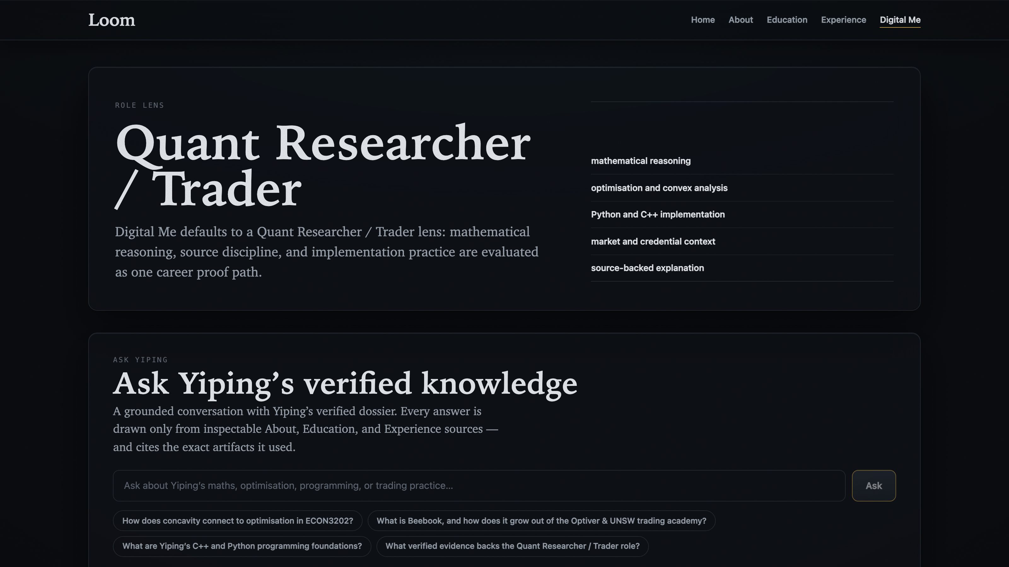
PRODUCT · DIGITAL ME
Ask my knowledge. Get cited answers.
Conversational core
Ask Yiping anything — answers drawn only from verified evidence, with citations.
Role OS
Claims mapped to evidence, scored by how strongly the sources back them.
Live proof
A working QBook market-making terminal embedded as runnable evidence.
LOOM
05

Slide 6
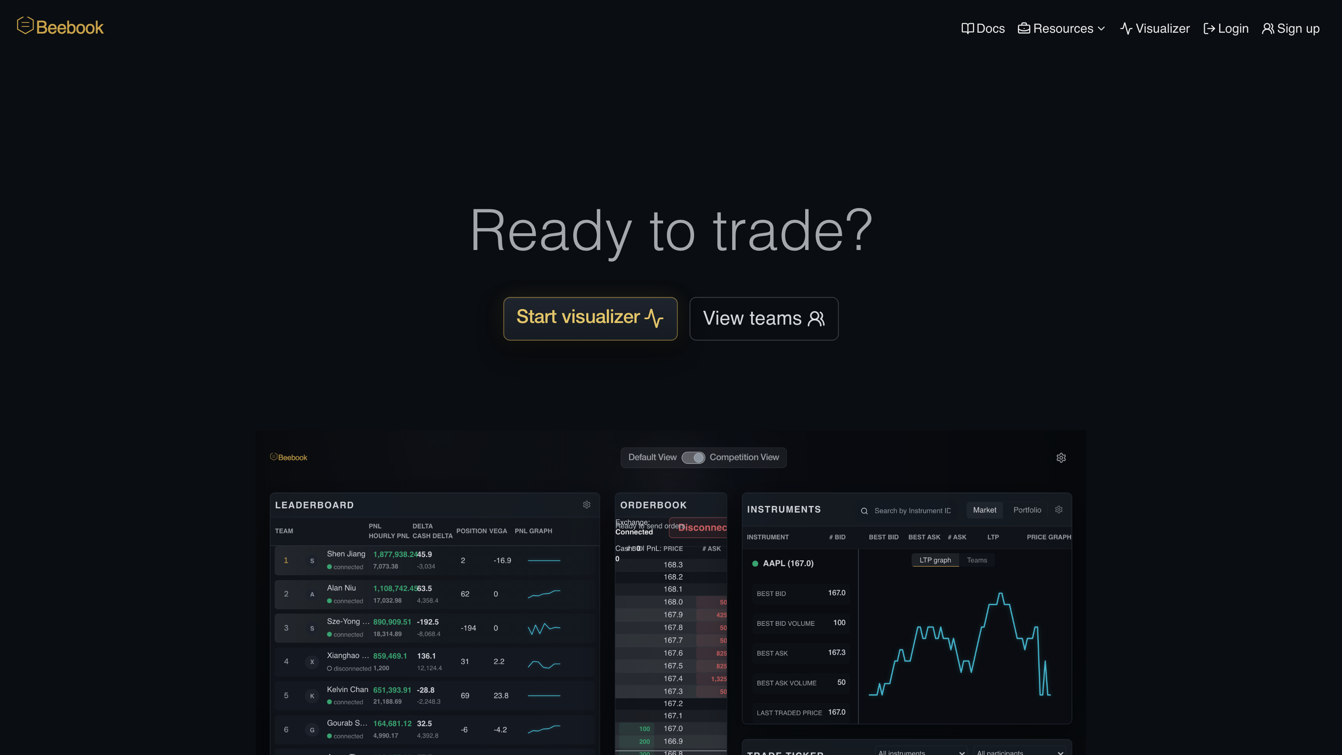
PROOF · CAPABILITY MADE TANGIBLE
A working exchange — not a screenshot.
QBook — a self-contained trading terminal inspired by the Optiver & UNSW trading academy — order book, leaderboard, and market-making practice that keeps running offline, after the source retires.
44
teams
26
instruments
0
remote calls
LOOM
06

Slide 7
WHY IT MATTERS
In the AI era, your most valuable asset isn’t your résumé.
It’s your
accumulated knowledge.
Loom helps people preserve it, showcase it, and unlock its value — turning a lifetime of scattered learning into compounding advantage.
LOOM
07

Slide 8
THE LOOP
Preserve. Connect. Showcase. Represent.
01
02
03
04
Preserve
Connect
Showcase
Represent
Capture sources — docs, slides, notes, certificates, AI chats — into one place.
→
Link them into an evidence graph: claims, sources, and the proof between them.
→
A dossier anyone can inspect — source-backed, never just asserted.
→
A personalised AI that answers for you, with citations to your real work.
LOOM
08

Slide 9
WHERE IT STANDS
Real, today — not a mockup.
Live
reference instance
241
contract tests green
Yiping’s Loom — a full working dossier, public on the web.
Built test-first; every surface pinned by a contract.
2
runtimes
5
real source shelves
A native macOS app and a deployable web app share one core.
UNSW · QuantNet · WorldQuant · Claude · Optiver — actual archives.
LOOM
09

Slide 10
THE VISION
A future where everyone can build
a digital extension of themselves.
Yiping Yin · building Loom
github.com/Yiping-Yin/loom · linkedin.com/in/yiping-yin
Loom

