Slide 1
Multiple Organ Dysfunction Syndrome
Pathophysiology Department, Tongji Medical College, HUST

Slide 2

Incidence
MODS
50-80%
ICU death
40% ICU patient
100,000 deaths every year

Slide 3

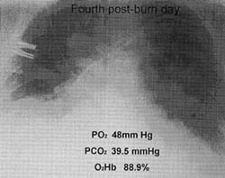
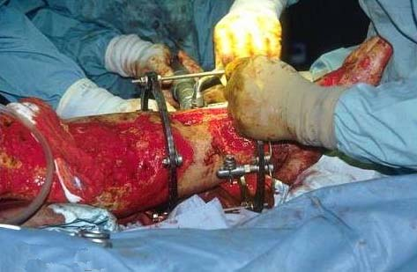
Case report
Left leg open trauma
Day 2:
Shortness of breath, Oliguria
Respiratory failure
Day 4:
T 39.5 ℃↑WBC (18×10⁹/L) ↑
R 35 /m, cyanosis, PaO₂<60mmHg
Urine <100ml/d
Serum Creatinine ↑↑ BUN ↑↑
Renal failure
Day 6:
Death

Slide 4


World War One
Circulatory failure, hypovolemic shock
Milestones of organ failure
Up through World War I—cardiovascular failure
World War II and Korea—renal failure
Vietnam War—pulmonary failure
1973—sequential systems failure after AAA
1975—multiple-organ failure syndrome
World War Two
Korean War
Post-traumatic acute renal insufficiency
Vietnam War
Post-traumatic acute respiratory insufficiency
Seventy’s
70’s syndrome
1991
Multiple organ dysfunction syndrome

Slide 5
（二） MODS命名的意义
1．肯定了严重的生理刺激可导致远隔器官损伤
2．体现了人们对MOF和MSOF认识上的升华，即器官功能改变都是遵循病理过程由轻到重的发展过程，存在恢复或者恶化两种可能，MOF则过于强调恶化这一终点。
3．有助于医疗较早地对MODS实施干预，争取好的预后。

Slide 6
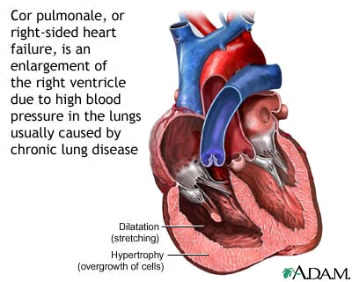
Definition
Multiple Organ Dysfunction Syndrome (MODS) is dysfunction of two or more organs (initially uninvolved developing within a short period of time.
two or more organs
initially
uninvolved
short period
Cor pulmonale?

Slide 7
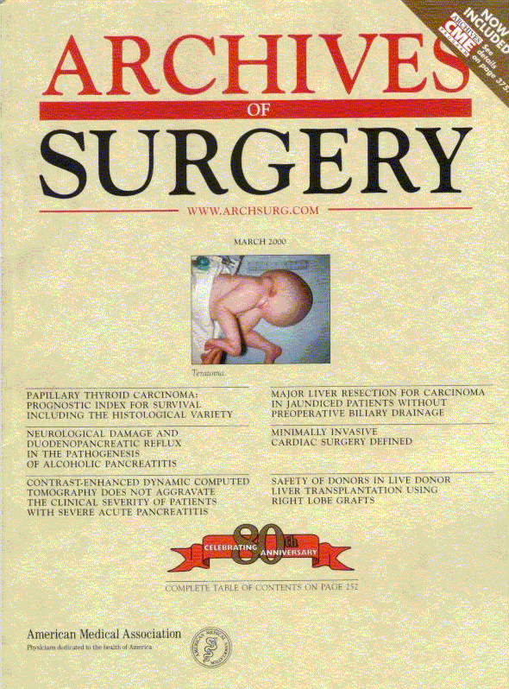
Causes
Multiple system organ failure.
The role of uncontrolled infection
1980,115(2):136-140.
They studied multiple parameters in
553 consecutive emergency surgical
patients.
MSOF is primarily due to infection.
MSOF is the most common fatal
expression of uncontrolled infection.
antibiotics + infection control

Slide 8
Why did anti-biotic strategies
fail in some
of the patients with MODS?

Slide 9
MODS two hit phenomenon
第一次打 击
第二次打击
组织损伤
全身性
炎症反应
逐级放大
晚期MODS
保 护
早期MODS
恢复

Slide 10

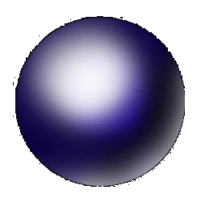
Etiology
Shock
Intra-abdominal infection
MODS
Pancreatitis
大量输血/输液及药物使用不当
Multiple trauma
Biliary tract infection
免疫功能低下
Burn
Infective diseases
Non-infective diseases

Slide 11
Infective diseases
Non-infective diseases
?
MODS

Slide 12
Mechanism

Slide 13

Causes
Q1
Uncontrolled inflammatory response
Q2
MODS

Slide 14
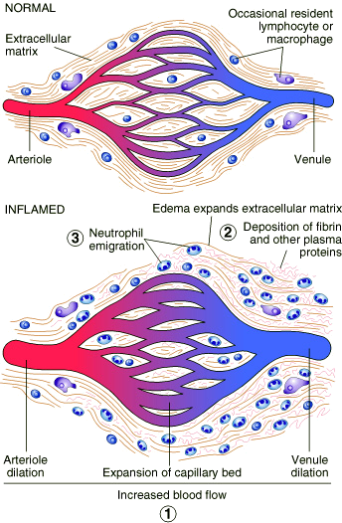
Inflammation
Inflammatory cells
Inflammatory cytokines

Slide 15
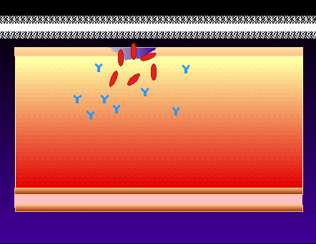
Infection/ injury
Inflammatory stimulator
Pro-inflammatory
mediators released
Local inflammatory
cell activated
(MΦ,PMN,VEC,)
Systemic inflammatory
cell activated
(MΦ,PMN,VEC,)
Tissue injury

Slide 16

Systemic Inflammatory Response Syndrome (SIRS)
【Definition】
An uncontrolled inflammation process
Pro-inflammatory signals exceed its normal
domain or degree
Result in end-organ damage and multi-system
failure.
Pro-inflammatory reaction
TNF-a, IL-1, IL-6, IFN
TXA₂, PAF
Cell activation

Slide 17
【SIRS Clinical manifestations】
Body temperature above 38℃ or less than 36℃.
Heart rate >90 beat/min.
Respiration rate >20/min or PaCO₂ <32 mmHg.
WBC >12×10⁹/L or <4×10⁹ cells/L, or >10%
immature cells.
above 38℃
>20/min
Biochemical feature: more consistent
elevated IL-6, CRP

Slide 18
Case review
Left leg open trauma
SIRS
Respiratory failure
Renal failure

Slide 19
三、 SIRS的发病机制
SIRS的本质是机体对原发打击因素作出的过度炎症反应。
炎症细胞过度激活、炎症介质失控性过量释放和内源性拮抗剂不足，对机体造成失控性渐进性损伤。

Slide 20
提出SIRS的临床意义*
SIRS的提出是对感染、创伤和MODS认识的重大突破
MODS的临床和基础研究的重点从感染创伤本身转移到机体炎症反应。
MODS的治疗手段从控制感染、创伤，延伸到调节机体炎症反应上。

Slide 21

Compensatory Anti-inflammatory Response Syndrome( CARS)
Anti-inflammatory reaction
IL-10, IL-4, TGF-β
IL-1ra ,Lipoxin
Glucocorticoids
Catecholamines
【Definition】
An uncontrolled anti-inflammation process
Anti-inflammatory signals exceed its normal
domain or degree
Result in end-organ damage and multi-system
failure.
Pro-inflammatory reaction
TNF-a, IL-1, IL-6, IFN
TXA₂, PAF
Cell activation
Immune paralysis

Slide 22
CARS的发生机制
抗炎性介质合成
  PGE2、IL-4、IL-10、IL-11、可溶性TNFα受体、转化生长因子等
抗炎性内分泌激素释放
  糖皮质激素、内源性儿茶酚胺物质
炎症细胞凋亡
  粒细胞凋亡加速

Slide 23
Mixed antagonist response syndrome
Temporal relation between SIRS and CARS
Pro- and anti-inflammatory signals: fluctuating
SIRS超过CARS时，导致自身性破坏。
CARS过强，可导致免疫功能低下。

Slide 24
Infection/Injury
Uncontrolled inflammatory response
Controlled inflammatory response
SIRS
CARS
MARS
Infection/injury controlled
MODS

Slide 25
SIRS、MODS、MSOF的关系
MSOF
MODS
SIRS

Slide 26



Summary
Infection/Injury
Host
response
Adequate
Inadequate
Infection/injury controlled
Death
Excessive
Uncontrolled inflammatory response
SIRS
CARS
MARS
MODS
Notes:
Finally, let us have a short summary about what we have studied this time. We know MODS is a kind of emergent clinical syndrome. It involves the dysfunction of two or more organs. It develops in very short time.
MODS can be caused by both infective and noninfective diseases.
Whatever the reason is, the clinical manifestations of these two types are not different. So we pay much attention on the common mechanisms of MODS.
Uncontrolled inflammatory response is the most important factor to trigger MODS.
In some of the patient, this uncontrolled inflammatory response may be presented as overregulated pro-inflammatory response. So, we can observe the disseminated pro-inflammatory mediators in the circulation. Some of the mediators are harmful to the body tissues, such as TNF-a, Free radical. That is the reason why these distant organs can receive the signal and become failure.
We call this phenomena as systemic inflammatory response syndrome.
The other type is compensatory anti-inflammatory response syndrome. The patients have overexpressioned anti-inflammatory mediators so they cannot confront with the microoragnisms. And body tissues can be injuried by these foreigners.
Although MODS has been studied for nearly 30 years, there are still a lot of blackholes for us. Till now, MODS is still the most important death cause of the patient in ICU.

Slide 27
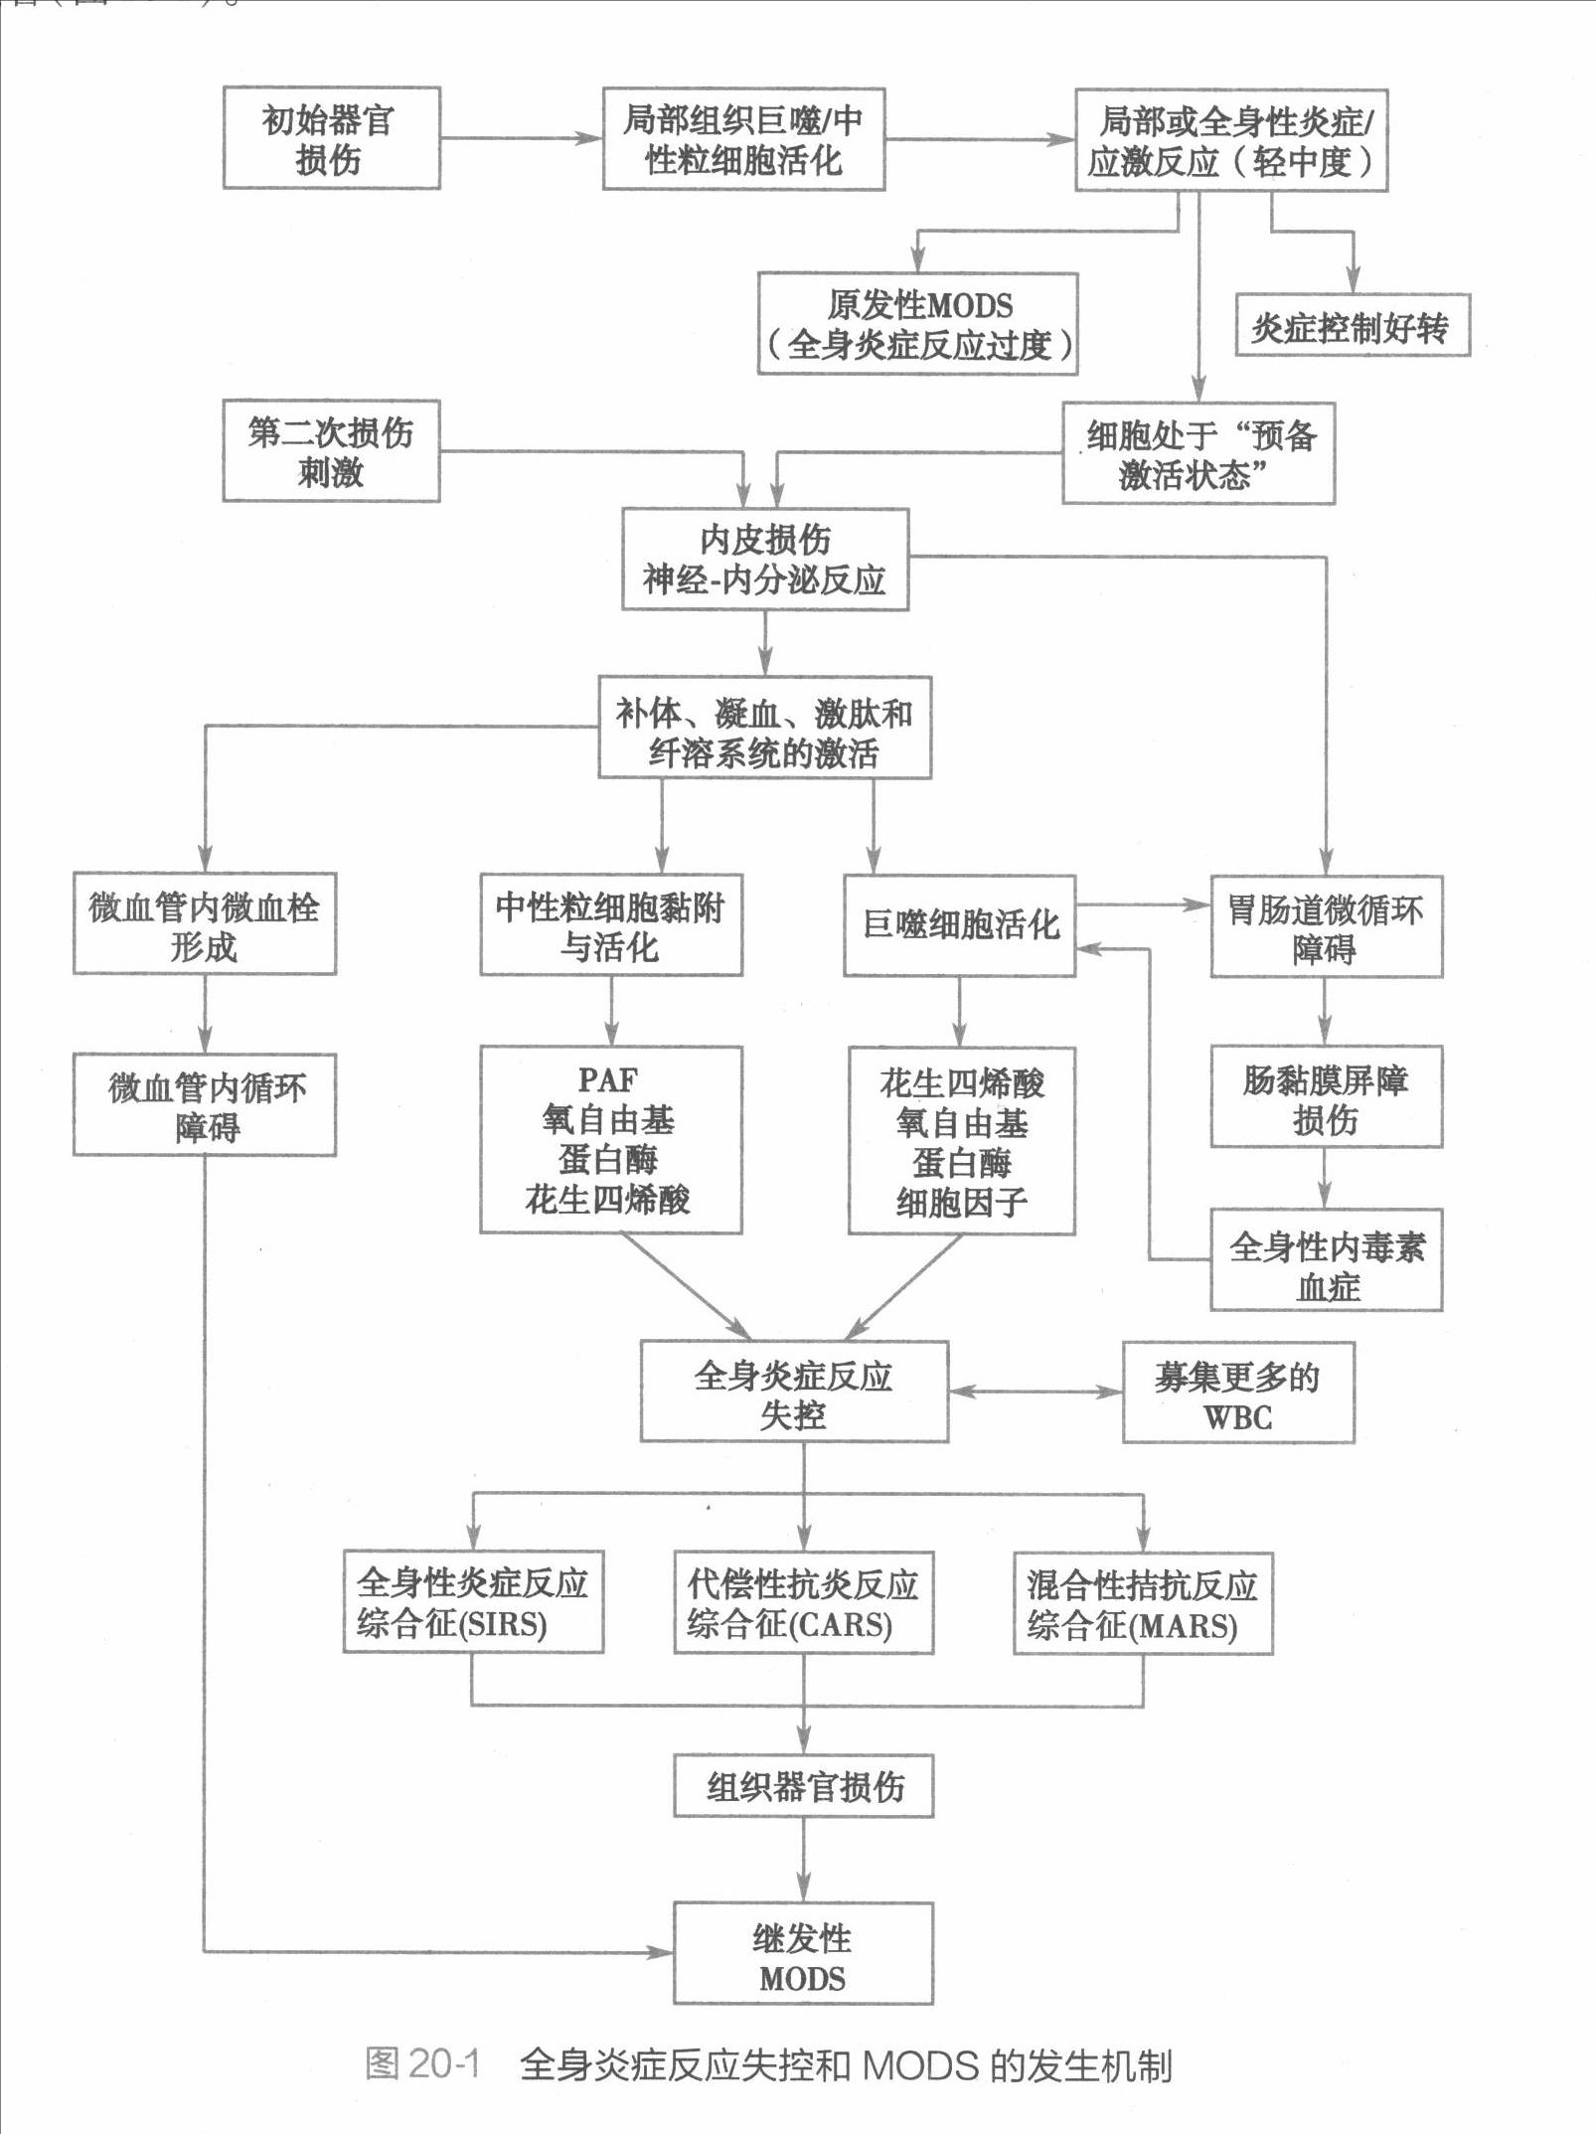

Slide 28
Mechanism
Uncontrolled inflammatory response(主要的)
缺血(能量代谢障碍)
Ischemia/reperfusion injury(氧自由基损伤)
Bacterial translocation 肠源性内毒素血症

Slide 29
Intra-abdominal infection
Shock
MODS
Pancreatitis
Multiple trauma
Biliary tract infection
Burn
Infective diseases
Non-infective diseases

Slide 30
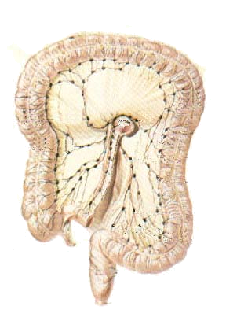
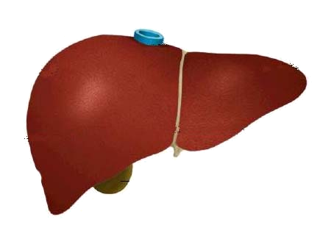
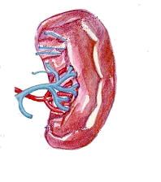
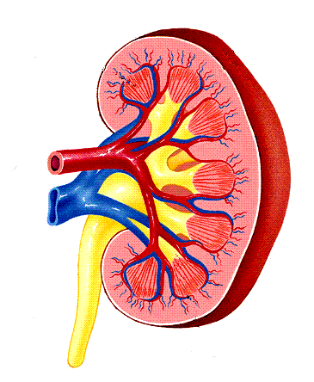
Bacterial translocation
The viable bacili translocate from the gastrointestinal tract to the other organs.

Slide 31
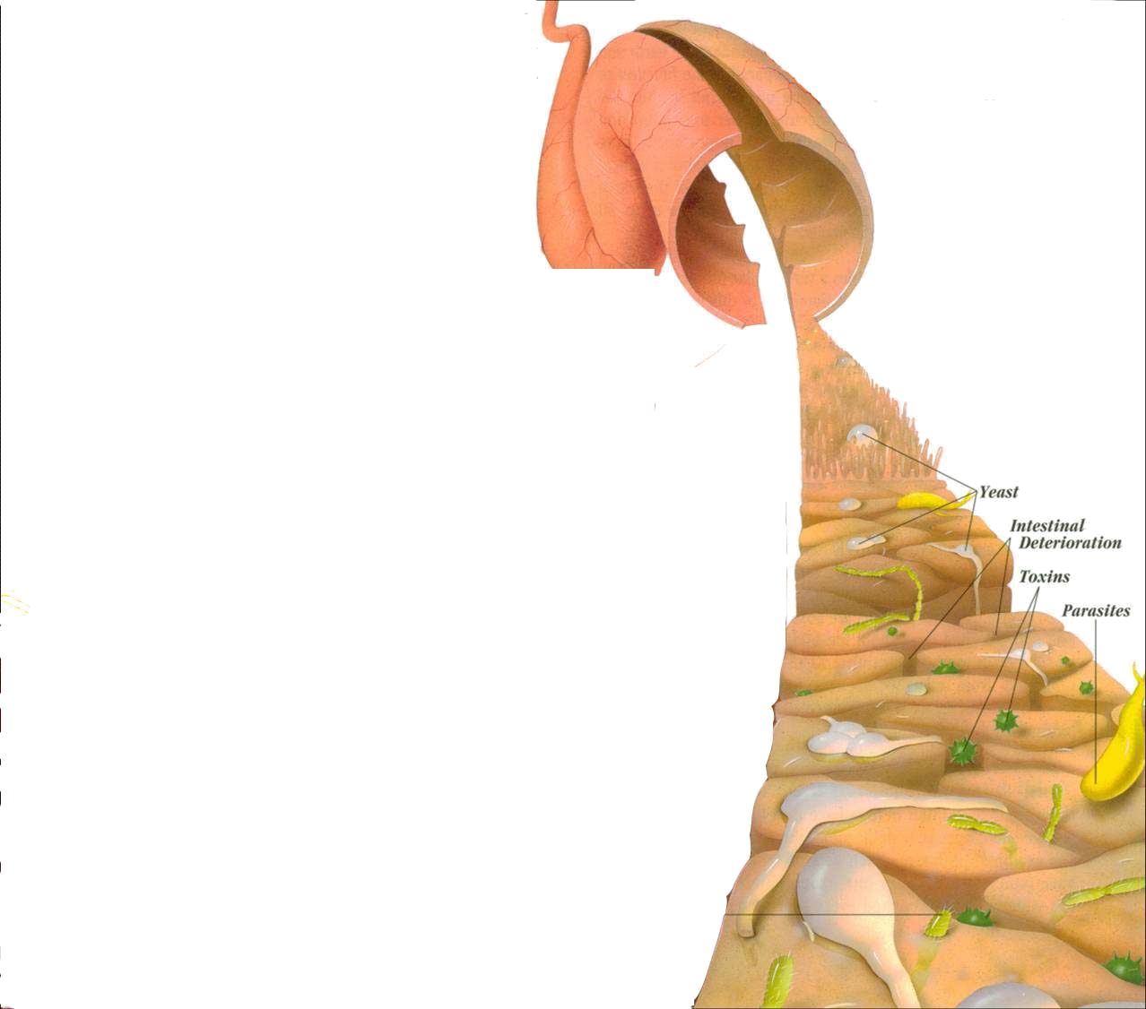
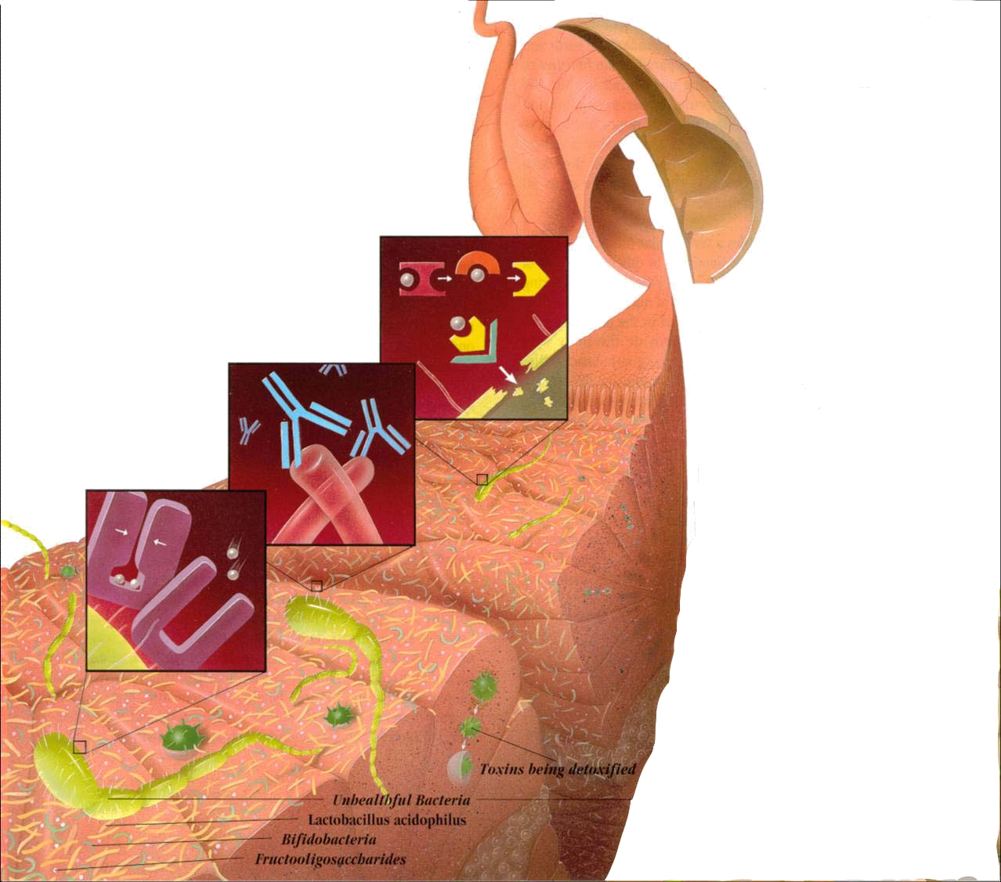
Causes for the translocation
Intestinal mucosal ischemia
Intestinal flora imbalance

Slide 32
What exactly is "leaky gut" or "increased intestinal permeability"?
A condition where in these basic functions are failing: The intestines are failing in the ability to absorb nutrients, and the intestines are absorbing too many toxins.
Why did not find bacteria or endotoxin in the portal blood of patients
in clinical trials?
Mesenteric lymphatics:
Gut released pro-inflammatory and tissue injurious factors
even without translocation

Slide 33
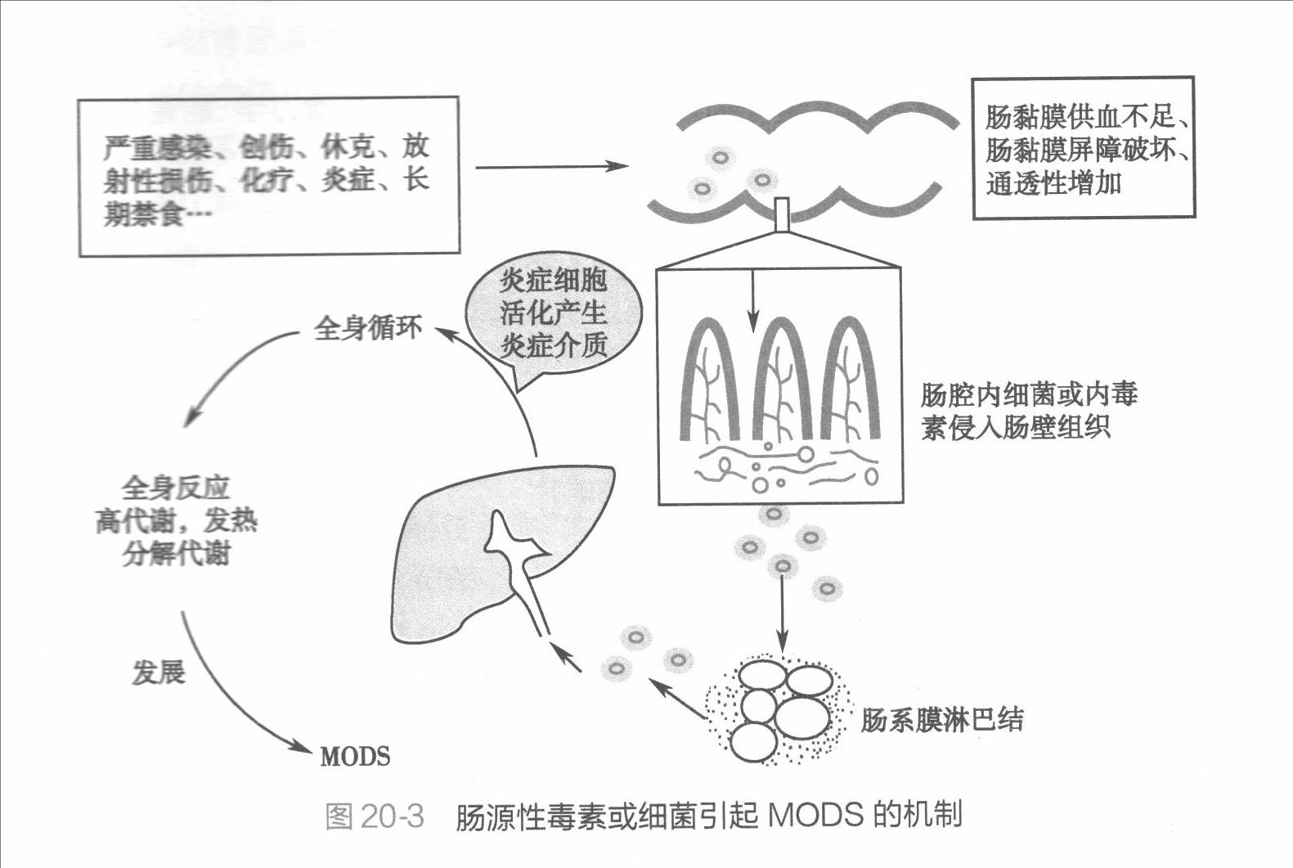

Slide 34
Alternations in Functions and Mechanism in different organs

Slide 35
主要功能代谢变化特点
新陈代谢的改变（stress hormones, cytokines)
  主要改变为高分解代谢和高动力循环。
  即全身氧耗量和能量消耗增加，糖、脂肪、氨基酸利用增加，肌肉蛋白分解增加，尿素氮增加，出现负氮平衡，CO₂产生增加。心输出量增加，外周阻力降低（高排低阻型），可导致难治性低血压；后期因心功能衰竭转变为“低排低阻型”。
组织细胞缺氧与能量代谢障碍：
临床表现为“氧供依赖”和“乳酸性酸中毒”

Slide 36
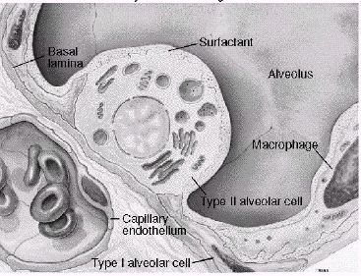
主要器官系统的功能障碍
Respiratory system（ARDS）
Alveolar epithelial cell swelling lack of surfactant
WBC assembling phagocytosis

Slide 37
肺易受损的原因：
①肺是全身静脉血的滤器，许多代谢产物在这里被吞噬、灭活和转换。
②肺泡巨噬细胞和炎性细胞可释放大量血管活性物质和炎症介质，损伤肺脏。
③肺内小血管内，活化的炎症细胞易与血管内皮细胞发生黏附和激活反应，释放活性氧、溶酶体酶、血管活性物质和炎症介质等。

Slide 38
肺功能不全对其它脏器的影响
①组织缺氧，代谢性酸中毒和ATP缺乏。
②很多血管活性物质不能被灭活，引起其它脏器功能的改变。
③伴肺动脉高压和肺血管阻力增高，导致右心后负荷增加和右心衰竭。

Slide 39
？
Respiratory system
Highest incidence earliest occurring
inferior vena cava
superior vena cava
Main manifestation
肺水肿
肺出血
肺不张
呼吸困难
Respiratory circulation
Systemic circulation

Slide 40
Acute renal dysfunction
Poor prognosis
Mechanism
Acute necrosis of tubular cells
Decreased perfusion of kidney
Consequence:
rising urea and creatinine
rising potassium
worsening metabolic acidosis
fluid balance abnormalities

Slide 41
Treatment principle
Management of initial dieases
Support of critical organs
Anti-inflammatory therapy
Others: nutrition, enteral feeding

Slide 42

THANK YOU!

