Slide 1
Classification of Disease Using CNN
Hu, Kaitian
Li, Yiqi
Zeng, Jing
Zhang, Yachen
Zheng, Dongdong

Slide 2
Table of contents
01
02
03
04
Problem Statement
Exploratory Analysis
Modeling
Conclusion

Slide 3
01
Introduction

Slide 4
The importance of Our Model
47.8%
12.3%
8.7%
Cataract
Glaucoma
Age related macular degeneration

Slide 5
An estimated 1.28 billion adults aged 30-79 years worldwide have hypertension, most (two-thirds) living in low- and middle-income countries in 2020
WHO

Slide 6
The Disease we focus on
Cataract | A cloudy lens
Glaucoma | A group of eye diseases that can cause vision loss and blindness by damaging a nerve in the back of your eye called the optic nerve.
Age related macular degeneration | A chronic irreversible medical condition that results in loss of central vision because of the damage to the macula, or central part of the retina.
pathological myopia | A type of myopia which is accompanied by degenerative changes occurring especially in the posterior pole of the globe.
hypertension | Blood pressure that is higher than normal. It put you at risk for stroke, heart failure, kidney failure and other medical problems

Slide 7
Exploratory Analysis
02

Slide 8
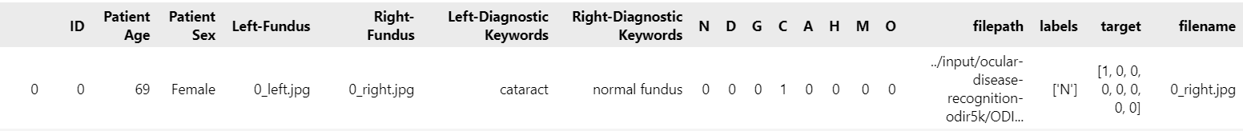
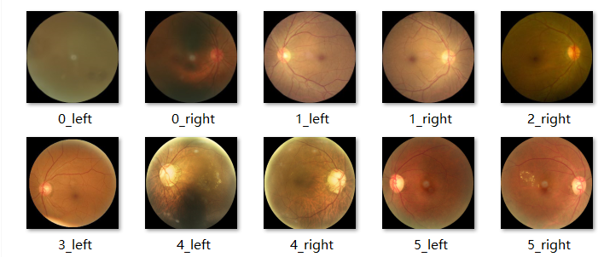
Data description
6392 color fundus photographs from left and right eyes of 5,000 patients
Ocular disease patients’ information
8 categories of disease:
Normal (N),
Diabetes (D),
Glaucoma (G),
Cataract (C),
Age related Macular Degeneration(A),
Hypertension (H),
Pathological Myopia (M)
Other diseases/abnormalities (O)

Slide 9
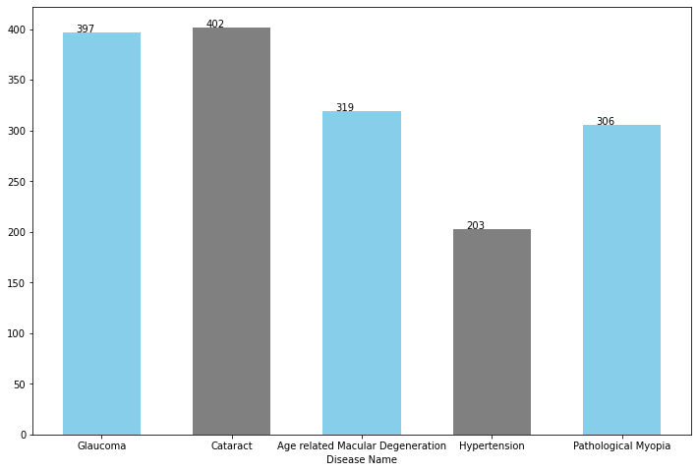
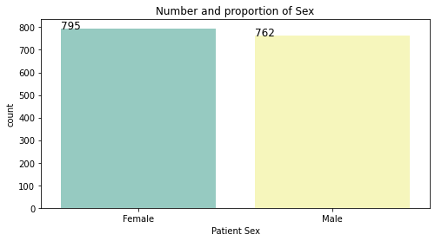
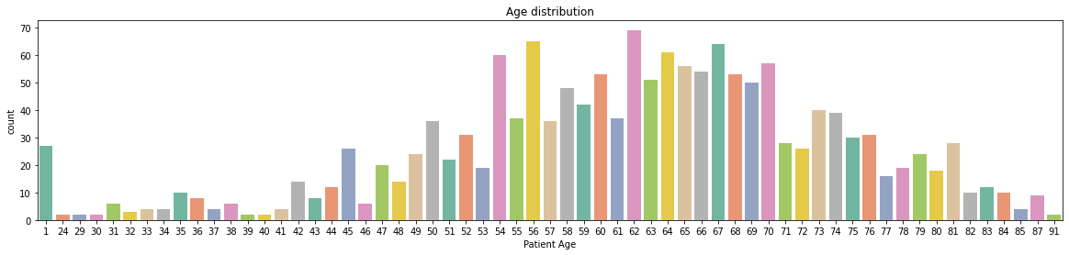
Patients Overview

Slide 10
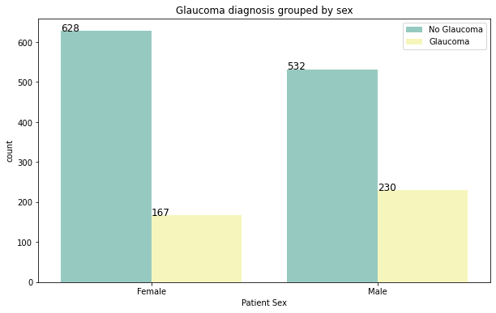
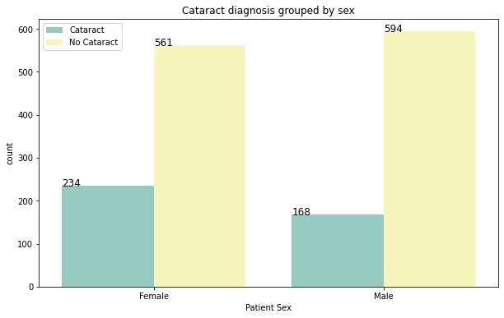
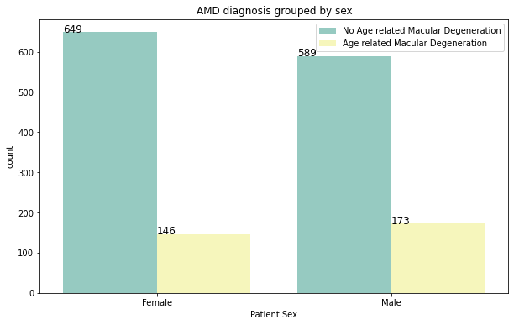
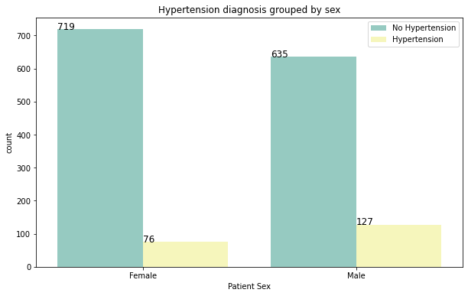
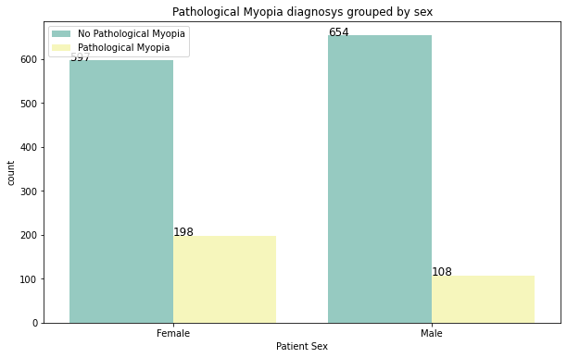
Gender distribution across each disease

Slide 11
Modeling
03

Slide 12
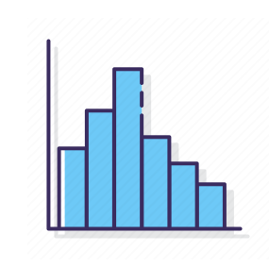
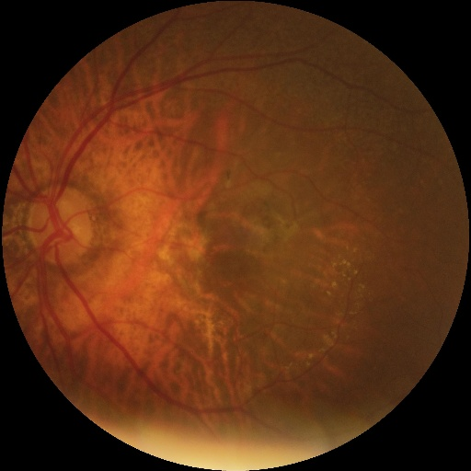
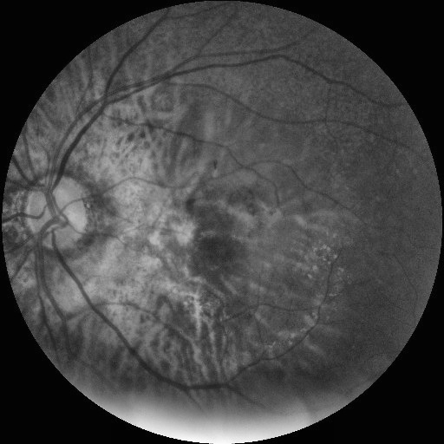
Data Preprocessing
(Clahe) Contrast limited adaptive histogram equalization
Enhance contrast and highlight the features and details of the image.
Suppress the overamplification of noise in the relatively homogenous area of image , compared to AHE.

Slide 13

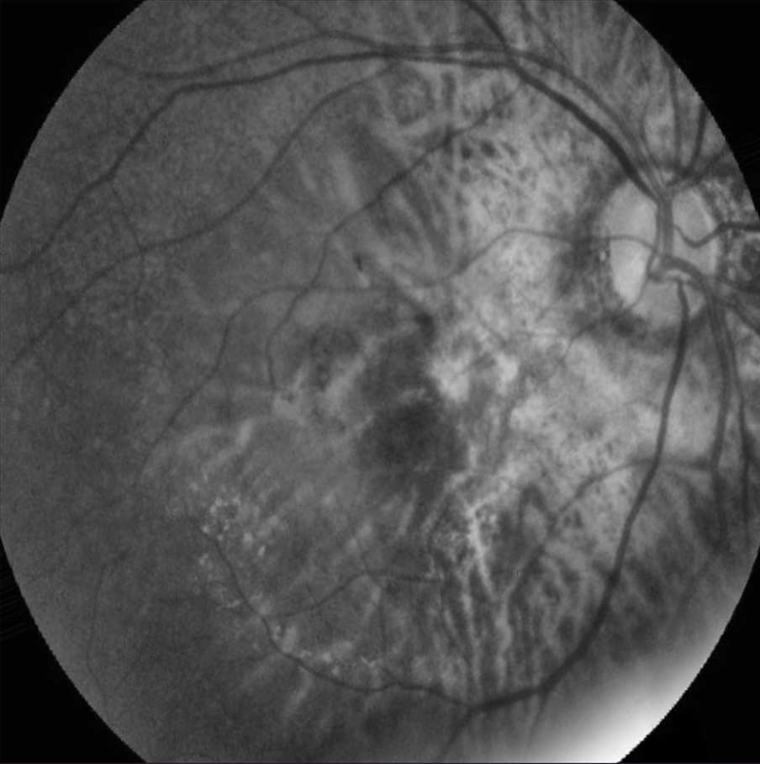
Data Preprocessing
Image Augmentation
Normalization
Horizontal Flip
Vertical Flip
Rotate
Zoom
Increase the amount of train dataset, which improves the generalization performance of model and helps prevent overfitting.

Slide 14
Methodology
Convolutional Neural Network | Model | Convolutional Neural Network | Model
Visual Geometry Group (VGG) | VGG 16 | Inception Network | InceptionResNetV2
 | VGG 19 |  | InceptionV3
Residual Neural Network (ResNet) | ResNet50V2 | Densely Connected Convolutional Network (DenseNet) | DenseNet121
 | ResNet101V2 |  | DenseNet169
 | ResNet152V2 |  | DenseNet 201
The application of CNN in the medical field has achieved state-of-the-art results, which facilitated us to explore 10 CNN models (classified into four categories) in this analysis

Slide 15
Methodology
Parameter | Value | Justification
Weights | ImageNet | Help capture general visual patterns and low-level features. Allow model to quickly adapt and fine-tune the parameters to the task.
Optimizer | Adam | Maintain an adaptive learning rate for each parameter, which resulted in faster convergence and improved performance.
Learning rate | 1e-5 | Achieve balance between convergence speed and generalization.
Epoch | 30 | Number of the training iteration over entire dataset
The value of these parameters lead to faster convergence of the model and improves performance by maximizes the avoidance of both under-fitting and over-fitting to make the accuracy on test set to be largest.

Slide 16
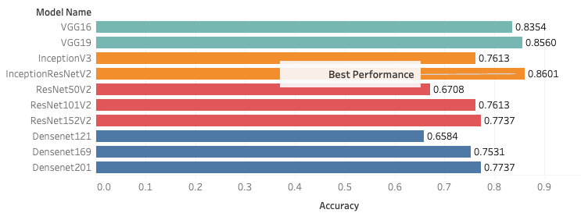
Methodology
The two best-performing CNN models are InceptionResNetV2 and VGG19, with the test accuracy of 0.8560 and 0.8601 respectively
Predictive performance of VGG and Inception model are similar, and achieve higher accuracy compared to ResNet and DenseNet
Deepening of the network is helpful to improve the accuracy on this fundus photograph

Slide 17
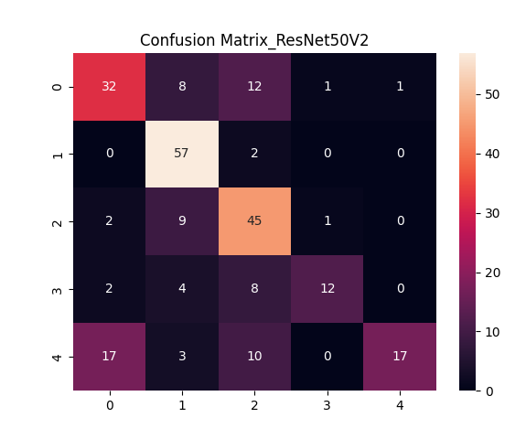
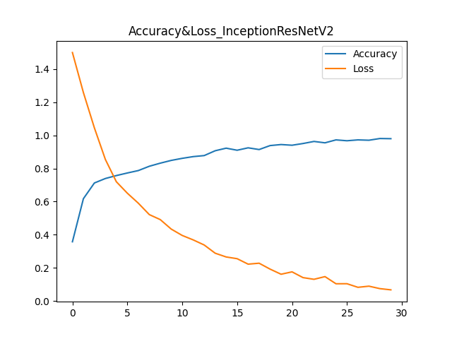
Methodology
The model correctly predicts 86.01% of the patients with one of the five ocular diseases, which could translate into a substantial advantage in terms of business performance.

Slide 18
04
Conclusion

Slide 19
Our values
Automation
Robust Model
Automatically generating result and diagnosis
Convolutional neural network trained and tuned
High accuracy
Improvement
More than 86% accuracy on best performance
Model re-trained using new pictures input

Slide 20
Our mission and vision
Mission
Vision
Our mission is to train and provide robust convolutional neural network model and increase the performance of the model.
Hospital systems will be improved and utilize AI techniques to provide fast, robust, and accurate diagnosis and treatment for patients.

Slide 21
THANKS

