Slide 1
Multi-head Self-Attention in Vision Transformer
Bofeng Cao
Shixiao Liang
Feb 12, 2026

Slide 2
Introduction
Bofeng Cao
2nd year PhD Student
Electrical and Computer Engineering
Shixiao Liang
3rd year PhD Student
Civil and Environmental Engineering
https://catslab.engr.wisc.edu

Slide 3
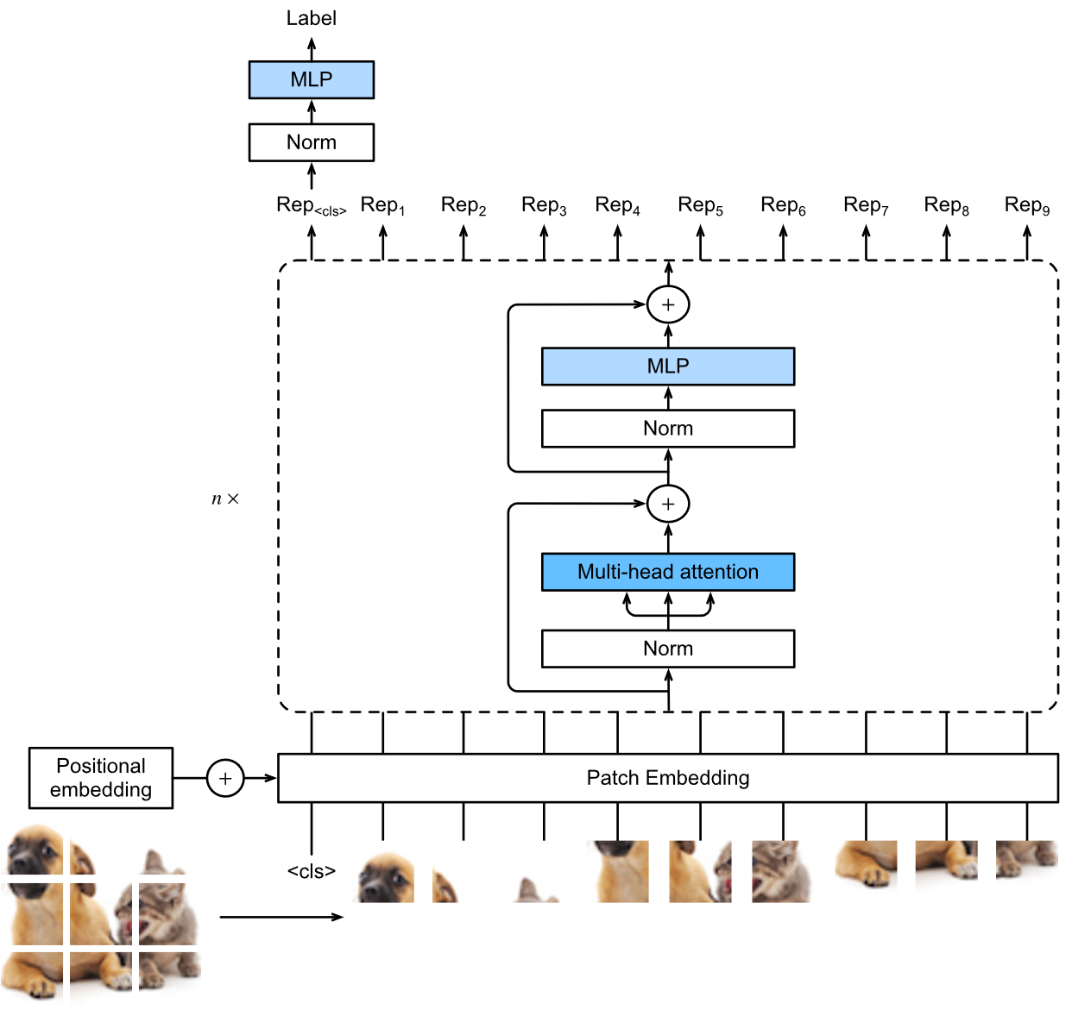
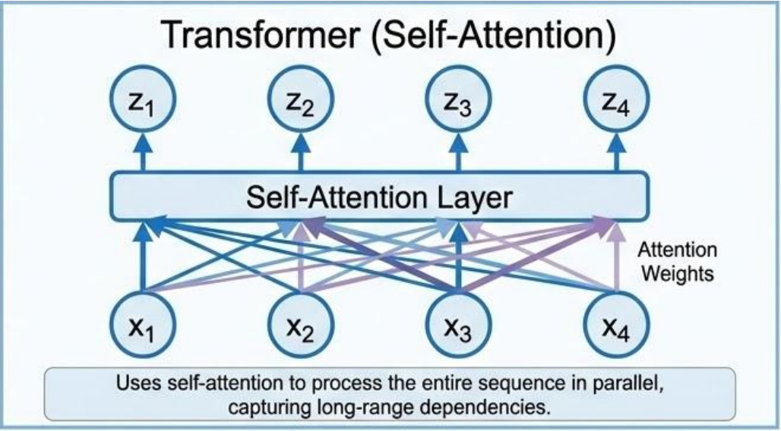
Multi-head Self-attention (MSA)
Transformer
Vision Transformer (ViT)
Alexey, et al. CVPR, 2020 https://arxiv.org/abs/2010.11929
Notes:
Let me start by briefly reviewing the standard Transformer architecture that we have learned in before for NLP.
A Transformer is built by stacking multiple Transformer blocks, and each block consists of two core components:
Multi-head self-attention (MSA)
A feed-forward network (MLP)
On the left, we see the classic Transformer in NLP, where self-attention allows each token to aggregate information from other tokens in the long sequence through data-dependent attention weights.mOne of the key insights we learned is that this helps at modeling long-range dependencies in long texts, which was a major limitation of earlier sequence models like RNN.
Now, on the right, we move to the Vision Transformer, introduced around 2020.
The Vision Transformer adopts a BERT-like, encoder-only Transformer architecture, but applies it to images instead of text.
Here, the input image is first divided into patches, and each patch is embedded into a vector, forming a sequence of patch embeddings. These patch tokens are then processed by the same type of Transformer blocks in each layer, again between multi-head self-attention and MLPs.
So architecturally, ViT looks very similar to a standard Transformer
This naturally leads to an interesting question.
What does multi-head self-attention contribute in each layer of Vision Transformers? Is its main role still to model long-range dependencies Or is there something different, about how self-attention aggregates spatial information in vision models?

Slide 4
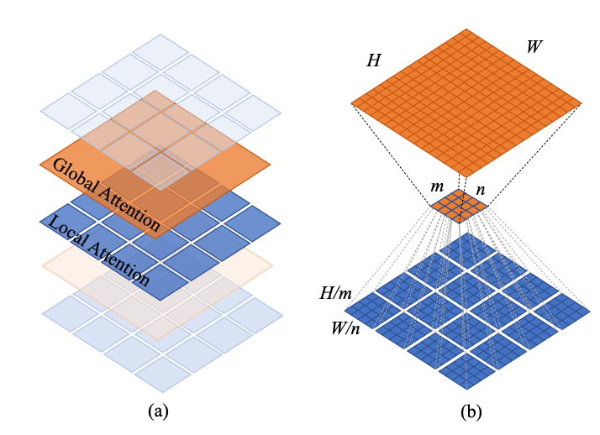
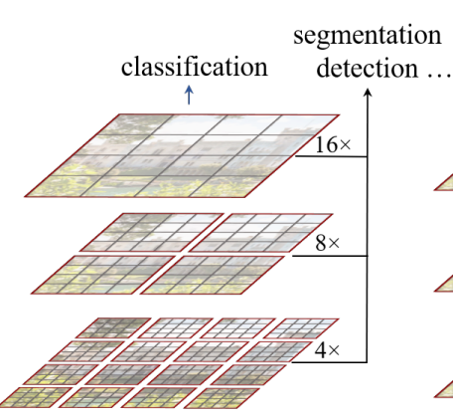
Is Long-Range Dependency Really the Key in Vision Transformers?
In NLP, self-attention is widely believed to work because it captures long-range dependencies.
Tokens that are far apart in the sequence can directly interact.
Twins-SVT [1]
Images are spatially structured: nearby patches are highly correlated.
Local MSAs may achieve better performance than global MSAs [1] [2].
Global attention can even make optimization harder on small datasets.
[1] Chu et al., NIPS 2021, https://arxiv.org/abs/2104.13840
[2] Liu et al., CVPR 2021, https://arxiv.org/abs/2103.14030
Swin-Transformer [2]
Notes:
Before giving the answer, let’s have a look at some classic models and intuitions.
(previously，self-attention is often explained through the lens of long-range dependency, especially based on our experience with NLP.)
Compared with NLP, the situation in vision is fundamentally different.
Images are spatially structured: nearby patches are highly correlated, and semantic information is often locally coherent. Also, Empirical evidence suggests that the answer may be no to the long range dependency assumption.
two successful Vision Transformer variants rely primarily on local self-attention rather than global attention, while still achieving strong performance.
On the top right, we see Twins-SVT, which mainly uses local attention combined with spatial reduction mechanisms, instead of full global attention. On the bottom right, Swin Transformer performs self-attention within local windows, and only gradually exchanges information across windows through shifted window designs.
Even more interestingly, global attention can sometimes be counterproductive on small datasets.
If not long-range dependency, what exactly does MSA contribute in Vision Transformers?

Slide 5
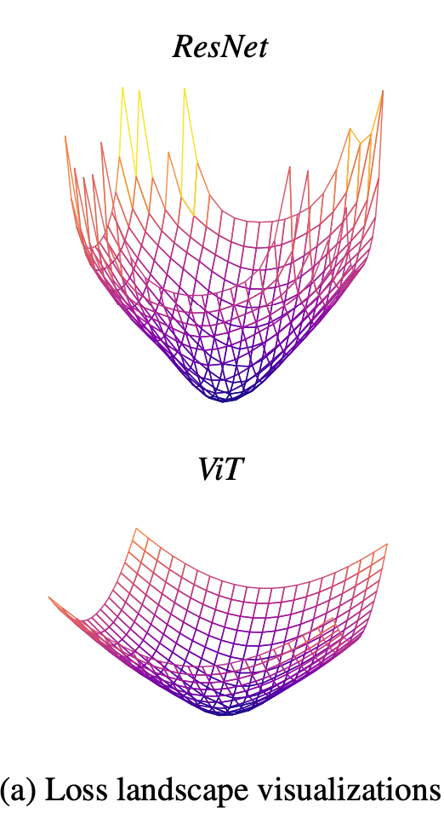
MSA as Generalized Spatial Smoothing
Spatial smoothing aggregates information across spatial locations, which leads to flatter and more stable loss landscapes
MSA performs weighted averaging spatial features, with positive, normalized, and data-dependent weights.
This makes MSA a generalized form of spatial smoothing, where the smoothing is learned from the data.
The inductive bias of MSA in ViT lies in its data specificity, rather than its ability to model long-range dependencies.
Park & Kim, ICLR 2022, https://arxiv.org/abs/2202.06709
Notes:
The paper “How Do Vision Transformers Work?” which is published in 2022, aims to answer this question. One of its key conclusions is that multi-head self-attention can be understood as a form of generalized spatial smoothing.
Spatial smoothing refers to aggregating information across spatial locations, which reduces sensitivity to local variations. From an optimization perspective, such smoothing is known to lead to flatter and more stable loss landscapes. As shown in figure on the top right, loss landscapes of ResNet is more shaper and ViT is more flatter.
In self-attention, each output token is computed as a weighted average of spatial features, where the weights are positive and normalized. From a mathematical standpoint, this already defines a smoothing operator.
What makes self-attention special is that this smoothing is data-specific. The attention weights are not fixed, but are dynamically determined by the input through the query and key representations.
Let‘s go back to the answer of last page. The inductive bias of MSA in ViT lies in its data specificity, rather than its ability to model long-range dependencies.
(The geometry of the loss function as a function of model parameters.)
Large Hessian eigenvalues correspond to sharp directions in the loss landscape.
Since the Hessian characterizes the local sharpness of the loss function, this smoothing behavior implies that Vision Transformers tend to converge to flatter loss landscapes than convolutional models such as ResNet, which is supported by the Hessian spectrum analysis in the paper.

Slide 6
Discussion:
Q: Why can local self-attention sometimes outperform global self-attention, especially on small datasets?
Hint: Constraining spatial interactions
Answer in paper: local self-attention reduces unnecessary spatial interactions, which limits excess degrees of freedom and makes optimization and generalization easier, especially on small datasets
Park & Kim, ICLR 2022, https://arxiv.org/abs/2202.06709

Slide 7
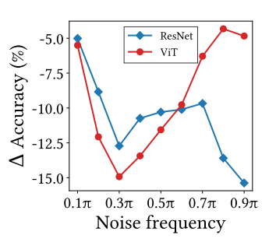
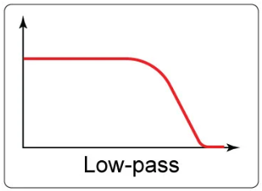
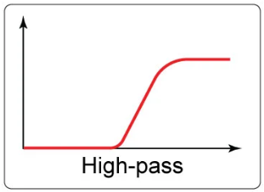
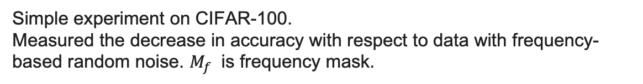
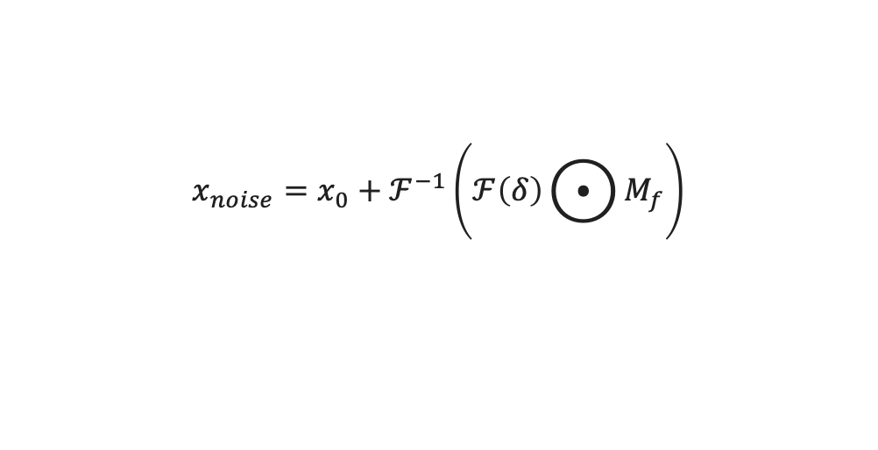
Conv vs MSA
“Convolution (Conv) is data-agnostic and channel-specific, multi-head self-attention (MSA) is data-specific and channel-agnostic.”
MSAs are low-pass filters, but Convs are highpass filters.
$$x_{noise}=x_{0}+ℱ^{−1}\left(ℱ\left(δ\right)⨀{M_{f}}\right)$$
Simple experiment on CIFAR-100. Measured the decrease in accuracy with respect to data with frequency-based random noise. $M_{f}$ is frequency mask.
Park & Kim, ICLR 2022, https://arxiv.org/abs/2202.06709
Notes:
“Convolution (Conv) is data-agnostic and channel-specific, meaning it does not leverage input-dependent content when mixing channel information, whereas multi-head self-attention (MSA) is data-specific and channel-agnostic. To some extend, we can say they are complementary. MSA behaves, in most visual scenarios, as a data-adaptive spatial smoothing mechanism, and spatial smoothing corresponds to low-pass filtering behavior in the frequency domain.

Slide 8
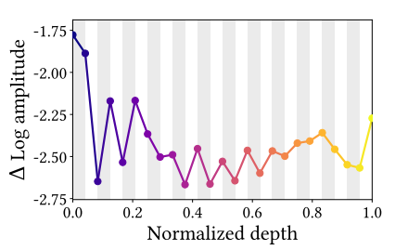
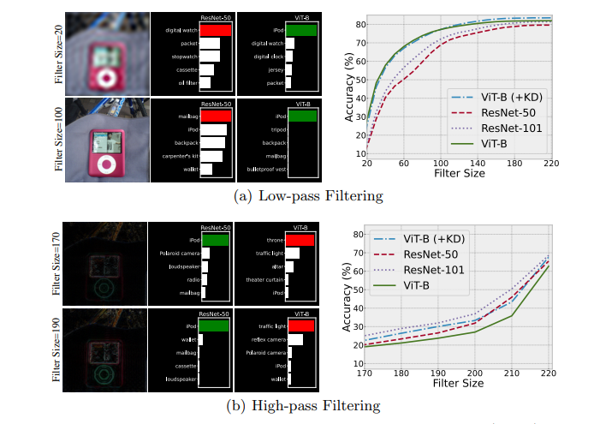
Conv vs MSA
MSAs are low-pass filters, but Convs are highpass filters.
More experiments on ImageNet.
Exp.1: Fourier transformed feature map at high-frequency (1.0π) on ImageNet. MSAs (gray area) generally reduce the high-frequency component of feature map, and MLPs (white area) amplify it.
Exp.2: Apply frequency-domain filtering to the test samples (via DFT), isolate low- or high-frequency components, reconstruct the images, and then evaluate model accuracy to analyze how much each model relies on different frequency information.
Park & Kim, ICLR 2022, https://arxiv.org/abs/2202.06709
Bai, et al., ECCV 2022, https://arxiv.org/abs/2204.00993
Notes:
Researchers did more experiments to prove this point. This figure shows the relative log amplitude (∆ log amplitude) of ViT’s Fourier transformed feature map at high-frequency (1.0π) on ImageNet. In this figure, MSAs almost always decrease the high-frequency amplitude, and MLPs—corresponding to Convs— increase it. The only exception is in the early stages of the model. In these stages, MSAs behave like Convs, i.e., they increase the amplitude.

Slide 9
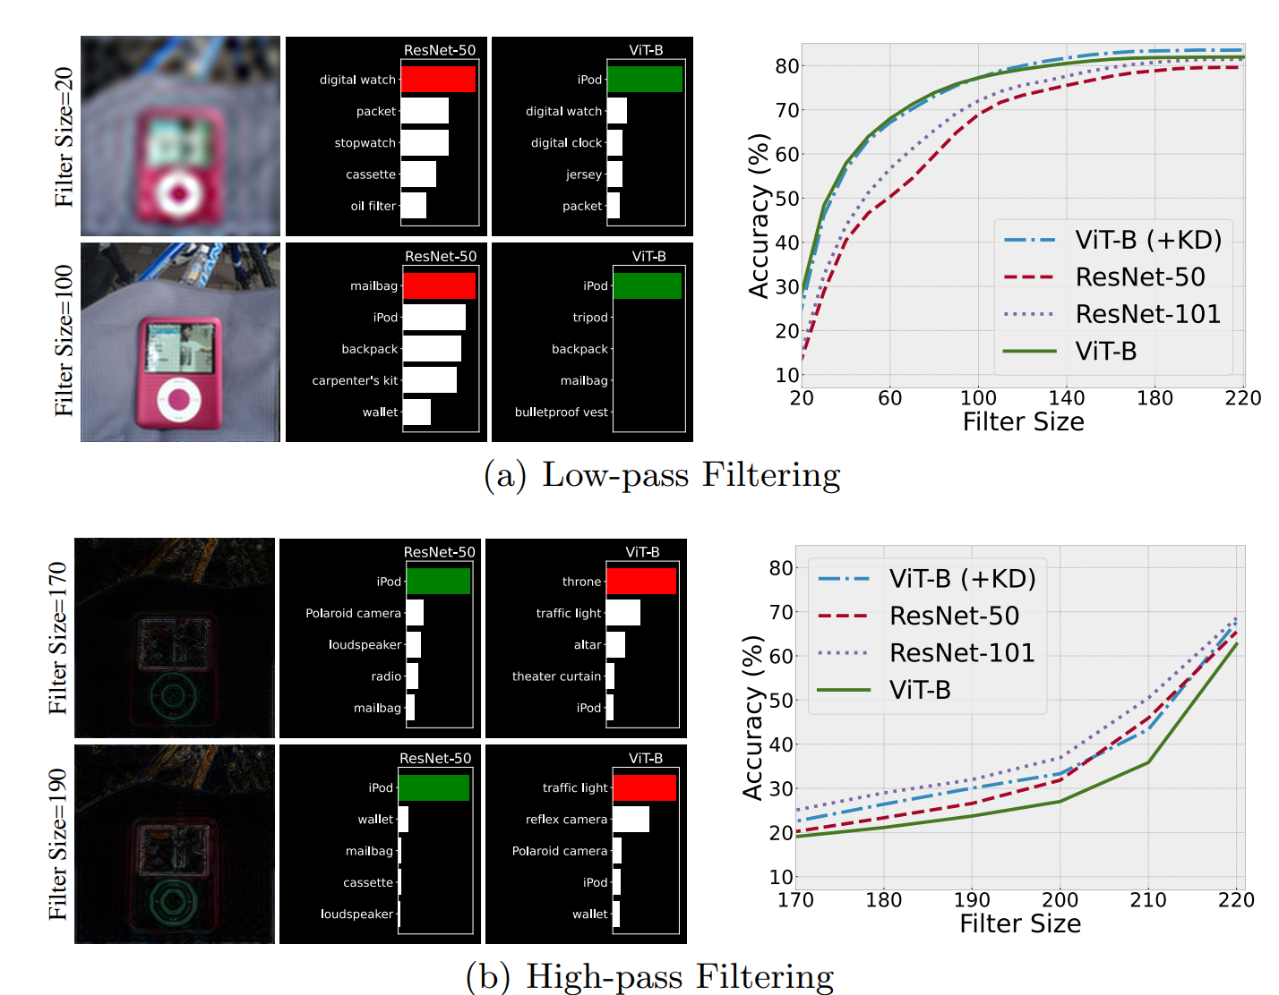
Exp.2: Apply frequency-domain filtering to the test samples (via DFT), isolate low- or high-frequency components, reconstruct the images, and then evaluate model accuracy to analyze how much each model relies on different frequency information.

Slide 10
Discussion
How can we improve MSA's ability to capture high-frequency components?
(data augmentation, distillation, hybrid architectures, loss function design)

Slide 11

Improve MSA
Adversarial Training with High-frequency Perturbations
Standard Training Objective
conventional adversarial objective
Proposed Training Objective
symmetric KL divergence regularization
Bai, et al., ECCV 2022, https://arxiv.org/abs/2204.00993
Notes:
They alter the high-frequency components of training images by adding adversarial perturbations and training ViT models on these altered images. It corresponds to adversarial training with high-frequency perturbations and is stated formally below. In standard training, the objective is simply: xxxx, where the model learns to correctly classify clean samples. With HAT, the objective becomes: xxxx.
Let’s break down a little, First Term: Clean Sample Training. This is the standard classification loss. Its role is straightforward: Ensure correct prediction on clean images Maintain the model’s basic classification capability.
Second Term: Adversarial. Here, the perturbation $δ$is generated using PGD. In other words: We search for a small perturbation. That maximally increases the classification loss. This finds the direction where the model is most vulnerable. Then during optimization, the model is forced to correctly classify these adversarially perturbed inputs. Symmetric KL divergence regularization term just encourage consistency between predictions on clean and perturbed inputs. Initially, the paper proposed:
Applying a high-pass filter to retain only the high-frequency part of the perturbation.However, experiments showed: Standard adversarial perturbations are already concentrated in high-frequency regions. Explicitly enforcing high-frequency filtering brings little additional benefit. Therefore, the final method is simplified to: Directly using standard adversarial training.

Slide 12
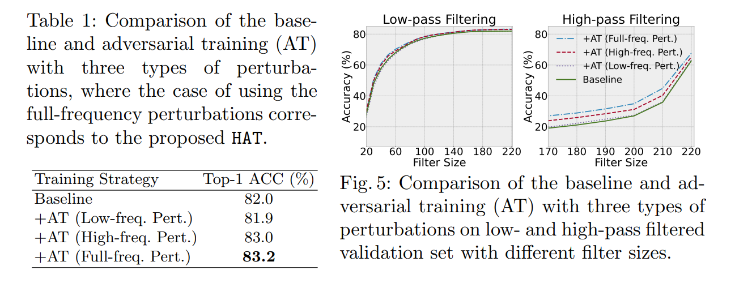
Bai, et al., ECCV 2022, https://arxiv.org/abs/2204.00993
Notes:
From Table 1 and Figure 5, we can see that the performance gain mainly comes from improving ViT’s ability to model high-frequency components. Adversarial training with low-frequency perturbations does not help and even slightly degrades performance, indicating that ViT already handles low-frequency, global information well. In contrast, adversarial training with high-frequency perturbations significantly improves accuracy, and the full-frequency version, namely HAT, achieves the best result. When evaluating on low-pass filtered images, all methods perform similarly, further confirming that low-frequency modeling is not the bottleneck. However, on high-pass filtered images, HAT shows clear advantages over the baseline, demonstrating that the improvement is primarily due to enhanced high-frequency representation. These results suggest that HAT does not simply improve robustness, but rather compensates for ViT’s structural weakness in capturing fine-grained, high-frequency details.

Slide 13
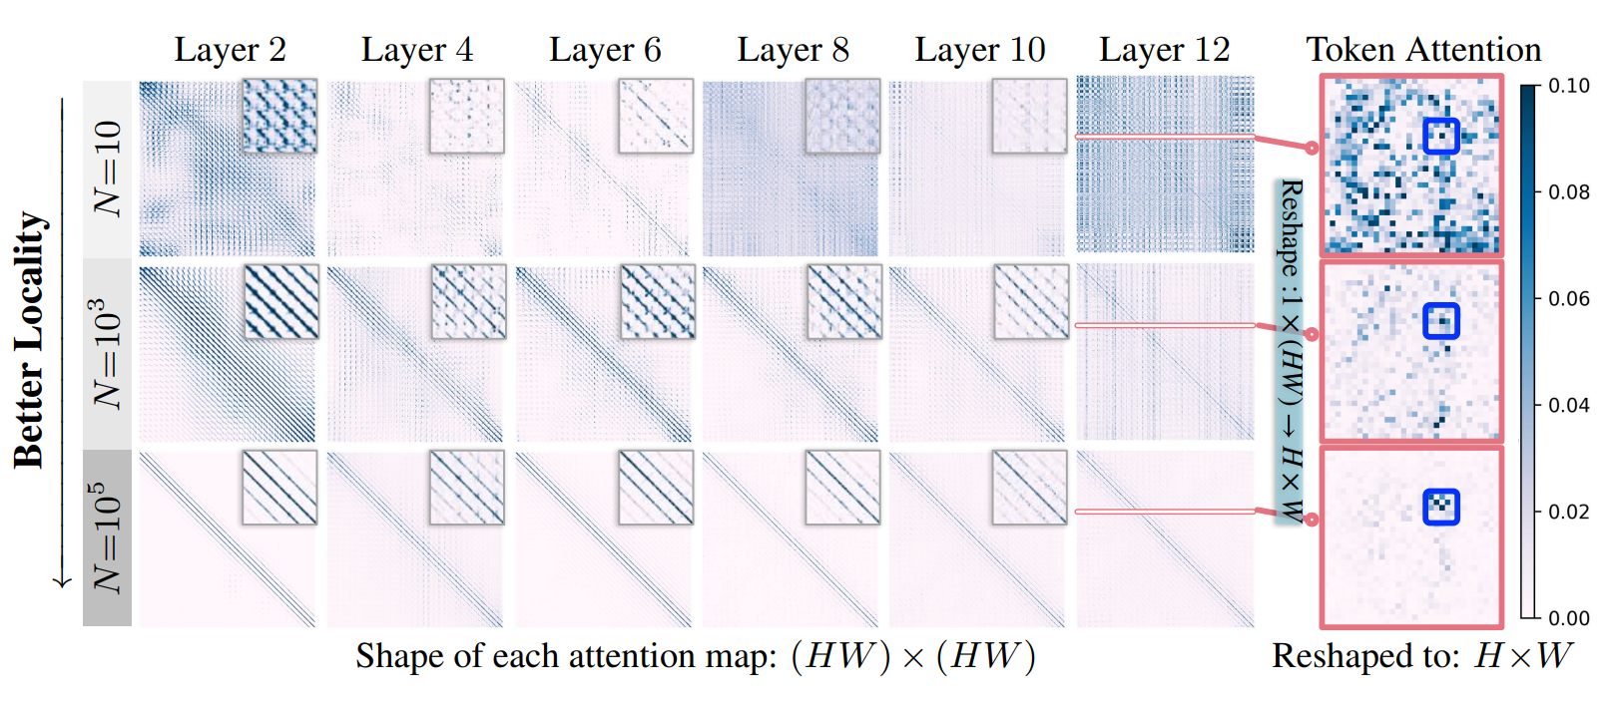
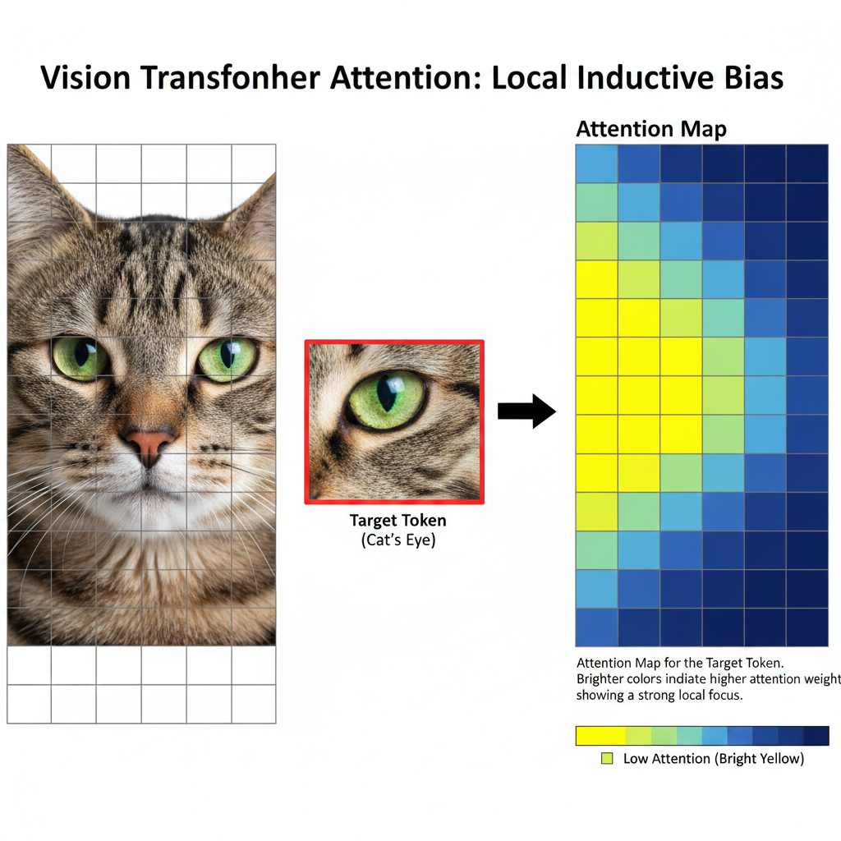
MSA in Generative Task
In classification (e.g., ImageNet, CIFAR-100), MSA behaves like a data-adaptive low-pass filter, but how about DiT?
Actually, MSA does not have a fixed spectral bias; it can learn convolution-like structures under generative objectives.
An, et al., NIPs 2025, https://arxiv.org/abs/2410.21273
Notes:
They empirically compare the attention maps of DiTs with varying levels of generalization: three DiT models trained with 10, 10^3 , and 10^5 images, where a DiT trained with more images demonstrates stronger generalization. For better readability of the attention maps, they linearly normalize each attention map to the range of [0, 1] and apply a colormap to the interval [0, 0.1], i.e., values exceeding the upper bound are clipped at 0.1. This shows the attention maps of DiTs with varying levels of generalization on a randomly selected image. Empirically, they observe that the attention maps of a DiT’s self-attention layers remain highly consistent across different images. As the number of training images increases from N=10 to N=10^5 , the attention maps of a DiT become increasingly concentrated along several diagonal lines. A closer inspection of the token attentions of a specific target token, i.e., a row in the attention map, shows that these diagonal patterns correspond to tokens near the target token, indicating that the generalization ability of a DiT is linked to the locality of its attention maps.

Slide 14
Thanks

