Slide 1
MPRA library for CRX HD muts
June 2022
Yiqiao

Slide 2
Overall goal and setup
Test HD mutant CRX (protein) transcriptional activity at CRX occupied CREs
Difference in activity at shared sites?
Does occupancy at novel sites matter?
Genotypes to test: CRX WT, E80A/+, E80A/A, K88N/+, K88N/N, R90W/W
Categories of ChIP peaks (FC 1.8, FDR 0.01) *see next slide for schematic representations
 | Category | N | Include in MPRA lib | HD site mutants | # BC/CRE | Total testing CREs | Notes
I | K88N/N gained | 465 | 1031 | 1568 | 4 | 10396 | See slides 6-9
I | E80A/A gained | 212 |  |  | 4
I | E80A/A lost | 307 |  |  | 4
II | CREs for selected genes | 55 |  |  | 4
III | Rest of ChIP peaks not in categories 1-4 (expected) | 8798 | 900 850 | 799 832 | 4 | 6796 6728 | See slides 6-9
 | Basal |  | 1 |  | 20 | 20 | See slides 10
 | Scrambles |  | 150 |  | 4 | 600 | See slides 10
 | Ctrl |  | 20 |  | 6 | 120
 | TOTAL |  | 4451 + basal |  |  | 17864

Slide 3
Categorization of CREs and controls
Categories I & II (1031)
E80A/A Gain
K88N/N Gain
20 Controls from Ryan
All CRX ChIP peaks
(9829)
Selected Retinal Gene CREs
Testing CREs: 4315
Scrambles: 150
Controls: 20
Basal: 1
Total: 4451
E80A/A Lost
Category III (8798)
Randomly select 150 and generate scrambles
K88N/N Lost
& not called differentially bound
Randomly select 850

Slide 4
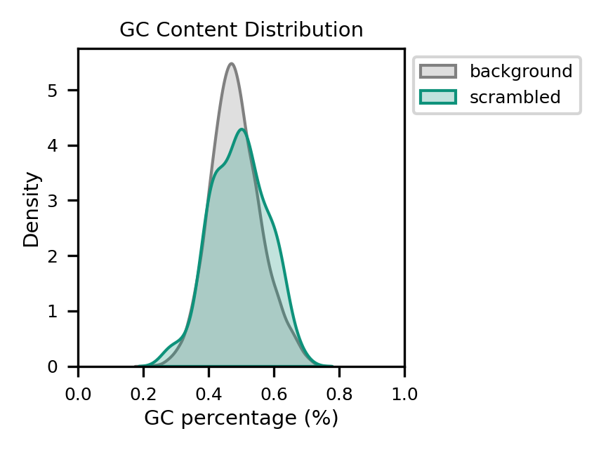
Three major categories of controls
Basal promoter
- pCrx-BC-DsRed
II. Controls (sequences from Ryan)
- Calibration of activity in WT animals
- For integration with other libraries tested also in WT animals
III. Scrambles
- Matched GC content distribution with the full set of CRX chip peaks
- Empirically null distribution

Slide 5
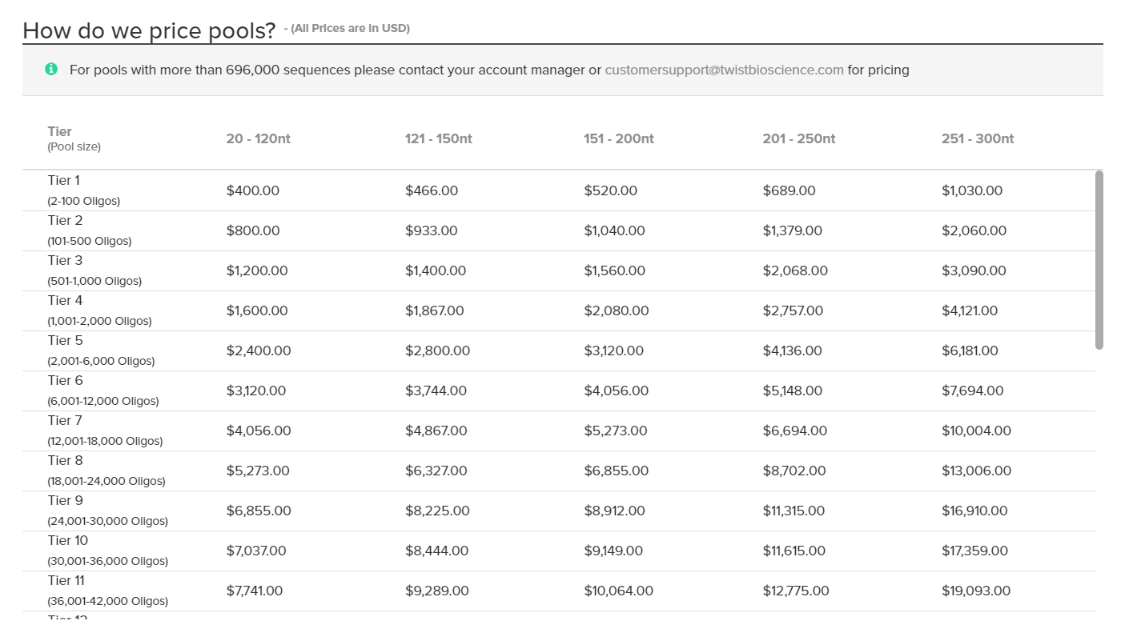
Twist Bioscience Oligo Pool Pricing – June 02 2022

Slide 6
Things to do
Select CREs mapped to important retinal genes – separate file
Finalized ChIPseq based sequences – major file
Center on summit and select central 133bp
Check motif content
Exclude CREs with bizarre motif contents (e.g. repeats of TA reach sequences)
Mutate HD motif
Whether to ask other co-occurred TF motifs? Has the power to do that?
Scan for EcoRI, SpeI, SphI, and EagI site
Generate 10bp barcodes and scan for GC contents
Assemble flanking sequences, RE sites, CREs, BCs

Slide 7
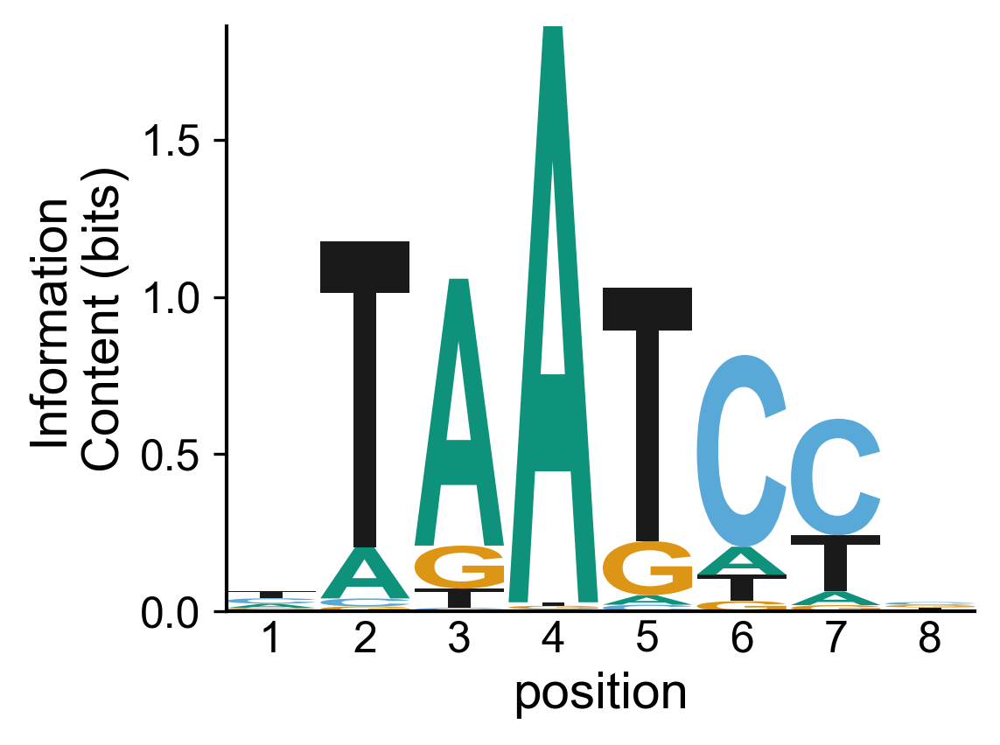
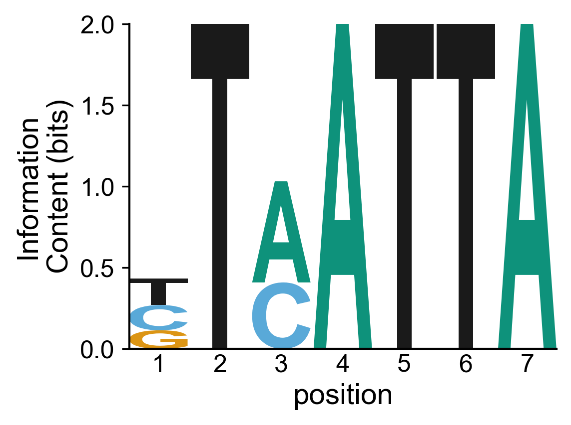
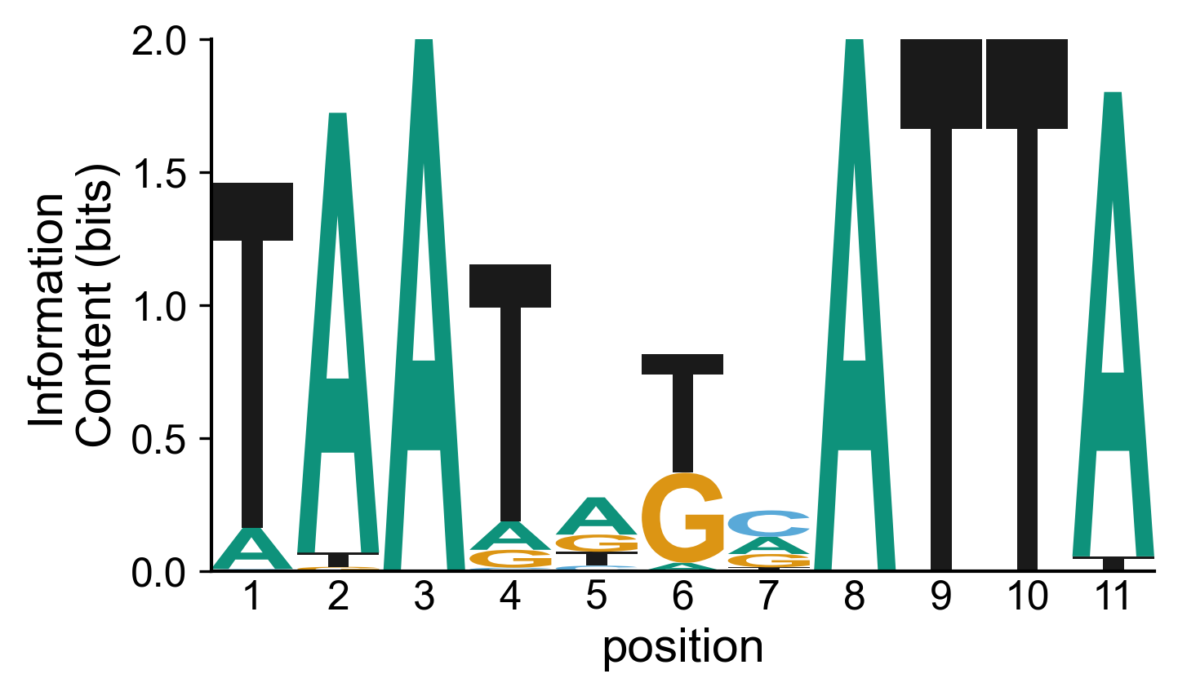

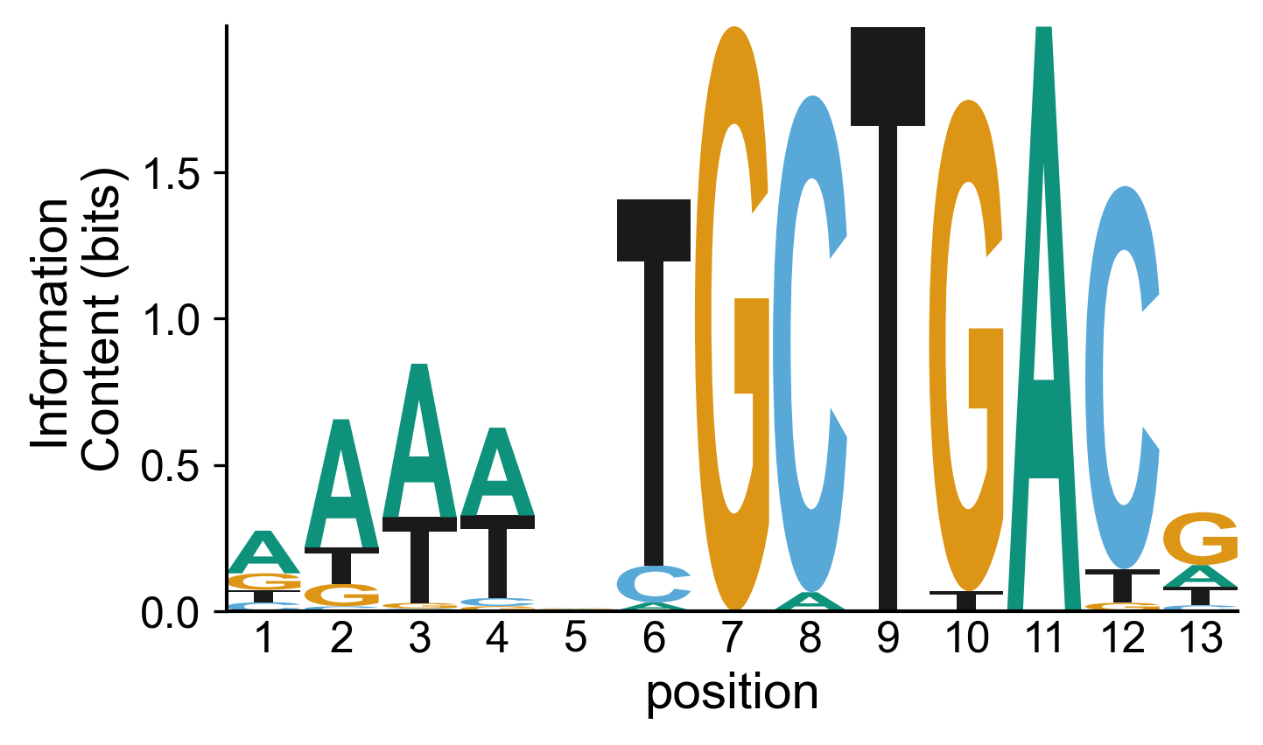
Motif Content – to identify putative TF binding sites
These are the PWMs I used for motif identification
WT CRX
K88N CRX
Dimeric HD (from K88N ChIP)
NRL
AP-1 (FOS::JUN)
a. Scan 133bp sequences surrounding CRX ChIP summit with FIMO using p-value cutoff 1e-03 (as in all previous CRX MPRA libraries except Ryan’s 2021 eLife paper)
b. Identify all dimeric sites and mask with N₁₁, repeat until no dimeric sites are called by FIMO
d. Identify monomeric HD sites from the rest of the sequences

Slide 8
Mutagenizing Design
For CREs containing multiple dimeric and/or monomeric HD sites, three ways of mutagenization:
ALL dimeric HD sites
ALL monomeric HD sites
ALL HD sites
Dimeric HD
Monomeric HD
CREs centered on ChIP peak summit
No HD site (FIMO p-value < 1e-03)
Dimeric + Monomeric HD site
Monomeric site only
Dimeric site only
Any HD motif core TAA > TAC

Slide 9
Three major categories of testing CREs
I. CRX ChIP differentially bound CREs:
Gained in E80A/A
Lost in E80A/A
Gained in K88N
MPRA library composition of categories I and II
 | Sum | EGain | ELost | KGain
Total CREs | 1031 | 212 | 307 | 465
Contains Dimeric site (D) | 369 | 3 | 89 | 274
Contains Monomeric site (M) | 864 | 187 | 223 | 414
Co-occurred monomeric and dimeric HD sites (D+M) | 335 | 3 | 82 | 247
Total testing CREs | 2599
II. CREs for selected retinal genes:
Gained in E80A/A
Lost in E80A/A
Gained in K88N
III. CREs randomly selected from the remaining ChIP peaks NOT IN categories I and II
MPRA library composition of category III
 | Sum | KLost | notDB
Total CREs | 850 | 505 | 345
Dimeric HD site only (D) | 80 | 46 | 34
Monomeric HD site only (M) | 678 | 406 | 272
Co-occurred monomeric and dimeric HD sites (D+M) | 74 | 44 | 30
Total testing CREs | 1682
*Peaks that were called lost in K88N/N (KLost) and those that not called differentially bound in any mutant (NotDB) have similar motif contents, so I grouped them together.
Compile all CREs in categories I, II and III. Check if these CREs have good representative of sequence features that we are potentially interested in.

Slide 10
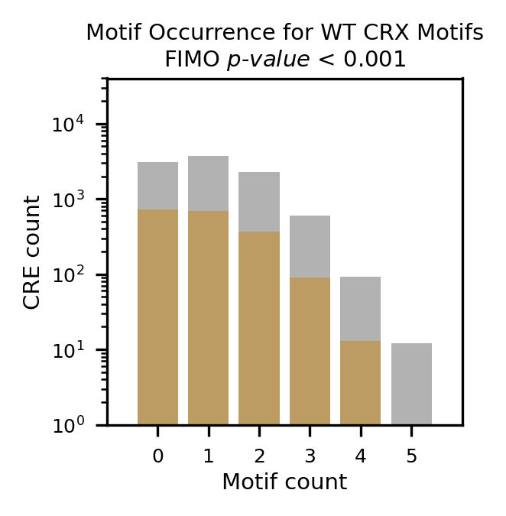
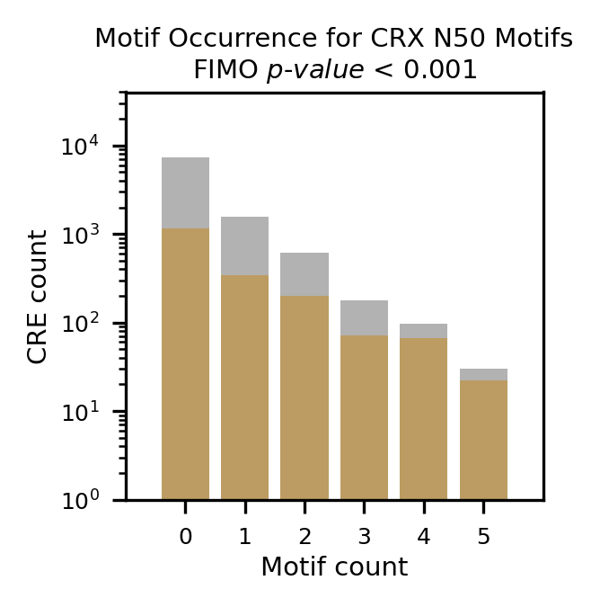
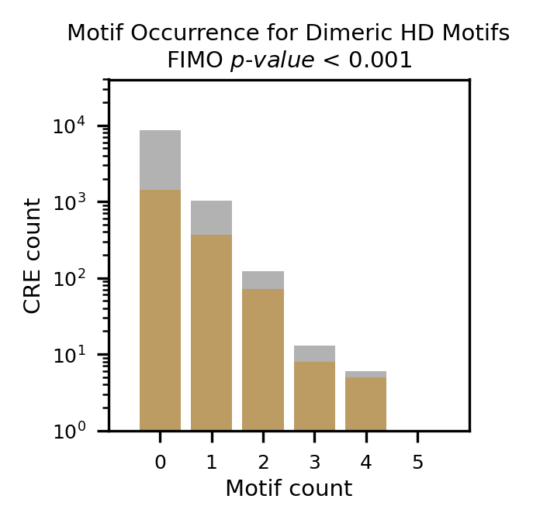
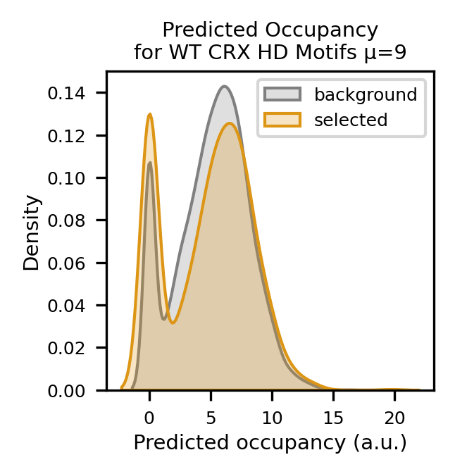
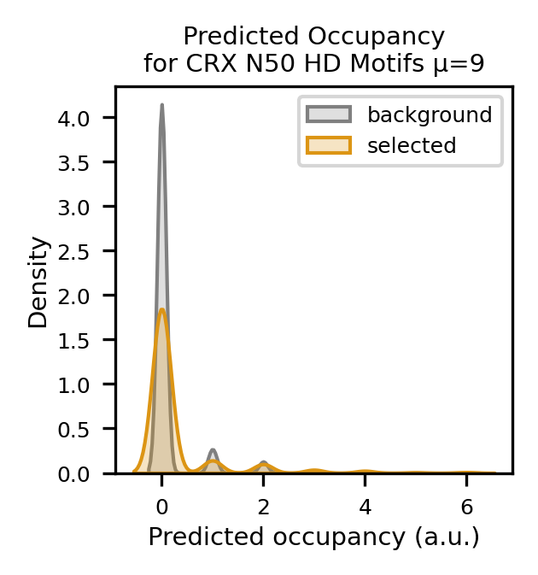
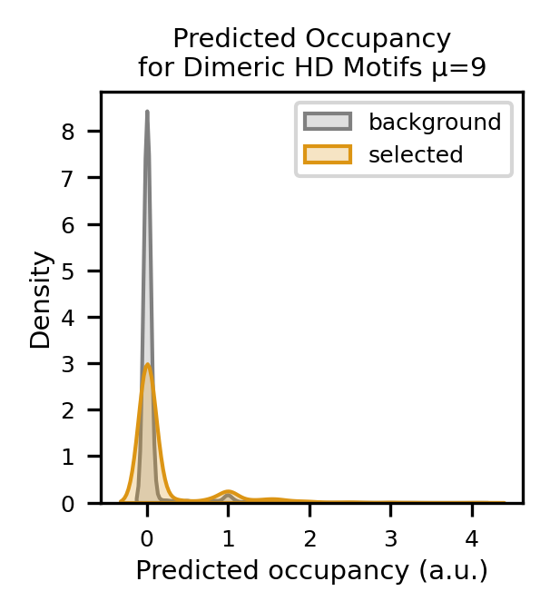
Motif occurrences and predicted affinity of selected CREs
Grey: background (all chip peaks/CRES)
Orange: selected CREs
Occurrence:
# of motif in a CRE
Predicted occupancy:
Predicted binding affinity/strength based on ePWM

Slide 11
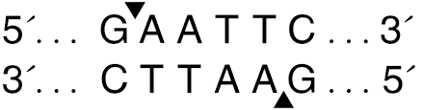
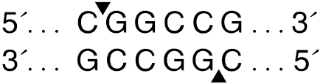
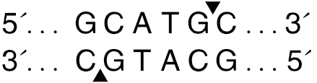
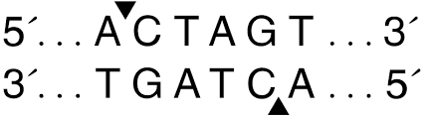
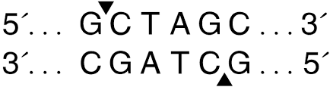
Cloning strategy – Mike Casey
Ordered oligos (66bp primers and RE sites)
1. Oligo amplification with primers
PrimerF: GTAGCGTCTGTCCGTGAATT
PrimerR: CTGTAGTAGTAGTTGGCGGC
Primer F
padding
10bp BC
Primer R
GTAGCGTCTGTCCGT GAATTC -------CRE Sequence----- ACTAGT C GCATGC ATCACGTCTG CGGCCG CCAACTACTACTACAG
EcoRI
SpeI
SphI
EagI
2. digested with EcoRI-EagI
And cloned in EcoRI-EagI digested backbone
Amplified pCrx-DsRed
Crx
Reporter
3. New oligos digested with SpeI-SphI
NheI-SphI digested PCR’d Crx promoter-DsRed is cloned in
Primers to amplify Crx-DsRed
F: aattGCTAGCCCTGGTTGCAGGCAG -- contains NheI
R: aattGCATGCCTACAGGAACAGGTG -- contains SphI
EcoRI
EagI
SphI
SpeI
NheI
Notes:
Attached is an example of the oligo we ordered, the Rho-basal MCS plasmid that the Oligo Library is cloned into, and the Crx-DsRed plasmid.
The Oligo Library is PCR amplified with the following primers…….
PrimerF: GTAGCGTCTGTCCGTGAATT
PrimerR: CTGTAGTAGTAGTTGGCGGC
The PCR’d Oligo Library is then digested with EcoRI-NotI and cloned into the EcoRI-EagI digested Rho-basal MSC plasmid. These new Oligo clones are then digested with SpeI-SphI and the NheI-SphI digested PCR’d Crx promoter-DsRed is cloned in.
These are the primers I used to amplify Crx-DsRed……..
F: aattGCTAGCCCTGGTTGCAGGCAG -- contains NheI
R: aattGCATGCCTACAGGAACAGGTG -- contains SphI

Slide 12
CREs of selected PR genes
Rod | Cone | Bipolar
Rax
Otx2 | Otx2
Gnb3
Prdm1 |  | Vxs2
Crx |  | Grm6
Abca4 |  | Caph5
Nrl | Rorb
Nr2e3 | Arr3
Rho | Opn1mw
Gnat1 | Opn1sw
Rp1
Pde6a
Pde6b
Rbp3 (Irbp)
Bbs4

