Slide 1


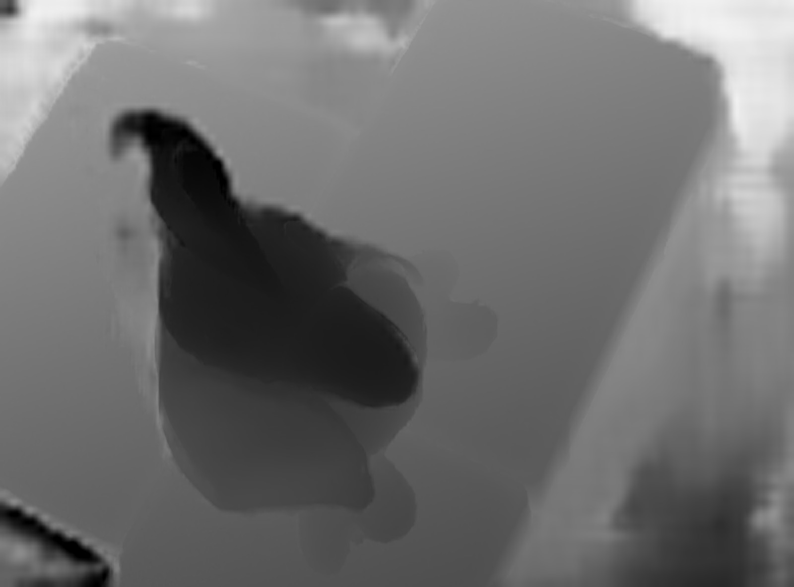
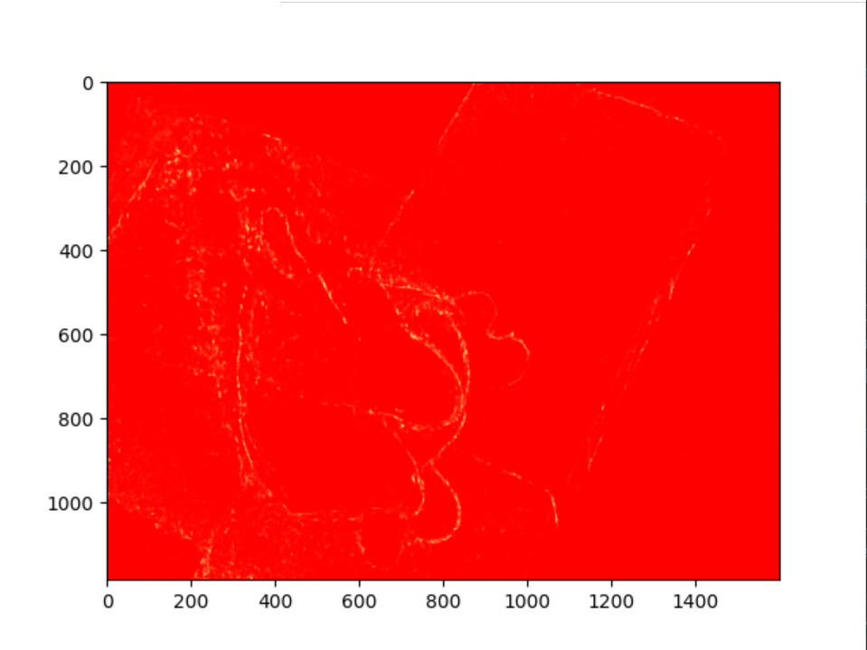
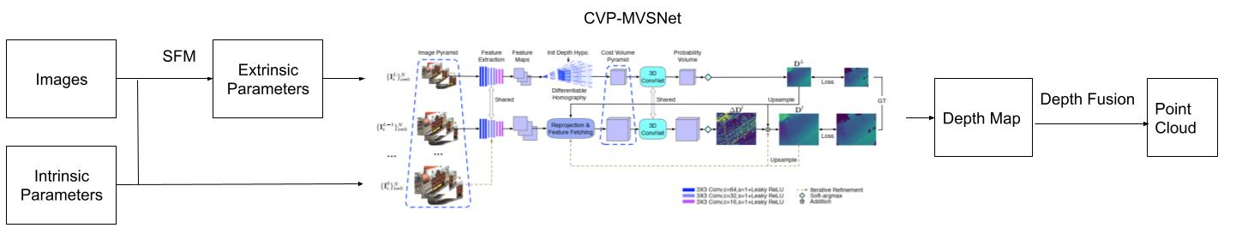
3D Reconstruction Tool based on Multi-View images
Hongyi Rao (raohy@bu.edu), Jiahao Wang(uf6@bu.edu), Yiqin Zhang(evezhang@bu.edu)
Background
Next Step
Increase the accuracy, especially the algorithm to get extrinsic parameters.
Reduce the running time.
Achieve the performance without converting the resolution of the input image.
Improve the interactive user interface.
Multi-view stereo (MVS) uses multiple images taken by one/multiple camera(s) to reconstruct the 3D scene.
Our goal is to create an Assisted Modeling Tool to meet the needs of designers, game developers, architects, engineers, and people who frequently do modeling.
Method
The method we adopted is shown in the figure below, and the meaning of each part is explained below.
SFM (Structure from motion):
Use SIFT to get corners that represent an image's character.
Math the corners of the input image to get the ten pictures with the most similar features.
Take the first image as a reference and obtain the extrinsic parameters of the most similar image and initialize a 3D model.
Based on the 3D model, use reprojection to obtain extrinsic parameters of other images.
Input the obtained extrinsic parameters, together with images and intrinsic parameters, into the CVP-MVSNet to generate depth maps.
Fuse multiple depth maps to form the point cloud.
Result
Standard
Our results
The intrinsic parameters: the focal length and lens distortion, etc.
The extrinsic parameters: describe the transformation between the camera and its external world.
depth map probability map
Depth map: reflects the distance of the object from the origin.
Probability map: reflects the depth estimation quality.

Slide 2
3D Reconstruction Tool based on Multi-View images
Hongyi Rao (raohy@bu.edu), Jiahao Wang(uf6@bu.edu), Yiqin Zhang(evezhang@bu.edu)
Backgroud
Next Step
Increase the accuracy, especially the algorithm to get extrinsic parameters.
Reduce the running time.
Achieve the performance without converting the resolution of the input image.
Improve the interactive user interface.
Multi-view stereo (MVS) uses multiple images taken by one/multiple camera(s) to reconstruct the 3D scene.
designers game developers house owner
Architect product manager engineer
Method
The method we adopted is shown in the figure below, and the meaning of each part is explained below.
SFM (Structure from motion):
Use SIFT to get corners that represent an image's character.
Math the corners of the input image to get the ten pictures with the most similar features.
Take the first image as a reference and obtain the extrinsic parameters of the most similar image and initialize a 3D model.
Based on the 3D model, use reprojection to obtain extrinsic parameters of other images.
Input the obtained extrinsic parameters, together with images and intrinsic parameters, into the CVP-MVSNet to generate depth maps.
Fuse multiple depth maps to form the point cloud.
Result
standard
Our results
depth map probability map
The intrinsic parameters: the focal length and lens distortion, etc.
The extrinsic parameters, used to describe the transformation between the camera and its external world.
Depth map: reflects the distance of the object from the origin.
Probability map: reflects the depth estimation quality.
Notes:
Our goal is to create a simple tool to meet the needs of designers, game developers, architect and all the people who will frequently do modelling.

