Slide 1
Captcha Automatic Segmentation and Recognition
Hao Ding A20289815
Yiran Zhang A20407655

Slide 2
Table of Contents
01
Problem statement
And Background material
02
Descirption of the proposed solution
03
Implementation details
04
Discussion of the obtained results.

Slide 3
Introduction
Captchas is widely used to authenticate users, which plays an important role in Internet security, and conglutination characters segmentation is still the bottleneck of captcha recognition research.
The problem needed to solved in the captchas recognition
Removing interfering background.
Segmentation
Captchas recognition

Slide 4

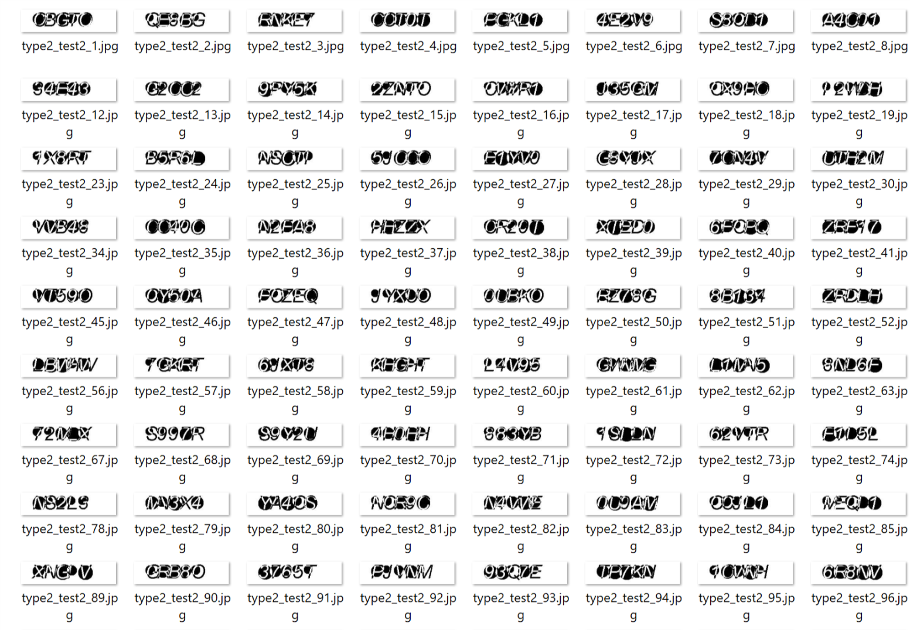
The Dataset that we used

Slide 5
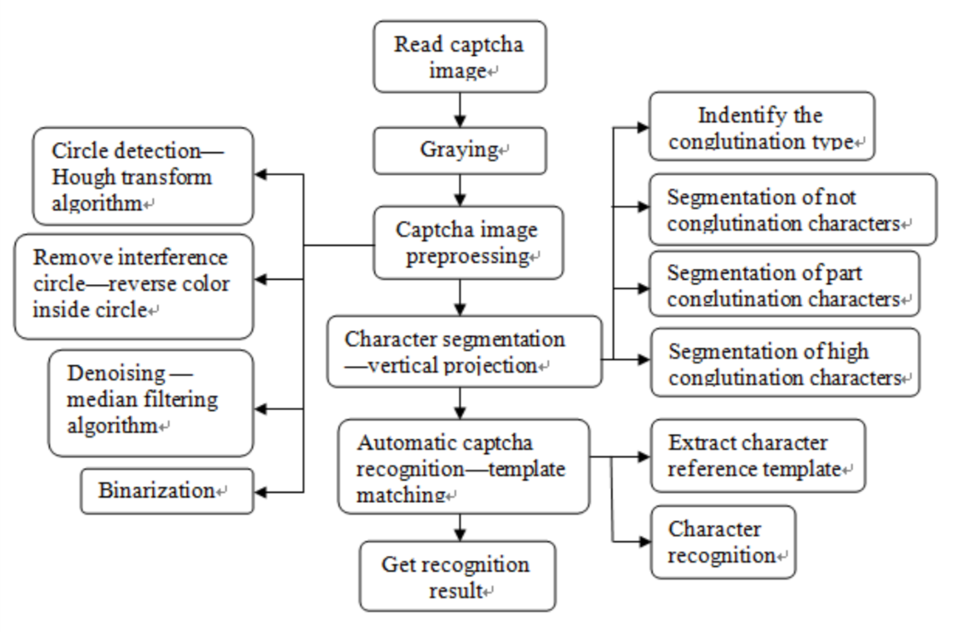
Recognition process

Slide 6
Captcha features
Background interference are the black circles.
The characters are the mixture of capital English letters and Number
No distortion or irregular
The width of letters and number are different
Some conglutination
Preprocess

Slide 7
step
Using Gaussion blur preprocess image
Remove circular interference based on hough algorithm
Denoise by median filtering algorithm
Binarizationon
Preprocess

Slide 8
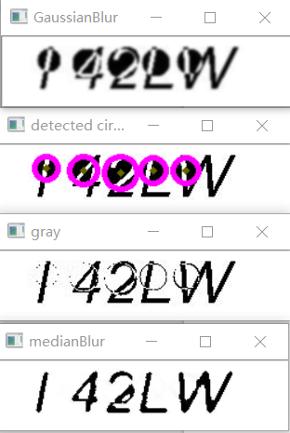
Preprocess

Slide 9
Improved Vertical Projection
Identify the conglutination type
No conglutination
Edge tangent conglutination
Edge horn conglutination
Segmentation of conglutination characters
Segmentation

Slide 10
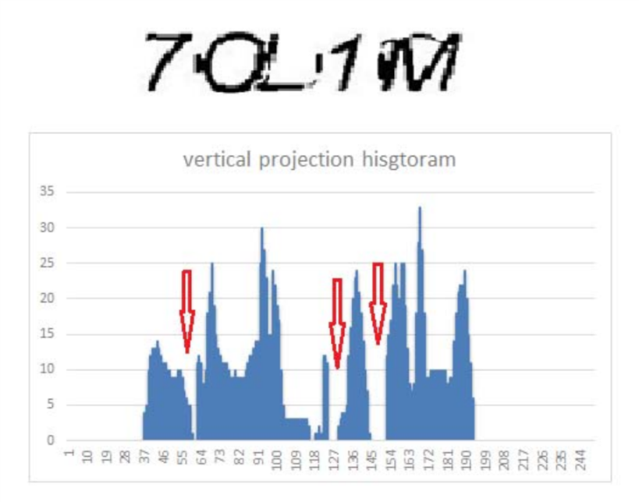
Conglutination Example
No conglutination
Segmentation
Vertical projection histogram of captcha image

Slide 11
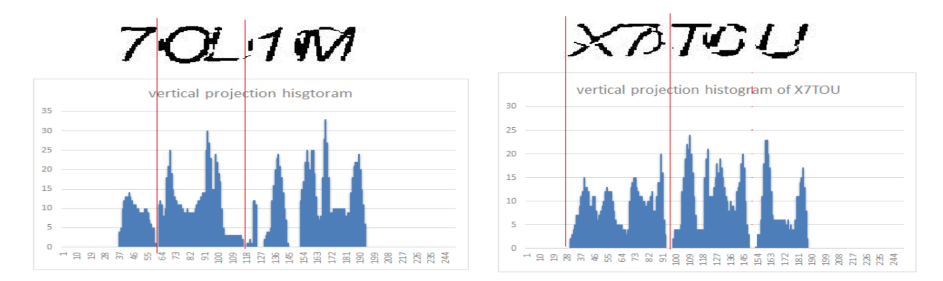
Conglutination Example
Edge tangent conglutination and edge horn conglutination
Vertical projection histogram of part conglutination

Slide 12
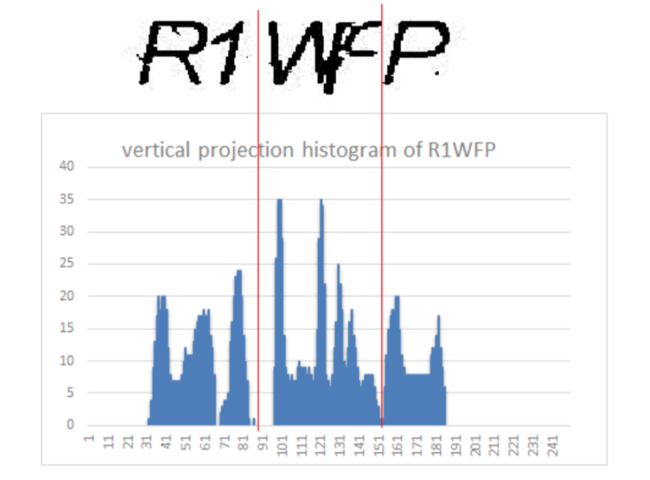
Conglutination Example
High conglutination
Segmentation
Vertical projection histogram of high conglutination characters

Slide 13
Segmentation Steps
Add up image 0-1 matrix by column and get a 1D array col[ ].
Traverse col and record the index of value 0 to p[ ].
Traverse p, do p[j]-p[j-1] and compare with character width d.
If p[j]-p[j-1]<d, two points in same blank area.
If d<p[j]-p[j-1]<2d, p[j] and p[j-1] are the segmentation point of not conglutination characters.
Segmentation

Slide 14
Segmentation Steps cont.
If p[j]-p[j-1]>2d, exists two characters in this area.
Iterate through col[i] (i in (p[j-1], p[j])), find the max value of col[i], then do i-p[j-1], compare this value with d, if they are nearly equal, i will be the segmentation point of edge tangent conglutination characters.
Segmentation

Slide 15
Segmentation Steps cont.
If p[j]-p[j-1]>2d, exists two characters in this area.
Iterate through col[i] (i in (p[j-1], p[j])), find the min value of col[i], then do i-p[j-1], compare this value with d, if they are nearly equal, i will be the segmentation point of edge horn conglutination characters.
If not two cases above, cut in the middle of the area.
Segmentation

Slide 16
Recognition Steps
Build cnn model and train with data set which obtained through preprocessing and segmentation with no fragmentary, no noise and no interference.
Predict with trained model.
Recongnation

Slide 17
Discussion of the obtain result

Slide 18
Thank You!

