Slide 1

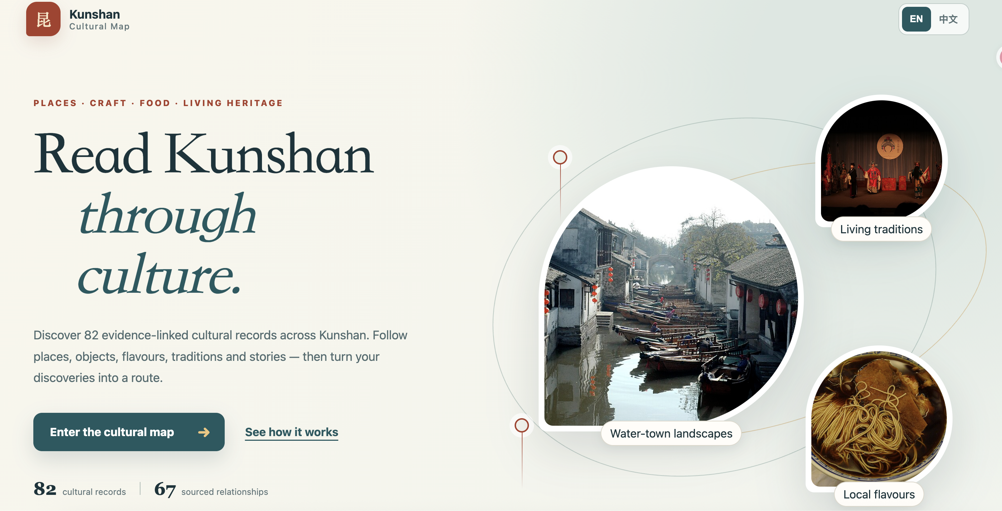
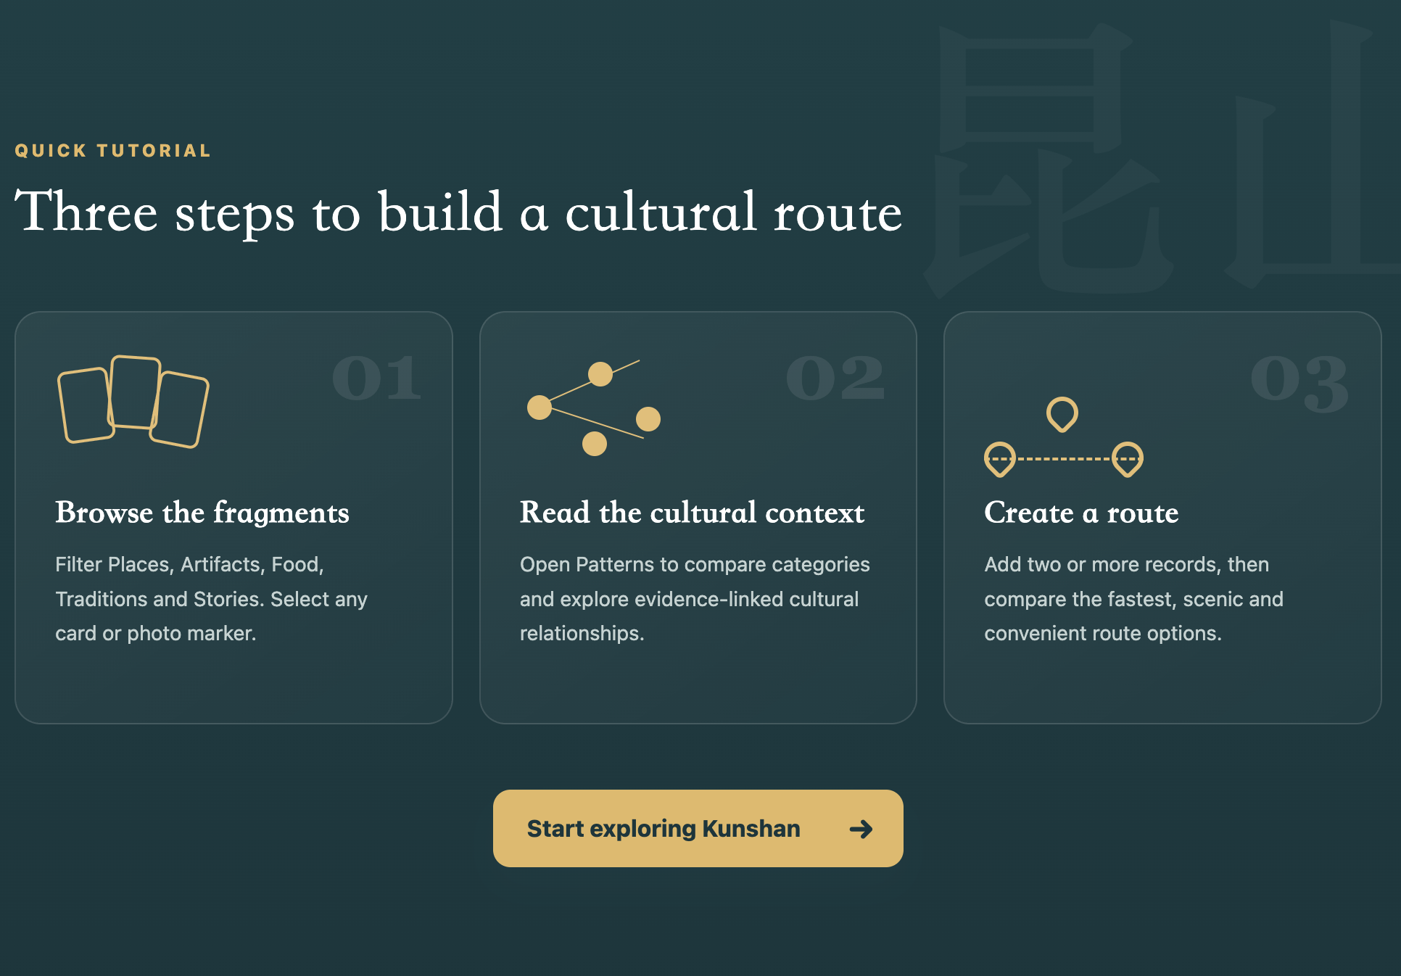
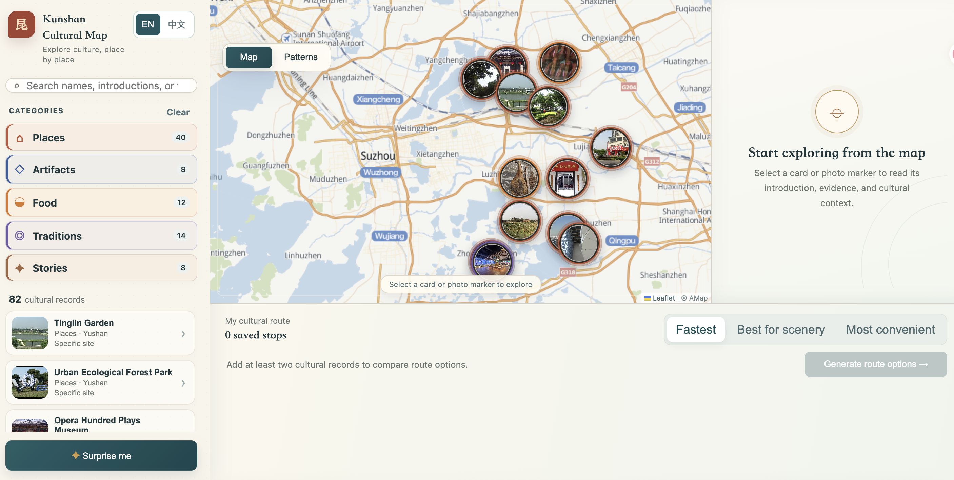
INFOSCI 301 · FINAL GROUP PROJECT · A0 LANDSCAPE
Kunshan Cultural Interactive Map for Cultural Exploration
A bilingual prototype that lets visitors inspect cultural records, source-linked relationships, and heuristic route options. It does not establish usability, live-navigation quality, or heritage impact.
TEAM 6 · Yihong Lin [yl999] system/data · Yiran Zheng [yz1011] visual/interface · Sitong Chang [sc972] visualization/evaluation · commit 5466e23 · 21 Oct 2026
01
Question, user task, and evidence boundary
FIG 1
Five visualization idioms serving one user task
QUESTION
How can visitors explore Kunshan through cultural records, evidence, and place?
SDG 11 · Target 11.4
Task: discover, inspect, save, and compare cultural records with their source context.
AUDIENCE
Visitors, newcomers, students, and interested residents
Strengthen efforts to protect and safeguard the world’s cultural and natural heritage.
A BASIC
B NETWORK
C SPATIAL
D INTERACTIVE
E ADVANCED
TASK
Use tutorial; inspect a record and source; save two stops; compare route options
LOCAL EVIDENCE
A bilingual prototype exists. Residents and cultural stewards have not yet been consulted.
Local contribution: a sourced cultural-discovery prototype. Evidence: curricular alignment only; no measured safeguarding outcome.
CURRENT CLAIM
82 cultural records, 67 source-linked relationships, and three schematic route options are implemented.
Category scan and bilingual cards
Source-linked relationship exploration
Photo markers locate approximate anchors
Search, filters, selection, and saved stops
Three route heuristics with transport estimates
BOUNDARY
Coverage, coordinates, image rights, accessibility, route validity, and community benefit remain unverified.
UN Goal 11 official icon; use does not imply UN endorsement.
Evidence: 82 records. Boundary: not a census.
Evidence: 67 relations. Boundary: interpretation untested.
Evidence: detailed map. Boundary: anchors are not entrances.
Evidence: controls implemented. Boundary: accessibility untested.
Evidence: route comparison. Boundary: not live navigation.
Data provenance: JuniceLin/Kunshan-Map, MIT source snapshot, 82 curated records / 67 documented relations / 13 source collections. Per-record source IDs, location precision, image source and credit fields are retained. Advanced view rationale: compare transparent heuristics beside a simple saved-stop list; it is not routing guidance.
FIG 2
Software architecture of the submitted version
FIG 3
User-experience walkthrough and evidence-based revision
1 · DATA
2 · TRANSFORM
3 · LOGIC
4 · VIEW
5 · RELEASE
START
ACTION
RESPONSE
REVISION
Tutorial
→
Search / marker
Source + Patterns
Save + routes
data/kunshan-cultural-dataset.json
82 records · 67 relations
source / credit / precision
→
data.js
static browser data
local assets + localStorage
→
app.js
filter, linking, clusters
route heuristics
→
index.html · map.html
Map / Patterns / details
saved route controls
→
Vercel static app
Leaflet + cached fallback
smoke check / degraded state
→
→
Learn the task
Select a record
Inspect relationship context
Compare schematic options
Observed peer feedback: unclear next steps, thin detail cards, uncertain connection meaning, and route eligibility. Decision: revise onboarding, source visibility, bilingual consistency, and save eligibility. Limit: peer feedback does not establish general usability or public benefit.
Flow and failure path: authored fields, sources, coordinates, relationships, and images → static browser state → linked filtered views and route alternatives. If detailed online map layers fail, locally cached bilingual map resources remain available. Current checks still needed: rights, coordinates, mobile, keyboard, screen-reader, and hosted parity.
02
Research, design, and validation
03
Full acknowledgements and credits
Primary frontier: Human-Centered Spatiotemporal Intelligence. Munzner (2009) separates validation of domain needs, data/tasks, idioms, and algorithms. This reframed the route button as a prototype requiring separate evidence, rather than proof of usefulness.
Instructor: Prof. Luyao Zhang. Peer feedback: Michelle Clark (route + marker meaning); Andi Wan (clearer controls and next action); Jiaxin Wang (relationship validation); Tingyi Xiao (node-link value and steps); Zhixin Liu; Yixuan Chen. Resulting changes: bilingual onboarding, richer details and sources, clearer guidance, widened save eligibility, and route comparison.
DOMAIN
Visitor task defined; community need remains inferred
Field context: Tencent’s Shanghai Office; Shanghai Science and Technology Museum; Jinxi Intangible Cultural Heritage Museum; China Ancient Brick and Tile Museum. These visits informed the project; they do not imply endorsement or co-design.
DATA / TASK
82 records and 67 relations; rights and coordinates need audit
IDIOM
Map, Patterns, and details visible; interpretation and access untested
Reused: Leaflet; AMap and OpenStreetMap map data; JuniceLin/Kunshan-Map source dataset under MIT; per-record credited image sources; course A0 template. Team: Yihong Lin system/data; Yiran Zheng visual/interface; Sitong Chang visualization/narrative and demo video.
ALGORITHM
Three heuristics visible; no live traffic, hours, or accessible-routing data
Next check: recruit visitors and cultural stewards with permission; test source explanation, keyboard path, and route-limit interpretation. Owners: team.
AI disclosure: OpenAI Codex assisted application development and documentation; ChatGPT assisted initial report drafting. The team remains responsible for claims, source checks, design decisions, code, testing, rights, and final release.
04 OPEN THE SAME SUBMITTED VERSION
Artifact: https://kunshan-cultural-interactive-map.vercel.app/
Repository + commit: https://github.com/YiranZheng0206/Kunshan-Cultural-Interactive-Map/tree/2eab8b7fc876711c0817cc0c41abfb8956e0b180
Poster: https://github.com/YiranZheng0206/Kunshan-Cultural-Interactive-Map/blob/main/Team6_INFOSCI301_FinalProject_Poster.pptx
Paper: https://github.com/YiranZheng0206/Kunshan-Cultural-Interactive-Map/blob/main/Team6_INFOSCI301_FinalProject_Poster.pptx
Video: https://github.com/YiranZheng0206/Kunshan-Cultural-Interactive-Map/blob/main/Team6_INFOSCI301_DemoVideo.mp4

