Slide 1

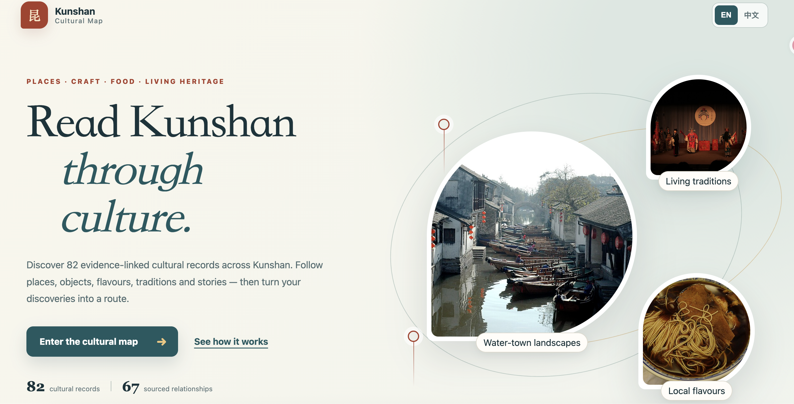
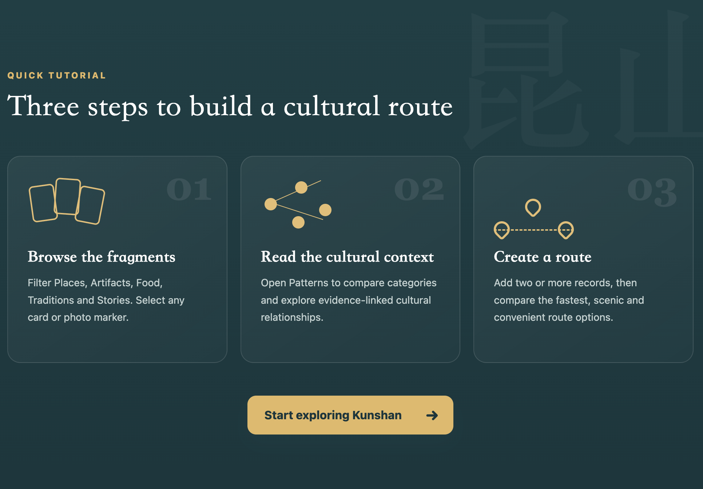
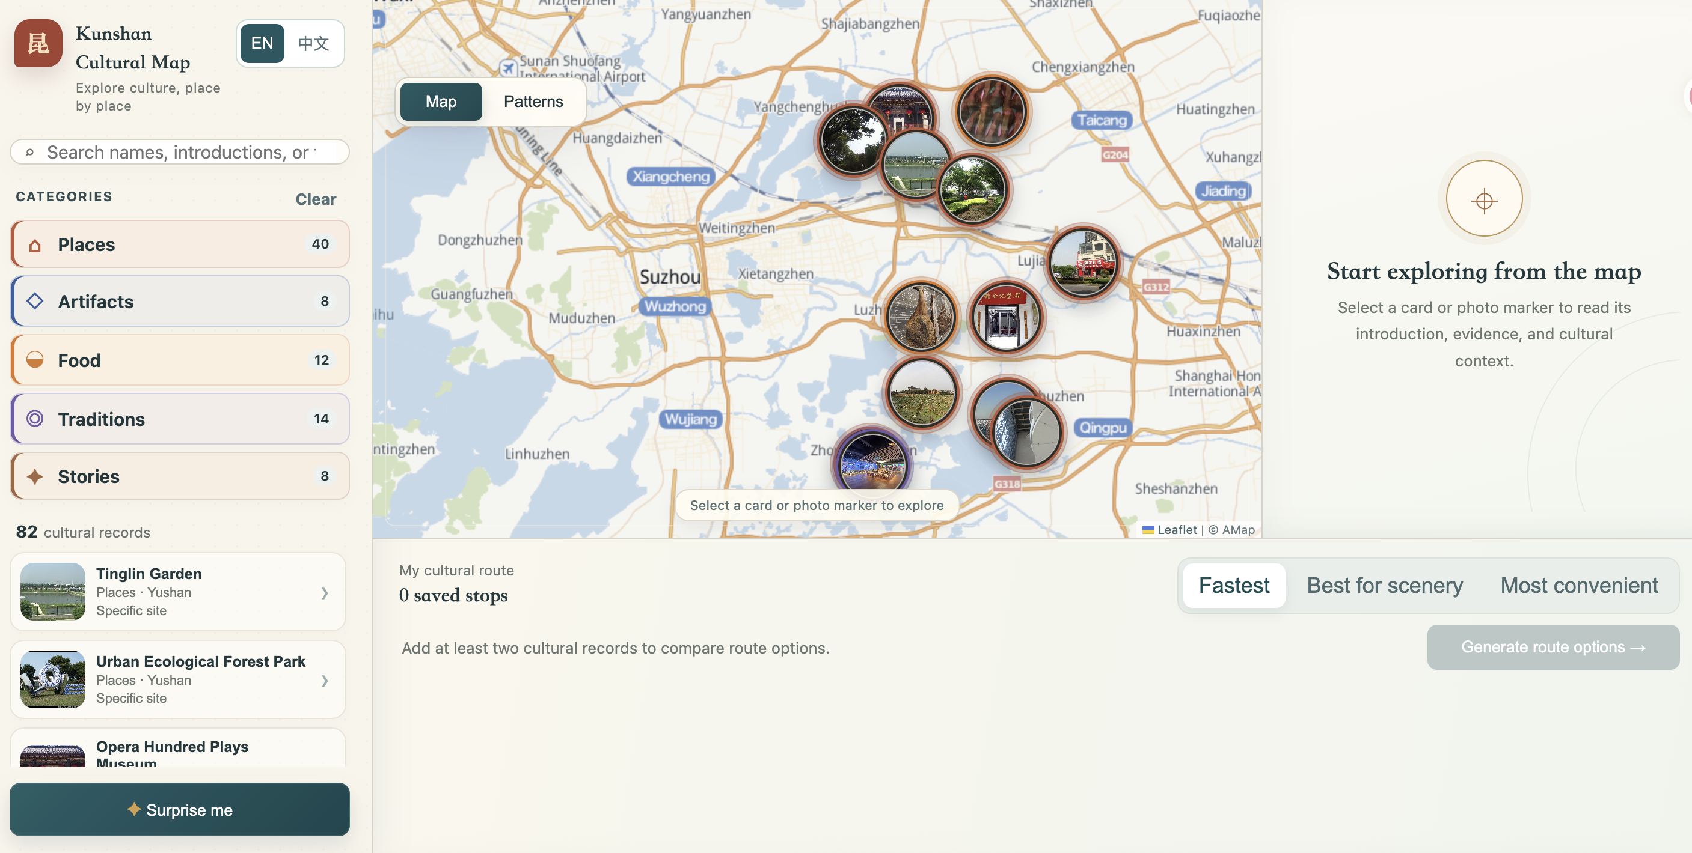
INFOSCI 301 FINAL GROUP PROJECT POSTER
Kunshan Cultural Interactive Map for Cultural Exploration
Yihong Lin [yl999] | Yiran Zheng [yz1011] | Sitong Chang [sc972] | Integrated app 2eab8b7 | 6 October 2026
Duke Kunshan University | INFOSCI 301 | Autumn 2026
Instructor: Prof. Luyao Zhang
Project frame and evidence
Repository and software architecture
Four validation levels
Question: How can visitors explore Kunshan through cultural records, evidence, and place?
The submitted version integrates the source-linked dataset, bilingual interface, and route comparison in one prototype.
Domain situation
Evidence: defined visitor task and formative peer feedback. Threat: no local consultation.
Intended users: visitors, newcomers, students, and interested residents
1 Data and provenance
82 records + 67 relationships
13 source collections; precision labels
2 Local data and state
Bilingual fields + image assets
localStorage saves language and stops
3 Logic and algorithms
app.js filters, linking, clustering
Three route heuristics
4 Views and interaction
Landing tutorial, Map/Patterns
Details, sources, and saved stops
5 Deploy and fallback
Vercel static app
Cached bilingual map fallback
Data and task
Evidence: 82 records and 67 sourced links. Threat: coverage, rights, and coordinates need audit.
Exact task: use the tutorial, inspect records and sources, save stops, then compare route options.
Idiom
Evidence: Map, Patterns, source details, saved routes. Threat: interpretation and accessibility untested.
Local context: A bilingual prototype supports discovery; residents and cultural stewards have not yet been consulted.
Algorithm
Evidence: three heuristics and travel-mode suggestions. Threat: no live traffic, hours, or accessibility routing.
Artifact: kunshan-cultural-interactive-map.vercel.app App repo: YiranZheng0206/Kunshan-Cultural-Interactive-Map Data repo: JuniceLin/Kunshan-Map Current app: 2eab8b7
Claim: The prototype combines 82 cultural records, 67 source-linked relationships, and three schematic route options.
Input: 82 bilingual records with sources, coordinates, and image metadata. Output: filters, Patterns views, saved stops, and route comparisons. Checks still needed: accessibility, rights, coordinates, and hosted parity.
Interdisciplinary contribution
Evidence boundary: Coverage, coordinates, rights, usability, route validity, and community impact remain unverified.
Primary frontier: Human-centered spatiotemporal intelligence.
User-experience walkthrough and revision
Open science, data governance, and responsible AI
Five representations, one task
1 Tutorial
2 Search or photo marker
3 Inspect source
4 Compare Patterns
5 Save stops
6 Compare routes
Source IDs, image credits, and precision labels are visible; rights and provenance reviews remain open.
Basic
Bilingual cards + category chart; 82 curated records
Scientific communication for emerging technologies
Bilingual landing, tutorial, map, and details support explanation; final comprehension testing remains pending.
Network
67 source-linked relationships; implemented network view
Human-centered spatiotemporal intelligence
The map connects culture to place; approximate anchors and route estimates remain unvalidated.
Spatial or temporal
Photo markers + detailed map; coordinate precision shown
Peer feedback led to clearer guidance, visible relationship evidence, broader route eligibility, and bilingual fixes.
Community-rooted global leadership
Interactive
Search, filters, source details, Map/Patterns, save/remove
Local community or audience
Visitors, newcomers, students, and interested residents; resident and steward consultation is pending.
Advanced
Three route heuristics + transport estimates; not live navigation
Service and accountability
The prototype supports cultural discovery; permissions, maintenance, and a correction process still need owners.
Verified data and provenance 82 records, 67 relationships, and 13 referenced source collections. Each record includes source IDs, location precision, and image credit metadata; audit remains in progress.
SDG 11.4: Sustainable Cities and Communities
Curricular alignment only; no measured safeguarding or local benefit.
CURRENT RESULT Bilingual explorer with 82 cultural records, 67 source-linked relationships, and three schematic route modes. LIMITATION Routes are not live navigation; accessibility, provenance, and rights require testing. NEXT VALIDATION Test the updated workflow with visitors and cultural stewards.
Sources: Munzner (2009); Dimara & Perin (2020); Kunshan-Map (86b5a69); Kunshan-Cultural-Interactive-Map (2eab8b7); UN SDG 11.4; Leaflet; OpenStreetMap; AMap.
Team roles Yihong: system/data; Yiran: interface; Sitong: visualization/evaluation. AI-assisted drafting disclosed; the team verifies facts, rights, versions, and final claims.
Notes:
Project artifact: https://kunshan-cultural-interactive-map.vercel.app/
App source: https://github.com/YiranZheng0206/Kunshan-Cultural-Interactive-Map (2eab8b7, 6 October 2026)
Dataset source: https://github.com/JuniceLin/Kunshan-Map (86b5a69)
UN SDG 11.4: https://sdgs.un.org/goals/goal11
Leaflet: https://leafletjs.com/
OpenStreetMap attribution: https://www.openstreetmap.org/copyright
AMap: https://lbs.amap.com/
Content summary checked against the supplied progress report and current repository README. Route options are prototype estimates, not live navigation.

