Slide 1
STAT 214 Spring 2025
Week 8
Zach Rewolinski
Based on Anthony Ozerov’s STAT 215A Materials.

Slide 2
Outline
Bias-Variance and regularization

Slide 3
Outline
Bias-Variance and regularization
Interpretability for DL

Slide 4
Interpretability (Traditional StatML)

Slide 5
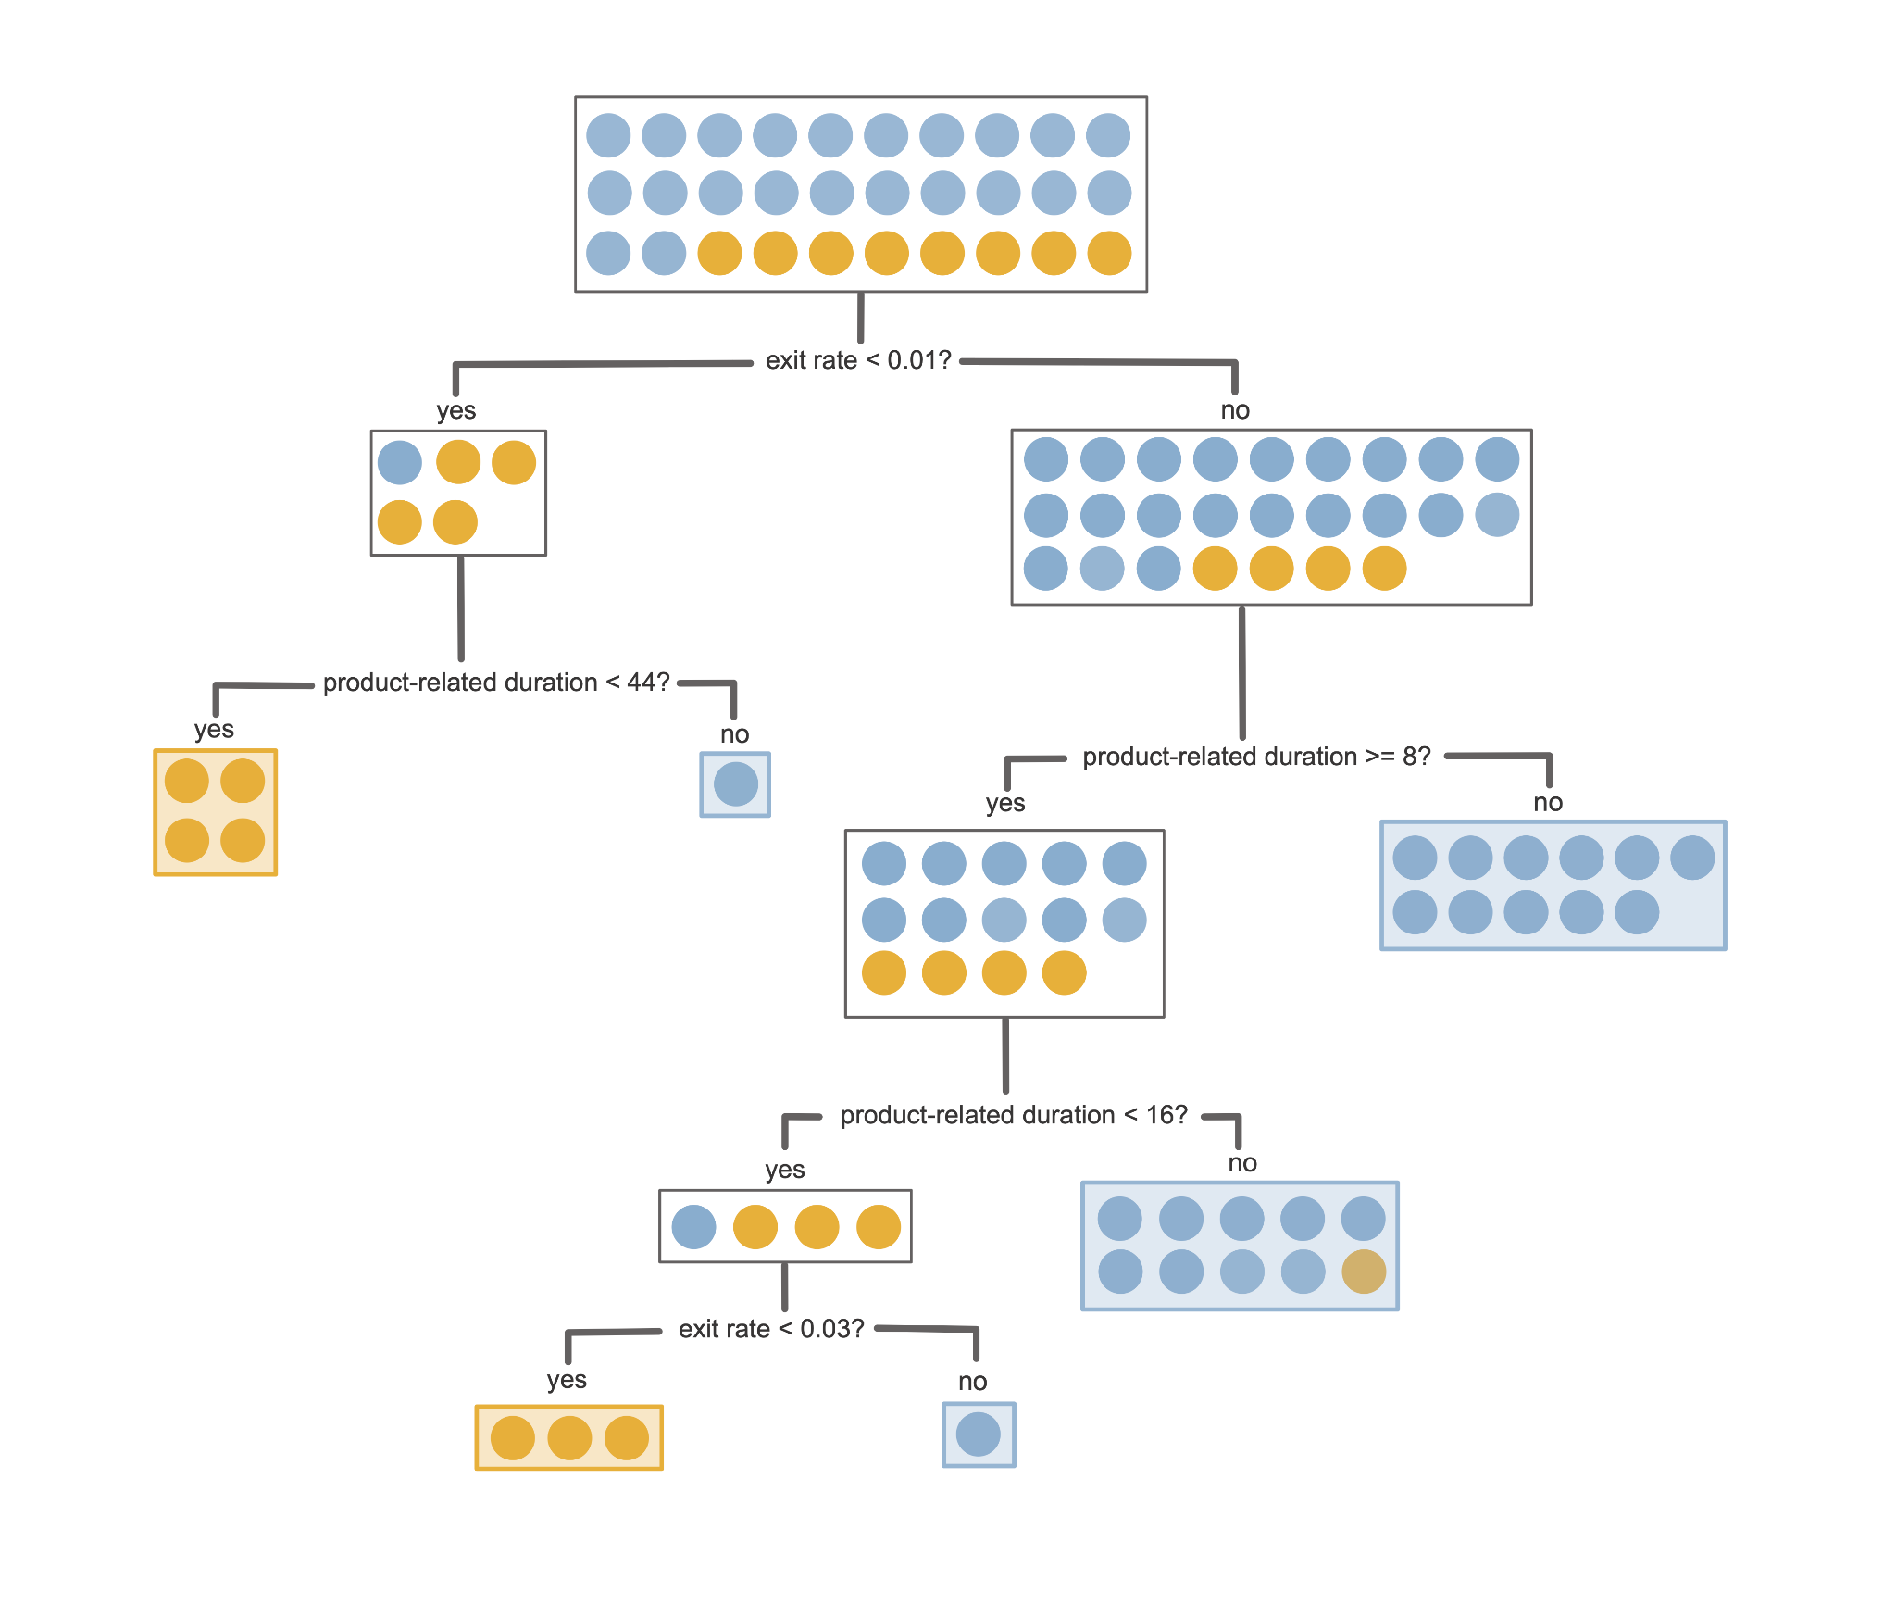
Tree models
Decision tree:
Just plot it as a tree and look at it (scikit-learn has built-in ways to do this, or do it manually and make it look nice)
Hopefully it’s not too big
Can maybe represent how the training data is filtered by the tree?
https://vdsbook.com/12-rf#the-classification-and-regression-trees-algorithm

Slide 6
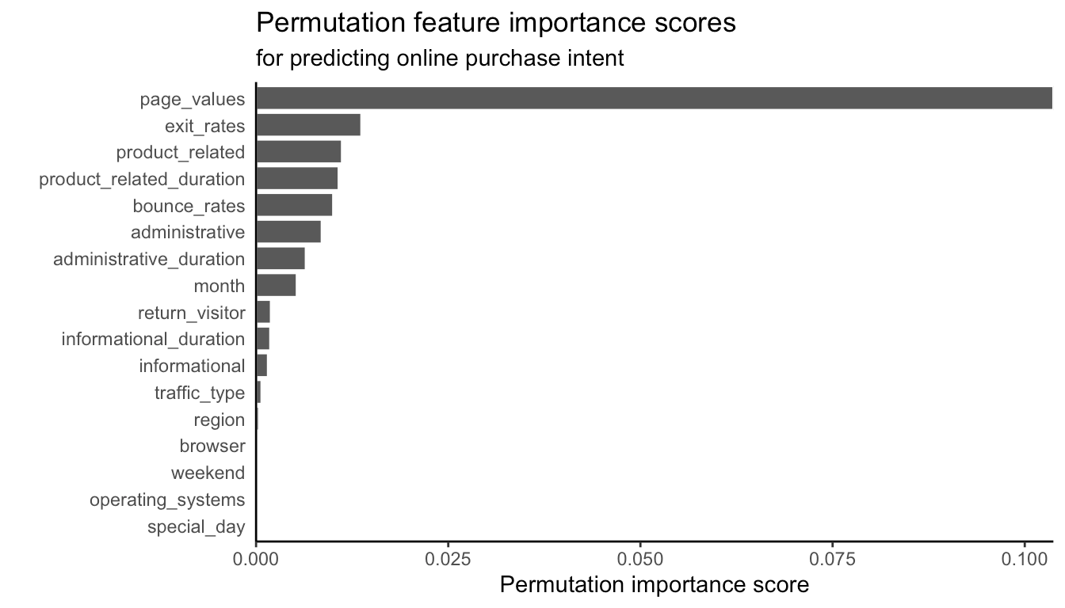
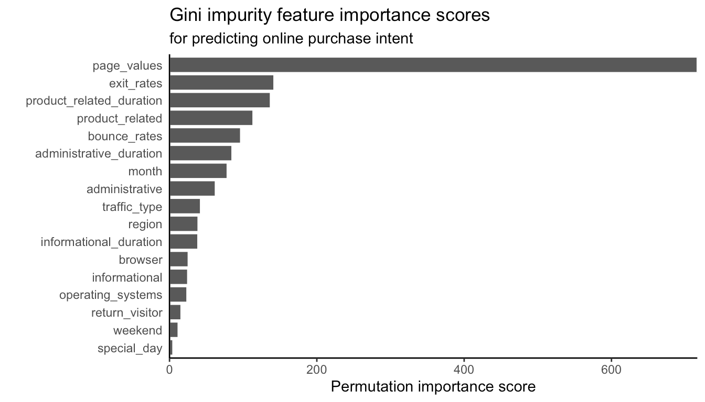
Tree models
Random forest
Too many trees to plot them!
Measure feature importance
permutation: measure how performance (e.g. out of bag error) changes if you randomly permute one of the features.
Gini impurity: measure how much the “impurity” decreases in splits involving each variable
Mean Decrease in Impurity
https://vdsbook.com/12-rf#random-forest-feature-importance-measures

Slide 7
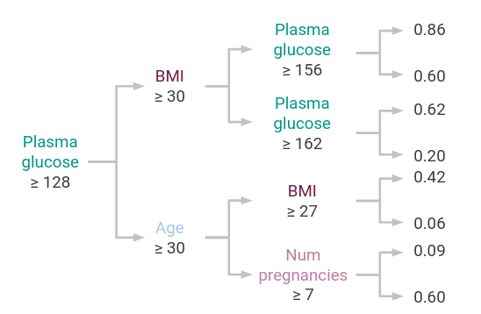
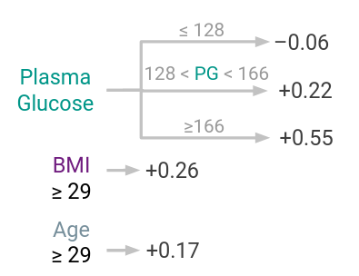
Tree models
Remember that there are also other tree models, some of which are very interpretable!
https://github.com/csinva/imodels ← good stuff from Bin’s group
CART
FIGS
https://arxiv.org/pdf/2201.11931

Slide 8
Linear models
Interpret by looking at coefficients
Intercept: the prediction you’ll make for an observation where all variables are zero (???). This usually doesn’t make much sense. To improve interpretability, can center all the variables. Then the intercept will be the prediction for the “average” observation.
Other coefficients: “holding all other variables constant, an increase of 1 in this variable changes our prediction by [coefficient]”. Does this make sense when variables are correlated? Also won’t work if you have nonlinear terms or interaction terms.
Comparing coefficients: It does not make sense to compare the magnitude of coefficients to measure their “importance” unless the variables are on the same scale. Still doesn’t make much sense if variables are correlated though.
Significance: a statement about the magnitude of the coefficient relative to its variability. Hard to interpret usefully in a domain context.
https://vdsbook.com/10-ls_continued#linear-fits-with-multiple-predictive-features

Slide 9
Linear models: logistic regression
Interpretation becomes a little more tricky.
We are linearly modeling the log-odds: log(p/(1-p)). So “with an increase of 1 in ___ while holding all other variables constant, the model predicts a change in the log-odds of [coefficient]”

Slide 10
Interpretability (Deep Learning)

Slide 11
Deep learning models
Key idea: attributions
Feature attributions: how the output of the model changes when the input changes. Understand the DL model as a whole.
Neuron attributions: how individual neurons in the model change when the input changes. Understand the internals of the DL model.

Slide 12
Feature attributions
Two general approaches:
Gradient-based: compute the gradient of the output of the model (i.e. the prediction) with respect to the inputs
Perturbation-based: change the inputs of the model, plug them through, and see how the output changes.
You can make very nice plots if your inputs are images :)

Slide 13
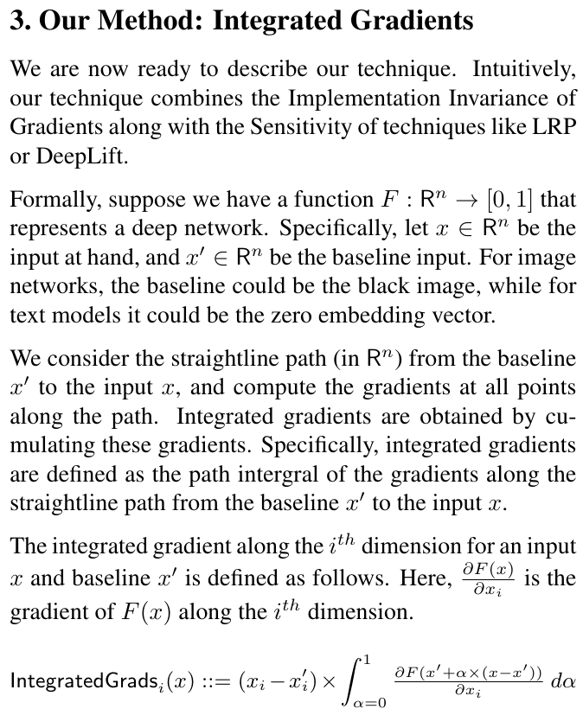
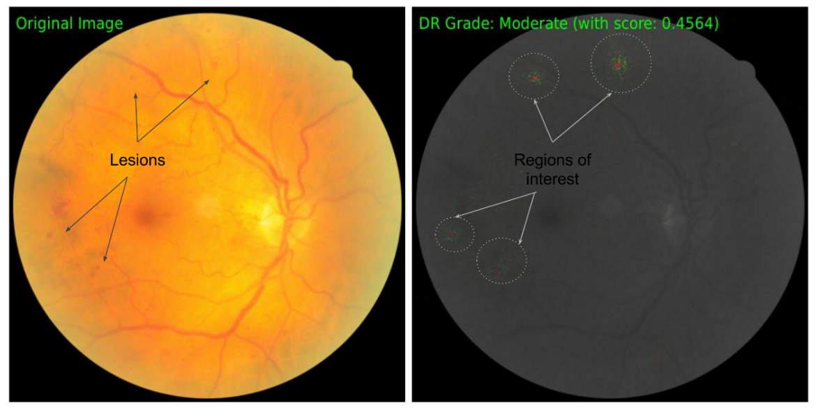
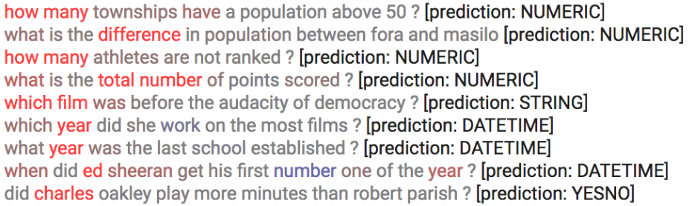
Gradient Approach: Integrated Gradients
https://arxiv.org/pdf/1703.01365

Slide 14
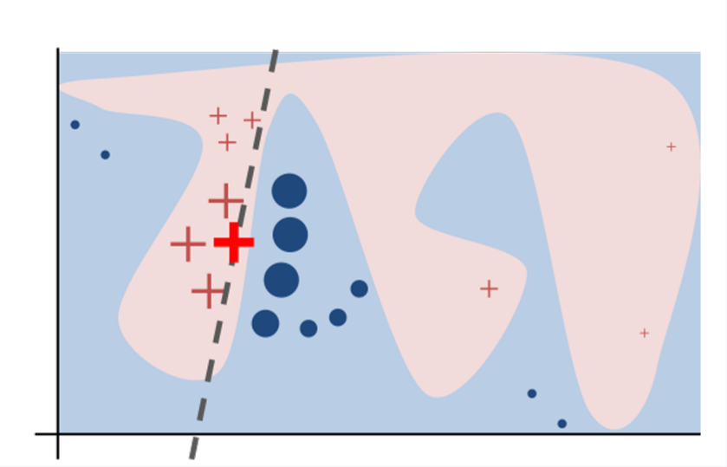
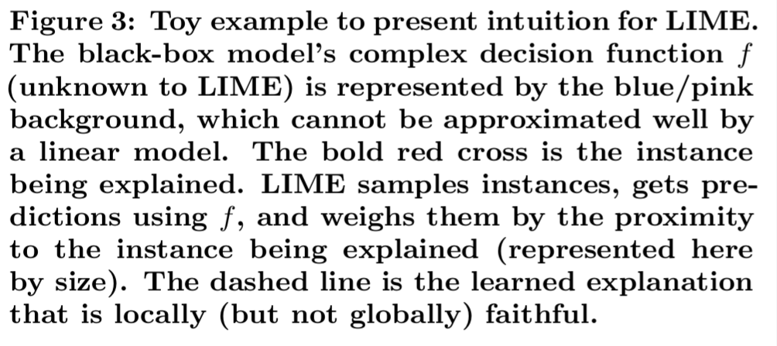
Perturbation Approach: LIME
Perturb the instance of interest and obtain black-box model predictions for the generated samples.
Assign weights to the new samples based on their proximity to the original instance.
Train a weighted, interpretable model using the perturbed dataset.
Interpret the local model to explain the prediction.

Slide 15






Perturbation Approach: SHAP
High-Level Idea:
How do we determine the contribution of a “player” to a group outcome?
Proposed Solution:
Examine performance of group under each combination of players.
Example: Los Angeles Lakers & Luka Doncic
Player Coalition
Point Differential

Slide 16
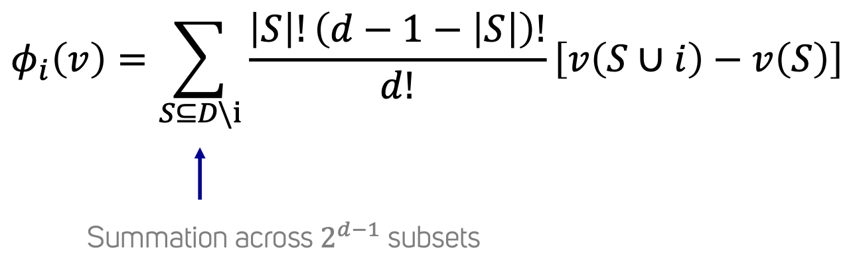
Existing Method #2: SHAP
High-Level Idea:
How do we determine the contribution of a “player” to a group outcome?
Proposed Solution:
Examine performance of group under each combination of players.
In Math:

Slide 17
Feature attributions
Feature attributions most obviously make sense for interpreting individual predictions, and not necessarily the model as a whole
You can do some obvious things (e.g. average over observations) to try to understand the model as a whole.

