Slide 1
Django Auth with Extra User Details

Slide 2
Django Default Authentication
Django provides a built-in User model
Supports login, logout, permissions
Can be extended when needed

Slide 3
Two Ways to Add Extra User Data
1. Custom User Model (Inheritance)
2. Profile Model (ForeignKey / OneToOne)

Slide 4
Option A: Custom User Model
Inherit from AbstractUser
Best for new projects
Full control over user fields

Slide 5
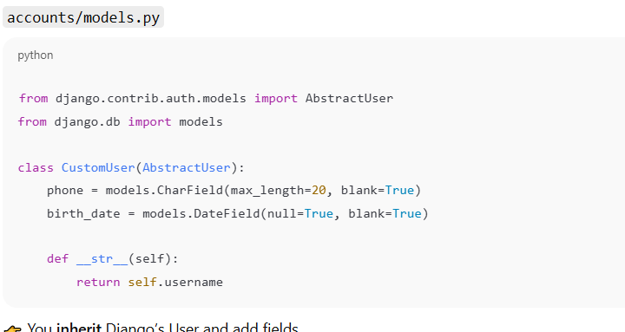
Step 1: Create a custom user model

Slide 6
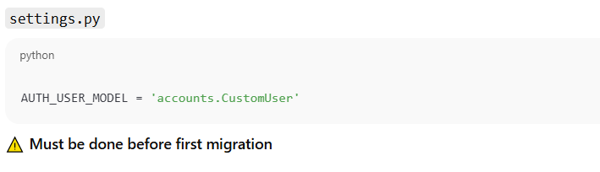
Step 2: Tell Django to use it

Slide 7
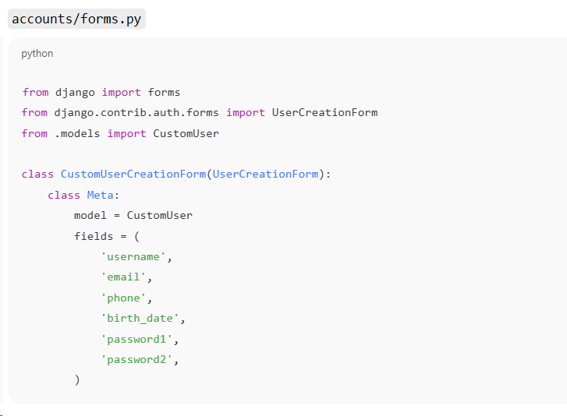
Step 3: Register form

Slide 8
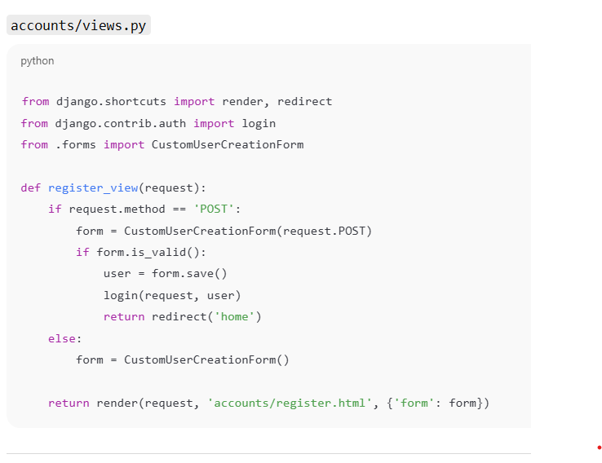
Step 4: Register View

Slide 9
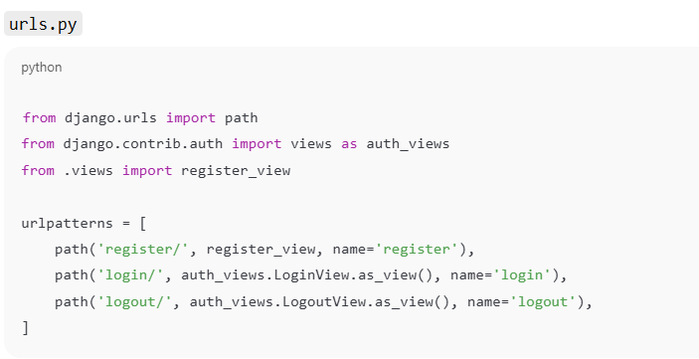
Step 5: Login & logout (built-in views)

Slide 10
Option B: Add extra details via ForeignKey / OneToOne
Use OneToOneField with User
Best for existing projects
Keeps default User unchanged

Slide 11
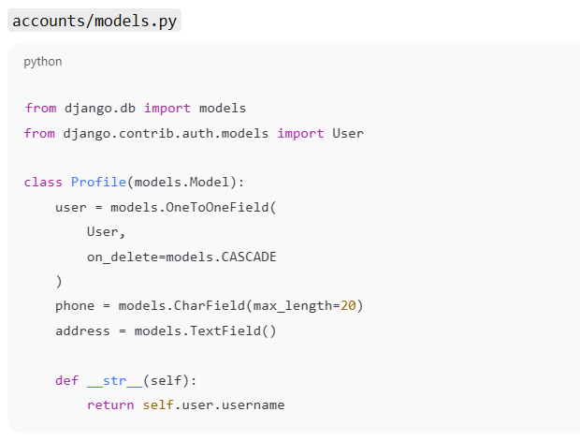
Step 1: Create profile model

Slide 12
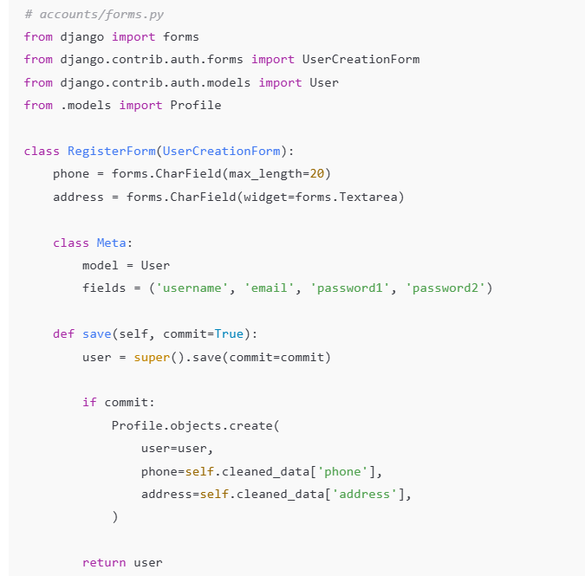
Step 2: Registration form (User + Profile)

Slide 13
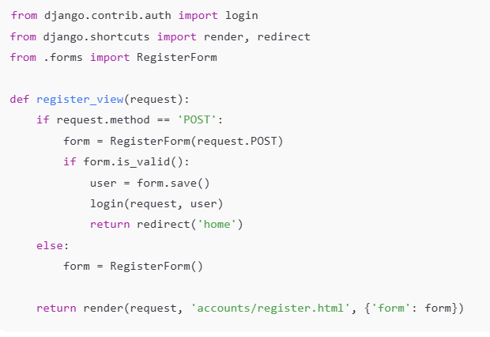
Step 3: View

