Slide 1
Car Rent & Tour Provider

Slide 2
Business Overview
The Car Rent and Tour Provider in Ethiopia is an information-based travel support platform designed to help both local and international travelers plan their trips efficiently and confidently. The system focuses on providing reliable car rental information, destination guidance, and nearby hotel recommendations, rather than online booking or payment.

Slide 3

key feature
Nearby hotels and lodges
Short descriptions of services offered
Approximate price ranges
Location context and travel notes

Slide 4

Target Users
local and international travelers who need reliable transportation and travel information within Ethiopia.
This includes tourists visiting major destinations, business travelers, and local residents planning short or long-distance trips.

Slide 5
User Journey Example
Bole International Airport → Entoto Park
Destinations → Hotels → Contact

Slide 6

Destination Explorer Concept
Tourist sites
Nearby hotels
Distance & price range

Slide 7
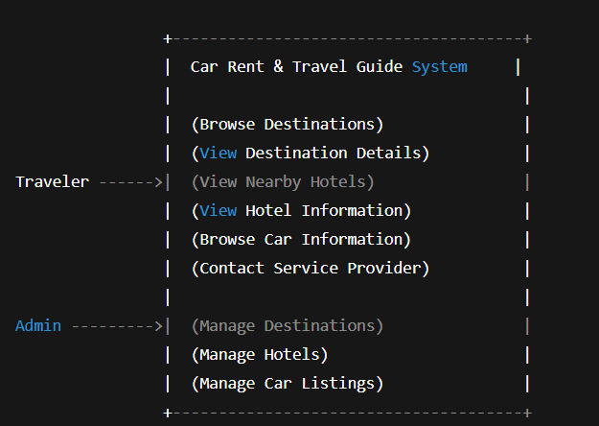
SRC Documentation
Hotel information structure
Car information structure
Admin-managed content

Slide 8

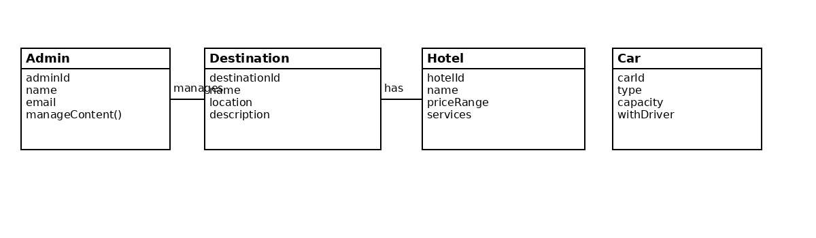
Section header

Slide 9

Thank you
Brita Tamm
502-555-0152
brita@firstupconsultants.com
www.firstupconsultants.com

