Slide 1

HONG KONG BAPTIST UNIVERSITY
Telegram Stock Query Assistant
COMP7940 Cloud Computing Project
Presented by: Yishi Qiu (25421018)
Department of Computer Science
APRIL 2026

Slide 2

PROJECT OVERVIEW
OBJECTIVES & GOALS
Cloud-Based Assistant: A Telegram-integrated tool designed for real-time financial data retrieval and personalized stock management.
Core Focus: Emphasizes cloud deployment, database logging, LLM integration, and containerization over simple bot functionality.
Observability: Integrated monitoring for metrics and performance tracking in a cloud-native environment.
Chatbot Identity: Registered under @comp7940_YishiQiu_bot, serving as a practical demonstration of cloud computing principles.

Slide 3

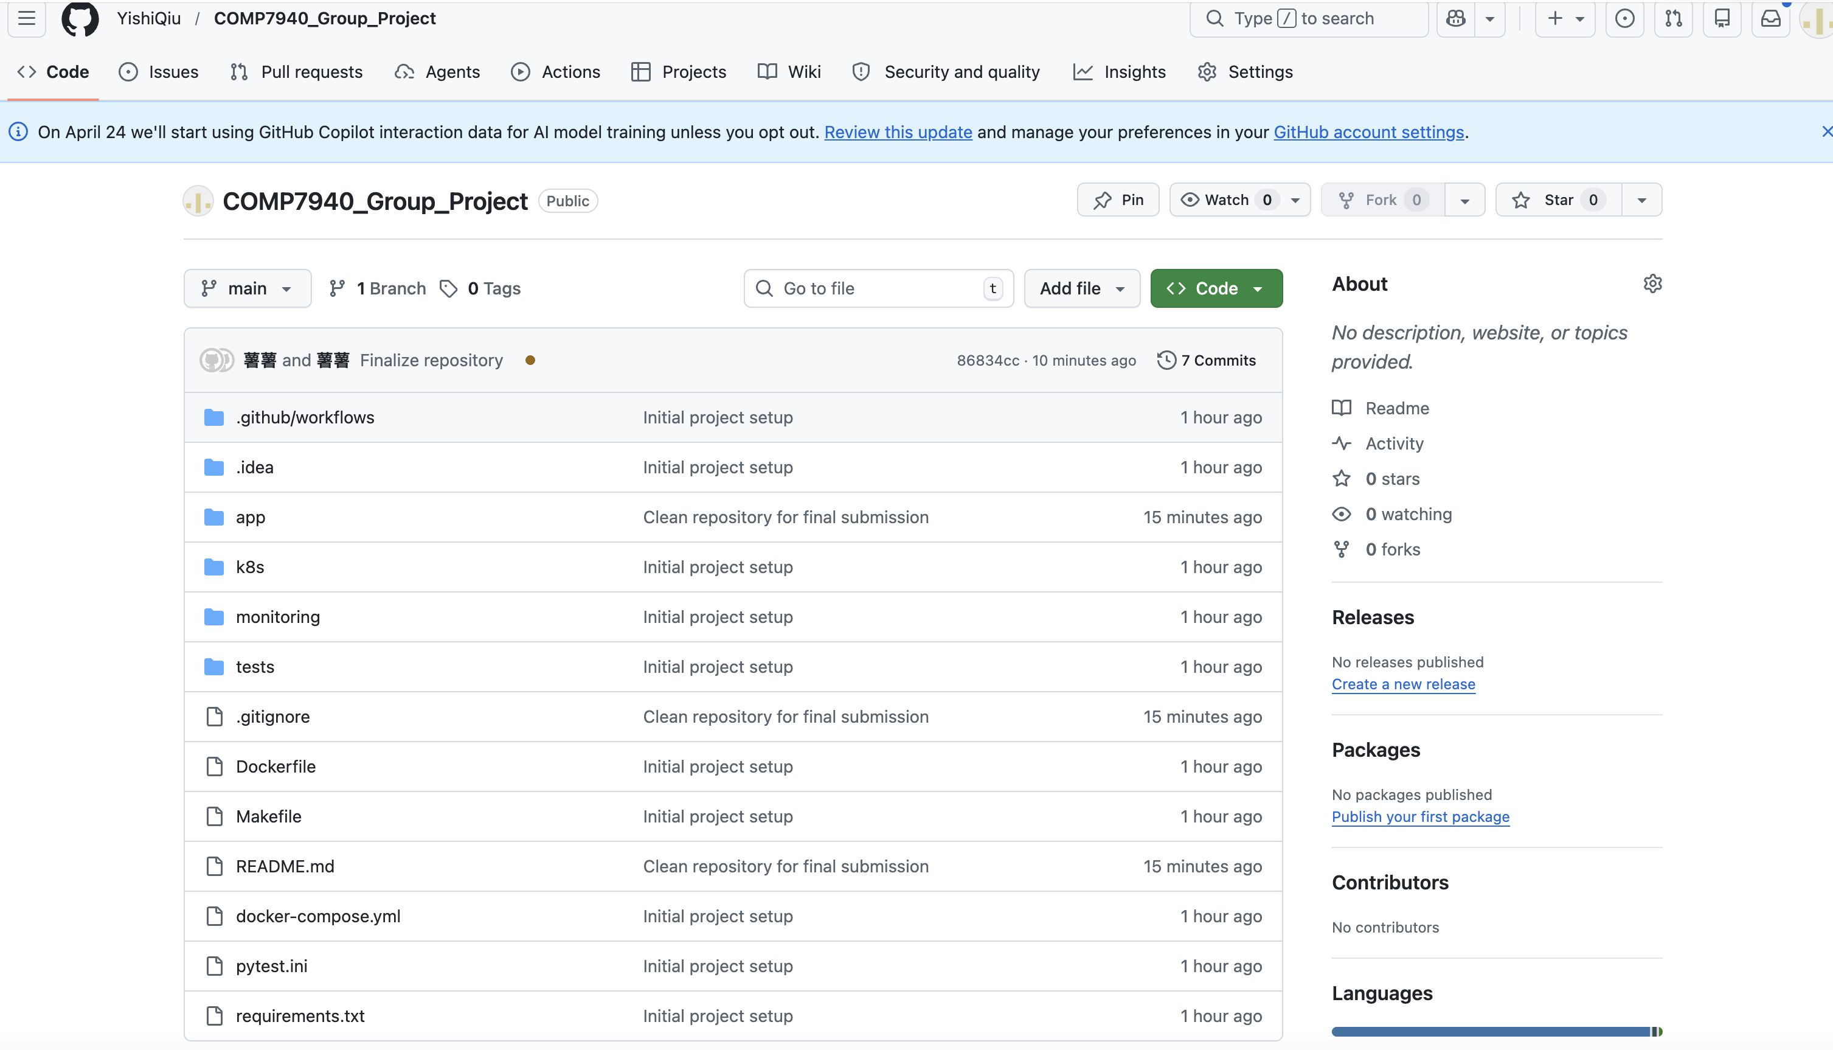
TECHNOLOGY STACK & EVIDENCE
BACKEND & DATABASE
Python 3.12 with FastAPI
Cloud MySQL (Tencent Cloud)
SQLAlchemy ORM Integration
APIS & INTELLIGENCE
MiMo OpenAI-Compatible API
Telegram Bot API
Twelve Data Stock API
DEVOPS CORE
Docker & Docker Compose
GitHub Actions CI/CD
Prometheus Monitoring
EVIDENCE: REPOSITORY & STACK

Slide 4

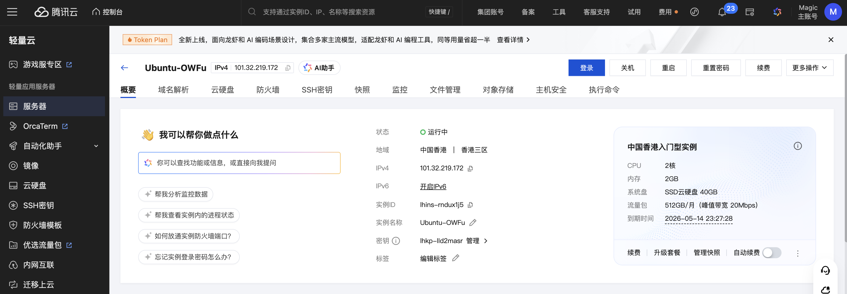
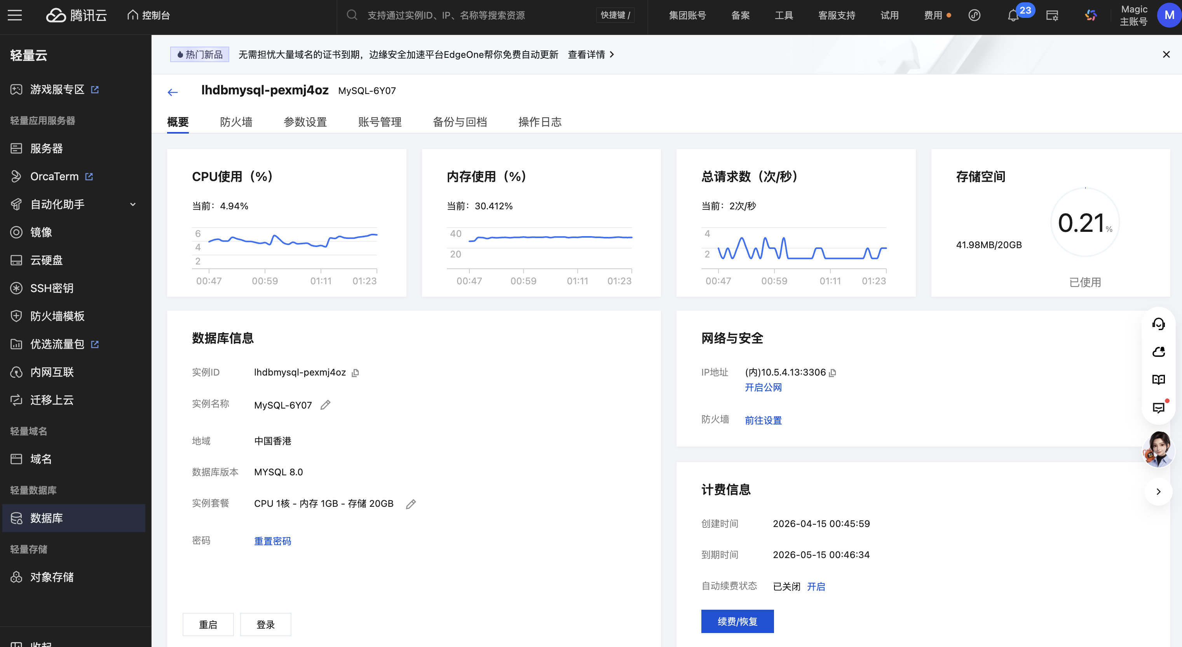
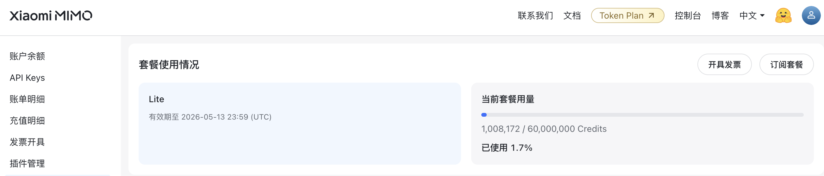
SYSTEM ARCHITECTURE & FLOW
MESSAGE PROCESSING
FastAPI backend handles webhooks from Telegram.
Intent parsing and API orchestration.
CLOUD DEPLOYMENT
Dockerized services for portability.
Tencent Cloud VM hosting.
DATA FLOW
Persistent logging in Cloud MySQL.
LLM-powered summarization layer.
EVIDENCE: INFRASTRUCTURE & DEPLOYMENT

Slide 5
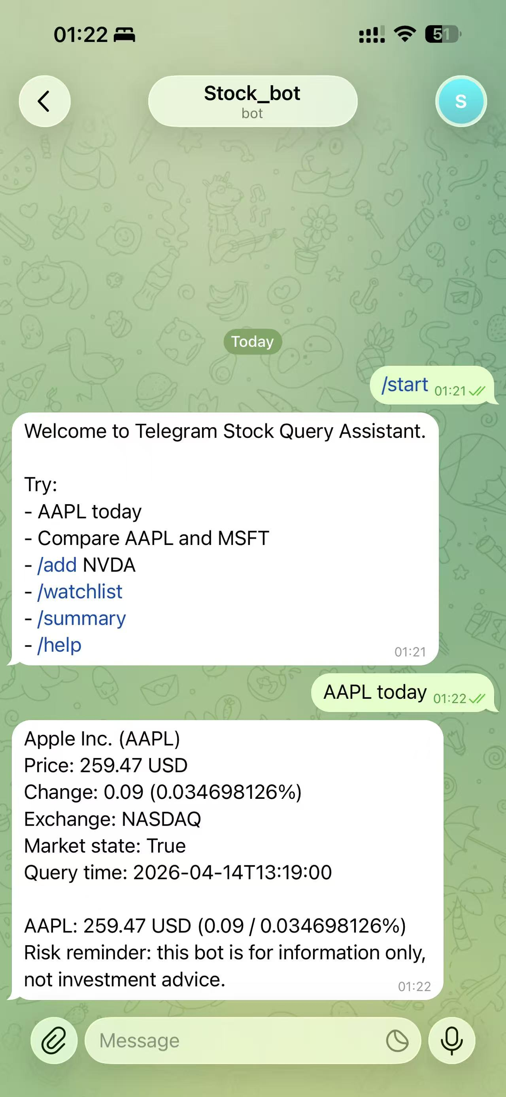
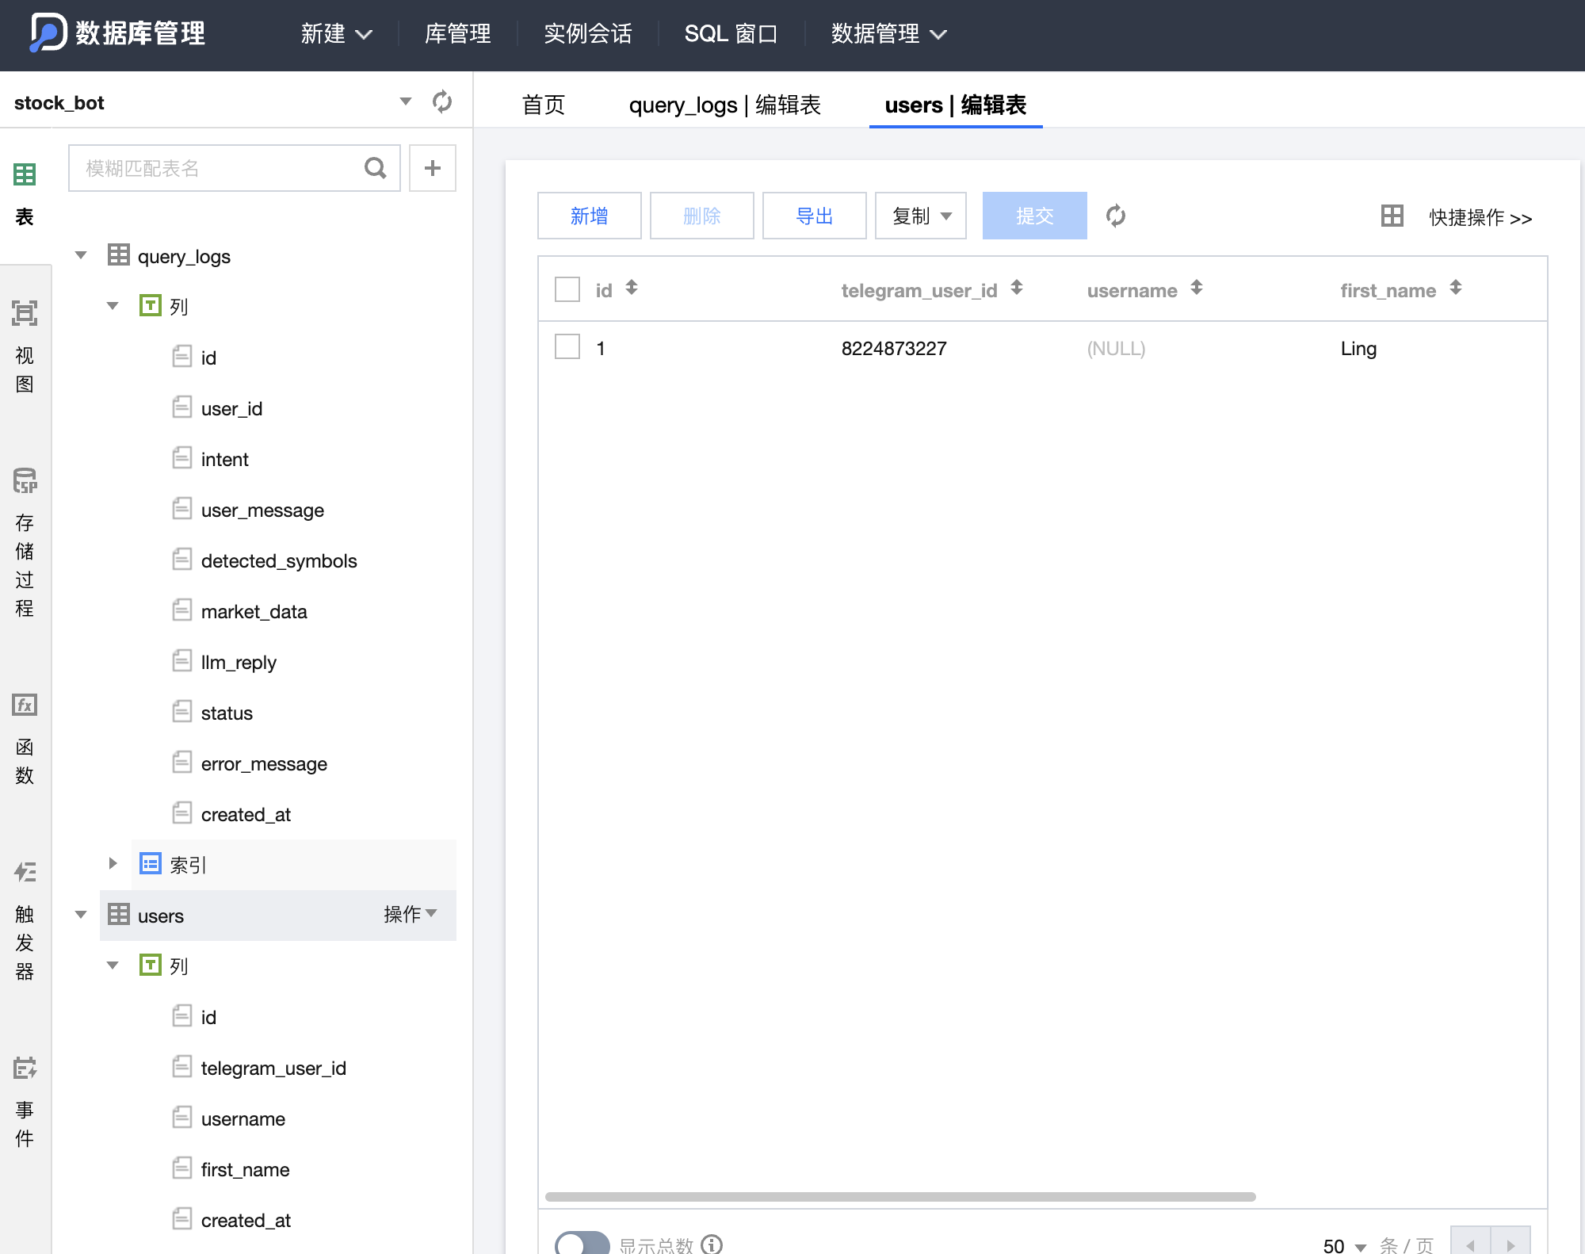
NATURAL-LANGUAGE QUERYING
QUERY PROCESSING
Parses plain English stock queries.
Supports single and multi-stock intents.
LLM INTEGRATION
Summarizes raw market data for users.
Provides context-aware insights.
USER VALUE
Eliminates complex syntax requirements.
Instant financial intelligence via Telegram.
EVIDENCE: BOT INTERACTION

Slide 6
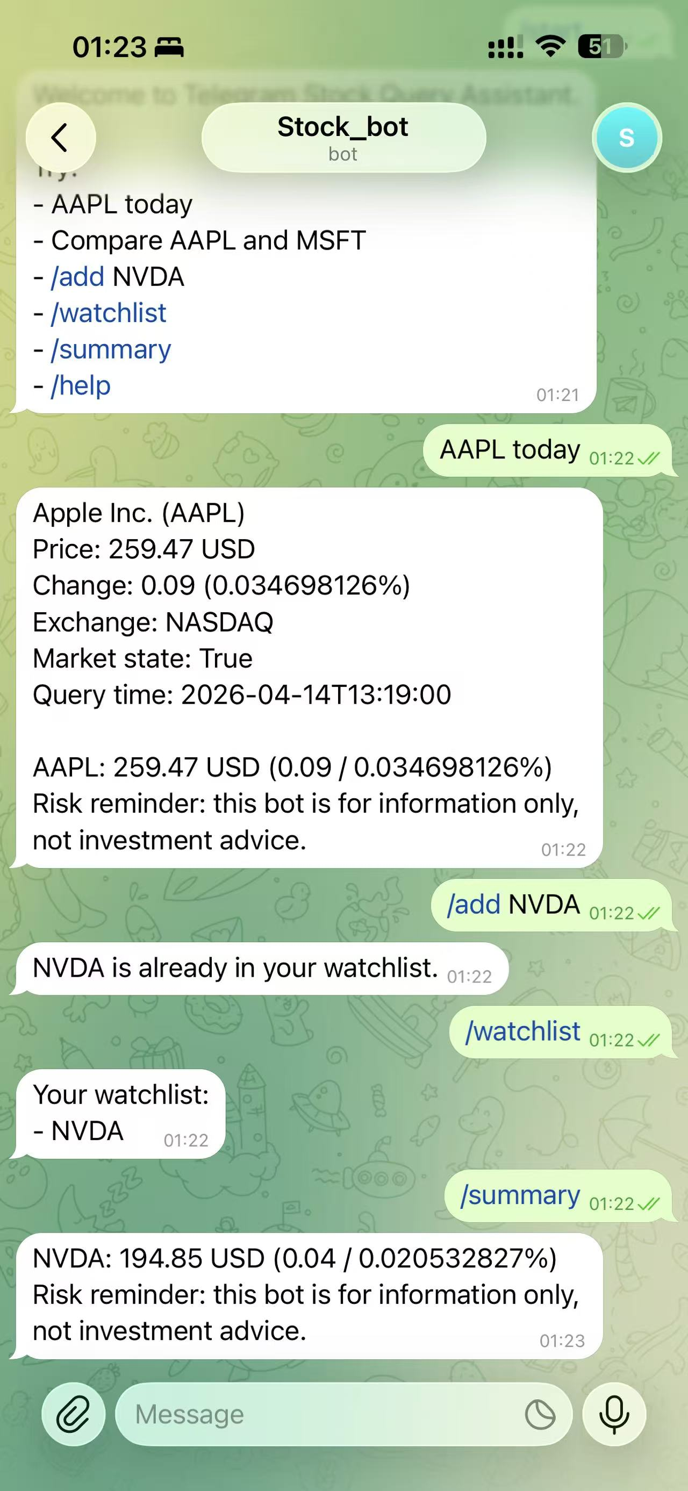
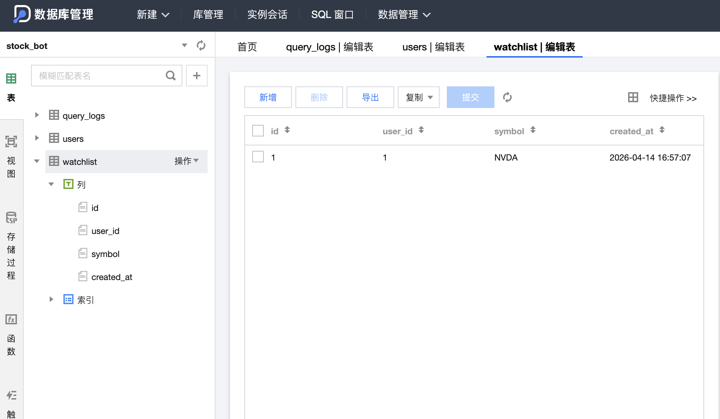
WATCHLIST MANAGEMENT
PERSONALIZED TRACKING
Manage stocks with /add and /remove.
View current watchlist with /watchlist.
SUMMARY FEATURE
LLM-powered updates for all followed stocks.
Consolidated market view via /summary.
PERSISTENCE
Data stored securely in Cloud MySQL.
Cross-session continuity for users.
EVIDENCE: WATCHLIST OPERATIONS

Slide 7

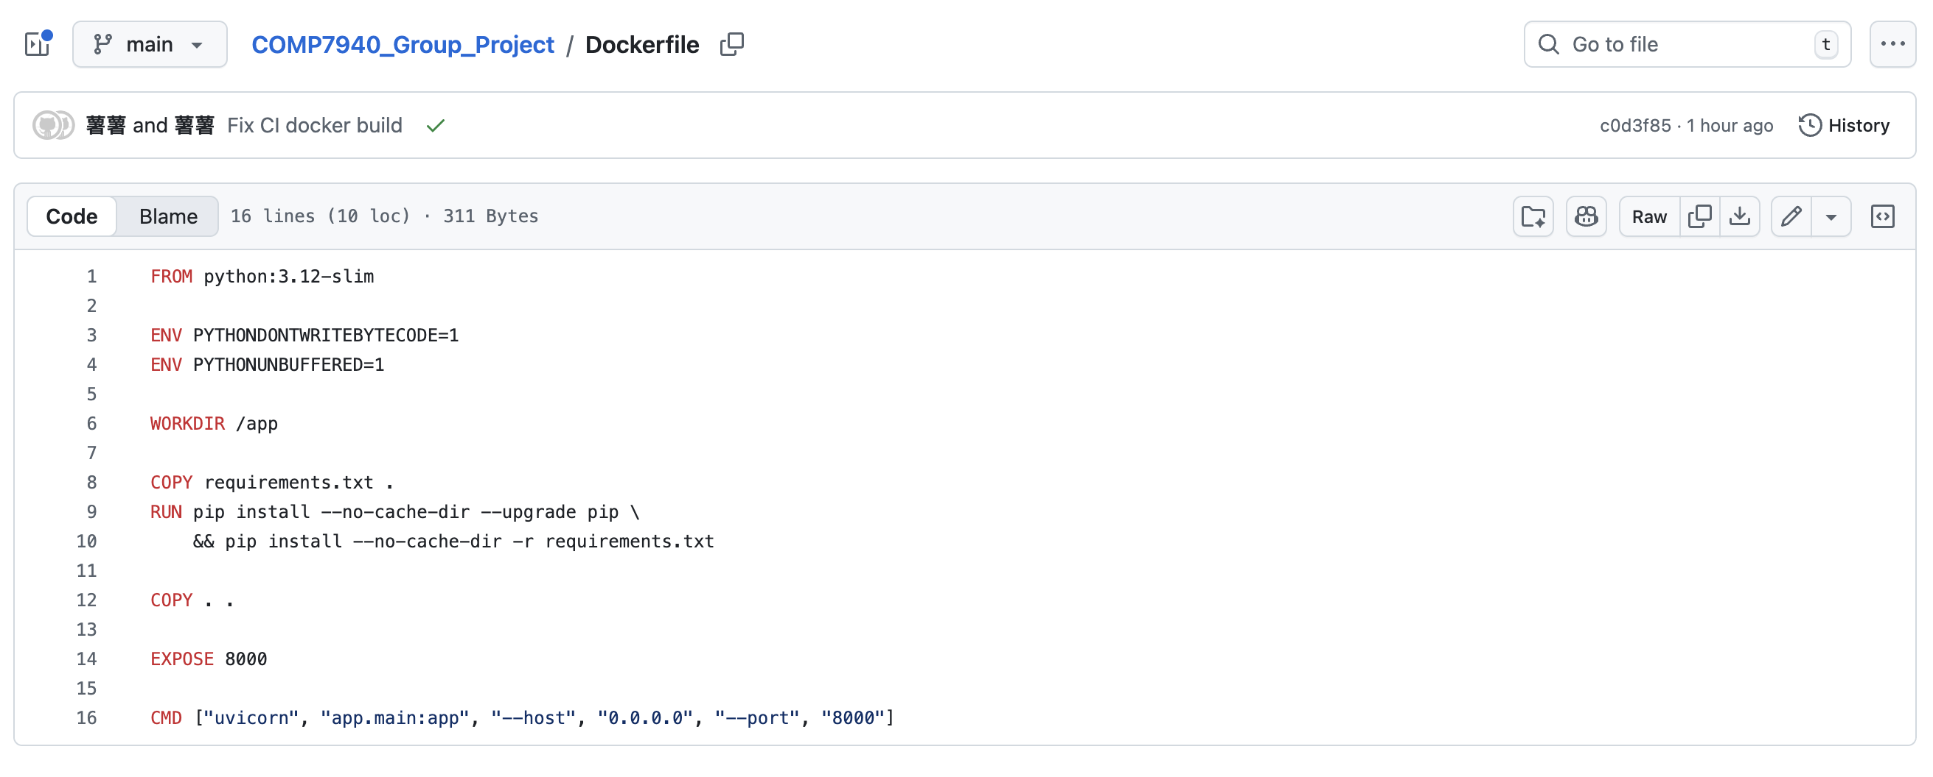
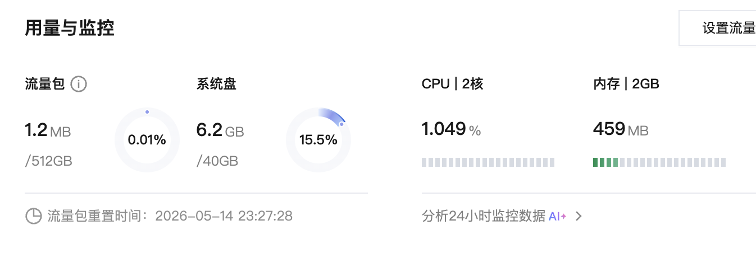
TECHNICAL REQUIREMENTS: MUST-HAVES
1. TELEGRAM CHATBOT
Fulfillment: Fully functional bot deployed on Telegram, accessible via @comp7940_YishiQiu_bot.
2. CLOUD DATABASE
Fulfillment: Cloud MySQL instance for persistent data logging and watchlist management.
3. CLOUD HOSTING
Fulfillment: Backend service hosted on a Tencent Cloud VM, ensuring cloud deployment.
4. LLM API USAGE
Fulfillment: Integrated MiMo OpenAI-compatible API for natural language summarization.
5. GIT MANAGEMENT
Fulfillment: Project managed with Git, hosted on a public GitHub repository.
6. CONTAINER TECHNOLOGIES
Fulfillment: Docker and Docker Compose used for containerization of services.
7. COST-AWARE MONITORING
Fulfillment: Prometheus-compatible metrics endpoint for monitoring cloud costs and usage.
EVIDENCE: CORE TECHNICAL COMPLIANCE

Slide 8

DEVOPS & OBSERVABILITY
AUTOMATION
MONITORING
CLOUD-NATIVE
GitHub Actions: Automated CI/CD pipelines for testing and deployment.
Prometheus: Real-time metrics collection and system health tracking.
Docker: Containerized FastAPI backend for environment parity.
Scalability: Stateless design ready for Kubernetes orchestration.
Git Management: Version-controlled source code and configuration.
Observability: Dedicated endpoints for performance analysis.

Slide 9

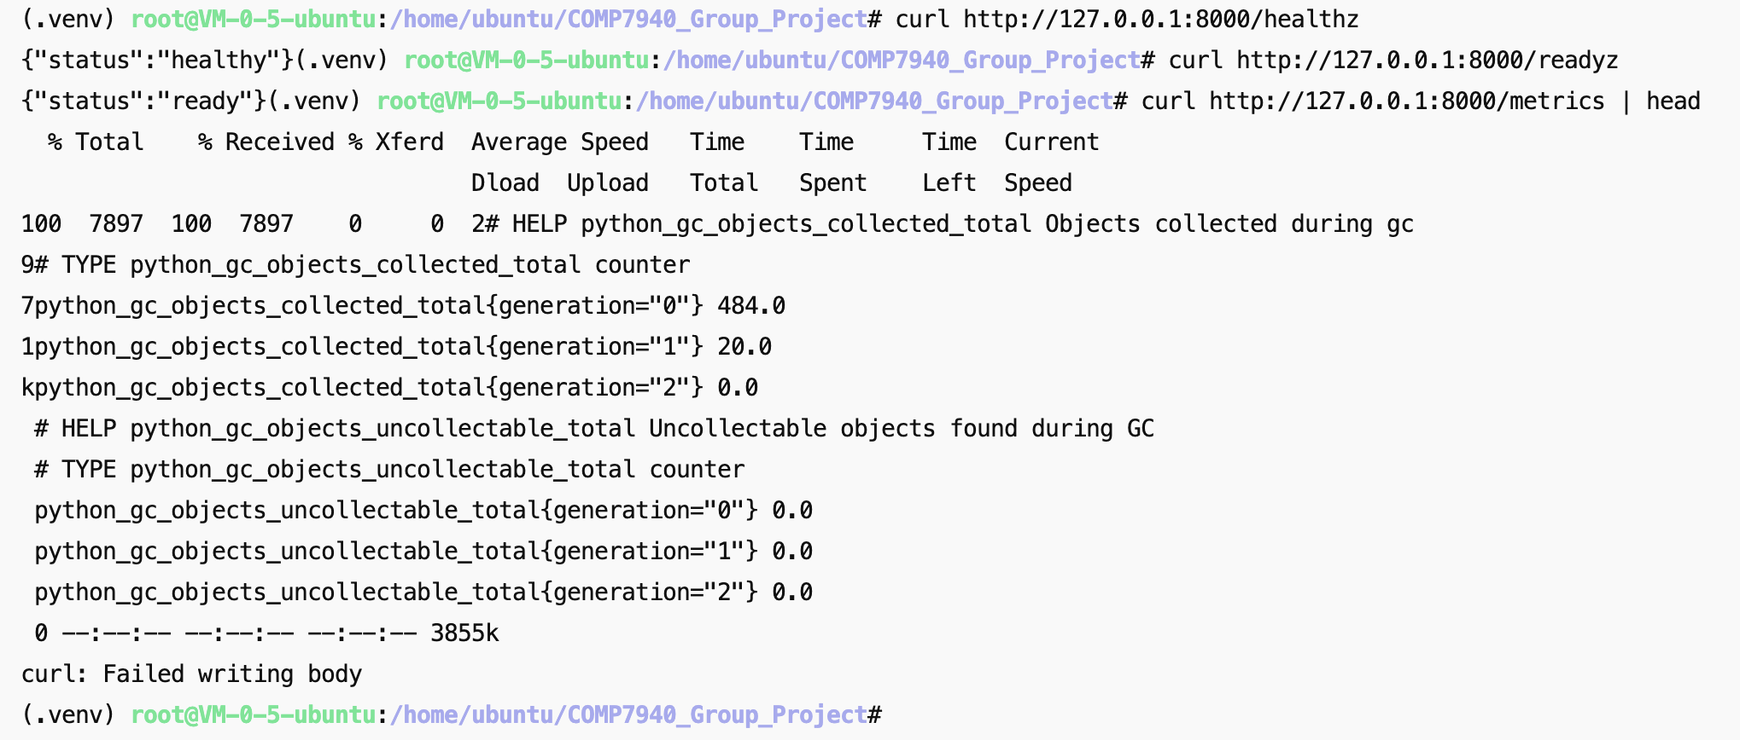
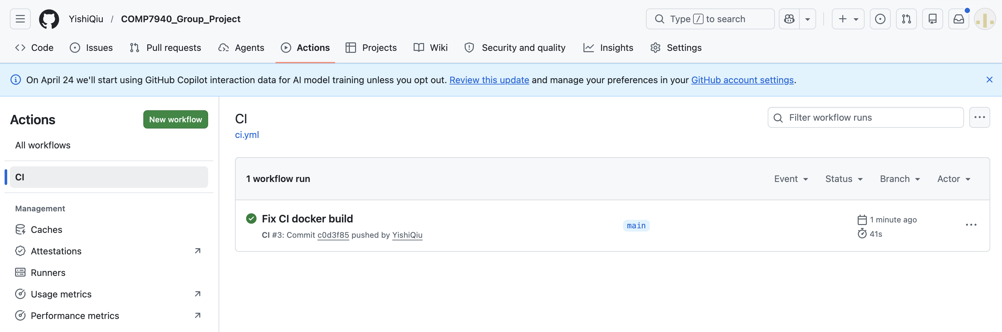
NICE-TO-HAVE CONSIDERATIONS
1. DEVOPS WORKFLOW
Demonstrated: Implemented CI/CD with GitHub Actions for automated testing and deployment.
2. SCALABILITY
Designed for: Stateless backend architecture amenable to horizontal scaling.
3. LOAD BALANCING
Considered: Deployment / Operations section emphasizes load balancing in design.
4. ORCHESTRATION
Prepared for: Kubernetes-related files included for multi-container orchestration.
5. SECURITY MEASUREMENTS
Implemented: Environment-based secret management for sensitive data.
6. PRACTICAL CONSIDERATIONS
Includes: Health checks, metrics, and fallback stock data sources for robustness.
EVIDENCE: ADVANCED PRACTICES

Slide 10
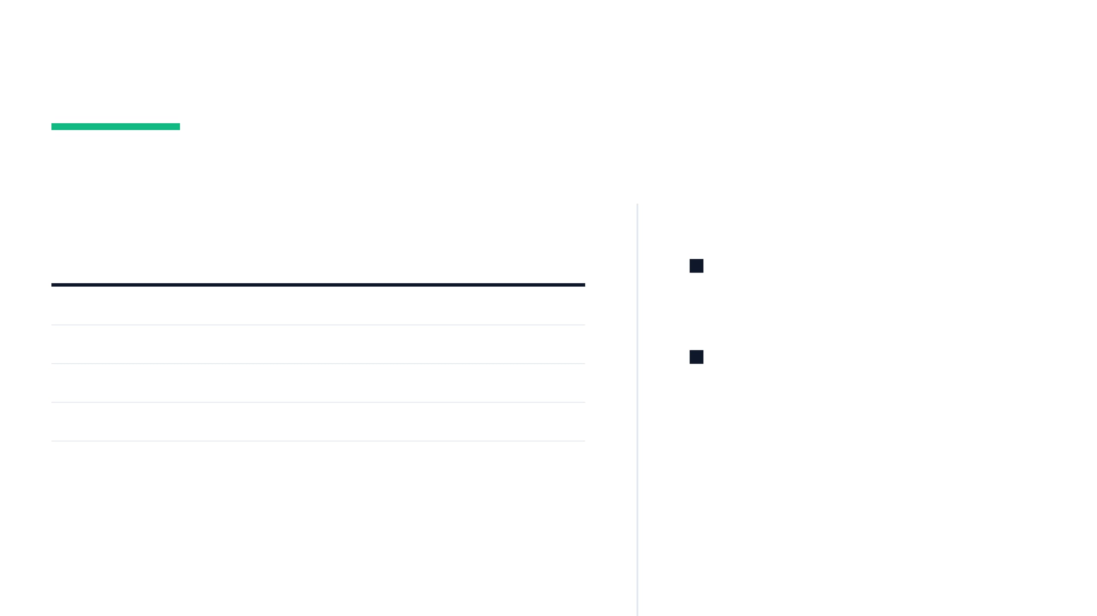
RESOURCE & COST MANAGEMENT
MONTHLY EXPENSE BREAKDOWN
EFFICIENCY STRATEGY
Resource Type
Estimated Cost
Lightweight Architecture: Intentionally designed to minimize resource consumption while meeting all technical goals.
Cloud VM (Tencent Cloud)
34 RMB
Cloud MySQL Database
34 RMB
Cost-Aware Cloud: Leverages low-cost VM and database instances suitable for educational prototypes.
LLM API Usage (MiMo)
35 RMB
Total Monthly Estimate
103 RMB
PROJECT DEPLOYMENT COST
103 RMB

Slide 11

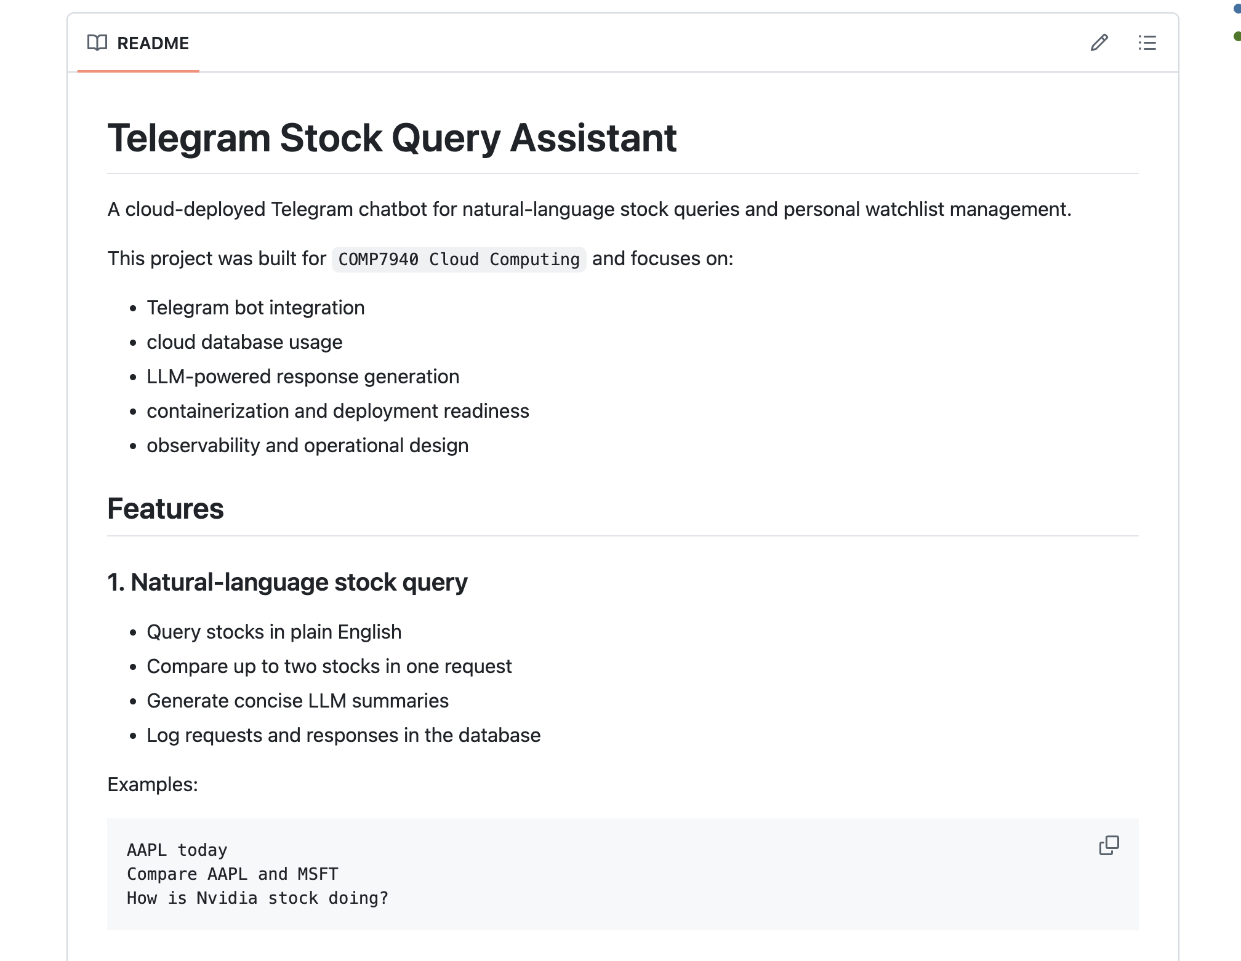
CONCLUSION & FUTURE WORK
PROJECT ACHIEVEMENTS
Integrated cloud-native bot for stock queries.
Demonstrated full DevOps lifecycle implementation.
Met all technical goals of COMP7940 course.
PLACE FINAL PROJECT
IMAGE HERE
FUTURE POTENTIAL
Expand LLM capabilities for deeper analysis.
Implement portfolio profit/loss tracking.
Scale with multi-region cloud deployment.
THANK YOU FOR YOUR ATTENTION

