Slide 1

“HUMANE” A Non-Profit Organization
Data Management for Analytics
- Yishtavi Gedipudi

Slide 2
Problem Definition
Have you ever wondered how much food gets wasted on daily basis?
Have you ever wondered how many still intact products are wasted yearly?
We wondered and that’s why we have “Humane” .
HUMANE, a non-profit organization mainly focused on providing essentials to the needful. Food, Clothes, Medicines, Electronics and Furniture are the items that the organization would be dealing with. We plan on collecting these items from individual donors or merchants and delivering it to the people in need by organizing an event where donations would be accepted and distributed to shelter homes on a daily requirement basis.

Slide 3
Requirements
MySQL Workbench for MySQL Implementation
Python
MongoDB for NoSQL Implementation
Jupyter Notebook for Data Insights
SQL Programming
NoSQL programming
EER, UML Diagram and Logical Model

Slide 4
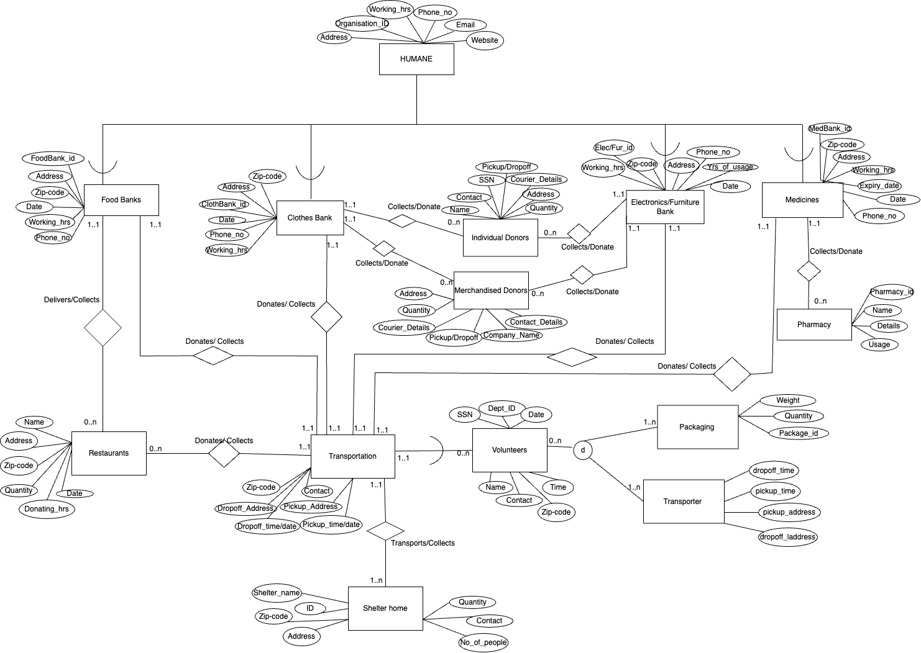
Conceptual design (EER)

Slide 5
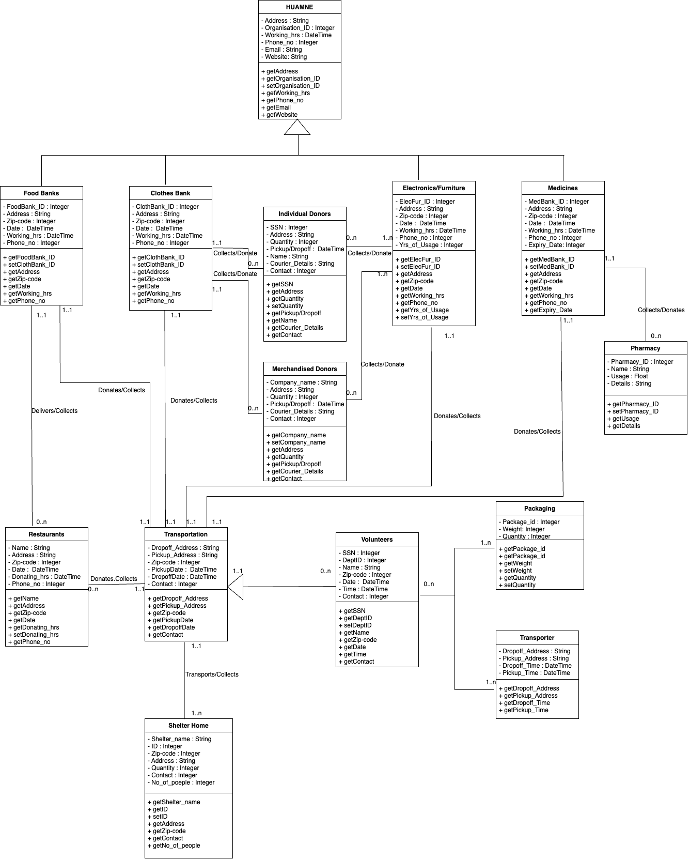
Conceptual design (UML)

Slide 6
Relational model or Logical Model
HUMANE(Organisation_ID, Address, Working_hrs, Phone_no, Email, Website )
Food_Banks(FoodBank_ID, Address, Zip-code, Date, Working_hrs, Phone_no, Restaurant_ID,Volunteer_SSN, H_Organisation_ID)
FoodBank_ID - Primary key
H_Organisation_ID - Foreign key refers to Organisation_ID in relation HUMANE and NULL not allowed
Restaurant_ID - Foriegn keys refers to name in relation Restaurant and NULL not allowed
Volunteer_SSN - Foriegn keys refers to SSN in relation Volunteers and NULL not allowed
Clothes_Banks(ClothBank_ID, Address, Zip-code, Date, Working_hrs, Phone_no, Individual_Donors_SSN,Merchandised_Donors_ID,Volunteer_SSN,H_Organisation_ID)
ClothBank_ID - Primary Key
Individual_Donors_SSN - Foriegn keys refers to SSN in relation Individual Donors and NULL not allowed
Merchandised_Donors_ID - Foriegn keys refers to Company_ID in relation Merchanised Donors and NULL not allowed
Volunteer_SSN - Foriegn keys refers to SSN in relation Volunteers and NULL not allowed
H_Organisation_ID - Foreign key refers to Organisation_ID in relation HUMANE and NULL not allowed

Slide 7
Electronics/Furniture(ElecFur_ID, Address, Zip-code, Date, Working_hrs, Phone_no,Yrs_of_Usage,Individual_Donors_SSN, Merchandised_Donors_ID, Volunteer_SSN)
ElecFur_ID - Primary Key
Individual_Donors_SSN - Foriegn keys refers to SSN in relation Individual Donors and NULL not allowed
Merchandised_Donors_ID - Foriegn keys refers to Company_ID in relation Merchanised Donors and NULL not allowed
Volunteer_SSN - Foriegn keys refers to SSN in relation Volunteers and NULL not allowed
H_Organisation_ID - Foreign key refers to Organisation_ID in relation HUMANE and NULL not allowed
Individual_Donors(SSN, Address, Quantity, Pickup/Dropoff, Name, Courier_Details, Contact,ClothBank_ID,ElecFur_ID)
SSN - Primary Key
ClothBank_ID - Foriegn keys refers to ClothBank_ID in relation Clothes Bank and NULL not allowed
ElecFur_ID - Foriegn keys refers to ElecFur_ID in relation Electronics/Furniture Bank and NULL not allowed
Merchandised_Donors(Company_ID, Company_name, Address, Quantity, Pickup/Dropoff, Courier_Details, Contact, ClothBank_ID,ElecFur_ID)
Company_ID - Primary Key
ClothBank_ID - Foriegn keys refers to ClothBank_ID in relation Clothes Bank and NULL not allowed
ElecFur_ID - Foriegn keys refers to ElecFur_ID in relation Electronics/Furniture Bank and NULL not allowed

Slide 8
Medicines(MedBank_ID, Address, Zip-code, Date, Working_hrs, Phone_no, Expiry_date, Pharm_ID, Volunteer_SSN, H_Organisation_ID)
MedBank_ID - Primary Key
Pharm_ID - Foreign key refers to Pharmacy_ID in relation Pharmacy and NULL not allowed
Volunteer_SSN - Foreign keys refers to SSN in relation Volunteers and NULL not allowed
H_Organisation_ID - Foreign key refers to Organisation_ID in relation HUMANE and NULL not allowed
Shelter_Home(Shelter_home_ID, Volunteer_SSN, Shelter_name, Zip-code, Address, Quantity, Contact, No_of_poeple)
Shelter_Home_ID - Primary Key
Volunteer_SSN - Foriegn keys refers to SSN in relation Volunteers and NULL not allowed.
Pharmacy(Pharmacy_ID, MedBank_ID, Name, Details, Usage)
Pharmacy_ID - Primary Key
MedBank_ID - Foriegn keys refers to MedBank_ID in relation Medicines and NULL not allowed

Slide 9
Restaurants(Res_ID, FoodBank_ID,Volunteer_SSN, Name, Address, Zip-code, Quantity, Date, Donating_hrs, Phone_no)
Res_ID - Primary Key
FoodBank_ID - Foriegn keys refers to FoodBank_ID IN relation Food_Banks and NULL not allowed
Volunteer_SSN - Foriegn keys refers to SSN in relation Volunteers and NULL not allowed
Transportation(Volunteer_SSN, ShelterHome_ID,Restuarant_ID, FoodBank_ID, ClothBank_ID, ElecFur_ID, MedBank_ID, Dropoff_Address, Pickup_Address, Zip-code, PickupDate, DropoffDate, Contact)
Volunteer_SSN - Foriegn keys refers to SSN in relation Volunteers and NULL not allowed
ShelterHome_ID - Foriegn keys refers to Shelter_Home_ID in relation Shelter_Home and NULL not allowed
Restuarant_ID - Foriegn keys refers to name in relation Restaurant
FoodBank_ID - Foriegn keys refers to FoodBank_ID IN relation Food_Banks
ClothBank_ID - Foriegn keys refers to ClothBank_ID in relation Clothes Bank
ElecFur_ID - Foriegn keys refers to ElecFur_ID in relation Electronics/Furniture Bank
MedBank_ID - Foriegn keys refers to MedBank_ID in relation Medicines

Slide 10
Volunteers(SSN, Dept_ID , Name, Zip-code, Date, Time, Contact)
SSN - Primary Key
Dept_ID - Foriegn keys refers to FoodBank_ID / ClothBank_ID / ElecFur_ID \ MedBank_ID in relation Food Banks / ClothesBank / Electronics Furniture Bank / Medicines
Packaging(Volunteer_SSN, Dept_ID,Package_ID, Volunteer_SSN, Weight, Quantity)
Transporters(Volunteer_SSN, Dept_ID, Dropoff_Address, Pickup_Address, Dropoff_Time, Pickup_Time)
Volunteer_SSN - Foriegn keys refers to SSN in relation Volunteers and NULL not allowed
Dept_ID - Foriegn keys refers to FoodBank_ID / ClothBank_ID / ElecFur_ID \ MedBank_ID in relation Food Banks / ClothesBank / Electronics Furniture Bank / Medicines

Slide 11
MySQL Queries
Query 1. Write a query to find unique Medicine Details present in Pharmacy
select distinct (Med_Details) from Pharmacy;
Query 2. Write a query to find Electronics and Furniture ID, Address, Zip-code, Phone no and their Years of Usage between 3 years and 9 years*
select Elec_fur_id, Address, Zip_code, Phone_number,Yrs_of_usage
from Electronics_Furniture_ID
where Yrs_of_usage between 3 and 9;
Query 3. Write a query to find total Quantity as Sum_Quantity where Quantity is greater
than "500"
select sum(Quantity) as Sum_Quantity
from Merchandised_Donors
where Quantity > 500;
Query 4.Write a query to find Medicine Details and total Dosage as Total_Dosage where Medicine is "Asprin"
select Med_Details,sum(dosage) as Total_Dosage from Pharmacy
group by Med_Details
having Med_Details = 'Asprin’;

Slide 12
Query 5. Write a query to find Pharmacy id and Name where Medicine Date is greater than "2012-05-11” (Use Exists)
select Pharmacy_id, Name from Pharmacy p
where exists (select * from Medicine_Banks m
where p.Pharmacy_id = m.Pharmacy_id
having date > "2012-05-11");
Query 6. Retrieve Department ID along with SNN, Name, Time and Date of availability and contact details of volunteers who are assigned to the Electronics/Furniture department*
select Department_ID,Volunteer_SSN,Name,Date,Time,Contact_Detailsn from Volunteers v
where v.Department_ID in (select Elec_fur_id from Electronics_Furniture_ID e
where e.Elec_fur_id = v.Department_ID );
Query 7. Retrieve volunteer information based on the date they are available for transportation
select Volunteer_SSN, Name, Date, Time from Volunteers v
where v.date in (select Pickup_Date
from Transportation t
where t.Pickup_Date = v.Date );

Slide 13
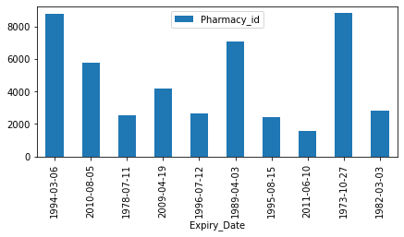
Analytics
Query 8- Retrieve MedBank_id, Expiry_Date, Pharmacy_id, dosage, Med_Details and name where Pharmacy_id > '1000' and plot the graph between Pharmacy_id and Expiry_Date.
select MedBank_id, Expiry_Date, Pharmacy_id from Medicine_Banks where Pharmacy_id in (select Pharmacy_id from Pharmacy where Pharmacy_id > '1000');

Slide 14
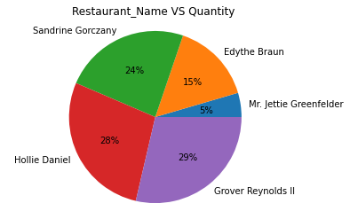
Analytics
Query 9. Retrieve FoodBank_ID Restaurant_ID, Name, Address, Date and Quantity after date ''2000-01-01’ where Quantity is greater than '13.4000' and plot pie chart between date and quantity.
select f.FoodBank_ID, r.Restaurant_id, r.Name, r.Address, f.Date, r.Quantity from Food_Banks f inner join Restaurants r where f.Restaurant_id = r.Restaurant_id and f.Date > '2000-01-01’ and r.Quantity > 13.0000;

Slide 15
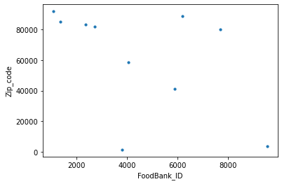
Analytics
Query 10. Retrieve the Foodbank ID of the restaurant who delivers the highest quantity of food and create a scatter plot between zip code and foodbank id
select FoodBank_ID, Zip_code, Address from Food_Banks where Restaurant_id IN (select Restaurant_id from Restaurants where Quantity >= ANY(select Quantity from Restaurants));

Slide 16

NoSQL Implementation
1. INSERT -
db.Restaurants.insert({"Restaurant_id": 1300,"Name":"Henry Brook","Address":"75 Saint Alphonsus Street","Zip_Code": "02120","Date": "2022-06-09", "Donating-hrs": "18:24:34", "Phone_number": 8764560987 ,"Quantity": 56.0});
db.Restaurants.find()
2. UPDATE -
db.Package.update(
{"Packaging_id": 879},
{$set:
{"Quantity":20}} );
db.Package.find();
3. AGGREGATE -
db.Shelter_Home.aggregate(
[
{ $group: { _id: "Quantity", total: { $sum: "$Quantity" } } },
{ $sort: { total: 1 } }
] );

Slide 17

THANK YOU !

