Slide 1
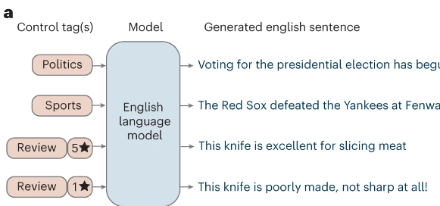
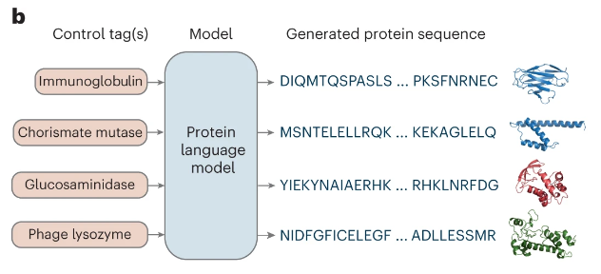
讨论
How could we embed the prior knowledge into DNA sequences?
Notes:
Large language models generate functional protein sequences across diverse families

Slide 2
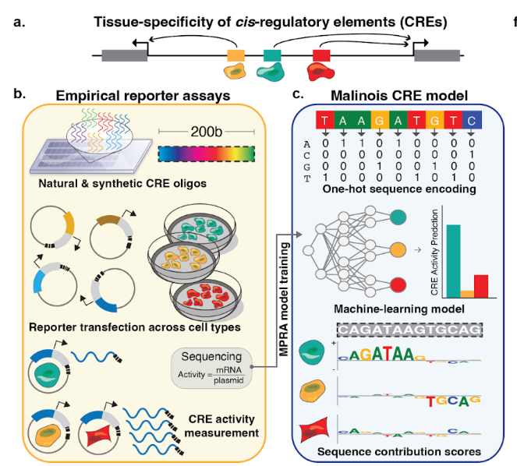
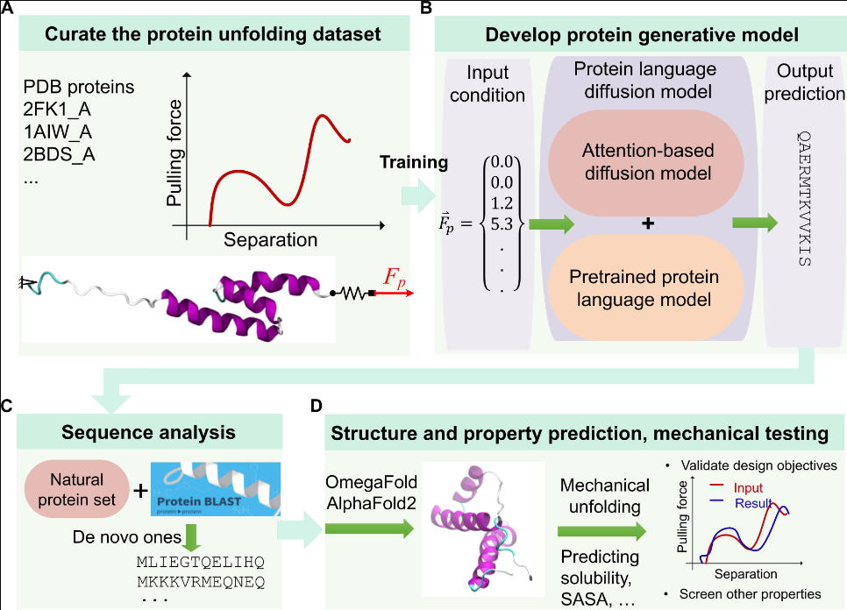
讨论
Current research for constrained sequence generation:
in silico
Notes:
Machine-guided design of synthetic cell type-specific cis-regulatory elements
ForceGen: End-to-end de novo protein generation based on nonlinear mechanical unfolding responses using a language diffusion model

Slide 3
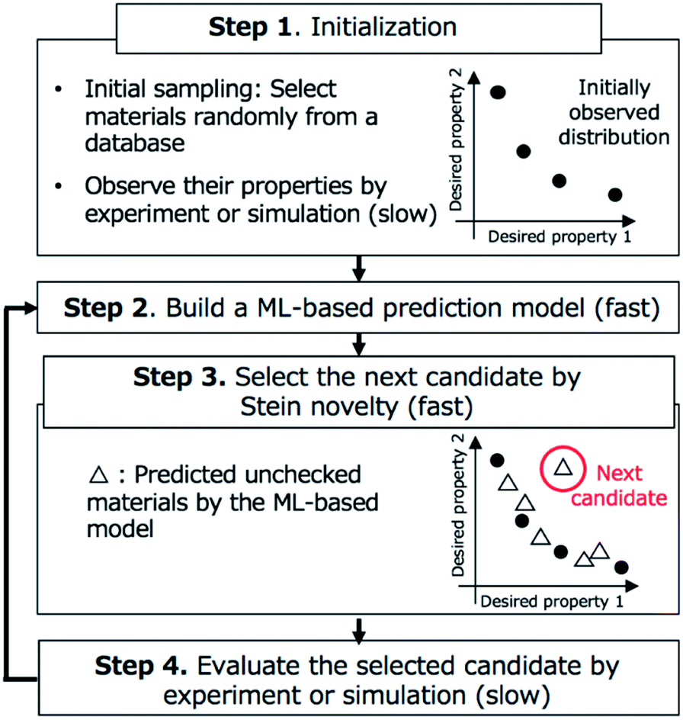
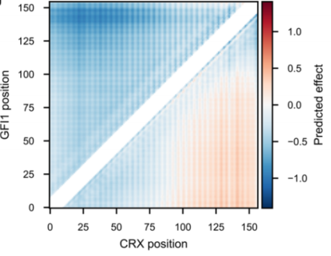
讨论
What biological grammar brings in the uncertainty?
Can uncertainty improves design of experiment (DoE)?
Notes:
Pushing property limits in materials discovery via boundless objective-free exploration
Active learning of enhancer and silencer regulatory grammar in photoreceptors

Slide 4
讨论
数据集:
GPro: https://github.com/WangLabTHU/GPro/tree/main/gpro
DNA-Diffusion
现有论文饱和突变集
验证方法:
计算方法: k-mer similarity, core motifs, mutagenesis, GC-contents, regression-prediction PCC, pretrained LLM…
实验方法(困难)
工作计划
做一个自己的PPT，能向汪老师阐述你的思想(待做)
Papers | Details
A rugged yet easily navigable fitness landscape | 9mer DNA
Informed training set design enables efficient machine learning-assisted directed protein evolution | GB1
Deep Mutational Scanning of an Oxygen-Independent Fluorescent Protein CreiLOV for Comprehensive Profiling of Mutational and Epistatic Effects | CreiLOV
Notes:
A rugged yet easily navigable fitness landscape

Slide 5
讨论
1. 总结一下不确定度量化的方法, 代码迁移到pytorch平台
现有方法:
Scaling deep learning for material discovery
Active Learning of enhancer and silencer …
Prioritizing transcription factor perturbations from single-cell transcriptomics
Characterizing uncertainty…
Deep Ensembles…
2. 深度学习指引:
GPro: https://academic.oup.com/bioinformatics/advance-article/doi/10.1093/bioinformatics/btae123/7617687

