Slide 1
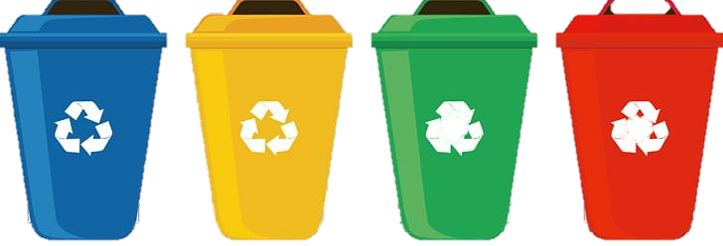
Take photos and collect information
Smart Trash Bin –Team 21
Camera
Vue&Electon
Front-end design
The Raspberry Pi processes the images captured by
the camera with opencv and returns them to the host
01
Raspberry pi
The host accepts the
processed image
and recognizes it
Gdb server
02
transmission design
Yolo
03
Motor
Host
Back-end design
Operating System: Windows
Linux
The Raspberry Pi gets the returned results and controls
the corresponding trash bins based on the results
The host processes the results and returns
them to the Raspberry Pi

