Slide 1
K2 followup paper plots

Slide 2
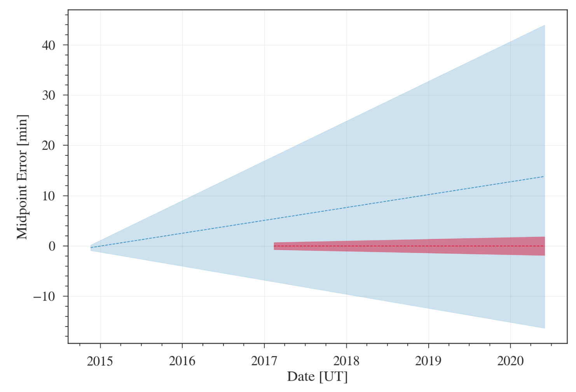
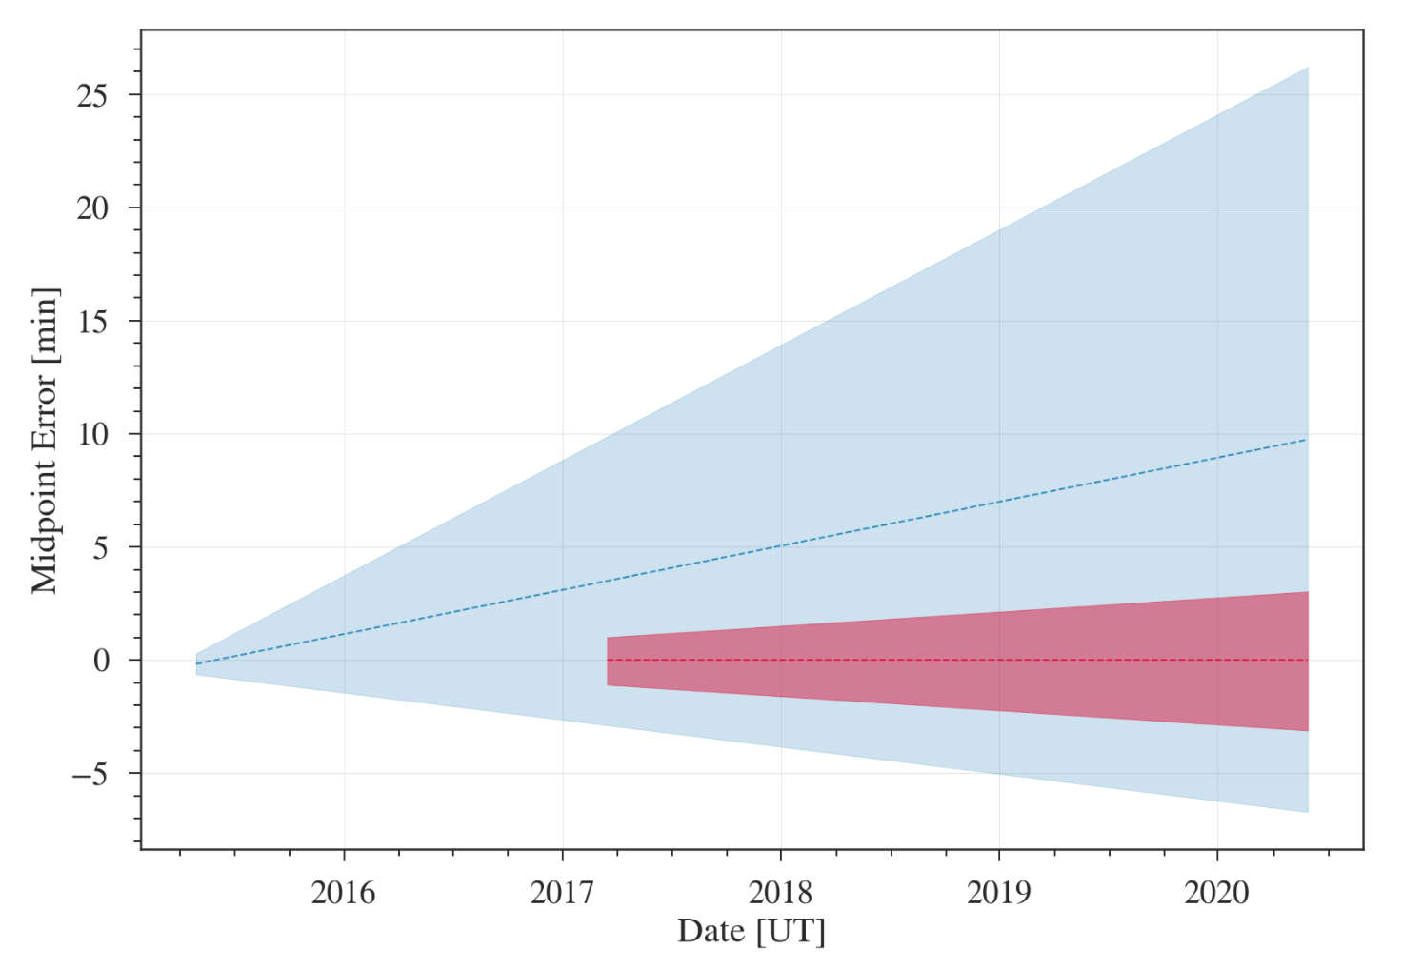
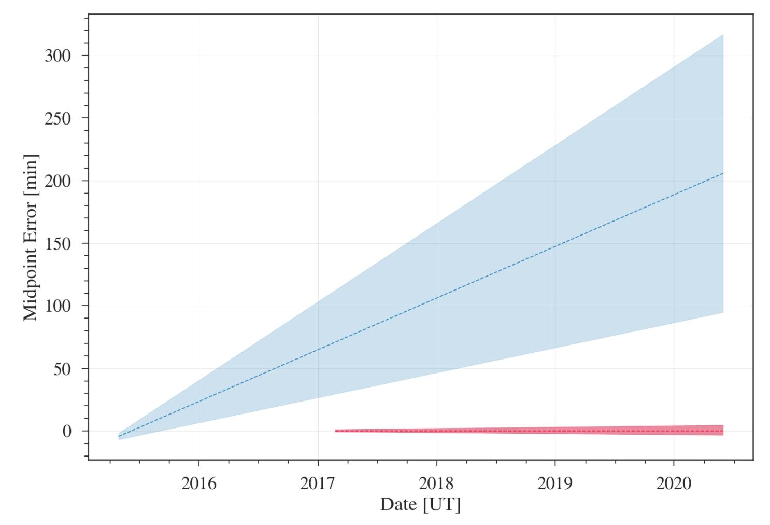
a) K2-28b
b) K2-100b
c) K2-104b

