Slide 1
Request
{
"name": "TEST_UPDATE",
"room_id": "D315",
"email": "TEST@mail.com",
"phone": "1112223333",
"sp_chart": "TEST",
"supervisor_name": "TESTNAME",
"service_type": "TEST",
"work_request": "TEST",
"model": "lenovo"
}
id
name
Room_id
email
phone
Requests
sp_chart
supervisor_name
Close_time
work_request
Open_time
status
model

Slide 2
Staff
user_name
name
email
Staff
role
shop

Slide 3
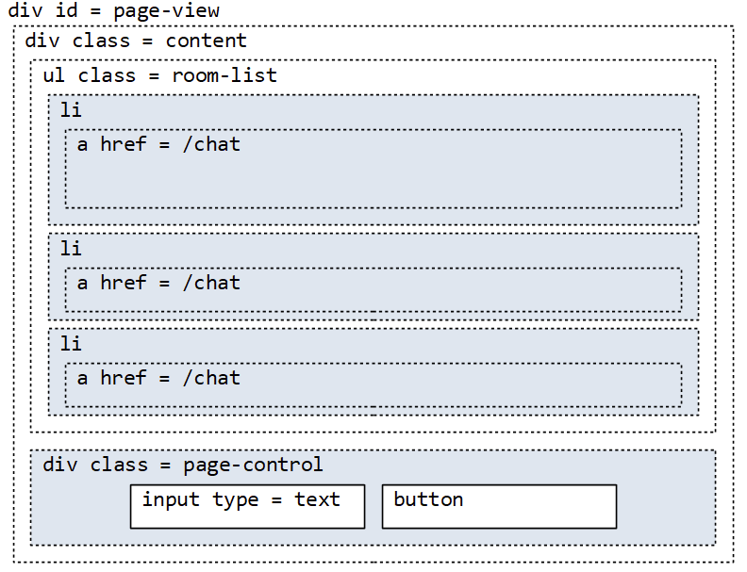


ticket
ticket
ticket

