Slide 1
Oct 24th, 2025
Gait Condition Recognition
from Multivariate Angle Data
Data Science Institute, Brown University
Yitong Peng
GitHub

Slide 2
Project Introduction
Data Source
  UCI Machine Learning Repository
Data Structure
  10 subjects x 3 conditions x 10 replications x 2 legs x 3 joints x 101 time points
Feature | Description
subject | Group ID
condition | 1 = unbraced, 2 = knee brace, 3 = ankle brace (integer)
replication | gait cycle (0, …, 10 integer)
leg | 1 = left, 2 = right (integer)
joint | 1 = ankle, 2 = knee, 3 = hip (integer)
time point | 0 = 0% gait cycle, …, 100 = 100% gait cycle
angle | joint angle in degrees (real valued)
Only on the right side

Slide 3
Project Introduction
Goal
  Classification
  Recognize walking conditions by analyzing the joint angles of the left and right legs (the unseen man)
4. Dataset is not IID
  Group structure
Feature | Description
subject | Group ID
condition | 1 = unbraced, 2 = knee brace, 3 = ankle brace (integer)
replication | gait cycle (0, …, 10 integer)
leg | 1 = left, 2 = right (integer)
joint | 1 = ankle, 2 = knee, 3 = hip (integer)
time point | 0 = 0% gait cycle, …, 100 = 100% gait cycle
angle | joint angle in degrees (real valued)
target

Slide 4
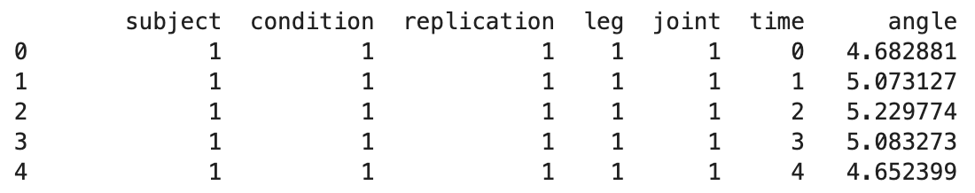
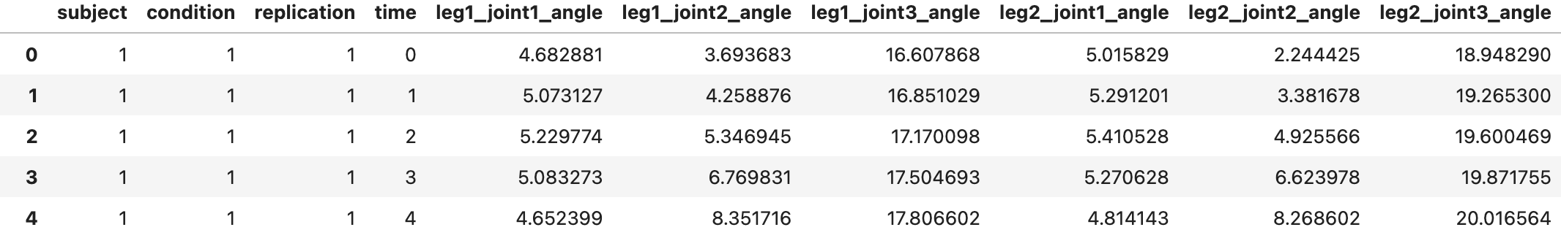
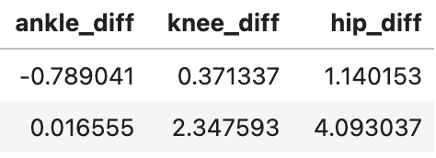
Restructure
The input of simple machine learning model (vector)
Sample 1 | X₁₁ | X₁₂ | … | X_{1n} | y₁
Sample 2 | X₂₁ | X₂₂ | … | X_{2n} | y₂
each row represents one complete sample (observation)
In my dataset
  606 rows (2 legs x 3 joints x 101 time points) belonging to the same gait cycle (matrix)
  Need to become a vector for one sample
Aggregate(AVG)
To highlight asymmetry
+

Slide 5
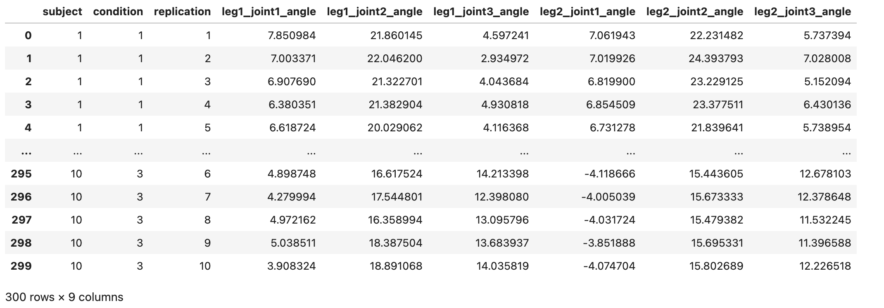
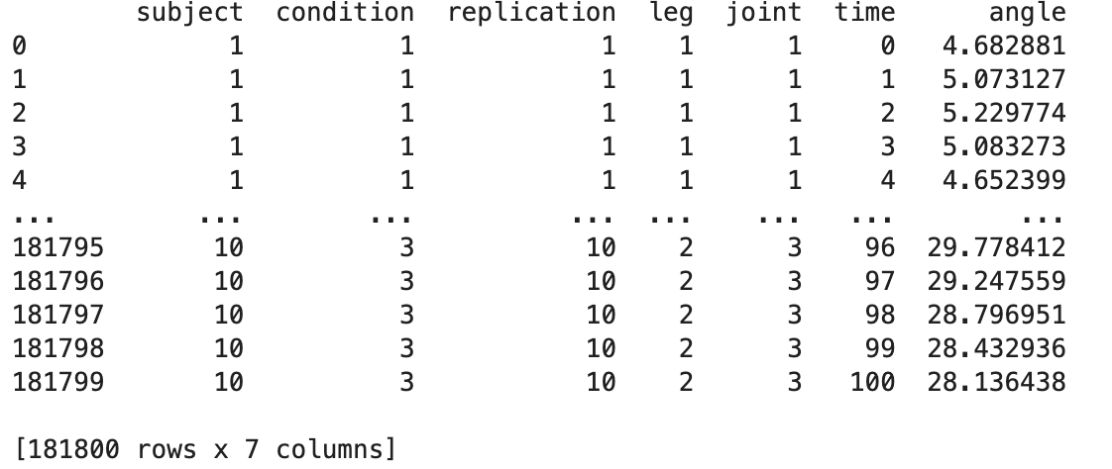
Restructure
Small dataset

Slide 6
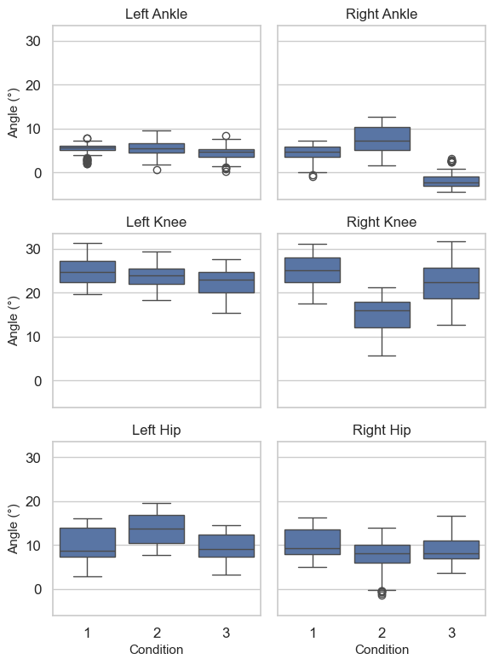
EDA
The left (control group)
The brace significantly affects the right leg
For the ankle
  movement is restricted (ankle brace)
  the angle & the range of motion increased (knee brace)
For the knee
  movement is restricted (knee brace)
  increases the range of motion (ankle brace)
For the hip
  movement is restricted (knee brace)
  increases the range of motion (ankle brace)

Slide 7
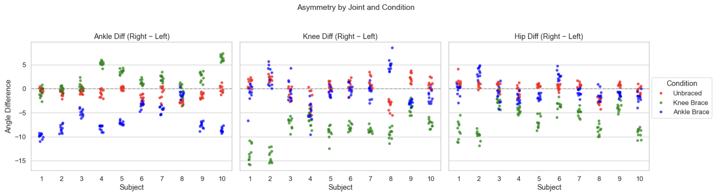
EDA
Ankle Diff
The ankle shows the strongest asymmetry (ankle brace)
Some subjects show greater right-ankle motion (knee brace)
The knee shows the strongest asymmetry (knee brace)
Only small variations (other two conditions)
The hip shows the greatest asymmetry (knee brace)
Knee Diff
Hip Diff

Slide 8
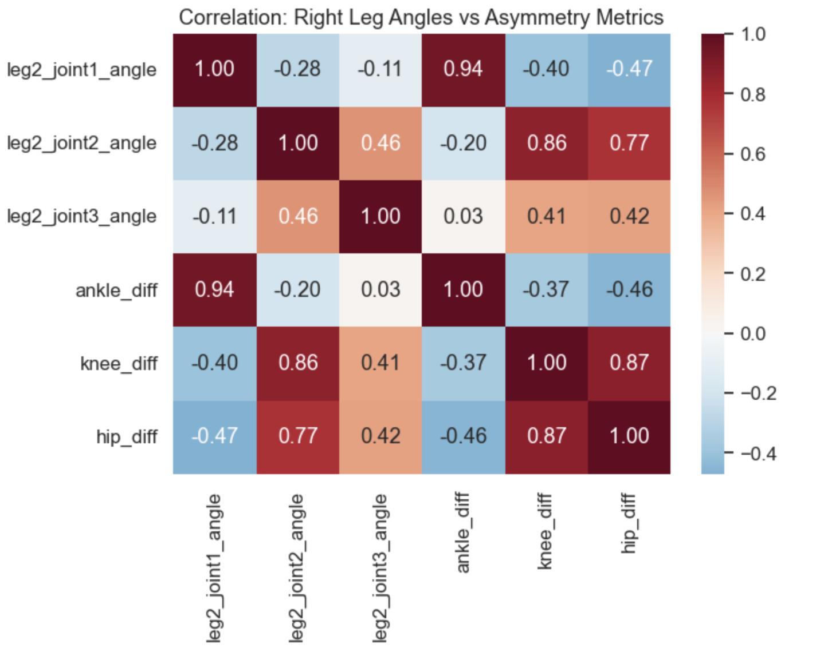
EDA
Larger right-ankle angle corresponds to greater ankle asymmetry (0.94)
Changes in the right-knee angle related to variations in knee asymmetry (0.86)
Changes in the right-knee angle are always accompanied by the hip asymmetry (0.77)
The high correlation between knee asymmetry and hip asymmetry (0.87)

Slide 9
Splitting & Prepossessing
Group Based Splitting
Original Dataset
Group Shuffle Split
Train&Val
Test
final evaluation
not involved in model training / hyperparameter tuning
Stratified Group K Fold
+
Standard Scaler
Train
Val

Slide 10
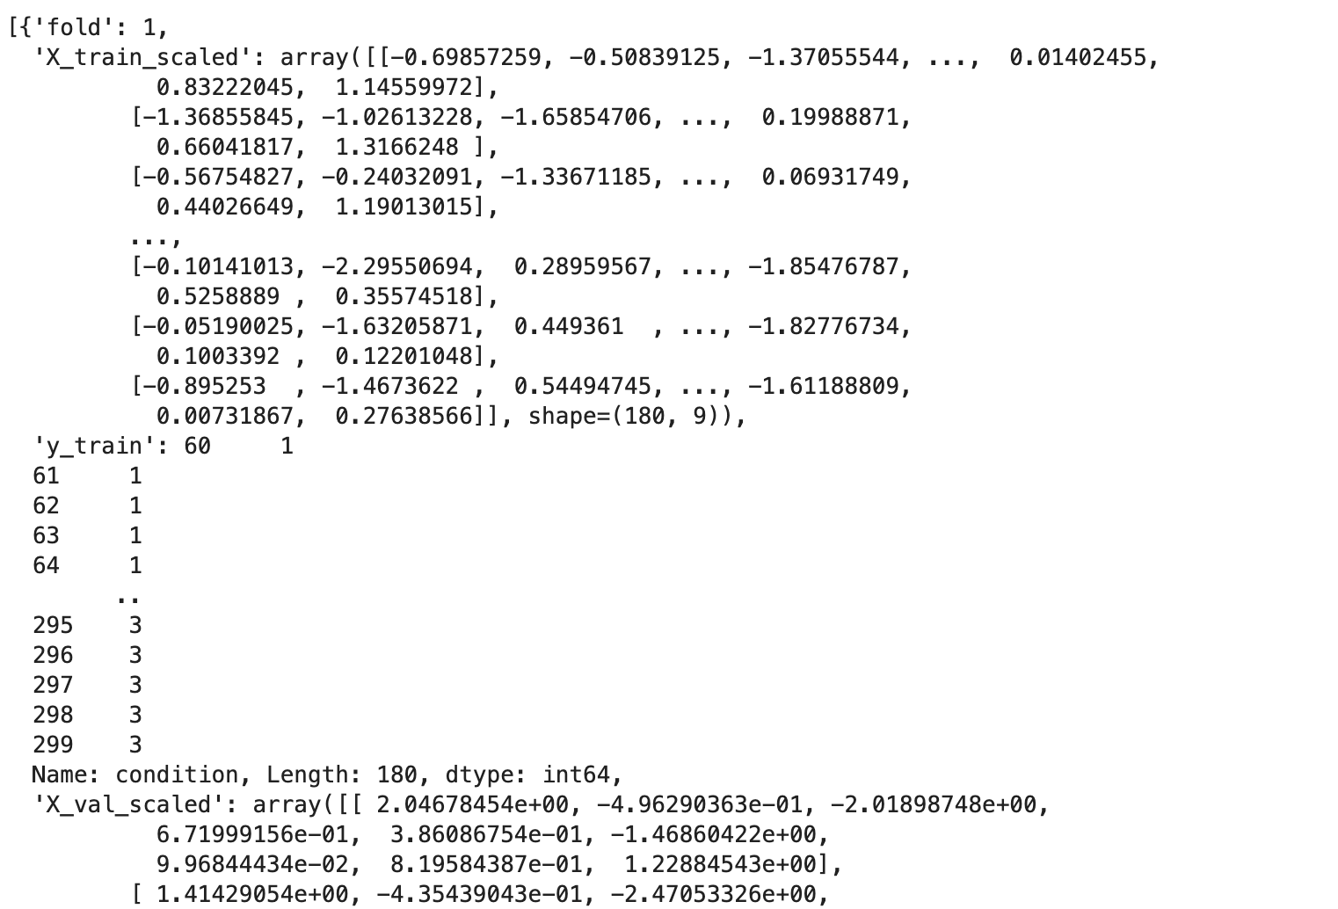
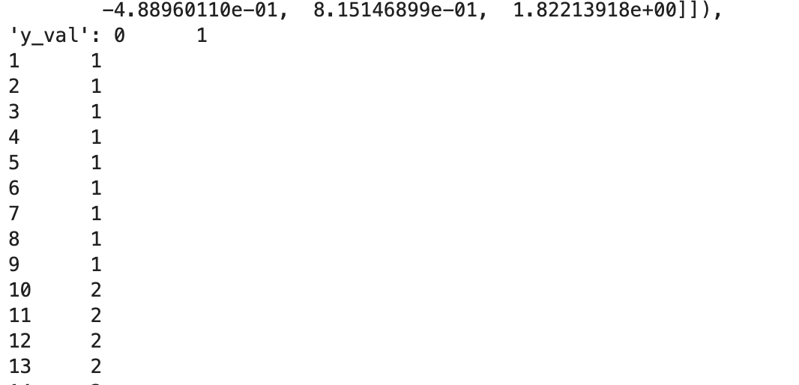
Splitting & Prepossessing
NEXT STEPS:
model training
&
accuracy evaluation

Slide 11
Q & A

