Slide 1
Dec 12th, 2025
Gait Condition Recognition
from Multivariate Angle Data
Data Science Institute, Brown University
Yitong Peng
GitHub

Slide 2
Project Introduction
Data Source
  UCI Machine Learning Repository
Data Structure
  10 subjects x 3 conditions x 10 replications x 2 legs x 3 joints x 101 time points
Goal
  Classification
  Recognize walking conditions by analyzing the joint angles of the left and right legs (the unseen man)
4. Dataset is not IID
  Group structure
Feature | Description
subject | Group ID
condition | 1 = unbraced, 2 = knee brace, 3 = ankle brace (integer)
replication | gait cycle (0, …, 10 integer)
leg | 1 = left, 2 = right (integer)
joint | 1 = ankle, 2 = knee, 3 = hip (integer)
time point | 0 = 0% gait cycle, …, 100 = 100% gait cycle
angle | joint angle in degrees (real valued)
target
Only on the right side

Slide 3
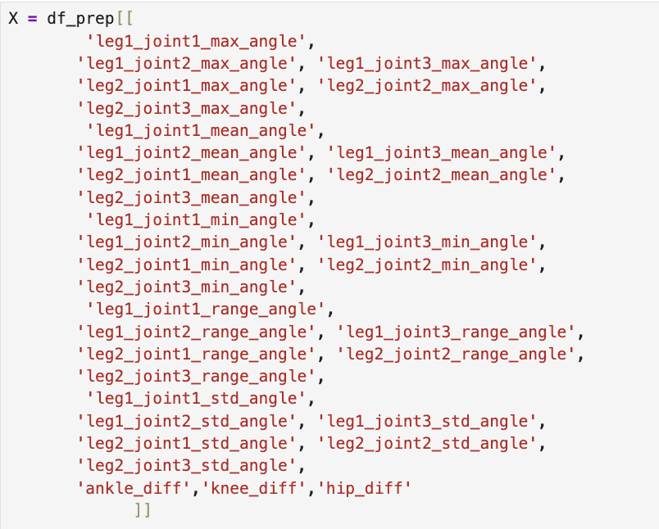
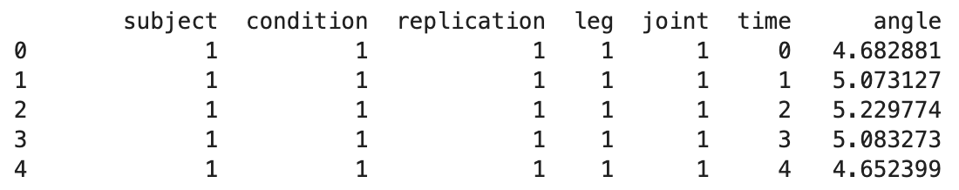
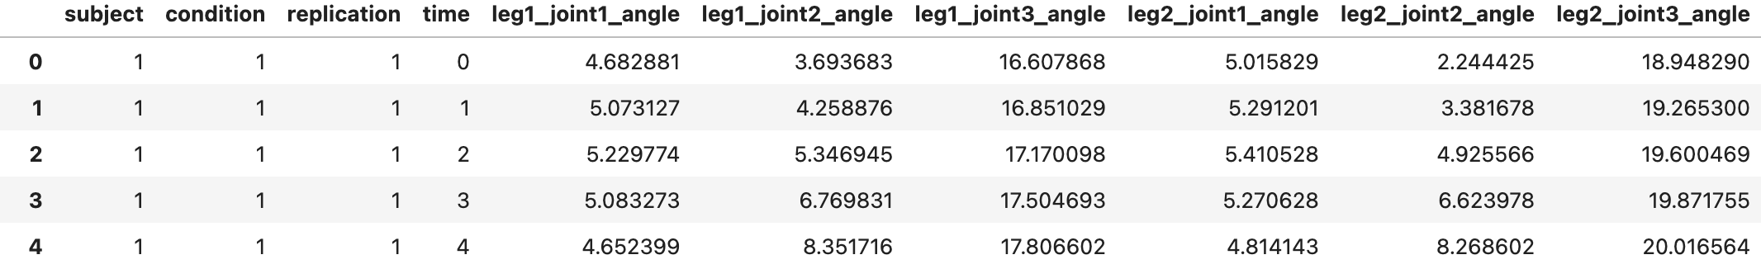
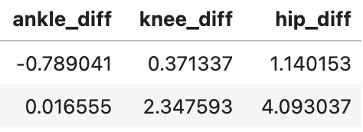
Restructure
Aggregate (AVG, std, Mean, Max, Min, Range)
To highlight asymmetry
+

Slide 4
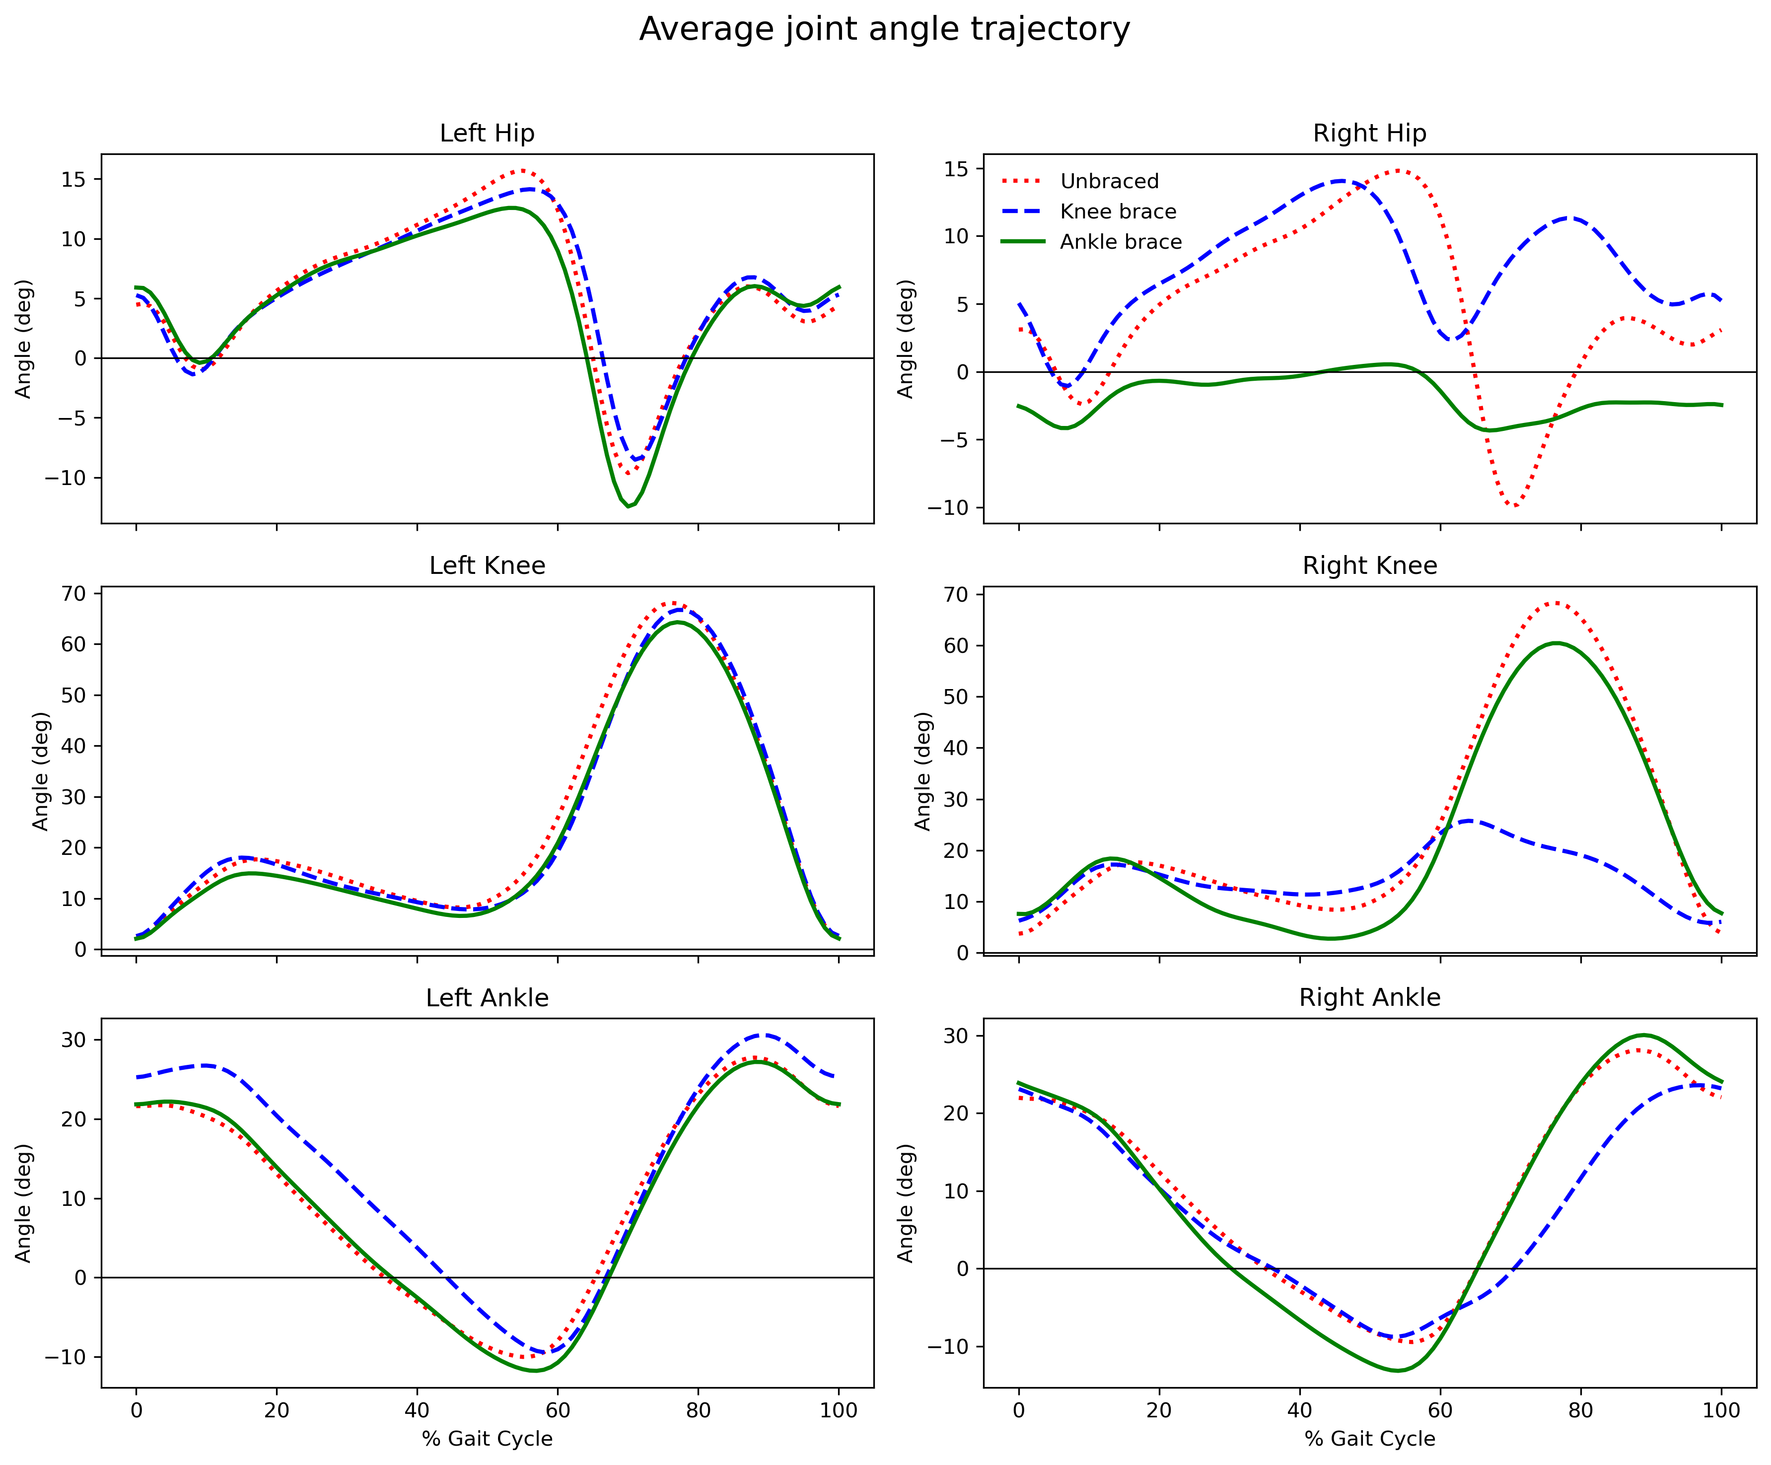
EDA
different joints move very differently
the braces clearly restrict motion
the different conditions are pretty easy to tell apart.

Slide 5
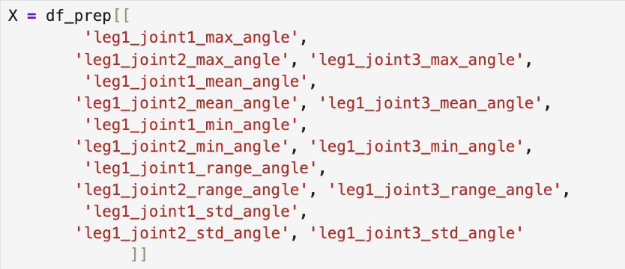
Restructure
pain and stiffness make it difficult to collect data from the affected leg
predict the right-leg condition using only features from the left leg

Slide 6
Pipeline
Dataset
Find highest validation accuracy
For each model
Random States
Group Shuffle Split
Train_Val
Group K Fold
Prepocess
Best Parameter
Test
Parameter Grid
Train CV
Evaluation
Fit Model
Val CV

Slide 7
Models & Parameters
increasing the number of trees → reduce variance
limit the depth of each tree and increase the minimum number of samples required for splitting and for leaf nodes → prevent overfitting
max features to increase randomness across trees → reduce variance
Model | Decision Tree | Random Forest | XGBoost | SVC | Logistic Regression
Parameters tuned | max_depth; min_samples_split | n_estimators; max_depth; max_features; min_samples_split; min_samples_leaf; | n_estimators; max_depth; learning_rate; subsample; min_child_weight; colsample_bytree; | C; gamma | C; max_iter
L2
small max depth
large minimum number of samples required to split a node
a balance
between bias and variance
use early stopping and fix the number of trees
use very small learning rates

Slide 8
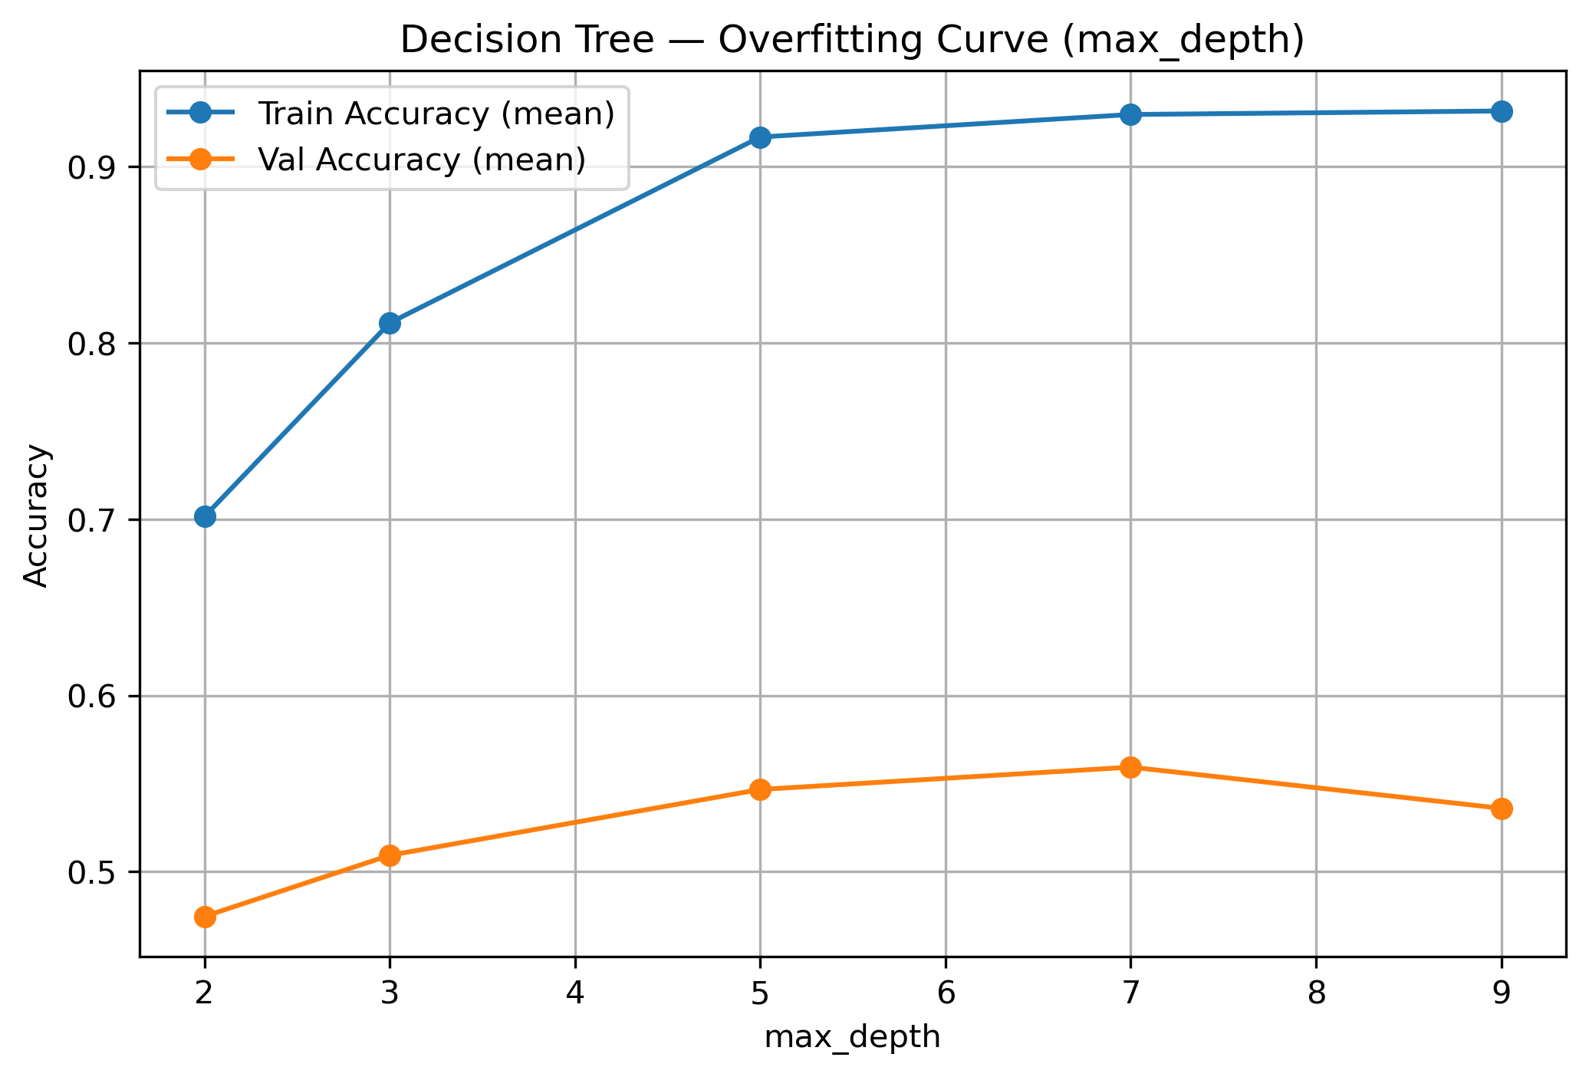
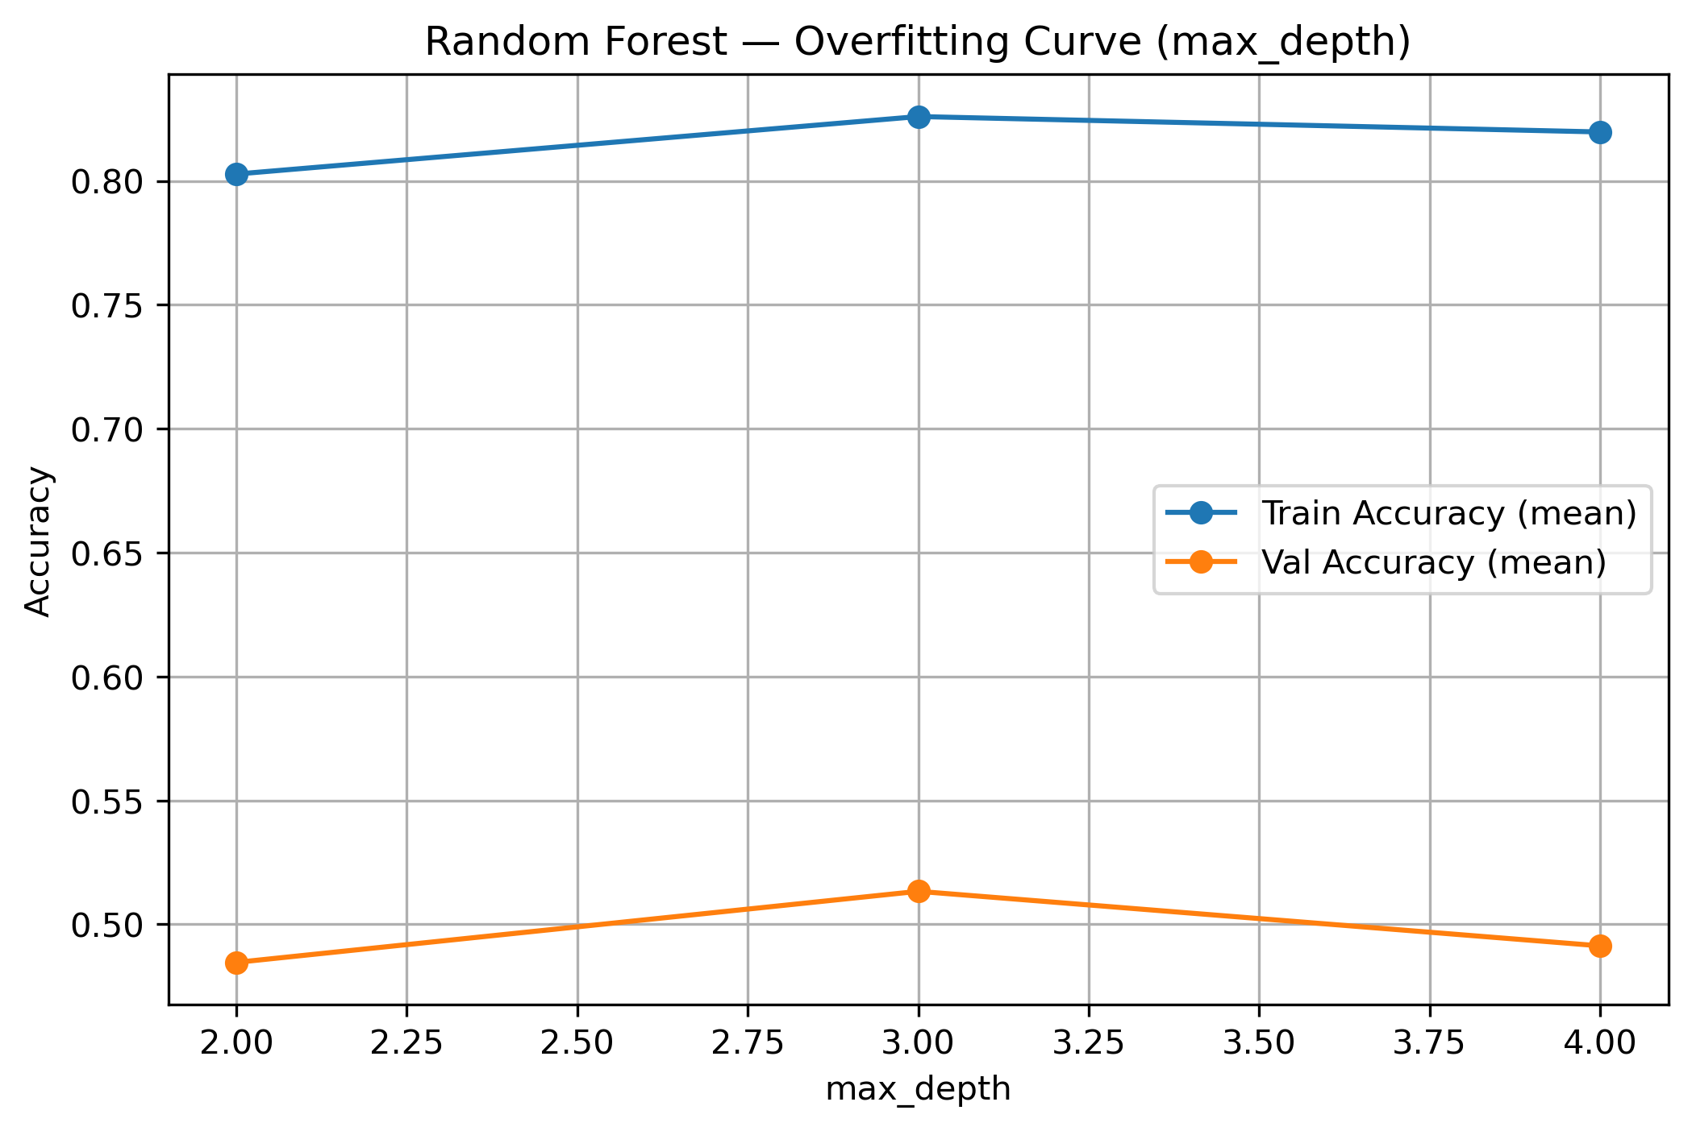
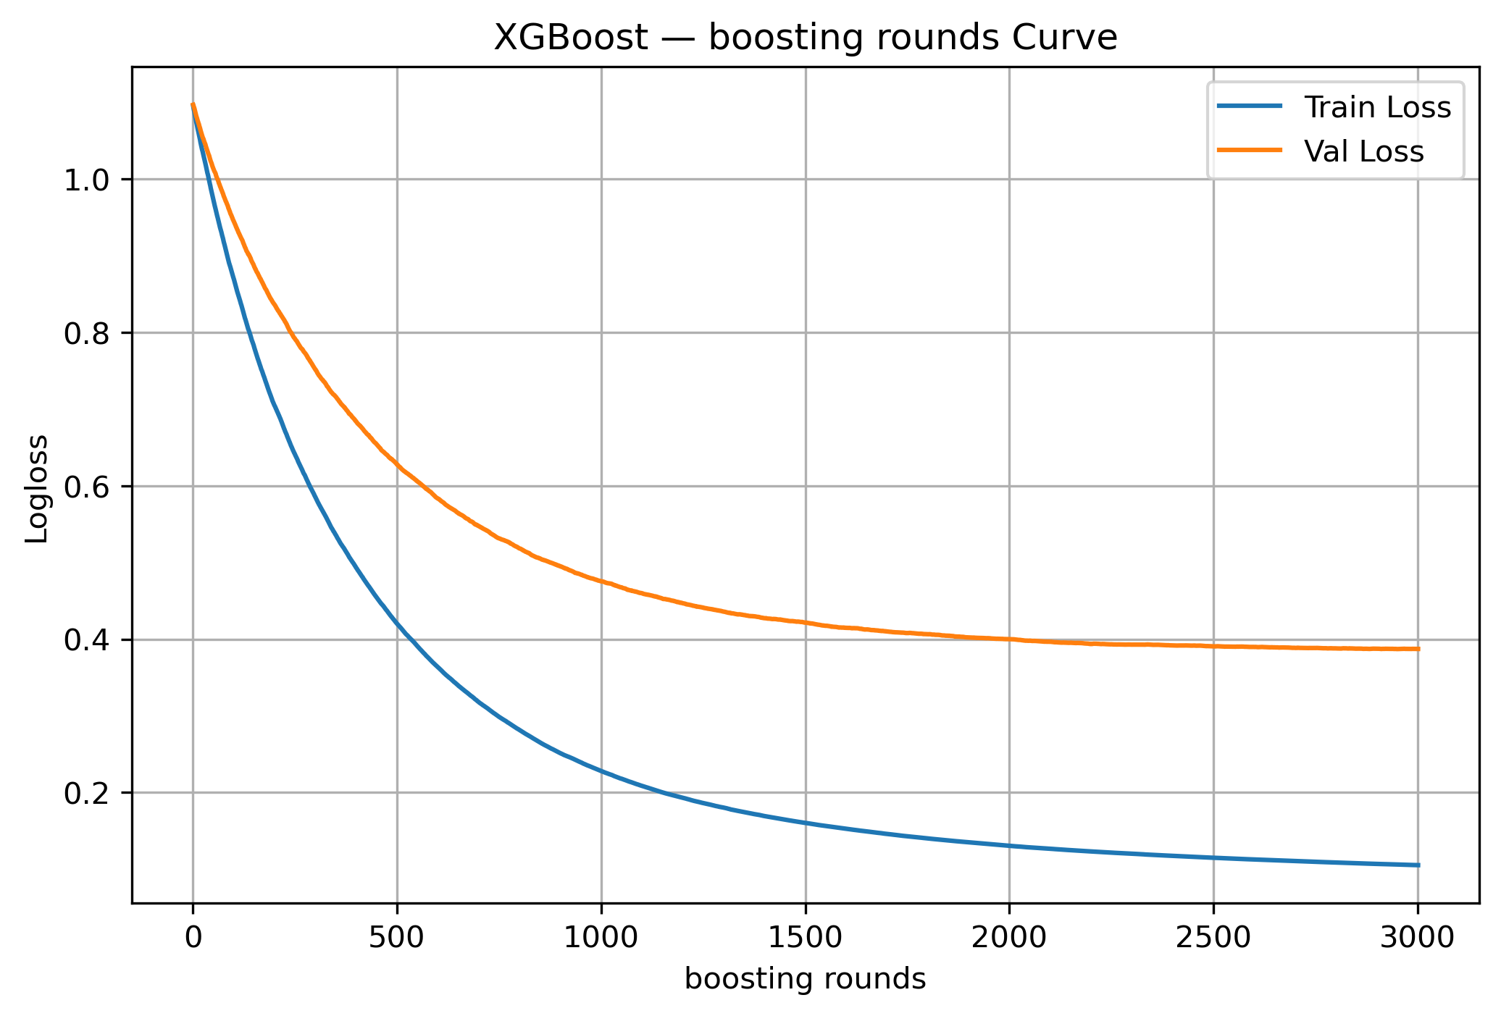
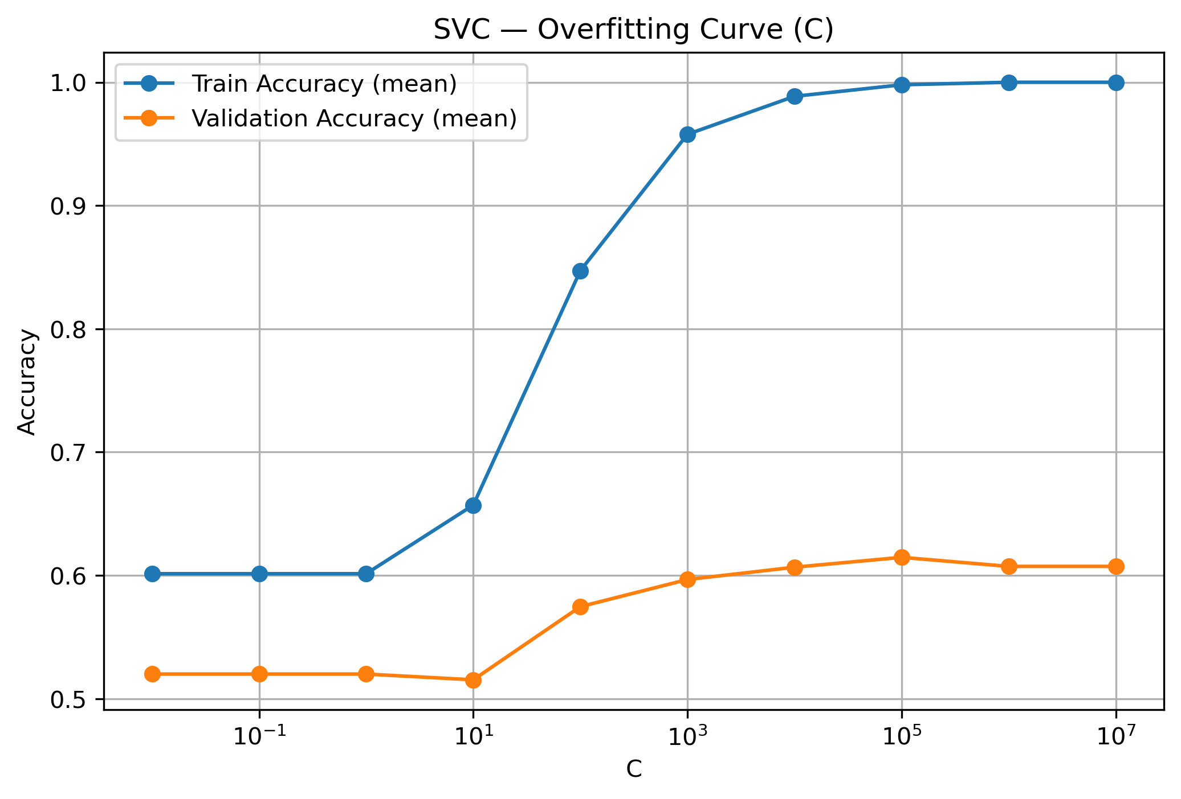
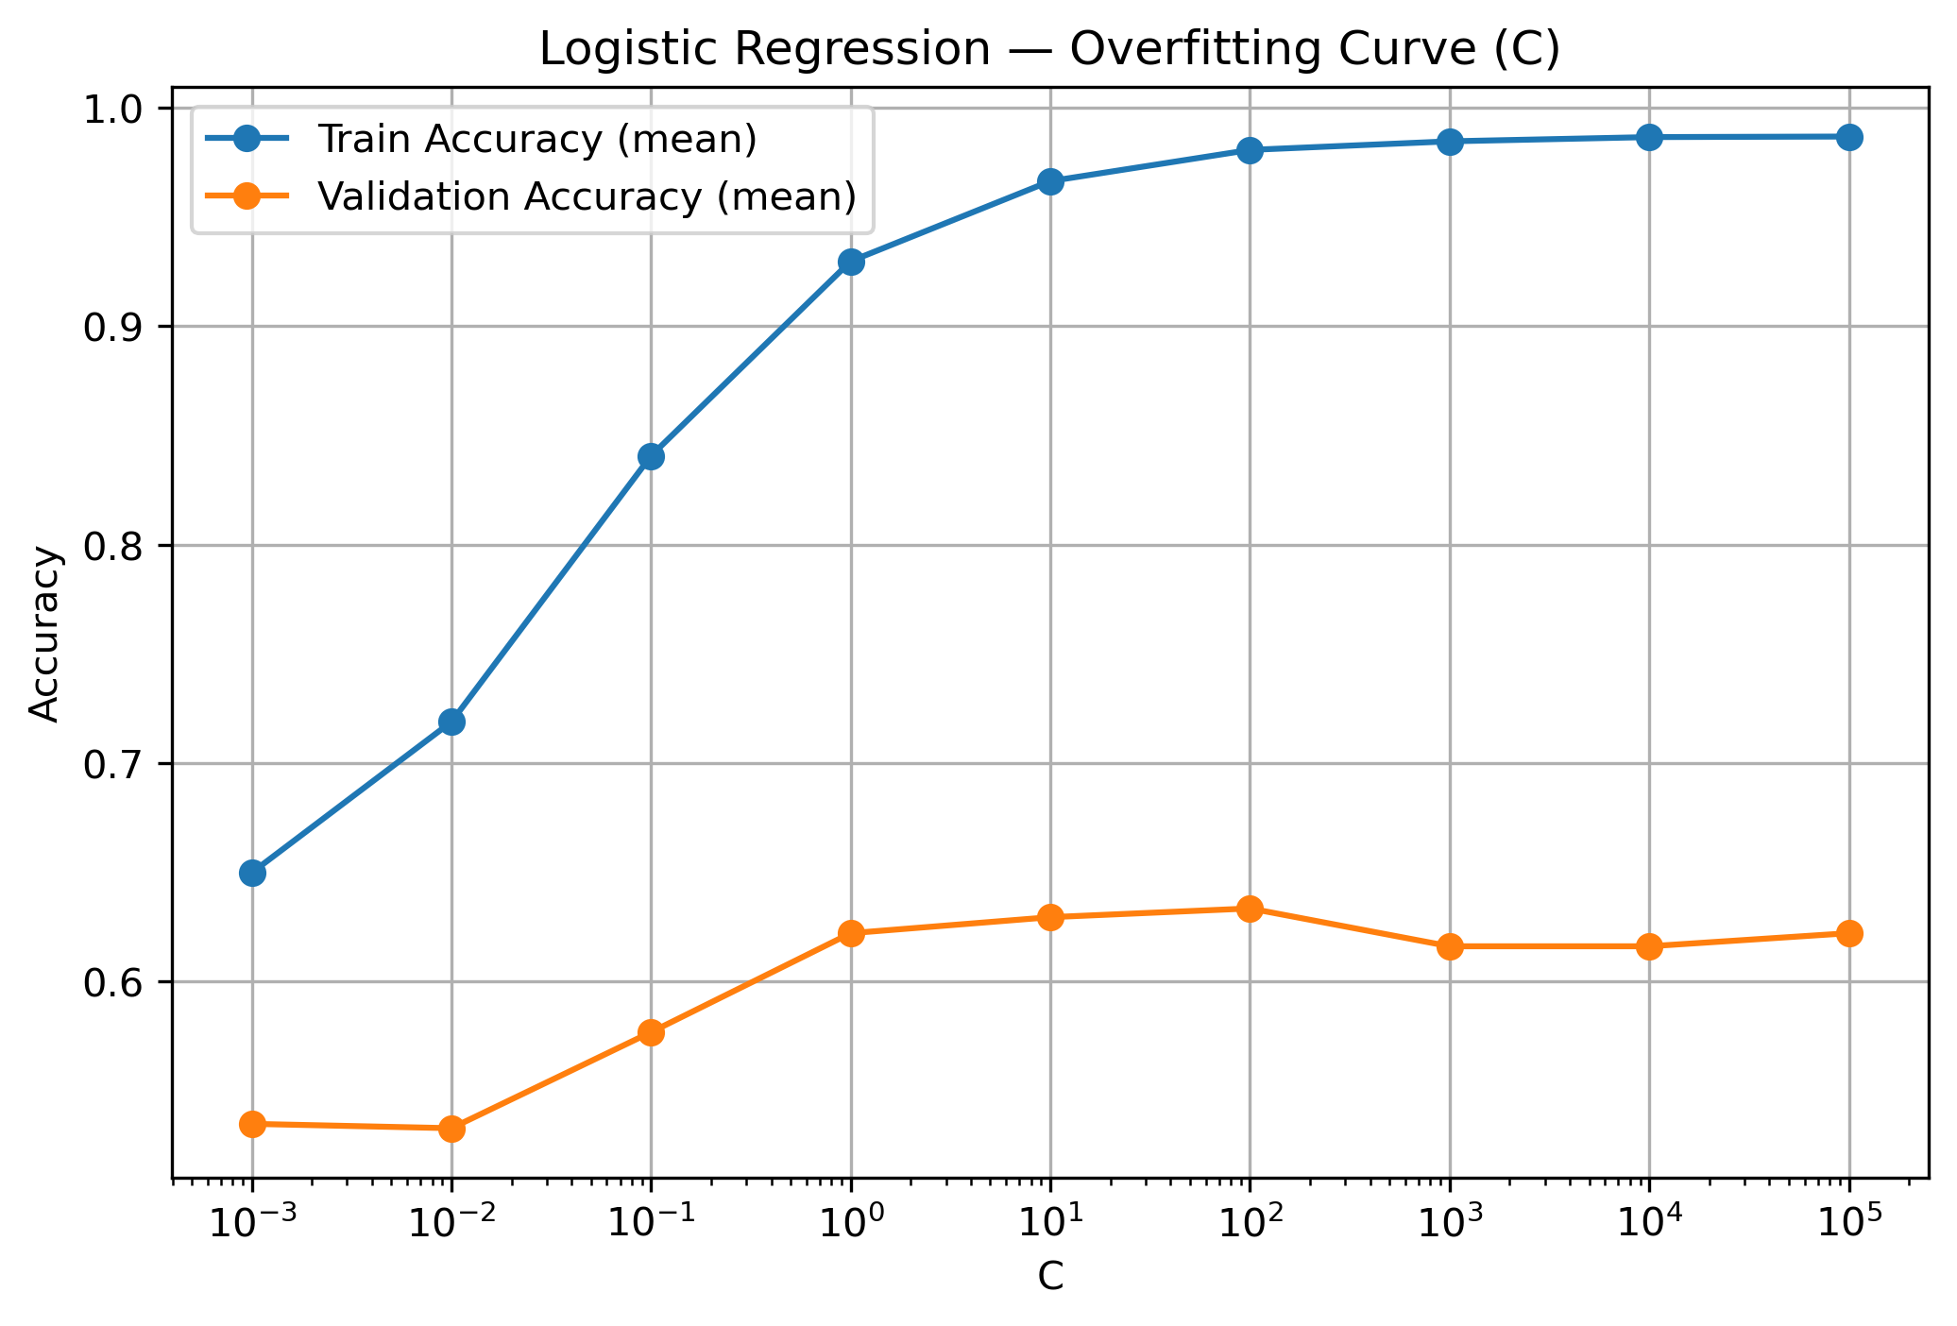
Overfitting

Slide 9
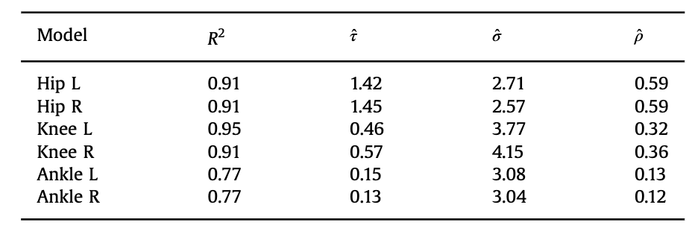
Original Paper
Individual steps are very noisy
Repeatability is limited, especially for knee and ankle
Significant deviation from the mean
Hip→ moderately repeatable
Knee→ low repeatability
Ankle → very low repeatability
Hip → signal slightly stronger than noise
Knee → noise dominates
Ankle → noise strongly dominates

Slide 10
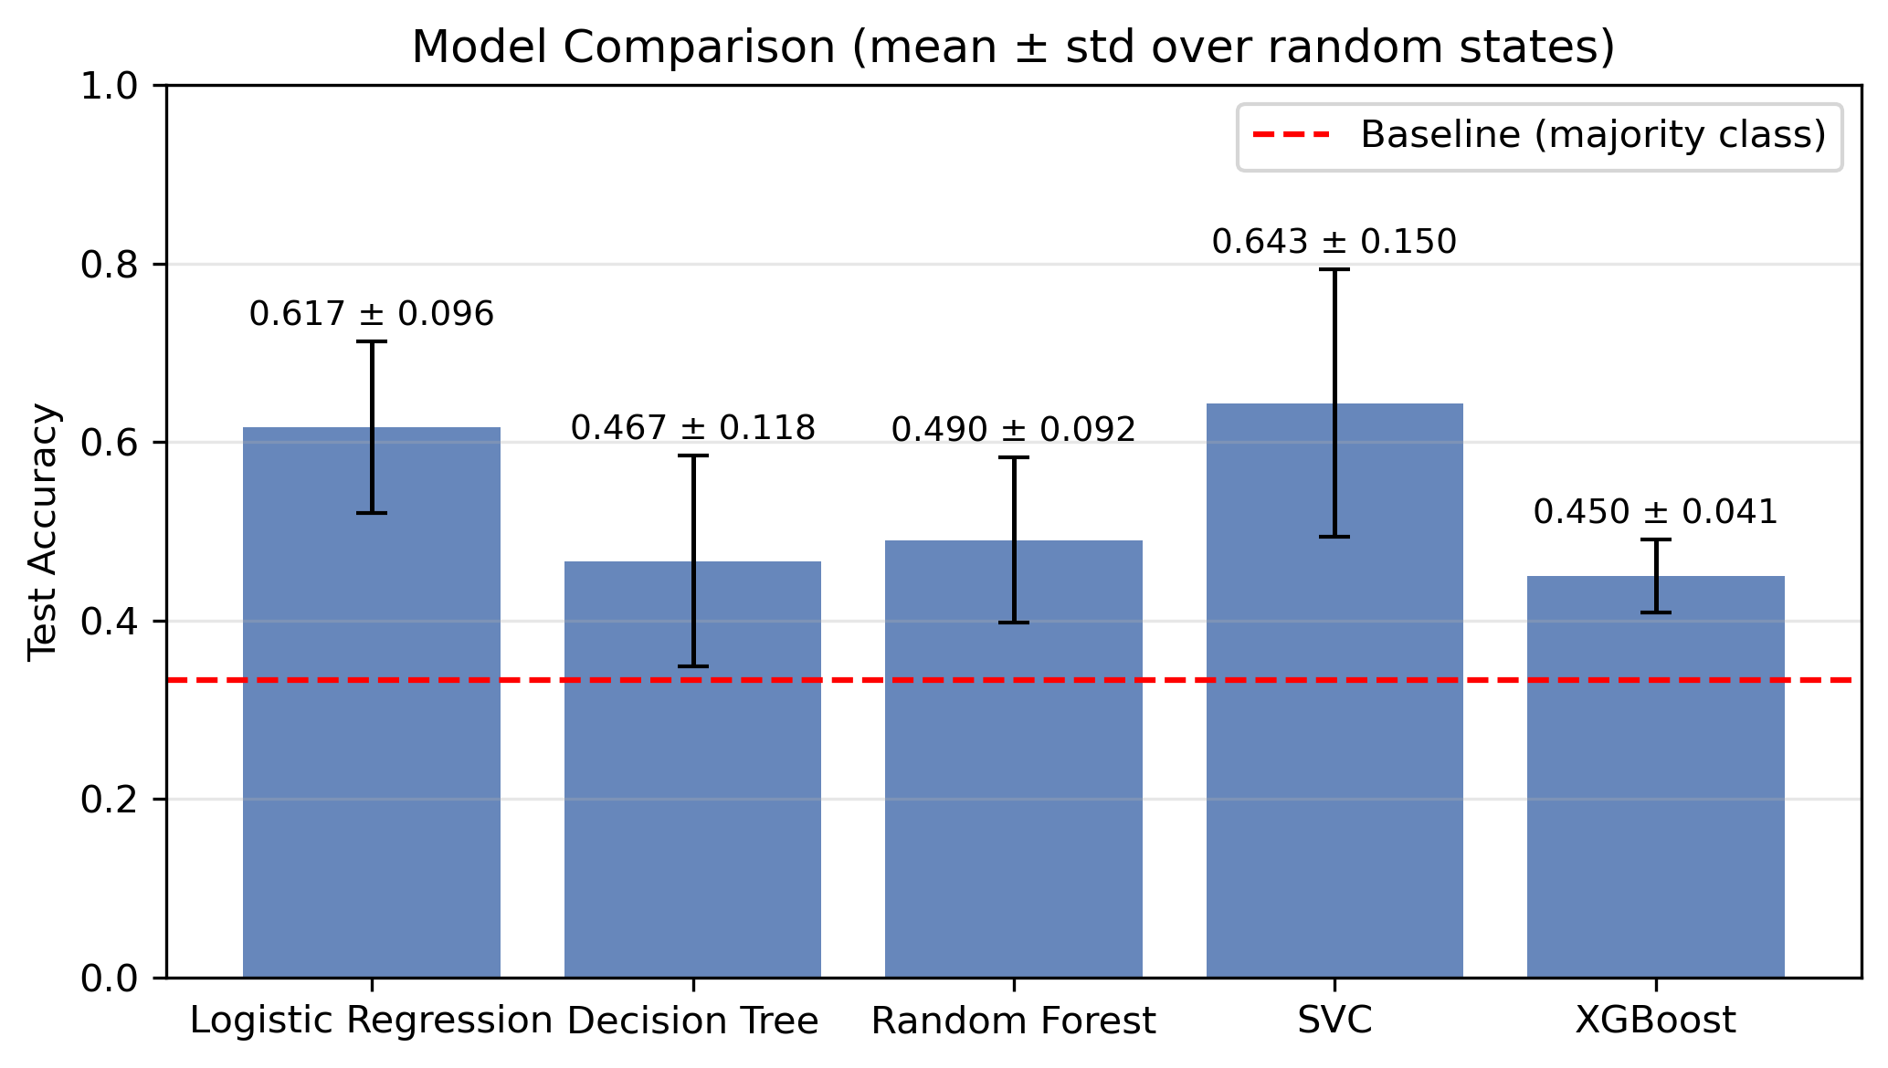
Results

Slide 11
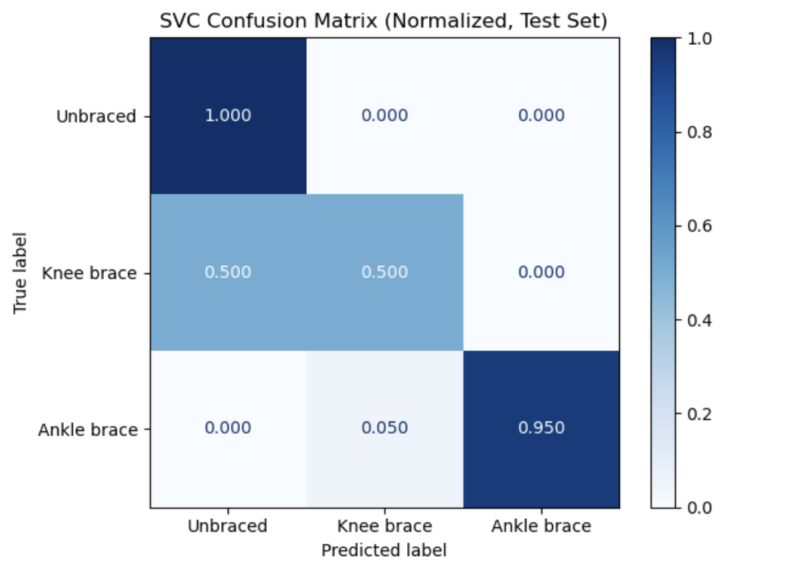
Results
classifies the unbraced and ankle-brace conditions very accurately
the knee-brace condition is more difficult to distinguish and is frequently misclassified as unbraced

Slide 12
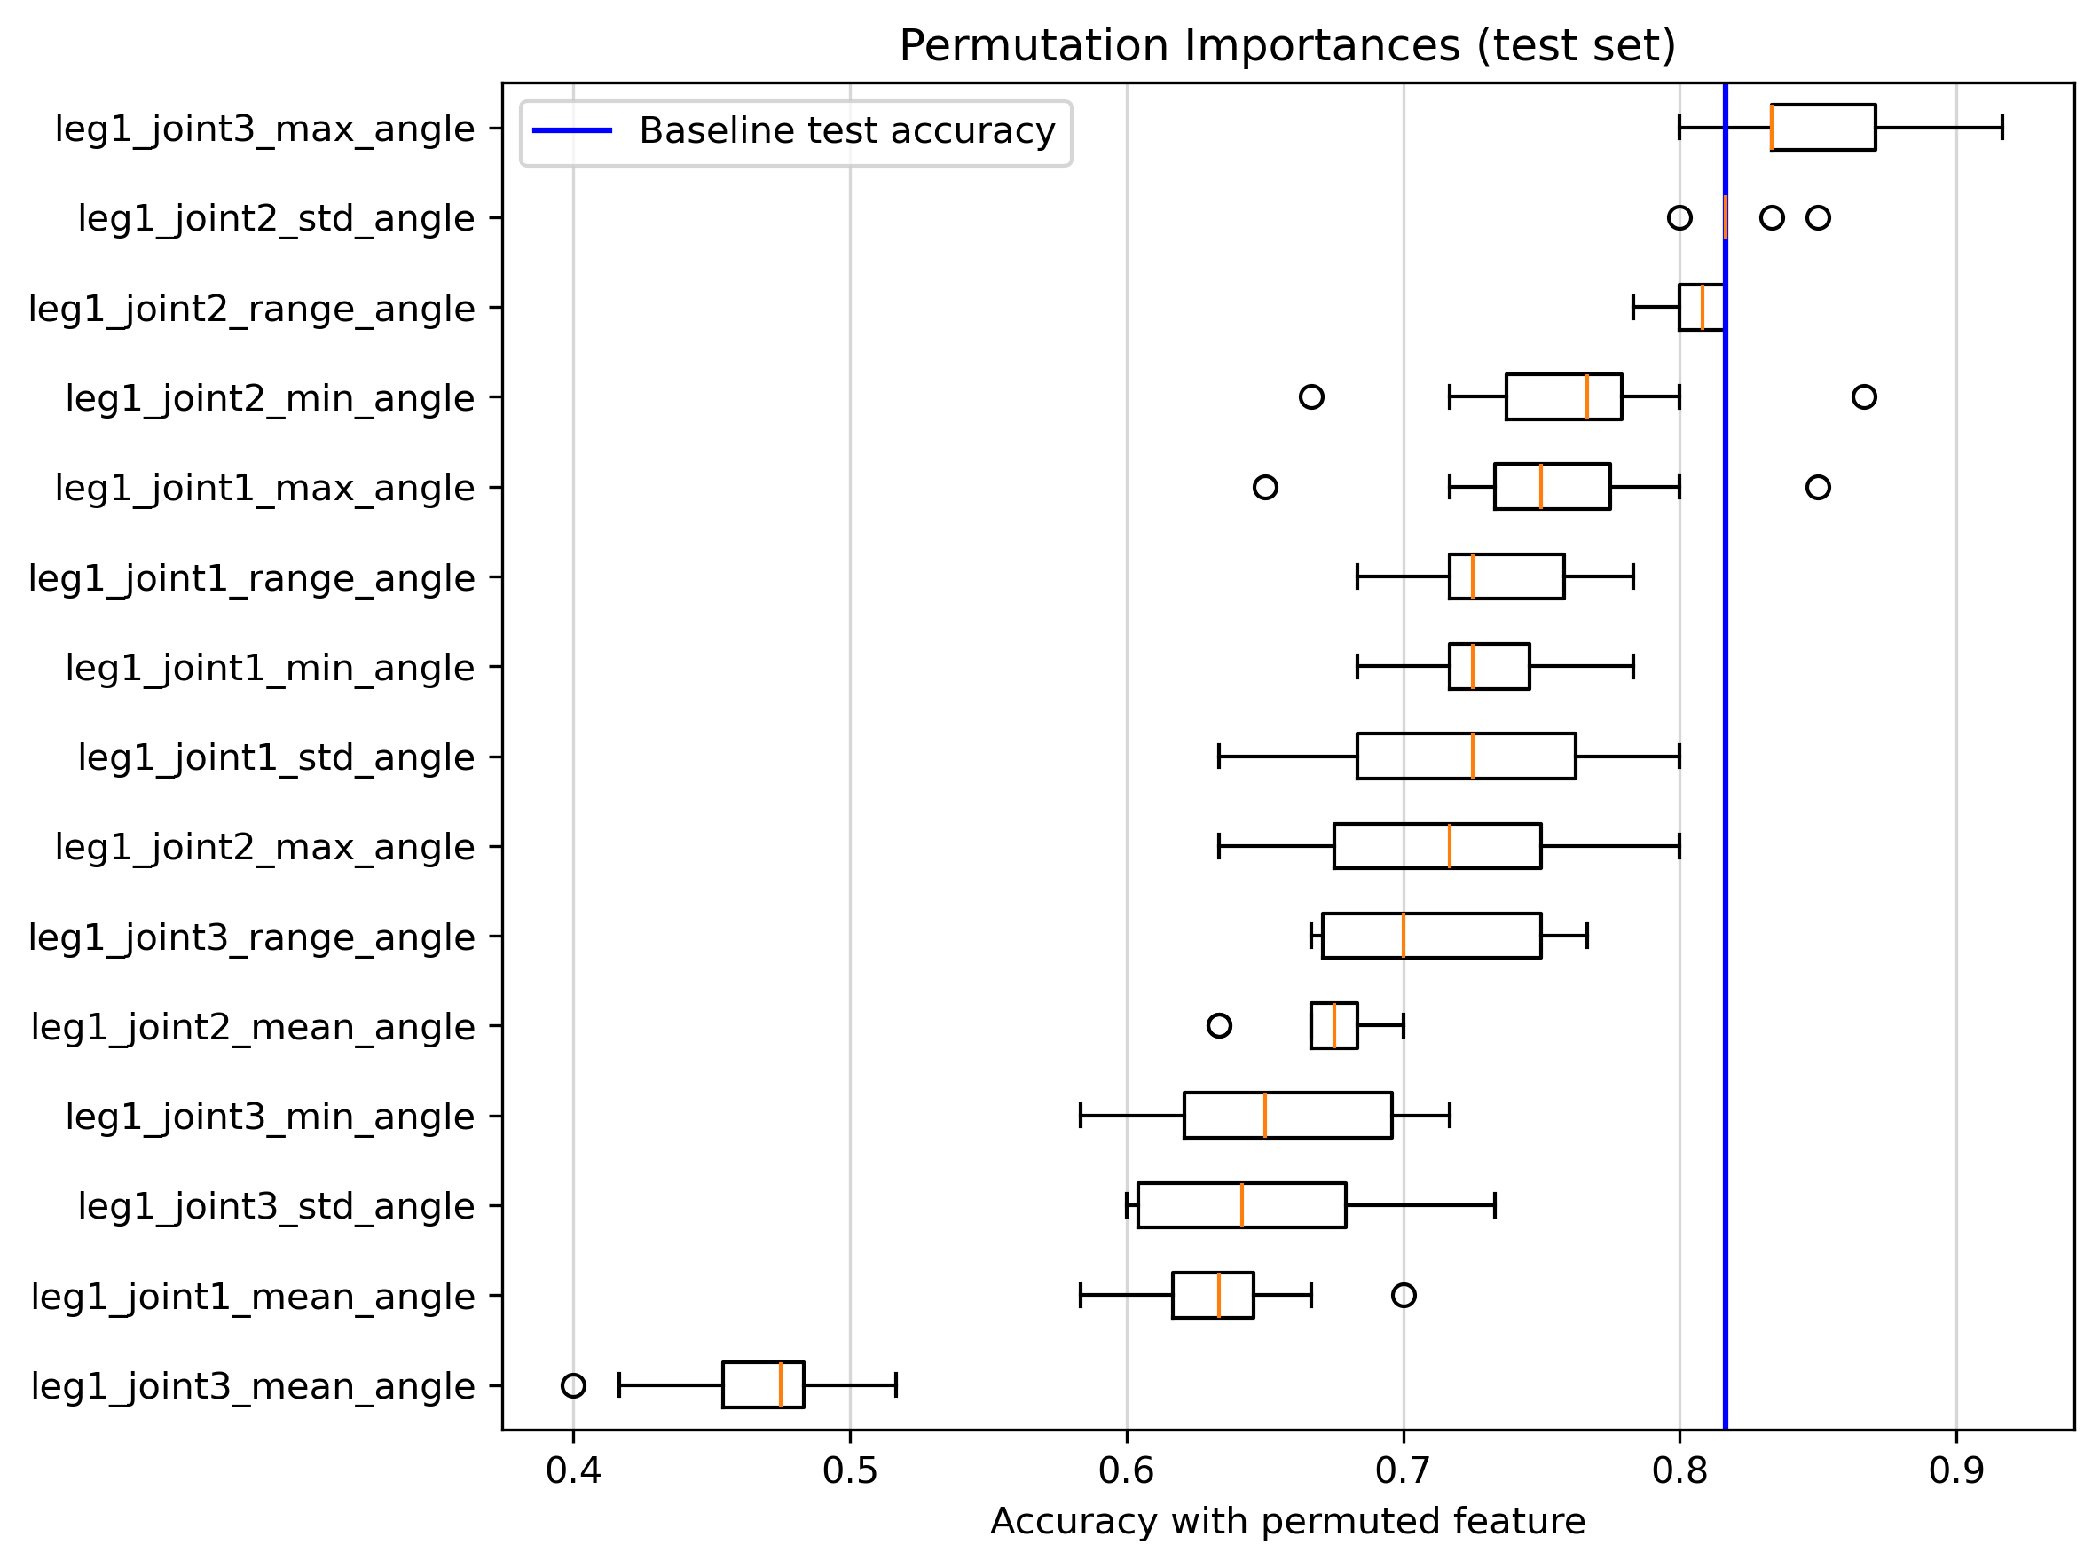
Global Feature Importances
unlikely to happen
future improvement would be to evaluate whether removing this features
leg1_joint3_mean_angle
is the most important feature

Slide 13
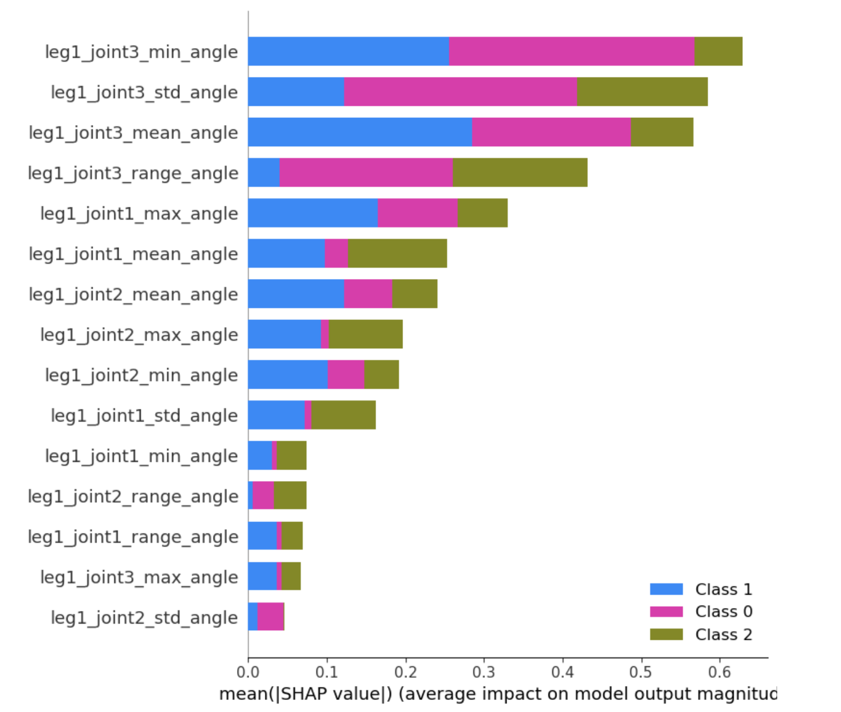
Global Feature Importances
features related to joint 3 have the largest overall impact on the model’s predictions
different features are important for distinguishing different brace conditions.

Slide 14
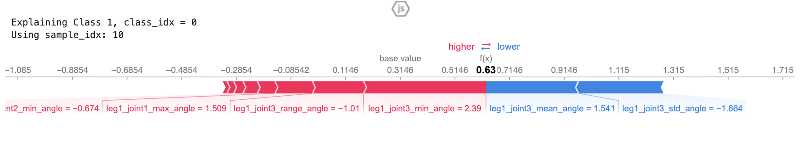
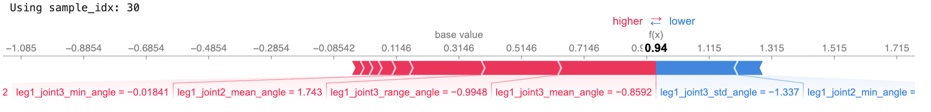
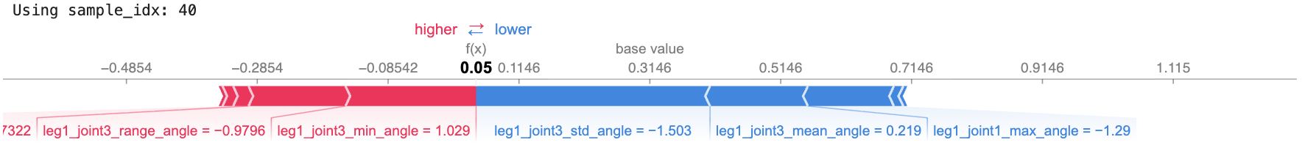
local feature importances

Slide 15
Outlook
feature selection
whether feature pairs contribute additional predictive power

Slide 16
Q & A

