Slide 1
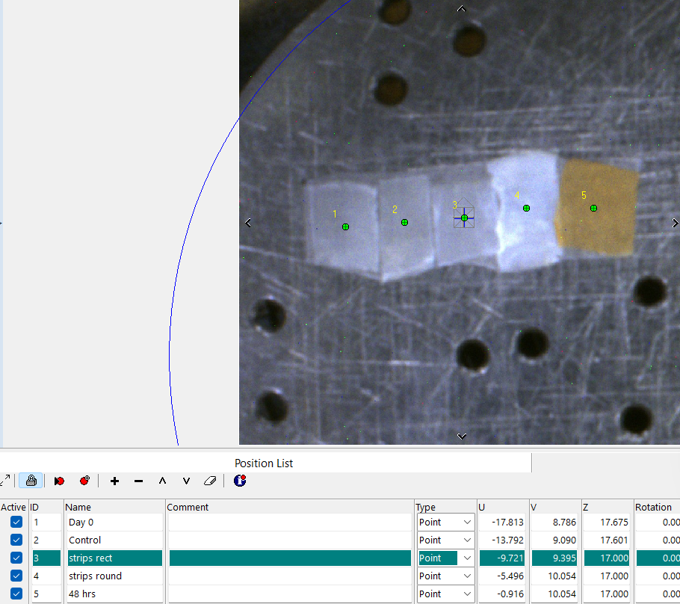
Analysis points optical image

Slide 2
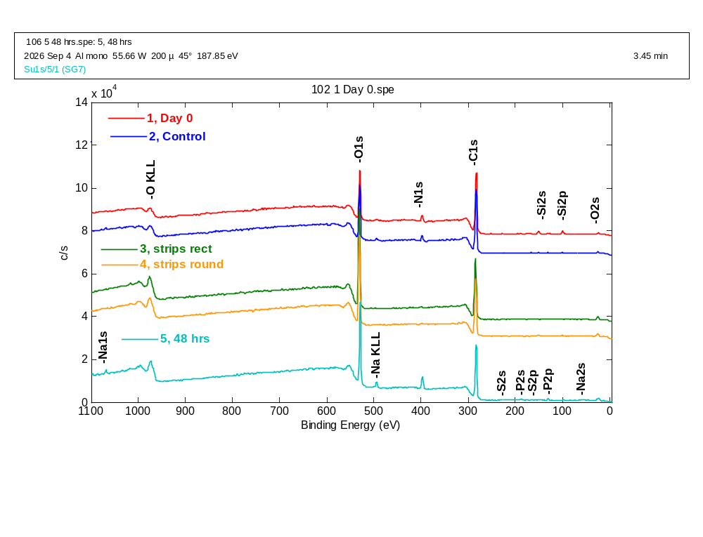
Survey spectra and atomic concentration ratios, O:C
--------------------------
Atomic Concentration Table
--------------------------
C1s , O1s ,
0.314 , 0.733 , RSF
58.600 , 137.167 , CorrectedRSF
76.05 , 23.95 , 1, Day 0
75.55 , 24.45 , 2, Control
61.45 , 38.55 , 3, strips rect
63.94 , 36.06 , 4, strips round
62.93 , 37.07 , 5, 48 hrs
67.99 , 32.01 , Mean
7.19 , 7.19 , Standard Deviation

Slide 3
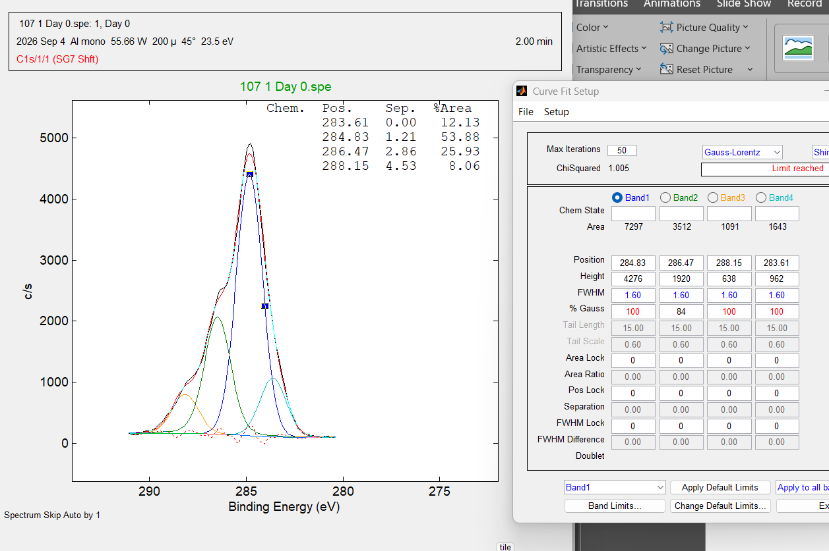
Day 0
C1s peak charge corrected to put dominant peak at 284.8 eV first pass at curve fitting

Slide 4
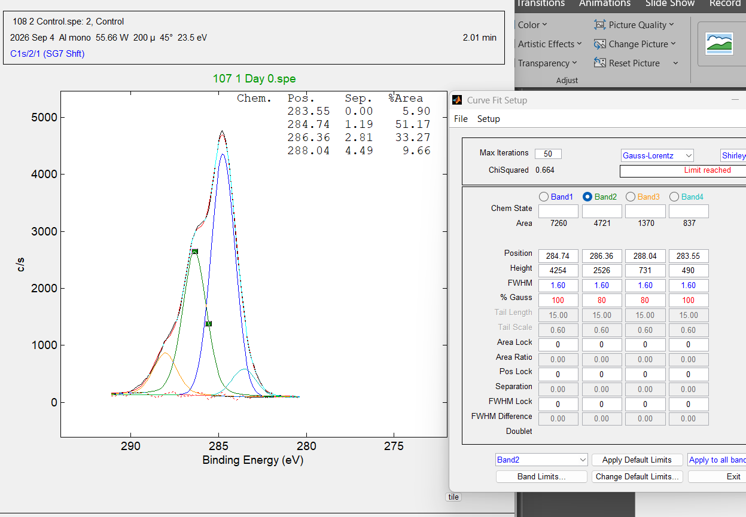
Control
C1s peak charge corrected to put dominant peak at 284.8 eV first pass at curve fitting

Slide 5
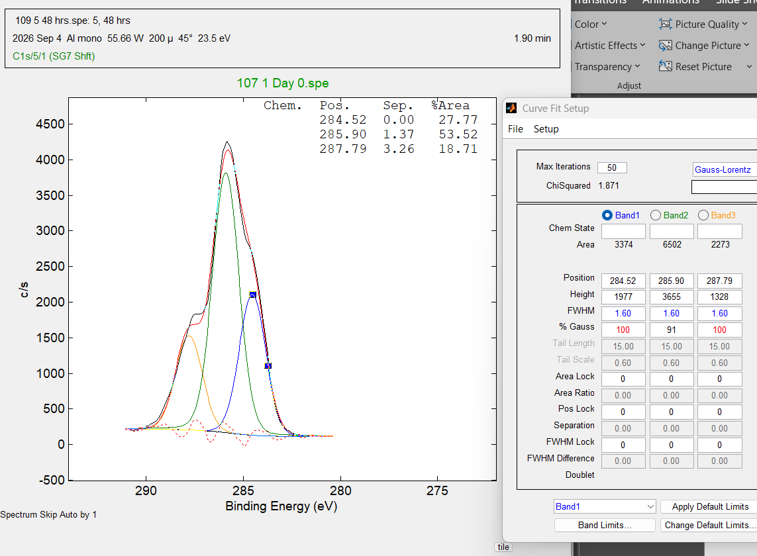
48 hrs
C1s peak charge corrected estimated rightmost peak at 284.8 eV (before curve fitting) first pass at curve fitting

Slide 6
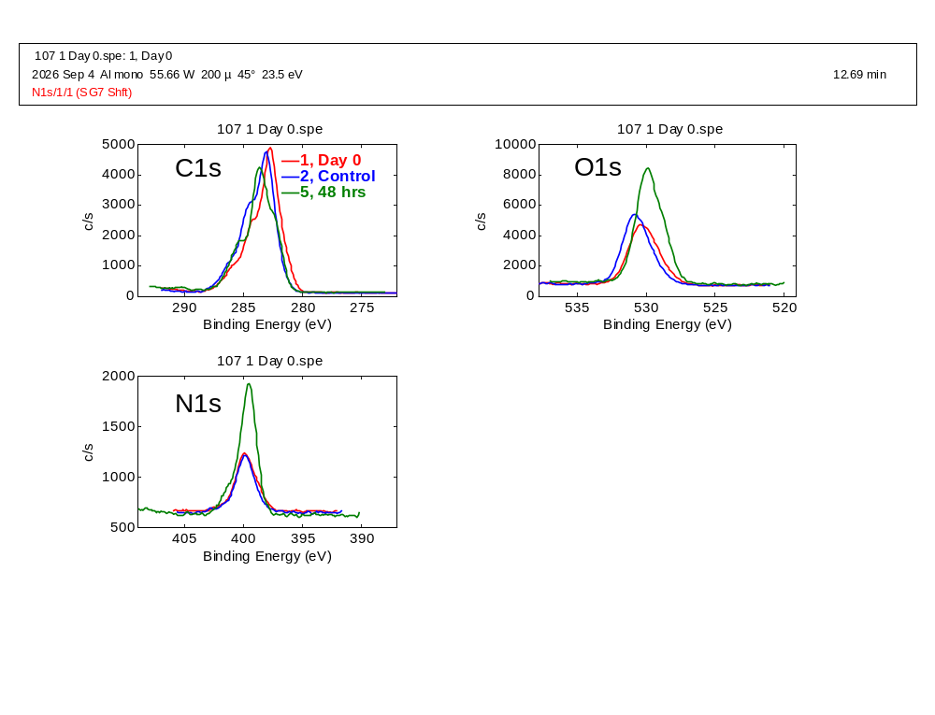
Day O, Control and 48 hrs charge corrected as commented on previous slides raw intensities
--------------------------
Atomic Concentration Table
--------------------------
C1s , N1s , O1s ,
0.314 , 0.499 , 0.733 , RSF
4.760 , 7.918 , 12.211 , CorrectedRSF
73.31 , 4.05 , 22.64 , 1, Day 0v
72.67 , 3.80 , 23.53 , 2, Control
58.55 , 7.17 , 34.27 , 5, 48 hr
68.18 , 5.01 , 26.82 , Mean
8.34 , 1.88 , 6.47 , Standard Deviation

